Slide 1
Parallelism, Multicore, and Synchronization
Hakim Weatherspoon
CS 3410
Computer Science
Cornell University
[Weatherspoon, Bala, Bracy, McKee, and Sirer, Roth, Martin]

Slide 2
Announcements
P4-Buffer Overflow is due today
Due Tuesday, April 16th
C practice assignment
Due Friday, April 19th
P5-Cache project
Due Friday, April 26th
Prelim2
Thursday, May 2nd, 7:30pm

Slide 3
xkcd/619

Slide 4
Pitfall: Amdahl’s Law
Execution time after improvement =
affected execution time
amount of improvement
+ execution time unaffected
T_{improved} = $\frac{Taffected}{improvement factor}$+ T_{unaffected}

Slide 5
Pitfall: Amdahl’s Law
Improving an aspect of a computer and expecting a proportional improvement in overall performance
T_{improved} = $\frac{Taffected}{improvement factor}$+ T_{unaffected}
Example: multiply accounts for 80s out of 100s
Multiply can be parallelized

Slide 6
Scaling Example
Workload: sum of 10 scalars, and 10 × 10 matrix sum
Speed up from 10 to 100 processors?
Single processor: Time = (10 + 100) × t_{add}
10 processors
100 processors
Assumes load can be balanced across processors

Slide 7
Scaling Example
What if matrix size is 100 × 100?
Single processor: Time = (10 + 10000) × t_{add}
10 processors
100 processors
Assuming load balanced

Slide 8
Takeaway
Unfortunately, we cannot not obtain unlimited scaling (speedup) by adding unlimited parallel resources, eventual performance is dominated by a component needing to be executed sequentially.
Amdahl's Law is a caution about this diminishing return

Slide 9
Performance Improvement 101
seconds instructions cycles seconds
program program instruction cycle
=
x
x
2 Classic Goals of Architects:
⬇ Clock period (⬆ Clock frequency)
⬇ Cycles per Instruction (⬆ IPC)

Slide 10
Clock frequencies have stalled
Darling of performance improvement for decades
Why is this no longer the strategy?
Hitting Limits:
Pipeline depth
Clock frequency
Moore’s Law & Technology Scaling
Power

Slide 11
Improving IPC via ILP
Exploiting Intra-instruction parallelism:
Pipelining (decode A while fetching B)
Exploiting Instruction Level Parallelism (ILP):
Multiple issue pipeline (2-wide, 4-wide, etc.)
Statically detected by compiler (VLIW)
Dynamically detected by HW
Dynamically Scheduled (OoO)

Slide 12
Instruction-Level Parallelism (ILP)
Pipelining: execute multiple instructions in parallel
Q: How to get more instruction level parallelism?
Notes:
Draw pictures: 250MHz 1-stage; 500Mhz 2-stage; 1GHz 4-stage; 4GHz 16-stage

Slide 13
Multiple issue pipeline
Static multiple issue
aka Very Long Instruction Word
Decisions made by compiler
Dynamic multiple issue
Decisions made on the fly
Cost: More execute hardware
Reading/writing register files: more ports

Slide 14
Static Multiple Issue
a.k.a. Very Long Instruction Word (VLIW)
Compiler groups instructions to be issued together
Packages them into “issue slots”
How does HW detect and resolve hazards?
It doesn’t. ☺ Compiler must avoid hazards
Example: Static Dual-Issue 32-bit RISC-V
Instructions come in pairs (64-bit aligned)
One ALU/branch instruction (or nop)
One load/store instruction (or nop)
Notes:
show program, decode stage
Ideal CPI = 0.5

Slide 15
RISC-V with Static Dual Issue
Two-issue packets
One ALU/branch instruction
One load/store instruction
64-bit aligned
ALU/branch, then load/store
Pad an unused instruction with nop
Address | Instruction type | Pipeline Stages
n | ALU/branch | IF | ID | EX | MEM | WB
n + 4 | Load/store | IF | ID | EX | MEM | WB
n + 8 | ALU/branch |  | IF | ID | EX | MEM | WB
n + 12 | Load/store |  | IF | ID | EX | MEM | WB
n + 16 | ALU/branch |  |  | IF | ID | EX | MEM | WB
n + 20 | Load/store |  |  | IF | ID | EX | MEM | WB

Slide 16
Scheduling Example
Schedule this for dual-issue MIPS
Loop: lw t0, s1, 0 # $t0=array element add t0, t0, s2 # add scalar in $s2 sw t0, s1, 0 # store result addi s1, s1,–4 # decrement pointer bne s1, zero, Loop # branch $s1!=0
 | ALU/branch | Load/store | cycle
Loop: |  |  | 1
 |  |  | 2
 |  |  | 3
 |  |  | 4

Slide 17
Techniques and Limits of Static Scheduling
Goal: larger instruction windows (to play with)
Predication
Loop unrolling
Function in-lining
Basic block modifications (superblocks, etc.)
Roadblocks
Memory dependences (aliasing)
Control dependences

Slide 18
Speculation
Reorder instructions
To fill the issue slot with useful work
Complicated: exceptions may occur

Slide 19
Optimizations to make it work
Move instructions to fill in nops
Need to track hazards and dependencies
Loop unrolling

Slide 20
Scheduling Example
Compiler scheduling for dual-issue RISC-V…
Loop: lw t0, s1, 0 # t0 = A[i]
lw t1, s1, 4 # t1 = A[i+1] add t0, t0, s2 # add s2 add t1, t1, s2 # add s2 sw t0, s1, 0 # store A[i] sw t1, s1, 4 # store A[i+1] addi s1, s1, +8 # increment pointer bne s1, s3, Loop # continue if s1!=end
ALU/branch slot Load/store slot cycle
Loop: nop lw t0, s1, 0 1
nop lw t1, s1, 4 2
add t0, t0, s2 nop 3
add t1, t1, s2 sw t0, s1, 0 4
addi s1, s1, +8 sw t1, s1, 4 5
bne s1, s3, Loop nop 6
Notes:
assume 1 delay slot for loads
can move addi earlier
CPI = 6 cycles / 8 instructions = 0.75
CPI = 5 cycles / 8 instructions = 0.625

Slide 21
Limits of Static Scheduling
Compiler scheduling for dual-issue RISC-V…
lw t0, s1, 0 # load A
addi t0, t0, +1 # increment A
sw t0, s1, 0 # store A
lw t0, s2, 0 # load B
addi t0, t0, +1 # increment B
sw t0, s2, 0 # store B
ALU/branch slot Load/store slot cycle
nop lw t0, s1, 0 1
nop nop 2
addi t0, t0, +1 nop 3
nop sw t0, s1, 0 4
nop lw t0, s2, 0 5
nop nop 6
addi t0, t0, +1 nop 7
nop sw t0, s2, 0 8
Notes:
Rename registers, move load B up, eliminate delay slot
But! s1 and s2 might be equal => Aliasing!

Slide 22
Improving IPC via ILP
Exploiting Intra-instruction parallelism:
Pipelining (decode A while fetching B)
Exploiting Instruction Level Parallelism (ILP):
Multiple issue pipeline (2-wide, 4-wide, etc.)
Statically detected by compiler (VLIW)
Dynamically detected by HW
Dynamically Scheduled (OoO)

Slide 23
Dynamic Multiple Issue
aka SuperScalar Processor (c.f. Intel)
CPU chooses multiple instructions to issue each cycle
Compiler can help, by reordering instructions….
… but CPU resolves hazards
Even better: Speculation/Out-of-order Execution
Execute instructions as early as possible
Aggressive register renaming (indirection to the rescue!)
Guess results of branches, loads, etc.
Roll back if guesses were wrong
Don’t commit results until all previous insns committed

Slide 24
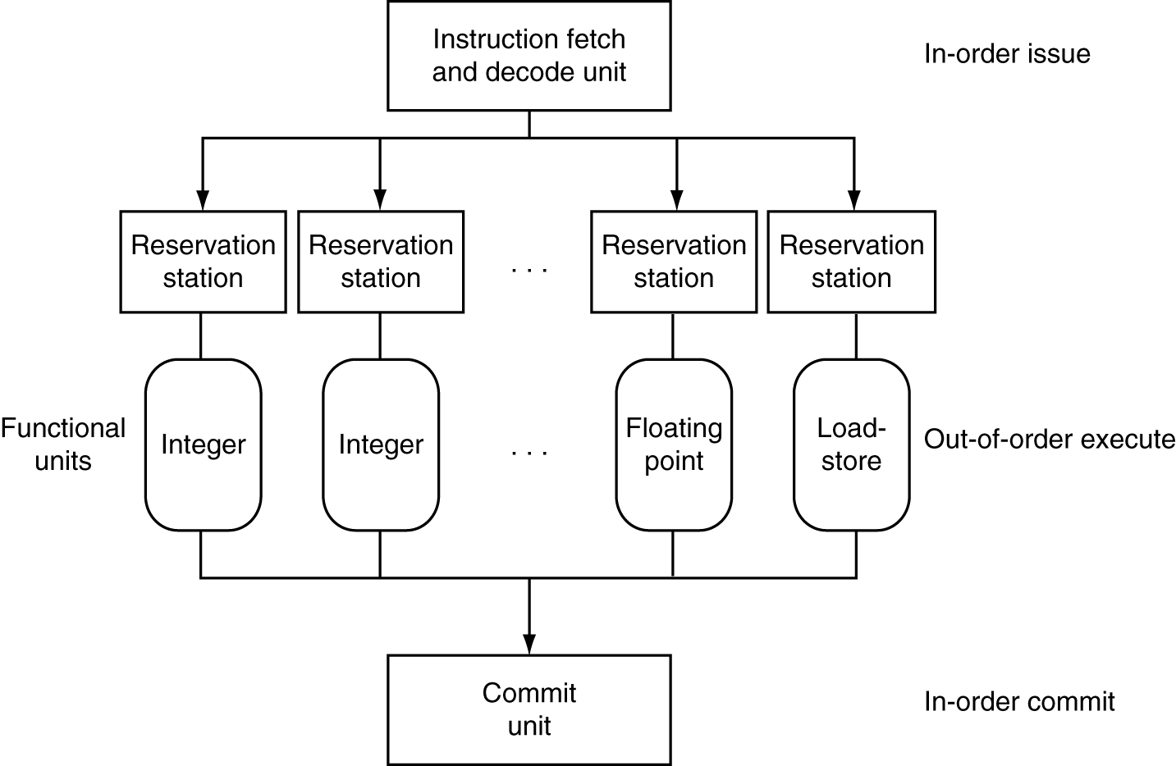
Dynamic Multiple Issue

Slide 25
Effectiveness of OoO Superscalar
It was awesome, but then it stopped improving
Limiting factors?
Programs dependencies
Memory dependence detection → be conservative
e.g. Pointer Aliasing: A[0] += 1; B[0] *= 2;
Hard to expose parallelism
Still limited by the fetch stream of the static program
Structural limits
Memory delays and limited bandwidth
Hard to keep pipelines full, especially with branches

Slide 26
Power Efficiency
Q: Does multiple issue / ILP cost much?
A: Yes.
→ Dynamic issue and speculation requires power
CPU | Year | Clock Rate | Pipeline Stages | Issue width | Out-of-order/ Speculation | Cores | Power
i486 | 1989 | 25MHz | 5 | 1 | No | 1 | 5W
Pentium | 1993 | 66MHz | 5 | 2 | No | 1 | 10W
Pentium Pro | 1997 | 200MHz | 10 | 3 | Yes | 1 | 29W
P4 Willamette | 2001 | 2000MHz | 22 | 3 | Yes | 1 | 75W
UltraSparc III | 2003 | 1950MHz | 14 | 4 | No | 1 | 90W
P4 Prescott | 2004 | 3600MHz | 31 | 3 | Yes | 1 | 103W
Those simpler cores did something very right.

Slide 27
Moore’s Law
Dual-core Itanium 2
K10
Itanium 2
K8
P4
Atom
Pentium
486
386
286
8088
8080
4004
8008

Slide 28
Why Multicore?
Moore’s law
A law about transistors
Smaller means more transistors per die
And smaller means faster too
But: Power consumption growing too…

Slide 29
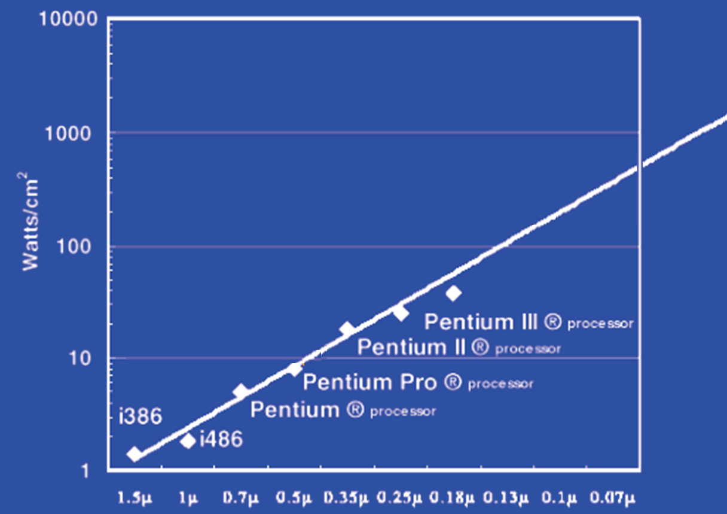
Power Limits
Surface of Sun
Rocket Nozzle
Nuclear Reactor
Xeon
Hot Plate
180nm
32nm

Slide 30
Power Wall
Power = capacitance * voltage² * frequency
In practice: Power ~ voltage³
Reducing voltage helps (a lot)
... so does reducing clock speed
Better cooling helps
The power wall
We can’t reduce voltage further
We can’t remove more heat
Lower Frequency

Slide 31
Why Multicore?
Performance
1.2x
Single-Core Overclocked +20%
Power
1.7x
Performance
1.0x
Single-Core
Power
1.0x
Performance
0.8x
1.6x
Single-Core
Underclocked -20%
Dual-Core
Underclocked -20%
Power
0.51x
1.02x

Slide 32
Power Efficiency
Q: Does multiple issue / ILP cost much?
A: Yes.
→ Dynamic issue and speculation requires power
CPU | Year | Clock Rate | Pipeline Stages | Issue width | Out-of-order/ Speculation | Cores | Power
i486 | 1989 | 25MHz | 5 | 1 | No | 1 | 5W
Pentium | 1993 | 66MHz | 5 | 2 | No | 1 | 10W
Pentium Pro | 1997 | 200MHz | 10 | 3 | Yes | 1 | 29W
P4 Willamette | 2001 | 2000MHz | 22 | 3 | Yes | 1 | 75W
UltraSparc III | 2003 | 1950MHz | 14 | 4 | No | 1 | 90W
P4 Prescott | 2004 | 3600MHz | 31 | 3 | Yes | 1 | 103W
Core | 2006 | 2930MHz | 14 | 4 | Yes | 2 | 75W
Core i5 Nehal | 2010 | 3300MHz | 14 | 4 | Yes | 1 | 87W
Core i5 Ivy Br | 2012 | 3400MHz | 14 | 4 | Yes | 8 | 77W
UltraSparc T1 | 2005 | 1200MHz | 6 | 1 | No | 8 | 70W
Those simpler cores did something very right.

Slide 33
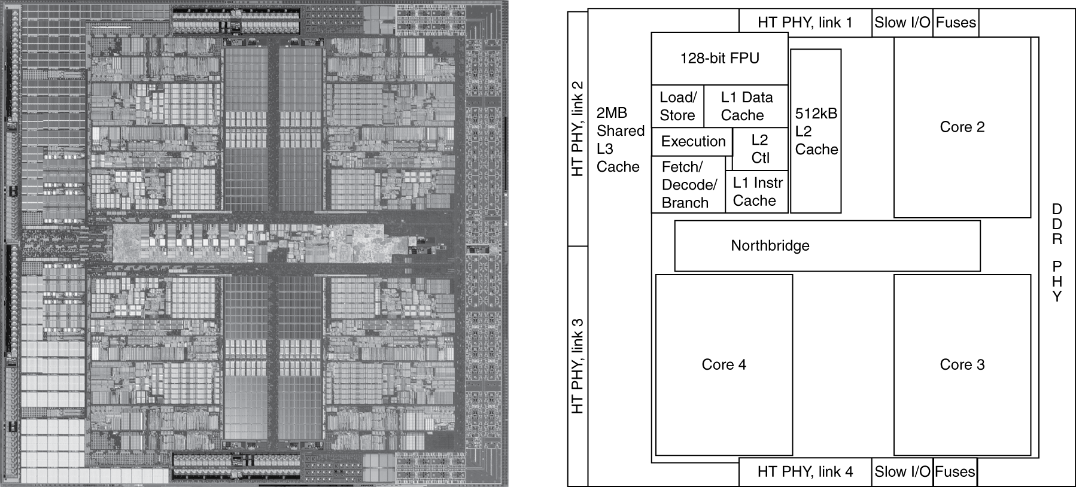
Inside the Processor
AMD Barcelona Quad-Core: 4 processor cores

Slide 34
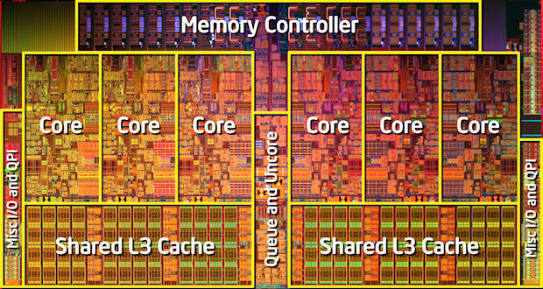
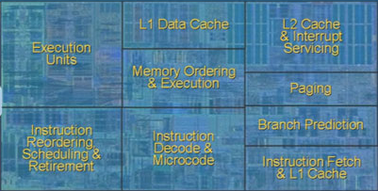
Inside the Processor
Intel Nehalem Hex-Core
4-wide pipeline

Slide 35
Improving IPC via ILP TLP
Exploiting Thread-Level parallelism
Hardware multithreading to improve utilization:
Multiplexing multiple threads on single CPU
Sacrifices latency for throughput
Single thread cannot fully utilize CPU? Try more!
Three types:
Course-grain (has preferred thread)
Fine-grain (round robin between threads)
Simultaneous (hyperthreading)

Slide 36
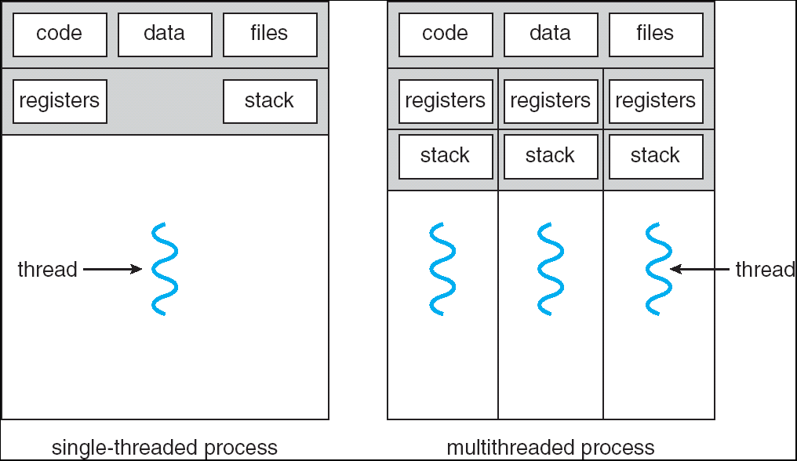
What is a thread?
Process: multiple threads, code, data and OS state
Threads: share code, data, files, not regs or stack

Slide 37
Standard Multithreading Picture
Time evolution of issue slots
Color = thread, white = no instruction
time
4-wide
Superscalar
CGMT
FGMT
SMT
Insns from multiple threads coexist
Switch to thread B on thread A L2 miss
Switch threads every cycle

Slide 38
Hyperthreading
vs. HT
Multi-Core vs. Multi-Issue
Programs:
Num. Pipelines:
Pipeline Width:
Hyperthreads
HT = MultiIssue + extra PCs and registers – dependency logic
HT = MultiCore – redundant functional units + hazard avoidance
Hyperthreads (Intel)
Illusion of multiple cores on a single core
Easy to keep HT pipelines full + share functional units

Slide 39
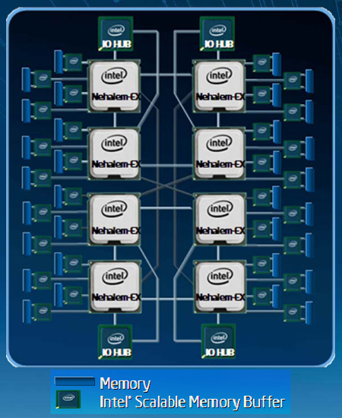
Example: All of the above
8 die (aka 8 sockets)
4 core per socket
2 HT per core
Note: a socket is a processor,
where each processor may
have multiple processing
cores, so this is an example
of a multiprocessor multicore
hyperthreaded system

Slide 40
Parallel Programming
Q: So lets just all use multicore from now on!
A: Software must be written as parallel program
Multicore difficulties
Partitioning work
Coordination & synchronization
Communications overhead
How do you write parallel programs?
... without knowing exact underlying architecture?

Slide 41
Work Partitioning
Partition work so all cores have something to do

Slide 42
Load Balancing
Load Balancing
Need to partition so all cores are actually working

Slide 43
Amdahl’s Law
If tasks have a serial part and a parallel part…
Example:
step 1: divide input data into n pieces
step 2: do work on each piece
step 3: combine all results
Recall: Amdahl’s Law
As number of cores increases …
time to execute parallel part?
time to execute serial part?
Serial part eventually dominates
goes to zero
Remains the same

Slide 44
Amdahl’s Law

Slide 45
Parallelism is a necessity
Necessity, not luxury
Power wall
Not easy to get performance out of
Many solutions
Pipelining
Multi-issue
Hyperthreading
Multicore

Slide 46
Parallel Programming
Q: So lets just all use multicore from now on!
A: Software must be written as parallel program
Multicore difficulties
Partitioning work
Coordination & synchronization
Communications overhead
How do you write parallel programs?
... without knowing exact underlying architecture?
SW
Your
career…
HW

Slide 47
Big Picture: Parallelism and Synchronization
How do I take advantage of parallelism?
How do I write (correct) parallel programs?
What primitives do I need to implement correct parallel programs?

Slide 48
Parallelism & Synchronization
Cache Coherency
Processors cache shared data → they see different (incoherent) values for the same memory location
Synchronizing parallel programs
Atomic Instructions
HW support for synchronization
How to write parallel programs
Threads and processes
Critical sections, race conditions, and mutexes

Slide 49
Parallelism and Synchronization
Cache Coherency Problem: What happens when to two or more processors cache shared data?

Slide 50
Parallelism and Synchronization
Cache Coherency Problem: What happens when to two or more processors cache shared data?
i.e. the view of memory held by two different processors is through their individual caches.
As a result, processors can see different (incoherent) values to the same memory location.

Slide 51
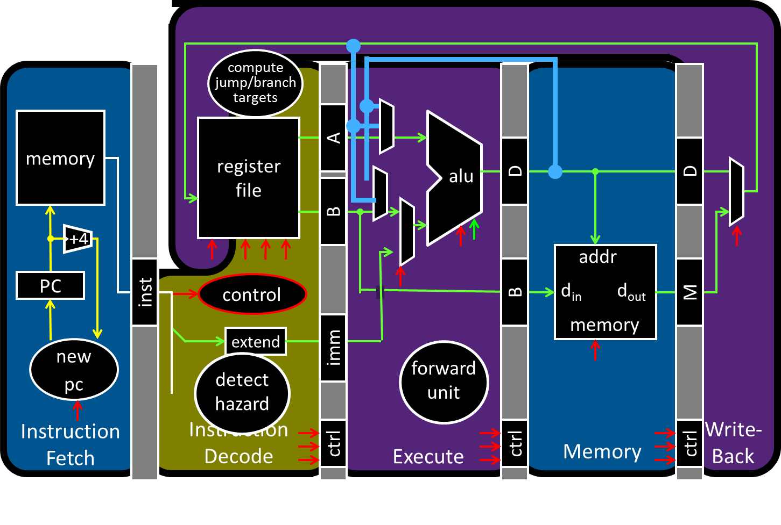
Parallelism and Synchronization

Slide 52
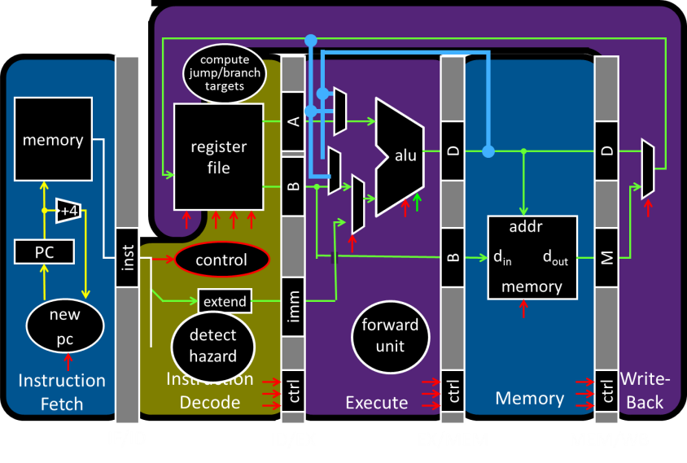
Parallelism and Synchronization
Each processor core has its own L1 cache

Slide 53
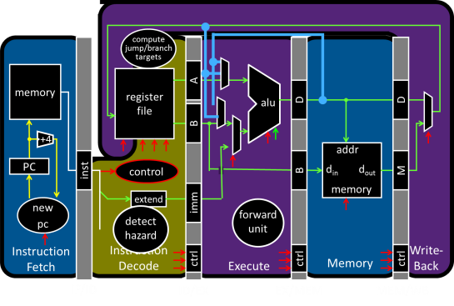
Parallelism and Synchronization
Each processor core has its own L1 cache

Slide 54
Parallelism and Synchronization
Each processor core has its own L1 cache
Core0
Core1
Core2
Core3
Cache
Cache
Cache
Cache
Interconnect
Memory
I/O

Slide 55
Shared Memory Multiprocessors
Shared Memory Multiprocessor (SMP)
Typical (today): 2 – 4 processor dies, 2 – 8 cores each
HW provides single physical address space for all processors
Core0
Core1
Core2
Core3
Cache
Cache
Cache
Cache
Interconnect
Memory
I/O

Slide 56
Shared Memory Multiprocessors
Shared Memory Multiprocessor (SMP)
Typical (today): 2 – 4 processor dies, 2 – 8 cores each
HW provides single physical address space for all processors
Core0
Core1
...
...
...
CoreN
Cache
Cache
Cache
Interconnect
Memory
I/O

Slide 57
Cache Coherency Problem
Thread A (on Core0) Thread B (on Core1) for(int i = 0, i < 5; i++) { for(int j = 0; j < 5; j++) { x = x + 1; x = x + 1; } }
What will the value of x be after both loops finish?
Core0
Core1
...
...
...
CoreN
Cache
Cache
Cache
Interconnect
Memory
I/O

Slide 58
Not just a problem for Write-Back Caches
Executing on a write-thru cache
Time step | Event | CPU A’s cache | CPU B’s cache | Memory
0 |  |  |  | 0
Core0
Core1
...
...
...
CoreN
Cache
Cache
Cache
Interconnect
Memory
I/O

Slide 59
Two issues
Coherence
What values can be returned by a read
Need a globally uniform (consistent) view of a single memory location
Solution: Cache Coherence Protocols
Consistency
When a written value will be returned by a read
Need a globally uniform (consistent) view of all memory locations relative to each other
Solution: Memory Consistency Models

Slide 60
Coherence Defined
Informal: Reads return most recently written value
Formal: For concurrent processes P₁ and P₂
P writes X before P reads X (with no intervening writes) ⇒ read returns written value
(preserve program order)
P₁ writes X before P₂ reads X ⇒ read returns written value
(coherent memory view, can’t read old value forever)
P₁ writes X and P₂ writes X ⇒ all processors see writes in the same order
all see the same final value for X
Aka write serialization
(else P_{A} can see P₂’s write before P₁’s and P_{B} can see the opposite; their final understanding of state is wrong)

Slide 61
Cache Coherence Protocols
Operations performed by caches in multiprocessors to ensure coherence
Migration of data to local caches
Reduces bandwidth for shared memory
Replication of read-shared data
Reduces contention for access
Snooping protocols
Each cache monitors bus reads/writes

Slide 62
Snooping
Snooping for Hardware Cache Coherence
All caches monitor bus and all other caches
Bus read: respond if you have dirty data
Bus write: update/invalidate your copy of data
Core0
Core1
...
...
...
CoreN
Snoop
Cache
Snoop
Cache
Snoop
Cache
Interconnect
Memory
I/O

Slide 63
Invalidating Snooping Protocols
Cache gets exclusive access to a block when it is to be written
Broadcasts an invalidate message on the bus
Subsequent read in another cache misses
Owning cache supplies updated value
Time Step | CPU activity | Bus activity | CPU A’s cache | CPU B’s cache | Memory
0 |  |  |  |  | 0
1 | CPU A reads X
2 | CPU B reads X
3 | CPU A writes 1 to X
4 | CPU B read X

Slide 64
Writing
Write-back policies for bandwidth
Write-invalidate coherence policy
First invalidate all other copies of data
Then write it in cache line
Anybody else can read it
Permits one writer, multiple readers
In reality: many coherence protocols
Snooping doesn’t scale
Directory-based protocols
Caches and memory record sharing status of blocks in a directory

Slide 65
Hardware Cache Coherence
Coherence
all copies have same data at all times
Coherence controller:
Examines bus traffic (addresses and data)
Executes coherence protocol
What to do with local copy when you see different things happening on bus
Three processor-initiated events
Ld: load
St: store
WB: write-back
Two remote-initiated events
LdMiss: read miss from another processor
StMiss: write miss from another processor
CPU
D$ data
CC
D$ tags
bus

Slide 66
VI Coherence Protocol
LdMiss/
StMiss
VI (valid-invalid) protocol:
Two states (per block in cache)
V (valid): have block
I (invalid): don’t have block
Can implement with valid bit
Protocol diagram (left)
If you load/store a block: transition to V
If anyone else wants to read/write block:
Give it up: transition to I state
Write-back if your own copy is dirty
I
Load, Store
LdMiss, StMiss, WB
V
Load, Store

Slide 67
VI Protocol (Write-Back Cache)
Thread A
lw t0, r3, 0
ADDIU t0, t0, 1
sw t0, r3, 0
Thread B
lw t0, r3, 0
ADDIU t0, t0, 1
sw t0, r3, 0
CPU0
CPU1
Mem
0
V:0
0
V:1
0
I:
V:1
1
V:2
1
lw by Thread B generates an “other load miss” event (LdMiss)
Thread A responds by sending its dirty copy, transitioning to I

Slide 68
VI → MSI
LdMiss/
StMiss
VI protocol is inefficient
Only one cached copy allowed in entire system
Multiple copies can’t exist even if read-only
Not a problem in example
Big problem in reality
MSI (modified-shared-invalid)
Fixes problem: splits “V” state into two states
M (modified): local dirty copy
S (shared): local clean copy
Allows either
Multiple read-only copies (S-state) --OR--
Single read/write copy (M-state)
I
Load
StMiss, WB
Store
StMiss
M
Store
S
LdMiss
Load, LdMiss
Load, Store

Slide 69
MSI Protocol (Write-Back Cache)
CPU0
CPU1
Mem
Thread A
lw t0, r3, 0
ADDIU t0, t0, 1
sw t0, r3, 0
Thread B
lw t0, r3, 0
ADDIU t0, t0, 1
sw t0, r3, 0
0
S:0
0
M:1
0
S:1
S:1
1
I:
M:2
1
lw by Thread B generates a “other load miss” event (LdMiss)
Thread A responds by sending its dirty copy, transitioning to S
sw by Thread B generates a “other store miss” event (StMiss)
Thread A responds by transitioning to I

Slide 70
Cache Coherence and Cache Misses
Coherence introduces two new kinds of cache misses
Upgrade miss
On stores to read-only blocks
Delay to acquire write permission to read-only block
Coherence miss
Miss to a block evicted by another processor’s requests
Making the cache larger…
Doesn’t reduce these type of misses
As cache grows large, these sorts of misses dominate
False sharing
Two or more processors sharing parts of the same block
But not the same bytes within that block (no actual sharing)
Creates pathological “ping-pong” behavior
Careful data placement may help, but is difficult

Slide 71
More Cache Coherence
In reality: many coherence protocols
Snooping: VI, MSI, MESI, MOESI, …
But Snooping doesn’t scale
Directory-based protocols
Caches & memory record blocks’ sharing status in directory
Nothing is free → directory protocols are slower!
Cache Coherency:
requires that reads return most recently written value
Is a hard problem!

Slide 72
Takeaway: Summary of cache coherence
Informally, Cache Coherency requires that reads return most recently written value
Cache coherence hard problem
Snooping protocols are one approach

Slide 73
Next Goal: Synchronization
Is cache coherency sufficient?
i.e. Is cache coherency (what values are read) sufficient to maintain consistency (when a written value will be returned to a read). Both coherency and consistency are required to maintain consistency in shared memory programs.

Slide 74
Are We Done Yet?
CPU0
CPU1
Mem
Thread A
lw t0, r3, 0
ADDIU t0, t0, 1
sw t0, x, 0
Thread B
lw t0, r3, 0
ADDIU t0, t0, 1
sw t0, x, 0
0
S:0
0
S:0
S:0
0
I:
M:1
0
M:1
I:
1
What just happened???
Is Cache Coherency Protocol Broken??

Slide 75
Is Cache Coherency Sufficient?
Thread A (on Core0) Thread B (on Core1) for(int i = 0, i < 5; i++) { for(int j = 0; j < 5; j++) { LW t0, addr(x) LW t0, addr(x)
ADDIU t0, t0, 1 ADDIU t0, t0, 1
SW t0, addr(x) SW t0, addr(x) } }
Very expensive and difficult to maintain consistency
Core0
Core1
...
...
...
CoreN
Cache
Cache
Cache
Interconnect
Memory
I/O

Slide 76
Programming with Threads
Need it to exploit multiple processing units
…to parallelize for multicore
…to write servers that handle many clients
Problem: hard even for experienced programmers
Behavior can depend on subtle timing differences
Bugs may be impossible to reproduce
Needed: synchronization of threads

Slide 77
Programming with Threads
Within a thread: execution is sequential
Between threads?
No ordering or timing guarantees
Might even run on different cores at the same time
Problem: hard to program, hard to reason about
Behavior can depend on subtle timing differences
Bugs may be impossible to reproduce
Cache coherency is not sufficient…
Need explicit synchronization to make sense of concurrency!

Slide 78
Programming with Threads
Concurrency poses challenges for:
Correctness
Threads accessing shared memory should not interfere with each other
Liveness
Threads should not get stuck, should make forward progress
Efficiency
Program should make good use of available computing resources (e.g., processors).
Fairness
Resources apportioned fairly between threads

Slide 79
Example: Multi-Threaded Program
Apache web server
void main() { setup();
while (c = accept_connection()) {
req = read_request(c);
hits[req]++; send_response(c, req);
}
cleanup();
}

Slide 80
Example: web server
Each client request handled by a separate thread (in parallel)
Some shared state: hit counter, ...
(look familiar?)
Timing-dependent failure ⇒ race condition
hard to reproduce ⇒ hard to debug
Thread 52
read hits
addiu
write hits
Thread 205
read hits
addiu
write hits

Slide 81
Two threads, one counter
Possible result: lost update!
Timing-dependent failure ⇒ race condition
Very hard to reproduce ⇒ Difficult to debug
hits = 0
T1
T2
time
LW (0)
LW (0)
ADDIU/SW: hits = 0 + 1
ADDIU/SW: hits = 0 + 1
hits = 1

Slide 82
Race conditions
Timing-dependent error involving access to shared state
Race conditions depend on how threads are scheduled
i.e. who wins “races” to update state
Challenges of Race Conditions
Races are intermittent, may occur rarely
Timing dependent = small changes can hide bug
Program is correct only if all possible schedules are safe
Number of possible schedules is huge
Imagine adversary who switches contexts at worst possible time

Slide 83
Critical Sections
What if we can designate parts of the execution as critical sections
Rule: only one thread can be “inside” a critical section
Thread 52
CSEnter()
read hits
addi
write hits
CSExit()
Thread 205
CSEnter()
read hits
addi
write hits
CSExit()

Slide 84
Critical Sections
To eliminate races: use critical sections that only one thread can be in
Contending threads must wait to enter
T1
T2
time
CSEnter();
Critical section
CSExit();
CSEnter();
# wait
# wait
Critical section
CSExit();
T1
T2

Slide 85
Mutual Exclusion Lock (Mutex)
Implement CSEnter and CSExit; ie. a critical section
Only one thread can hold the lock at a time
“I have the lock”
Mutual Exclusion Lock (mutex)
lock(m): wait till it becomes free, then lock it
unlock(m): unlock it
safe_increment() {
pthread_mutex_lock(&m);
hits = hits + 1;
pthread_mutex_unlock(&m);
}

Slide 86
Mutexes
Only one thread can hold a given mutex at a time
Acquire (lock) mutex on entry to critical section
Or block if another thread already holds it
Release (unlock) mutex on exit
Allow one waiting thread (if any) to acquire & proceed
pthread_mutex_init(&m);
pthread_mutex_lock(&m);
# wait
# wait
hits = hits+1;
pthread_mutex_unlock(&m);
pthread_mutex_lock(&m);
hits = hits+1;
pthread_mutex_unlock(&m);
T1
T2

Slide 87
Next Goal
How to implement mutex locks?
What are the hardware primitives?
Then, use these mutex locks to implement critical sections, and use critical sections to write parallel safe programs

Slide 88
Hardware Support for Synchronization
Atomic read & write memory operation
Between read & write: no writes to that address
Many atomic hardware primitives
test and set (x86)
atomic increment (x86)
bus lock prefix (x86)
compare and exchange (x86, ARM deprecated)
linked load / store conditional (pair of insns) (RISC-V, ARM, PowerPC, DEC Alpha, …)

Slide 89
Synchronization in RISC-V
Load Reserved: LR.W rd, rs1
“I want the value at address X. Also, start monitoring any writes to this address.”
Store Conditional: SC.W rd, rs1, rs2
“If no one has changed the value at address X since the LL, perform this store and tell me it worked.”
Data at location has not changed since the LR?
SUCCESS:
Performs the store
Returns 1 in rd
Data at location has changed since the LR?
FAILURE:
Does not perform the store
Returns 0 in rd

Slide 90
Synchronization in RISC-V
Load Reserved: LR.W rd, rs1
Store Conditional: SC.W rd, rs1, rs2
Succeeds if location not changed since the LR
Returns 1 in rd
Fails if location is changed
Returns 0 in rd
Any time a processor intervenes and modifies the value in memory between the LR and SC instruction, the SC returns 0 in t0, causing the code to try again.
i.e. use this value 0 in t0 to try again.

Slide 91
Synchronization in RISC-V
Load Reserved: LR.W rd, rs1
Store Conditional: SC.W rd, rs1, rs2
Succeeds if location not changed since the LR
Returns 1 in rd
Fails if location is changed
Returns 0 in rd
Example: atomic incrementor
i++
↓
LW t0, s0, 0
ADDIU t0, t0, 1
SW t0, s0, 0
atomic(i++)
↓
try:
LR.W t0, s0
ADDIU t0, t0, 1
SC.W t0, s0, 0
BEQZ t0, try
Value in memory changed between LR and SC ?
→ SC returns 0 in t0 → retry

Slide 92
Atomic Increment in Action
Load Reserved: LR.W rd, rs1
Store Conditional: SC.W rd, rs1, rs2
Time | Thread A | Thread B | Thread A $t0 | Thread B $t0 | Mem [$s0]
0 |  |  |  |  | 0
1 | try: LR.W t0, s0
2 |  | try: LR.W t0, s0
3 | ADDIU t0, t0, 1
4 |  | ADDIU t0, t0, 1
5 | SC.W t0, s0, 0
6 | BEQZ t0, try
7 |  | SC.W t0, s0, 0
8 |  | BEQZ t0, try

Slide 93
Mutex from LR and SC
Load Reserved / Store Conditional
m = 0; // m=0 means lock is free; otherwise, if m=1, then lock locked
mutex_lock(int *m) {
while(test_and_set(m)){}
}
int test_and_set(int *m) {
old = *m;
*m = 1;
return old;
}
LR.W Atomic
SC.W
Notes:
LL just like LW
SC jus like SW, but overwrites src register with 1 “success” or 0 “fail”

Slide 94
Mutex from LR and SC
Load Reserved / Store Conditional
m = 0; // m=0 means lock is free; otherwise, if m=1, then lock locked
mutex_lock(int *m) {
while(test_and_set(m)){}
}
int test_and_set(int *m) {
LI t0, 1
LR.W t1, a0
SC.W t0, a0, 0
MOVE v0, t1
}
try:
BEQZ t0, try

Slide 95
Mutex from LR and SC
Load Reserved / Store Conditional
m = 0; // m=0 means lock is free; otherwise, if m=1, then lock locked
mutex_lock(int *m) {
while(test_and_set(m)){}
}
int test_and_set(int *m) {
try:
LI t0, 1
LR.W t1, a0,
SC.W t0, a0, 0
BEQZ t0, try
MOVE a0, t1
}

Slide 96
Mutex from LR and SC
Load Reserved / Store Conditional
m = 0; // m=0 means lock is free; otherwise, if m=1, then lock locked
mutex_lock(int *m) {
test_and_set:
LI t0, 1
LR.W t1, a0
BNEZ t1, test_and_set
SC.W t0, a0, 0
BEQZ t0, test_and_set
}
mutex_unlock(int *m) {
*m = 0;
}

Slide 97
Mutex from LR and SC
Load Reserved / Store Conditional
m = 0; // m=0 means lock is free; otherwise, if m=1, then lock locked
mutex_lock(int *m) {
test_and_set:
LI t0, 1
LR.W t1, a0
BNEZ t1, test_and_set
SC.W t0, a0, 0
BEQZ t0, test_and_set
}
mutex_unlock(int *m) {
SW zero, a0, 0
}
This is called a
Spin lock
Aka spin waiting

Slide 98
Mutex from LR and SC
Load Reserved / Store Conditional
m = 0; // m=0 means lock is free; otherwise, if m=1, then lock locked
mutex_lock(int *m) {
Time Step | Thread A | Thread B | ThreadA t0 | ThreadA t1 | ThreadB t0 | ThreadB t1 | Mem M[a0]
0 |  |  |  |  |  |  | 0
1 | try: LI t0, 1 | try: LI t0, 1
2 | LR.W t1, a0 | LR.W t1, a0
3 | BNEZ t1, try | BNEZ t1, try
4 |  | SC.W t0, a0, 0
5 | SC.W t0, a0, 0
6 | BEQZ t0, try | BEQZ t0, try
7

Slide 99
Mutex from LR and SC
Load Reserved / Store Conditional
m = 0; // m=0 means lock is free; otherwise, if m=1, then lock locked
mutex_lock(int *m) {
test_and_set:
LI t0, 1
LR.W t1, a0
BNEZ t1, test_and_set
SC.W t0, a0, 0
BEQZ t0, test_and_set
}
mutex_unlock(int *m) {
SW zero, a0, 0
}
This is called a
Spin lock
Aka spin waiting

Slide 100
Mutex from LR and SC
Load Reserved / Store Conditional
m = 0; // m=0 means lock is free; otherwise, if m=1, then lock locked
mutex_lock(int *m) {
Time Step | Thread A | Thread B | ThreadA t0 | ThreadA t1 | ThreadB t0 | ThreadB t1 | Mem M[a0]
0 |  |  |  |  |  |  | 1
1 | try: LI t0, 1 | try: LI t0, 1
2
3
4
5
6
7
8
9

Slide 101
Now we can write parallel and correct programs
Thread A Thread B for(int i = 0, i < 5; i++) { for(int j = 0; j < 5; j++) {
x = x + 1; x = x + 1;
} }
mutex_lock(m); mutex_lock(m);
mutex_unlock(m); mutex_unlock(m);

Slide 102
Alternative Atomic Instructions
Other atomic hardware primitives
- test and set (x86)
- atomic increment (x86)
- bus lock prefix (x86)
- compare and exchange (x86, ARM deprecated)
- load reserved / store conditional (RISC-V, ARM, PowerPC, DEC Alpha, …)

Slide 103
Synchronization
Synchronization techniques
clever code
must work despite adversarial scheduler/interrupts
used by: hackers
also: noobs
disable interrupts
used by: exception handler, scheduler, device drivers, …
disable preemption
dangerous for user code, but okay for some kernel code
mutual exclusion locks (mutex)
general purpose, except for some interrupt-related cases

Slide 104
Summary
Need parallel abstractions, especially for multicore
Writing correct programs is hard
Need to prevent data races
Need critical sections to prevent data races
Mutex, mutual exclusion, implements critical section
Mutex often implemented using a lock abstraction
Hardware provides synchronization primitives such as LR and SC (load reserved and store conditional) instructions to efficiently implement locks

Slide 105
Next Goal
How do we use synchronization primitives to build concurrency-safe data structure?

Slide 106
Producer/Consumer Example (1)
Access to shared data must be synchronized
Goal: enforce datastructure invariants
// invariant: // data is in A[h … t-1]
char A[100];
int h = 0, t = 0;
// producer: add to list tail
void put(char c) {
A[t] = c;
t = (t+1)%n;
}
head
tail
1
2
3

Slide 107
Producer/Consumer Example (1)
Access to shared data must be synchronized
Goal: enforce datastructure invariants
// invariant: // data is in A[h … t-1]
char A[100];
int h = 0, t = 0;
// producer: add to list tail
void put(char c) {
A[t] = c;
t = (t+1)%n;
}
head
tail
1
2
3
4
// consumer: take from list head
char get() {
while (h == t) { };
char c = A[h];
h = (h+1)%n;
return c;
}

Slide 108
Protecting an invariant Example (2)
// invariant: (protected by mutex m) // data is in A[h … t-1]
pthread_mutex_t *m = pthread_mutex_create();
char A[100];
int h = 0, t = 0;
// producer: add to list tail
void put(char c) {
pthread_mutex_lock(m);
A[t] = c;
t = (t+1)%n;
pthread_mutex_unlock(m);
}
// consumer: take from list head
char get() {
pthread_mutex_lock(m);
while(h == t) {}
char c = A[h];
h = (h+1)%n;
pthread_mutex_unlock(m);
return c;
}

Slide 109
Guidelines for successful mutexing
Insufficient locking can cause races
Skimping on mutexes? Just say no!
Poorly designed locking can cause deadlock
know why you are using mutexes!
acquire locks in a consistent order to avoid cycles
use lock/unlock like braces (match them lexically)
lock(&m); …; unlock(&m)
watch out for return, goto, and function calls!
watch out for exception/error conditions!
P1: lock(m1); lock(m2);
P2: lock(m2); lock(m1);
Circular
Wait

Slide 110
Beyond mutexes Example (3)
Writers must check for full buffer & Readers must check for empty buffer
ideal: don’t busy wait… go to sleep instead
char get() {
acquire(L);
char c = A[h];
h = (h+1)%n;
release(L);
return c;
}
head
last==head
empty

Slide 111
Language-level Synchronization

Slide 112
Condition variables
Use [Hoare] a condition variable to wait for a condition to become true (without holding lock!)
wait(m, c) :
atomically release m and sleep, waiting for condition c
wake up holding m sometime after c was signaled
signal(c) : wake up one thread waiting on c
broadcast(c) : wake up all threads waiting on c
POSIX (e.g., Linux): pthread_cond_wait, pthread_cond_signal, pthread_cond_broadcast

Slide 113
Using a condition variable Example (5)
wait(m, c) : release m, sleep until c, wake up holding m
signal(c) : wake up one thread waiting on c
cond_t *not_full = ...;
cond_t *not_empty = ...;
mutex_t *m = ...;
void put(char c) {
lock(m);
while ((t-h) % n == 1)
wait(m, not_full);
A[t] = c;
t = (t+1) % n;
unlock(m);
signal(not_empty);
}
char get() {
lock(m);
while (t == h)
wait(m, not_empty);
char c = A[h];
h = (h+1) % n;
unlock(m);
signal(not_full);
return c;
}

Slide 114
Monitors
A Monitor is a concurrency-safe datastructure, with…
one mutex
some condition variables
some operations
All operations on monitor acquire/release mutex
one thread in the monitor at a time
Ring buffer was a monitor
Java, C#, etc., have built-in support for monitors

Slide 115
Java concurrency
Java objects can be monitors
“synchronized” keyword locks/releases the mutex
Has one (!) builtin condition variable
o.wait() = wait(o, o)
o.notify() = signal(o)
o.notifyAll() = broadcast(o)
Java wait() can be called even when mutex is not held. Mutex not held when awoken by signal(). Useful?

Slide 116
Language-level Synchronization
Lots of synchronization variations… Reader/writer locks
Any number of threads can hold a read lock
Only one thread can hold the writer lock
Semaphores
N threads can hold lock at the same time
Monitors
Concurrency-safe data structure with 1 mutex
All operations on monitor acquire/release mutex
One thread in the monitor at a time
Message-passing, sockets, queues, ring buffers, …
transfer data and synchronize

Slide 117
Summary
Hardware Primitives: test-and-set, LR.W/SC.W, barrier, ...
… used to build …
Synchronization primitives: mutex, semaphore, ...
… used to build …
Language Constructs: monitors, signals, ...

