Slide 1
What does the Future Hold?
Prof. Hakim Weatherspoon
CS 3410, Spring 2015
Computer Science
Cornell University

Slide 2
Announcements
Final Project
Demo Sign-Up via CMS.
sign up Tuesday, May 12th
or Wednesday, May 13th
CMS submission due:
  Due 6:30pm Wednesday, May 13th

Slide 3
Announcements
Prelim2 Results
  Mean 61.5 ± 17.3 (median 62), Max 95.5
  Pickup in Homework Passback Room (216 Gates)

Slide 4
Announcements
Prelim2 Results
2⁶⁴=16EB
8 byte= 64-bit
2⁴⁸
or
256TB
V | R | W | X |  | Physical Page Number
0
1 |  |  |  |  | 0x10045
0
0
1 |  |  |  |  | 0xC20A3
1 |  |  |  |  | 0x4123B
1 |  |  |  |  | 0x10044
1
2⁶⁴
2¹⁴
=2⁵⁰
16kB
16kB
Virtual Memory
34-bit = 48-bit – 14 bit
Physical Memory
Notes:
A: can make code read-only, executable; make data read-write but not executable; etc.

Slide 5
Announcements
Prelim2 Results
2⁶⁴=16EB
8 byte= 64-bit
2⁴⁸
or
256TB
V | R | W | X |  | Physical Page Number
0
1 |  |  |  |  | 0x10045
0
0
1 |  |  |  |  | 0xC20A3
1 |  |  |  |  | 0x4123B
1 |  |  |  |  | 0x10044
1
2⁶⁴
2¹⁴
=2⁵⁰
2⁵⁰
x 8
=2⁵³
8PB
16kB
Virtual Memory
34-bit = 48-bit – 14 bit
Physical Memory
Notes:
A: can make code read-only, executable; make data read-write but not executable; etc.

Slide 6
Announcements
Prelim2 Results
2²¹=2MB
8 byte= 32-bit
V | R | W | X |  | Physical Page Number
0
1 |  |  |  |  | 0x10045
0
0
1 |  |  |  |  | 0xC20A3
1 |  |  |  |  | 0x4123B
1 |  |  |  |  | 0x10044
0
2⁶⁴
2¹⁴
=2⁵⁰
2⁵⁰
x 8
=2⁵³
8PB + 2MB
16kB
Virtual Memory
Physical Memory
Notes:
A: can make code read-only, executable; make data read-write but not executable; etc.

Slide 7
Announcements
Multi-level PageTable
25 bits
25 bits
14 bits
vaddr
8B
Word
2²⁵x8B
=2²⁸B
=256MB
=1page
PTEntry
Page
PDEntry
Page Table
PTBR
Page Directory
Page table = 256MB+256MB +2MB
Notes:
Q: Benefits?
A1: Don’t need 4MB contiguous physical memory
A2: Don’t need to allocate every PageTable, only those containing valid PTEs
Q: Drawbacks?
A: Longer lookups.

Slide 8
Announcements
Multi-level PageTable
25 bits
25 bits
14 bits
vaddr
8B
Word
2²⁵x8B
=2²⁸B
=256MB
=1page
PTEntry
Page
PDEntry
Page Table
PTBR
Page Directory
Page table = 512MB +2MB = 514MB
Notes:
Q: Benefits?
A1: Don’t need 4MB contiguous physical memory
A2: Don’t need to allocate every PageTable, only those containing valid PTEs
Q: Drawbacks?
A: Longer lookups.

Slide 9
Announcements
How to improve your grade?
Submit a course evaluation and drop lowest in-class lab score
  To receive credit, Submit before Monday, May 11th

Slide 10
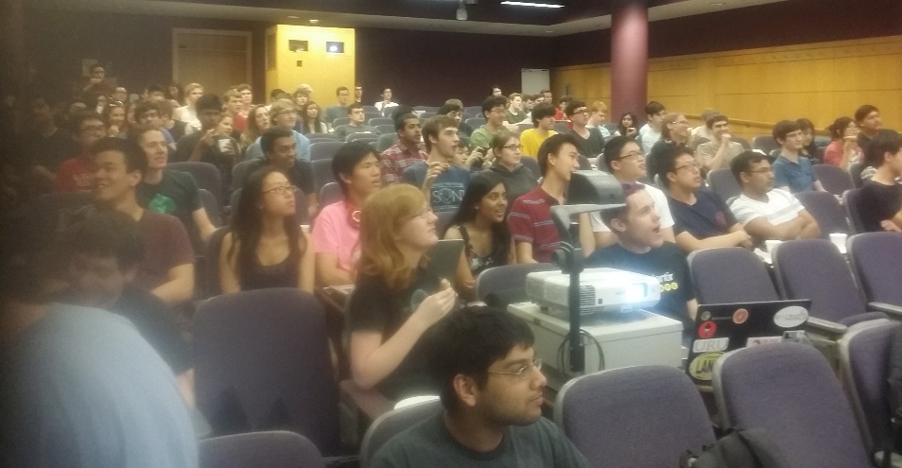
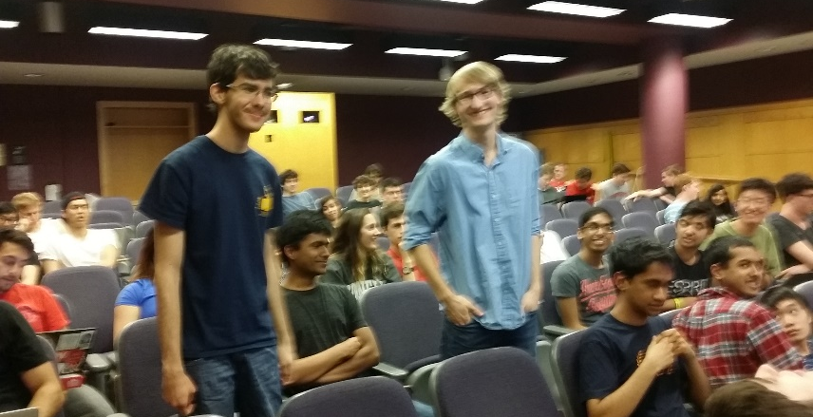
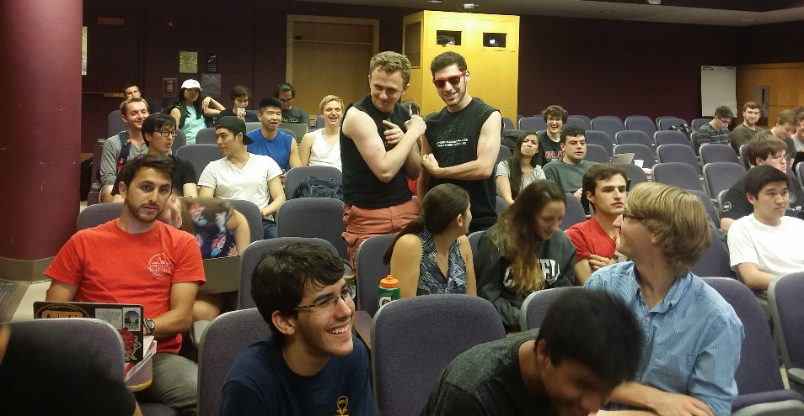
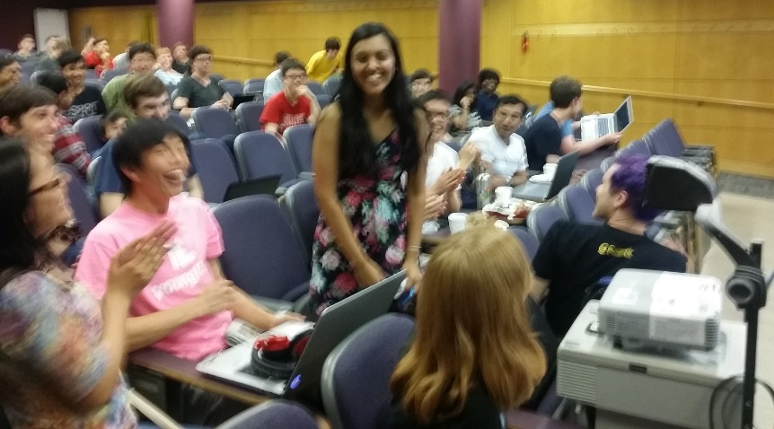
Announcements
Lord of the Cache Games Night was great!

Slide 11
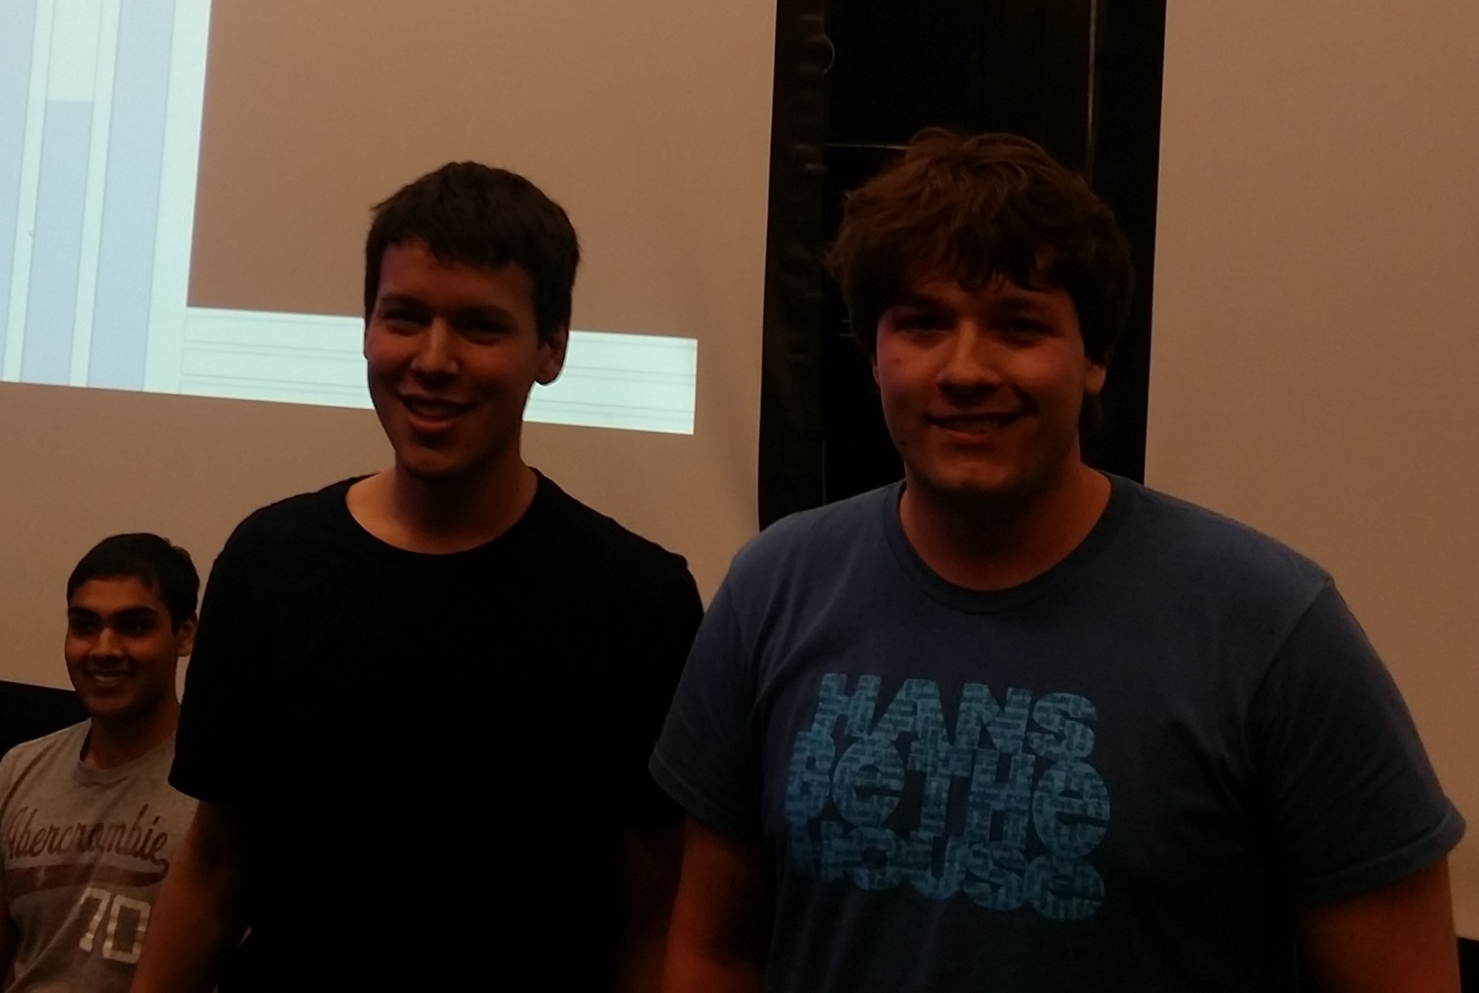
Announcements
Lord of the Cache Games Night was great!
  Winner: Team xyzzy
Andrew Matsumoto and Ian Leeming

Slide 12
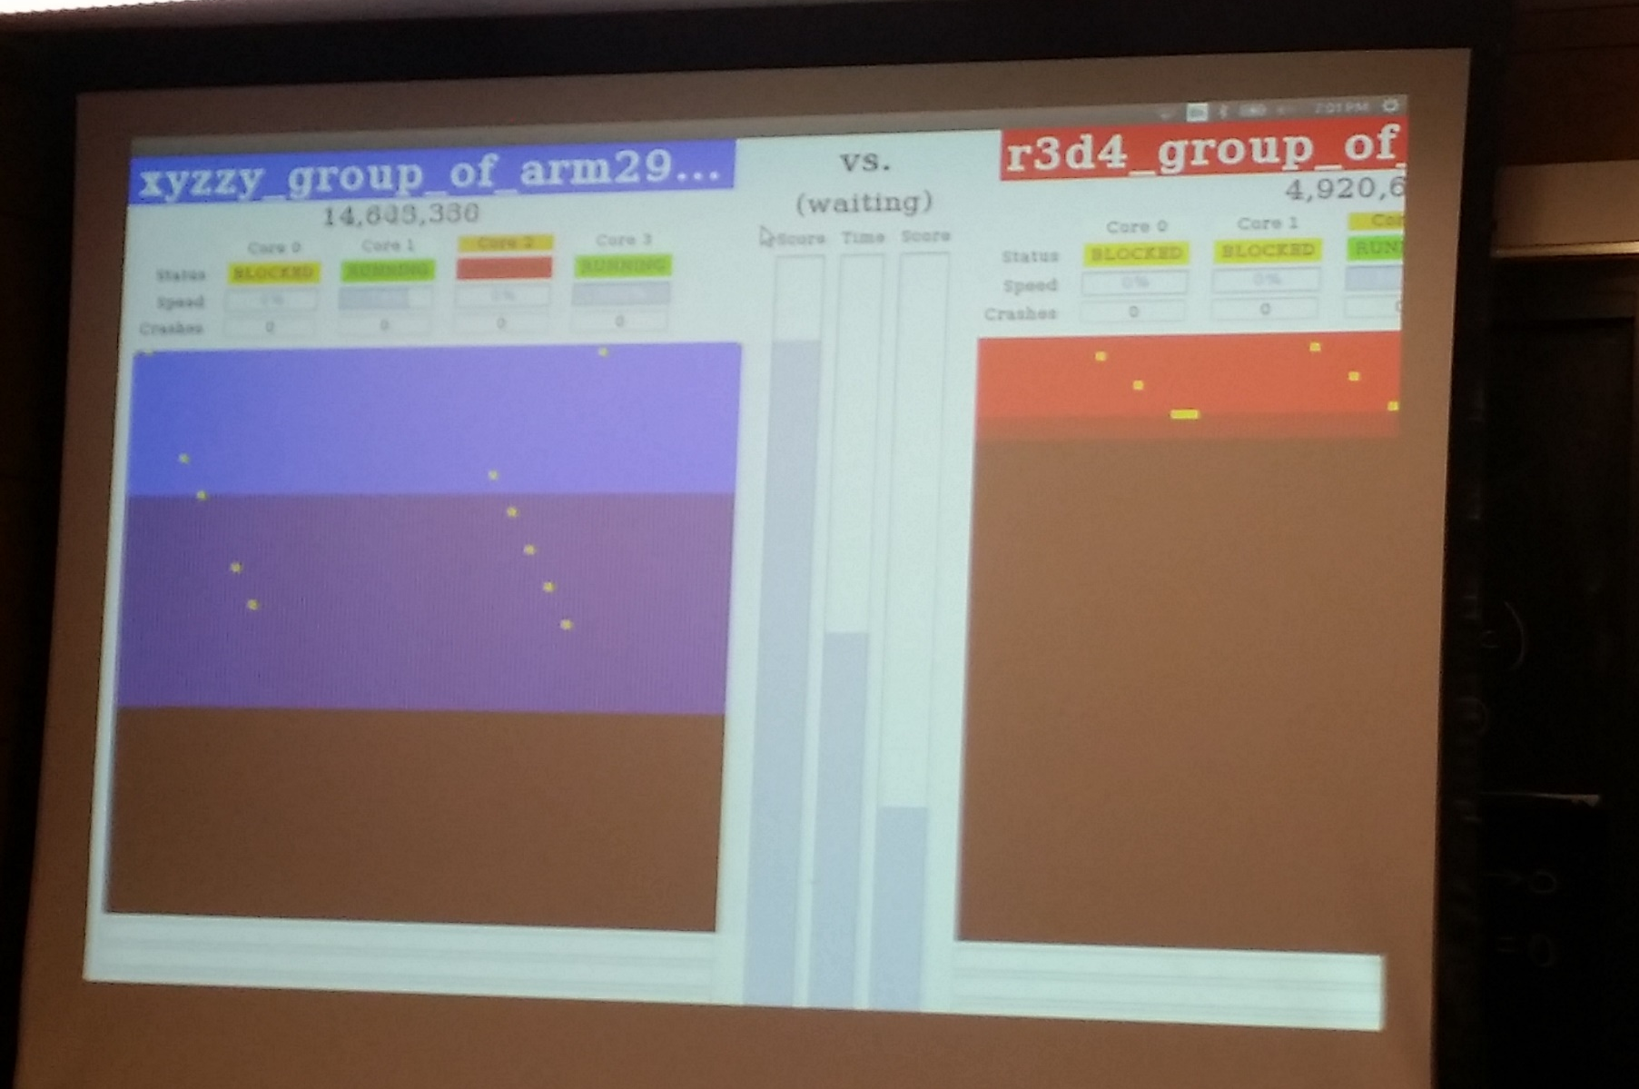
Announcements
Lord of the Cache Games Night was great!
  Winner: Team xyzzy
Andrew Matsumoto and Ian Leeming

Slide 13

Announcements
Lord of the Cache Games Night was great!
  Champion of Champions: 2015 vs 2011
xyzzy (2015) vs hakimPeterspoon (2011)
Notes:
2014: Jason Zhao and Joe Mongeluzzi

Slide 14
Big Picture about the Future

Slide 15
“Sometimes it is the people that no one imagines anything of
who do the things that no one can imagine”
--quote from the movie The Imitation Game

Slide 16
“Can machines think?”
-- Alan Turing, 1950
Computing Machinery and Intelligence
Notes:
http://en.wikipedia.org/wiki/The_Imitation_Game
The film's title [The Imitation Game] refers to Turing's proposed test of the same name, which he discussed in his 1950 paper on artificial intelligence entitled "Computing Machinery and Intelligence".[29] The paper opens: "I propose to consider the question, 'Can machines think?' This should begin with definitions of the meaning of the terms 'machine' and 'think'.“

Slide 17
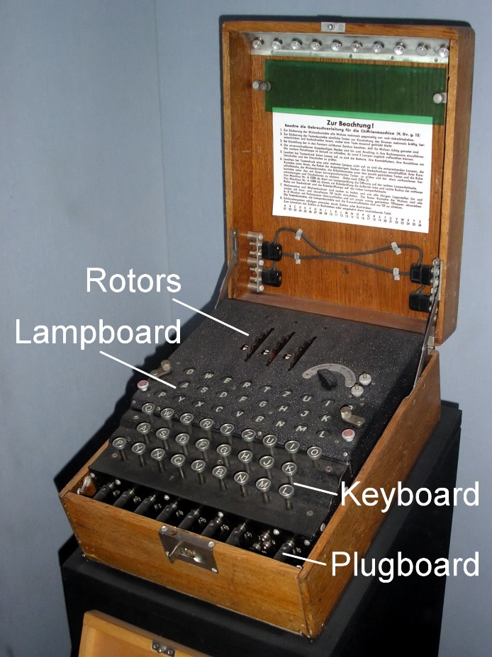
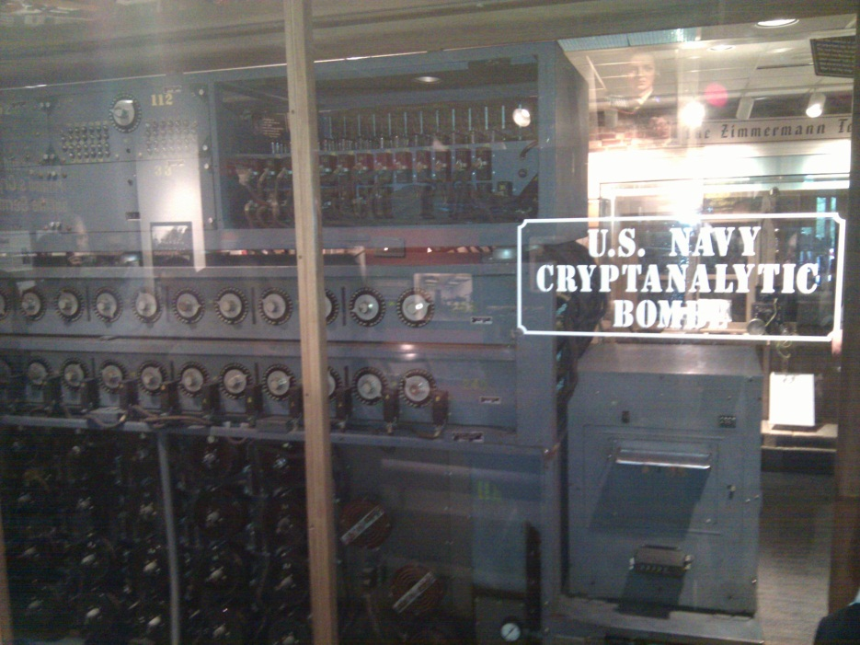
The Bombe
used by the Allies to
break the German
Enigma machine during
World War II
Enigma machine
Used by the Germans during
World War II to encrypt and
exchange secret messages
Notes:
http://en.wikipedia.org/wiki/Bombe
How many possible combinations to break an Enigma cipher text (msg encrypted by the Enigma machine)?
Rotors x Rotor posititions x plugboard combinations with 10 pairs = 159 quintillion = 1.59 x 10^20 158,962,555,217,826,360,000
Rotors (3 of 5 rotors): 5 x 4 x 3 = 60
Rotor positions: 26 x 26 x 26 = 17,526
plugboard: 26! / (6!10!2^10)
Numberphile on Enigma/Bombe
For those who want to learn more about the mechanism of the Bombe and how it exploited the flaw in the Enigma, Numberphile has recently done an excellent episode on it. Enjoy!
Flaw in the Enigma: http://www.youtube.com/watch?v=V4V2bpZlqx8
Previous episode on Enigma: http://www.youtube.com/watch?v=G2_Q9FoD-oQ

Slide 18
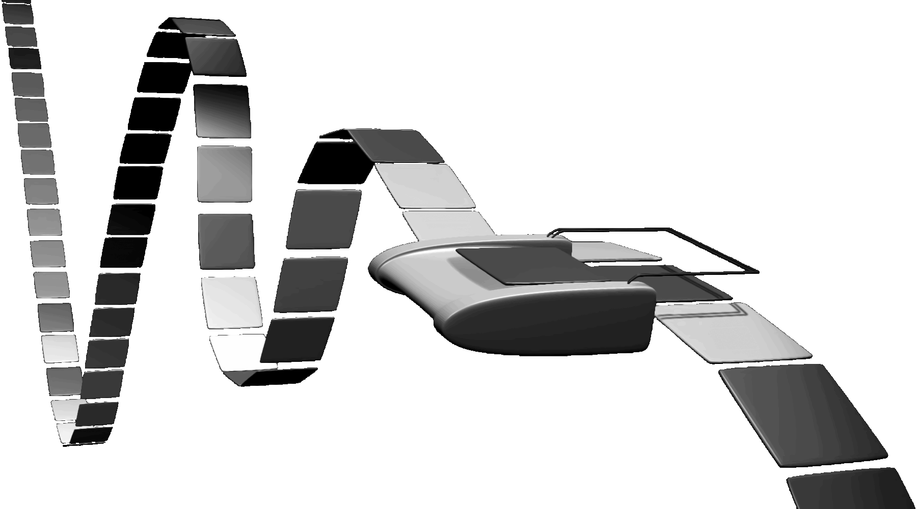

Turing Machine
1936
Alan Turing
Notes:
How does The Imitation Game, Engima/Bombe, Turing relate to you and this course?!
Alan Turing thesis in 1936 came up with an abstract model for a CPU that can simulate any algorithm, a Turing Machine. You will build a CPU and understand it and its organization
http://en.wikipedia.org/wiki/Turing_machine
A Turing machine is a hypothetical device that manipulates symbols on a strip of tape according to a table of rules. Despite its simplicity, a Turing machine can be adapted to simulate the logic of any computer algorithm, and is particularly useful in explaining the functions of a CPU inside a computer.
Note that every part of the machine (i.e. its state, symbol-collections, and used tape at any given time) and its actions (such as printing, erasing and tape motion) is finite, discrete and distinguishable; it is the unlimited amount of tape and runtime that gives it an unbounded amount of storage space.

Slide 19
Big Picture
How a processor works? How a computer is organized?
compute
jump/branch
targets
memory
register
file
A
alu
D
D
B
+4
addr
PC
inst
control
B
d_{in}
d_{out}
M
memory
new
pc
extend
imm
detect
hazard
forward
unit
Instruction
Fetch
Instruction
Decode
Write-
Back
ctrl
ctrl
ctrl
Execute
Memory
IF/ID
ID/EX
EX/MEM
MEM/WB
Notes:
Caching,
Virtual Memory, Paging, TLBs
Operating System, Traps, Exceptions,
Multicore and synchronization

Slide 20
What’s next?
More of Moore

Slide 21
Moore’s Law
Moore’s Law introduced in 1965
  Number of transistors that can be integrated on a single die would double every 18 to 24 months (i.e., grow exponentially with time).
Amazingly visionary
  2300 transistors, 1 MHz clock (Intel 4004) - 1971
  16 Million transistors (Ultra Sparc III)
  42 Million transistors, 2 GHz clock (Intel Xeon) – 2001
  55 Million transistors, 3 GHz, 130nm technology, 250mm2 die (Intel Pentium 4) – 2004
  290+ Million transistors, 3 GHz (Intel Core 2 Duo) – 2007
  731 Million transistors, 2-3Ghz (Intel Nehalem) – 2009
  1.4 Billion transistors, 2-3Ghz (Intel Ivy Bridge) – 2012
Notes:
Tbyte = 2^40 bytes (or 10^12 bytes)
Note that Moore’s law is not about speed predictions but about chip complexity

Slide 22
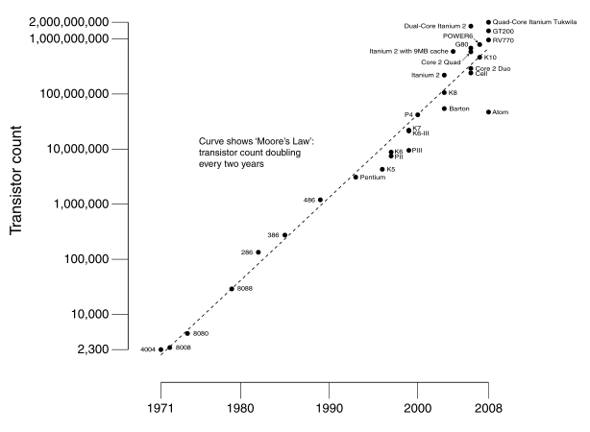
Moore’s Law
Ivy Bridge
Dual-core Itanium 2
K10
Itanium 2
K8
P4
Atom
Pentium
486
386
286
8088
8080
4004
8008
Notes:
NVIDIA GF100 has 3B transistors

Slide 23
Why Multicore?
Moore’s law
  A law about transistors
  Smaller means more transistors per die
  And smaller means faster too
But: Power consumption growing too…

Slide 24
What to do with all these transistors?
Multi-core

Slide 25

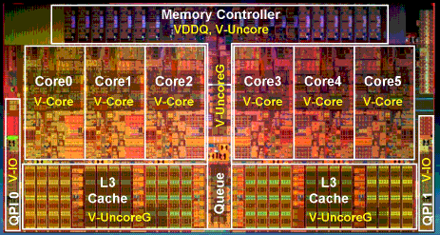
Multi-core
http://www.theregister.co.uk/2010/02/03/intel_westmere_ep_preview/
The first transistor
  on a workbench at
  AT&T Bell Labs in 1947
  Bardeen, Brattain, and Shockley
An Intel Westmere
  1.17 billion transistors
  240 square millimeters
  32 nanometer: transistor gate width
  Six processing cores
  Release date: January 2010
Notes:
John Bardeen
Walter Brattain
William Shockley

Slide 26
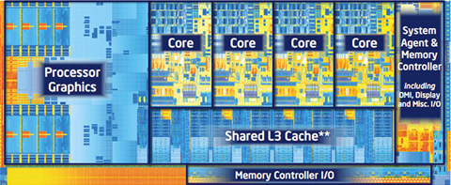
Multi-core
http://forwardthinking.pcmag.com/none/296972-intel-releases-ivy-bridge-first-processor-with-tri-gate-transistor
The first transistor
  on a workbench at
  AT&T Bell Labs in 1947
  Bardeen, Brattain, and Shockley
An Intel Ivy Bridge
  1.4 billion transistors
  160 square millimeters
  22 nanometer: transistor gate width
  Up to eight processing cores
  Release date: April 2012
Notes:
John Bardeen
Walter Brattain
William Shockley

Slide 27
What to do with all these transistors?
Cloud Computing

Slide 28







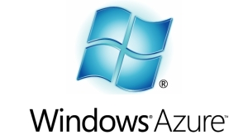



Cloud Computing
The promise of the Cloud
  ubiquitous, convenient, on-demand network access to a shared pool of configurable computing resources (e.g., networks, servers, storage, applications, and services) that can be rapidly provisioned and released with minimal management effort or service provider interaction.
NIST Cloud Definition
SEATTLE
Notes:
The cloud completes the commoditization process and makes storage and computation a commodity.
Public vs private
IaaS, PaaS, SaaS
On demand (self service), network access, resource pooling, rapid elasticity, measured service

Slide 29
Cloud Computing
The promise of the Cloud
  ubiquitous, convenient, on-demand network access to a shared pool of configurable computing resources (e.g., networks, servers, storage, applications, and services) that can be rapidly provisioned and released with minimal management effort or service provider interaction.
NIST Cloud Definition
SEATTLE
Notes:
The cloud completes the commoditization process and makes storage and computation a commodity.
Public vs private
IaaS, PaaS, SaaS
On demand (self service), network access, resource pooling, rapid elasticity, measured service

Slide 30
Cloud Computing
The promise of the Cloud
  ubiquitous, convenient, on-demand network access to a shared pool of configurable computing resources (e.g., networks, servers, storage, applications, and services) that can be rapidly provisioned and released with minimal management effort or service provider interaction.
Requires fundamentals in systems
  Computation
  Networking
  Storage
NIST Cloud Definition
Notes:
The cloud completes the commoditization process and makes storage and computation a commodity.
Public vs private
IaaS, PaaS, SaaS
On demand (self service), network access, resource pooling, rapid elasticity, measured service

Slide 31
Cloud Computing
Large organizations considering using the cloud
  New York Times
  Netflix
  Nintendo
  Cornell
  Library of Congress
The more data you have, the harder it is to move
  Switching providers entails paying for bandwidth twice
  Inhibits opportunistic migration

Slide 32

Cloud Computing
How hard is to program with a ExaByte of data?
Titan tech boom, randy katz, 2008

Slide 33
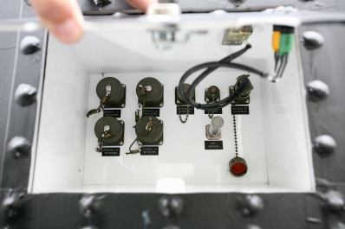
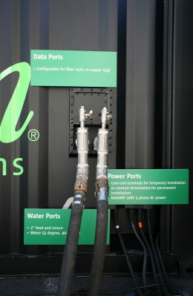
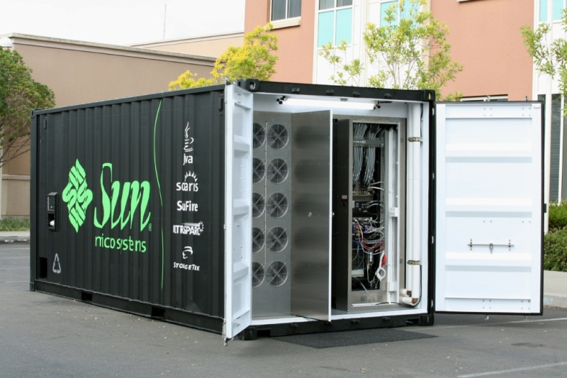
Cloud Computing
Datacenters are becoming a commodity
Order online and have it delivered
  Datacenter in a box: already set up with commodity hardware & software (Intel, Linux, petabyte of storage)
  Plug data, power & cooling and turn on
    typically connected via optical fiber
    may have network of such datacenters
Notes:
datacenters built from commodity components are becoming a commodity themselves
it’s as easy as ordering it online and have it shipped
comes with commodity hardware & software
simply plug power, data and potentially cooling & flip the switch
may have a bunch of these datacenters, typically connected over fiber residing at distant geographical location
Datacenters of commodity components have emerged as the computing platform of choice for a wide variety of applications, ranging from blunt content delivery to more advanced complete in-browser document & spreadsheet processing. In fact this paradigm has been so successful that it has driven datacenters to becoming a commodity themselves. It’s as easy as ordering one online and having it shipped to any location. These datacenters in a box typically come already set up with commodity hardware and software; all you need to do is plug the power, data and potentially cooling and flip the switch. This great ease is ushering in the global network of datacenters paradigm.

Slide 34
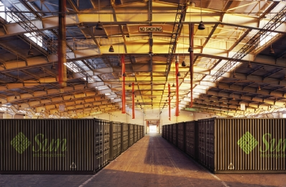
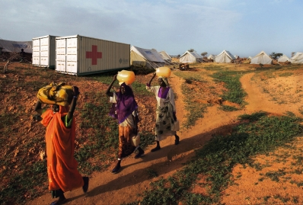
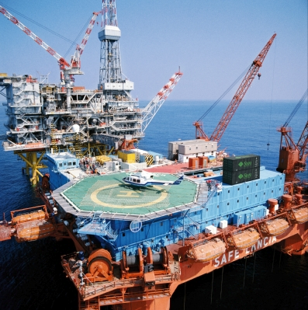
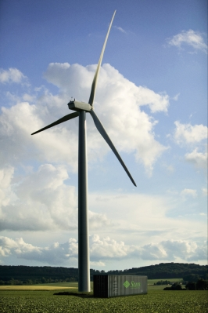
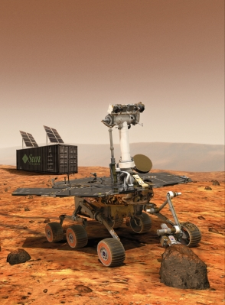
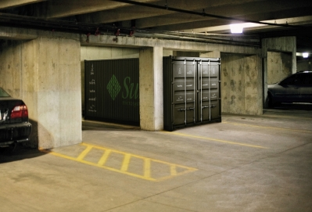
Cloud Computing = Network of Datacenters
Notes:
%Naturally, having multiple datacenters at various distant geographical locations raises the next challenge – coordinating them as part of a single global distributed system.
%Interconnecting the datacenters via high bandwidth, large latency links like optical fiber networks is a viable option today.
Interconnecting datacenters over distant geographical locations can be usually done via high bandwidth, optical fiber networks. Already laid down dark fiber is cheap and can be acquired in bulk – making private lambda networks a reality.
Although the raw bandwidth is cheap, these networks experience some level of packet loss due to cabling, equipment, dirty or degraded fiber and other glitches. Eliminating the packet loss altogether on such links is not an option – the general belief is that non congestion packet loss is unavoidable. For example, on managed links, tier 1 ISP service level agreements cite packet loss rates in the range of 0.1% - 0.3%-0.7%.
% for various reasons like transient malfunctions, poorly configured equipment and dirty or degraded optical fiber.

Slide 35


Cloud Computing
How to optimize a global network of data centers?

Slide 36
Cloud Computing = Network of Datacenters
Notes:
%Naturally, having multiple datacenters at various distant geographical locations raises the next challenge – coordinating them as part of a single global distributed system.
%Interconnecting the datacenters via high bandwidth, large latency links like optical fiber networks is a viable option today.
Interconnecting datacenters over distant geographical locations can be usually done via high bandwidth, optical fiber networks. Already laid down dark fiber is cheap and can be acquired in bulk – making private lambda networks a reality.
Although the raw bandwidth is cheap, these networks experience some level of packet loss due to cabling, equipment, dirty or degraded fiber and other glitches. Eliminating the packet loss altogether on such links is not an option – the general belief is that non congestion packet loss is unavoidable. For example, on managed links, tier 1 ISP service level agreements cite packet loss rates in the range of 0.1% - 0.3%-0.7%.
% for various reasons like transient malfunctions, poorly configured equipment and dirty or degraded optical fiber.

Slide 37
Cloud Computing
Vision
The promise of the Cloud
  A computer utility; a commodity
  Catalyst for technology economy
  Revolutionizing for health care, financial systems,
  scientific research, and society
However, cloud platforms today
  Entail significant risk: vendor lock-in vs control
  Entail inefficient processes: energy vs performance
  Entail poor communication: fiber optics vs COTS endpoints
Notes:
The cloud completes the commoditization process and makes storage and computation a commodity.

Slide 38
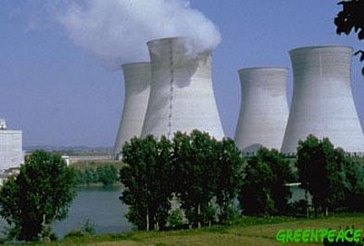
Example: Energy and Performance
Why don’t we save more energy in the cloud?
No one deletes data anymore!
  Huge amounts of seldom-accessed data
Data deluge
  Google (YouTube, Picasa, Gmail, Docs), Facebook, Flickr
  100 GB per second is faster than hard disk capacity growth!
  Max amount of data accessible at one time << Total data
New scalable approach needed to store this data
  Energy footprint proportional to number of HDDs is
  not sustainable

Slide 39
What to do with all these transistors?
Embedded Processors

Slide 40
Where is the Market?
Millions of Computers
Notes:
For “definitions” of desktop, servers, supercomputers (100’s to 1000’s of processors, Gbytes to Tbytes of main memory, Tbytes to Pbytes of secondary storage), and embedded systems (cell phones, automobile control, video games, entertainment systems (digital TVs), PDAs, etc.).
The computer (IT) industry is responsible for almost 10% of the GNP of the US.
The embedded market has shown the strongest growth (40% compounded annual growth compared to only 9% for desktops – where do laptops fit?). This chart/number does not include the low-end 8-bit and 16-bit embedded processors that are everywhere!
This is a good slide to talk about the other performance metrics in addition to speed (or see if the students can come up with them) including
Power, space/volume, memory space, cost, reliability

Slide 41
Where is the Market?
Millions of Computers
Notes:
For “definitions” of desktop, servers, supercomputers (100’s to 1000’s of processors, Gbytes to Tbytes of main memory, Tbytes to Pbytes of secondary storage), and embedded systems (cell phones, automobile control, video games, entertainment systems (digital TVs), PDAs, etc.).
The computer (IT) industry is responsible for almost 10% of the GNP of the US.
The embedded market has shown the strongest growth (40% compounded annual growth compared to only 9% for desktops – where do laptops fit?). This chart/number does not include the low-end 8-bit and 16-bit embedded processors that are everywhere!
This is a good slide to talk about the other performance metrics in addition to speed (or see if the students can come up with them) including
Power, space/volume, memory space, cost, reliability

Slide 42
Where is the Market?
Millions of Computers
Notes:
For “definitions” of desktop, servers, supercomputers (100’s to 1000’s of processors, Gbytes to Tbytes of main memory, Tbytes to Pbytes of secondary storage), and embedded systems (cell phones, automobile control, video games, entertainment systems (digital TVs), PDAs, etc.).
The computer (IT) industry is responsible for almost 10% of the GNP of the US.
The embedded market has shown the strongest growth (40% compounded annual growth compared to only 9% for desktops – where do laptops fit?). This chart/number does not include the low-end 8-bit and 16-bit embedded processors that are everywhere!
This is a good slide to talk about the other performance metrics in addition to speed (or see if the students can come up with them) including
Power, space/volume, memory space, cost, reliability

Slide 43
Where is the Market?
Millions of Computers
Notes:
For “definitions” of desktop, servers, supercomputers (100’s to 1000’s of processors, Gbytes to Tbytes of main memory, Tbytes to Pbytes of secondary storage), and embedded systems (cell phones, automobile control, video games, entertainment systems (digital TVs), PDAs, etc.).
The computer (IT) industry is responsible for almost 10% of the GNP of the US.
The embedded market has shown the strongest growth (40% compounded annual growth compared to only 9% for desktops – where do laptops fit?). This chart/number does not include the low-end 8-bit and 16-bit embedded processors that are everywhere!
This is a good slide to talk about the other performance metrics in addition to speed (or see if the students can come up with them) including
Power, space/volume, memory space, cost, reliability

Slide 44
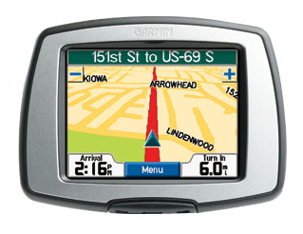
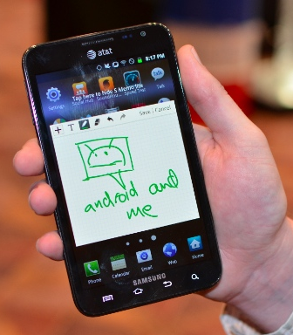


Slide 45
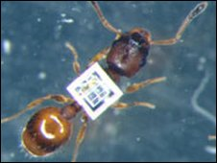
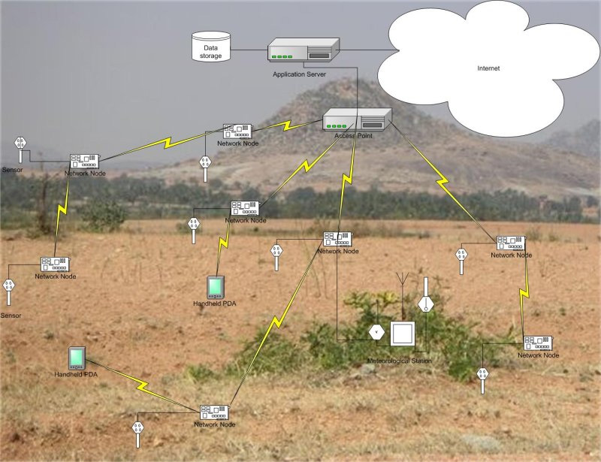
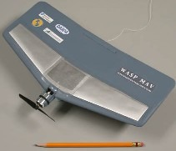
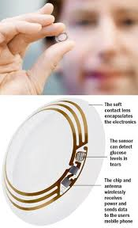
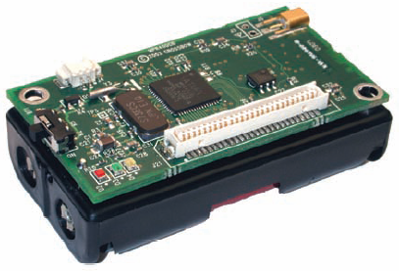
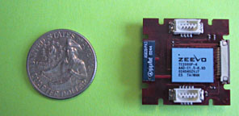
Where to?
Smart Dust….

Slide 46
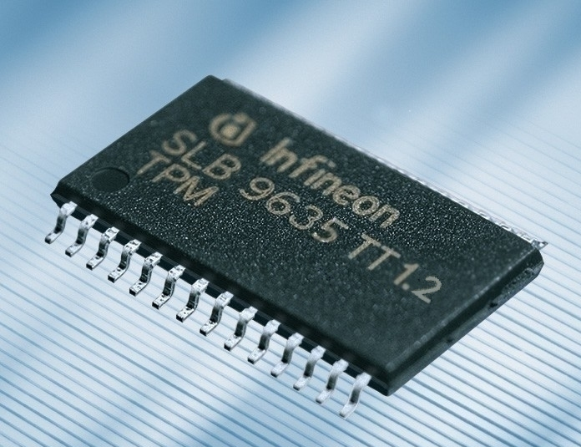
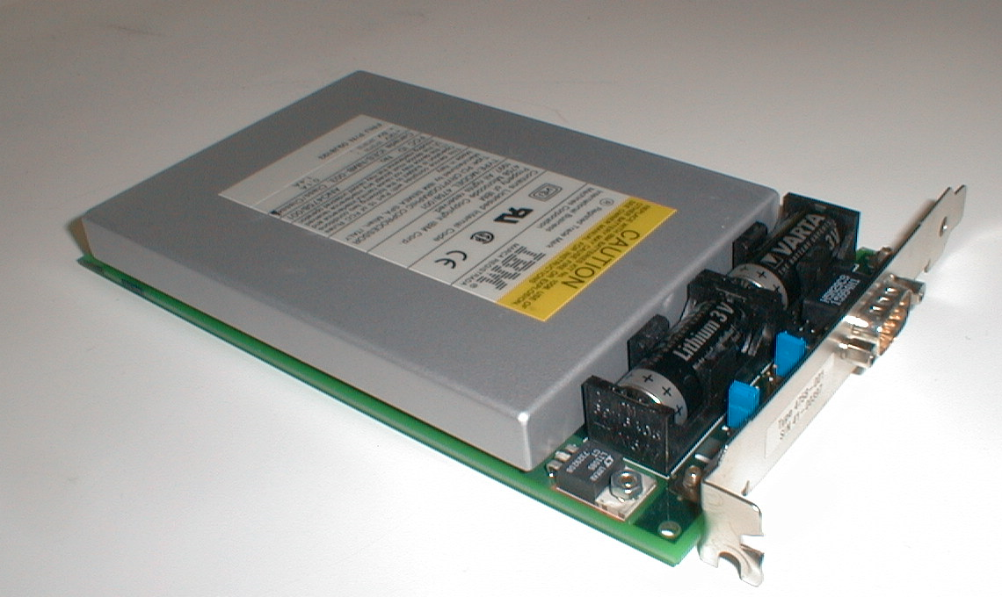
Security?
Cryptography and security…
TPM 1.2
IBM 4758
Secure Cryptoprocessor

Slide 47
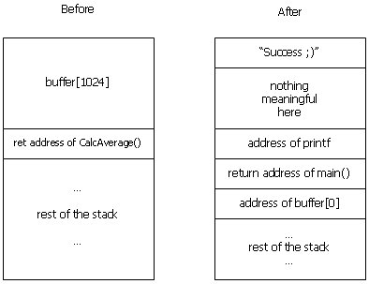
Security?
Stack Smashing…

Slide 48
What’s next?

Slide 49
Moore’s Law
Moore’s Law introduced in 1965
  Number of transistors that can be integrated on a single die would double every 18 to 24 months (i.e., grow exponentially with time)
Amazingly visionary
  2300 transistors, 1 MHz clock (Intel 4004) - 1971
  16 Million transistors (Ultra Sparc III)
  42 Million transistors, 2 GHz clock (Intel Xeon) – 2001
  55 Million transistors, 3 GHz, 130nm technology, 250mm2 die (Intel Pentium 4) – 2004
  290+ Million transistors, 3 GHz (Intel Core 2 Duo) – 2007
  731 Million transistors, 2-3Ghz (Intel Nehalem) – 2009
  1.4 Billion transistors, 2-3Ghz (Intel Ivy Bridge) – 2012
Notes:
Tbyte = 2^40 bytes (or 10^12 bytes)
Note that Moore’s law is not about speed predictions but about chip complexity

Slide 50
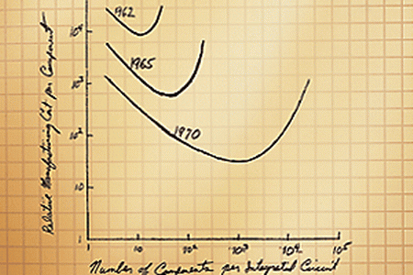
Moore’s Law

Slide 51
Parallelism
Dennard scaling: power
Must exploit parallelism for performance
MIMD: multiple instruction, multiple data
  Multicore
SIMD: single instruction, multiple data
  GPUs

Slide 52
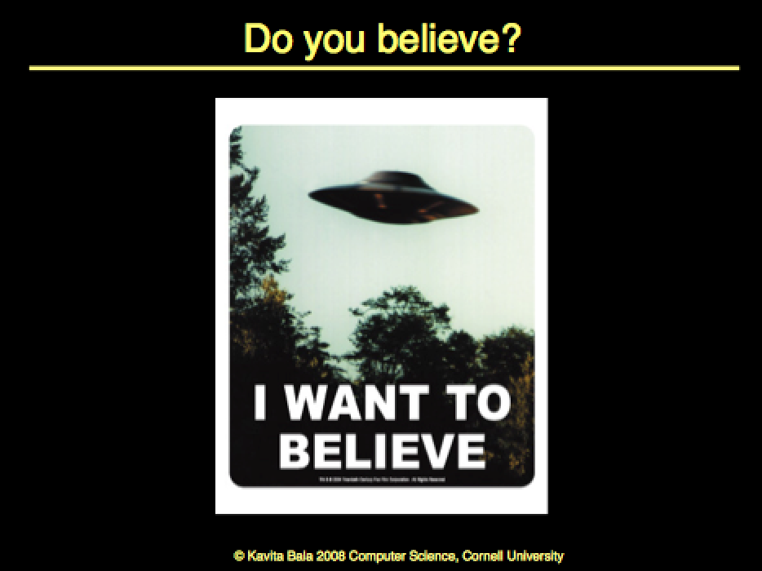
My slide from 2008

Slide 53
Is Moore’s law dead?

Slide 54
Some thoughts
Bob Colwell
Chief Architect Pentium
DARPA
Introduction
Bill Dally, Nvidia CTO
Talk
The Chip Design Game at the End of Moore's Law
Hot Chips, Aug 2013
Notes:
3:07-4:20 End of Moore’s Law
10:25-11:25 Exponentials must end. Singularity
-7nm (currently 14nm) - 12:58 Singularity
End of Moore’s Law predicted by
-17:56 (18:00)
Graphics, Neural Nets,

Slide 55
Singularity
Approximate Computing
Better interfaces
Brain interfaces
Specialized chips
Make it programmable
More

Slide 56
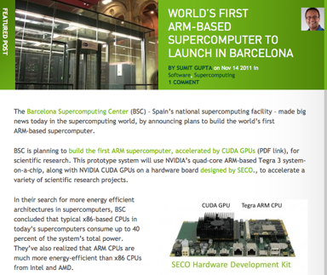
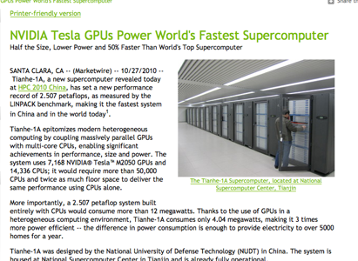
Supercomputers
Petaflops: GPUs/multicore/100s-1000s cores
Kavita Bala, Cornell University

Slide 57
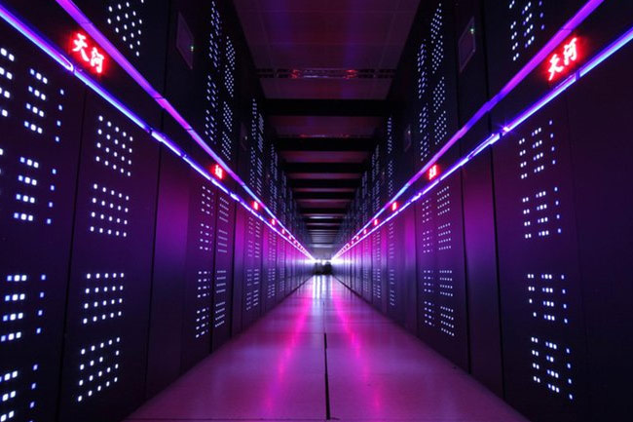
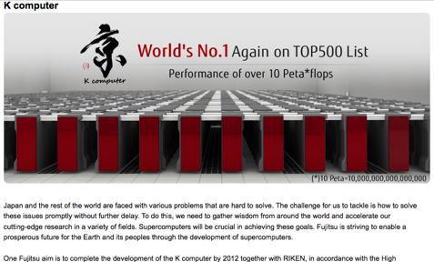
Petaflops
Kavita Bala, Cornell University

Slide 58
Petaflops
Tianhe-2 is the fastest computer in the world!
It is a 33.86 petaflop supercomputer

Slide 59
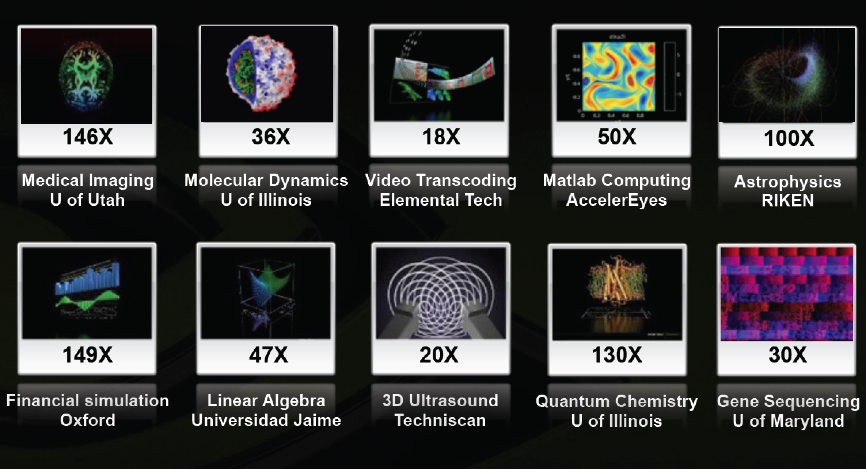
GPUs for Scientific Computing

Slide 60
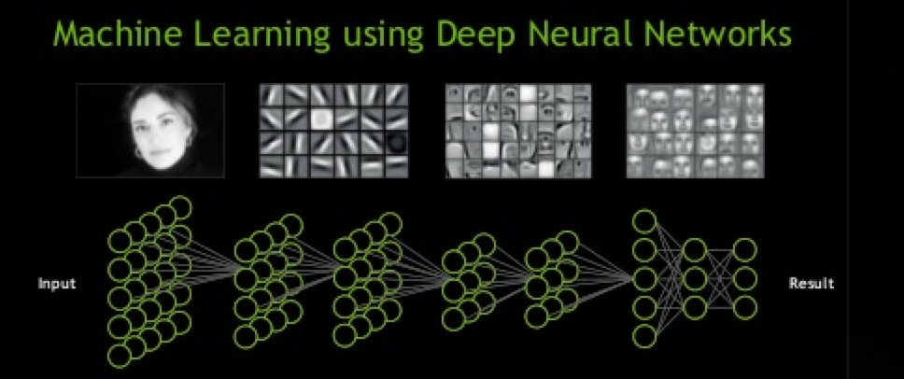
GPUs for Neural Nets

Slide 61



GPUs for Graphics, of course

Slide 62
What to do with all these transistors?
You could save the world one day?

Slide 63
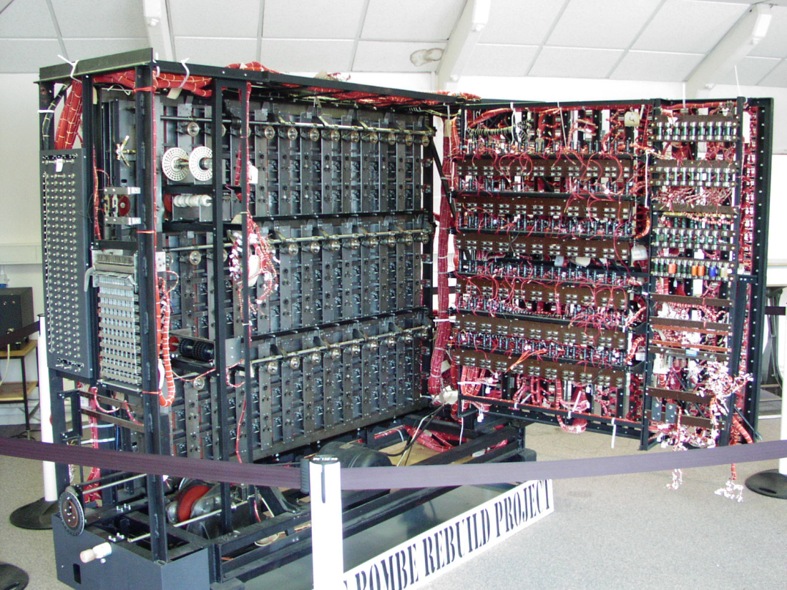
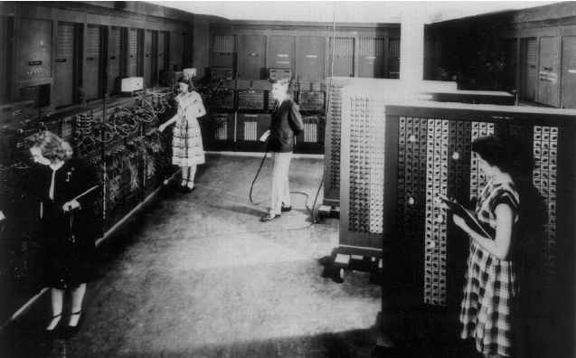
ENIAC - 1946
First general purpose
electronic computer. Designed
to calculate ballistic trajectories
Alan Turing’s Bombe
Used to crack Germany’s
enigma machine

Slide 64
Smart Dust
& Sensor Networks
Games
Embedded
Computing
Save the world?
Graphics
Security
Scientific
Computing
Cloud Computing
Cryptography

Slide 65
Survey Questions
Are you a better computer scientist and software engineering knowing “the low-level stuff”?
How much of computer architecture do software engineers actually have to deal with?
What are the most important aspects of computer architecture that a software engineer should keep in mind while programming?

Slide 66
Why?
These days, programs run on hardware...
… more than ever before
Google Chrome
→ Operating Systems
→ Multi-Core & Hyper-Threading
→ Datapath Pipelines, Caches, MMUs, I/O & DMA
→ Busses, Logic, & State machines
→ Gates
→ Transistors
→ Silicon
→ Electrons

Slide 67
Where to?
CS 3110: Better concurrent programming
CS 4410/4411: The Operating System!
CS 4420/ECE 4750: Computer Architecture
CS 4450: Networking
CS 4620: Graphics
MEng
5412—Cloud Computing, 5414—Distr Computing
5430—Systems Secuirty, 5413 – high perf systems and netowrking
5300—Arch of Larg scale Info Systems
6644 – Modeling the world
And many more…

Slide 68











Why?
Your job as a computer scientist will require knowledge the computer
Research/University
Industry
Government

Slide 69
Thank you!
If you want to make an apple pie from scratch, you must first create the universe.
– Carl Sagan

