Slide 1
Multicore and Parallelism
Prof. Hakim Weatherspoon
CS 3410, Spring 2015
Computer Science
Cornell University
P & H Chapter 4.10, 1.7, 1.8, 5.10, 6

Slide 2
Announcements
HW2 Review Sessions!
  Saturday, April 18th, Hollister B14@7pm
  Tuesday, April 21st, Hollister B14@7pm
Lab3 is due yesterday!
  Wednesday, April 15th
PA3 started this week!
  The Lord of the Cache!
  Due Friday, April 24th

Slide 3
Announcements
HW2-P5 (Pre-Lab4) due next week!
  Monday, April 20th
  Don’t forget to submit on CMS!
  Designed for you to look over the code and understand virtual memory before coming to Lab 4.

Slide 4
Announcements
Prelim 2 is on April 30th at 7 PM at Statler Hall!
If you have a conflict e-mail me:
deniz@cs.cornell.edu

Slide 5
Announcements
Next three weeks
  Week 12 (Apr 21): Lab4 due in-class, Proj3 due Fri, HW2 due Sat
  Week 13 (Apr 28): Proj4 release, Prelim2
  Week 14 (May 5): Proj3 tournament Mon, Proj4 design doc due
Final Project for class
  Week 15 (May 12): Proj4 due Wed

Slide 6
Today
Many ways to improve performance
Instruction Level Parallelism
Multicore
Performance in multicore
Next 2 lectures: synchronization

Slide 7

xkcd/619

Slide 8
Pitfall: Amdahl’s Law
Execution time after improvement =
affected execution time
amount of improvement
+ execution time unaffected
Notes:
Amdahl’s Law

Slide 9
Pitfall: Amdahl’s Law
Improving an aspect of a computer and expecting a proportional improvement in overall performance
Example: multiply accounts for 80s out of 100s
Notes:
Clicker question

Slide 10
Scaling Example
Workload: sum of 10 scalars, and 10 × 10 matrix sum
  Speed up from 10 to 100 processors?
Single processor: Time = (10 + 100) × t_{add}
10 processors
100 processors
.
Notes:
Pair up question

Slide 11
Scaling Example
What if matrix size is 100 × 100?
Single processor: Time = (10 + 10000) × t_{add}
10 processors
100 processors
.

Slide 12
Goals for Today
How to improve System Performance?
  Instruction Level Parallelism (ILP)
  Multicore
    Increase clock frequency vs multicore
  Beware of Amdahls Law
Next time:
  Concurrency, programming, and synchronization

Slide 13
Problem Statement
Q: How to improve system performance?
→ Increase CPU clock rate?
→ But I/O speeds are limited
Disk, Memory, Networks, etc.
Recall: Amdahl’s Law
Solution: Parallelism

Slide 14
Instruction-Level Parallelism (ILP)
Pipelining: execute multiple instructions in parallel
Q: How to get more instruction level parallelism?
A: Deeper pipeline
    E.g. 250MHz 1-stage; 500Mhz 2-stage; 1GHz 4-stage; 4GHz 16-stage
Pipeline depth limited by…
    max clock speed (less work per stage ⇒ shorter clock cycle)
    min unit of work
    dependencies, hazards / forwarding logic
Notes:
Draw pictures: 250MHz 1-stage; 500Mhz 2-stage; 1GHz 4-stage; 4GHz 16-stage

Slide 15
Instruction-Level Parallelism (ILP)
Pipelining: execute multiple instructions in parallel
Q: How to get more instruction level parallelism?
Notes:
Draw picture; 4 stage, 4-way * 4GHz = 16B inst/cycles
Next: Static issue

Slide 16
Static Multiple Issue
Static Multiple Issue
a.k.a. Very Long Instruction Word (VLIW)
Compiler groups instructions to be issued together
  Packages them into “issue slots”
Q: How does HW detect and resolve hazards?
Notes:
show program, decode stage
Ideal CPI = 0.5

Slide 17
MIPS with Static Dual Issue
Two-issue packets
  One ALU/branch instruction
  One load/store instruction
  64-bit aligned
    ALU/branch, then load/store
    Pad an unused instruction with nop
Address | Instruction type | Pipeline Stages
n | ALU/branch | IF | ID | EX | MEM | WB
n + 4 | Load/store | IF | ID | EX | MEM | WB
n + 8 | ALU/branch |  | IF | ID | EX | MEM | WB
n + 12 | Load/store |  | IF | ID | EX | MEM | WB
n + 16 | ALU/branch |  |  | IF | ID | EX | MEM | WB
n + 20 | Load/store |  |  | IF | ID | EX | MEM | WB

Slide 18
Scheduling Example
Schedule this for dual-issue MIPS
Loop: lw $t0, 0($s1) # $t0=array element
addu $t0, $t0, $s2 # add scalar in $s2
sw $t0, 0($s1) # store result
addi $s1, $s1,–4 # decrement pointer
bne $s1, $zero, Loop # branch $s1!=0
 | ALU/branch | Load/store | cycle

Slide 19
Scheduling Example
Compiler scheduling for dual-issue MIPS…
Loop: lw $t0, 0($s1) # $t0 = A[i]
lw $t1, 4($s1) # $t1 = A[i+1]
addu $t0, $t0, $s2 # add $s2
addu $t1, $t1, $s2 # add $s2
sw $t0, 0($s1) # store A[i]
sw $t1, 4($s1) # store A[i+1]
addi $s1, $s1, +8 # increment pointer
bne $s1, $s3, TOP # continue if $s1!=end
ALU/branch slot Load/store slot cycle
Loop: nop lw $t0, 0($s1) 1
nop lw $t1, 4($s1) 2
addu $t0, $t0, $s2 nop 3
addu $t1, $t1, $s2 sw $t0, 0($s1) 4
addi $s1, $s1, +8 sw $t1, 4($s1) 5
bne $s1, $s3, TOP nop 6
Notes:
assume 1 delay slot for loads
can move addi earlier
CPI = 6 cycles / 8 instructions = 0.75
CPI = 5 cycles / 8 instructions = 0.625

Slide 20
Scheduling Example
Compiler scheduling for dual-issue MIPS…
Loop: lw $t0, 0($s1) # $t0 = A[i]
lw $t1, 4($s1) # $t1 = A[i+1]
addu $t0, $t0, $s2 # add $s2
addu $t1, $t1, $s2 # add $s2
sw $t0, 0($s1) # store A[i]
sw $t1, 4($s1) # store A[i+1]
addi $s1, $s1, +8 # increment pointer
bne $s1, $s3, TOP # continue if $s1!=end
ALU/branch slot Load/store slot cycle
Loop: nop lw $t0, 0($s1) 1
addi $s1, $s1, +8 lw $t1, 4($s1) 2
addu $t0, $t0, $s2 nop 3
addu $t1, $t1, $s2 sw $t0, -8($s1) 4
bne $s1, $s3, Loop sw $t1, -4($s1) 5
Notes:
assume 1 delay slot for loads
can move addi earlier
CPI = 6 cycles / 8 instructions = 0.75
CPI = 5 cycles / 8 instructions = 0.625

Slide 21
Limits of Static Scheduling
Compiler scheduling for dual-issue MIPS…
lw $t0, 0($s1) # load A
addi $t0, $t0, +1 # increment A
sw $t0, 0($s1) # store A
lw $t0, 0($s2) # load B
addi $t0, $t0, +1 # increment B
sw $t0, 0($s2) # store B
ALU/branch slot Load/store slot cycle
nop lw $t0, 0($s1) 1
nop nop 2
addi $t0, $t0, +1 nop 3
nop sw $t0, 0($s1) 4
nop lw $t0, 0($s2) 5
nop nop 6
addi $t0, $t0, +1 nop 7
nop sw $t0, 0($s2) 8
Notes:
Rename registers, move load B up, eliminate delay slot
But! s1 and s2 might be equal => Aliasing!

Slide 22
Limits of Static Scheduling
Compiler scheduling for dual-issue MIPS…
lw $t0, 0($s1) # load A
addi $t0, $t0, +1 # increment A
sw $t0, 0($s1) # store A
lw $t1, 0($s2) # load B
addi $t1, $t1, +1 # increment B
sw $t0, 0($s2) # store B
ALU/branch slot Load/store slot cycle
nop lw $t0, 0($s1) 1
nop lw $t1, 0($s2) 2
addi $t0, $t0, +1 nop 3
addi $t1, $t1, +1 sw $t0, 0($s1) 4
nop sw $t1, 0($s2) 5
Notes:
Rename registers, move load B up, eliminate delay slot
But! s1 and s2 might be equal => Aliasing!

Slide 23
Dynamic Multiple Issue
Dynamic Multiple Issue
a.k.a. SuperScalar Processor (c.f. Intel)
  CPU examines instruction stream and chooses multiple instructions to issue each cycle
  Compiler can help by reordering instructions….
  … but CPU is responsible for resolving hazards
Even better: Speculation/Out-of-order Execution
  Execute instructions as early as possible
  Aggressive register renaming
  Guess results of branches, loads, etc.
  Roll back if guesses were wrong
  Don’t commit results until all previous insts. are retired

Slide 24
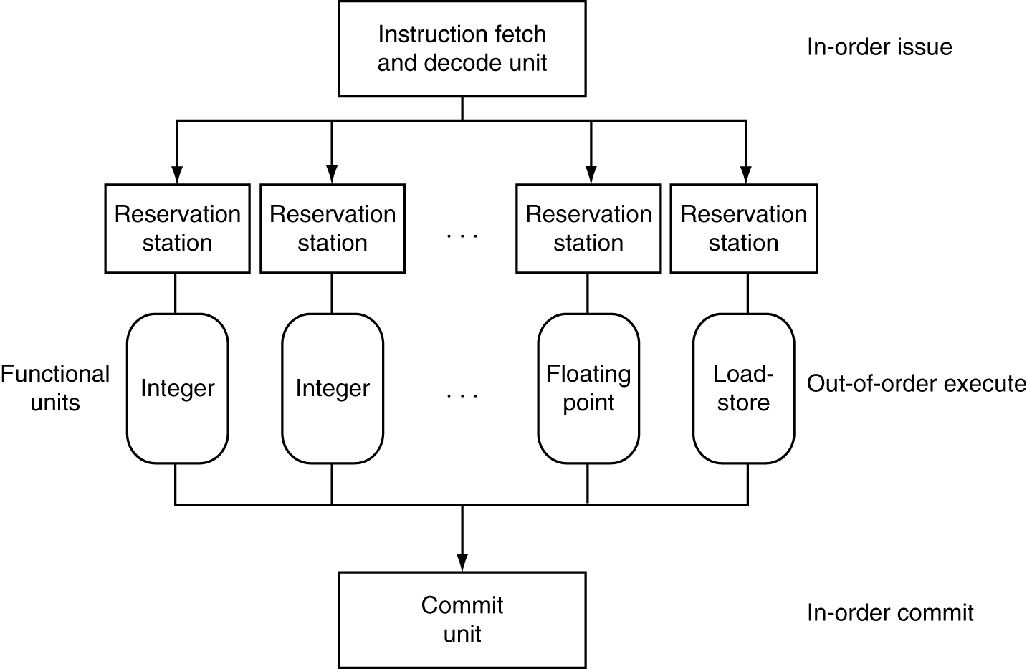
Dynamic Multiple Issue

Slide 25
Does Multiple Issue Work?
Q: Does multiple issue / ILP work?

Slide 26
Power Efficiency
Q: Does multiple issue / ILP cost much?

Slide 27
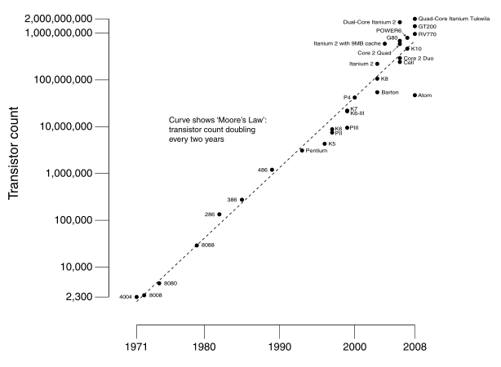
Moore’s Law
Dual-core Itanium 2
K10
Itanium 2
K8
P4
Atom
Pentium
486
386
286
8088
8080
4004
8008
Notes:
NVIDIA GF100 has 3B transistors

Slide 28
Why Multicore?
Moore’s law
  A law about transistors
  Smaller means more transistors per die
  And smaller means faster too
But: Power consumption growing too…

Slide 29
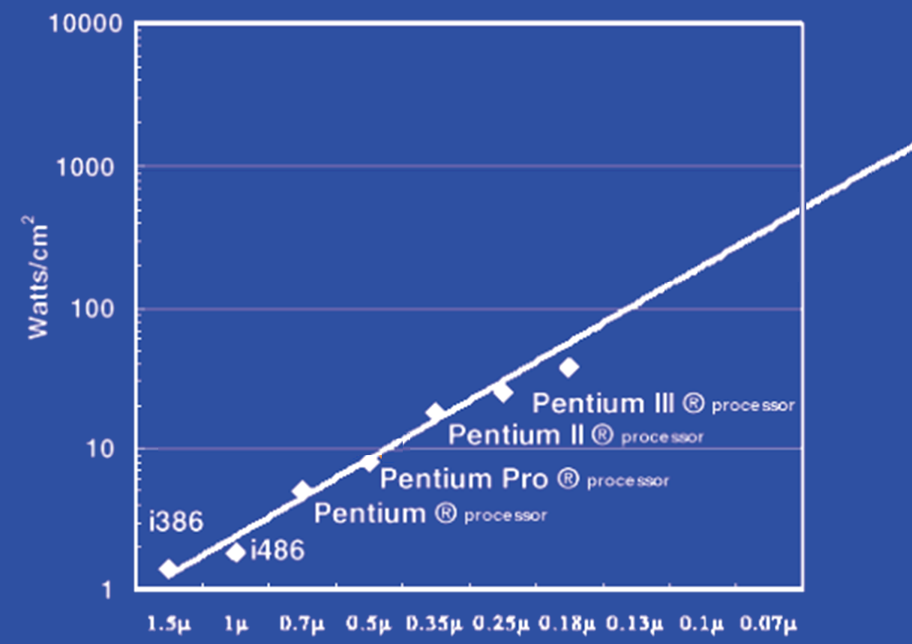
Power Limits
Surface of Sun
Rocket Nozzle
Nuclear Reactor
Xeon
Hot Plate
Notes:
Intel Westmere: 32 nm = 0.032u, 130W / 240mm^2 = 54 W/cm^2

Slide 30
Power Wall
Power = capacitance * voltage² * frequency
In practice: Power ~ voltage³
Reducing voltage helps (a lot)
... so does reducing clock speed
Better cooling helps
The power wall
  We can’t reduce voltage further
  We can’t remove more heat

Slide 31
Why Multicore?
Performance
1.2x
Single-Core
Overclocked +20%
Power
1.7x
Performance
1.0x
Power
Single-Core
1.0x
Performance
0.8x
1.6x
Single-Core
Underclocked -20%
Dual-Core
Underclocked -20%
Power
0.51x
1.02x

Slide 32
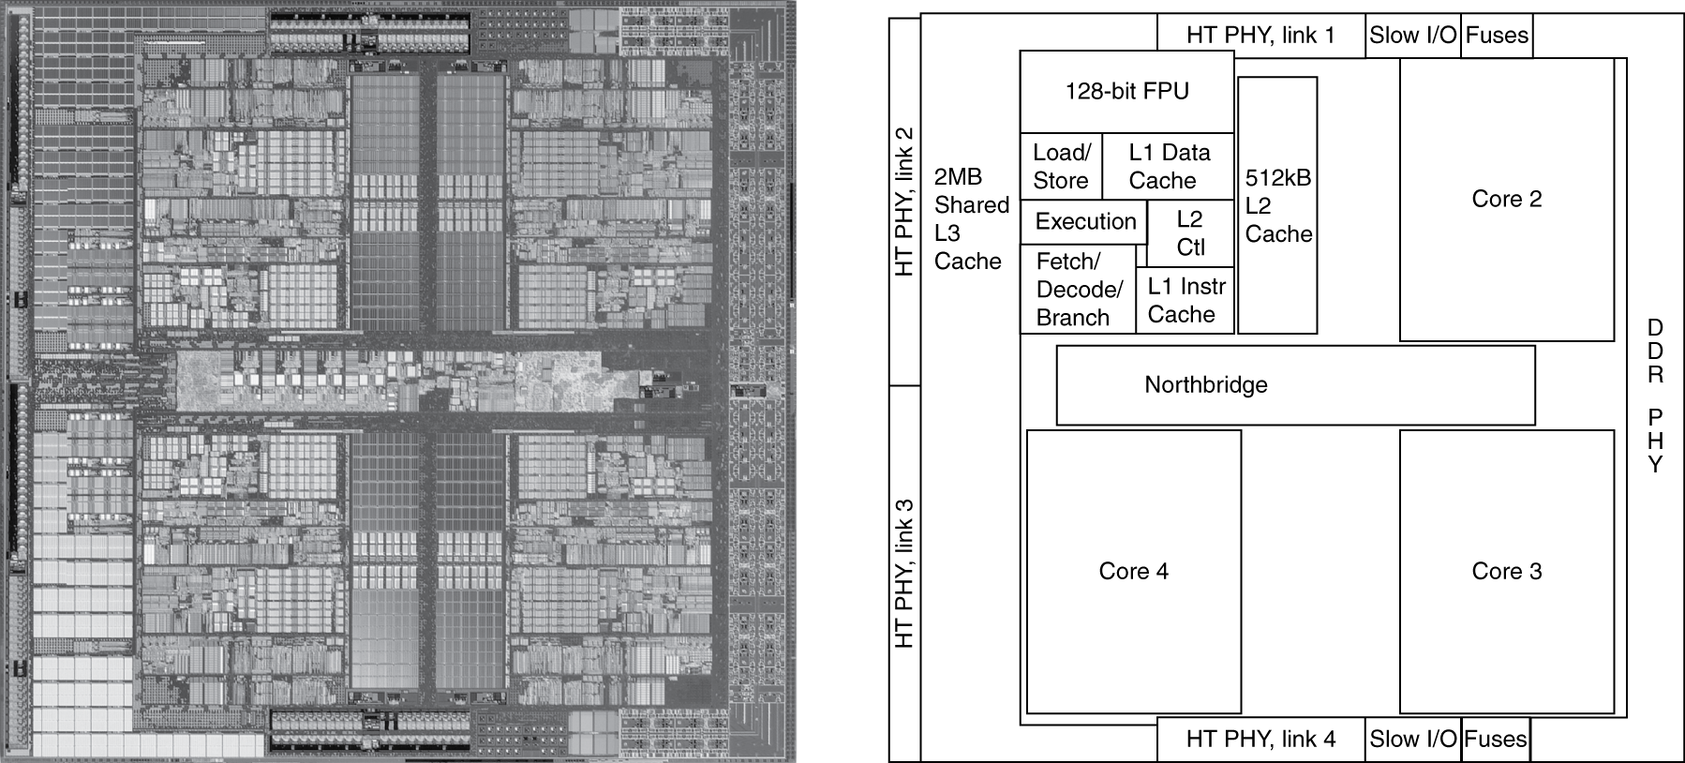
Inside the Processor
AMD Barcelona Quad-Core: 4 processor cores

Slide 33
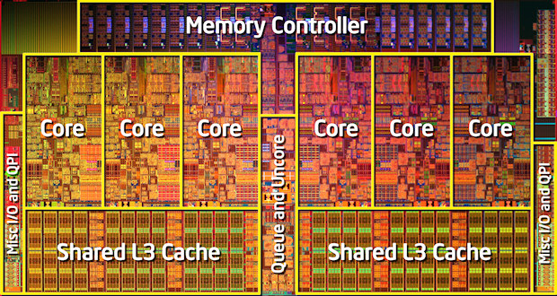
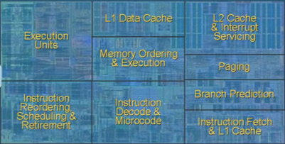
Inside the Processor
Intel Nehalem Hex-Core

Slide 34
Hyperthreading
vs. HT
Multi-Core vs. Multi-Issue
Programs:
Num. Pipelines:
Pipeline Width:
.
Notes:
HT = MultiIssue + extra PCs and registers – dependency logic
HT = MultiCore – redundant functional units + hazard avoidance

Slide 35
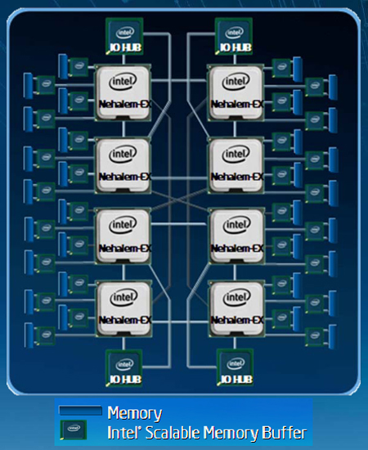
Example: All of the above
Notes:
MultiCore: 8 processors dies * 8 cores per processor die
Hyperthreading: 2 HT per core
Dynamic Multi-Issue: 4 issue
Pipeline: 16 stages

Slide 36
Parallel Programming
Q: So lets just all use multicore from now on!
A: Software must be written as parallel program
Multicore difficulties
  Partitioning work
  Coordination & synchronization
  Communications overhead
  Balancing load over cores
  How do you write parallel programs?
    ... without knowing exact underlying architecture?
Notes:
Or hyperthreads

Slide 37
Work Partitioning
Partition work so all cores have something to do

Slide 38
Load Balancing
Load Balancing
Need to partition so all cores are actually working

Slide 39
Amdahl’s Law
If tasks have a serial part and a parallel part…
Example:
step 1: divide input data into n pieces
step 2: do work on each piece
step 3: combine all results
Recall: Amdahl’s Law
As number of cores increases …
  time to execute parallel part?
  time to execute serial part?
  Serial part eventually dominates
goes to zero
Remains the same

Slide 40
Amdahl’s Law
Notes:
Underclocking messes up the ratios completely. Work through a 8x slowdown example.

Slide 41
Parallel Programming
Q: So lets just all use multicore from now on!
Multicore difficulties
  Partitioning work
  Coordination & synchronization
  Communications overhead
  Balancing load over cores
  How do you write parallel programs?
    ... without knowing exact underlying architecture?
Notes:
Most is software, but hardware can help:
- communications (fast core-to-core interconnect)
- coordination and synchronization primitives (next time)

