Slide 1
Lab4: Virtual Memory
CS 3410 : Computer System Organization & Programming
Spring 2015

Slide 2
Why do we need Virtual Memory?
We want to run multiple processes at the same time!
Even if we have multiple CPUs, addresses used by multiple processes will conflict!
Even if they do not conflict, they may not fit in memory together!
Solution: Use a Mapping!
Map a Virtual Address (generated by CPU)
to a Physical Address (in memory)!

Slide 3
How does Virtual Memory work?
How do we create the “map” that maps a virtual address generated by the CPU to a physical address used by main memory?

Slide 4
How does Virtual Memory work?
Each process has its own virtual address space
A process is a program being executed
Programmer can code as if they own all of memory
On-the-fly at runtime, for each memory access
all accesses are indirect through a virtual address
translate fake virtual address to a real physical address
redirect load/store to the physical address
Addresses are mapped in chunks called Pages!
4KB – 16KB pages are typical.

Slide 5
MMU (Memory Management Unit)
Responsible for translating on the fly
Keeps a Page Table
Essentially, just a big array of integers:
paddr = PageTable[vaddr];
Page tables are indexed by virtual page number!

Slide 6
Address Translation
Page size: 4 kB = 2¹²
CPU
generated
Virtual page number
Page Offset
vaddr
31 12 11 0
Lookup
in
page table
Main
Memory
Physical page number
Page offset
paddr
12 11 0

Slide 7
Page Table Size
Where is the page table stored?
In Memory!
PTBR (Page Table Base Register) holds the base address for the page table of the current process.
How large is the page table?
page table size =
logical address space size
× page table entry size
page size

Slide 8
Page Table Size
Page table size:
Many processors have 32-bit logical addresses, which results in a 4GB logical address space size. The page table entries size is usually 4B. If the page size is 4KB then the page table size is:
4 MB in memory just for the page table is a too much!
Page table size =
4 GB
= 4 MB
× 4 B
4 kB

Slide 9
Multi-level Page Tables
Used to reduce page table size!
10 bits
10 bits
10 bits
2
vaddr
31 22 21 12 11 2 1 0
Word
PTEntry
Page
PDEntry
Page Table
PTBR
Page Directory

Slide 10
Virtual Memory with 3 Processes
Each process has its own page tables!
Page
Page Directory
1
Page Table
1
Page
Process 1
…
Page
…
Page
Page Table
1
Page
Page Directory
2
Page
Process 2
PTBR
…
Page Table
2
Page
…
…
Page
Page Table
1
Page
Process 3
Page Directory
3
…
Page
…
CPU
Memory

Slide 11
Paging!
How can we run processes larger than the physical memory?
The OS copies pages from disk to main memory as they are needed!
Memory is the cache of disk!

Slide 12
Page Table Performance
Every load/store translated to physical addresses.
To write to virtual memory:
Look up vaddr to paddr translation in page table.
Then write to physical memory.
Page Table Miss: Page fault
load the page on disk and retry instruction
kill program if the page really doesn’t exist
tell the program it made a mistake

Slide 13
Paging is too slow!!
Solution: Instead of looking up translations on Page Tables, cache them:
TLB (Translation Lookaside Buffer)
A small, very fast cache of recent address mappings
TLB hit: avoids PageTable lookup
TLB miss: do PageTable lookup, cache result for later

Slide 14
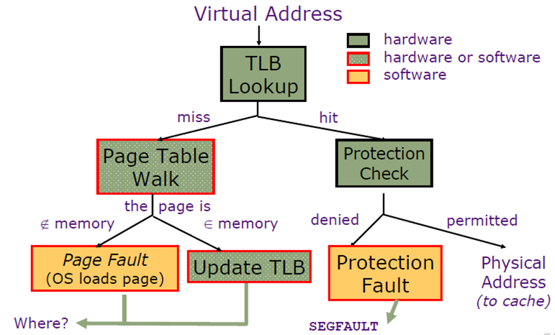
Address Lookup Procedure

Slide 15
Lab4
Modify the MIPS simulator to simulate virtual memory!
Including a shared memory system call with copy-on-write semantics.

Slide 16
A quick reminder: C Operators
Leftshift a variable A to the left by 5 bits and store it in A.
A = A << 5;
Rightshift a variable A to the left by 5 bits and store it in A.
A = A >> 5;
AND, OR, and XOR two variables and store them into a third variable.
z = x & y; z = x | y; z = x ^ y;
Change a variable into its negation.
z = ~z;

Slide 17
Two-level Page Table Structure
The Context Register (c0r4) contains a pointer to a 4096-byte page directory
4096 Bytes = 2¹² Bytes → We need 20 bits!
Each of the 4-byte page directory entries (PDEs) points to a 4096-byte page table.
4096/4 = 1024 entries → We need 10 bits!
Each of the 4-byte page table entries (PTEs) points to a 4096-byte page of data.
4096/4 = 1024 entries → We need 10 bits!

Slide 18
Two-level Page Table
10 bits
10 bits
vaddr
31 22 21 12 11 0
Word
PTEntry
Page
PDEntry
Page Table
c0r4
Page Directory

Slide 19
Create address space per process!
unsigned int create_address_space() {
return allocate_physical_page()<<12;
}
allocate_physical_page() returns a 32-bit physical page number for a free physical page
We only need 20 bits to map into a page.
Discard the left 12-bits and use the remaining 20 bits!
Ex. If we had 1,000 things to refer to and ids from 0 to 10,000, we would only use the last 3 digits! Same logic.

Slide 20
Map page!
Returns the physical page number for a given virtual address.
unsigned int map_page(
unsigned int context, /*page number for the PageDir*/
unsigned int vaddr, /* virtual address*/
int writable, /* zero for read-only, non-zero for writable */
int executable /* zero for no-execute, non-zero for executable */
);
Check where map_page is called:
Context is CPR[0][4]: Context Register
Upper 20 bits of CPR[0][4] is the page number for the PageDir

Slide 21
Get the indexes first!
We have a 32-bit Virtual Address vaddr
Get the index of the page directory entry and the index of the page table entry
unsigned int pd_index = vaddr >> 22;
// We only need the left 10 bits!
unsigned int pt_index =(vaddr<<10)>> 22;
// We only need the second left 10 bits!

Slide 22
Two-level Page Table
10 bits
10 bits
vaddr
31 22 21 12 11 0
Word
PTEntry
Page
PDEntry
Page Table
c0r4
Page Directory

Slide 23
Get the PDE!
Get the page directory entry!
unsigned int *directory = (unsigned int*)dereference_physical_page(context >> 12);
// Page number for page dir is in c0r4 (context)
// We only need the left 20 bits: rest is reserved!
unsigned int pde = directory[pd_index];
// Get the page directory entry!

Slide 24
Is the PDE valid?
NO? ☹
Allocate a fresh page for the Page Table!
Update the Page Directory!
if(!(pde & 1)){
unsigned int newptbl = allocate_physical_page();
pde = (newptbl << 12) | 1;
// We only care about the right 20 bits!
directory[pd_index] = pde;
}

Slide 25
Now we know that PDE valid!
Get the page table entry!
unsigned int *page_table = (unsigned int*)dereference_physical_page(pde >> 12);
// We need only the next 10 bits in pde!
unsigned int pte = page_table[pt_index];
// We have the Page Table Entry now!

Slide 26
Is the PTE valid?
NO? ☹
Allocate a fresh page!
if(!(pte & 1)){
unsigned int page = allocate_physical_page();
pte = (page << 12);
// We only care about the right 20 bits!
}

Slide 27
We are so close!
Set the permissions, update the page table entry!
page_table[pt_index]= pte | (executable << 2)|
(writable << 1) | 1;
// Should be executable for instruction fetch!
// Should be writable for writes!
// Bits can be found in mem.c ☺

Slide 28
And done!
Return the Physical Address for this Page!
// Shift it back before returning!
return pte >> 12;

Slide 29
More?
map_shared_page
To support shared, copy-on-write virtual memory.
pfault
To support killing processes and shared, copy-on-write virtual memory.

