Slide 1
What does the Future Hold?
Prof. Kavita Bala and Prof. Hakim Weatherspoon
CS 3410, Spring 2014
Computer Science
Cornell University

Slide 2
Announcements
Final Project
Demo Sign-Up via CMS.
sign up Tuesday, May 13th
or Wednesday, May 14th
CMS submission due:
Due 6:30pm Wednesday, May 14th

Slide 3
Announcements
Prelim3 Results
Mean 58 ± 16.2 (median 60), Max 93
Pickup in Homework Passback Room (216 Gates)

Slide 4
Announcements
Prelim3 Results
2³⁶=64GB
4 byte= 32-bit
2²⁸
x2¹³
=2⁴¹
or
2TB
V | R | W | X |  | Physical Page Number
0
1 |  |  |  |  | 0x10045
0
0
1 |  |  |  |  | 0xC20A3
1 |  |  |  |  | 0x4123B
1 |  |  |  |  | 0x10044
1
2³⁶
2¹³
=2²³
8kB
8kB
Virtual Memory
28-bit = 32-bit – 4 bit
Physical Memory
Notes:
A: can make code read-only, executable; make data read-write but not executable; etc.

Slide 5
Announcements
Prelim3 Results
2³⁶=64GB
4 byte= 32-bit
2²⁸
x2¹³
=2⁴¹
or
2TB
V | R | W | X |  | Physical Page Number
0
1 |  |  |  |  | 0x10045
0
0
1 |  |  |  |  | 0xC20A3
1 |  |  |  |  | 0x4123B
1 |  |  |  |  | 0x10044
1
2³⁶
2¹³
=2²³
2²³
x 4
=2²⁵
32MB
8kB
Virtual Memory
28-bit = 32-bit – 4 bit
Physical Memory
Notes:
A: can make code read-only, executable; make data read-write but not executable; etc.

Slide 6
Announcements
Prelim3 Results
2³³=8GB
4 byte= 32-bit
V | R | W | X |  | Physical Page Number
0
1 |  |  |  |  | 0x10045
0
0
1 |  |  |  |  | 0xC20A3
1 |  |  |  |  | 0x4123B
1 |  |  |  |  | 0x10044
0
2³³
2¹³
=2²⁰
2²⁰
x 4
=2²²
4MB
8kB
Virtual Memory
Physical Memory
Notes:
A: can make code read-only, executable; make data read-write but not executable; etc.

Slide 7
Announcements
Multi-level PageTable
12 bits
11 bits
13 bits
vaddr
4B
Word
2¹²x4B
=2¹⁴B
=16kB
=2pages
PTEntry
Page
PDEntry
Page Table
PTBR
Page Directory
Page table = 16kB + 4MB
Notes:
Q: Benefits?
A1: Don’t need 4MB contiguous physical memory
A2: Don’t need to allocate every PageTable, only those containing valid PTEs
Q: Drawbacks?
A: Longer lookups.

Slide 8
Announcements
Multi-level PageTable
12 bits
11 bits
13 bits
vaddr
4B
Word
2¹²x4B
=2¹⁴B
=16kB
=2pages
PTEntry
Page
PDEntry
Page Table
PTBR
Page Directory
Page table = 16kB + 8kB
Notes:
Q: Benefits?
A1: Don’t need 4MB contiguous physical memory
A2: Don’t need to allocate every PageTable, only those containing valid PTEs
Q: Drawbacks?
A: Longer lookups.

Slide 9
Announcements
How to improve your grade?
Submit a course evaluation and drop lowest in-class lab score
To receive credit, Submit before Monday, May 12th

Slide 10
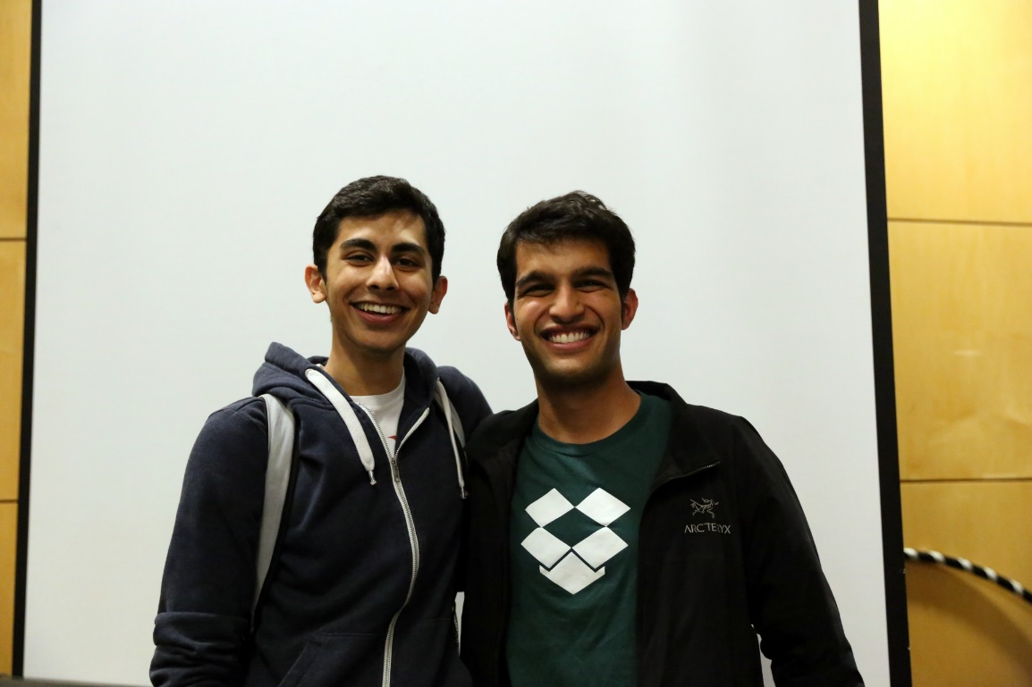
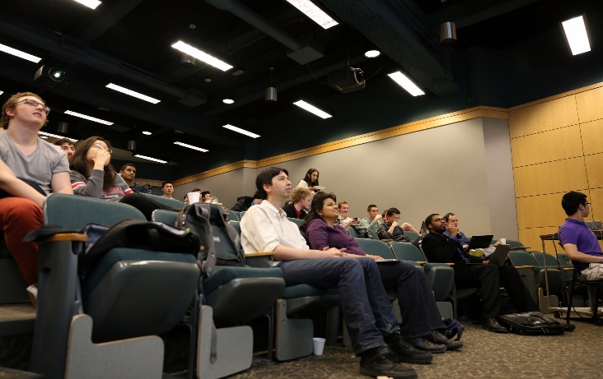

Announcements
CacheRace Games Night was great!
Winner: Team balabot
Adwit Tumuluri and Arjun Biddanda

Slide 11
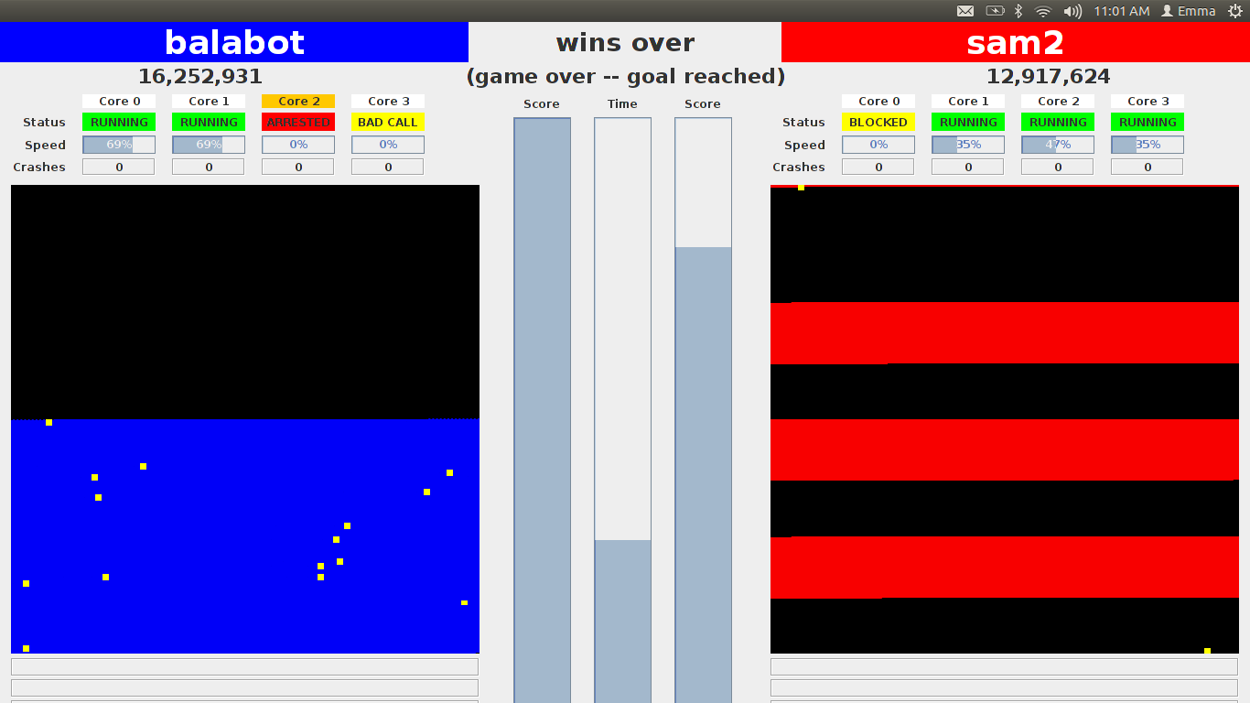

Announcements
CacheRace Games Night was great!
Winner: Team balabot
Adwit Tumuluri and Arjun Biddanda

Slide 12
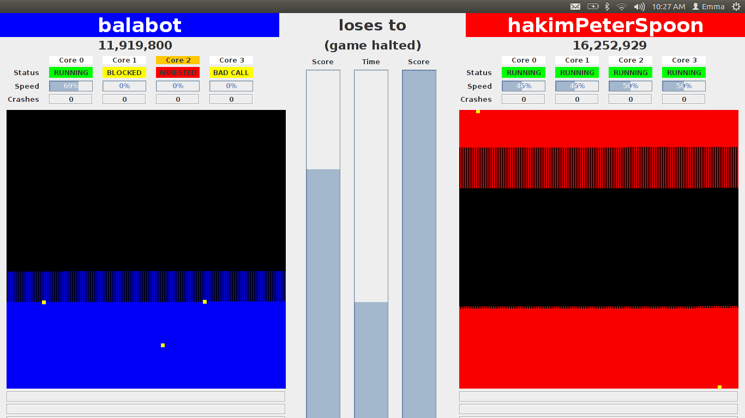
Announcements
CacheRace Games Night was great!
Champion of Champions: 2014 vs 2011
balabot (2014) vs hakimPeterspoon (2011)
Notes:
2014: Jason Zhao and Joe Mongeluzzi

Slide 13
Big Picture about the Future

Slide 14
Big Picture
How a processor works? How a computer is organized?
compute jump/branch targets
memory
register file
A
alu
D
D
B
+4
addr
PC
inst
control
B
d_{in}
d_{out}
M
memory
new pc
extend
imm
detect hazard
forward unit
Instruction Fetch
Instruction Decode
Write- Back
ctrl
ctrl
ctrl
Execute
Memory
IF/ID
ID/EX
EX/MEM
MEM/WB
Notes:
Caching,
Virtual Memory, Paging, TLBs
Operating System, Traps, Exceptions,
Multicore and synchronization

Slide 15
What’s next?
More of Moore

Slide 16
Moore’s Law
Moore’s Law introduced in 1965
Number of transistors that can be integrated on a single die would double every 18 to 24 months (i.e., grow exponentially with time).
Amazingly visionary
2300 transistors, 1 MHz clock (Intel 4004) - 1971
16 Million transistors (Ultra Sparc III)
42 Million transistors, 2 GHz clock (Intel Xeon) – 2001
55 Million transistors, 3 GHz, 130nm technology, 250mm2 die (Intel Pentium 4) – 2004
290+ Million transistors, 3 GHz (Intel Core 2 Duo) – 2007
731 Million transistors, 2-3Ghz (Intel Nehalem) – 2009
1.4 Billion transistors, 2-3Ghz (Intel Ivy Bridge) – 2012
Notes:
Tbyte = 2^40 bytes (or 10^12 bytes)
Note that Moore’s law is not about speed predictions but about chip complexity

Slide 17
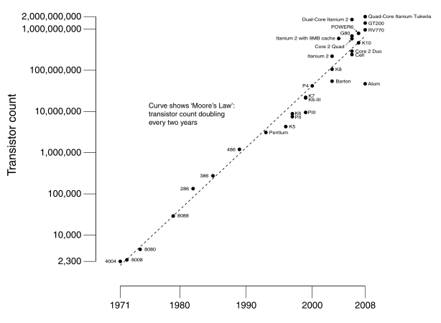
Moore’s Law
Ivy Bridge
Dual-core Itanium 2
K10
Itanium 2
K8
P4
Atom
Pentium
486
386
286
8088
8080
4004
8008
Notes:
NVIDIA GF100 has 3B transistors

Slide 18
Why Multicore?
Moore’s law
A law about transistors
Smaller means more transistors per die
And smaller means faster too
But: Power consumption growing too…

Slide 19
What to do with all these transistors?
Multi-core

Slide 20
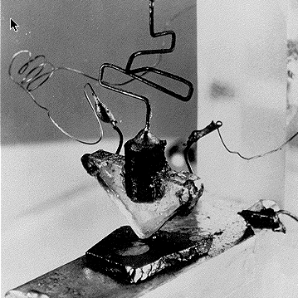
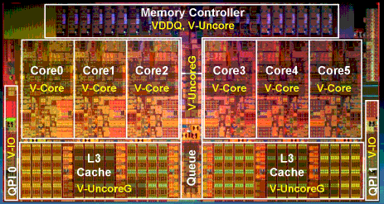
Multi-core
http://www.theregister.co.uk/2010/02/03/intel_westmere_ep_preview/
The first transistor
on a workbench at
AT&T Bell Labs in 1947
Bardeen, Brattain, and Shockley
An Intel Westmere
1.17 billion transistors
240 square millimeters
32 nanometer: transistor gate width
Six processing cores
Release date: January 2010
Notes:
John Bardeen
Walter Brattain
William Shockley

Slide 21
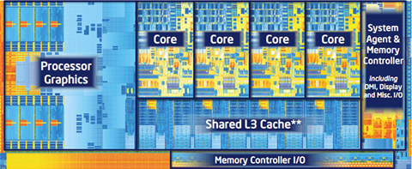
Multi-core
http://forwardthinking.pcmag.com/none/296972-intel-releases-ivy-bridge-first-processor-with-tri-gate-transistor
The first transistor
on a workbench at
AT&T Bell Labs in 1947
Bardeen, Brattain, and Shockley
An Intel Ivy Bridge
1.4 billion transistors
160 square millimeters
22 nanometer: transistor gate width
Up to eight processing cores
Release date: April 2012
Notes:
John Bardeen
Walter Brattain
William Shockley

Slide 22
What to do with all these transistors?
Cloud Computing

Slide 23







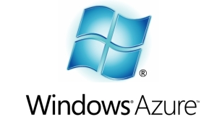



Cloud Computing
The promise of the Cloud
ubiquitous, convenient, on-demand network access to a shared pool of configurable computing resources (e.g., networks, servers, storage, applications, and services) that can be rapidly provisioned and released with minimal management effort or service provider interaction.
NIST Cloud Definition
SEATTLE
Notes:
The cloud completes the commoditization process and makes storage and computation a commodity.
Public vs private
IaaS, PaaS, SaaS
On demand (self service), network access, resource pooling, rapid elasticity, measured service

Slide 24
Cloud Computing
The promise of the Cloud
ubiquitous, convenient, on-demand network access to a shared pool of configurable computing resources (e.g., networks, servers, storage, applications, and services) that can be rapidly provisioned and released with minimal management effort or service provider interaction.
NIST Cloud Definition
SEATTLE
Notes:
The cloud completes the commoditization process and makes storage and computation a commodity.
Public vs private
IaaS, PaaS, SaaS
On demand (self service), network access, resource pooling, rapid elasticity, measured service

Slide 25
Cloud Computing
The promise of the Cloud
ubiquitous, convenient, on-demand network access to a shared pool of configurable computing resources (e.g., networks, servers, storage, applications, and services) that can be rapidly provisioned and released with minimal management effort or service provider interaction.
Requires fundamentals in systems
Computation
Networking
Storage
NIST Cloud Definition
Notes:
The cloud completes the commoditization process and makes storage and computation a commodity.
Public vs private
IaaS, PaaS, SaaS
On demand (self service), network access, resource pooling, rapid elasticity, measured service

Slide 26
Cloud Computing
Large organizations considering using the cloud
New York Times
Netflix
Nintendo
Cornell
Library of Congress
The more data you have, the harder it is to move
Switching providers entails paying for bandwidth twice
Inhibits opportunistic migration

Slide 27
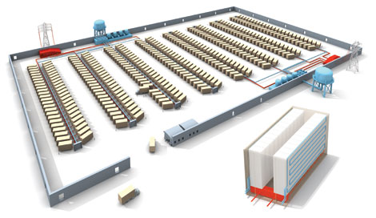
Cloud Computing
How hard is to program with a ExaByte of data?
Titan tech boom, randy katz, 2008

Slide 28
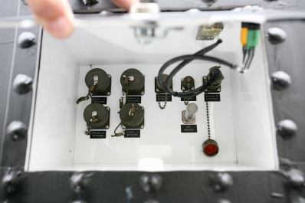
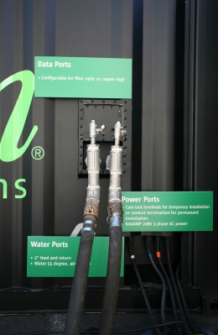
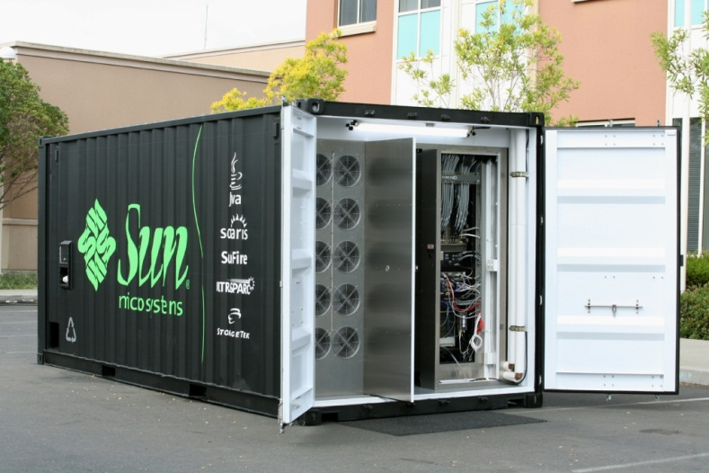
Cloud Computing
Datacenters are becoming a commodity
Order online and have it delivered
Datacenter in a box: already set up with commodity hardware & software (Intel, Linux, petabyte of storage)
Plug data, power & cooling and turn on
typically connected via optical fiber
may have network of such datacenters
Notes:
datacenters built from commodity components are becoming a commodity themselves
it’s as easy as ordering it online and have it shipped
comes with commodity hardware & software
simply plug power, data and potentially cooling & flip the switch
may have a bunch of these datacenters, typically connected over fiber residing at distant geographical location
Datacenters of commodity components have emerged as the computing platform of choice for a wide variety of applications, ranging from blunt content delivery to more advanced complete in-browser document & spreadsheet processing. In fact this paradigm has been so successful that it has driven datacenters to becoming a commodity themselves. It’s as easy as ordering one online and having it shipped to any location. These datacenters in a box typically come already set up with commodity hardware and software; all you need to do is plug the power, data and potentially cooling and flip the switch. This great ease is ushering in the global network of datacenters paradigm.

Slide 29
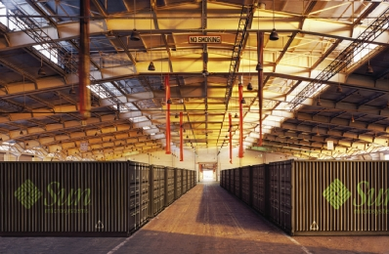

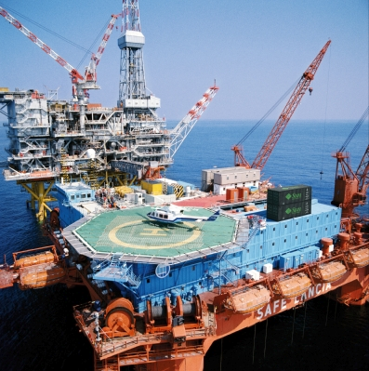
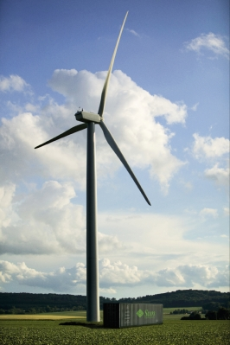
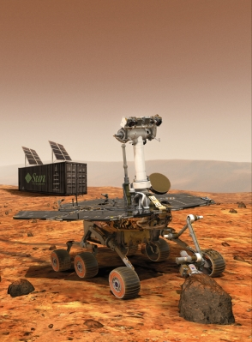
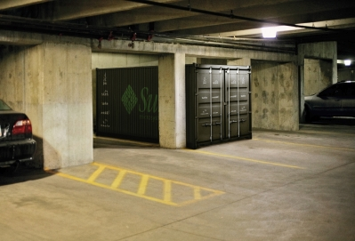
Cloud Computing = Network of Datacenters
Notes:
%Naturally, having multiple datacenters at various distant geographical locations raises the next challenge – coordinating them as part of a single global distributed system.
%Interconnecting the datacenters via high bandwidth, large latency links like optical fiber networks is a viable option today.
Interconnecting datacenters over distant geographical locations can be usually done via high bandwidth, optical fiber networks. Already laid down dark fiber is cheap and can be acquired in bulk – making private lambda networks a reality.
Although the raw bandwidth is cheap, these networks experience some level of packet loss due to cabling, equipment, dirty or degraded fiber and other glitches. Eliminating the packet loss altogether on such links is not an option – the general belief is that non congestion packet loss is unavoidable. For example, on managed links, tier 1 ISP service level agreements cite packet loss rates in the range of 0.1% - 0.3%-0.7%.
% for various reasons like transient malfunctions, poorly configured equipment and dirty or degraded optical fiber.

Slide 30
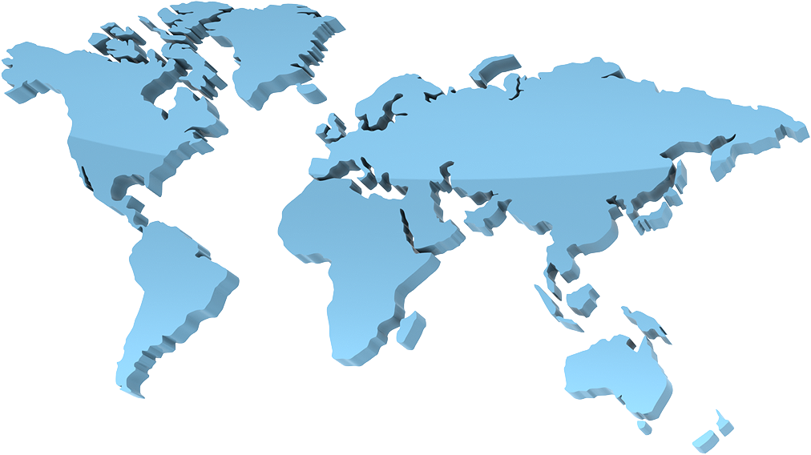

Cloud Computing
How to optimize a global network of data centers?

Slide 31
Cloud Computing = Network of Datacenters
Notes:
%Naturally, having multiple datacenters at various distant geographical locations raises the next challenge – coordinating them as part of a single global distributed system.
%Interconnecting the datacenters via high bandwidth, large latency links like optical fiber networks is a viable option today.
Interconnecting datacenters over distant geographical locations can be usually done via high bandwidth, optical fiber networks. Already laid down dark fiber is cheap and can be acquired in bulk – making private lambda networks a reality.
Although the raw bandwidth is cheap, these networks experience some level of packet loss due to cabling, equipment, dirty or degraded fiber and other glitches. Eliminating the packet loss altogether on such links is not an option – the general belief is that non congestion packet loss is unavoidable. For example, on managed links, tier 1 ISP service level agreements cite packet loss rates in the range of 0.1% - 0.3%-0.7%.
% for various reasons like transient malfunctions, poorly configured equipment and dirty or degraded optical fiber.

Slide 32
Cloud Computing
Vision
The promise of the Cloud
A computer utility; a commodity
Catalyst for technology economy
Revolutionizing for health care, financial systems,
scientific research, and society
However, cloud platforms today
Entail significant risk: vendor lock-in vs control
Entail inefficient processes: energy vs performance
Entail poor communication: fiber optics vs COTS endpoints
Notes:
The cloud completes the commoditization process and makes storage and computation a commodity.

Slide 33
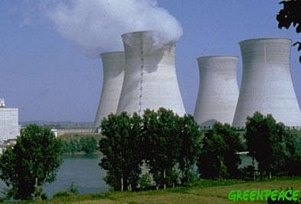
Example: Energy and Performance
Why don’t we save more energy in the cloud?
No one deletes data anymore!
Huge amounts of seldom-accessed data
Data deluge
Google (YouTube, Picasa, Gmail, Docs), Facebook, Flickr
100 GB per second is faster than hard disk capacity growth!
Max amount of data accessible at one time << Total data
New scalable approach needed to store this data
Energy footprint proportional to number of HDDs is
not sustainable

Slide 34
What to do with all these transistors?
Embedded Processors

Slide 35
Where is the Market?
Millions of Computers
Notes:
For “definitions” of desktop, servers, supercomputers (100’s to 1000’s of processors, Gbytes to Tbytes of main memory, Tbytes to Pbytes of secondary storage), and embedded systems (cell phones, automobile control, video games, entertainment systems (digital TVs), PDAs, etc.).
The computer (IT) industry is responsible for almost 10% of the GNP of the US.
The embedded market has shown the strongest growth (40% compounded annual growth compared to only 9% for desktops – where do laptops fit?). This chart/number does not include the low-end 8-bit and 16-bit embedded processors that are everywhere!
This is a good slide to talk about the other performance metrics in addition to speed (or see if the students can come up with them) including
Power, space/volume, memory space, cost, reliability

Slide 36
Where is the Market?
Millions of Computers
Notes:
For “definitions” of desktop, servers, supercomputers (100’s to 1000’s of processors, Gbytes to Tbytes of main memory, Tbytes to Pbytes of secondary storage), and embedded systems (cell phones, automobile control, video games, entertainment systems (digital TVs), PDAs, etc.).
The computer (IT) industry is responsible for almost 10% of the GNP of the US.
The embedded market has shown the strongest growth (40% compounded annual growth compared to only 9% for desktops – where do laptops fit?). This chart/number does not include the low-end 8-bit and 16-bit embedded processors that are everywhere!
This is a good slide to talk about the other performance metrics in addition to speed (or see if the students can come up with them) including
Power, space/volume, memory space, cost, reliability

Slide 37
Where is the Market?
Millions of Computers
Notes:
For “definitions” of desktop, servers, supercomputers (100’s to 1000’s of processors, Gbytes to Tbytes of main memory, Tbytes to Pbytes of secondary storage), and embedded systems (cell phones, automobile control, video games, entertainment systems (digital TVs), PDAs, etc.).
The computer (IT) industry is responsible for almost 10% of the GNP of the US.
The embedded market has shown the strongest growth (40% compounded annual growth compared to only 9% for desktops – where do laptops fit?). This chart/number does not include the low-end 8-bit and 16-bit embedded processors that are everywhere!
This is a good slide to talk about the other performance metrics in addition to speed (or see if the students can come up with them) including
Power, space/volume, memory space, cost, reliability

Slide 38
Where is the Market?
Millions of Computers
Notes:
For “definitions” of desktop, servers, supercomputers (100’s to 1000’s of processors, Gbytes to Tbytes of main memory, Tbytes to Pbytes of secondary storage), and embedded systems (cell phones, automobile control, video games, entertainment systems (digital TVs), PDAs, etc.).
The computer (IT) industry is responsible for almost 10% of the GNP of the US.
The embedded market has shown the strongest growth (40% compounded annual growth compared to only 9% for desktops – where do laptops fit?). This chart/number does not include the low-end 8-bit and 16-bit embedded processors that are everywhere!
This is a good slide to talk about the other performance metrics in addition to speed (or see if the students can come up with them) including
Power, space/volume, memory space, cost, reliability

Slide 39
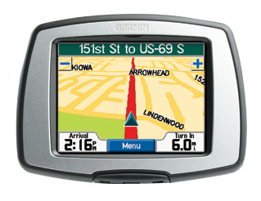
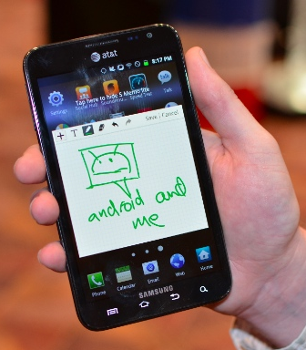


Slide 40
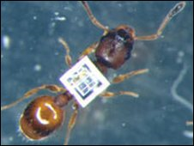
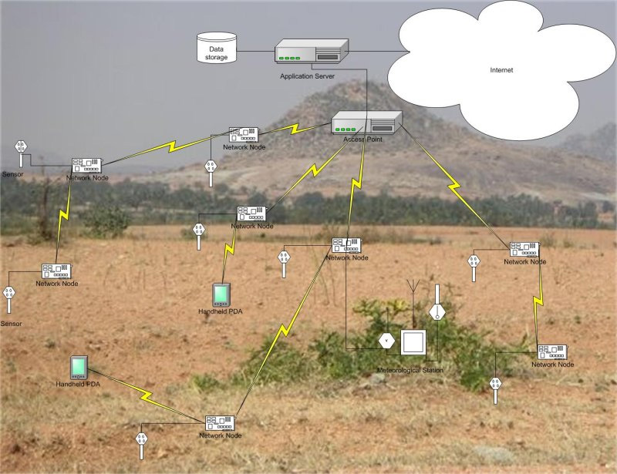
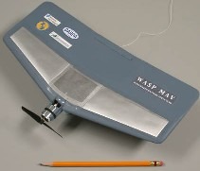
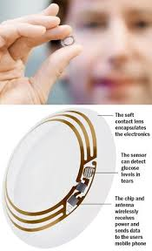
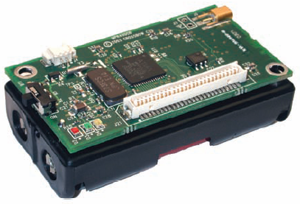
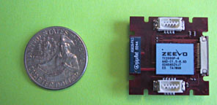
Where to?
Smart Dust….

Slide 41
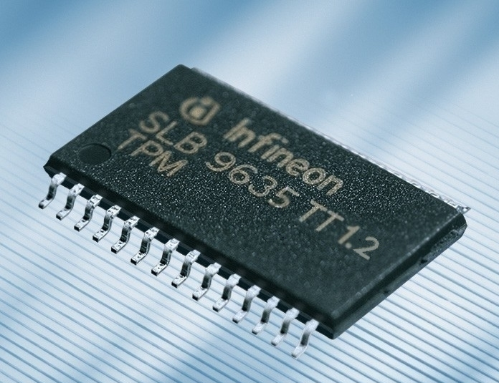
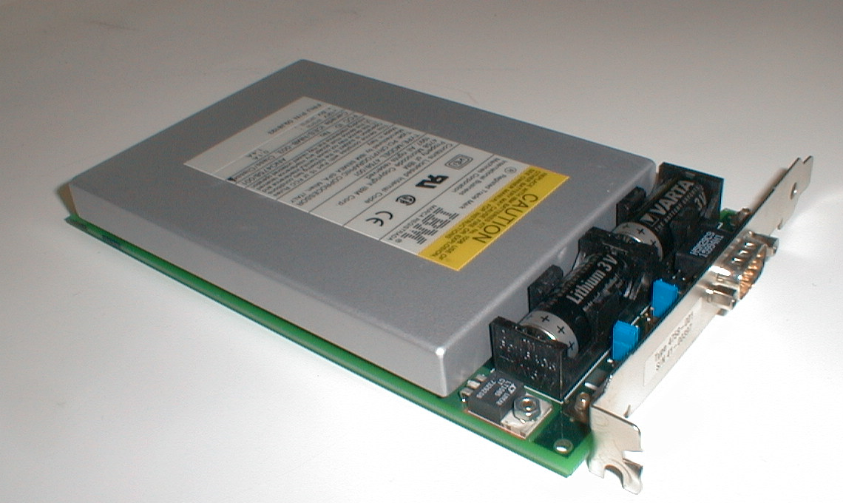
Security?
Cryptography and security…
TPM 1.2
IBM 4758 Secure Cryptoprocessor

Slide 42
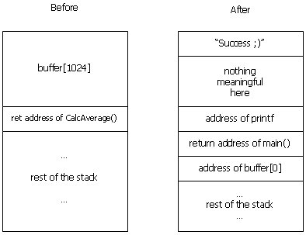
Security?
Stack Smashing…

Slide 43
What’s next?

Slide 44
Moore’s Law
Moore’s Law introduced in 1965
Number of transistors that can be integrated on a single die would double every 18 to 24 months (i.e., grow exponentially with time)
Amazingly visionary
2300 transistors, 1 MHz clock (Intel 4004) - 1971
16 Million transistors (Ultra Sparc III)
42 Million transistors, 2 GHz clock (Intel Xeon) – 2001
55 Million transistors, 3 GHz, 130nm technology, 250mm2 die (Intel Pentium 4) – 2004
290+ Million transistors, 3 GHz (Intel Core 2 Duo) – 2007
731 Million transistors, 2-3Ghz (Intel Nehalem) – 2009
1.4 Billion transistors, 2-3Ghz (Intel Ivy Bridge) – 2012
Notes:
Tbyte = 2^40 bytes (or 10^12 bytes)
Note that Moore’s law is not about speed predictions but about chip complexity

Slide 45
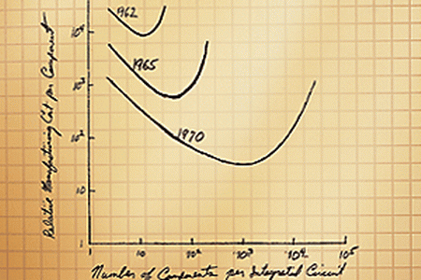
Moore’s Law

Slide 46
Parallelism
Dennard scaling: power
Must exploit parallelism for performance
MIMD: multiple instruction, multiple data
Multicore
SIMD: single instruction, multiple data
GPUs

Slide 47
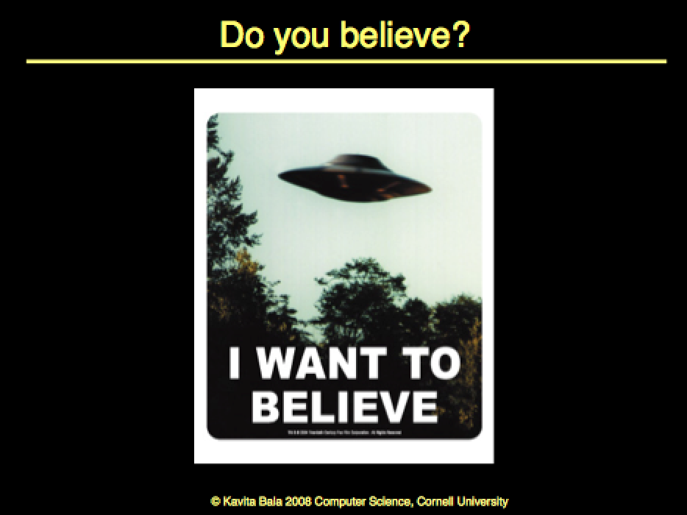
My slide from 2008

Slide 48
Is Moore’s law dead?

Slide 49
Some thoughts
Bob Colwell
Chief Architect Pentium
DARPA
Introduction
Bill Dally, Nvidia CTO
Talk
The Chip Design Game at the End of Moore's Law
Hot Chips, Aug 2013
Notes:
3:07-4:20 End of Moore’s Law
10:25-11:25 Exponentials must end. Singularity
-7nm (currently 14nm) - 12:58 Singularity
End of Moore’s Law predicted by
-17:56 (18:00)
Graphics, Neural Nets,

Slide 50
Singularity
Approximate Computing
Better interfaces
Brain interfaces
Specialized chips
Make it programmable
More

Slide 51
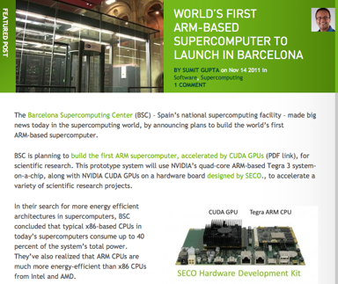
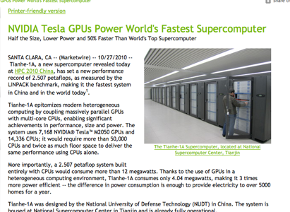
Supercomputers
Petaflops: GPUs/multicore/100s-1000s cores
Kavita Bala, Cornell University

Slide 52
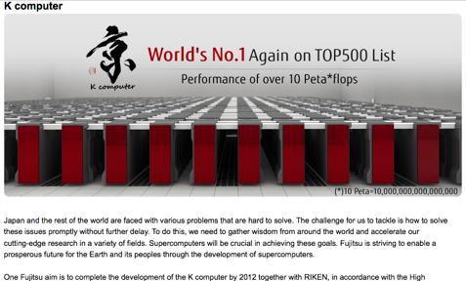
Petaflops
Kavita Bala, Cornell University

Slide 53
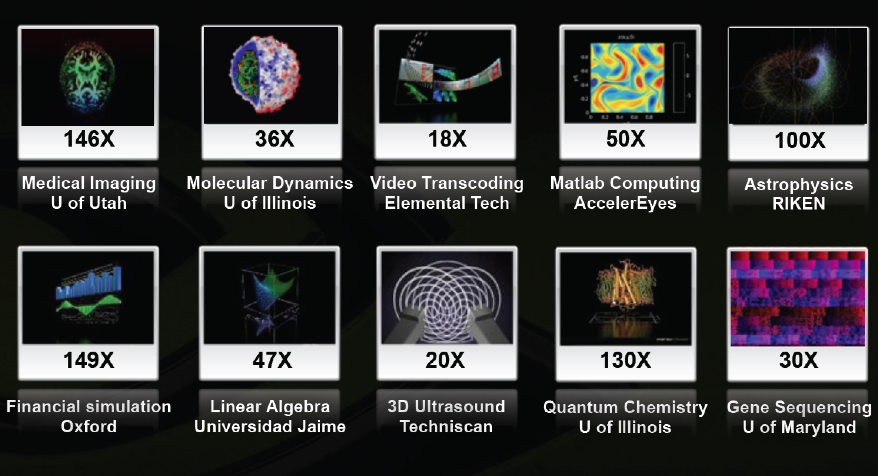
GPUs for Scientific Computing

Slide 54
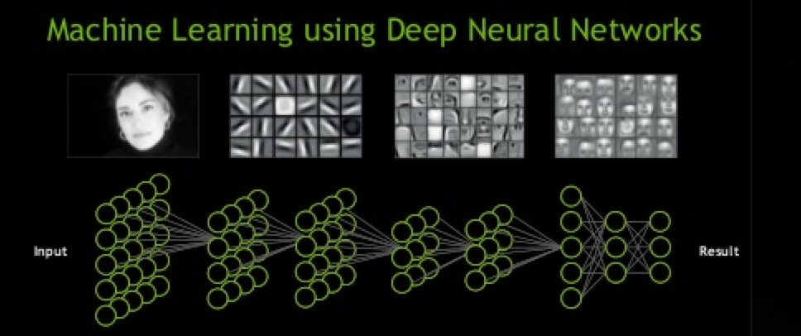
GPUs for Neural Nets

Slide 55



GPUs for Graphics, of course

Slide 56
What to do with all these transistors?
You could save the world one day?

Slide 57
Smart Dust & Sensor Networks
Games
Embedded
Computing
Save the world?
Graphics
Security
Scientific Computing
Cloud Computing
Cryptography

Slide 58
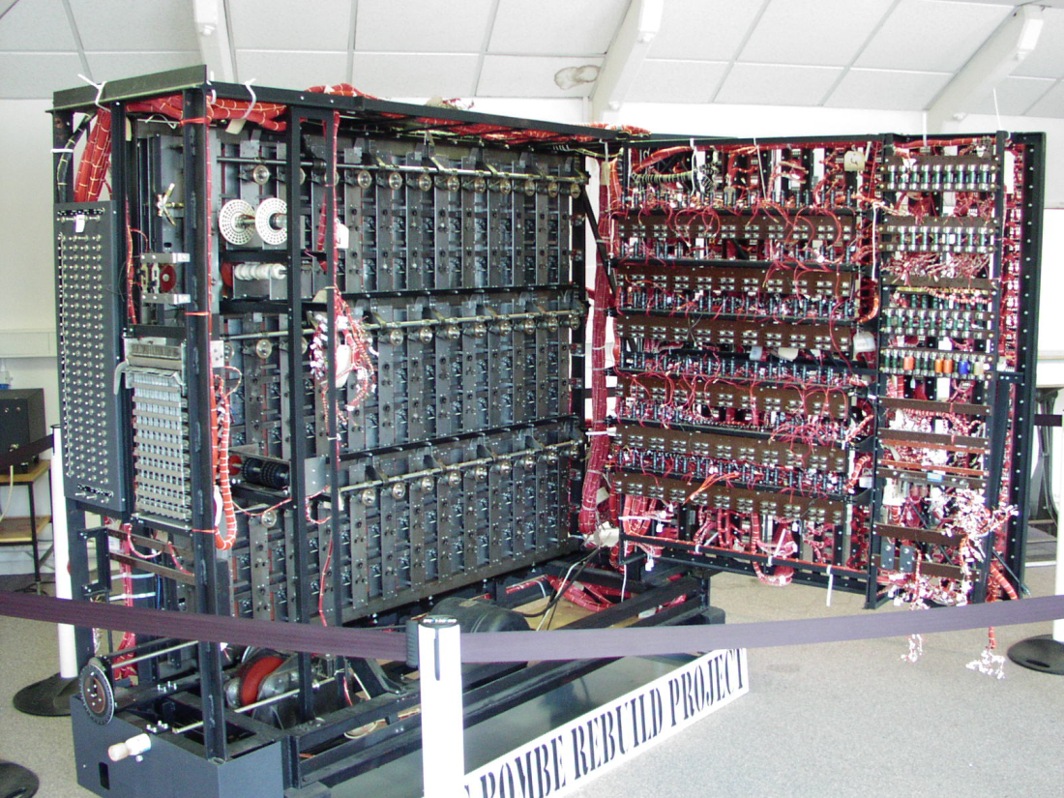
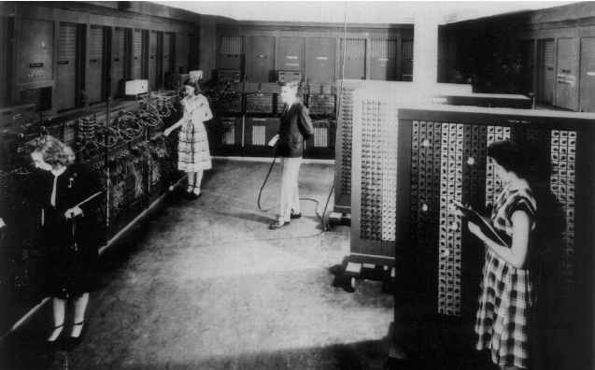
ENIAC - 1946
First general purpose
electronic computer. Designed
to calculate ballistic trajectories
Alan Turing’s Bombe
Used to crack Germany’s
enigma machine

Slide 59
Survey Questions
Are you a better computer scientist and software engineering knowing “the low-level stuff”?
How much of computer architecture do software engineers actually have to deal with?
What are the most important aspects of computer architecture that a software engineer should keep in mind while programming?

Slide 60
Why?
These days, programs run on hardware...
… more than ever before
Google Chrome
→ Operating Systems
→ Multi-Core & Hyper-Threading
→ Datapath Pipelines, Caches, MMUs, I/O & DMA
→ Busses, Logic, & State machines
→ Gates
→ Transistors
→ Silicon
→ Electrons

Slide 61











Why?
Your job as a computer scientist will require knowledge the computer
Research/University
Industry
Government

Slide 62
Where to?
CS 3110: Better concurrent programming
CS 4410/4411: The Operating System!
CS 4420/ECE 4750: Computer Architecture
CS 4450: Networking
CS 4620: Graphics
CS 4821: Quantum Computing
MEng
5412—Cloud Computing, 5414—Distr Computing,
5430—Systems Secuirty,
5300—Arch of Larg scale Info Systems
And many more…

Slide 63
Thank you!
If you want to make an apple pie from scratch, you must first create the universe.
– Carl Sagan

