Slide 1
Multicore and Parallelism
CS 3410, Spring 2014
Computer Science
Cornell University
See P&H Chapter: 4.10, 1.7, 1.8, 5.10, 6.4, 2.11

Slide 2
Announcements
Notes:
Register renaming
Hardware multithreading
Write serializability
Synchronization

Slide 3
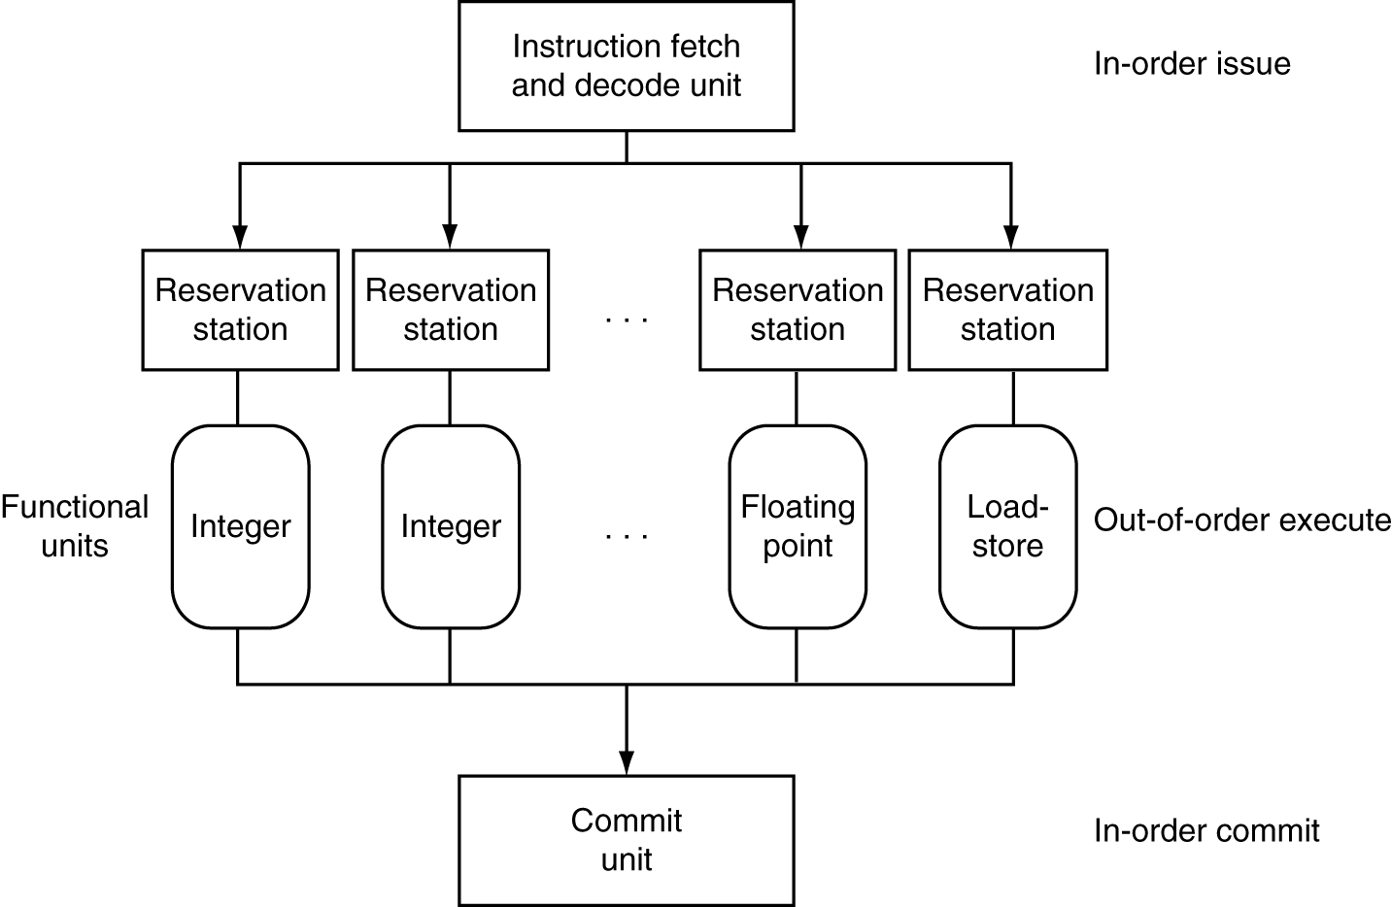
Dynamic Multiple Issue
Notes:
In-order commit: A commit in which the results of pipelined execution are written to the programmer visible state in the same order that instructions are

Slide 4
Limits of Static Scheduling
Compiler scheduling for dual-issue MIPS…
lw $t0, 0($s1) # load A
addi $t0, $t0, +1 # increment A
sw $t0, 0($s1) # store A
lw $t1, 0($s2) # load B
addi $t1, $t1, +1 # increment B
sw $t1, 0($s2) # store B
ALU/branch slot Load/store slot cycle
nop lw $t0, 0($s1) 1
nop nop 2
addi $t0, $t0, +1 nop 3
nop sw $t0, 0($s1) 4
nop lw $t1, 0($s2) 5
nop nop 6
addi $t1, $t1, +1 nop 7
nop sw $t1, 0($s2) 8
Notes:
Rename registers, move load B up, eliminate delay slot
But! s1 and s2 might be equal => Aliasing!

Slide 5
Does Multiple Issue Work?
Q: Does multiple issue / ILP work?
A: Kind of… but not as much as we’d like
Limiting factors?
Programs dependencies
Hard to detect dependencies → be conservative
e.g. Pointer Aliasing: A[0] += 1; B[0] *= 2;
Hard to expose parallelism
Can only issue a few instructions ahead of PC
Structural limits
Memory delays and limited bandwidth
Hard to keep pipelines full

Slide 6
Administrivia
Next few weeks
Week 12 (Apr 22): Lab4 release and Proj3 due Fri
Note Lab 4 is now IN CLASS
Week 13 (Apr 29): Proj4 release, Lab4 due Tue, Prelim2
Week 14 (May 6): Proj3 tournament Mon, Proj4 design doc due
Final Project for class
Week 15 (May 13): Proj4 due Wed

Slide 7
Today
Many ways to improve performance
Multicore
Performance in multicore
Synchronization
Next 2 lectures: synchronization and GPUs

Slide 8
How to improve performance?
We have looked at
Pipelining
To speed up:
Deeper pipelining
Make the clock run faster
Parallelism
Not a luxury, a necessity

Slide 9
Why Multicore?
Moore’s law
A law about transistors
Smaller means more transistors per die
And smaller means faster too
But: need to worry about power too…

Slide 10
Power Wall
Power = capacitance * voltage² * frequency
approx. capacitance * voltage³
Reducing voltage helps (a lot)
Better cooling helps
The power wall
We can’t reduce voltage further - leakage
We can’t remove more heat
Notes:
If frequency drops, voltage can be dropped. So sometimes use the

Slide 11
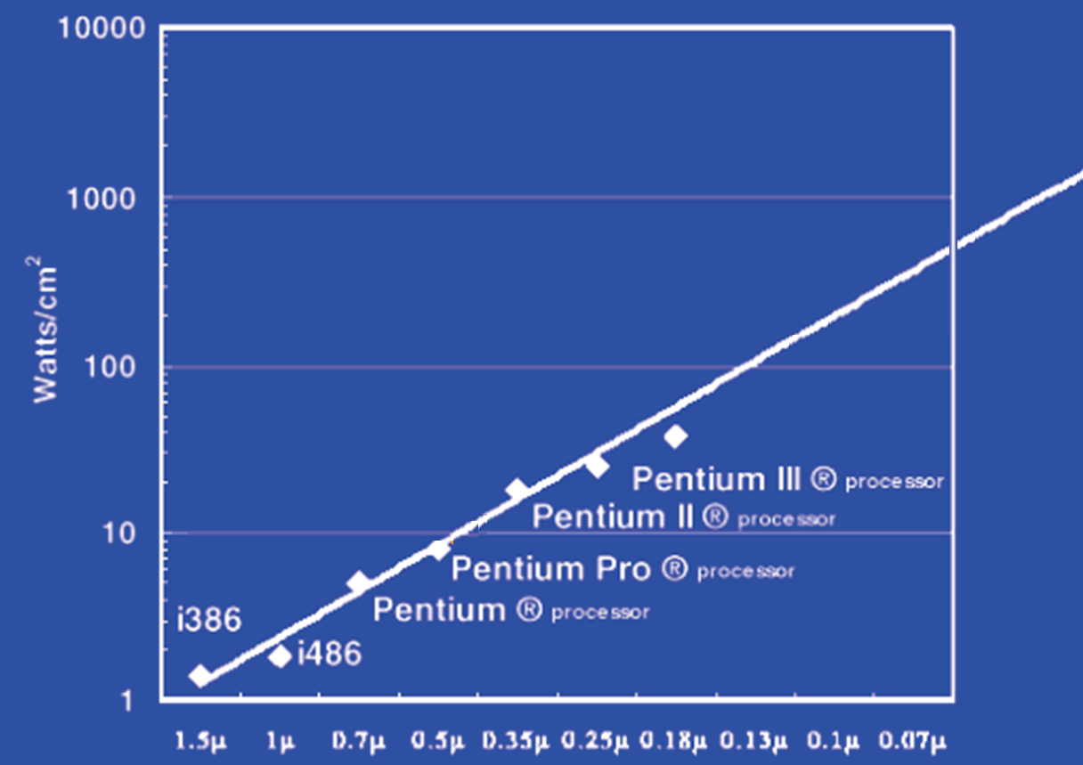
Power Limits
Surface of Sun
Rocket Nozzle
Nuclear Reactor
Xeon
Hot Plate
180nm
32nm
Notes:
Intel Westmere: 32 nm = 0.032u, 130W / 240mm^2 = 54 W/cm^2

Slide 12
Why Multicore?
Performance
1.2x
Single-Core Overclocked +20%
Power
1.7x
Performance
1.0x
Power
Single-Core
1.0x
Performance
0.8x
1.6x
Single-Core
Underclocked -20%
Dual-Core
Underclocked -20%
Undervolted -20%
Power
0.51x
1.02x

Slide 13
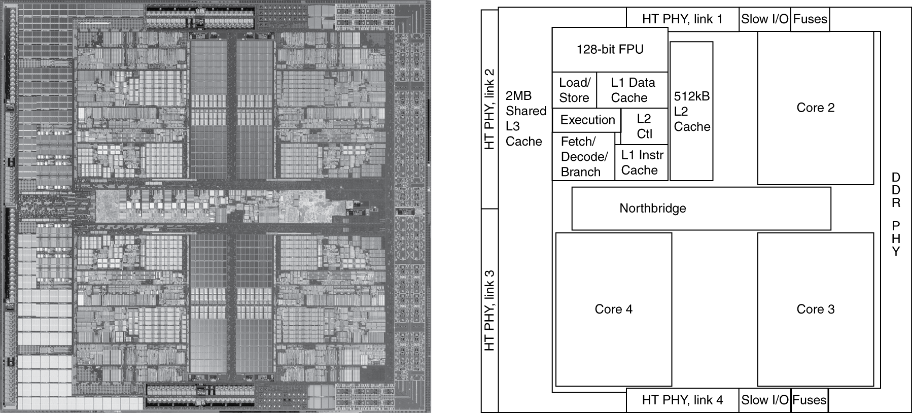
Inside the Processor
AMD Barcelona Quad-Core: 4 processor cores

Slide 14
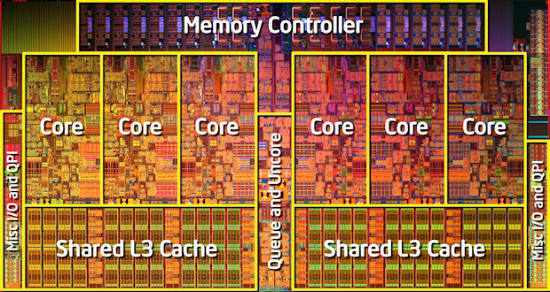
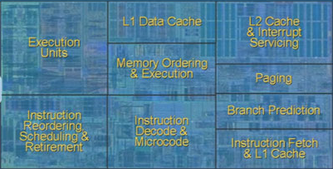
Inside the Processor
Intel Nehalem Hex-Core
Notes:
4 wide pipeline

Slide 15
Hardware multithreading
Hardware multithreading
Increase utilization with low overhead
Switch between hardware threads for stalls

Slide 16
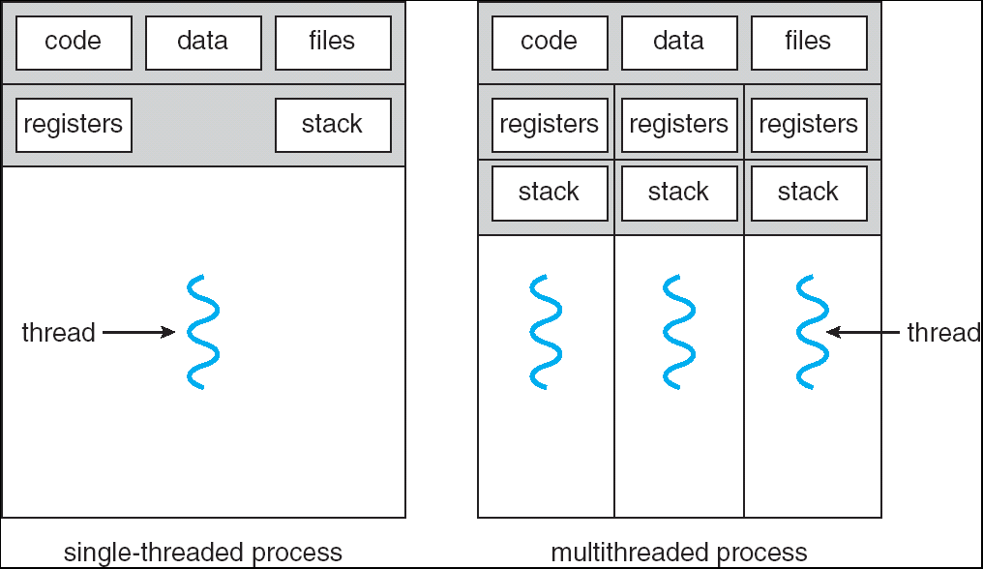
What is a thread?
Process includes multiple threads, code, data and OS state

Slide 17
Hardware multithreading
Fine grained vs. Coarse grained hardware multithreading
Simultaneous multithreading (SMT)
Hyperthreads (Intel simultaneous multithreading)
Need to hide latency

Slide 18
Hardware multithreading
Fine grained vs. Coarse grained hardware multithreading
Fine grained multithreading
Switch on each cycle
Pros: Can hide very short stalls
Cons: Slows down every thread
Coarse grained multithreading
Switch only on quite long stalls
Pros: removes need for very fast switches
Cons: flush pipeline, short stalls not handled

Slide 19
Simultaneous multithreading
SMT
Leverages multi-issue pipeline with dynamic instruction scheduling and ILP
Exploits functional unit parallelism better than single threads
Always running multiple instructions from multiple threads
No cost of context switching
Uses dynamic scheduling and register renaming through reservation stations
Can use all functional units very efficiently

Slide 21
Hyperthreading
vs. HT
Multi-Core vs. Multi-Issue
Programs:
Num. Pipelines:
Pipeline Width:
Hyperthreads
HT = MultiIssue + extra PCs and registers – dependency logic
HT = MultiCore – redundant functional units + hazard avoidance
Hyperthreads (Intel)
Illusion of multiple cores on a single core
Easy to keep HT pipelines full + share functional units
N | 1 | N
N | 1 | 1
1 | N | N
Notes:
HT = MultiIssue + extra PCs and registers – dependency logic
HT = MultiCore – redundant functional units + hazard avoidance

Slide 22
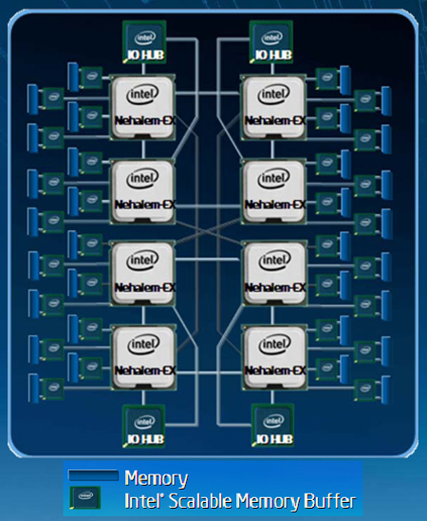
Example: All of the above
8 multiprocessors
4 core per multiprocessor
2 HT per core
Dynamic multi-issue: 4 issue
Pipeline depth: 16
Note: each processor may
have multiple processing
cores, so this is an example
of a multiprocessor multicore
hyperthreaded system
Notes:
MultiCore: 8 processors dies * 4 cores per processor die
Hyperthreading: 2 HT per core
Dynamic Multi-Issue: 4 issue
Pipeline: 16 stages

Slide 23
Parallel Programming
Q: So lets just all use multicore from now on!
A: Software must be written as parallel program
Multicore difficulties
Partitioning work, balancing load
Coordination & synchronization
Communication overhead
How do you write parallel programs?
... without knowing exact underlying architecture?
Notes:
Or hyperthreads

Slide 24
Work Partitioning
Partition work so all cores have something to do

Slide 25
Load Balancing
Need to partition so all cores are actually working

Slide 26
Amdahl’s Law
If tasks have a serial part and a parallel part…
Example:
step 1: divide input data into n pieces
step 2: do work on each piece
step 3: combine all results
Recall: Amdahl’s Law
As number of cores increases …
time to execute parallel part?
time to execute serial part?
Serial part eventually dominates
goes to zero
Remains the same

Slide 27
Amdahl’s Law
Notes:
Underclocking messes up the ratios completely. Work through a 8x slowdown example.

Slide 28
Pitfall: Amdahl’s Law
Execution time after improvement =
affected execution time
amount of improvement
+ execution time unaffected
T_{improved} = $\frac{Taffected}{improvement factor}$+ T_{unaffected}
Notes:
Amdahl’s Law

Slide 29
Pitfall: Amdahl’s Law
Improving an aspect of a computer and expecting a proportional improvement in overall performance
T_{improved} = $\frac{Taffected}{improvement factor}$+ T_{unaffected}
Example: multiply accounts for 80s out of 100s
How much improvement do we need in the multiply performance to get 5× overall improvement?
20 = 80/n + 20
Can’t be done!
Notes:
Clicker question

Slide 30
Scaling Example
Workload: sum of 10 scalars, and 10 × 10 matrix sum
Speed up from 10 to 100 processors?
Single processor: Time = (10 + 100) × t_{add}
10 processors
Time = 100/10 × t_{add} + 10 × t_{add} = 20 × t_{add}
Speedup = 110/20 = 5.5
100 processors
Time = 100/100 × t_{add} + 10 × t_{add} = 11 × t_{add}
Speedup = 110/11 = 10
Assumes load can be balanced across processors
Notes:
Pair up question
10 processors
Speedup = 110/20 = 5.5 (55% of potential)
100 processors
Speedup = 110/11 = 10 (10% of potential)

Slide 31
Scaling Example
What if matrix size is 100 × 100?
Single processor: Time = (10 + 10000) × t_{add}
10 processors
Time = 10 × t_{add} + 10000/10 × t_{add} = 1010 × t_{add}
Speedup = 10010/1010 = 9.9
100 processors
Time = 10 × t_{add} + 10000/100 × t_{add} = 110 × t_{add}
Speedup = 10010/110 = 91
Assuming load balanced
Notes:
10 processors
Speedup = 10010/1010 = 9.9 (99% of potential)
100 processors
Speedup = 10010/110 = 91 (91% of potential)

Slide 32
Scaling
Strong scaling vs. weak scaling
Strong scaling: scales with same problem size
Weak scaling: scales with increased problem size

Slide 33
Parallelism is a necessity
Necessity, not luxury
Power wall
Not easy to get performance out of
Many solutions
Pipelining
Multi-issue
Hyperthreading
Multicore

Slide 34
Parallel Programming
Q: So lets just all use multicore from now on!
A: Software must be written as parallel program
Multicore difficulties
Partitioning work
Coordination & synchronization
Communications overhead
Balancing load over cores
How do you write parallel programs?
... without knowing exact underlying architecture?
SW
Your
career…
HW
Notes:
Most is software, but hardware can help:
- communications (fast core-to-core interconnect)
- coordination and synchronization primitives (next time)

Slide 35
Synchronization
P&H Chapter 2.11 and 5.10

Slide 36
Parallelism and Synchronization
How do I take advantage of parallelism?
How do I write (correct) parallel programs?
What primitives do I need to implement correct parallel programs?

Slide 37
Topics
Understand Cache Coherency
Synchronizing parallel programs
Atomic Instructions
HW support for synchronization
How to write parallel programs
Threads and processes
Critical sections, race conditions, and mutexes

Slide 38
Parallelism and Synchronization
Cache Coherency Problem: What happens when two or more processors cache shared data?

Slide 39
Parallelism and Synchronization
Cache Coherency Problem: What happens when two or more processors cache shared data?
i.e. the view of memory held by two different processors is through their individual caches
As a result, processors can see different (incoherent) values to the same memory location

Slide 40
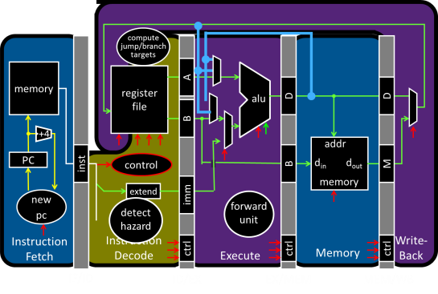
Parallelism and Synchronization
Each processor core has its own L1 cache

Slide 41
Parallelism and Synchronization
Each processor core has its own L1 cache
Core0
Core1
Core2
Core3
Cache
Cache
Cache
Cache
Interconnect
Memory
I/O

Slide 42
Shared Memory Multiprocessors
Shared Memory Multiprocessor (SMP)
Typical (today): 2 – 8 cores each
HW provides single physical address space for all processors
Assume uniform memory access (UMA) (ignore NUMA)
Core0
Core1
Core2
Core3
Cache
Cache
Cache
Cache
Interconnect
Memory
I/O
Notes:
How do they share data? How do they coordinate? How do they scale?

Slide 43
Shared Memory Multiprocessors
Shared Memory Multiprocessor (SMP)
Typical (today): 2 – 8 cores each
HW provides single physical address space for all processors
Assume uniform memory access (ignore NUMA)
Core0
Core1
...
...
...
CoreN
Cache
Cache
Cache
Interconnect
Memory
I/O
Notes:
How do they share data? How do they coordinate? How do they scale?

Slide 44
Cache Coherency Problem
Thread A (on Core0) Thread B (on Core1) for(int i = 0, i < 5; i++) { for(int j = 0; j < 5; j++) { x = x + 1; x = x + 1; } }
What will the value of x be after both loops finish?
Start: x = 0
Core0
Core1
...
...
...
CoreN
Cache
Cache
Cache
Interconnect
Memory
I/O
Notes:
How do they share data? How do they coordinate? How do they scale?

Slide 45
iClicker
Thread A (on Core0) Thread B (on Core1) for(int i = 0, i < 5; i++) { for(int j = 0; j < 5; j++) { x = x + 1; x = x + 1; } }
Notes:
How do they share data? How do they coordinate? How do they scale?
T0 1, T1 6, T0 simultaneously does its remaining 4 and writes 5 which is lost.
T0 3, T0 writes 4, T1 simultaneously does 3+5 = 8

Slide 46
Cache Coherency Problem
Thread A (on Core0) Thread B (on Core1) for(int i = 0, i < 5; i++) { for(int j = 0; j < 5; j++) { LW $t0, addr(x) LW $t1, addr(x)
ADDIU $t0, $t0, 1 ADDIU $t1, $t1, 1
SW $t0, addr(x) SW $t1, addr(x) } }
Notes:
How do they share data? How do they coordinate? How do they scale?

Slide 47
iClicker
Thread A (on Core0) Thread B (on Core1) for(int i = 0; i < 5; i++) { for(int j = 0; j < 5; j++) { x = x + 1; x = x + 1; } }
What can the value of x be after both loops finish?
6
8
10
All of the above
None of the above
Notes:
How do they share data? How do they coordinate? How do they scale?

Slide 48
Cache Coherence Problem
Suppose two CPU cores share a physical address space
Write-through caches
Time step | Event | CPU A’s cache | CPU B’s cache | Memory
0 |  |  |  | 0
Time step | Event | CPU A’s cache | CPU B’s cache | Memory
0 |  |  |  | 0
1 | CPU A reads X | 0 |  | 0
Time step | Event | CPU A’s cache | CPU B’s cache | Memory
0 |  |  |  | 0
1 | CPU A reads X | 0 |  | 0
2 | CPU B reads X | 0 | 0 | 0
Time step | Event | CPU A’s cache | CPU B’s cache | Memory
0 |  |  |  | 0
1 | CPU A reads X | 0 |  | 0
2 | CPU B reads X | 0 | 0 | 0
3 | CPU A writes 1 to X | 1 | 0 | 1
Core0
Core1
...
...
...
CoreN
Cache
Cache
Cache
Interconnect
Memory
I/O

Slide 49
Two issues
Coherence
What values can be returned by a read
Consistency
When a written value will be returned by a read

Slide 50
Coherence Defined
Informal: Reads return most recently written value
Formal: For concurrent processes P₁ and P₂
P writes X before P reads X (with no intervening writes) ⇒ read returns written value
P₁ writes X before P₂ reads X ⇒ read returns written value
P₁ writes X and P₂ writes X ⇒ all processors see writes in the same order
all see the same final value for X
Aka write serialization
Notes:
second case: for some definition of “before”
third case: see relativity
complication: clocks are not synchronized across cores
1 light nanosecond = 30cm, so 3GHz can do 1 instruction per 10cm

Slide 51
Coherence Defined
Formal: For concurrent processes P₁ and P₂
P writes X before P reads X (with no intervening writes) ⇒ read returns written value
(preserve program order)
P₁ writes X before P₂ reads X ⇒ read returns written value
(coherent memory view, can’t read old value forever)
P₁ writes X and P₂ writes X ⇒ all processors see writes in the same order
all see the same final value for X
Aka write serialization
(else X can see P2’s write before P1 and Y can see the opposite; their final understanding of state is wrong)
Notes:
second case: for some definition of “before”
third case: see relativity
complication: clocks are not synchronized across cores
1 light nanosecond = 30cm, so 3GHz can do 1 instruction per 10cm

Slide 52
Cache Coherence Protocols
Operations performed by caches in multiprocessors to ensure coherence and support shared memory
Migration of data to local caches
Reduces bandwidth for shared memory (performance)
Replication of read-shared data
Reduces contention for access (performance)
Snooping protocols
Each cache monitors bus reads/writes (correctness)

Slide 53
Snooping
Snooping for Hardware Cache Coherence
All caches monitor bus and all other caches
Write invalidate protocol
Bus read: respond if you have dirty data
Bus write: update/invalidate your copy of data
Snoop
Snoop
...
Snoop
Core0
Core1
...
...
CoreN
Snoop
Cache
Snoop
Cache
Snoop
Cache
Interconnect
Memory
I/O
Notes:
In reality: very complicated, lots of corner cases

Slide 54
Invalidating Snooping Protocols
Cache gets exclusive access to a block when it is to be written
Broadcasts an invalidate message on the bus
Subsequent read is another cache miss
Owning cache supplies updated value
Time Step | CPU activity | Bus activity | CPU A’s cache | CPU B’s cache | Memory
0 |  |  |  |  | 0
1 | CPU A reads X | Cache miss for X | 0 |  | 0
Time Step | CPU activity | Bus activity | CPU A’s cache | CPU B’s cache | Memory
0 |  |  |  |  | 0
1 | CPU A reads X | Cache miss for X | 0 |  | 0
2 | CPU B reads X | Cache miss for X | 0 | 0 | 0
Time Step | CPU activity | Bus activity | CPU A’s cache | CPU B’s cache | Memory
0 |  |  |  |  | 0
1 | CPU A reads X | Cache miss for X | 0 |  | 0
2 | CPU B reads X | Cache miss for X | 0 | 0 | 0
3 | CPU A writes 1 to X | Invalidate for X | 1 |  | 0
Time Step | CPU activity | Bus activity | CPU A’s cache | CPU B’s cache | Memory
0 |  |  |  |  | 0
1 | CPU A reads X | Cache miss for X | 0 |  | 0
2 | CPU B reads X | Cache miss for X | 0 | 0 | 0
3 | CPU A writes 1 to X | Invalidate for X | 1 |  | 0
4 | CPU B read X | Cache miss for X | 1 | 1
Time Step | CPU activity | Bus activity | CPU A’s cache | CPU B’s cache | Memory
0 |  |  |  |  | 0

Slide 55
Invalidating Snooping Protocols
Cache gets exclusive access to a block when it is to be written
Broadcasts an invalidate message on the bus
Subsequent read is another cache miss
Owning cache supplies updated value
Time Step | CPU activity | Bus activity | CPU A’s cache | CPU B’s cache | Memory
0 |  |  |  |  | 0
1 | CPU A reads X | Cache miss for X | 0 |  | 0
Time Step | CPU activity | Bus activity | CPU A’s cache | CPU B’s cache | Memory
0 |  |  |  |  | 0
1 | CPU A reads X | Cache miss for X | 0 |  | 0
2 | CPU B reads X | Cache miss for X | 0 | 0 | 0
Time Step | CPU activity | Bus activity | CPU A’s cache | CPU B’s cache | Memory
0 |  |  |  |  | 0
1 | CPU A reads X | Cache miss for X | 0 |  | 0
2 | CPU B reads X | Cache miss for X | 0 | 0 | 0
3 | CPU A writes 1 to X | Invalidate for X | 1 |  | 0
Time Step | CPU activity | Bus activity | CPU A’s cache | CPU B’s cache | Memory
0 |  |  |  |  | 0
1 | CPU A reads X | Cache miss for X | 0 |  | 0
2 | CPU B reads X | Cache miss for X | 0 | 0 | 0
3 | CPU A writes 1 to X | Invalidate for X | 1 |  | 0
4 | CPU B read X | Cache miss for X | 1 | 1 | 1
Time Step | CPU activity | Bus activity | CPU A’s cache | CPU B’s cache | Memory
0 |  |  |  |  | 0

Slide 56
Writing
Write-back policies for bandwidth
Write-invalidate coherence policy
First invalidate all other copies of data
Then write it in cache line
Anybody else can read it
Works with one writer, multiple readers
In reality: many coherence protocols
Snooping doesn’t scale
Directory-based protocols
Caches and memory record sharing status of blocks in a directory

Slide 57
Summary of cache coherence
Informally, Cache Coherency requires that reads return most recently written value
Cache coherence hard problem
Snooping protocols are one approach

Slide 59
Next Goal: Synchronization
Is cache coherency sufficient?
i.e. Is cache coherency (what values are read) sufficient to maintain consistency (when a written value will be returned to a read)
Need both coherency and consistency

Slide 60
Is Cache Coherency Sufficient?
Thread A (on Core0) Thread B (on Core1) for(int i = 0, i < 5; i++) { for(int j = 0; j < 5; j++) { LW $t0, addr(x) LW $t0, addr(x)
ADDIU $t0, $t0, 1 ADDIU $t0, $t0, 1
SW $t0, addr(x) SW $t0, addr(x) } }
Very expensive and difficult to maintain consistency
Core0
Core1
...
...
...
CoreN
Cache
Cache
Cache
Interconnect
Memory
I/O
Notes:
Is cache coherence enough? Maybe?
read (1) 40 read (3) 40
Inc (2) 41 inc (4) 41
Write (5) 41 write (6) 41
second case: for some definition of “before”
third case: see relativity
complication: clocks are not synchronized across cores
1 light nanosecond = 30cm, so 3GHz can do 1 instruction per 10cm

Slide 61
Synchronization
Two processors sharing an area of memory
P1 writes, then P2 reads
Data race if P1 and P2 don’t synchronize
Result depends of order of accesses
Hardware support required
Atomic read/write memory operation
No other access to the location allowed between the read and write
Could be a single instruction
E.g., atomic swap of register ↔ memory (e.g. ATS, BTS; x86)
Or an atomic pair of instructions (e.g. LL and SC; MIPS)

Slide 62
Synchronization in MIPS
Load linked: LL rt, offset(rs)
Store conditional: SC rt, offset(rs)
Succeeds if location not changed since the LL
Returns 1 in rt
Fails if location is changed
Returns 0 in rt
Example: atomic swap (to test/set lock variable)
try: MOVE $t0,$s4 ;copy exchange value
LL $t1,0($s1) ;load linked
SC $t0,0($s1) ;store conditional
BEQZ $t0,try ;branch store fails
MOVE $s4,$t1 ;put load value in $s4
Any time a processor intervenes and modifies the value in memory between the LL and SC instruction, SC returns 0 in $t0, causing the code to try again

