Slide 1
Multicore and Parallelism
CS 3410, Spring 2014
Computer Science
Cornell University
See P&H Chapter: 4.10, 1.7, 1.8, 5.10, 6

Slide 2
How to improve performance?
We have looked at
Pipelining
To speed up:
Deeper pipelining
Make the clock run faster
Parallelism
Not a luxury, a necessity

Slide 3
Instruction-Level Parallelism (ILP)
Pipelining: execute multiple instructions in parallel
Q: How to get more instruction level parallelism?
A: Deeper pipeline
E.g. 250MHz 1-stage; 500Mhz 2-stage; 1GHz 4-stage; 4GHz 16-stage
Pipeline depth limited by…
max clock speed
min unit of work (less work per stage ⇒ shorter clock cycle)
dependencies, hazards / forwarding logic
Notes:
Draw pictures: 250MHz 1-stage; 500Mhz 2-stage; 1GHz 4-stage; 4GHz 16-stage

Slide 4
Instruction-Level Parallelism (ILP)
Pipelining: execute multiple instructions in parallel
Q: How to get more instruction level parallelism?
A: Multiple issue pipeline
Start multiple instructions per clock cycle in duplicate stages
ALU/Br
LW/SW
Notes:
Draw picture; 4 stage, 4-way * 4GHz = 16B inst/cycles Next: Static issue

Slide 5
Multiple issue pipeline
Static multiple issue
aka Very Long Instruction Word
Decisions made by compiler
Dynamic multiple issue
Decisions made on the fly
Cost: More execute hardware
Reading/writing register files: more ports

Slide 6
Static Multiple Issue
a.k.a. Very Long Instruction Word (VLIW)
Compiler groups instructions to be issued together
Packages them into “issue slots”
Q: How does HW detect and resolve hazards?
A: It doesn’t
→ Simple HW, assumes compiler avoids hazards
Example: Static Dual-Issue 32-bit MIPS
Instructions come in pairs (64-bit aligned)
One ALU/branch instruction (or nop)
One load/store instruction (or nop)
Notes:
show program, decode stage
Ideal CPI = 0.5

Slide 7
MIPS with Static Dual Issue
Two-issue packets
One ALU/branch instruction
One load/store instruction
64-bit aligned
ALU/branch, then load/store
Pad an unused instruction with nop
Delay slot: 2 instructions (1 cycle)
Address | Instruction type | Pipeline Stages
n | ALU/branch | IF | ID | EX | MEM | WB
n + 4 | Load/store | IF | ID | EX | MEM | WB
n + 8 | ALU/branch |  | IF | ID | EX | MEM | WB
n + 12 | Load/store |  | IF | ID | EX | MEM | WB
n + 16 | ALU/branch |  |  | IF | ID | EX | MEM | WB
n + 20 | Load/store |  |  | IF | ID | EX | MEM | WB

Slide 8
Scheduling Example
Schedule this for dual-issue MIPS
Loop: lw $t0, 0($s1) # $t0=array element addu $t0, $t0, $s2 # add scalar in $s2 sw $t0, 0($s1) # store result addi $s1, $s1,–4 # decrement pointer bne $s1, $zero, Loop # branch $s1!=0
Loop: lw $t0, 0($s1) # $t0=array element addu $t0, $t0, $s2 # add scalar in $s2 sw $t0, 0($s1) # store result addi $s1, $s1,–4 # decrement pointer bne $s1, $zero, Loop # branch $s1!=0
 | ALU/branch | Load/store | cycle
Loop: |  |  | 1
 |  |  | 2
 |  |  | 3
 |  |  | 4
Notes:
Nop lw
Addi nop
Addu nop
Bne sw

Slide 9
Speculation
Reorder instructions
To fill the issue slot with useful work
Complicated: exceptions may occur

Slide 10
Optimizations to make it work
Move instructions to fill in nops
Need to track hazards and dependencies
Loop unrolling

Slide 11
Scheduling Example
Schedule this for dual-issue MIPS
Loop: lw $t0, 0($s1) # $t0=array element addu $t0, $t0, $s2 # add scalar in $s2 sw $t0, 0($s1) # store result addi $s1, $s1,–4 # decrement pointer bne $s1, $zero, Loop # branch $s1!=0
Loop: lw $t0, 0($s1) # $t0=array element addu $t0, $t0, $s2 # add scalar in $s2 sw $t0, 0($s1) # store result addi $s1, $s1,–4 # decrement pointer bne $s1, $zero, Loop # branch $s1!=0

Slide 12
Scheduling Example
Compiler scheduling for dual-issue MIPS…
Loop: lw $t0, 0($s1) # $t0 = A[i]
lw $t1, 4($s1) # $t1 = A[i+1] addu $t0, $t0, $s2 # add $s2 addu $t1, $t1, $s2 # add $s2 sw $t0, 0($s1) # store A[i] sw $t1, 4($s1) # store A[i+1] addi $s1, $s1, +8 # increment pointer bne $s1, $s3, Loop # continue if $s1!=end
ALU/branch slot Load/store slot cycle
8 cycles
6 cycles
Notes:
assume 1 delay slot for loads
can move addi earlier
CPI = 6 cycles / 8 instructions = 0.75

Slide 13
Scheduling Example
Compiler scheduling for dual-issue MIPS…
Loop: lw $t0, 0($s1) # $t0 = A[i]
lw $t1, 4($s1) # $t1 = A[i+1] addu $t0, $t0, $s2 # add $s2 addu $t1, $t1, $s2 # add $s2 sw $t0, 0($s1) # store A[i] sw $t1, 4($s1) # store A[i+1] addi $s1, $s1, +8 # increment pointer bne $s1, $s3, Loop # continue if $s1!=end
ALU/branch slot Load/store slot cycle
8 cycles
5 cycles
Notes:
assume 1 delay slot for loads
can move addi earlier
CPI = 6 cycles / 8 instructions = 0.75
CPI = 5 cycles / 8 instructions = 0.625

Slide 14
Limits of Static Scheduling
Compiler scheduling for dual-issue MIPS…
lw $t0, 0($s1) # load A
addi $t0, $t0, +1 # increment A
sw $t0, 0($s1) # store A
lw $t0, 0($s2) # load B
addi $t0, $t0, +1 # increment B
sw $t0, 0($s2) # store B
ALU/branch slot Load/store slot cycle
nop lw $t0, 0($s1) 1
nop nop 2
addi $t0, $t0, +1 nop 3
nop sw $t0, 0($s1) 4
nop lw $t0, 0($s2) 5
nop nop 6
addi $t0, $t0, +1 nop 7
nop sw $t0, 0($s2) 8
Notes:
Rename registers, move load B up, eliminate delay slot
But! s1 and s2 might be equal => Aliasing!

Slide 15
Limits of Static Scheduling
Compiler scheduling for dual-issue MIPS…
lw $t0, 0($s1) # load A
addi $t0, $t0, +1 # increment A
sw $t0, 0($s1) # store A
lw $t1, 0($s2) # load B
addi $t1, $t1, +1 # increment B
sw $t1, 0($s2) # store B
ALU/branch slot Load/store slot cycle
nop lw $t0, 0($s1) 1
nop nop 2
addi $t0, $t0, +1 nop 3
nop sw $t0, 0($s1) 4
nop lw $t1, 0($s2) 5
nop nop 6
addi $t1, $t1, +1 nop 7
nop sw $t1, 0($s2) 8
Notes:
Rename registers, move load B up, eliminate delay slot
But! s1 and s2 might be equal => Aliasing!

Slide 16
Limits of Static Scheduling
Compiler scheduling for dual-issue MIPS…
lw $t0, 0($s1) # load A
addi $t0, $t0, +1 # increment A
sw $t0, 0($s1) # store A
lw $t1, 0($s2) # load B
addi $t1, $t1, +1 # increment B
sw $t1, 0($s2) # store B
ALU/branch slot Load/store slot cycle
nop lw $t0, 0($s1) 1
nop lw $t1, 0($s2) 2
addi $t0, $t0, +1 nop 3
addi $t1, $t1, +1 sw $t0, 0($s1) 4
nop sw $t1, 0($s2) 5
Problem: What if $s1 and $s2 are equal (aliasing)? Won’t work
Notes:
Rename registers, move load B up, eliminate delay slot
But! s1 and s2 might be equal => Aliasing!

Slide 17
Dynamic Multiple Issue
a.k.a. SuperScalar Processor
CPU examines instruction stream and chooses multiple instructions to issue each cycle
Compiler can help by reordering instructions….
… but CPU is responsible for resolving hazards

Slide 18
Dynamic Multiple Issue
a.k.a. SuperScalar Processor
Speculation/Out-of-order Execution
Execute instructions as early as possible
Aggressive register renaming
Guess results of branches, loads, etc.
Roll back if guesses were wrong
Don’t commit results until all previous insts. are retired

Slide 19
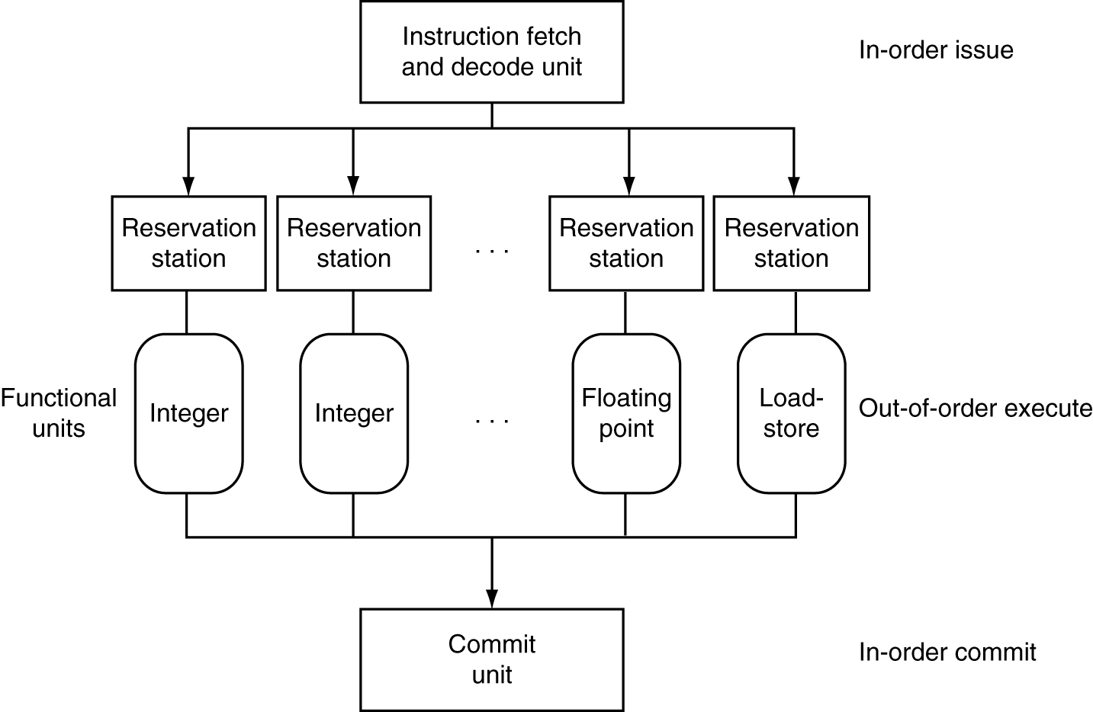
Dynamic Multiple Issue
Notes:
In-order commit: A commit in which the results of pipelined execution are written to the programmer visible state in the same order that instructions are

Slide 20
Why dynamic scheduling?
To handle unpredictable stalls
Like cache misses
Hides details of pipeline from applications
Abstraction

Slide 21
Does Multiple Issue Work?
Q: Does multiple issue / ILP work?
A: Kind of… but not as much as we’d like
Limiting factors?
Programs dependencies
Hard to detect dependencies → be conservative
e.g. Pointer Aliasing: A[0] += 1; B[0] *= 2;
Hard to expose parallelism
Can only issue a few instructions ahead of PC
Structural limits
Memory delays and limited bandwidth
Hard to keep pipelines full

Slide 22
Moore’s Law
Dual-core Itanium 2
K10
Itanium 2
K8
P4
Atom
Pentium
486
386
286
8088
8080
4004
8008
Notes:
NVIDIA GF100 has 3B transistors

Slide 23
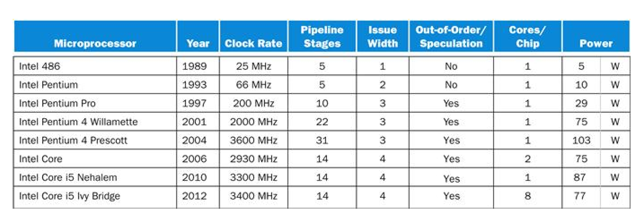
Power Efficiency
Q: Does multiple issue / ILP cost much?
A: Yes. Dynamic issue & speculation requires power
→ Multiple simpler cores may be better?

Slide 24
Why Multicore?
Moore’s law
A law about transistors
Smaller means more transistors per die
And smaller means faster too
But: need to worry about power too…

Slide 25
Power Wall
Power = capacitance * voltage² * frequency
approx. capacitance * voltage³
Reducing voltage helps (a lot)
Better cooling helps
The power wall
We can’t reduce voltage further - leakage
We can’t remove more heat

Slide 26
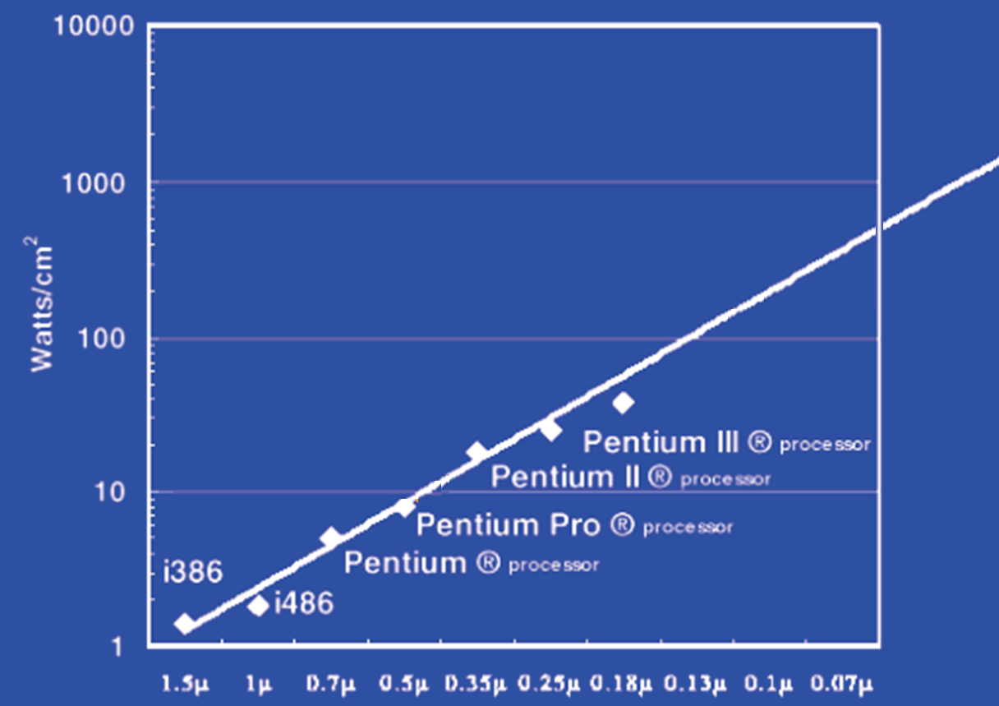
Power Limits
Surface of Sun
Rocket Nozzle
Nuclear Reactor
Xeon
Hot Plate
180nm
32nm
Notes:
Intel Westmere: 32 nm = 0.032u, 130W / 240mm^2 = 54 W/cm^2

Slide 27
Why Multicore?
Performance
1.2x
Single-Core Overclocked +20%
Power
1.7x
Performance
1.0x
Power
Single-Core
1.0x
Performance
0.8x
1.6x
Single-Core
Underclocked -20%
Dual-Core
Underclocked -20%
Power
0.51x
1.02x

Slide 28
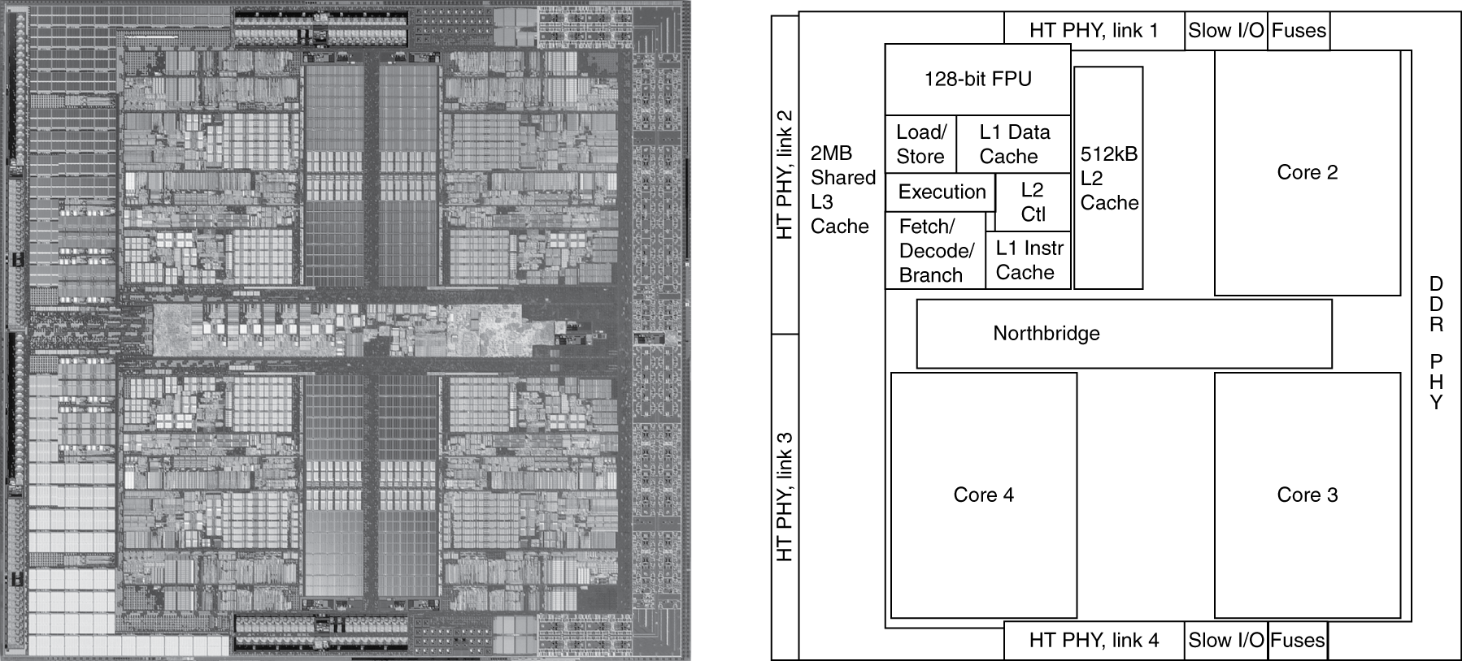
Inside the Processor
AMD Barcelona Quad-Core: 4 processor cores

Slide 29
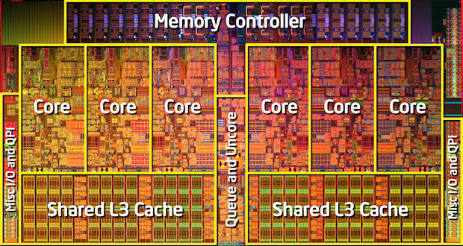
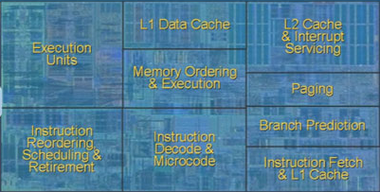
Inside the Processor
Intel Nehalem Hex-Core
Notes:
4 wide pipeline

Slide 30
Hyperthreading
Hyperthreads (Intel)
Illusion of multiple cores on a single core
Switch between hardware threads for stalls
Fine grained and coarse grained

Slide 31
Hyperthreading
vs. HT
Multi-Core vs. Multi-Issue
Programs:
Num. Pipelines:
Pipeline Width:
Hyperthreads
HT = MultiIssue + extra PCs and registers – dependency logic
HT = MultiCore – redundant functional units + hazard avoidance
Hyperthreads (Intel)
Illusion of multiple cores on a single core
Easy to keep HT pipelines full + share functional units
N | 1 | N
N | 1 | 1
1 | N | N
Notes:
HT = MultiIssue + extra PCs and registers – dependency logic
HT = MultiCore – redundant functional units + hazard avoidance

Slide 32
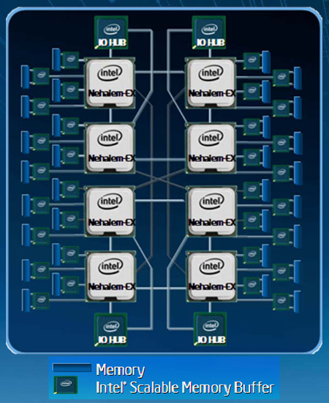
Example: All of the above
8 multiprocessors
4 core per multiprocessor
2 HT per core
Dynamic multi-issue: 4 issue
Pipeline depth: 16
Note: each processor may
have multiple processing
cores, so this is an example
of a multiprocessor multicore
hyperthreaded system
Notes:
MultiCore: 8 processors dies * 4 cores per processor die
Hyperthreading: 2 HT per core
Dynamic Multi-Issue: 4 issue
Pipeline: 16 stages

Slide 33
Parallel Programming
Q: So lets just all use multicore from now on!
A: Software must be written as parallel program
Multicore difficulties
Partitioning work, balancing load
Coordination & synchronization
Communication overhead
How do you write parallel programs?
... without knowing exact underlying architecture?
Notes:
Or hyperthreads

Slide 34
Work Partitioning
Partition work so all cores have something to do

Slide 35
Load Balancing
Need to partition so all cores are actually working

Slide 36
Amdahl’s Law
If tasks have a serial part and a parallel part…
Example:
step 1: divide input data into n pieces
step 2: do work on each piece
step 3: combine all results
Recall: Amdahl’s Law
As number of cores increases …
time to execute parallel part?
time to execute serial part?
Serial part eventually dominates
goes to zero
Remains the same

Slide 37
Amdahl’s Law
Notes:
Underclocking messes up the ratios completely. Work through a 8x slowdown example.

Slide 38
Pitfall: Amdahl’s Law
Execution time after improvement =
affected execution time
amount of improvement
+ execution time unaffected
T_{improved} = $\frac{Taffected}{improvement factor}$+ T_{unaffected}
Notes:
Amdahl’s Law

Slide 39
Pitfall: Amdahl’s Law
Improving an aspect of a computer and expecting a proportional improvement in overall performance
T_{improved} = $\frac{Taffected}{improvement factor}$+ T_{unaffected}
Example: multiply accounts for 80s out of 100s
How much improvement do we need in the multiply performance to get 5× overall improvement?
20 = 80/n + 20
Can’t be done!
Notes:
Clicker question

Slide 40
Scaling Example
Workload: sum of 10 scalars, and 10 × 10 matrix sum
Speed up from 10 to 100 processors?
Single processor: Time
10 processors
Time =
Speedup =
100 processors
Time =
Speedup =
Assumes load can be balanced across processors
Notes:
Pair up question
10 processors
Speedup = 110/20 = 5.5 (55% of potential)
100 processors
Speedup = 110/11 = 10 (10% of potential)

Slide 41
Scaling Example
What if matrix size is 100 × 100?
Single processor: Time = (10 + 10000) × t_{add}
10 processors
Time =
Speedup =
100 processors
Time =
Speedup =
Assuming load balanced
Notes:
10 processors
Speedup = 10010/1010 = 9.9 (99% of potential)
100 processors
Speedup = 10010/110 = 91 (91% of potential)

Slide 42
Scaling
Strong scaling vs. weak scaling
Strong scaling: scales with same problem size
Weak scaling: scales with increased problem size

Slide 43
Parallel Programming
Q: So lets just all use multicore from now on!
A: Software must be written as parallel program
Multicore difficulties
Partitioning work
Coordination & synchronization
Communications overhead
Balancing load over cores
How do you write parallel programs?
... without knowing exact underlying architecture?
SW
Your
career…
HW
Notes:
Most is software, but hardware can help:
- communications (fast core-to-core interconnect)
- coordination and synchronization primitives (next time)

Slide 44
Synchronization
P&H Chapter 2.11 and 5.10

Slide 45
Parallelism and Synchronization
How do I take advantage of multiple processors; parallelism?
How do I write (correct) parallel programs, cache coherency and synchronization?
What primitives do I need to implement correct parallel programs?

Slide 46
Topics
Understand Cache Coherency
Synchronizing parallel programs
Atomic Instructions
HW support for synchronization
How to write parallel programs
Threads and processes
Critical sections, race conditions, and mutexes

Slide 47
Parallelism and Synchronization
Cache Coherency Problem: What happens when two or more processors cache shared data?

Slide 48
Parallelism and Synchronization
Cache Coherency Problem: What happens when two or more processors cache shared data?
i.e. the view of memory held by two different processors is through their individual caches
As a result, processors can see different (incoherent) values to the same memory location

Slide 49
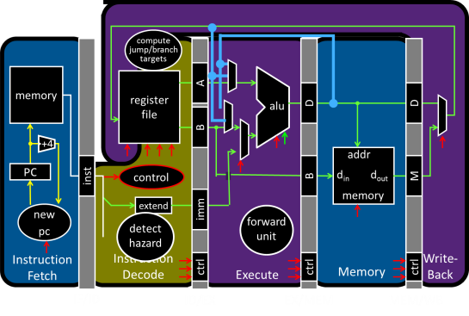
Parallelism and Synchronization
Each processor core has its own L1 cache

Slide 50
Parallelism and Synchronization
Each processor core has its own L1 cache
Core0
Core1
Core2
Core3
Cache
Cache
Cache
Cache
Interconnect
Memory
I/O

Slide 51
Shared Memory Multiprocessors
Shared Memory Multiprocessor (SMP)
Typical (today): 2 – 8 cores each
HW provides single physical address space for all processors
Assume uniform memory access (ignore NUMA)
Core0
Core1
Core2
Core3
Cache
Cache
Cache
Cache
Interconnect
Memory
I/O
Notes:
How do they share data? How do they coordinate? How do they scale?

Slide 52
Shared Memory Multiprocessors
Shared Memory Multiprocessor (SMP)
Typical (today): 2 – 8 cores each
HW provides single physical address space for all processors
Assume uniform memory access (ignore NUMA)
Core0
Core1
...
...
...
CoreN
Cache
Cache
Cache
Interconnect
Memory
I/O
Notes:
How do they share data? How do they coordinate? How do they scale?

Slide 53
Cache Coherency Problem
Thread A (on Core0) Thread B (on Core1) for(int i = 0, i < 5; i++) { for(int j = 0; j < 5; j++) { x = x + 1; x = x + 1; } }
What will the value of x be after both loops finish?
Start: x = 0
Core0
Core1
...
...
...
CoreN
Cache
Cache
Cache
Interconnect
Memory
I/O
Notes:
How do they share data? How do they coordinate? How do they scale?

Slide 54
iClicker
Thread A (on Core0) Thread B (on Core1) for(int i = 0, i < 5; i++) { for(int j = 0; j < 5; j++) { x = x + 1; x = x + 1; } }
Notes:
How do they share data? How do they coordinate? How do they scale?
T0 1, T1 6, T0 simultaneously does its remaining 4 and writes 5 which is lost.
T0 3, T0 writes 4, T1 simultaneously does 3+5 = 8

Slide 55
Cache Coherency Problem
Thread A (on Core0) Thread B (on Core1) for(int i = 0, i < 5; i++) { for(int j = 0; j < 5; j++) { LW $t0, addr(x) LW $t0, addr(x)
ADDIU $t0, $t0, 1 ADDIU $t0, $t0, 1
SW $t0, addr(x) SW $t0, addr(x) } }
Notes:
How do they share data? How do they coordinate? How do they scale?

Slide 56
iClicker
Thread A (on Core0) Thread B (on Core1) for(int i = 0, i < 5; i++) { for(int j = 0; j < 5; j++) { x = x + 1; x = x + 1; } }
What will the value of x be after both loops finish?
6
8
10
All of the above
None of the above
Notes:
How do they share data? How do they coordinate? How do they scale?

