Slide 1
Lab4: Virtual Memory
CS 3410 : Computer System Organization & Programming
Spring 2014

Slide 2
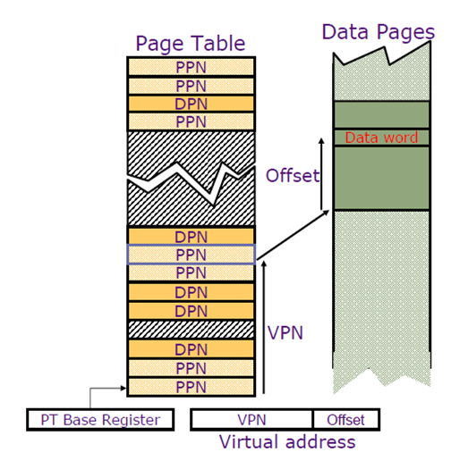
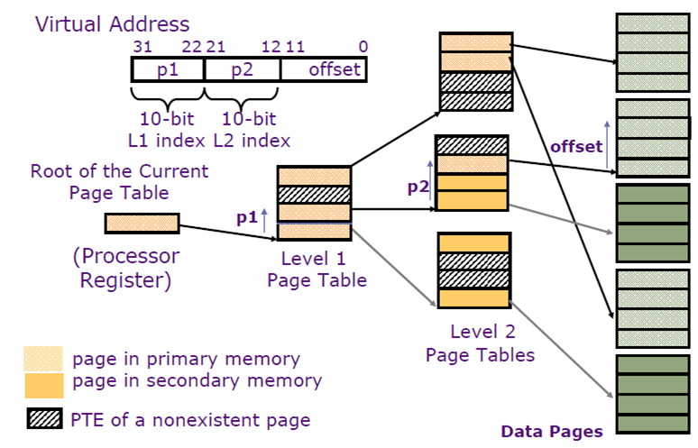
Single vs. Multi Level Page Table
Directory
Single-Level Page Table
Multi-Level Page Table

Slide 3
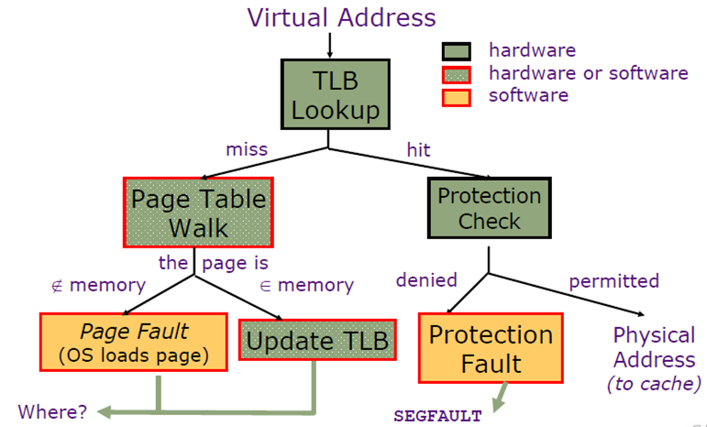
Wrap-up : Address Translation

Slide 4
Lab 4 : C Operator Exercise
Leftshift a variable A to the left by 5 bits and store it in A.
A = A << 5;
Rightshift a variable A to the left by 5 bits and store it in A.
A = A >> 5;
AND, OR, and XOR two variables and store them into a third variable.
z = x & y; z = x | y; z = x ^ y;
Change a variable into its negation.
z = ~z;

Slide 5
Lab 4 : Virtual Memory
What to implement (vmem.c)
create_address_space()
map_page()
Optional:
map_shared_page()
pfault()
Where to start with
Start from reading ‘mem.h’
Each function in vmem.c has headers in mem.h which has comprehensive comments on what to do.

Slide 6
Lab 4 : Virtual Memory
Useful Physical Memory API functions
Headers provided in mem.h, implementations provided in pmem.c
allocate_physical_page()
dereference_physical_page(unsigned int ppn)
Debugging Tools
gdb debuggers
Function : dump_physical_memory()

