Slide 1
RISC, CISC, and Assemblers
Hakim Weatherspoon
CS 3410, Spring 2012
Computer Science
Cornell University
See P&H Appendix B.1-2, and Chapters 2.8 and 2.12; als 2.16 and 2.17

Slide 2
Big Picture: Understanding Tradeoffs
compute
jump/branch
targets
memory
register
file
A
alu
D
D
B
+4
addr
PC
inst
control
B
d_{in}
d_{out}
M
memory
new
pc
extend
imm
detect
hazard
forward
unit
Instruction
Fetch
Instruction
Decode
Write-
Back
ctrl
ctrl
ctrl
Execute
Memory
IF/ID
ID/EX
EX/MEM
MEM/WB

Slide 3
Big Picture: How do I Program?
compute
jump/branch
targets
memory
register
file
A
alu
D
D
B
+4
addr
PC
inst
control
B
d_{in}
d_{out}
M
memory
new
pc
extend
imm
detect
hazard
forward
unit
Instruction
Fetch
Instruction
Decode
Write-
Back
ctrl
ctrl
ctrl
Execute
Memory
IF/ID
ID/EX
EX/MEM
MEM/WB

Slide 4
Goals for Today
Instruction Set Architectures
  ISA Variations
  Complexity: CISC, RISC
Assemblers
  Translate symbolic instructions to binary machine code
  instructions
  psuedo-instructions
  data and layout directives
  executable programs
Next Time
  Program Structure and Calling Conventions

Slide 5
What is not a valid hazard resolution?
a) Stall
b) Forward/Bypass
c) Reorder instructions in hardware
c) New Hardware Instruction
e) None (i.e. all are valid hazard resolution)

Slide 6
Recall: Control Hazards
inst
mem
A
D
+4
B
data
mem
PC
beq r1, r2, L | IF | ID | Ex | M | WB
add r3, r0, r3
sub r5, r4, r6
L: or r3, r2, r4 |  |  | IF | ID | Ex | M | WB
Notes:
branch decision in EX
need 2 stalls, and maybe kill

Slide 7
ISA Variations: Conditional Instructions
  while(i != j) {
  if (i > j)
  i -= j;
  else
  j -= i;
  }
  LOOP: CMP Ri, Rj // set condition "NE" if (i != j)
  // "GT" if (i > j),
  // or "LT" if (i < j)
  SUBGT Ri, Ri, Rj // if "GT" (greater than), i = i-j;
  SUBLT Rj, Rj, Ri // if "LT" (less than), j = j-i;
  BNE loop // if "NE" (not equal), then loop
Notes:
In ARM assembly, the loop avoids the branches around the then and else clauses. Note that if Ri and Rj are equal then neither of the SUB instructions will be executed, optimising out the need for a conditional branch to implement the while check at the top of the loop, for example had SUBLE (less than or equal) been used.

Slide 8
MIPS instruction formats
All MIPS instructions are 32 bits long, has 3 formats
R-type
I-type
J-type
op | rs | rt | rd | shamt | func
6 bits | 5 bits | 5 bits | 5 bits | 5 bits | 6 bits
op | rs | rt | immediate
6 bits | 5 bits | 5 bits | 16 bits
op | immediate (target address)
6 bits | 26 bits

Slide 9
ARM instruction formats
All MIPS instructions are 32 bits long, has 3 formats
R-type
I-type
J-type
opx | op | rs | rd | opx | rt
4 bits | 8 bits | 4 bits | 4 bits | 8 bits | 4 bits
opx | op | rs | rd | immediate
4 bits | 8 bits | 4 bits | 4 bits | 16 bits
opx | op | immediate (target address)
4 bits | 8 bits | 26 bits
Notes:
9 addressing modes

Slide 10
Instruction Set Architecture
ISA defines the permissible instructions
  MIPS: load/store, arithmetic, control flow, …
  ARM: similar to MIPS, but more shift, memory, & conditional ops
  VAX: arithmetic on memory or registers, strings, polynomial evaluation, stacks/queues, …
  Cray: vector operations, …
  x86: a little of everything

Slide 11
Complex Instruction Set Computers
People programmed in assembly and machine code!
  Needed as many addressing modes as possible
  Memory was (and still is) slow
CPUs had relatively few registers
  Register’s were more “expensive” than external mem
  Large number of registers requires many bits to index
Memories were small
  Encoraged highly encoded microcodes as instructions
  Variable length instructions, load/store, conditions, etc

Slide 12


Reduced Instruction Set Computer
Dave Patterson
  RISC Project, 1982
  UC Berkeley
  RISC-I: ½ transtisters & 3x faster
  Influences: Sun SPARC, namesake of industry
John L. Hennessy
  MIPS, 1981
  Stanford
  Simple pipelining, keep full
  Influences: MIPS computer system, PlayStation, Nintendo

Slide 13
Complexity
MIPS = Reduced Instruction Set Computer (RlSC)
  ≈ 200 instructions, 32 bits each, 3 formats
  all operands in registers
    almost all are 32 bits each
  ≈ 1 addressing mode: Mem[reg + imm]
x86 = Complex Instruction Set Computer (ClSC)
  > 1000 instructions, 1 to 15 bytes each
  operands in dedicated registers, general purpose registers, memory, on stack, …
    can be 1, 2, 4, 8 bytes, signed or unsigned
  10s of addressing modes
    e.g. Mem[segment + reg + reg*scale + offset]
Notes:
DEC PDP-8 has about 8 insructions

Slide 14
RISC vs CISC
RISC Philosophy
Regularity & simplicity
Leaner means faster
Optimize the
common case
CISC Rebuttal
Compilers can be smart
Transistors are plentiful
Legacy is important
Code size counts
Micro-code!
Notes:
RISC:
regularity means no mem-to-mem, few addressing modes… thus load-store
regularity means uniform instruction size… sizeof(common) = sizeof(rare)
lean means fewer, more general instructions… thus bigger programs, more instructions
common case means measurement
CISC:
Compilers can be smart
Transistors are plentiful
Legacy is important
Code size counts
Micro-code!

Slide 15
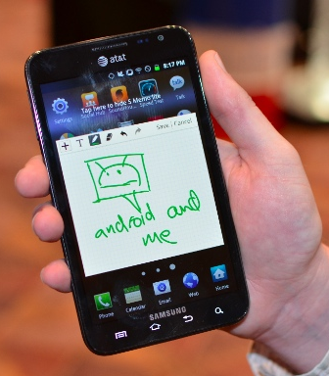
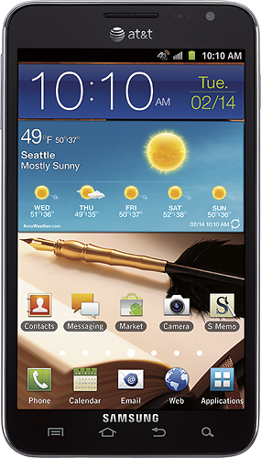

ARMDroid vs WinTel
  Android OS on ARM processor
  Windows OS on Intel (x86) processor
Notes:
In 2005, about 98% of the more than one billion mobile phones sold each year used at least one ARM processor.[5] As of 2009, ARM processors account for approximately 90% of all embedded 32-bit RISC processors[6] and are used extensively in consumer electronics, including personal digital assistants (PDAs), tablets, mobile phones, digital media and music players, hand-held game consoles, calculators and computer peripherals such as hard drives and routers.

Slide 16
Administrivia
Project1 (PA1) due next Monday, March 5th
  Continue working diligently. Use design doc momentum
Save your work!
  Save often. Verify file is non-zero. Periodically save to Dropbox, email.
  Beware of MacOSX 10.5 (leopard) and 10.6 (snow-leopard)
Use your resources
  Lab Section, Piazza.com, Office Hours, Homework Help Session,
  Class notes, book, Sections, CSUGLab

Slide 17
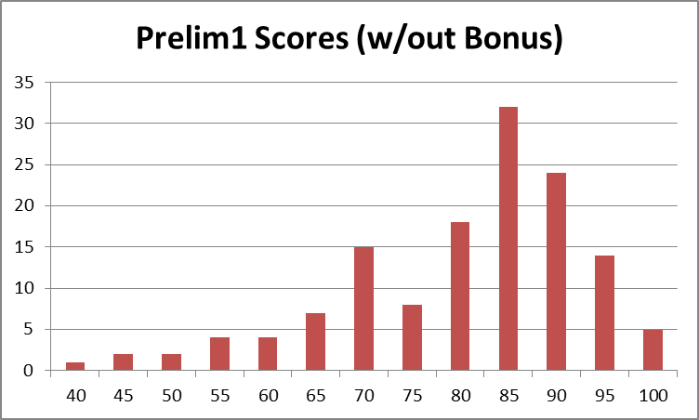
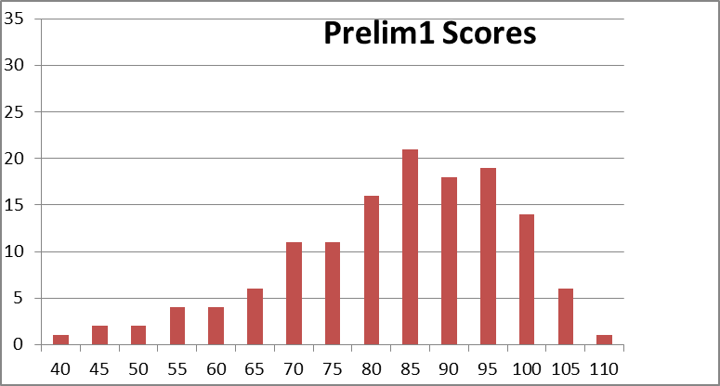
Administrivia
Prelim1 results
  Mean 80 (without bonus 78), standard deviation 15
  Prelims available in Upson 360 after today
  Regrade requires written request
    Whole test is regraded

Slide 18
Goals for Today
Instruction Set Architectures
  ISA Variations
  Complexity: CISC, RISC
Assemblers
  Translate symbolic instructions to binary machine code
  instructions
  psuedo-instructions
  data and layout directives
  executable programs
Next Time
  Program Structure and Calling Conventions

Slide 19
How do I program a MIPS processor?
C
int x = 10;
x = 2 * x + 15;
compiler
MIPS
assembly
addi r5, r0, 10
muli r5, r5, 2
addi r5, r5, 15
assembler
machine
code
00100000000001010000000000001010
00000000000001010010100001000000
00100000101001010000000000001111
CPU
Circuits
Gates
Transistors
Silicon
Notes:
32 bits, 4 bytes

Slide 20
Assembler
Translates text assembly language to binary machine code
Input: a text file containing MIPS instructions in human readable form
Output: an object file (.o file in Unix, .obj in Windows) containing MIPS instructions in executable form

Slide 21
Assembly Language
Assembly language is used to specify programs at a low-level
What does a program consist of?
  MIPS instructions
  Program data (strings, variables, etc)

Slide 22
MIPS Instruction Types
Arithmetic/Logical
  ADD, ADDU, SUB, SUBU, AND, OR, XOR, NOR, SLT, SLTU
  ADDI, ADDIU, ANDI, ORI, XORI, LUI, SLL, SRL, SLLV, SRLV, SRAV, SLTI, SLTIU
  MULT, DIV, MFLO, MTLO, MFHI, MTHI
Memory Access
  LW, LH, LB, LHU, LBU, LWL, LWR
  SW, SH, SB, SWL, SWR
Control flow
  BEQ, BNE, BLEZ, BLTZ, BGEZ, BGTZ
  J, JR, JAL, JALR, BEQL, BNEL, BLEZL, BGTZL
Special
  LL, SC, SYSCALL, BREAK, SYNC, COPROC

Slide 23
Assembling Programs
Assembly files consist of a mix of
+ instructions
+ pseudo-instructions
+ assembler (data/layout) directives
(Assembler lays out binary values
in memory based on directives)
Assembled to an Object File
  Header
  Text Segment
  Data Segment
  Relocation Information
  Symbol Table
  Debugging Information
.text
.ent main
main: la $4, Larray
li $5, 15
...
li $4, 0
jal exit
.end main
.data
Larray:
.long 51, 491, 3991
Notes:
A program is made up by code and data from several object files
Each object file is generated independently
Assembler starts at some PC address, e.g. 0, in each object file, generates code as if the program were laid out starting out at location 0x0
It also generates a symbol table, and a relocation table
In case the segments need to be moved

Slide 24
Example 1
...
T: ADDI r4,r0,-1
BEQ r3, r0, B
ADDI r4,r4, 1
LW r3, 0(r3)
J T
NOP
B: ...
...
001000
000100
001000
100011
000010
00000000000000000000000000000000
...
Notes:
length of linked list
Q: how is this assembled?
A: mostly, just encode in binary; but need 2 passes to resolve forward references

Slide 25
References
Q: How to resolve labels into offsets and addresses?
A: Two-pass assembly
  1st pass: lay out instructions and data, and build
  a symbol table (mapping labels to addresses) as you go
  2nd pass: encode instructions and data in binary, using symbol table to resolve references

Slide 26
Example 2
...
JAL L
nop
nop
L: LW r5, 0(r31)
ADDI r5,r5,1
SW r5, 0(r31)
...
...
00100000000100000000000000000100
00000000000000000000000000000000
00000000000000000000000000000000
10001111111001010000000000000000
00100000101001010000000000000001
00000000000000000000000000000000
...
Notes:
Counts how many times it was executed
lessons:
data and instructions are mixed: von Neumann machine
-need better way to specify data: replace second nop with “.word 0”
-better to separate code and data: use .text and .data segments
-being careful of branch delay slot is painful

Slide 27
Example 2 (better)
.text 0x00400000 # code segment
...
ORI r4, r0, counter
LW r5, 0(r4)
ADDI r5, r5, 1
SW r5, 0(r4)
...
.data 0x10000000 # data segment
counter:
.word 0
Notes:
ORI is broken; need to do LUI then ORI
-better to use pseudoinstruction: LA (load 32-bit address) or LI (load 32-bit immediate)

Slide 28
Pseudo-Instructions
Pseudo-Instructions
NOP # do nothing
MOVE reg, reg # copy between regs
LI reg, imm # load immediate (up to 32 bits)
LA reg, label # load address (32 bits)
B label # unconditional branch
BLT reg, reg, label # branch less than
Notes:
BLT rA, rB, label
becomes
SLT r1, rA, rB
BNE r1, r0, label

Slide 29
Assembler
Lessons:
  Von Neumann architecture mixes data and instructions
  … but best kept in separate segments
  Specify layout and data using assembler directives
  Use pseudo-instructions

Slide 30
Assembler
Assembler:
assembly instructions
+ psuedo-instructions
+ data and layout directives
= executable program
Slightly higher level than plain assembly
e.g: takes care of delay slots
(will reorder instructions or insert nops)

Slide 31
Will I program in assembly?
A: I do...
  For CS 3410 (and some CS 4410/4411)
  For kernel hacking, device drivers, GPU, etc.
  For performance (but compilers are getting better)
  For highly time critical sections
  For hardware without high level languages
  For new & advanced instructions: rdtsc, debug registers, performance counters, synchronization, ...

Slide 32
How do I program a MIPS processor?
C
int x = 10;
x = 2 * x + 15;
compiler
MIPS
assembly
addi r5, r0, 10
muli r5, r5, 2
addi r5, r5, 15
assembler
machine
code
00100000000001010000000000001010
00000000000001010010100001000000
00100000101001010000000000001111
CPU
Circuits
Gates
Transistors
Silicon
Notes:
32 bits, 4 bytes

Slide 33
Example program
calc.c
vector v = malloc(8);
v->x = prompt(“enter x”);
v->y = prompt(“enter y”);
int c = pi + tnorm(v);
print(“result”, c);
math.c
int tnorm(vector v) {
return abs(v->x)+abs(v->y);
}
lib3410.o
global variable: pi
entry point: prompt
entry point: print
entry point: malloc
Notes:
OS
stack: function local vars and args
heap: vector object (8 bytes)
data: strings, pi
text: assembly

Slide 34
Stages
calc.c
calc.s
calc.o
math.c
math.s
math.o
calc.exe
io.s
io.o
libc.o
libm.o
Notes:
C compiller produces assembly files (contain MIPS assembly, pseudo-instructions, directives, etc.)
MIPS assembler produces object files (contain MIPS machine code, missing symbols, some layout information, etc.)
MIPS linker produces executable file (contains MIPS machine code, no missing symbols, some layout information)
OS loader gets it into memory and jumps to first instruction (machine code)

Slide 35
Anatomy of an executing program
0xfffffffc
top
system reserved
0x80000000
(stack grows down)
(.stack)
0x7ffffffc
(heap grows up)
(static) data
.data
0x10000000
text
.text
0x00400000
reserved
0x00000000
bottom

Slide 36
math.s
.global tnorm
MOVE r30, r31
LW r3, 0(r4)
JAL abs
MOVE r6, r3
LW r3, 4(r4)
JAL abs
ADD r4, r6, r3
JR r30
math.c
int abs(x) {
return x < 0 ? –x : x;
}
int tnorm(vector v) {
return abs(v->x)+abs(v->y);
}
tnorm:
# arg in r4, return address in r31
# leaves result in r4
abs:
# arg in r3, return address in r31
# leaves result in r3
BLEZ r3, pos
SUB r3, r0, r3
pos:
JR r31
Notes:
lessons:
need “.global” directive
starting to need conventions:
- where to put function arguments
- where to put return value

Slide 37
calc.s
calc.c
dostuff:
# no args, no return value, return addr in r31
MOVE r30, r31
LI r3, 8 # call malloc: arg in r3, ret in r3
JAL malloc
MOVE r6, r3 # r6 holds v
LA r3, str1 # call prompt: arg in r3, ret in r3
JAL prompt
SW r3, 0(r6)
LA r3, str2 # call prompt: arg in r3, ret in r3
JAL prompt
SW r3, 4(r6)
MOVE r4, r6 # call tnorm: arg in r4, ret in r4
JAL tnorm
LA r5, pi
LW r5, 0(r5)
ADD r5, r4, r5
LA r3, str3 # call print: args in r3 and r4
MOVE r4, r5
JAL print
JR r30
# clobbered: need stack
# might clobber stuff
# might clobber stuff
# might clobber stuff
# clobbers r6, r31, r30 …
vector v = malloc(8);
v->x = prompt(“enter x”);
v->y = prompt(“enter y”);
int c = pi + tnorm(v);
print(“result”, c);
.data
str1: .asciiz “enter x”
str2: .asciiz “enter y”
str3: .asciiz “result”
.text
.extern prompt
.extern print
.extern malloc
.extern tnorm
.global dostuff
Notes:
step through, then ask what is broken
lessons:
string data goes elsewhere
definitely need conventions:
- where to put function arguments
- where to put return value
- which functions modify which registers
- where to save registers?

Slide 38
Next time
How do we coordinate use of registers?
Calling Conventions!
PA1 due Monday

