Slide 1
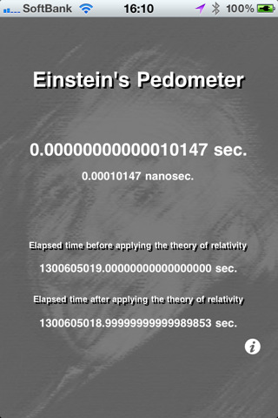

Slide 2
Parallel Programming and Synchronization
Guest Lecture: Kevin Walsh
CS 3410, Spring 2011
Computer Science
Cornell University
P&H Chapter 2.11

Slide 3
Multi-core is a reality…
… but how do we write multi-core safe code?

Slide 4
Cache Coherence:
Necessary, but not Sufficient

Slide 5
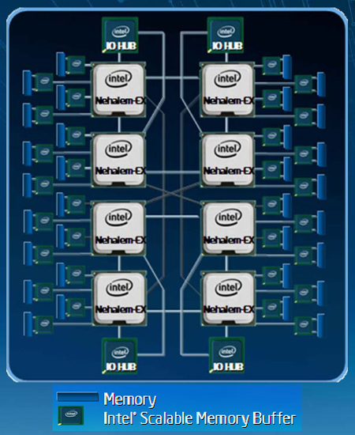
NUMA
Notes:
Non-uniform memory access

Slide 6
Shared Memory Multiprocessors
Shared Memory Multiprocessor (SMP)
Typical (today): 2 – 4 processor dies, 2 – 8 cores each
Assume physical addresses (ignore virtual memory)
Assume uniform memory access (ignore NUMA)
...
Core0
Core1
CoreN
Cache
Cache
Cache
Interconnect
Memory
I/O

Slide 7
Cache Coherence Problem
Shared Memory Multiprocessor (SMP)
What could possibly go wrong?
...
...
x = x+1
...
...
while (x==5) { // wait
}
...
Core0
Core1
Core3
Interconnect
I/O
Notes:
show assembly: LW, ADDI, SW; LW, LW, LW, …
show table of cycles: Core3 load, Core0 modify, core 3 never finishes
stale data -> Cache Coherence
Does write-through or write-back cache help? no

Slide 8
Coherence Defined
Cache coherence defined...
Informal: Reads return most recently written value
Formal: For concurrent processes P₁ and P₂
P writes X before P reads X (with no intervening writes) ⇒ read returns written value
P₁ writes X before P₂ reads X ⇒ read returns written value
P₁ writes X and P₂ writes X ⇒ all processors see writes in the same order
all see the same final value for X
Notes:
second case: for some definition of “before”
third case: see relativity
complication: clocks are not synchronized across cores
1 light nanosecond = 30cm, so 3GHz can do 1 instruction per 10cm

Slide 9
Snooping
Recall: Snooping for Hardware Cache Coherence
All caches monitor bus and all other caches
Bus read: respond if you have dirty data
Bus write: update/invalidate your copy of data
...
Core0
Core1
CoreN
Snoop
Cache
Snoop
Cache
Snoop
Cache
Interconnect
Memory
I/O
Notes:
In reality: very complicated, lots of corner cases

Slide 10
Is cache coherence sufficient?
Example with cache coherence:
P₁ P₂
x = x +1 while (x==5) ;
Notes:
Is cache coherence enough? Maybe?

Slide 11
Is cache coherence sufficient?
Example with cache coherence:
P₁ P₂
x = x +1 x = x + 1
→ happens even on single-core (context switches!)
Notes:
Is cache coherence enough? No
This bug happens on single core too

Slide 12
Software Support for Synchronization and Coordination:
Programs and Processes

Slide 13
Processes
How do we cope with lots of activity?
Simplicity? Separation into processes
Reliability? Isolation
Speed? Program-level parallelism
OS
ls
www
emacs
gcc
nfsd
emacs
nfsd
lpr
ls
www
lpr
OS
Notes:
(isolation e.g. virtual memory)
(parallelism e.g. during I/O)

Slide 14
Process and Program
Process
OS abstraction of a running computation
The unit of execution
The unit of scheduling
Execution state + address space
From process perspective
a virtual CPU
some virtual memory
a virtual keyboard, screen, …
Program
“Blueprint” for a process
Passive entity (bits on disk)
Code + static data
Notes:
A virtual machine of sorts
Draw saved PTBR and Registers table

Slide 15
Role of the OS
Role of the OS
Context Switching
Provides illusion that every process owns a CPU
Virtual Memory
Provides illusion that process owns some memory
Device drivers & system calls
Provides illusion that process owns a keyboard, …
To do:
How to start a process?
How do processes communicate / coordinate?
Notes:
Draw OS on next slide

Slide 16
Role of the OS
Notes:
Draw OS and Process state

Slide 17
Creating Processes:
Fork

Slide 18
How to create a process?
Q: How to create a process?
A: Double click
After boot, OS starts the first process
…which in turn creates other processes
parent / child → the process tree
Notes:
1st process = init

Slide 19
pstree example
$ pstree | view -
init-+-NetworkManager-+-dhclient
|-apache2
|-chrome-+-chrome
| `-chrome
|-chrome---chrome
|-clementine
|-clock-applet
|-cron
|-cupsd
|-firefox---run-mozilla.sh---firefox-bin-+-plugin-cont
|-gnome-screensaver
|-grep
|-in.tftpd
|-ntpd
`-sshd---sshd---sshd---bash-+-gcc---gcc---cc1
|-pstree
|-vim
`-view

Slide 20
Processes Under UNIX
Init is a special case. For others…
Q: How does parent process create child process?
A: fork() system call
Wait. what? int fork() returns TWICE!
Notes:
1. creates new address space (Copy-On-Write duplicate of parent’s)
2. creates new execution state in OS process table (Exact copy of parent’s)
3. returns child’s id to parent (context[parent_id]->v0 = child_id)
4. returns zero to child (context[child_id]->v0 = 0)

Slide 21
Example
main(int ac, char **av) {
int x = getpid(); // get current process ID from OS
char *hi = av[1]; // get greeting from command line
printf(“I’m process %d\n”, x);
int id = fork();
if (id == 0)
printf(“%s from %d\n”, hi, getpid());
else
printf(“%s from %d, child is %d\n”, hi, getpid(), id);
}
$ gcc -o strange strange.c
$ ./strange “Hey”
I’m process 23511
Hey from 23512
Hey from 23511, child is 23512
Notes:
Draw OS state

Slide 22
Inter-process Communication
Parent can pass information to child
In fact, all parent data is passed to child
But isolated after (C-O-W ensures changes are invisible)
Q: How to continue communicating?
A: Invent OS “IPC channels” : send(msg), recv(), …
Notes:
IPC = inter-process communication
sockets, RMI, ipc, unix-domain sockets, pipes

Slide 23
Inter-process Communication
Parent can pass information to child
In fact, all parent data is passed to child
But isolated after (C-O-W ensures changes are invisible)
Q: How to continue communicating?
A: Shared (Virtual) Memory!
Notes:
Before fork: allocate pages, mark as “shared”
During fork: don’t set copy-on-write for these pages
After fork: either can read/write

Slide 24
Processes and Threads

Slide 25
Processes are heavyweight
Parallel programming with processes:
They share almost everything code, shared mem, open files, filesystem privileges, …
Pagetables will be almost identical
Differences: PC, registers, stack
Recall: process = execution context + address space
Notes:
pstree example: Firefox downloader, renderer, toolbar, etc.
Idea: multiple execution contexts sharing a single address space!

Slide 26
Processes and Threads
Process
OS abstraction of a running computation
The unit of execution
The unit of scheduling
Execution state + address space
From process perspective
a virtual CPU
some virtual memory
a virtual keyboard, screen, …
Thread
OS abstraction of a single thread of control
The unit of scheduling
Lives in one single process
From thread perspective
one virtual CPU core on a virtual multi-core machine
Notes:
d/Unit of scheduling/
s/execution state/one or more threads/
s/virtual CPU/virtual multi-core machine/

Slide 27
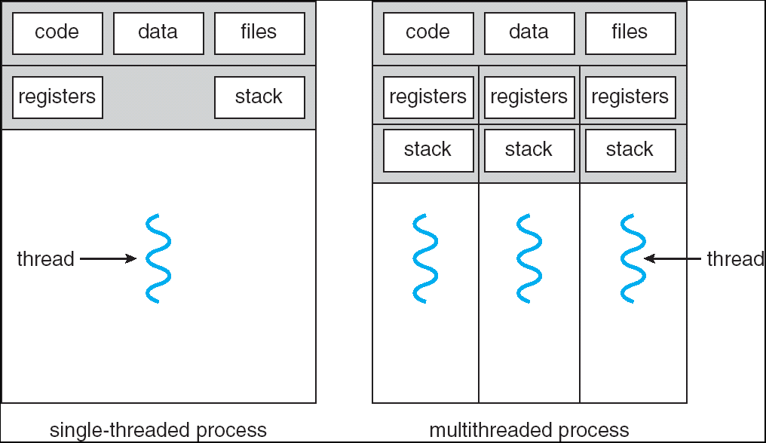
Multithreaded Processes

Slide 28
Threads
#include <pthread.h>
int counter = 0;
void PrintHello(int arg) {
printf(“I’m thread %d, counter is %d\n”, arg, counter++);
... do some work ...
pthread_exit(NULL);
}
int main () {
for (t = 0; t < 4; t++) {
printf(“in main: creating thread %d\n", t);
pthread_create(NULL, NULL, PrintHello, t);
}
pthread_exit(NULL);
}

Slide 29
Threads versus Fork
in main: creating thread 0
I’m thread 0, counter is 0
in main: creating thread 1
I’m thread 1, counter is 1
in main: creating thread 2
in main: creating thread 3
I’m thread 3, counter is 2
I’m thread 2, counter is 3
If processes?

Slide 30
Example Multi-Threaded Program
Example: Apache web server
void main() { setup();
while (c = accept_connection()) {
req = read_request(c);
hits[req]++; send_response(c, req);
}
cleanup();
}
Notes:
Use fork
Use threads

Slide 31
Race Conditions
Example: Apache web server
Each client request handled by a separate thread (in parallel)
Some shared state: hit counter, ...
(look familiar?)
Timing-dependent failure ⇒ race condition
hard to reproduce ⇒ hard to debug
Thread 52
read hits
addi
write hits
Thread 205
read hits
addi
write hits
Thread 52
...
hits = hits + 1;
...
Thread 205
...
hits = hits + 1;
...
Notes:
What happens when two threads execute concurrently?
sequential with threads
between threads is unsynchronized

Slide 32
Programming with threads
Within a thread: execution is sequential
Between threads?
No ordering or timing guarantees
Might even run on different cores at the same time
Problem: hard to program, hard to reason about
Behavior can depend on subtle timing differences
Bugs may be impossible to reproduce
Cache coherency isn’t sufficient…
Need explicit synchronization to make sense of concurrency!

Slide 33
Managing Concurrency
Races, Critical Sections, and Mutexes

Slide 34
Goals
Concurrency Goals
Liveness
Make forward progress
Efficiency
Make good use of resources
Fairness
Fair allocation of resources between threads
Correctness
Threads are isolated (except when they aren’t)

Slide 35
Race conditions
Race Condition
Timing-dependent error when accessing shared state
Depends on scheduling happenstance … e.g. who wins “race” to the store instruction?
Concurrent Program Correctness = all possible schedules are safe
Must consider every possible permutation
In other words…
… the scheduler is your adversary

Slide 36
Critical sections
What if we can designate parts of the execution as critical sections
Rule: only one thread can be “inside”
Thread 52
read hits
addi
write hits
Thread 205
read hits
addi
write hits
Notes:
Show picture

Slide 37
Interrupt Disable
Q: How to implement critical section in code?
A: Lots of approaches….
Disable interrupts?
CSEnter() = disable interrupts (including clock)
CSExit() = re-enable interrupts
Works for some kernel data-structures
Very bad idea for user code
read hits
addi
write hits
Notes:
but only within a single core: why?
(important events are delayed… forever?)

Slide 38
Preemption Disable
Q: How to implement critical section in code?
A: Lots of approaches….
Modify OS scheduler?
CSEnter() = syscall to disable context switches
CSExit() = syscall to re-enable context switches
Doesn’t work if interrupts are part of the problem
Usually a bad idea anyway
read hits
addi
write hits
Notes:
(e.g. won’t work for many kernel datastructures)
(caller forgets to CSExit? Or waits a long time?)

Slide 39
Mutexes
Q: How to implement critical section in code?
A: Lots of approaches….
Mutual Exclusion Lock (mutex)
acquire(m): wait till it becomes free, then lock it
release(m): unlock it
apache_got_hit() {
pthread_mutex_lock(m);
hits = hits + 1;
pthread_mutex_unlock(m)
}

Slide 40
Q: How to implement mutexes?
Notes:
A: next time…

