Slide 1
Caches
P & H Chapter 5.1, 5.2 (except writes)

Slide 2
Performance
CPU clock rates ~0.2ns – 2ns (5GHz-500MHz)
Technology Capacity $/GB Latency
Tape 1 TB $.17 100s of seconds
Disk 1 TB $.08 Millions cycles (ms)
SSD (Flash) 128GB $3 Thousands of cycles (us)
DRAM 4GB $25 50-300 cycles (10s of ns)
SRAM off-chip 4MB $4k 5-15 cycles (few ns)
SRAM on-chip 256 KB ??? 1-3 cycles (ns)
Others: eDRAM aka 1-T SRAM, FeRAM, CD, DVD, …
Q: Can we create illusion of cheap + large + fast?
Notes:
Capacity and latency are closely coupled
Cost is inversely proportional

Slide 3
Memory Pyramid
RegFile
100s bytes
1 cycle access
L1 Cache
(several KB)
1-3 cycle access
L3 becoming more common
(eDRAM ?)
L2 Cache (½-32MB)
5-15 cycle access
Memory Pyramid
Memory (128MB – few GB)
50-300 cycle access
Disk (Many GB – few TB)
1000000+
cycle access
These are rough numbers: mileage may vary for latest/greatest
Caches usually made of SRAM (or eDRAM)
Notes:
L1 L2 and even L3 all on-chip these days using SRAM and eDRAM

Slide 4
Memory Hierarchy
Memory closer to processor
  small & fast
  stores active data
Memory farther from processor
  big & slow
  stores inactive data

Slide 5
Active vs Inactive Data
Assumption: Most data is not active.
Q: How to decide what is active?
A: Some committee decides
A: Programmer decides
A: Compiler decides
A: OS decides at run-time
A: Hardware decides
at run-time

Slide 6
Insight of Caches
Q: What is “active” data?
A: Data that will be used soon.
If Mem[x] is was accessed recently...
… then Mem[x] is likely to be accessed soon
  Caches exploit temporal locality by putting recently accessed Mem[x] higher in the pyramid
… then Mem[x ± ε] is likely to be accessed soon
  Caches exploit spatial locality by putting an entire block containing Mem[x] higher in the pyramid

Slide 7
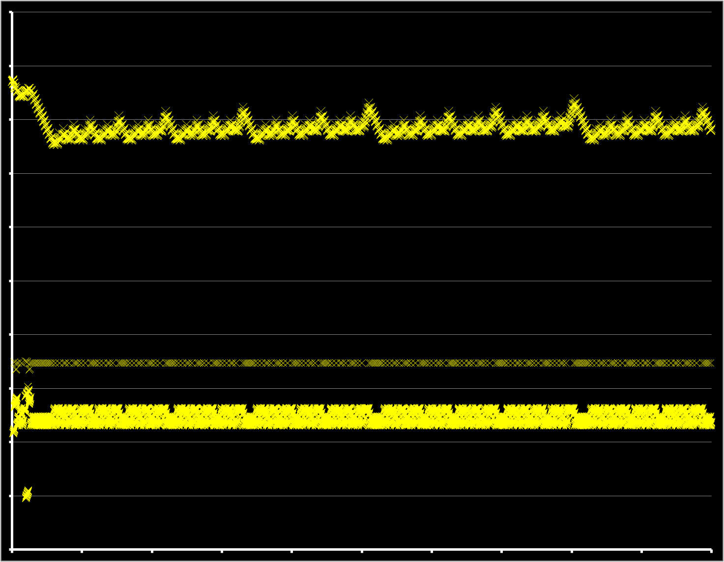
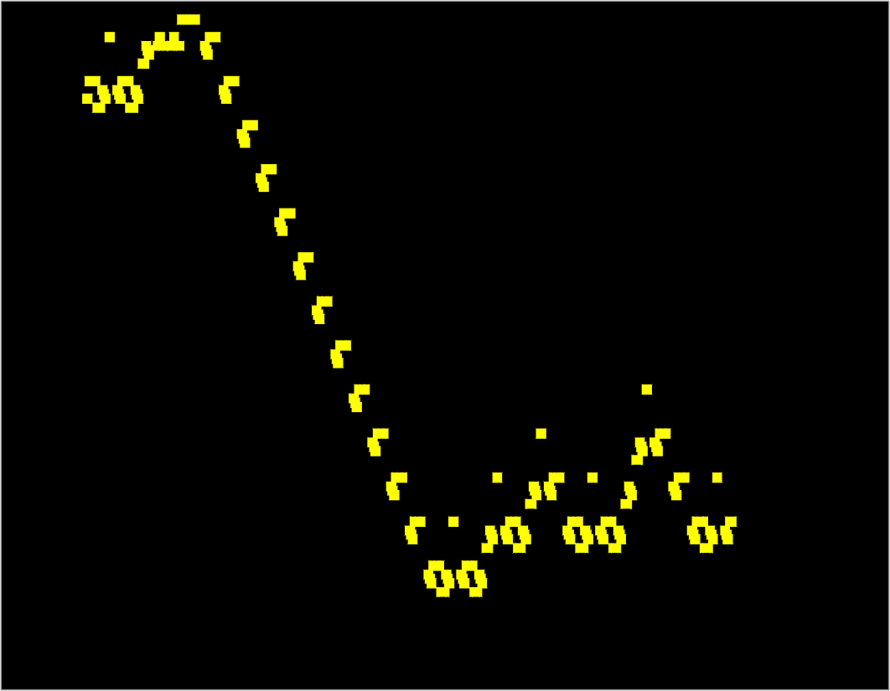
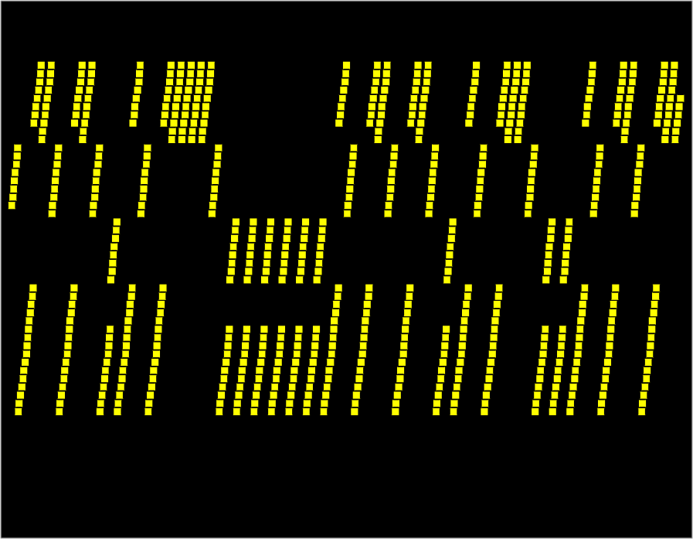
Locality
Memory trace
0x7c9a2b18
0x7c9a2b19
0x7c9a2b1a
0x7c9a2b1b
0x7c9a2b1c
0x7c9a2b1d
0x7c9a2b1e
0x7c9a2b1f
0x7c9a2b20
0x7c9a2b21
0x7c9a2b22
0x7c9a2b23
0x7c9a2b28
0x7c9a2b2c
0x0040030c
0x00400310
0x7c9a2b04
0x00400314
0x7c9a2b00
0x00400318
0x0040031c
...
int n = 4;
int k[] = { 3, 14, 0, 10 };
int fib(int i) {
  if (i <= 2) return i;
  else return fib(i-1)+fib(i-2);
}
int main(int ac, char **av) {
for (int i = 0; i < n; i++) {
printi(fib(k[i]));
prints("\n");
}
}
0x7c9a2b1f
0x00400318
0x00000000

Slide 8
Memory Hierarchy
Memory closer to processor is fast and small
  usually stores subset of memory farther from processor
    “strictly inclusive”
  alternatives:
    strictly exclusive
    mostly inclusive
  Transfer whole blocks
  cache lines, e.g:
  4kb: disk ↔ ram
  256b: ram ↔ L2
  64b: L2 ↔ L1

Slide 9
Cache Lookups (Read)
Processor tries to access Mem[x]
Check: is block containing x in the cache?
  Yes: cache hit
    return requested data from cache line
  No: cache miss
    read block from memory (or lower level cache)
    (evict an existing cache line to make room)
    place new block in cache
    return requested data
    → and stall the pipeline while all of this happens

Slide 10
Cache Organization
Cache Controller
CPU
Cache has to be fast and dense
  Gain speed by performing lookups in parallel
    but requires die real estate for lookup logic
  Reduce lookup logic by limiting where in the cache a block might be placed
    but might reduce cache effectiveness
Notes:
draw: dram on right; sram in controller; lookup logic;

Slide 11
Three common designs
A given data block can be placed…
  … in any cache line → Fully Associative
  … in exactly one cache line → Direct Mapped
  … in a small set of cache lines → Set Associative

Slide 12
Direct Mapped Cache
Direct Mapped Cache
  Each block number mapped to a single
  cache line index
  Simplest hardware
0x000000
0x000004
0x000008
0x00000c
0x000010
0x000014
0x000018
0x00001c
0x000020
0x000024
0x00002c
0x000030
0x000034
0x000038
0x00003c
0x000040
0x000044
0x000048
0x00004c
line 0
line 1
line 2
line 3

Slide 13
Tags and Offsets
Assume sixteen 64-byte cache lines
0x7FFF3D4D
= 0111 1111 1111 1111 0011 1101 0100 1101
Need meta-data for each cache line:
  valid bit: is the cache line non-empty?
  tag: which block is stored in this line (if valid)
Q: how to check if X is in the cache?
Q: how to clear a cache line?
Notes:
bottom 2 = byte offset within word
bottom 6 = byte offset within cache line
next 4 = cache line index
remaining = tag

Slide 14
Direct Mapped Cache Size
Tag Index Offset
n bit index, m bit offset
Q: How big is cache (data only)?
Q: How much SRAM needed (data + overhead)?
Notes:
(2**m bytes per line) (2**n lines) = 2**(n+m) bytes of data
(1+(32-n-m) bits of overhead per line) (2**n lines)
Some numbers: 32Kb cache, 64byte line size → 512 lines, 6bit offset, 9bit index, 17 bit tag → 18*512 = 16*512+1024 = 1024bytes + 128 bytes = 1152 bytes overhead

Slide 15
A Simple Direct Mapped Cache
Using byte addresses in this example! Addr Bus = 5 bits
Processor
Direct Mapped
Cache
Memory
0 | 101
1 | 103
2 | 107
3 | 109
4 | 113
5 | 127
6 | 131
7 | 137
8 | 139
9 | 149
10 | 151
11 | 157
12 | 163
13 | 167
14 | 173
15 | 179
16 | 181
lb $1 ← M[ 1 ]
lb $2 ← M[ 13 ]
lb $3 ← M[ 0 ]
lb $3 ← M[ 6 ]
lb $2 ← M[ 5 ]
lb $2 ← M[ 6 ]
lb $2 ← M[ 10 ]
lb $2 ← M[ 12 ]
0 | 101
1 | 103
2 | 107
3 | 109
4 | 113
5 | 127
6 | 131
7 | 137
8 | 139
9 | 149
10 | 151
11 | 157
12 | 163
13 | 167
14 | 173
15 | 179
16 | 181
A =
V tag data
$1
$2
$3
$4
Hits: Misses:
Notes:
4 cache lines
line size = 2 words
offset is 1 bit
index is 2 bits
tag is 2 bits

Slide 16
A Simple Direct Mapped Cache
Using byte addresses in this example! Addr Bus = 5 bits
Processor
Direct Mapped
Cache
Memory
0 | 101
1 | 103
2 | 107
3 | 109
4 | 113
5 | 127
6 | 131
7 | 137
8 | 139
9 | 149
10 | 151
11 | 157
12 | 163
13 | 167
14 | 173
15 | 179
16 | 181
lb $1 ← M[ 1 ]
lb $2 ← M[ 13 ]
lb $3 ← M[ 0 ]
lb $3 ← M[ 6 ]
lb $2 ← M[ 5 ]
lb $2 ← M[ 6 ]
lb $2 ← M[ 10 ]
lb $2 ← M[ 12 ]
0 | 101
1 | 103
2 | 107
3 | 109
4 | 113
5 | 127
6 | 131
7 | 137
8 | 139
9 | 149
10 | 151
11 | 157
12 | 163
13 | 167
14 | 173
15 | 179
16 | 181
A =
V tag data
$1
$2
$3
$4
Hits: Misses:
Notes:
4 cache lines
line size = 2 words
offset is 1 bit
index is 2 bits
tag is 2 bits

Slide 17
Direct Mapped Cache (Reading)
Tag Index Offset
V
Tag
Block
=
word select
data
hit?

Slide 18
Direct Mapped Cache Size
Tag Index Offset
n bit index, m bit offset
Q: How big is cache (data only)?
Q: How much SRAM needed (data + overhead)?
Notes:
(2**m bytes per line) (2**n lines) = 2**(n+m) bytes of data
(1+(32-n-m) bits of overhead per line) (2**n lines)
Some numbers: 32Kb cache, 64byte line size → 512 lines, 6bit offset, 9bit index, 17 bit tag → 18*512 = 16*512+1024 = 1024bytes + 128 bytes = 1152 bytes overhead

Slide 19
Cache Performance
Cache Performance (very simplified):
L1 (SRAM): 512 x 64 byte cache lines, direct mapped
Data cost: 3 cycle per word access
Lookup cost: 2 cycle
Mem (DRAM): 4GB
Data cost: 50 cycle per word, plus 3 cycle per consecutive word
Performance depends on:
Access time for hit, miss penalty, hit rate
Notes:
Hit rate 90%
.90 *5 + .10*(2+50+16*3) = 4.5 + 10.0 = 14.5 cycles on average
Hit rate 95 % → 9.5 cycles on average

Slide 20
Misses
Cache misses: classification
The line is being referenced for the first time
  Cold (aka Compulsory) Miss
  The line was in the cache, but has been evicted
Notes:
Q: What causes a cache miss?
conflict: collisions, competition

Slide 21
Avoiding Misses
Q: How to avoid…
Cold Misses
  Unavoidable? The data was never in the cache…
  Prefetching!
Other Misses
  Buy more SRAM
  Use a more flexible cache design
Notes:
prefetching = special instructions, prediction in CPU, prediction in cache controller, …

Slide 22
0
1
2
3
4
5
6
7
8
9
10
11
12
13
14
15
16
17
18
19
20
21
Bigger cache doesn’t always help…
Memcpy access trace: 0, 16, 1, 17, 2, 18, 3, 19, 4, 20, …
Hit rate with four direct-mapped 2-byte cache lines?
With eight 2-byte cache lines?
With four 4-byte cache lines?

Slide 23
Misses
Cache misses: classification
The line is being referenced for the first time
  Cold (aka Compulsory) Miss
  The line was in the cache, but has been evicted…
  … because some other access with the same index
  Conflict Miss
… because the cache is too small
  i.e. the working set of program is larger than the cache
  Capacity Miss
Notes:
Q: What causes a cache miss?
conflict: collisions, competition

Slide 24
Avoiding Misses
Q: How to avoid…
Cold Misses
  Unavoidable? The data was never in the cache…
  Prefetching!
Capacity Misses
  Buy more SRAM
Conflict Misses
  Use a more flexible cache design
Notes:
prefetching = special instructions, prediction in CPU, prediction in cache controller, …

Slide 25
Three common designs
A given data block can be placed…
  … in any cache line → Fully Associative
  … in exactly one cache line → Direct Mapped
  … in a small set of cache lines → Set Associative

Slide 26
A Simple Fully Associative Cache
Using byte addresses in this example! Addr Bus = 5 bits
Processor
Fully Associative
Cache
Memory
lb $1 ← M[ 1 ]
lb $2 ← M[ 13 ]
lb $3 ← M[ 0 ]
lb $3 ← M[ 6 ]
lb $2 ← M[ 5 ]
lb $2 ← M[ 6 ]
lb $2 ← M[ 10 ]
lb $2 ← M[ 12 ]
0 | 101
1 | 103
2 | 107
3 | 109
4 | 113
5 | 127
6 | 131
7 | 137
8 | 139
9 | 149
10 | 151
11 | 157
12 | 163
13 | 167
14 | 173
15 | 179
16 | 181
A =
V tag data
$1
$2
$3
$4
Hits: Misses:
Notes:
4 cache lines
line size = 2 words
offset is 1 bit
tag is 4 bits

Slide 27
Fully Associative Cache (Reading)
Tag Offset
V
Tag
Block
=
=
=
=
line select
64bytes
word select
32bits
hit?
data

Slide 28
Fully Associative Cache Size
Tag Offset
m bit offset
Q: How big is cache (data only)?
Q: How much SRAM needed (data + overhead)?
, 2^{n} cache lines
Notes:
(2**m bytes per line) (2**n lines) = 2**(n+m) bytes of data
(1+(32-m) bits of overhead per line) (2**n lines)
Some numbers: 32Kb cache, 64byte line size → 512 lines, 6bit offset, 26 bit tag → 27*512 = 24*512+1536 = 1536bytes + 192 bytes = 1728bytes overhead

Slide 29
0
1
2
3
4
5
6
7
8
9
10
11
12
13
14
15
16
17
18
19
20
21
Fully-associative reduces conflict misses...
… assuming good eviction strategy
Memcpy access trace: 0, 16, 1, 17, 2, 18, 3, 19, 4, 20, …
Hit rate with four fully-associative 2-byte cache lines?

Slide 30
… but large block size can still reduce hit rate
vector add access trace: 0, 100, 200, 1, 101, 201, 2, 202, …
Hit rate with four fully-associative 2-byte cache lines?
With two 4-byte cache lines?

Slide 31
Misses
Cache misses: classification
Cold (aka Compulsory)
  The line is being referenced for the first time
Capacity
  The line was evicted because the cache was too small
  i.e. the working set of program is larger than the cache
Conflict
  The line was evicted because of another access whose index conflicted
Notes:
conflict can’t happen with fully associative
block size influences cold misses

Slide 32
Summary
Caching assumptions
  small working set: 90/10 rule
  can predict future: spatial & temporal locality
Benefits
  big & fast memory built from (big & slow) + (small & fast)
Tradeoffs:
associativity, line size, hit cost, miss penalty, hit rate
  Fully Associative → higher hit cost, higher hit rate
  Larger block size → lower hit cost, higher miss penalty
Next up: other designs; writing to caches

