Slide 1
CS 3410
Computer System Organization and Programming
K. Walsh
kwalsh@cs
TAs:
Deniz Altinbuken
Hussam Abu-Libdeh
Consultants:
Adam Sorrin
Arseney Romanenko
If you want to make an apple pie from scratch, you must first create the universe.
– Carl Sagan

Slide 2
Compilers & Assemblers
C
int x = 10;
x = 2 * x + 15;
compiler
MIPS
assembly
language
addi r5, r0, 10
muli r5, r5, 2
addi r5, r5, 15
assembler
MIPS
machine
language
00100000000001010000000000001010
00000000000001010010100001000000
00100000101001010000000000001111
Notes:
32 bits, 4 bytes

Slide 3
Compilers
C
compiler
MIPS
assembly language
int sum3(int v[]) {
return v[0] +
v[1] +
v[2];
}
main() {
...
int v[] = ...;
int a = sum3(v);
v[3] = a;
...
}
sum3:
lw r9, 0(r5)
lw r10, 4(r5)
lw r11, 8(r5)
add r3, r9, r10
add r3, r3, r11
jr r31
main:
...
addi r5, r0, 1000
jal sum3
sw r3, 12(r5)
...
3

Slide 4
Assemblers
MIPS
assembly language
assembler
MIPS
machine language
sum3:
lw r9, 0(r5)
lw r10, 4(r5)
lw r11, 8(r5)
add r3, r9, r10
add r3, r3, r11
jr r31
main:
...
addi r5, r0, 1000
jal sum3
sw r3, 12(r5)
...
10001100101010010000000000000000
10001100101010100000000000000100
10001100101010110000000000001000
00000001001010100001100000100000
00000000011010110001100000100000
00000011111000000000000000001000
...
...
...
00100000000001010000001111101000
00001100000100000000000000000000
10101100101000110000000000001100
...

Slide 5
Computer System Organization
Computer System =
?
Input +
Output +
Memory +
Datapath +
Control
Keyboard
Mouse
Video
Network
USB
CPU
Registers
bus
bus
Serial
Memory
Disk
Audio

Slide 6
Fetch, Execute, Decode
1. Fetch
2. Decode
3. Execute
r0 :
0
r5 :
Control
Unit
addi r5, r0, 10
muli r5, r5, 2
addi r5, r5, 15
Function Unit
CPU

Slide 7
Fetch, Execute, Decode
1. Fetch
2. Decode
3. Execute
r0 :
0
r5 :
Control
Unit
addi r5, r0, 10
muli r5, r5, 2
addi r5, r5, 15
Function Unit
CPU

Slide 8
Fetch, Execute, Decode
1. Fetch
2. Decode
3. Execute
r0 :
0
r5 :
Control
Unit
addi r5, r0, 10
muli r5, r5, 2
addi r5, r5, 15
Function Unit
CPU

Slide 9
Fetch, Execute, Decode
1. Fetch
2. Decode
3. Execute
r0 :
0
r5 :
Control
Unit
addi r5, r0, 10
muli r5, r5, 2
addi r5, r5, 15
Function Unit
CPU

Slide 10
Now With Memory
1. Fetch
2. Decode
3. Execute
r3 :
lw r9, 0(r5)
lw r10, 4(r5)
add r3, r9, r10
sw r3, 12(r5)
r5 :
1000
Control
Unit
r9 :
r10 :
...
1000: | 10
1004: | 20
1008: | 30
1012: | 40
...
Function Unit
MDR:
MAR:
CPU
memory
bus

Slide 11
Now With Memory
1. Fetch
2. Decode
3. Execute
r3 :
lw r9, 0(r5)
lw r10, 4(r5)
add r3, r9, r10
sw r3, 12(r5)
r5 :
1000
Control
Unit
r9 :
r10 :
...
1000: | 10
1004: | 20
1008: | 30
1012: | 40
...
Function Unit
MDR:
MAR:
CPU
memory
bus

Slide 12
Now With Memory
1. Fetch
2. Decode
3. Execute
r3 :
lw r9, 0(r5)
lw r10, 4(r5)
add r3, r9, r10
sw r3, 12(r5)
r5 :
1000
Control
Unit
r9 :
r10 :
...
1000: | 10
1004: | 20
1008: | 30
1012: | 40
...
Function Unit
MDR:
MAR:
CPU
memory
bus

Slide 13
Now With Memory
1. Fetch
2. Decode
3. Execute
r3 :
lw r9, 0(r5)
lw r10, 4(r5)
add r3, r9, r10
sw r3, 12(r5)
r5 :
1000
Control
Unit
r9 :
r10 :
...
1000: | 10
1004: | 20
1008: | 30
1012: | 40
...
Function Unit
MDR:
MAR:
CPU
memory
bus

Slide 14
Harvard and von Neumann Architecture
Machine language represents program as numbers
  Store in / fetch from memory like other data
  2 new registers:
    Program counter (PC): address of next instruction
    Instruction register (IR): current instruction
Revolutionary idea: a program is just data
  → von Neumann Architecture
Alternative:
  Separate memory systems for code and data
  → Harvard Architecture

Slide 15
Now With Control
1. Fetch @ PC
2. Update PC
3. Decode IR
4. Execute
0: | 00000000000001010100000010000000
4: | 00000001000001000100000000100000
8: | 00000011111000000000000000001000
12: | 00000001000001000100000000100000
16: | 00100000000000110000000000000011
20: | 00001100000100000000000000000000
24: | 00100000000000110000000000000011
28: | 00001100000100000000000000000000
32: | 00100000101001010000000000000001
... | ...
1000: | 10
1004: | 20
1008: | 30
1012: | 40
...
r3:
r5 :
Control
Unit
r9 :
r10 :
r31 :
IR:
PC:
Function Unit
MDR:
MAR:
CPU
memory
bus
15

Slide 16
Now With Control
1. Fetch @ PC
2. Update PC
3. Decode IR
4. Execute
0: | lw r9, 4(r5)
4: | addi r3, r9, 5
8: | jr r31
12: | ...
16: | ...
20: | addi r5, r0, 1000
24: | jal 0
28: | sw r3, 12(r5)
32: | ...
... | ...
1000: | 10
1004: | 20
1008: | 30
1012: | 40
...
r3:
r5 :
Control
Unit
r9 :
r10 :
r31 :
IR:
PC:
Function Unit
MDR:
MAR:
CPU
memory
bus
16

Slide 17
Now With Control
1. Fetch @ PC
2. Update PC
3. Decode IR
4. Execute
0: | lw r9, 4(r5)
4: | addi r3, r9, 5
8: | jr r31
12: | ...
16: | ...
20: | addi r5, r0, 1000
24: | jal 0
28: | sw r3, 12(r5)
32: | ...
... | ...
1000: | 10
1004: | 20
1008: | 30
1012: | 40
...
r3:
r5 :
Control
Unit
r9 :
r10 :
r31 :
IR:
PC:
Function Unit
MDR:
MAR:
CPU
memory
bus
17

Slide 18
Now With Control
1. Fetch @ PC
2. Update PC
3. Decode IR
4. Execute
0: | lw r9, 4(r5)
4: | addi r3, r9, 5
8: | jr r31
12: | ...
16: | ...
20: | addi r5, r0, 1000
24: | jal 0
28: | sw r3, 12(r5)
32: | ...
... | ...
1000: | 10
1004: | 20
1008: | 30
1012: | 40
...
r3:
r5 :
Control
Unit
r9 :
r10 :
r31 :
IR:
PC:
Function Unit
MDR:
MAR:
CPU
memory
bus
18

Slide 19
MIPS ISA
MIPS R3000 ISA (Instruction Set Architecture)
Interface between hardware and software
  memory: load, store, ...
  computational: add, sub, mul, ...
  control: jump, branch, ...
  floating point, cpu and memory management, …
Instruction Formats
Registers
OP rs rt rd sa funct
OP rs rd immediate
OP address
10001000101010100000000000000100
lw r10, 4(r5)
RO – R31
PC
HI
LO

Slide 20
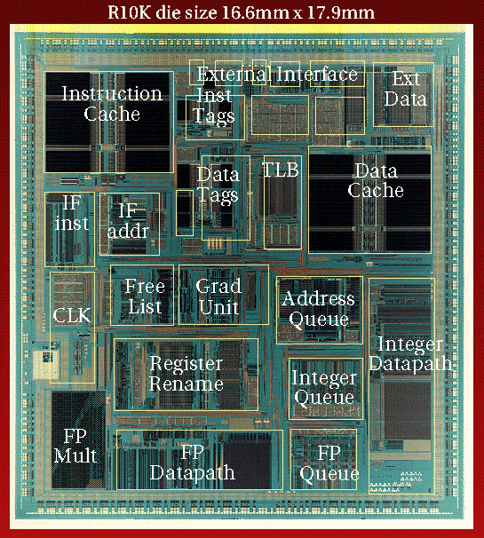
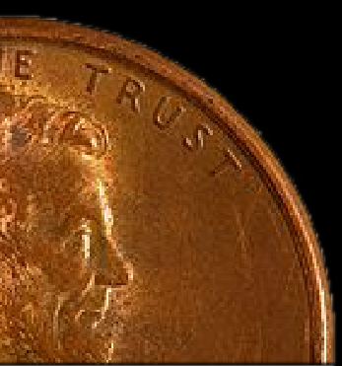
R10K Die

Slide 21
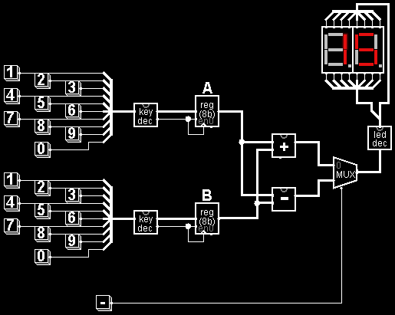
A Simple Calculator

Slide 22
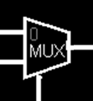
A Simpler Component
1-bit Multiplexor
P
R
P
Q
S
R
Q
S

Slide 23

Logic and States
Computation
E.g. Multiplexor
Transistors
P
R
Gates
E.g. AND
Q
S
P
State
E.g. Register
R
Q
D
Q
Clk
WE

Slide 24
Why?

Slide 25
Example 1: Performance
void A() {
for (int i = 0; i < 4096; i++)
for (int j = 0; j < 4096; j++)
v[i][j] = f(v[i][j], i, j);
}
void B() {
for (int j = 0; j < 4096; j++)
for (int i = 0; i < 4096; i++)
v[i][j] = f(v[i][j], i, j);
}
0.45 sec, (0.12 sec optimized)
4.05 sec (3.52 sec optimized)

Slide 26
Example 2: Moore's Law
The number of transistors integrated on a single die will double every 24 months...
– Gordon Moore, Intel co-founder, 1965
1971 – 2300 transistors – 1MHz – 4004
1990 – 1M transistors – 50MHz – i486
2001 – 42M transistors – 2GHz – Xeon
2004 – 55M transistors – 3GHz – P4
2007 – 290M transistors – 3GHz – Core 2 Duo
2009 – 731M transistors – 2GHz – Nehalem
Notes:
Complexity is *the* issue.

Slide 27
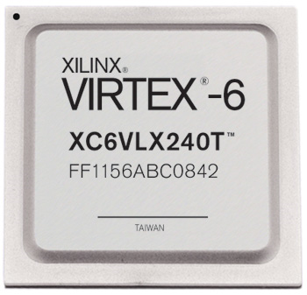
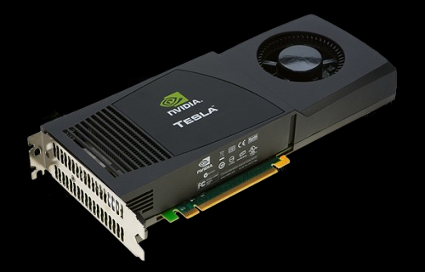

Example 3: New Devices
Xilinx FPGA
Berkeley mote
NVidia GPU

Slide 28
Why?
Why?
  Basic knowledge needed for all other areas of CS:
    operating systems, compilers, ...
  Levels are not independent
    hardware design ↔ software design ↔ performance
  Crossing boundaries is hard but important
    device drivers
  Good design techniques
    abstraction, layering, pipelining, parallel vs. serial, ...
  Understand where the world is going

Slide 29
Administration: OH, Sections
http://www.cs.cornell.edu/courses/cs3410
  Office Hours / Consulting Hours
  Lecture slides & schedule
  Logisim
  CSUG lab access (esp. second half of course)
Sections (choose one):
T 2:55 – 4:10pm Hollister 110
W 3:35 – 4:50pm Hollister 320
R 11:40 – 12:55pm Hollister 401
R 2:55 – 4:10pm Hollister 401
F 2:55 – 4:10pm Snee 1150
  Will cover new material
  This week: intro to logisim

Slide 30
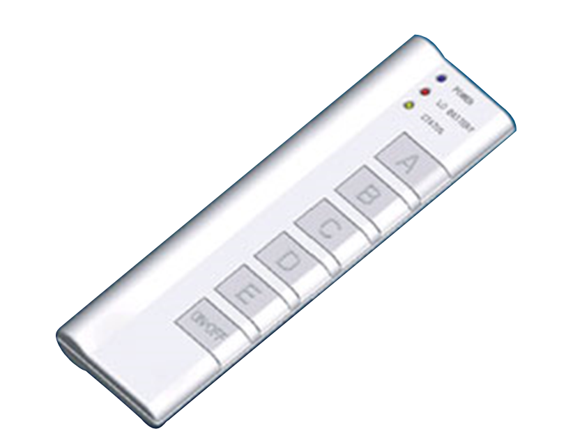
Administration: Clickers
Love it
Okay
What?
Whatever
Please don’t

Slide 31
Administration: Grading
Grading:
  4 Programming Assignments (35 – 45%)
    Work in groups of two
  2 Prelims (30 – 40%)
  4-5 Homework Assignments (20 – 25%)
    Work alone
  Discretionary (5%)

Slide 32
Administration: Academic Integrity
Academic Integrity:
  All submitted work must be your own (or your groups)
    OK to study together, but do not share solutions
  Cite your sources
  Stressed? Tempted? Lost?
  Come see me before due date!
Plagiarism in any form will not be tolerated

