Slide 1
Sec 01: Logisim

Slide 2
Why Logisim?
Most real-world hardware design is done using a text-based hardware description language – VHDL, AHDL, etc.
Schematics can be "compiled" into a text description
Can use a simulator to test the circuit
Other back-end tools optimize, perform layout and wire routing, floorplan, etc.
Final spec is either downloaded onto a programmable device, or etched into silicon
We will be using Logisim for all hardware design
interactive, graphical schematic editor
educational use mainly (makes it user-friendly)

Slide 3
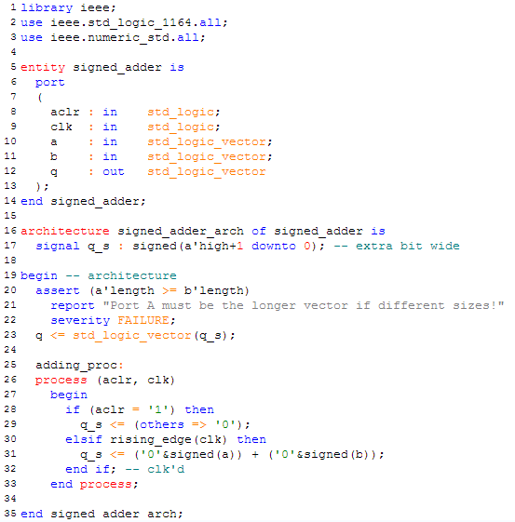
VHDL Example: Signed Adder

Slide 4
Why Logisim?
Most real-world hardware design is done using a text-based hardware description language – VHDL, AHDL, etc.
Schematics can be "compiled" into a text description
Can use a simulator to test the circuit
Other back-end tools optimize, perform layout and wire routing, floorplan, etc.
Final spec is either downloaded onto a programmable device, or etched into silicon
We will be using Logisim for all hardware design
interactive, graphical schematic editor
educational use mainly (makes it user-friendly)

Slide 5
What are we going to talk about?
Using Logisim:
pins and subcircuits
probes for debugging
bundles/splitters (with labels!)
logging
test vectors
Example Circuits: 1-bit & 32-bit 2:1 Mux
Using Subcircuits: 2:1 Mux and Controller
Logging & Test Vectors
Logisim Don’ts

Slide 6
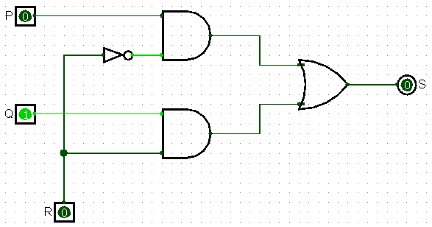
Example Circuit: 1-bit 2:1 Mux
S = P if R == 0
S = Q if R == 1

Slide 7
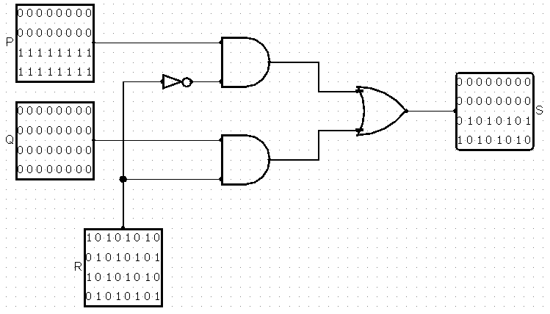
Example Circuit: 32-bit 2:1 Mux

Slide 8
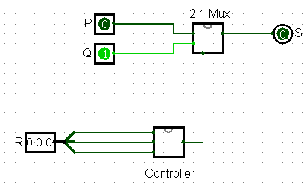
Using Subcircuits: 2:1 Mux and Controller
S = Q if R == 010
S = P otherwise

Slide 9
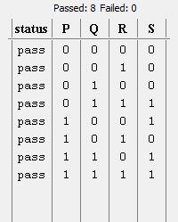
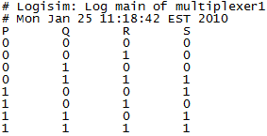
Logging & Test Vectors
Test Vector Truth Table
Log File

Slide 10
Logisim Don’ts

Slide 11
Logisim Don’ts

Slide 12
Logisim Don’ts

Slide 13
Logisim Don’ts

Slide 14
Logisim Don’ts

Slide 15
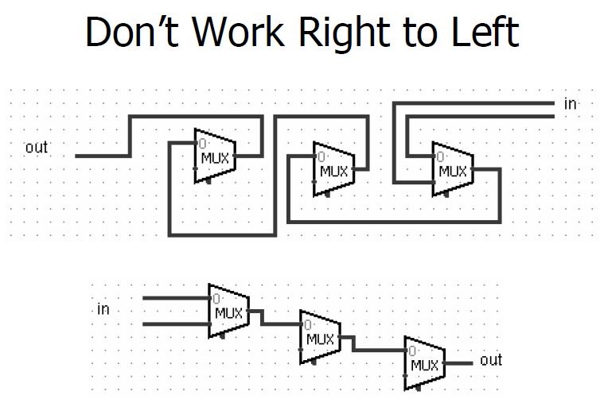
Logisim Don’ts

Slide 16
Some more information
MIPS Assignments:
32-bit ALU
32-bit Processor
32-bit Pipelined Processor
Webpage: http://www.cs.cornell.edu/courses/cs3410/2010sp/

