Slide 1
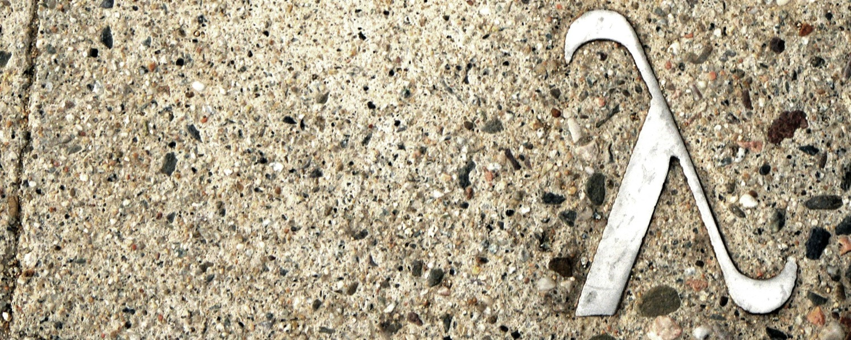

Data Structures and
Functional Programming
Computability
http://www.flickr.com/photos/rofi/2097239111/
Ramin Zabih
Cornell University
Fall 2012

Slide 2
What have we covered?
Tools for solving difficult computational problems
  Abstraction, specification, design
  Functional programming
  Concurrency
  Reasoning about programs
  Data structures and algorithms

Slide 3
Computer science vs programming
There are over 100x as many computer programmers as computer scientists
  What is the difference?
There are programs that exist, and programs that do not but clearly could
  Ukrainian spell checker for Android
Computer programmers write such programs
  Always clear such a program exists
  Not trivial to write within resource constraints
    Programmer time, budget, running time & space, …

Slide 4
When do computer scientists program?
Programs whose existence is not at all clear
  Make a car that drives itself?
  Distinguish pictures of cats from dogs?
  Find broken bones in x-ray images?
  Synthesize pictures that look real?
Sometimes (often) we fail
  “If you aren’t occasionally failing, then you are working on problems that are too easy.”
Maybe the problem is fundamentally hard
  No one could have solved it!
  Correct compression algorithm?

Slide 5
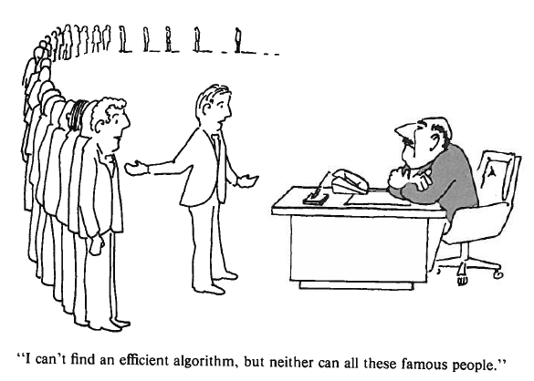
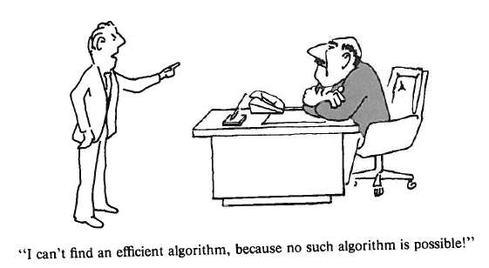
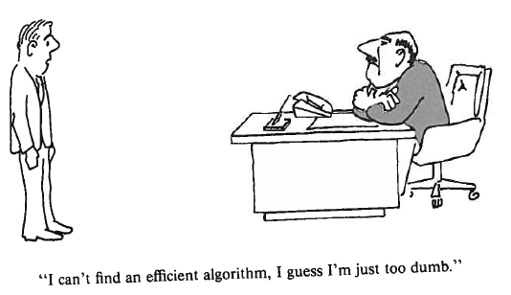
Different excuses for failure
Garey & Johnson, Computers and Intractability

Slide 6
Set sizes
Two sets A and B are the same size if there is an exact pairing between them.
There is a set R of pairs (a b) such that:
  every element of A occurs on the left-hand side of exactly one pair in R and
  every element of B occurs on the right-hand side of exactly one pair in R.
Example: the sets {0,1,2} and {2,4,6} are the same size because we can pair them up as follows: (0 2), (1 4), (2 6).
This definition goes for infinite sets as well.

Slide 7
Countable sets
A set is countable if it is the same size as the natural numbers N = {0,1,2,…}.
Countable sets are all the same size א₀
This is the smallest infinite size
Not all infinite sets are this size!
There are larger infinities (how many?)
If a set is countable we can list out its elements, starting with the zero-th, first, second, etc.
For example, Z is countable: we pair n with 2n, and –n with 2n+1

Slide 8
Countable sets (2)
N is a subset of Z, but they are the same size??
Welcome to the confusing world of the infinite!
The even numbers are a subset of N
But also countable: pair up n with 2n
The rational numbers are countable also
1/1 1/2 1/3 1/4 1/5
2/1 2/2 2/3 2/4 2/5
3/1 3/2 3/3 3/4 3/5
4/1 4/2 4/3 4/4 4/5
5/1 5/2 5/3 5/4 5/5
Diagonal zigzag, skipping duplicates

Slide 9
There are countably many programs
In OCaml, or any other language (or all)
  A program is a finite string
  We can number these: first is “a”, second is “b”, etc.
Not all of these are legal programs
But all legal programs are on the list!
So far it looks like everything is countable
In fact, any set whose elements are finite is countable!
If you can write down an element without risking taking forever, the set is guaranteed to be countable

Slide 10
Real numbers are uncountable
The real numbers in [0,1) are not countable
The discoverer (Cantor) went to the asylum
Think of a real number as a function from N to {0,1,…,9}, where f(m) is the m^{th} digit
Example: π-3 = f, f(0)=1, f(1)=4, f(2)=1, f(3)=5
But functions from N to {0,1,…,9} are not countable!
Consider the simpler case of functions from N to {0,1}, i.e. binary representation of a real
Let’s write these functions down in order, starting with the first, and find a contradiction

Slide 11
Real numbers are uncountable (2)
Call the first function f0, then f1, etc. Will write output as #f/#t for convenience
inputs
0 1 2 3 4 5 6 7 8 9 ...
------------------------------
f0 | #f #t #f #t #f #t #f #t #f #t ...
f1 | #f #f #t #t #f #t #f #t #f #f ...
f2 | #t #f #t #f #t #f #t #f #t #f ...
f3 | #f #f #f #f #t #f #f #f #f #f ...
f4 | #f #t #f #f #t #t #t #f #f #t ...
But we can easily create a function not on this table by diagonalization
One of the all-time best ideas, applied by Cantor, Godel, Russell, Turing

Slide 12
Some uncountable sets
The following sets are all the same size:
Boolean valued functions of 1 argument
Infinite binary strings
Real numbers in [0,1)
Paths in the infinite complete binary tree (0 = go left, 1 = go right)
Subsets of N
There are uncountably infinitely many of each of these!

Slide 13
Back from math to programs
Easy to write programs from integers to bool
  Examples: prime, even, perfect, etc.
But there are countably many programs and uncountably many such functions
So there must be some function that we cannot write a program for
In fact, almost all such functions cannot be written, in any programming language
Similarly, almost all real numbers have no finite description
  “Almost all” means a set of measure 0

Slide 14
An uncomputable programming task
Does a function of one argument run forever on a given input?
  halts(f,a) is true or false depending on f(a)
Such a function is impossible in any programming language
We’ll prove it in a generic language (not OCaml)
Consider a new boolean-valued function safely
Check to see if your argument halts on itself
Note that this always returns true or false
safely(g) = if halts(g,g) then not(g(g)) else false
What is the boolean value of safely(safely)?

Slide 15
Uncomputable functions
The halting problem is uncomputable
  No matter the language or programmer!
  More broadly, the only way you can figure out what a program does is to run it
Enormous real-world consequences
App store
Microsoft plug-ins
Viruses
Computer security
Etc, etc.

Slide 16
Turing equivalence
Computer scientists tend to say that all programming languages are equivalent
This isn’t quite true, there are actually some useful “weak” languages
There is a precise way to say this using Turing equivalence
See CS3810, taught by John Hopcroft
One of Cornell’s Turing Award winners

Slide 17
When is a problem uncomputable?
This is actually extremely difficult, but there are some good rules
Any non-trivial property of a program is uncomputable (Rice’s theorem)
Anything you can solve with exhaustive search is obviously computable
Small differences in problem formulation can change a computable problem into an uncomputable one!
Here are some cool example problems

Slide 18
A children’s game
We are given blocks with symbols such as a,b,c. Each block has a top and a bottom.
There are certain types of blocks, such as a block with “ab” above “bc”. We have as many blocks of each type as we want.
Can we find a series of blocks so that the top and bottoms symbols are the same?

Slide 19
Game examples

Slide 20
Can we solve the children’s game?
For a binary alphabet (example 1) this is decidable
For an alphabet with 7 characters or more it is undecidable!
For an alphabet with 3 characters (example 2) it is an open question
What if we can use no more than k blocks, including copies, in our solution?
It’s decidable but you can’t do better than exhaustive search!

Slide 21
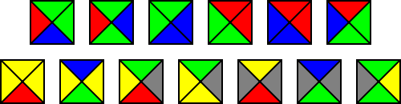
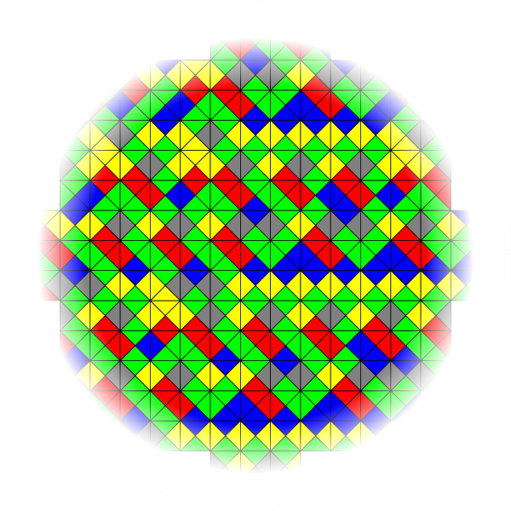
Tiling the plane

Slide 22
Final CS3110 example: hashing
Problem: given a hash function from bit strings to bit strings (no size limits), does this function have two inputs that produce the same output, i.e. a collision?
Reduction: if we could solve this we could solve the halting problem. Here’s how, care of Bobby Kleinberg:
Consider this hash function
1. Let n denote the length of the input string, x.
2. Run program P for at most n steps.
3. If P halts before step n, output 0.
4. Else, output x.
If P halts, this hashes all but finitely many strings to 0, so lots of collisions. If P does not halt, no collisions (identity function).
So if we could determine that this hash function has collisions, we would know if P halts!

Slide 23
What have we learned?
Smart ways to write big programs
Fundamental algorithms and data structures
Parallel programming
Thursday night at 11:59PM will never be the same!

Slide 24
THANK YOU
(See you at the final!)

