Slide 1
GRAPHS
Lecture 17
CS 2110 — Spring 2019

Slide 2
JavaHyperText Topics
“Graphs”, topics 1-3
1: Graph definitions
2: Graph terminology
3: Graph representations

Slide 3
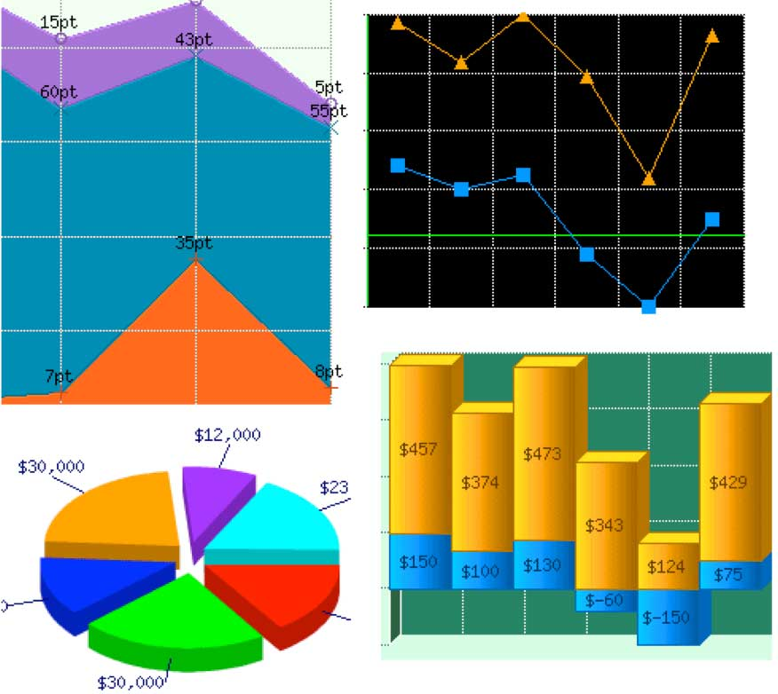
Charts (aka graphs)

Slide 4
Graphs
Graph:
[charts] Points connected by curves
[in CS] Vertices connected by edges
Graphs generalize trees
Graphs are relevant far beyond CS…examples…
5
4
2
7
8
9

Slide 5
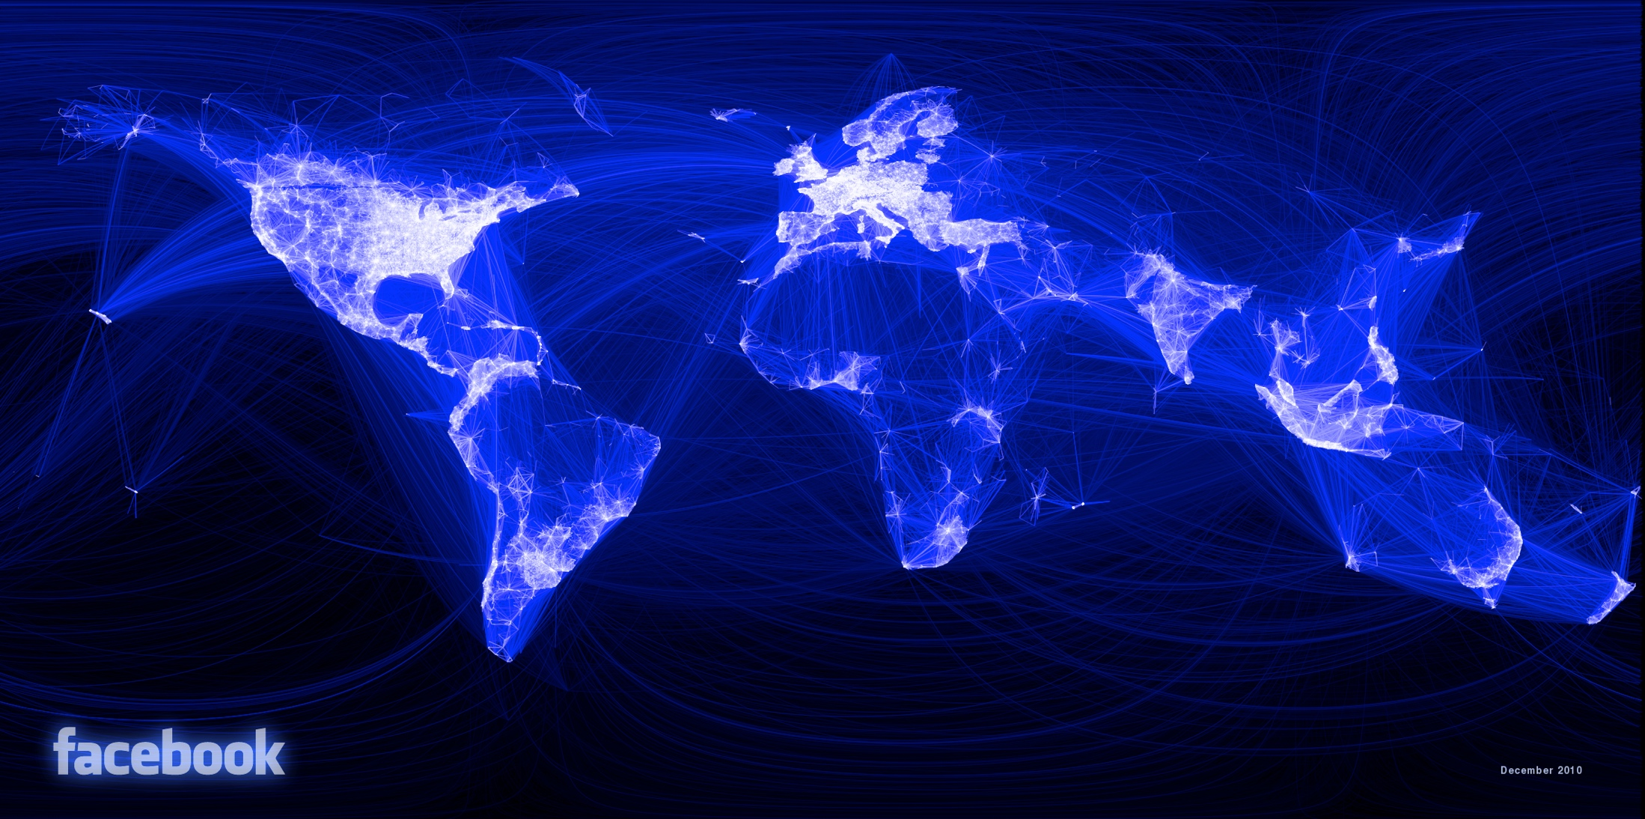
Vertices: people “from”
Edges: friendships
https://medium.com/@johnrobb/facebook-the-complete-social-graph-b58157ee6594

Slide 6
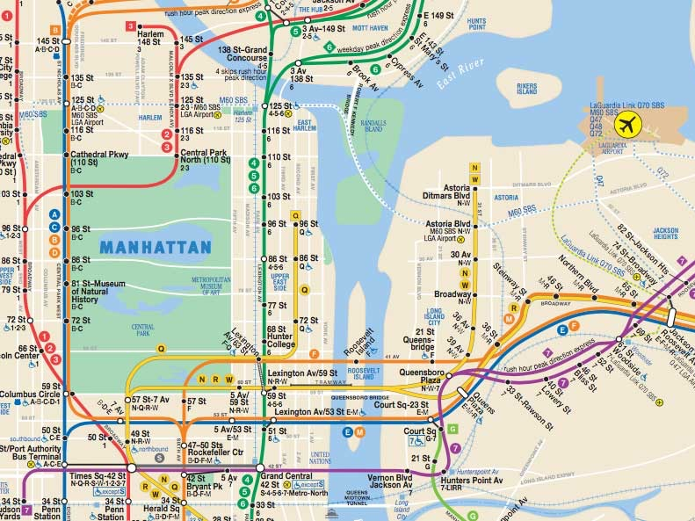
Vertices: subway stops
Edges: railways

Slide 7
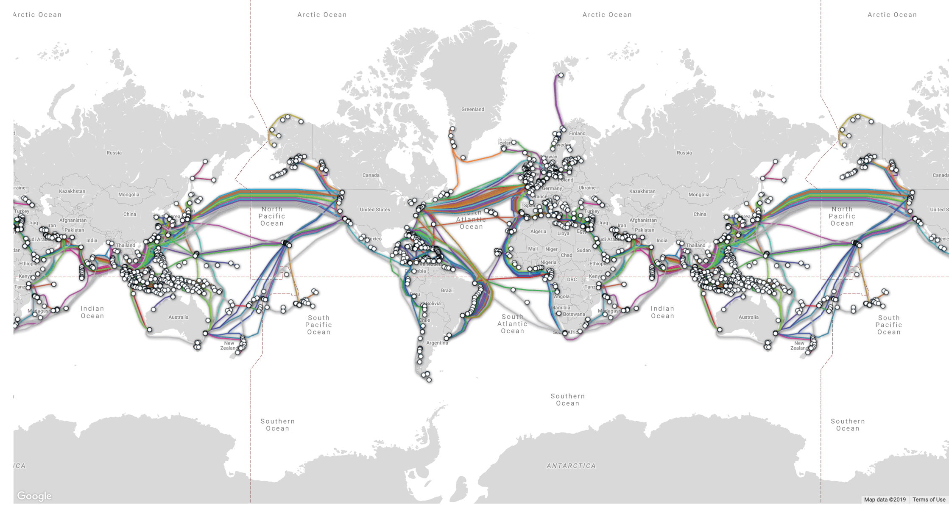
Vertices: stations
Edges: cables
https://www.submarinecablemap.com/
Notes:
Submarine fibre optic cables carry 99% of international data. Source: https://www.newsweek.com/undersea-cables-transport-99-percent-international-communications-319072

Slide 8
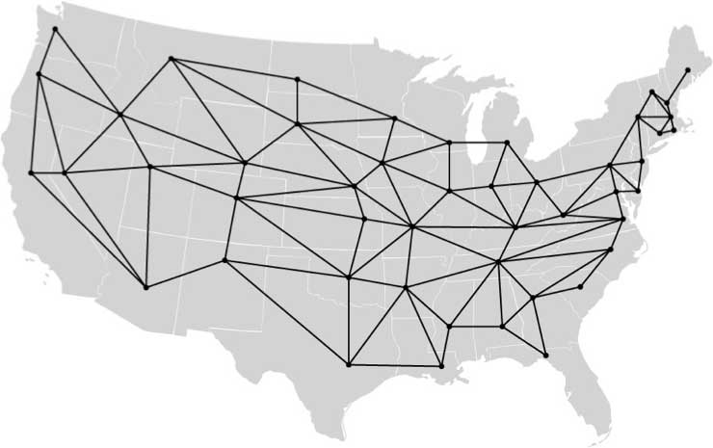
Vertices: State capitals
Edges: “States have shared border”
http://www.cs.cmu.edu/~bryant/boolean/maps.html

Slide 9
Graphs as mathematical structures

Slide 10
Undirected graphs
An undirected graph is a pair (V, E) where
V is a set
Element of V is called a vertex or node
We’ll consider only finite graphs
Ex: V = {A, B, C, D, E}; |V| = 5
E is a set
Element of E is called an edge or arc
An edge is itself a two-element set {u, v} where {u, v} ⊆ V
Often require u ≠ v (i.e., no self-loops)
Ex: E = {{A, B}, {A, C}, {B, C}, {C, D}}, |E| = 4
A
B
C
E
D

Slide 11
Directed graphs
A directed graph is similar except the edges are pairs (u, v), hence order matters
A
B
C
V = {A, B, C, D, E}
E = {(A, C), (B, A), (B, C), (C, D), (D, C)}
|V| = 5
|E| = 5
E
D

Slide 12
Convert undirected ←→ directed?
Right question is: convert and maintain which properties of graph?
Convert undirected to directed and maintain paths?
Notes:
Any path from A to B in undirected graph would be reversible to a path from B to A, which does not exist in original graph

Slide 13
Paths
A path is a sequence v₀,v₁,v₂,...,v_{p} of vertices such that for 0 ≤ i < p,
Directed: (v_{i}, v_{i+1}) ∈ E
Undirected: {v_{i}, v_{i+1}} ∈ E
The length of a path is its number of edges
A
Path: A,C,D
B
C
E
D

Slide 14
Convert undirected ←→ directed?
Right question is: convert and maintain which properties of graph?
Convert undirected to directed and maintain paths:
Nodes unchanged
Replace each edge {u,v} with two edges {(u,v), (v,u)}
Convert directed to undirected and maintain paths: Can’t:
A
B
Notes:
Any path from A to B in undirected graph would be reversible to a path from B to A, which does not exist in original graph

Slide 15
Labels
Whether directed or undirected, edges and vertices can be labeled with additional data
A
2
5
Nodes already labeled with characters
1
Edges now labeled with integers
B
C
1
-3
E
D

Slide 16
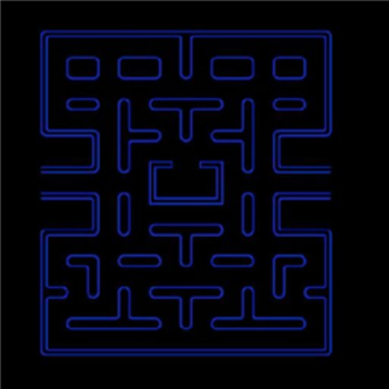
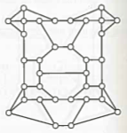
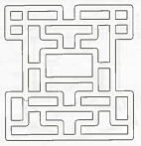
Discuss
How could you represent a maze as a graph?
Algorithms, 2nd ed., Sedgewick, 1988
Notes:
Vertex for each point where there is more than one path to take
Edges connect according to paths between those points

Slide 17
Announcement
A4: See time distribution and comments @735
Spending >16 hours is a problem; talk to us or a TA about why that might be happening
Comments on the GUI:
“GUI was pretty awesome.”
“I didn't see the relevance of the GUI.”
Hints:
“Hints were extremely useful and I would've been lost without them.”
“Hints are too helpful. You should leave more for people to figure out on their own.”
Adjectives:
“Fun” (x30), “Cool” (x19)
“Whack”, “Stressful”, “Tedious”, “Rough”

Slide 18
Graphs as data structures

Slide 19
Graph ADT
Operations could include:
Add a vertex
Remove a vertex
Search for a vertex
Number of vertices
Add an edge
Remove an edge
Search for an edge
Number of edges
Demo
Notes:
You aren’t going to find a standard Graph ADT in the Java library. Usually these are custom-built for the graphs you want to represent. Much like trees.

Slide 20
Graph representations
Two vertices are adjacent if they are connected by an edge
Common graph representations:
Adjacency list
Adjacency matrix
1
2
3
4
running example
(directed, no edge labels)

Slide 21
Adjacency “list”
Maintain a collection of the vertices
For each vertex, also maintain a collection of its adjacent vertices
Vertices: 1, 2, 3, 4
Adjacencies:
1: 2, 3
2: 4
3: 2, 4
4: none
1
2
3
4
Could implement these “lists” in many ways…

Slide 22
Adjacency list implementation #1
Map from vertex label to sets of vertex labels
1 ↦ {2, 3}
2 ↦ {4}
3 ↦ {2, 4}
4 ↦ {none}
1
2
3
4
Notes:
Recall, no order implied on sets or in map

Slide 23
Adjacency list implementation #2
Linked list, where each node contains vertex label and linked list of adjacent vertex labels
1
2
3
1
2
2
4
3
4
3
2
4
4
Demo
Notes:
Definitely an order now

Slide 24
Adjacency list implementation #3
Array, where each element contains linked list of adjacent vertex labels
0
1
2
1
2
3
2
4
3
2
4
3
4
4
Requires: labels are integers; dealing with bounded number of vertices
Notes:
Definitely an order now

Slide 25
Adjacency “matrix”
Given integer labels and bounded # of vertices…
Maintain a 2D Boolean array b
Invariant: element b[i][j] is true iff there is an edge from vertex i to vertex j
 | 0 | 1 | 2 | 3 | 4
0 | F | F | F | F | F
1 | F | F | T | T | F
2 | F | F | F | F | T
3 | F | F | T | F | T
4 | F | F | F | F | F
1
2
3
4

Slide 26
Adjacency list vs. Adjacency matrix
 | 0 | 1 | 2 | 3 | 4
0 | F | F | F | F | F
1 | F | F | T | T | F
2 | F | F | F | F | T
3 | F | F | T | F | T
4 | F | F | F | F | F
1
2
3
2
4
3
2
4
4
Efficiency: Space to store?
O(|V| + |E|)
O(|V|²)

Slide 27
Adjacency list vs. Adjacency matrix
 | 0 | 1 | 2 | 3 | 4
0 | F | F | F | F | F
1 | F | F | T | T | F
2 | F | F | F | F | T
3 | F | F | T | F | T
4 | F | F | F | F | F
1
2
3
2
4
3
2
4
4
Efficiency: Time to visit all edges?
O(|V| + |E|)
O(|V|²)

Slide 28
Adjacency list vs. Adjacency matrix
 | 0 | 1 | 2 | 3 | 4
0 | F | F | F | F | F
1 | F | F | T | T | F
2 | F | F | F | F | T
3 | F | F | T | F | T
4 | F | F | F | F | F
1
2
3
2
4
3
2
4
4
Efficiency: Time to determine whether edge from v₁ to v₂ exists?
O(|V| + |E|)
O(1)
Tighter: O(|V| + # edges leaving v₁)

Slide 29
More graph terminology
Vertices u and v are called
the source and sink of the directed edge (u, v), respectively
the endpoints of (u, v) or {u, v}
The outdegree of a vertex u in a directed graph is the number of edges for which u is the source
The indegree of a vertex v in a directed graph is the number of edges for which v is the sink
The degree of a vertex u in an undirected graph is the number of edges of which u is an endpoint
A
1
2
C
B
E
D
A
2
B
C
0
E
D

Slide 30
Adjacency list vs. Adjacency matrix
 | 0 | 1 | 2 | 3 | 4
0 | F | F | F | F | F
1 | F | F | T | T | F
2 | F | F | F | F | T
3 | F | F | T | F | T
4 | F | F | F | F | F
1
2
3
2
4
3
2
4
4
Efficiency: Time to determine whether edge from v₁ to v₂ exists?
O(|V| + |E|)
O(1)
Tighter: O(|V| + outdegree(v₁))

Slide 31
Adjacency list vs. Adjacency matrix
List | Property | Matrix
O(|V| + |E|) | Space | O(|V|²)
O(|V| + |E|) | Time to visit all edges | O(|V|²)
O(|V| + od(v₁)) | Time to find edge (v₁,v₂) | O(1)

Slide 32
Adjacency list vs. Adjacency matrix
List | Property | Matrix
O(|V| + |E|) | Space | O(|V|²)
O(|V| + |E|) | Time to visit all edges | O(|V|²)
O(|V| + od(v₁)) | Time to find edge (v₁,v₂) | O(1)
Max # edges = |V|²
Sparse
Dense

Slide 33
Adjacency list vs. Adjacency matrix
List | Property | Matrix
O(|V| + |E|) | Space | O(|V|²)
O(|V| + |E|) | Time to visit all edges | O(|V|²)
O(|V| + od(v₁)) | Time to find edge (v₁,v₂) | O(1)
Max # edges = |V|²
Sparse: |E| ≪ |V|²
Dense: |E| ≈ |V|²

Slide 34
Adjacency list vs. Adjacency matrix
List | Property | Matrix
O(|V| + |E|) | Space | O(|V|²)
O(|V| + |E|) | Time to visit all edges | O(|V|²)
O(|V| + od(v₁)) | Time to find edge (v₁,v₂) | O(1)
Sparse graphs | Better for | Dense graphs
Max # edges = |V|²
Sparse: |E| ≪ |V|²
Dense: |E| ≈ |V|²

