Slide 1
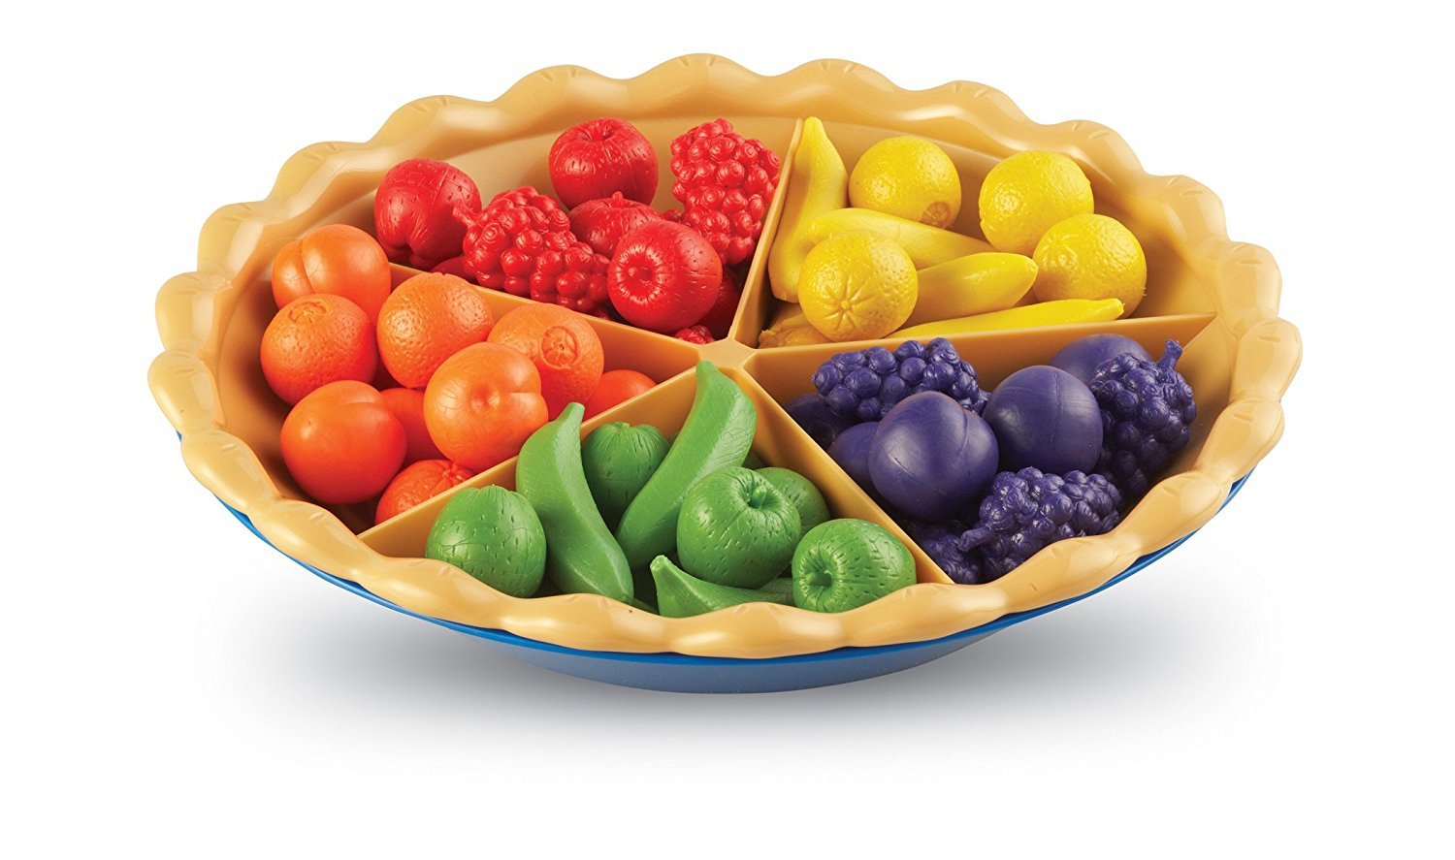
Sorting
"Organizing is what you do before you do something, so that when you do it, it is not all mixed up."
~ A. A. Milne
Lecture 11
CS2110 – Fall 2017

Slide 2
Prelim 1
It's on Tuesday Evening (3/13)
Two Sessions:
5:30-7:00PM: netid aa..ks
7:30-9:00PM: netid kt..zz
If you have a conflict with your assigned time but can make the other time, fill out conflict assignment on CMS BY TOMORROW
Three Rooms:
We will email you Tuesday morning with your room
Bring your Cornell ID!!!

Slide 3
Prelim 1
Recitation 5: prelim review
Review Session: Sunday 3/11, 1-3pm in Kimball B11
Study guide on course website

Slide 4
Why Sorting?
Sorting is useful
Database indexing
Operations research
Compression
There are lots of ways to sort
There isn't one right answer
You need to be able to figure out the options and decide which one is right for your application.
Today, we'll learn about several different algorithms (and how to derive them)

Slide 5
Some Sorting Algorithms
Insertion sort
Selection sort
Merge sort
Quick sort

Slide 6
InsertionSort
0 b.length
0 b.length
b
?
b
sorted
pre:
post:
0 i b.length
A loop that processes elements of an array in increasing order has this invariant
b
sorted ?
inv:
or: b[0..i-1] is sorted

Slide 7
Each iteration, i= i+1; How to keep inv true?
0 i b.length
inv:
b
sorted ?
0 i b.length
e.g.
b
2 5 5 5 7 3 ?
0 i b.length
b
2 3 5 5 5 7 ?

Slide 8
What to do in each iteration?
8
0 i b.length
inv:
b
sorted ?
0 i b.length
e.g.
b
2 5 5 5 7 3 ?
2 5 5 5 3 7 ?
Push b[i] to its sorted position in b[0..i], then increase i
Loop body
(inv true before and after)
2 5 5 3 5 7 ?
2 5 3 5 5 7 ?
2 3 5 5 5 7 ?
0 i b.length
This will take time proportional to the number of swaps needed
b
2 3 5 5 5 7 ?

Slide 9
Insertion Sort
// sort b[], an array of int
// inv: b[0..i-1] is sorted
for (int i= 0; i < b.length; i= i+1) {
// Push b[i] down to its sorted // position in b[0..i]
}
Note English statement in body.
Abstraction. Says what to do, not how.
This is the best way to present it. We expect you to present it this way when asked.
Later, can show how to implement that with an inner loop
Present algorithm like this

Slide 10
Insertion Sort
// sort b[], an array of int
// inv: b[0..i-1] is sorted
for (int i= 0; i < b.length; i= i+1) {
// Push b[i] down to its sorted // position in b[0..i]
}
invariant P: b[0..i] is sorted
except that b[k] may be < b[k-1]
k
i
2 5 3 5 5 7 ?
example
int k= i;
start?
while (k > 0 && b[k] < b[k-1]) {
}
Swap b[k] and b[k-1]
stop?
k= k–1;
progress?
maintain invariant?

Slide 11
Insertion Sort
// sort b[], an array of int
// inv: b[0..i-1] is sorted
for (int i= 0; i < b.length; i= i+1) {
// Push b[i] down to its sorted
// position in b[0..i]}
Let n = b.length
Worst-case: O(n²)
(reverse-sorted input)
Best-case: O(n) (sorted input)
Expected case: O(n²)
Pushing b[i] down can take i swaps. Worst case takes
1 + 2 + 3 + … n-1 = (n-1)*n/2
Swaps.

Slide 12
Performance
Algorithm | Time | Space | Stable?
Insertion Sort | $O(n)$ to $O(n^{2})$ | $$O(1)$$ | Yes
Merge Sort
Quick Sort
Algorithm | Time | Space | Stable?
Insertion Sort | $O(n)$ to $O(n^{2})$ | $$O(1)$$ | Yes
Selection Sort | $$O(n^{2})$$ | $$O(1)$$ | No
Merge Sort
Quick Sort

Slide 13
SelectionSort
0 b.length
0 b.length
pre:
b
?
b
sorted
post:
0 i b.length
b
, <= b[i..] >= b[0..i-1]
inv:
sorted
Additional term in invariant
Keep invariant true while making progress?
0 i b.length
e.g.:
b
1 2 3 4 5 6 9 9 9 7 8 6 9
Increasing i by 1 keeps inv true only if b[i] is min of b[i..]

Slide 14
SelectionSort
//sort b[], an array of int
// inv: b[0..i-1] sorted AND
// b[0..i-1] <= b[i..]
for (int i= 0; i < b.length; i= i+1) {
int m= index of minimum of b[i..];
Swap b[i] and b[m];
}
Another common way for people to sort cards
Runtime with n = b.length
Worst-case O(n²)
Best-case O(n²)
Expected-case O(n²)
0 i length
b
sorted, smaller values larger values
Each iteration, swap min value of this section into b[i]

Slide 15
Performance
Algorithm | Time | Space | Stable?
Insertion Sort | $O(n)$ to $O(n^{2})$ | $$O(1)$$ | Yes
Selection Sort | $$O(n^{2})$$ | $$O(1)$$ | No
Merge Sort
Quick Sort

Slide 16
Merge two adjacent sorted segments
/* Sort b[h..k]. Precondition: b[h..t] and b[t+1..k] are sorted. */
public static merge(int[] b, int h, int t, int k) {
}
h t k
h t k
b
4 7 7 8 9 3 4 7 8
sorted sorted
h k
b
3 4 4 7 7 7 8 8 9
merged, sorted

Slide 17
Merge two adjacent sorted segments
/* Sort b[h..k]. Precondition: b[h..t] and b[t+1..k] are sorted. */
public static merge(int[] b, int h, int t, int k) {
Copy b[h..t] into a new array c;
Merge c and b[t+1..k] into b[h..k];
}
h t k
sorted sorted
h k
merged, sorted

Slide 18
Merge two adjacent sorted segments
// Merge sorted c and b[t+1..k] into b[h..k]
h t k
0 t-h
pre:
c
x
b
? y
x, y are sorted
h k
post: b
x and y, sorted
0 i c.length
invariant:
c
head of x tail of x
h u v k
b
tail of y
?
head of x and head of y, sorted

Slide 19
Merge
int i = 0;
int u = h;
int v = t+1;
while( i <= t-h){
if(v < k && b[v] < c[i]) {
b[u] = b[v];
u++; v++;
}else {
b[u] = c[i];
u++; i++;
}
}
}
0 t-h
h t k
pre:
c
sorted
b
? sorted
x, y are sorted
h k
post: b
sorted
inv:
0 i c.length
c
sorted sorted
h u v k
b
sorted
sorted ?

Slide 20
Mergesort
/** Sort b[h..k] */
public static void mergesort(int[] b, int h, int k]) {
if (size b[h..k] < 2)
return;
int t= (h+k)/2;
mergesort(b, h, t);
mergesort(b, t+1, k);
merge(b, h, t, k);
}
h t k
sorted
sorted
h k
merged, sorted

Slide 21
Performance
Algorithm | Time | Space | Stable?
Insertion Sort | $O(n)$ to $O(n^{2})$ | $$O(1)$$ | Yes
Merge Sort | $$n log⁡(n)$$ | $$O(n)$$ | Yes
Quick Sort
Algorithm | Time | Space | Stable?
Insertion Sort | $O(n)$ to $O(n^{2})$ | $$O(1)$$ | Yes
Selection Sort | $$O(n^{2})$$ | $$O(1)$$ | No
Merge Sort | $$n log⁡(n)$$ | $$O(n)$$ | Yes
Quick Sort

Slide 22
QuickSort
Quicksort developed by Sir Tony Hoare (he was knighted by the Queen of England for his contributions to education and CS).
83 years old.
Developed Quicksort in 1958. But he could not explain it to his colleague, so he gave up on it.
Later, he saw a draft of the new language Algol 58 (which became Algol 60). It had recursive procedures. First time in a procedural programming language. “Ah!,” he said. “I know how to write it better now.” 15 minutes later, his colleague also understood it.

Slide 23
Partition algorithm of quicksort
Swap array values around until b[h..k] looks like this:
h h+1 k
x is called the pivot
pre:
x ?
h j k
post:
<= x x >= x

Slide 24
Partition algorithm of quicksort
20 31 24 19 45 56 4 20 5 72 14 99
partition
pivot
j
19 4 5 14 20 31 24 45 56 20 72 99
Not yet sorted
Not yet sorted
these can be in any order
these can be in any order
The 20 could be in the other partition

Slide 25
Partition algorithm
h h+1 k
pre:
b
x ?
h j k
post:
b
<= x x >= x
invariant needs at least 4 sections
Combine pre and post to get an invariant
h j t k
b
<= x x ? >= x

Slide 26
Partition algorithm
h j t k
b
<= x x ? >= x
Initially, with j = h and t = k, this diagram looks like the start diagram
j= h; t= k;
while (j < t) {
if (b[j+1] <= b[j]) {
Swap b[j+1] and b[j]; j= j+1;
} else {
Swap b[j+1] and b[t]; t= t-1;
}
}
Terminate when j = t, so the “?” segment is empty, so diagram looks like result diagram
Takes linear time: O(k+1-h)

Slide 27
QuickSort procedure
/** Sort b[h..k]. */
public static void QS(int[] b, int h, int k) {
if (b[h..k] has < 2 elements) return;
Base case
int j= partition(b, h, k);
// We know b[h..j–1] <= b[j] <= b[j+1..k]
}
// Sort b[h..j-1] and b[j+1..k]
Function does the partition algorithm and returns position j of pivot
QS(b, h, j-1);
QS(b, j+1, k);
h j k
<= x x >= x

Slide 28
Worst case quicksort: pivot always smallest value
j n
x0 >= x0
partioning at depth 0
j
x0 x1 >= x1
partioning at depth 1
j
x0 x1 x2 >= x2
partioning at depth 2
Depth of recursion: O(n)
Processing at depth i: O(n-i)
O(n*n)
/** Sort b[h..k]. */
public static void QS(int[] b, int h, int k) {
if (b[h..k] has < 2 elements) return;
int j= partition(b, h, k);
QS(b, h, j-1); QS(b, j+1, k);

Slide 29
Best case quicksort: pivot always middle value
0 j n
depth 0. 1 segment of size ~n to partition.
<= x0 x0 >= x0
<=x1 x1 >= x1 x0 <=x2 x2 >=x2
Depth 2. 2 segments of size ~n/2 to partition.
Depth 3. 4 segments of size ~n/4 to partition.
Max depth: O(log n). Time to partition on each level: O(n)
Total time: O(n log n).
Average time for Quicksort: n log n. Difficult calculation

Slide 30
QuickSort complexity to sort array of length n
Time complexity
Worst-case: O(n*n)
Average-case: O(n log n)
/** Sort b[h..k]. */
public static void QS(int[] b, int h, int k) {
if (b[h..k] has < 2 elements) return;
int j= partition(b, h, k);
// We know b[h..j–1] <= b[j] <= b[j+1..k]
// Sort b[h..j-1] and b[j+1..k]
QS(b, h, j-1);
QS(b, j+1, k);
}
Worst-case space: ?
What’s depth of recursion?
Worst-case space: O(n)!
--depth of recursion can be n
Can rewrite it to have space O(log n)
Show this at end of lecture if we have time

Slide 31
QuickSort versus MergeSort
31
/** Sort b[h..k] */
public static void QS
(int[] b, int h, int k) {
if (k – h < 1) return;
int j= partition(b, h, k);
QS(b, h, j-1);
QS(b, j+1, k);
}
/** Sort b[h..k] */
public static void MS
(int[] b, int h, int k) {
if (k – h < 1) return;
MS(b, h, (h+k)/2);
MS(b, (h+k)/2 + 1, k);
merge(b, h, (h+k)/2, k);
}
One processes the array then recurses.
One recurses then processes the array.

Slide 32
Partition. Key issue. How to choose pivot
h h k
pre:
b
x ?
Choosing pivot
Ideal pivot: the median, since it splits array in half
But computing is O(n), quite complicated
h j k
post:
b
<= x x >= x
Popular heuristics: Use
first array value (not so good)
middle array value (not so good)
Choose a random element (not so good)
median of first, middle, last, values (often used)!

Slide 33
Performance
Algorithm | Time | Space | Stable?
Insertion Sort | $O(n)$ to $O(n^{2})$ | $$O(1)$$ | Yes
Selection Sort | $$O(n^{2})$$ | $$O(1)$$ | No
Merge Sort | $$n log⁡(n)$$ | $$O(n)$$ | Yes
Quick Sort | $n\log{(n)}$ to $O(n^{2})$ | $$O(\log\left(n\right))$$ | No

Slide 34
Sorting in Java
Java.util.Arrays has a method Sort()
implemented as a collection of overloaded methods
for primitives, Sort is implemented with a version of quicksort
for Objects that implement Comparable, Sort is implemented with mergesort
Tradeoff between speed/space and stability/performance guarantees

Slide 35
Quicksort with logarithmic space
Problem is that if the pivot value is always the smallest (or always the largest), the depth of recursion is the size of the array to sort.
Eliminate this problem by doing some of it iteratively and some recursively. We may show you this later. Not today!

Slide 36
QuickSort with logarithmic space
/** Sort b[h..k]. */
public static void QS(int[] b, int h, int k) {
int h1= h; int k1= k;
// invariant b[h..k] is sorted if b[h1..k1] is sorted
while (b[h1..k1] has more than 1 element) {
Reduce the size of b[h1..k1], keeping inv true
}
}

Slide 37
QuickSort with logarithmic space
/** Sort b[h..k]. */
public static void QS(int[] b, int h, int k) {
int h1= h; int k1= k;
// invariant b[h..k] is sorted if b[h1..k1] is sorted
while (b[h1..k1] has more than 1 element) {
int j= partition(b, h1, k1);
// b[h1..j-1] <= b[j] <= b[j+1..k1]
if (b[h1..j-1] smaller than b[j+1..k1])
{ QS(b, h, j-1); h1= j+1; }
else
{QS(b, j+1, k1); k1= j-1; }
}
}
Only the smaller segment is sorted recursively. If b[h1..k1] has size n, the smaller segment has size < n/2.
Therefore, depth of recursion is at most log n

