Slide 1
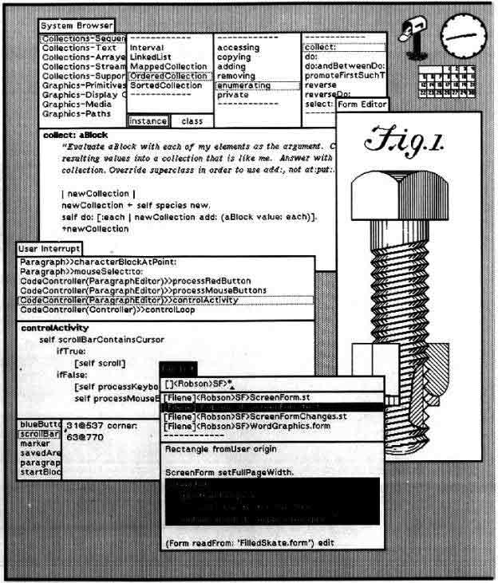
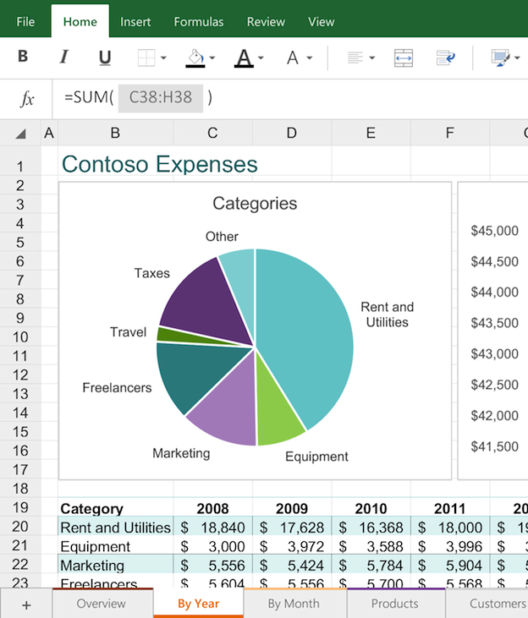
Graphical User Interfaces
CS 2110 Spring 2015

Slide 2
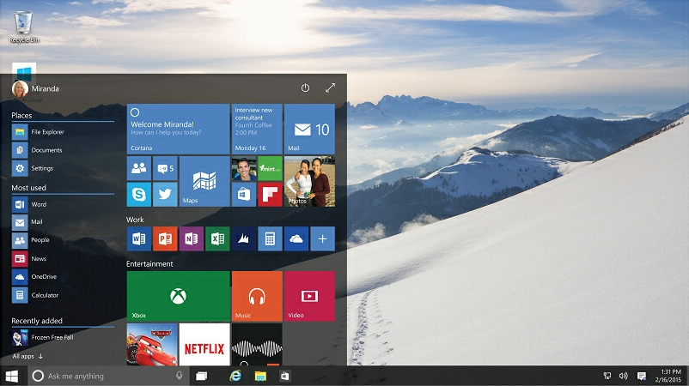
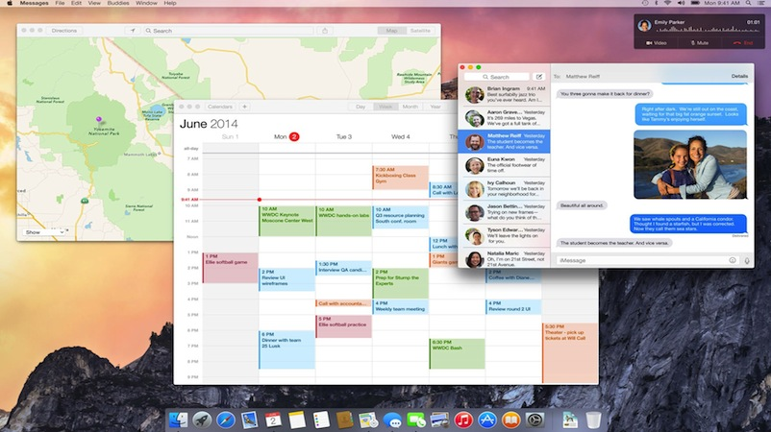
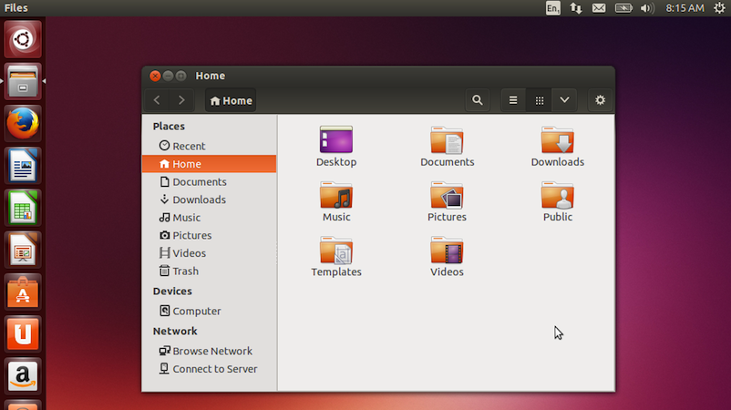
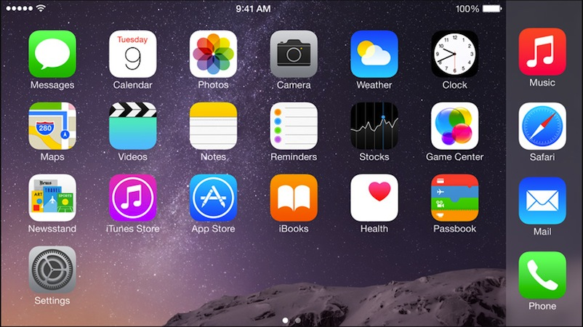

Slide 3
Ivan Sutherland: “Sketchpad”, https://youtu.be/57wj8diYpgY

Slide 4
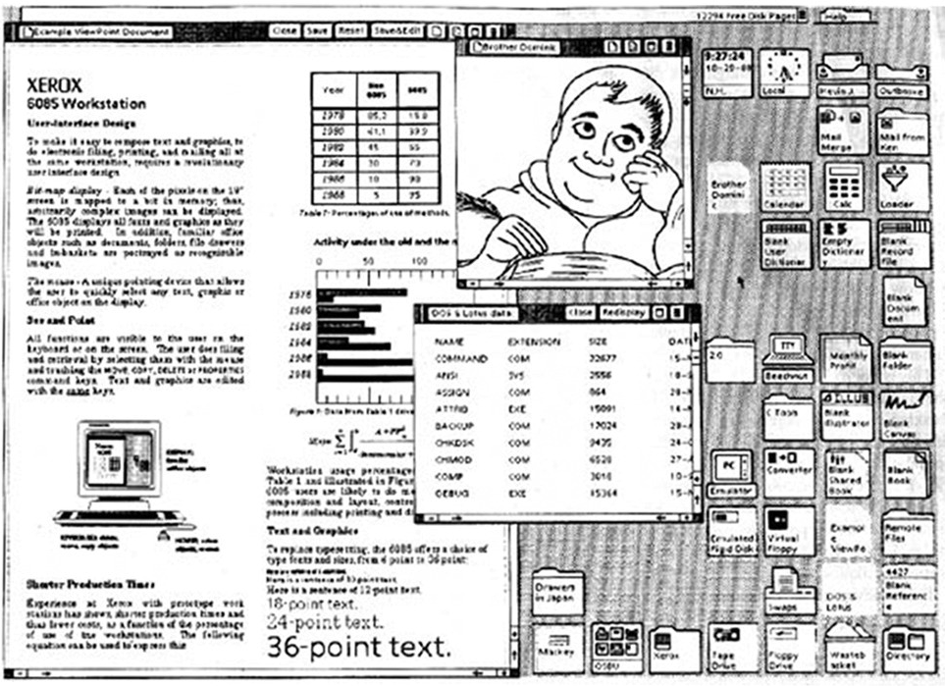
The Xerox Star GUI, 1981

Slide 5
Xerox and Apple
“Steve was working on a new secret project… and [we] were asked to go over to Xerox PARC and take a look at a new computer. We weren't told why.”
“We got a demonstration of the Star, which had a graphical user interface, a laser printer, and a mouse.”
“Xerox had done research to find out what the best input system for a computer was… After ten PhD-years of research they had concluded that the mouse was the best input device.”
Jim Sachs on Apple Lisa, the first commercial computer with a GUI ($10k in 1982)

Slide 6
Microsoft Research: “Room Alive”, https://youtu.be/ILb5ExBzHqw

Slide 7
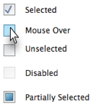
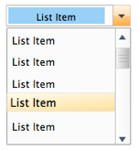
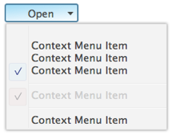
GUIs consist of Components/Widgets

Slide 8
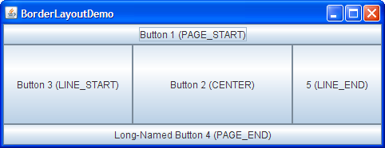
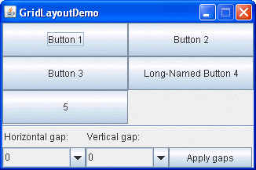
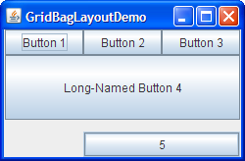
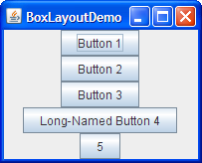
Components are arranged in Layouts
BorderLayout
GridLayout
GridBagLayout
FlowLayout
BoxLayout

Slide 9
Components communicate via Events
Events

Slide 10
GUI
Provides a friendly interface between user and program
Allows event-driven or reactive programming: The program reacts to events such as button clicks, mouse movement, keyboard input
Often is multi-threaded: Different threads of execution can be going on simultaneously

Slide 11
GUI
Java provides two standard packages for making GUIs
AWT (Abstract or Awful Window Toolkit) – original one (import java.awt.*)
Swing – newer one, which builds on AWT as much as possible (import javax.swing.*)
Two aspects to making a GUI:
Placing components (buttons, text…) TODAY
Listening/responding to events Next Lecture

Slide 12
Class JFrame
JFrame object: associated with a window on your monitor.
Generally, a GUI is a JFrame object with various components placed in it
Some methods in a JFrame object
hide() show() setVisible(boolean)
getX() getY() (coordinates of top-left point)
getWidth() getHeight() setLocation(int, int)
getTitle() setTitle(String)
getLocation() setLocation(int, int)
Over 100 methods in a JFrame object!
Class JFrame is in package javax.swing

Slide 13
Placing components in a JFrame
Layout manager: Instance controls placement of components.
JFrame layout manager default: BorderLayout.
BorderLayout layout manager: Can place 5 components:
public class C extends JFrame {
public C() {
Container cp= getContentPane();
JButton jb= new JButton(“Click here”);
JLabel jl= new JLabel(“label 2”);
cp.add(jb, BorderLayout.EAST);
cp.add(jl, BorderLayout.WEST);
pack();
setVisible(true);
}
North
West
Center
East
South
JFrameDemo.java

Slide 14
Placing components in a JFrame
import java.awt.*; import javax.swing.*;
/** Demonstrate placement of components in a JFrame.
Places five components in 5 possible areas:
(1) a JButton in the east, (2) a JLabel in the west,
(3) a JLabel in the south, (4) a JTextField in the north
(5) a JTextArea in the center. */
public class ComponentExample extends JFrame {
/** Constructor: a window with title t and 5 components */
public ComponentExample(String t) {
super(t);
Container cp= getContentPane();
cp.add(new JButton(“click me”), BorderLayout.EAST);
cp.add(new JTextField(“type here”, 22), BorderLayout.NORTH);
cp.add(new JCheckBox("I got up today"), BorderLayout.SOUTH);
cp.add(new JLabel(“still winter”), BorderLayout.WEST);
cp.add(new JTextArea("type\nhere", 4, 10), BorderLayout.CENTER);
pack();
}
Add components to its contentPane
ComponentExample.java

Slide 15
Packages – Components
Packages that contain classes that deal with GUIs: java.awt: Old package. javax.swing: New package. javax.swing has a better way of listening to buttons, text fields, etc. Components are more flexible.
JButton, Button: Clickable button JLabel, Label: Line of text JTextField, TextField: Field into which the user can type JTextArea, TextArea: Many-row field into which user can type JPanel, Panel: Used for graphics; to contain other components JCheckBox: Checkable box with a title JComboBox: Menu of items, one of which can be checked JRadioButton: Similar functionality as JCheckBox Container: Can contain other components Box: Can contain other components
Jxxxx: in Swing, with xxxx in awt
Component: Something that can be placed in a GUI window. They are instances of certain classes, e.g.

Slide 16
Hierarchy of Basic Components
Component
Button, Canvas
Checkbox, Choice
Label, List, Scrollbar
TextComponent
TextField, TextArea
Container
JComponent
AbstractButton
JButton
JToggleButton
JCheckBox
RadioButton
JLabel, JList
JOptionPane, JPanel
JPopupMenu, JScrollBar, JSlider
JTextComponent
JTextField, JTextArea
Component: Something that can be placed in a GUI window. These are the basic ones used in Java GUIs
Note the use of subclasses to provide structure and efficiency. For example, there are two kinds of JToggleButtons, so that class has two subclasses.

Slide 17
Components that can contain other components
java.awt is the old GUI package.
javax.swing is the new GUI package. When they wanted to use an old name, they put J in front of it.
(e.g. Frame and JFrame)
Component
Box
Container
JComponent
JPanel
Panel
Applet
Window
Frame
JFrame
JWindow
When constructing javax.swing, the attempt was made to rely on the old package as much as possible.
So, JFrame is a subclass of Frame.
But they couldn’t do this with JPanel.

Slide 18
JPanel: a container
import java.awt.*; import javax.swing.*;
/** Instance has labels in east /west, JPanel with four buttons in center. */
public class PanelDemo extends JFrame {
JPanel p= new JPanel();
/** Constructor: a frame with title "Panel demo", labels in east/west,
blank label in south, JPanel of 4 buttons in the center */
public PanelDemo() {
super("Panel demo");
p.add(new JButton("0")); p.add(new JButton("1"));
p.add(new JButton("2")); p.add(new JButton("3"));
Container cp= getContentPane();
cp.add(new JLabel("east"), BorderLayout.EAST);
cp.add(new JLabel("west"), BorderLayout.WEST);
cp.add(new JLabel(" "), BorderLayout.SOUTH);
cp.add(p, BorderLayout.CENTER);
pack();
}
}
JPanel layout manager default: FlowLayout.
FlowLayout layout manager: Place any number of components. They appear in the order added, taking as many rows as necessary.

Slide 19
Box: a container
import javax.swing.*; import java.awt.*;
/** Demo class Box. Comment on constructor says how frame is laid out. */
public class BoxDemo extends JFrame {
/** Constructor: frame with title "Box demo", labels in the east/west,
blank label in south, horizontal Box with 4 buttons in center. */
public BoxDemo() {
super("Box demo");
Box b= new Box(BoxLayout.X_AXIS);
b.add(new JButton("0")); b.add(new JButton("1"));
b.add(new JButton("2")); b.add(new JButton("3"));
Container cp= getContentPane();
cp.add(new JLabel("east"), BorderLayout.EAST);
cp.add(new JLabel("west"), BorderLayout.WEST);
cp.add(new JLabel(" "), BorderLayout.SOUTH);
cp.add(b, BorderLayout.CENTER);
pack();
}
}
Box layout manager default: BoxLayout.
BoxLayout layout manager: Place any number of components. They appear in the order added, taking only one row.

Slide 20
Boxes within a Box 3 vertical boxes, each a column of buttons, are placed in a horizontal box
public class BoxDemo2 extends JFrame {
/** Constructor: frame with title t and 3 columns with n, n+1, and n+2 buttons. */
public BoxDemo2(String t, int n) {
super(t);
// Create Box b1 with n buttons.
Box b1= new Box(BoxLayout.Y_AXIS);
for (int i= 0; i != n; i= i+1)
b1.add(new JButton(“i ” + i));
// Create Box b2 with n+1 buttons.
Box b2= …
// Create Box b3 with n+2 buttons.
Box b3= …
// Create horizontal box b containing b1, b2, b3
Box b= new Box(BoxLayout.X_AXIS);
b.add(b1);
b.add(b2);
b.add(b3);
Container cp= getContentPane();
cp.add(b, BorderLayout.CENTER);
pack(); show();
}
}
BoxLayout layout manager: Place any number of components. They appear in the order added, taking only one row.

Slide 21
Simulate BoxLayout Manager in a JFrame
To simulate using a BoxLayout manager for a JFrame, create a Box and place it as the sole component of the Jframe:
JFrame jf= new JFrame(“title”);
Box b= new Box(BoxLayout.X_AXIS);
Add components to b;
jf.add(b, BorderLayout.CENTER);
Start developing a GUI by changing an already existing one. A lot of details. Hard to get all details right when one starts from scratch and has little idea about the Java GUI package
Showed how to place components in a GUI. Next time: how to “listen” to things like button clicks in a GUI
There are usually 5 different ways to achieve the same thing. Some are more elegant/efficient than others
To debug layouts, add borders to containers: c.setBorder(BorderFactory.createLineBorder(Color.black));

