Slide 1
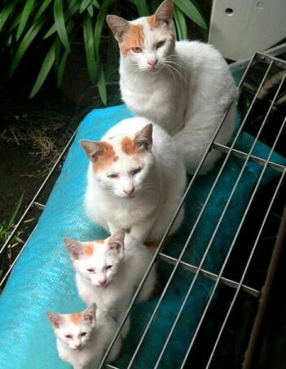
Recursion
Lecture 6
CS2110 – Fall 2013

Slide 2
Overview references to sections in text
Note: We’ve covered everything in JavaSummary.pptx!
What is recursion? 7.1-7.39 slide 1-7
Base case 7.1-7.10 slide 13
How Java stack frames work 7.8-7.10 slide 28-32
Homework. Copy our “sum the digits” method but comment out the base case. Now run it: what happens in Eclipse?
Now restore the base case. Use Eclipse in debug mode and put a break statement on the “return” of the base case. Examine the stack and look at arguments to each level of the recursive call.

Slide 3
Recursion
Arises in two forms in computer science
Recursion as a mathematical tool for defining a function in terms of itself in a simpler case
Recursion as a programming tool. You’ve seen this previously but we’ll take it to mind-bending extremes (by the end of the class it will seem easy!)
Mathematical induction is used to prove that a recursive function works correctly. This requires a good, precise function specification.
See this in a later lecture.

Slide 4
Recursion as a math technique
Broadly, recursion is a powerful technique for defining functions, sets, and programs
A few recursively-defined functions and programs
factorial
combinations
exponentiation (raising to an integer power)
Some recursively-defined sets
grammars
expressions
data structures (lists, trees, ...)

Slide 5
Example: Sum the digits in a number
/** return sum of digits in n.
* Precondition: n >= 0 */
public static int sum(int n) {
if (n < 10) return n;
// { n has at least two digits }
// return first digit + sum of rest
return n%10 + sum(n/10);
}
sum calls itself!
E.g. sum(87012) = 2+(1+(0+(7+8))) = 18

Slide 6
Example: Is a string a palindrome?
/** = "s is a palindrome" */
public static boolean isPal(String s) {
if (s.length() <= 1)
return true;
// { s has at least 2 chars }
int n= s.length()-1;
return s.charAt(0) == s.charAt(n) && isPal(s.substring(1, n));
}
Substring from s[1] to s[n-1]
r | a | c | e | c | a | r
isPal(“racecar”) = true
isPal(“pumpkin”) = false
a | c | e | c | a
c | e | c
e

Slide 7
Example: Count the e’s in a string
/** = number of times c occurs in s */
public static int countEm(char c, String s) {
if (s.length() == 0) return 0;
// { s has at least 1 character }
if (s.charAt(0) != c)
return countEm(c, s.substring(1));
// { first character of s is c}
return 1 + countEm (c, s.substring(1));
}
Substring s[1..], i.e. s[1], …, s(s.length()-1)
countEm(‘e’, “it is easy to see that this has many e’s”) = 4
countEm(‘e’, “Mississippi”) = 0

Slide 8
Example: The Factorial Function (n!)
Define n! = n·(n−1)·(n−2)···3·2·1 read: “n factorial”
E.g. 3! = 3·2·1 = 6
Looking at definition, can see that n! = n * (n-1)!
By convention, 0! = 1
The function int → int that gives n! on input n is called the factorial function

Slide 9
A Recursive Program
0! = 1
n! = n·(n−1)!, n > 0
/** = n!. Precondition: n >= 0 */
static int fact(int n) {
if (n = = 0)
return 1;
// { n > 0 }
return n*fact(n-1);
}

Slide 10
General Approach to Writing Recursive Functions
Find base case(s) – small values of n for which you can just write down the solution (e.g. 0! = 1)
Try to find a parameter, say n, such that the solution for n can be obtained by combining solutions to the same problem using smaller values of n (e.g. (n-1) in our factorial example)
Verify that, for any valid value of n, applying the reduction of step 1 repeatedly will ultimately hit one of the base cases

Slide 11
Example: Tower of Hanoi
Legend has it that there were three diamond needles set into the floor of the temple of Brahma in Hanoi.
Stacked upon the leftmost needle were 64 golden disks, each a different size, stacked in concentric order:

Slide 12
A Legend
The priests were to transfer the disks from the first needle to the second needle, using the third as necessary.
But they could only move one disk at a time, and could never put a larger disk on top of a smaller one.
When they completed this task, the world would end!

Slide 13
To Illustrate
For simplicity, suppose there were just 3 disks, and we’ll refer to the three needles as A, B, and C...
Since we can only move one disk at a time, we move the top disk from A to B.

Slide 14
Example
For simplicity, suppose there were just 3 disks, and we’ll refer to the three needles as A, B, and C...
We then move the top disk from A to C.

Slide 15
Example (Ct’d)
For simplicity, suppose there were just 3 disks, and we’ll refer to the three needles as A, B, and C...
We then move the top disk from B to C.

Slide 16
Example (Ct’d)
For simplicity, suppose there were just 3 disks, and we’ll refer to the three needles as A, B, and C...
We then move the top disk from A to B.

Slide 17
Example (Ct’d)
For simplicity, suppose there were just 3 disks, and we’ll refer to the three needles as A, B, and C...
We then move the top disk from C to A.

Slide 18
Example (Ct’d)
For simplicity, suppose there were just 3 disks, and we’ll refer to the three needles as A, B, and C...
We then move the top disk from C to B.

Slide 19
Example (Ct’d)
For simplicity, suppose there were just 3 disks, and we’ll refer to the three needles as A, B, and C...
We then move the top disk from A to B.

Slide 20
Example (Ct’d)
For simplicity, suppose there were just 3 disks, and we’ll refer to the three needles as A, B, and C...
and we’re done!
The problem gets more difficult as the number of disks increases...

Slide 21
Our Problem
Today’s problem is to write a program that generates the instructions for the priests to follow in moving the disks.
While quite difficult to solve iteratively, this problem has a simple and elegant recursive solution.

Slide 22
General Approach to Writing Recursive Functions
Find base case(s) – small values of n for which you can just write down the solution (e.g. 0! = 1)
Try to find a parameter, say n, such that the solution for n can be obtained by combining solutions to the same problem using smaller values of n (e.g. (n-1) in our factorial example)
Verify that, for any valid value of n, applying the reduction of step 1 repeatedly will ultimately hit one of the base cases

Slide 23
Design
Basis: What is an instance of the problem that is trivial?
→ n == 1
Since this base case could occur when the disk is on any needle, we simply output the instruction to move the top disk from A to B.

Slide 24
Design
Basis: What is an instance of the problem that is trivial?
→ n == 1
Since this base case could occur when the disk is on any needle, we simply output the instruction to move the top disk from A to B.

Slide 25
Design (Ct’d)
Induction Step: n > 1
→ How can recursion help us out?
a. Recursively move n-1 disks from A to C.

Slide 26
Design (Ct’d)
Induction Step: n > 1
→ How can recursion help us out?
b. Move the one remaining disk from A to B.

Slide 27
Design (Ct’d)
Induction Step: n > 1
→ How can recursion help us out?
c. Recursively move n-1 disks from C to B...

Slide 28
Design (Ct’d)
Induction Step: n > 1
→ How can recursion help us out?
d. We’re done!

Slide 29
Tower of Hanoi: Code
void Hanoi(int n, string a, string b, string c)
{
if (n == 1) /* base case */
Move(a,b);
else { /* recursion */
Hanoi(n-1,a,c,b);
Move(a,b);
Hanoi(n-1,c,b,a);
}
}

Slide 30
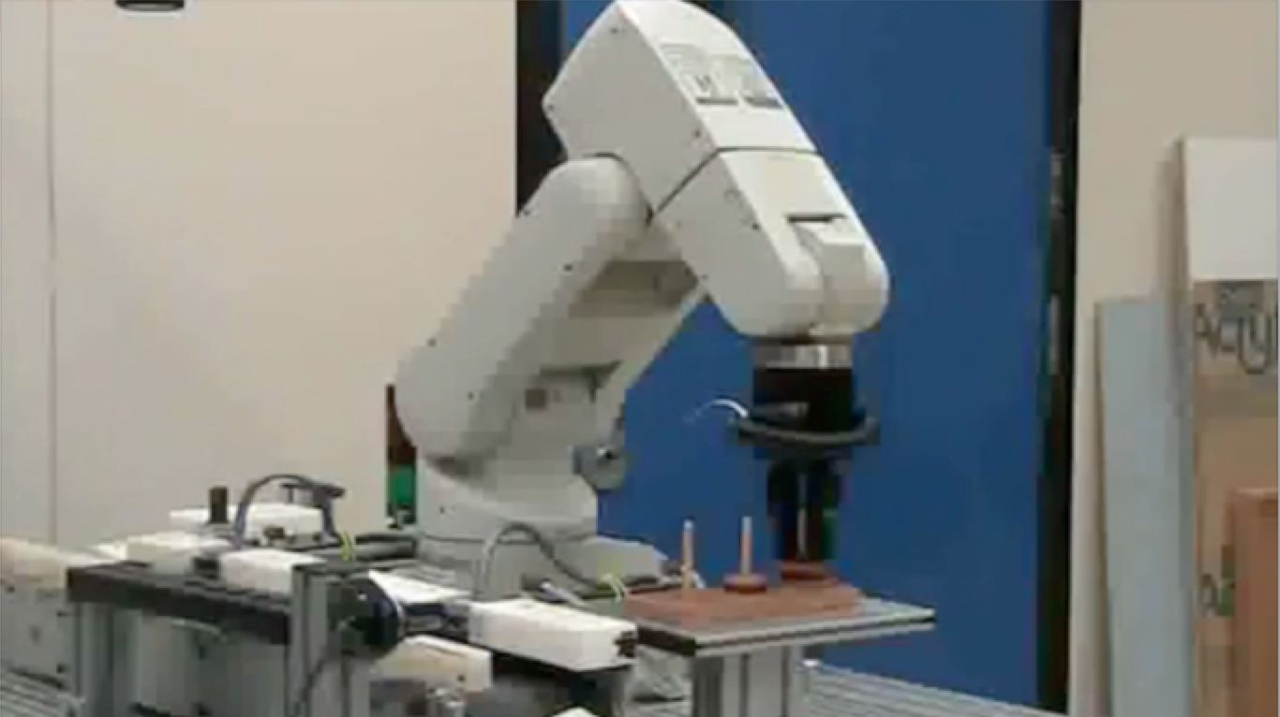
Tower of Hanoi on Robot!

Slide 31
The Fibonacci Function
Mathematical definition:
fib(0) = 0
fib(1) = 1
fib(n) = fib(n − 1) + fib(n − 2), n ≥ 2
Fibonacci sequence: 0, 1, 1, 2, 3, 5, 8, 13, …
two base cases!
Fibonacci (Leonardo Pisano) 1170-1240?
Statue in Pisa, Italy
Giovanni Paganucci
1863
/** = fibonacci(n). Pre: n >= 0 */
static int fib(int n) {
if (n <= 1) return n;
// { 1 < n }
return fib(n-2) + fib(n-1);
}

Slide 32
Recursive Execution
/** = fibonacci(n) …*/
static int fib(int n) {
if (n <= 1) return n;
// { 1 < n }
return fib(n-2) + fib(n-1);
}
Execution of fib(4):
fib(4)
fib(2)
fib(3)
fib(0)
fib(1)
fib(1)
fib(2)
fib(0)
fib(1)

Slide 33
Non-Negative Integer Powers
a^{n} = a·a·a···a (n times)
Alternative description:
a⁰ = 1
a^{n+1} = a·a^{n}
/** = a^{n}. Pre: n >= 0 */
static int power(int a, int n) {
if (n == 0) return 1;
return a*power(a, n-1); }

Slide 34
A Smarter Version
Power computation:
a⁰ = 1
If n is nonzero and even, a^{n} = (a*a)^{n/2}
If n is nonzero, a^{n} = a * a^{n-1}
Java note: For ints x and y, x/y is the integer part of the quotient
Judicious use of the second property makes this a logarithmic algorithm, as we will see
Example: 3⁸ = (3*3) * (3*3) * (3*3) * (3*3) = (3*3) ⁴

Slide 35
Smarter Version in Java
n = 0: a⁰ = 1
n nonzero and even: a^{n} = (a*a)^{n/2}
n nonzero: a^{n} = a·a^{n-1}
/** = a**n. Precondition: n >= 0 */
static int power(int a, int n) {
if (n == 0) return 1;
if (n%2 == 0) return power(a*a, n/2);
return a * power(a, n-1);
}

Slide 36
Build table of multiplications
n | n | mults
0 |  | 0
1 | 2**0 | 1
2 | 2**1 | 2
3 |  | 3
4 | 2**2 | 3
5 |  | 4
6 |  | 4
7 |  | 4
8 | 2**3 | 4
9 |  | 5
…
16 | 2**4 | 5
Start with n = 0, then n = 1, etc. For
each, calculate number of mults based on method body and recursion.
See from the table: For n a power of 2,
n = 2**k, only k+1 = (log n) + 1 mults
For n = 2**15 = 32768, only 16 mults!
static int power(int a, int n) {
if (n == 0) return 1;
if (n%2 == 0) return power (a*a, n/2);
return a * power (a, n-1);
}

Slide 37
How Java “compiles” recursive code
Key idea:
Java uses a stack to remember parameters and local variables across recursive calls
Each method invocation gets its own stack frame
A stack frame contains storage for
Local variables of method
Parameters of method
Return info (return address and return value)
Perhaps other bookkeeping info

Slide 38
Stacks
stack grows
top-of-stack
pointer
top element
2nd element
3rd element
Like a stack of dinner plates
You can push data on top or pop data off the top in a LIFO (last-in-first-out) fashion
A queue is similar, except it is FIFO (first-in-first-out)
...
...
bottom element

Slide 39
Stack Frame
A new stack frame is pushed with each recursive call
The stack frame is popped when the method returns
Leaving a return value (if there is one) on top of the stack
local variables
a stack frame
a, n
parameters
retval
return info

Slide 40
Example: power(2, 5)
(retval = ) 1
(hP = ) ?
(hP = ) 1
(n = ) 1
(n = ) 1
hP: short for halfPower
(a = ) 2
(a = ) 2
return info
return info
(retval = ) 2
(hP = ) ?
(hP = ) ?
(hP = ) ?
(hP = ) 2
(n = ) 2
(n = ) 2
(n = ) 2
(n = ) 2
(a = ) 2
(a = ) 2
(a = ) 2
(a = ) 2
return info
return info
return info
return info
(retval = ) 4
(hP = ) ?
(hP = ) ?
(hP = ) ?
(hP = ) ?
(hP = ) ?
(hP = ) 4
(n = ) 5
(n = ) 5
(n = ) 5
(n = ) 5
(n = ) 5
(n = ) 5
(a = ) 2
(a = ) 2
(a = ) 2
(a = ) 2
(a = ) 2
(a = ) 2
return info
return info
return info
return info
return info
return info
(retval = ) 32

Slide 41
How Do We Keep Track?
Many frames may exist, but computation occurs only in the top frame
The ones below it are waiting for results
The hardware has nice support for this way of implementing function calls, and recursion is just a kind of function call

Slide 42
Conclusion
Recursion is a convenient and powerful way to define functions
Problems that seem insurmountable can often be solved in a “divide-and-conquer” fashion:
Reduce a big problem to smaller problems of the same kind, solve the smaller problems
Recombine the solutions to smaller problems to form solution for big problem
Important application (next lecture): parsing

Slide 43
Extra Slides

Slide 44
A cautionary note
Keep in mind that each instance of the recursive function has its own local variables
Also, remember that “higher” instances are waiting while “lower” instances run
Do not touch global variables from within recursive functions
Legal … but a common source of errors
Must have a really clear mental picture of how recursion is performed to get this right!

Slide 45
Memoization (fancy term for “caching”)
Memoization is an optimization technique used to speed up computer programs by having function calls avoid repeating the calculation of results for previously processed inputs.
First time the function is called, save result
Next times, look up the result
Assumes a “side-effect free” function: The function just computes the result, it doesn’t change things
If the function depends on anything that changes, must “empty” the saved results list

Slide 46
One thing to notice: Fibonacci
This way of computing the Fibonacci function is elegant but inefficient
It “recomputes” answers again and again!
To improve speed, need to save known answers in a table!
One entry per answer
Such a table is called a cache
fib(4)
fib(2)
fib(3)
fib(0)
fib(1)
fib(1)
fib(2)
fib(0)
fib(1)

Slide 47
Adding Memoization to our solution
Before memoization:
static int fib(int n) {
if (n <= 1) return n;
return fib(n-2) + fib(n-1);
}
The list used to memoize
/** For 0 <= k < cached.size(), cached[k] = fib(k) */
static ArrayList<Integer> cached= new ArrayList<Integer>();

Slide 48
After Memoization
/** For 0 <= k < cached.size(), cached[k] = fib(k) */
static ArrayList<Integer> cached= new ArrayList<Integer>();
static int fib(int n) {
if (n < cached.size()) return cached.get(n);
int v;
if (n <= 1)
v= n;
else v= fib(n-2) + fib(n-1);
if (n == cached.size())
cached.add(v);
return v;
}
This works because of definition of cached
This appends v to cached, keeping cached’s definition true

Slide 49
Notice the development process
We started with the idea of recursion
Created a very simple recursive procedure
Noticed it will be slow because it wastefully recomputes the same thing again and again
We made it a bit more complex but gained a lot of speed in doing so
This is a common software engineering pattern

Slide 50
Why did it work?
This cached list “works” because for each value of n, either cached.get(n) is still undefined or has fib(n)
Takes advantage of the fact that an ArrayList adds elements at the end and indexes from 0
cached@BA8900, size=5
0 | 1 | 1 | 2 | 3
cached.get(0) = 0
cached.get(1) = 1
… cached.get(n) = fib(n)
Property of our code: cached.get(n) accessed after fib(n) computed

