Slide 1
CS/ENGRD 2110 Spring 2014
Lecture 4: The class hierarchy; static components
http://courses.cs.cornell.edu/cs2110

Slide 2
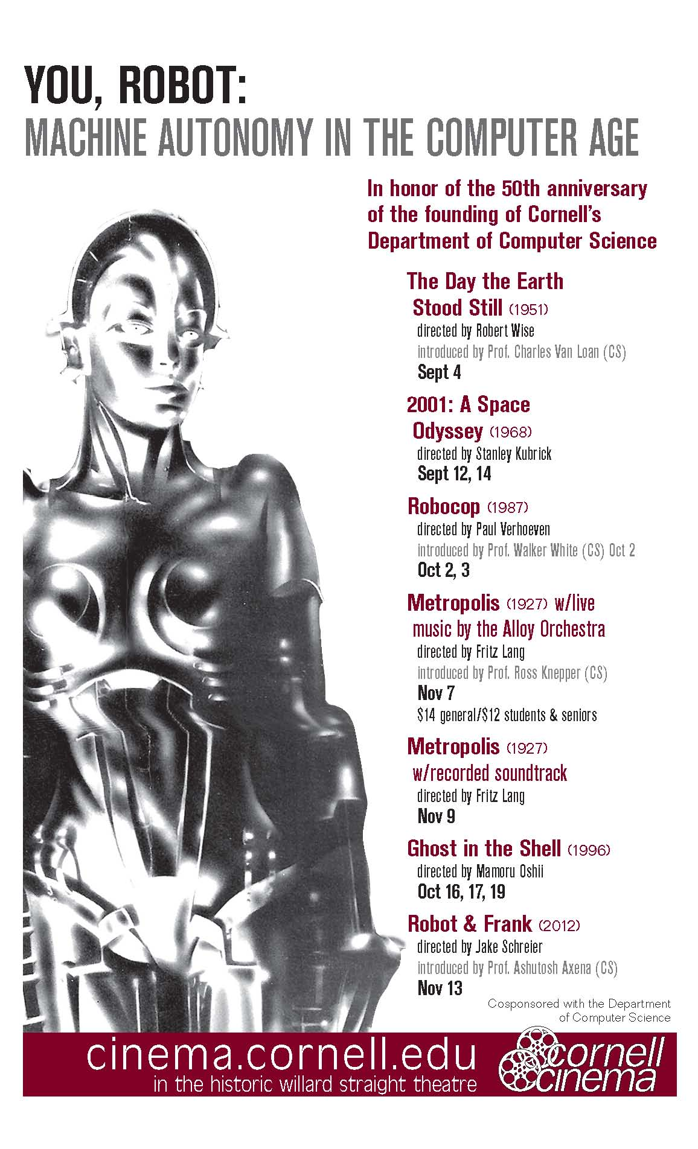
First show is tonight at 7pm!
Klaatu barada nikto

Slide 3
We are recruiting developers for the Fall semester.
We will also be offering a training program for interested, but inexperienced developers that will teach Swift and iOS8.
Info Sessions:
Olin Hall
Room 155
5:00PM
Website: CUAPPDEV.ORG
Email: INFO@CUAPPDEV.ORG

Slide 4
Announcements
A0 will be graded soon —everyone who submitted it gets full credit.
It was simple enough that there is no need for us to check anything.
A1 is due Saturday night.
We will try to get more consultants to be available Saturday
Check the schedule on the course website.
Groups: If you are going to form a group/team of two people, do it BEFORE you submit.
Both members must do something: one invites and the other accepts. Thereafter, only ONE member has to submit the files.
A2: Practice with Strings
Assignment available now on web + CMS
Due on CMS by Friday, 12 September.

Slide 5
References to text and JavaSummary.pptx
A bit about testing and test cases
Class Object, superest class of them all. Text: C.23 slide 30
Function toString() C.24 slide 31-33
Overriding a method C15–C16 slide 31-32
Static components (methods and fields) B.27 slide 21, 45
Java application: a program with a class that declares a method with this signature:
public static void toString(String[])

Slide 6
Homework
Read the text, Appendix A.1–A.3
Read the text, about the if-statement: A.38–A.40
Visit course website, click on Resources and then on Code Style Guidelines. Study
2. Format Conventions
4.5 About then-part and else-part of if-statement

Slide 7
Specifications of boolean functions
/** Return true if this Bee is male and false if not. */
public boolean isMale()
Says same thing. Shorter, no case analysis. Think of it as
return value of sentence
“this Bee is male”
/** Return “this Bee is male”. */
public boolean isMale()
abs(-20)
Do you say, “it returns absolute value of -20?
Of course not. Mathematicians say simply “that’s the absolute value of 60
/** = “this Bee is male”. */
Read as: the call isMale() equals the value of the sentence “this Bee is male”.

Slide 8
A bit about testing
Test case: Set of input values, together with the expected output.
Develop test cases for a method from its specification --- even before you write the methods body.
/** = number of vowels in word w.
Precondition: w contains at least one letter and nothing but letters */
public int numberOfVowels(String w) {
…
}
Developing test cases first, in “critique” mode, can prevent wasted work and errors.
How many vowels in each of these words?
creek
syzygy

Slide 9
Test cases for number of children
s0
w0
L0
Elephant
Elephant
Elephant
name
“Child 2”
name
“Popsi”
name
“Child 1”
mom
j0
pop
w0
mom
pop
b0
mom
null
pop
w0
null
children
0
children
2
children
1
j0
b0
If L0 gets a mom, say j0, the mom’s number of children must increase.
You should test this.
Elephant
Elephant
name
“Mumsie”
name
“Opa”
mom
null
pop
null
mom
null
pop
null
children
1
children
1

Slide 10
Class W (for Worker)
/** Constructor: worker with last name n, SSN s, boss b (null if none).
Prec: n not null, s in 0..999999999 with no leading zeros.*/
public W(String n, int s, W b)
/** = worker's last name */
public String getLname()
/** = last 4 SSN digits */
public String getSsn()
/** = worker's boss (null if none) */
public W getBoss()
/** Set boss to b */
public void setBoss(W b)
W@af
W
lname
“Obama”
ssn
123456789
boss
null
W(…) getLname()
getSsn() getBoss() setBoss(W)
toString()
equals(Object) hashCode()
Contains other methods!

Slide 11
Class Object: the superest class of them all
Java: Every class that does not extend another extends class Object. That is,
public class W {…}
is equivalent to
public class W extends Object {…}
We draw object like this
W@af
Object
toString()
equals(Object) hashCode()
W
lname
“Obama”
ssn
123456789
boss
null
We often leave off this to reduce clutter; we know that it is effectively always there.
W(…) getLname()
getSsn(), getBoss() setBoss(W)

Slide 12
What is “the name of” the object?
The name of the object below is
Elephant@aa11bb24
It contains a pointer to the object –i.e. its address in memory, and you can call it a pointer if you wish. But it contains more than that.
Variable e, declared as
Elephant e;
contains not the object but the name of the object (or a pointer to the object).
Elephant@aa11bb24
Elephant
name
“Mumsie”
e
Elephant@aa11bb24
mom
null
pop
null
Elephant
children
1

Slide 13
Method toString
toString() in Object returns the name of the object: W@af
Java Convention: Define toString() in any class to return a representation of an object, giving info about the values in its fields.
New definitions of toString() override the definition in Object.toString()
c
W@af
W@af
Object
toString() …
W
lname
“Obama”
ssn
123456789
In appropriate places, the expression c automatically does c.toString()
boss
null
getSsn() …
c.toString() calls this method
toString() …

Slide 14
Method toString
toString() in Object returns the name of the object: W@af
public class W {
…
/** Return a representation of this object */
public String toString() {
return “Worker ” + lname + “.” +
“ Soc sec: …” + getSSn() + “.” +
(boss == null ? “” : “Boss ” + boss.lname + “.”);
}
c
W@af
W@af
Object
toString() …
W
lname
“Obama”
ssn
123456789
boss
null
getSsn() …
c.toString() calls this method
toString() …

Slide 15
Another example of toString()
/** An instance represents a point (x, y) in the plane */
public class Point {
private int x; // x-coordinate
private int y; // y-coordinate
…
/** = repr. of this point in form “(x, y)” */
public String toString() {
return “(” + x + “, ” + y + “)”;
}
}
Point@fa8
Point
x
9
y
5
(9, 5)
Function toString should give the values in the fields in a format that makes sense for the class.

Slide 16
What about this
this keyword
Let’s an object instance access its own object reference
Example: Referencing a shadowed class field
public class Point {
public int x = 0;
public int y = 0;
//constructor
public Point(int x, int y) {
x = x;
y = y;
}
}
public class Point {
public int x = 0;
public int y = 0;
//constructor
public Point(int x, int y) {
this.x = x;
this.y = y;
}
}

Slide 17
Intro to static components
/** = “this object is c’s boss”.
Pre: c is not null. */
public boolean isBoss(W c) {
return this == c.boss;
}
x.isBoss(y) is false
y.isBoss(x) is true
x
W@b4
y
W@af
Spec: return the value of that true-false sentence.
True if this object is c’s boss, false otherwise
W@b4
W@af
W
W
lname
“Jo”
lname
“Om”
boss
W@af
boss
null
keyword this evaluates to the name of the object in which it appears
isBoss(W c) { return this == c.boss; }
isBoss(W c) {
…}

Slide 18
Intro to static components
Body doesn’t refer to any field or method in the object.
Why put method in object?
/** = “b is c’s boss”.
Pre: b and c are not null. */
public boolean isBoss(W b, W c) {
return b == c.getBoss();
}
x
W@b4
y
W@af
W@b4
W@af
W
W
/** = “this object is c’s boss”.
Pre: c is not null. */
public boolean isBoss(W c) {
return this == c.boss;
}
lname
“Jo”
lname
“Om”
boss
W@af
boss
null
ssn
21
ssn
35
isBoss(W)
isBoss(W)
isBos(W,W) isBoss(W,W)

Slide 19
Intro to static components
static: there is only one copy of the method. It is not in each object
/** = “b is c’s boss”.
Pre: b and c are not null. */
public static boolean isBoss(W b, W c) {
return b == c.getBoss();
}
Box for W (objects, static components)
x.isBoss(x, y)
y.isBoss(x, y)
W@b4
W@af
W
W
lname
“Jo”
lname
“Om”
Preferred:
W.isBoss(x, y)
boss
W@af
boss
null
ssn
21
ssn
35
isBoss(W)
isBoss(W)
W@b4
W@af
isBoss(W,W)
x
y

Slide 20
Good example of static methods
java.lang.Math
http://docs.oracle.com/javase/7/docs/api/java/lang/Math.html

Slide 21
Java application
Java application: bunch of classes with at least one class that has this procedure:
public static void main(String[] args) {
…
}
Type String[]: array of elements of type String.
We will discuss later
Running the application effectively calls the method main
Command line arguments can be entered with args

Slide 22
Uses of static variables: Maintaining info about created objects
To have numObjects contain the number of Objects of class W that have been created, simply increment it in constructors.
public class W {
private static int numObjects;
…
}
/** Constructor: */
public W(…) {
…
numObjects =
numObjects + 1;
}
W@bd
W@12
W
W
lname
“Ob”
lname
“Bid”
numObjects
2
Box for W

Slide 23
Uses of static variables: Implementing the Singleton pattern
Only one Singleton can ever exist.
public class Singleton {
private static final Singleton INSTANCE = new Singleton();
private Singleton() { } // ... constructor
public static Singleton getInstance() {
return INSTANCE;
}
// ... methods
}
Singleton@x3k3
Singleton
…
INSTANCE
Singleton@x3k3
Box for Singleton

Slide 24
Example of class hierarchy: Minecraft
MCP: Minecraft coder pack (http://mcp.ocean-labs.de)
Warning: Decompiled code with no comments ☹

