Slide 1
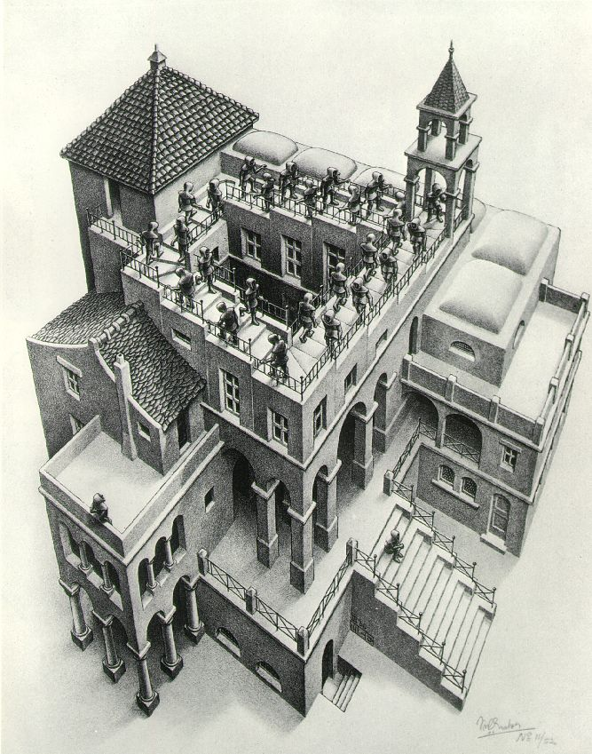
Priority Queues and Heaps
Lecture 18
CS2110 Spring 2013

Slide 2
The Bag Interface
A Bag:
interface Bag<E> {
void insert(E obj);
E extract(); //extract some element
boolean isEmpty();
}
Examples: Stack, Queue, PriorityQueue

Slide 3
Stacks and Queues as Lists
Stack (LIFO) implemented as list
insert(), extract() from front of list
Queue (FIFO) implemented as list
insert() on back of list, extract() from front of list
All Bag operations are O(1)
first
55
120
19
16
last

Slide 4
Priority Queue
A Bag in which data items are Comparable
lesser elements (as determined by compareTo()) have higher priority
extract() returns the element with the highest priority = least in the compareTo() ordering
break ties arbitrarily

Slide 5
Priority Queue Examples
Scheduling jobs to run on a computer
default priority = arrival time
priority can be changed by operator
Scheduling events to be processed by an event handler
priority = time of occurrence
Airline check-in
first class, business class, coach
FIFO within each class

Slide 6
java.util.PriorityQueue<E>
boolean add(E e) {...} //insert an element (insert)
void clear() {...} //remove all elements
E peek() {...} //return min element without removing
//(null if empty)
E poll() {...} //remove min element (extract)
//(null if empty)
int size() {...}

Slide 7
Priority Queues as Lists
Maintain as unordered list
insert() puts new element at front – O(1)
extract() must search the list – O(n)
Maintain as ordered list
insert() must search the list – O(n)
extract() gets element at front – O(1)
In either case, O(n²) to process n elements
Can we do better?

Slide 8
Important Special Case
Fixed number of priority levels 0,...,p – 1
FIFO within each level
Example: airline check-in
insert()– insert in appropriate queue – O(1)
extract()– must find a nonempty queue – O(p)

Slide 9
Heaps
A heap is a concrete data structure that can be used to implement priority queues
Gives better complexity than either ordered or unordered list implementation:
insert(): O(log n)
extract(): O(log n)
O(n log n) to process n elements
Do not confuse with heap memory, where the Java virtual machine allocates space for objects – different usage of the word heap

Slide 10
Heaps
Binary tree with data at each node
Satisfies the Heap Order Invariant:
Size of the heap is “fixed” at n. (But can usually double n if heap fills up)
The least (highest priority) element of any subtree is found at the root of that subtree

Slide 11
Heaps
Least element in any subtree is always found at the root of that subtree
4
6
14
21
8
19
35
22
38
55
10
20
Note: 19, 20 < 35: we can often find smaller elements deeper in the tree!

Slide 12
Examples of Heaps
Ages of people in family tree
parent is always older than children, but you can have an uncle who is younger than you
Salaries of employees of a company
bosses generally make more than subordinates, but a VP in one subdivision may make less than a Project Supervisor in a different subdivision

Slide 13
Balanced Heaps
These add two restrictions:
Any node of depth < d – 1 has exactly 2 children, where d is the height of the tree
implies that any two maximal paths (path from a root to a leaf) are of length d or d – 1, and the tree has at least 2^{d} nodes
All maximal paths of length d are to the left of those of length d – 1

Slide 14
Example of a Balanced Heap
4
6
14
21
8
19
35
22
38
55
10
20
d = 3

Slide 15
Store in an ArrayList or Vector
Elements of the heap are stored in the array in order, going across each level from left to right, top to bottom
The children of the node at array index n are found at 2n + 1 and 2n + 2
The parent of node n is found at (n – 1)/2

Slide 16
Store in an ArrayList or Vector
4
0
6
1
14
2
21
3
8
4
19
5
35
6
22
7
38
8
55
9
10
10
20
11
children of node n are found at 2n + 1 and 2n + 2

Slide 17
Store in an ArrayList or Vector
4
0
6
1
14
2
21
3
8
4
19
5
35
6
22
7
38
8
55
9
10
10
20
11
0 | 1 | 2 | 3 | 4 | 5 | 6 | 7 | 8 | 9 | 10 | 11
4 | 6 | 14 | 21 | 8 | 19 | 35 | 22 | 38 | 55 | 10 | 20
children of node n are found at 2n + 1 and 2n + 2

Slide 18
insert()
Put the new element at the end of the array
If this violates heap order because it is smaller than its parent, swap it with its parent
Continue swapping it up until it finds its rightful place
The heap invariant is maintained!

Slide 19
insert()
4
6
14
21
8
19
35
22
38
55
10
20

Slide 20
insert()
4
6
14
21
8
19
35
22
38
55
10
20
5

Slide 21
insert()
4
6
14
21
8
5
35
22
38
55
10
20
19

Slide 22
insert()
4
6
5
21
8
14
35
22
38
55
10
20
19

Slide 23
insert()
4
6
5
21
8
14
35
22
38
55
10
20
19

Slide 24
insert()
4
6
5
21
8
14
35
22
38
55
10
20
19
2

Slide 25
insert()
4
6
5
21
8
14
2
22
38
55
10
20
19
35

Slide 26
insert()
4
6
2
21
8
14
5
22
38
55
10
20
19
35

Slide 27
insert()
2
6
4
21
8
14
5
22
38
55
10
20
19
35

Slide 28
insert()
2
6
4
21
8
14
5
22
38
55
10
20
19
35

Slide 29
insert()
Time is O(log n), since the tree is balanced
size of tree is exponential as a function of depth
depth of tree is logarithmic as a function of size

Slide 30
insert()
class PriorityQueue<E> extends java.util.Vector<E> {
public void insert(E obj) {
super.add(obj); //add new element to end of array
rotateUp(size() - 1);
}
private void rotateUp(int index) {
if (index == 0) return;
int parent = (index - 1)/2;
if (elementAt(parent).compareTo(elementAt(index)) <= 0)
return;
swap(index, parent);
rotateUp(parent);
}

Slide 31
extract()
Remove the least element – it is at the root
This leaves a hole at the root – fill it in with the last element of the array
If this violates heap order because the root element is too big, swap it down with the smaller of its children
Continue swapping it down until it finds its rightful place
The heap invariant is maintained!

Slide 32
extract()
4
6
5
21
8
14
35
22
38
55
10
20
19

Slide 33
extract()
4
6
5
21
8
14
35
22
38
55
10
20
19

Slide 34
extract()
4
6
5
21
8
14
35
22
38
55
10
20
19

Slide 35
extract()
4
19
6
5
21
8
14
35
22
38
55
10
20

Slide 36
extract()
4
5
6
19
21
8
14
35
22
38
55
10
20

Slide 37
extract()
4
5
6
14
21
8
19
35
22
38
55
10
20

Slide 38
extract()
4
5
6
14
21
8
19
35
22
38
55
10
20

Slide 39
extract()
4 5
6
14
21
8
19
35
22
38
55
10
20

Slide 40
extract()
4 5
6
14
21
8
19
35
22
38
55
10
20

Slide 41
extract()
4 5
20
6
14
21
8
19
35
22
38
55
10

Slide 42
extract()
4 5
6
20
14
21
8
19
35
22
38
55
10

Slide 43
extract()
4 5
6
8
14
21
20
19
35
22
38
55
10

Slide 44
extract()
4 5
6
8
14
21
10
19
35
22
38
55
20

Slide 45
extract()
4 5
6
8
14
21
10
19
35
22
38
55
20

Slide 46
extract()
Time is O(log n), since the tree is balanced

Slide 47
extract()
public E extract() {
if (size() == 0) return null;
E temp = elementAt(0);
setElementAt(elementAt(size() - 1), 0);
setSize(size() - 1);
rotateDown(0);
return temp;
}
private void rotateDown(int index) {
int child = 2*(index + 1); //right child
if (child >= size()
|| elementAt(child - 1).compareTo(elementAt(child)) < 0)
child -= 1;
if (child >= size()) return;
if (elementAt(index).compareTo(elementAt(child)) <= 0)
return;
swap(index, child);
rotateDown(child);
}

Slide 48
HeapSort
Given a Comparable[] array of length n,
Put all n elements into a heap – O(n log n)
Repeatedly get the min – O(n log n)
public static void heapSort(Comparable[] a) {
PriorityQueue<Comparable> pq = new PriorityQueue<Comparable>(a);
for (int i = 0; i < a.length; i++) { a[i] = pq.extract(); }
}

Slide 49
PQ Application: Simulation
Example: Probabilistic model of bank-customer arrival times and transaction times, how many tellers are needed?
Assume we have a way to generate random inter-arrival times
Assume we have a way to generate transaction times
Can simulate the bank to get some idea of how long customers must wait
Time-Driven Simulation
Check at each tick to see if any event occurs
Event-Driven Simulation
Advance clock to next event, skipping intervening ticks
This uses a PQ!

