Slide 1
CS 2110 Prelim 1 Review

Slide 2
What is Covered
Everything up to and including Lecture 11
  Types
  Recursion (including grammars)
  Lists and Trees
  GUIs
  Does not include Big-O notation (Lecture 12)
Other topics
  Software Design Patterns
  How Java works

Slide 3
Types

Slide 4
Primitive vs. Reference Types
Primitive types
  int, boolean, float, char, ...
  Variable stores the actual data itself
Reference types
  Object, String, Gene, …
    Basically any class
  Variable stores a reference to the actual object
    Reference is the memory location of the object
    Creating a variable does not create a new object
  new keyword creates an object, returns a reference to it

Slide 5
== vs. equals()
==
  Compares the contents of two variables
  For primitive types, this is the actual data
  For reference types, this is the reference, not the object
    Two variables are == if they point to the same object
    Two different objects with the same contents are not ==
      different location in memory
equals() is the smarter version
  Looks at the contents of the objects
  Need to override equals() if you create a new class

Slide 6
== vs. equals()
StringBuilder x = new StringBuilder();
x.append(“a”);
StringBuilder y = x;
StringBuilder z = new StringBuilder();
z.append(“a”);
x == y; // true
x == z; // false
x.equals(z); // true

Slide 7
Call By Value
Java is call by value
  Creates a copy of each argument for function calls
Primitive types
  Java copies the data itself; original data is unchanged
Reference types
  Java makes a copy of the reference to the object
  Both references point to the same object
  Changes affecting the object are permanent
  If new reference changes, old reference is unchanged

Slide 8
Primitive Argument Type
void f(int x) {
x--;
}
int x = 10;
f(x);
// x = 10

Slide 9
Reference Argument Type
void f(ArrayList<Integer> l) {
l.add(2);
l = new ArrayList<Integer>();
}
ArrayList<Integer> l =
new ArrayList<Integer>();
l.add(1);
f(l);
// l contains 1, 2

Slide 10
Typing
Suppose type B implements or extends type A
  B is a subtype of A; A is a supertype of B
Each variable has a static type
  List<Integer> x; – List<Integer> is the static type
Can safely assign x a static subtype of List<Integer>
  x = new ArrayList<Integer>;
Static type can differ from actual type at runtime
  Actual type when the program runs is the dynamic type
  The dynamic type cannot be an interface

Slide 11
Casting
Variable x has a static type of List<Integer>
  Its dynamic type at runtime is ArrayList<Integer>
Suppose x needs to behave like an ArrayList<Integer>
  Will not compile; compiler only know the static type
Need to use a cast: (ArrayList<Integer>)x
  Creates a copy of x with a different static type
  Static, dynamic type of x does not change
Dynamic type must be a subtype of the type you cast to
  We now use the dynamic type, but the rule is the same!

Slide 12
Casting
List<Integer> l;
ArrayList<Integer> al;
LinkedList<Integer> ll;
l = new ArrayList<Integer>();
al = l; // does not compile
al = (ArrayList<Integer>)l; // safe
ll = (LinkedList<Integer>)l; // exception!

Slide 13
Inheritance
If B extends A, and B and A both have function foo()
Which foo gets called?
  Answer depends on the dynamic type
If the dynamic type is B, B’s foo() will be called
  Static type of A may be an inteface!
Exception: static functions
  Static functions are not associated with any object
  Thus, they do not have any type
This does not apply to variables

Slide 14
interface A { /* has foo() */ }
class B implements A { /* has foo() */ }
A a = new B(); // dynamic type is B
a.foo(); // call B’s foo()

Slide 15
Recursion and Grammars

Slide 16
Recursion
A procedure or subroutine whose implementation references itself
Examples
  Fibonacci
  Factorial
  Grammar Parsing

Slide 17
Grammars and Parsing
Refer to the following grammar (ignore spaces). <S> is the start symbol of the grammar. (Note that P → a | b is really two rules, P → a and P → b)
  <S> → <exp>
  <exp> → <int> + <int> | <int> - <med_int> | <int> + <exp>
  <int> → <small_int> | <med_int> <large_int> | <small_int>.<large_int>
  <large_int> → 8 | 9
  <med_int> → 5 | 6 | 7
  <small_int> → 0 | 1 | 2 | 3 | 4

Slide 18
Grammars and Parsing
Refer to the following grammar (ignore spaces). <S> is the start symbol of the grammar. (Note that P → a | b is really two rules, P → a and P → b)
  <S> → <exp>
  <exp> → <int> + <int> | <int> - <med_int> | <int> + <exp>
  <int> → <small_int> | <med_int> <large_int> | <small_int>.<large_int>
  <large_int> → 8 | 9
  <med_int> → 5 | 6 | 7
  <small_int> → 0 | 1 | 2 | 3 | 4
  Is “3 + 2.8 – 7” a valid sentence?

Slide 19
Grammars and Parsing
Refer to the following grammar (ignore spaces). <S> is the start symbol of the grammar. (Note that P → a | b is really two rules, P → a and P → b)
  <S> → <exp>
  <exp> → <int> + <int> | <int> - <med_int> | <int> + <exp>
  <int> → <small_int> | <med_int> <large_int> | <small_int>.<large_int>
  <large_int> → 8 | 9
  <med_int> → 5 | 6 | 7
  <small_int> → 0 | 1 | 2 | 3 | 4
  Is “5.8 - 7” a valid sentence?

Slide 20
Grammars and Parsing
Refer to the following grammar (ignore spaces). <S> is the start symbol of the grammar. (Note that P → a | b is really two rules, P → a and P → b)
  <S> → <exp>
  <exp> → <int> + <int> | <int> - <med_int> | <int> + <exp>
  <int> → <small_int> | <med_int> <large_int> | <small_int>.<large_int>
  <large_int> → 8 | 9
  <med_int> → 5 | 6 | 7
  <small_int> → 0 | 1 | 2 | 3 | 4
  Is “0.9 + 68 - 5” a valid sentence?

Slide 21
Grammars and Parsing
Refer to the following grammar (ignore spaces). <S> is the start symbol of the grammar. (Note that P → a | b is really two rules, P → a and P → b)
  <S> → <exp>
  <exp> → <int> + <int> | <int> - <med_int> | <int> + <exp>
  <int> → <small_int> | <med_int> <large_int> | <small_int>.<large_int>
  <large_int> → 8 | 9
  <med_int> → 5 | 6 | 7
  <small_int> → 0 | 1 | 2 | 3 | 4
  Is “30 + 0 + 0.99” a valid sentence?

Slide 22
Grammars and Parsing
Refer to the following grammar (ignore spaces). <S> is the start symbol of the grammar. (Note that P → a | b is really two rules, P → a and P → b)
  <S> → <exp>
  <exp> → <int> + <int> | <int> - <med_int> | <int> + <exp>
  <int> → <small_int> | <med_int> <large_int> | <small_int>.<large_int>
  <large_int> → 8 | 9
  <med_int> → 5 | 6 | 7
  <small_int> → 0 | 1 | 2 | 3 | 4
  Is “1 + 2 + 4 - 7” a valid sentence?

Slide 23
Grammars and Parsing
Refer to the following grammar (ignore spaces). <S> is the start symbol of the grammar. (Note that P → a | b is really two rules, P → a and P → b)
  <S> → <exp>
  <exp> → <int> + <int> | <int> - <med_int> | <int> + <exp>
  <int> → <small_int> | <med_int> <large_int> | <small_int>.<large_int>
  <large_int> → 8 | 9
  <med_int> → 5 | 6 | 7
  <small_int> → 0 | 1 | 2 | 3 | 4
  Which rule makes the grammar infinite?

Slide 24
Lists

Slide 25
Lists
Definition:
  A data structure that contains a sequence of elements such that each element contains a reference to the next element
public interface List<T> {
public void insert(T element);
public void delete(T element);
public boolean contains(T element);
public int size();
}

Slide 26
Trees

Slide 27
Trees
A tree has a single root node
  Ancestor of all nodes
New node is added as a child of a node in the tree
  Node can have arbitrary number of children
  Each node (except the root) has only one parent
Single path exists from root to every other node
  No cycles in the tree
No constraints on where values can go in the tree

Slide 28
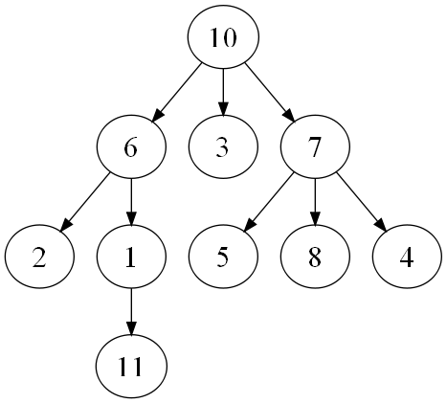
Tree<Integer>

Slide 29
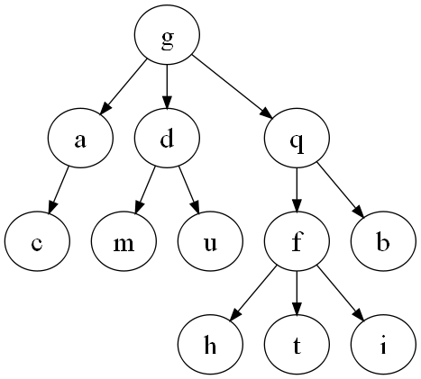
Tree<Character>

Slide 30
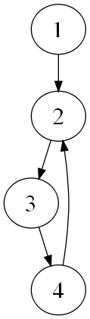
Not a Tree
Cycle between 2, 3, 4

Slide 31
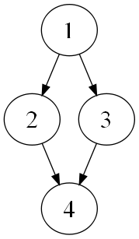
Not a Tree
4 has two parents

Slide 32
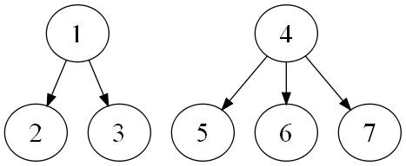
Technically Not a Tree
It is a forest

Slide 33
Binary Trees
Each node can have at most two children
  Usually we care whether we have a left or right child
Still no constraints on where values can go

Slide 34
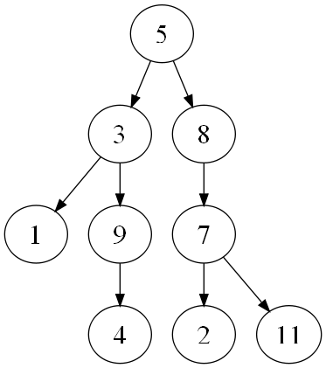
Binary Tree

Slide 35
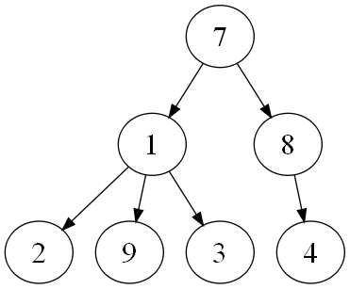
Not a Binary Tree
1 has three children

Slide 36
Binary Search Tree
Used to sort data inside a tree
There is a difference between the left and right child
For every node with value x:
  Every node in the left subtree has a value < x
  Every node in the right subtree has a value > x
Binary search tree is not guaranteed to be balanced
  If it is balanced, we can find a node in O(log n) time

Slide 37
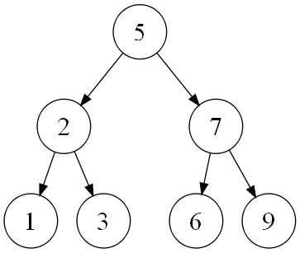
Binary Search Tree

Slide 38
Adding to a Binary Search Tree
Adding 4 to the BST
Start at root (5)
4 < 5
  Go left to 2
4 > 2
  Go right to 3
4 > 3
  Add 4 as right child of 3

Slide 39
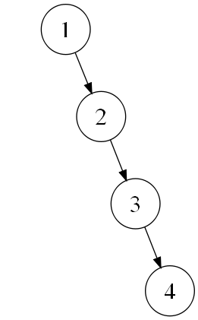
Binary Search Tree
Completely unbalanced, but still a BST

Slide 40
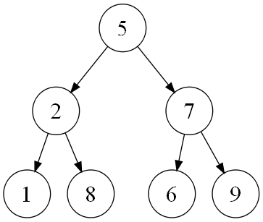
Not a Binary Search Tree
8 is in the left subtree of 5

Slide 41
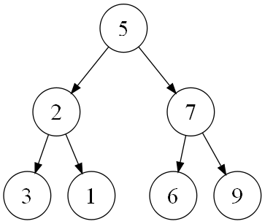
Not a Binary Search Tree
3 is the left child of 2

Slide 42
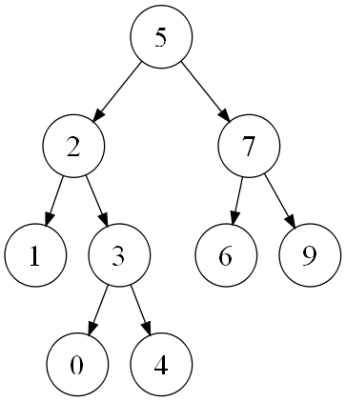
Not a Binary Search Tree
0 is in the right subtree of 2

Slide 43
Tree Traversals
Converts the tree into a list
Works on any binary tree
  It matters whether we have a left child or right child
  Do not need a binary search tree
Traverse node and its left and right subtrees
  Order is different for each traveral type
  Subtrees are traversed recursively

Slide 44
Tree Traversals
Preorder
  Traverse node, left subtree, right subtree
Inorder
  Traverse left subtree, node, right subtree
  Produces a sorted list for binary search trees
Postorder
  Traverse left subtree, right subtree, node

Slide 45
Tree Traversals
Preorder/Postorder Traversals
  Can easily find the root of the tree
  Impossible to distinguish between left, right subtree
Inorder Traversal
  Impossible to find the root of the tree
  If given the root, can easily find left, right subtree

Slide 46
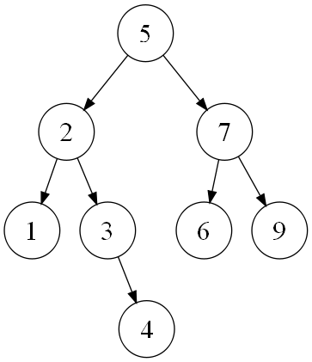
Preorder Traversal
Pre(5)
5, Pre(2), Pre(7)
5, 2, 1, Pre(3), Pre(7)
5, 2, 1, 3, 4, Pre(7)
5, 2, 1, 3, 4, 7, 6, 9

Slide 47
Inorder Traversal
In(5)
In(2), 5, In(7)
1, 2, In(3), 5, In(7)
1, 2, 3, 4, 5, In(7)
1, 2, 3, 4, 5, 6, 7, 9

Slide 48
Postorder Traversal
Post(5)
Post(2), Post(7), 5
1, Post(3), 2, Post(7), 5
1, 4, 3, 2, Post(7), 5
1, 4, 3, 2, 6, 9, 7, 5

Slide 49
GUIs

Slide 50
GUIs
Classes to be familiar with:
  JButton
  JLabel
  JFrame
  JPanel
  ActionListener
  LayoutManager

Slide 51
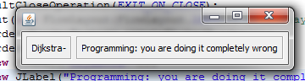
JPanel
import javax.swing.*;
import java.awt.*;
import java.awt.event.*;
public class Panels extends JFrame {
private JPanel panel1 = new JPanel();
private JPanel panel2 = new JPanel();
public Panels() {
this.setDefaultCloseOperation(EXIT_ON_CLOSE);
this.setLayout(new FlowLayout(FlowLayout.LEFT)); //set layout manager
panel1.setBorder(BorderFactory.createEtchedBorder());
panel2.setBorder(BorderFactory.createEtchedBorder());
panel1.add(new JLabel("Dijkstra-"));
panel2.add(new JLabel("Programming: you are doing it completely wrong"));
add(panel1); //add components
add(panel2);
pack();
setVisible(true);
}
public static void main(String[] args) {
try {
UIManager.setLookAndFeel(UIManager.getSystemLookAndFeelClassName());
} catch (Exception exc) {}
new Panels();
}
}

Slide 52
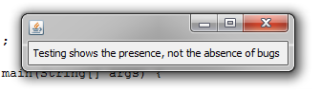
JLabel
import javax.swing.*;
import java.awt.*;
import java.awt.event.*;
public class Labels extends JFrame {
private String myText="Testing shows the presence, not the absence of bugs”
private JLabel myLabel = new JLabel(myText);
public Labels() {
this.setDefaultCloseOperation(EXIT_ON_CLOSE);
this.setLayout(new FlowLayout(FlowLayout.LEFT)); //set layout manager
add(myLabel); //add components
pack();
setVisible(true);
}
public static void main(String[] args) {
try {
UIManager.setLookAndFeel(UIManager.getSystemLookAndFeelClassName());
} catch (Exception exc) {}
new Labels();
}
}
JLabel

Slide 53
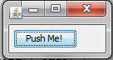
JButton
import javax.swing.*;
import java.awt.*;
import java.awt.event.*;
public class Buttons extends JFrame {
private JButton myButton = new JButton("Push Me!");
private String[] text={"Push Me!","Click me!"};
public Buttons() {
this.setDefaultCloseOperation(EXIT_ON_CLOSE);
this.setLayout(new FlowLayout(FlowLayout.LEFT)); //set layout manager
add(myButton); //add components
myButton.addActionListener(new ActionListener() {
public void actionPerformed(ActionEvent e) {
myButton.setText(text[(int)(Math.random()+.5)]);
}
});
pack();
setVisible(true);
}
public static void main(String[] args) {
try {
UIManager.setLookAndFeel(UIManager.getSystemLookAndFeelClassName());
} catch (Exception exc) {}
new Buttons();
}
}
JButton

Slide 54
Lecture Example
import javax.swing.*;
import java.awt.*;
import java.awt.event.*;
public class Intro extends JFrame {
private int count = 0;
private JButton myButton = new JButton("Push Me!");
private JLabel label = new JLabel("Count: " + count);
public Intro() {
setDefaultCloseOperation(EXIT_ON_CLOSE);
setLayout(new FlowLayout(FlowLayout.LEFT)); //set layout manager
add(myButton); //add components
add(label);
label.setPreferredSize(new Dimension(60, 10));
myButton.addActionListener(new ActionListener() {
public void actionPerformed(ActionEvent e) {
count++;
label.setText("Count: " + count);
}
});
pack();
setVisible(true);
}
public static void main(String[] args) {
new Intro();
}
}

