Slide 1
CS 2110
Based on slides originally by Juan Altmayer Pizzorno port25.com
Software Design Principles II

Slide 2
Overview
Last week:
Design Concepts & Principles
Refactoring
Today: Test-Driven Development
TDD + JUnit by Example
We use JUnit testing to evaluate your homework assignments…

Slide 3
Tests can be great!
“In my country of Kazakhstan testing is very nice! Make many tests please!

Slide 4
Testing can be great!
Many people
Write code without being sure it will work
Press run and pray
If it fails, they change something random
This
Never works
And ruins your Friday evening social plans
Test-Driven Development saves the day!

Slide 5
The Example
A collection class SmallSet
containing up to N objects (hence “small”)
typical operations:
we’ll implement add(), size()
add | adds item
contains | item in the set?
size | # items

Slide 6
Test Driven Development
We’ll go about in small iterations
add a test
run all tests and watch the new one fail
make a small change
run all tests and see them all succeed
refactor (as needed)
We’ll use JUnit

Slide 7
JUnit
What do JUnit tests look like?
SmallSet.java
package edu.cornell.cs.cs2110;
public class SmallSet {
...
}
SmallSetTest.java
package edu.cornell.cs.cs2110;
import org.junit.Test;
import static org.junit.Assert.*;
public class SmallSetTest {
@Test public void testFoo() {
SmallSet s = new SmallSet();
...
assertTrue(...);
}
@Test public void testBar() {
...
}
}

Slide 8
A List of Tests
We start by thinking about how to test, not how to implement
size=0 on empty set
size=N after adding N distinct elements
adding element already in set doesn’t change it
throw exception if adding too many
...
Each test verifies a certain “feature”

Slide 9
A First Test
We pick a feature and test it:
This doesn’t compile: size() is undefined
But that’s all right: we’ve started designing the interface by using it
SmallSet
class SmallSet {}
SmallSetTest
class SmallSetTest {
@Test public void testEmptySetSize() {
SmallSet s = new SmallSet();
assertEquals(0, s.size()); }
}

Slide 10
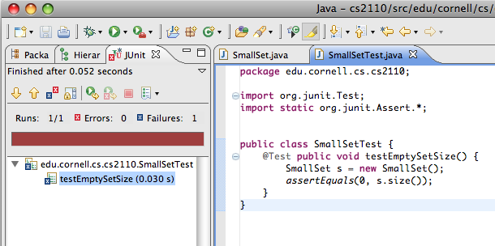
Red Bar
A test can be defined before the code is written
Running the test yields a red bar indicating failure:
If we add the size function and re-run the the test, it works!
SmallSet
class SmallSet {
public int size() {
return 42;
}
}

Slide 11
Green Bar
What’s the simplest way to make a test pass?
“Fake it till you make it”
Re-running yields the legendary JUnit Green Bar:
We could now refactor, but we choose to move on with the next feature instead
SmallSet
class SmallSet {
public int size() {
return 0;
}
}

Slide 12
Adding Items
To implement adding items, we first test for it:
add() is undefined, so to run the test we define it:
SmallSetTest
class SmallSetTest {
@Test public void testEmptySetSize() ...
@Test public void testAddOne() {
SmallSet s = new SmallSet();
s.add(new Object());
assertEquals(1, s.size()); }
}
SmallSet
public int size() ...
public void add(Object o) {}

Slide 13
Adding Items
The test now fails as expected:
It seems obvious we need to count the number of items:
And we get a green bar:
SmallSet
private int _size = 0;
public int size() {
return 0;
return _size;
}
public void add(Object o) {
++_size;
}

Slide 14
Adding Something Again
So what if we added an item already in the set?
As expected, the test fails...
SmallSetTest
class SmallSetTest {
@Test public void testEmptySetSize() ...
@Test public void testAddOne() ...
@Test public void testAddAlreadyInSet() {
SmallSet s = new SmallSet();
Object o = new Object();
s.add(o);
s.add(o);
assertEquals(1, s.size()); }
}

Slide 15
Remember that Item?...
We need to remember which items are in the set...
All tests pass, so we can refactor that loop...
SmallSet
private int _size = 0;
public static final int MAX = 10;
private Object _items[] = new Object[MAX];
...
public void add(Object o) {
for (int i=0; i < MAX; i++) {
if (_items[i] == o) {
return;
}
}
_items[_size] = o;
++_size;
}

Slide 16
Refactoring
(...loop) which doesn’t “speak to us” as it could...
All tests still pass, so we didn’t break it!
SmallSet (after)
private boolean inSet(Object o) { for (int i=0; i < MAX; i++) {
if (_items[i] == o) {
return true;
}
}
return false;
}
public void add(Object o) {
if (!inSet(o)) {
_items[_size] = o;
++_size;
}
}
SmallSet (before)
public void add(Object o) {
for (int i=0; i < MAX; i++) {
if (_items[i] == o) {
return;
}
}
_items[_size] = o;
++_size;
}

Slide 17
Too Many
What if we try to add more than SmallSet can hold?
The test fails with an error: ArrayIndexOutOfBoundsException
We know why this occurred, but it should bother us: “ArrayIndex” isn’t a sensible error for a “set”
SmallSetTest
...
@Test public void testAddTooMany() {
SmallSet s = new SmallSet();
for (int i=0; i < SmallSet.MAX; i++) {
s.add(new Object());
}
s.add(new Object());
}

Slide 18
Size Matters
We first have add() check the size,
... re-run the tests, check for green, define our own exception...
... re-run the tests, check for green, and...
SmallSet
public void add(Object o) {
if (!inSet(o) && _size < MAX) {
_items[_size] = o;
++_size;
}
}
SmallSetFullException
public class SmallSetFullException extends Error {}

Slide 19
Testing for Exceptions
... finally test for our exception:
The test fails as expected, so now we fix it...
SmallSetTest
@Test public void testAddTooMany() {
SmallSet s = new SmallSet();
for (int i=0; i < SmallSet.MAX; i++) {
s.add(new Object());
}
try {
s.add(new Object());
fail(“SmallSetFullException expected”);
}
catch (SmallSetFullException e) {}
}

Slide 20
Testing for Exceptions
... so now we modify add() to throw:
All tests now pass, so we’re done:
SmallSet
public void add(Object o) {
if (!inSet(o) && _size < MAX) {
if (_size >= MAX) {
throw new SmallSetFullException();
}
_items[_size] = o;
++_size;
}
}

Slide 21
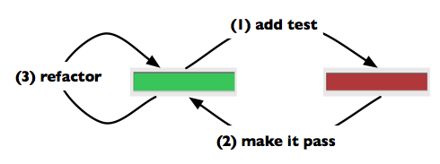
Review
Started with a “to do” list of tests / features
could have been expanded as we thought of more tests / features
Added features in small iterations
“a feature without a test doesn’t exist”

Slide 22
Is testing obligatory?
Yes and no…
When you write code in professional settings with teammates, definitely!
In such settings, failing to test your code just means you are inflicting errors you could have caught on teammates!
At Google, people get fired for this sort of thing!
So… in industry… test or perish!
But what if code is just “for yourself”?
Testing can still help you debug, and if you go to the trouble of doing the test, JUnit helps you “keep it” for re-use later.
But obviously no need to go crazy in this case

Slide 23
Fixing a Bug
What if after releasing we found a bug?
Famous last words: “It works!”

Slide 24
A bug can reveal a missing test
… but can also reveal that the specification was faulty in the first place, or incomplete
Code “evolves” and some changing conditions can trigger buggy behavior
This isn’t your fault or the client’s fault but finger pointing is common
Great testing dramatically reduces bug rates
And can make fixing bugs way easier
But can’t solve everything: Paradise isn’t attainable in the software industry

Slide 25
Reasons for TDD
By writing the tests first, we
test the tests
design the interface by using it
ensure the code is testable
ensure good test coverage
By looking for the simplest way to make tests pass,
the code becomes “as simple as possible, but no simpler”
may be simpler than you thought!
Notes:
“things should be as simple as possible, but no simpler” A. Einstein

Slide 26
Not the Whole Story
There’s a lot more worth knowing about TDD
What to test / not to test
e.g.: external libraries?
How to refactor tests
Fixtures
Mock Objects
Crash Test Dummies
...
Beck, Kent: Test-Driven Development: By Example
Notes:
In the time I had, I could only give you is a TASTE
Kent Beck is one of the authors of JUnit

Slide 27
Even so…
The best code written by professionals will still have some rate of bugs
They reflect design oversights
Evolutionary change in requirements
Incompatibilities between modules developed by different people
So never believe that software will be flawless
Our goal in cs2110 is to do as well as possible
In later cs courses we’ll study “fault tolerance”!

