Slide 1
Learning for 3D

Slide 2
Recognition and 3D reasoning
Statistical properties of visual world
Recognition
Reconstruction
Physics of image formation

Slide 3
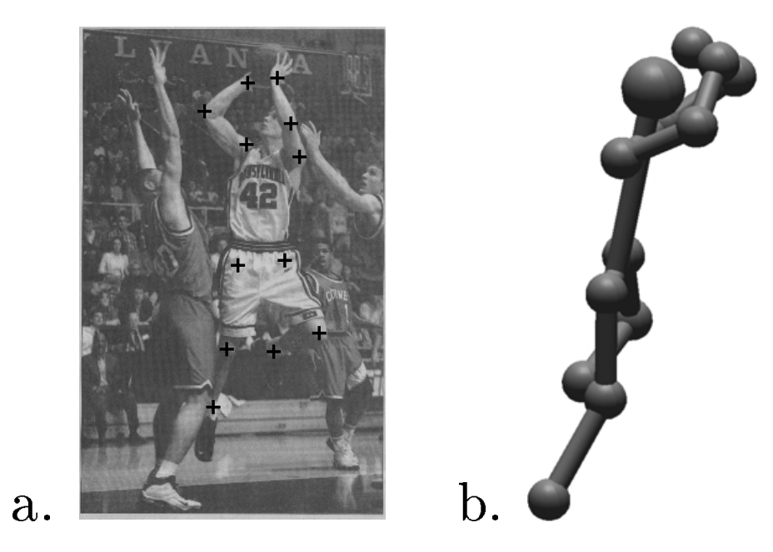
Pose estimation in 3D
Reconstruction of Articulated Objects from Point Correspondences in a Single Uncalibrated Image. C. J. Taylor. In CVPR, 2000

Slide 4
Pose estimation in 3D
Key idea: know relative lengths of each limb4
Assume scaled orthographic projection
  Valid when variation in depth much smaller than depth
constant
Reconstruction of Articulated Objects from Point Correspondences in a Single Uncalibrated Image. C. J. Taylor. In CVPR, 2000

Slide 5
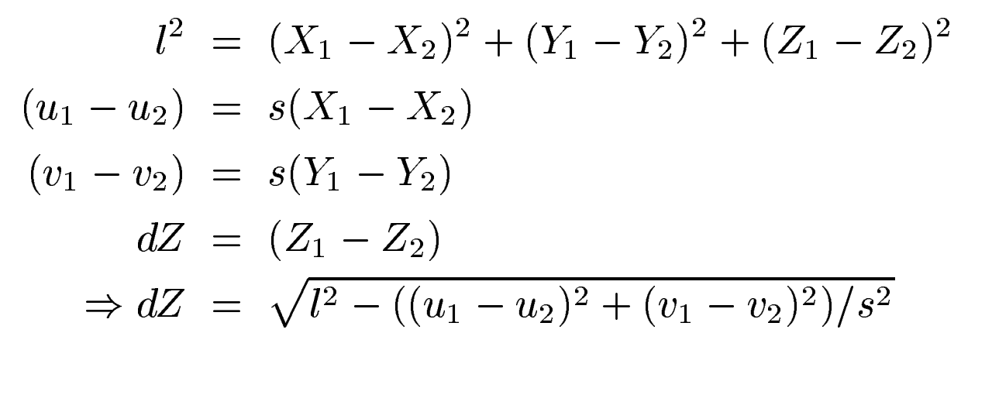
Pose estimation in 3D
Reconstruction of Articulated Objects from Point Correspondences in a Single Uncalibrated Image. C. J. Taylor. In CVPR, 2000

Slide 6
Pose estimation for rigid objects

Slide 7
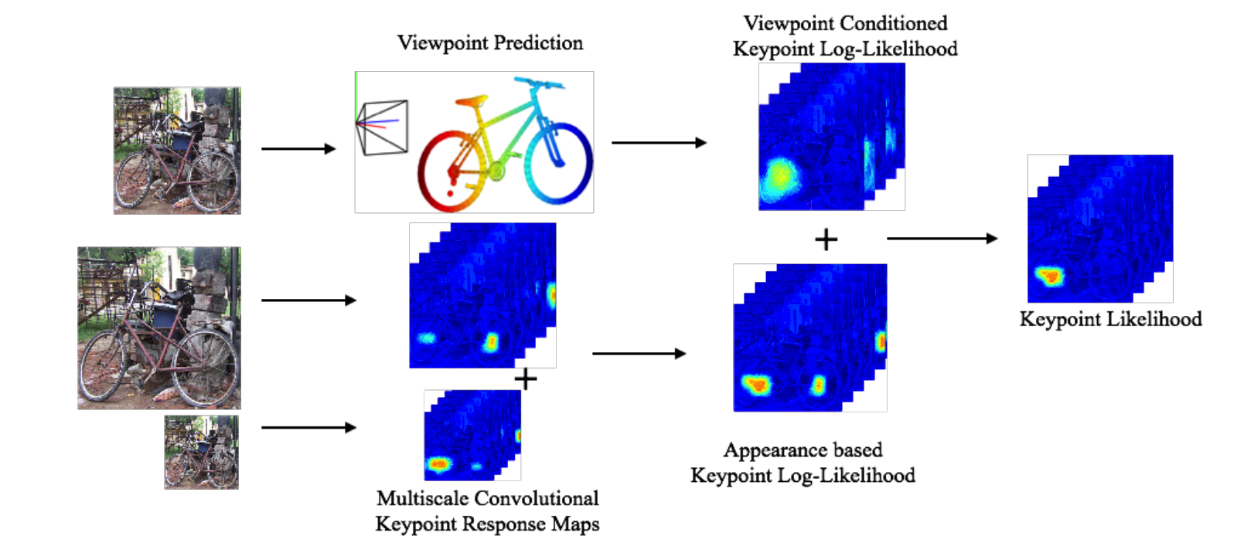
Pose estimation for rigid objects
Viewpoints and keypoints. S. Tulsiani and J. Malik. In CVPR, 2015

Slide 8
Pose estimation for rigid objects
Cyclo-rotation / roll
Azimuth / yaw
Elevation / pitch

Slide 9
Viewpoint-conditioned pose
Viewpoint prediction
Viewpoints and keypoints. S. Tulsiani and J. Malik. In CVPR, 2015

Slide 10
Viewpoint-conditioned pose
Viewpoint prediction
Viewpoints and keypoints. S. Tulsiani and J. Malik. In CVPR, 2015

Slide 11
Disparity estimation

Slide 12
Disparity estimation

Slide 13
Disparity estimation
Goal:
  Assign disparity value to each pixel
Basic idea:
  Disparity image should be smooth
Energy minimization
  min E(d), where d is disparity image
  E(d) = E_{data}(d) + E_{smoothness}(d)
E_{data}(d) : scores based on NCC (for example)
E_{smoothness}(d) =

Slide 14


Measuring patch similarity is hard

Slide 15
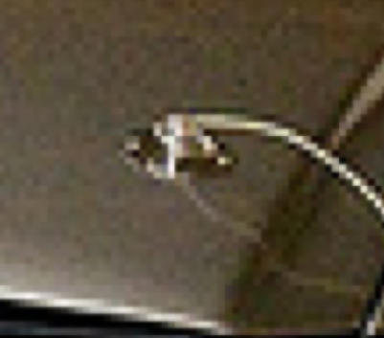

Measuring patch similarity is hard
Idea: learn to compute patch similarity?

Slide 16
The KITTI Dataset and Benchmark
Depth from here
Stereo pair from here

Slide 17
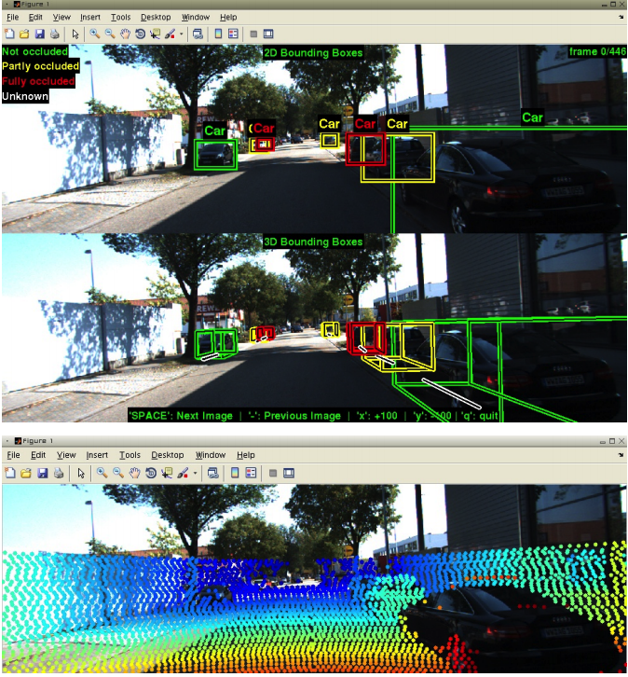
The KITTI Dataset and Benchmark
Vision meets Robotics: The KITTI Dataset. Andreas Geiger, Philip Lenz, Christoph Stiller and Raquel Urtasun. In IJRR, 2013.

Slide 18
Learning patch similarity for disparity estimation
Given a pixel in image 1, and corresponding row in image 2, get matching location

Slide 19
Learning patch similarity for disparity estimation
Required Output:
Input:

Slide 20
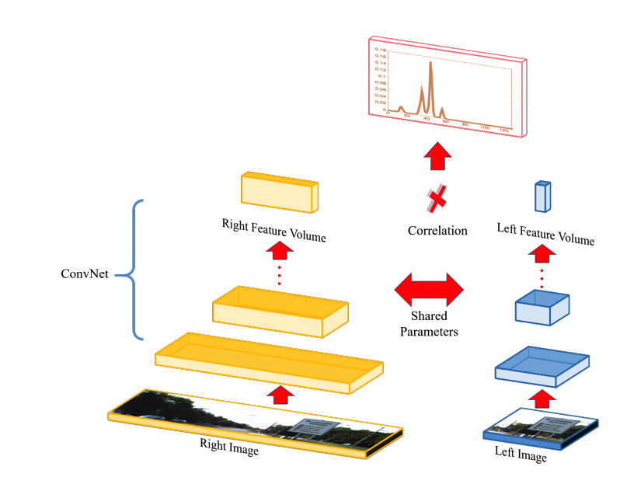
Learning patch similarity for disparity estimation
Efficient Deep Learning for Stereo Matching. Wenjie Luo, Alexander G. Schwing, Raquel Urtasun. In CVPR, 2016

Slide 21
Learning stereo without depth supervision
Given scenes with >=3 rectified views
Use 2 views to produce depth
  Compute scores for each disparity
  Match pixel to pixel with best disparity
  Disparity = 1/depth
Use depth to produce 3rd view
Use reconstruction error

Slide 22
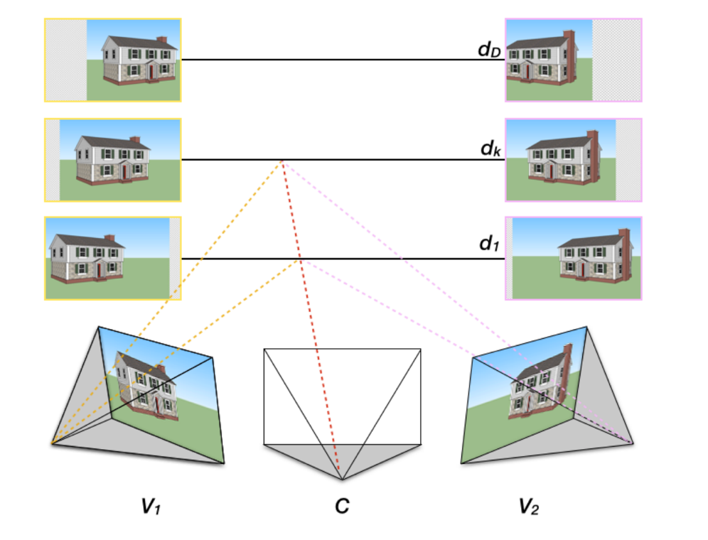
Plane-sweep stereo
For every possible depth value d:
  Assume every pixel in middle image has the same depth d
  Use d to compute disparity to left and right image
  Reproject left and right images to center coordinate system using disparity
  Compute score for all pixels

Slide 23
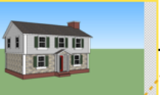
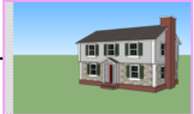
Plane-sweep stereo
If depth is correct, appearance should match!

Slide 24
Plane-sweep stereo
Score for pixel only depends on the two patches at that pixel
Can be computed using convolutions

Slide 25
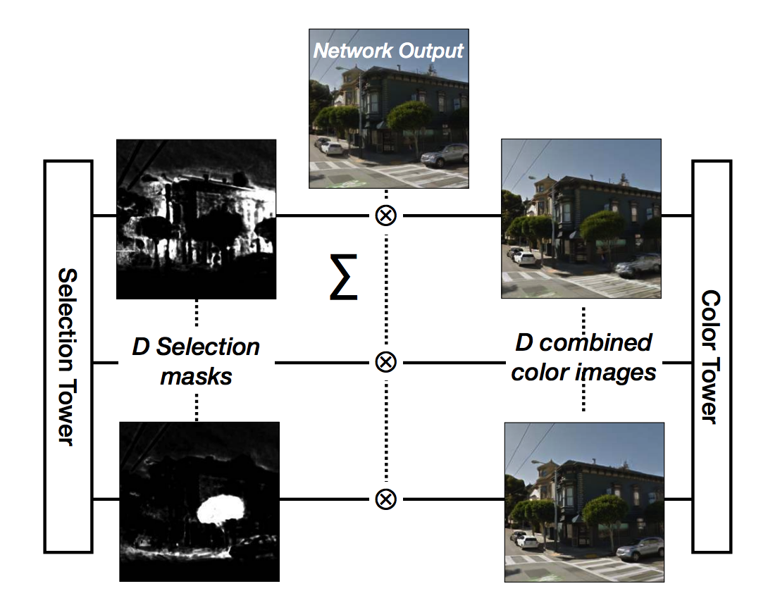
Deep Stereo
DeepStereo: Learning to Predict New Views from the World’s Imagery. John Flynn, Ivan Neulander, James Philbin, Noah Snavely. CVPR, 2016

Slide 26
Estimating depth from a single image
Why is this even possible?

Slide 27
Estimating depth from a single image
Why is this even possible?

Slide 28
Estimating depth from a single image
Why is this even possible?

Slide 29
Estimating depth from a single image
Why is this even possible?

Slide 30
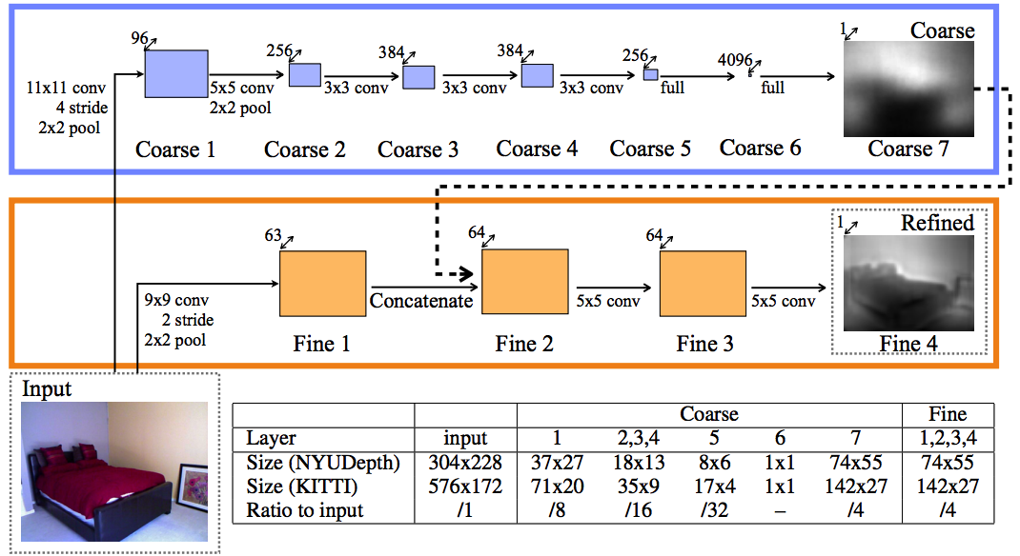
Estimating depth from a single image
Yet another image-to-image translation
Again, resolution issues
Depth Map Prediction from a Single Image using a Multi-Scale Deep Network. David Eigen, Christian Puhrsch, Rob Fergus. In NIPS, 2014

Slide 31
Metric depth is a bad target

Slide 32
Metric depth is a bad target
Only relative depths matter
Only logarithmic scales matter
Depth Map Prediction from a Single Image using a Multi-Scale Deep Network. David Eigen, Christian Puhrsch, Rob Fergus. In NIPS, 2014

Slide 33
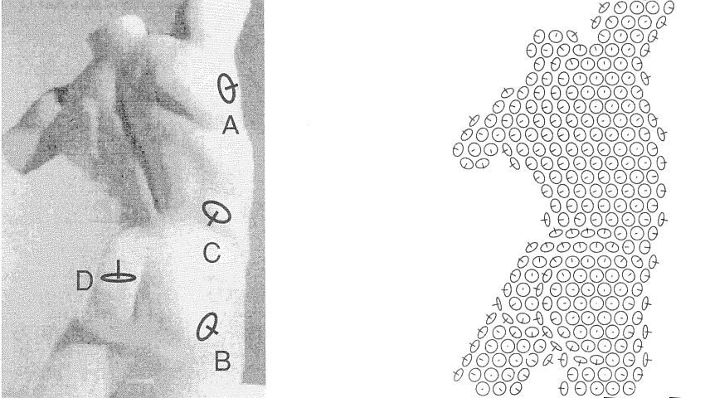
Humans perceive surface normals, not just depth, through a combination of various pictorial cues
Surface perception in pictures. Koenderink, van Doorn and Kappers, 1992
Slide credit: Jitendra Malik

Slide 34
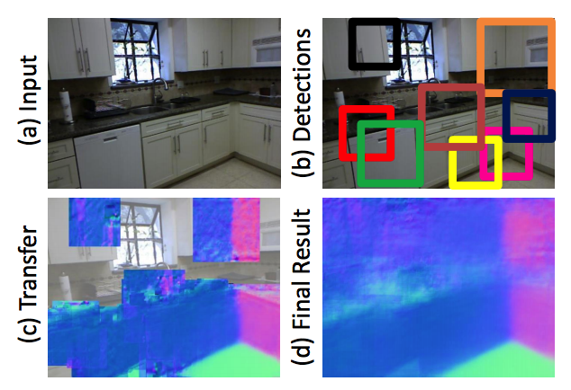
Estimating normals from a single image
Data-Driven 3D Primitives for Single Image Understanding. David F. Fouhey, Abhinav Gupta, Martial Hebert. In ICCV 2013.

Slide 35
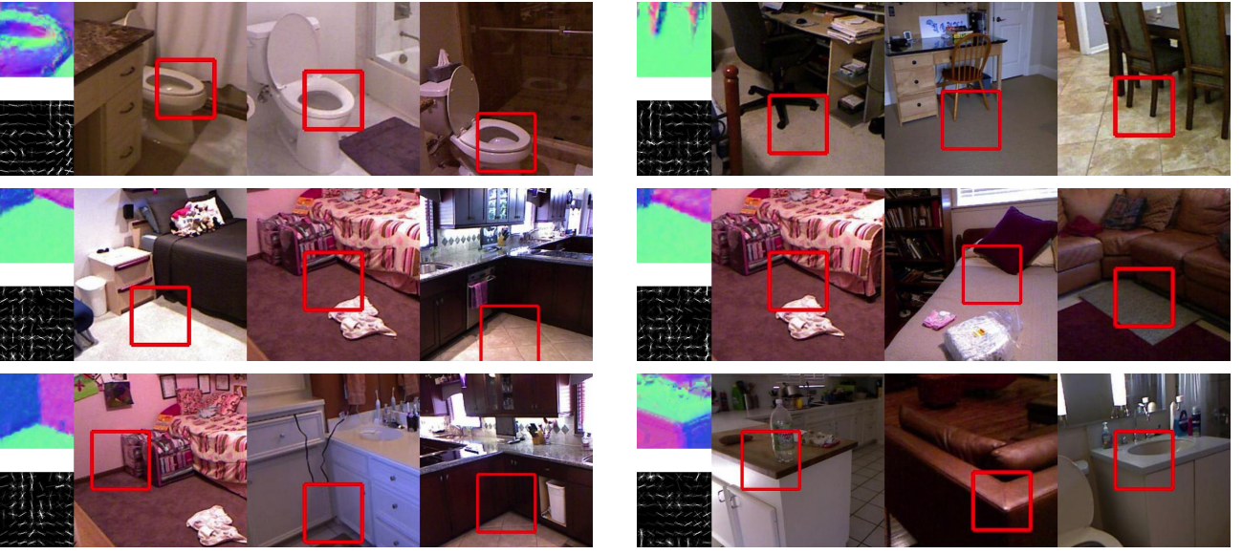
Estimating normals from a single image

Slide 36
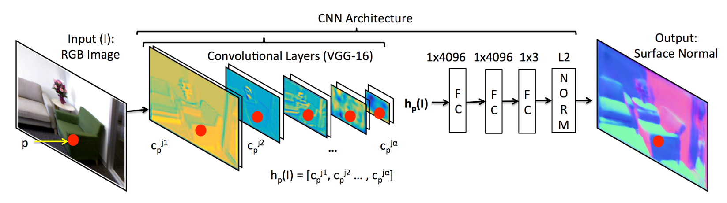
Estimating normals from a single image
Marr Revisited: 2D-3D Alignment via Surface Normal Prediction. Aayush Bansal, Bryan Russell, Abhinav Gupta. In CVPR, 2016

Slide 37
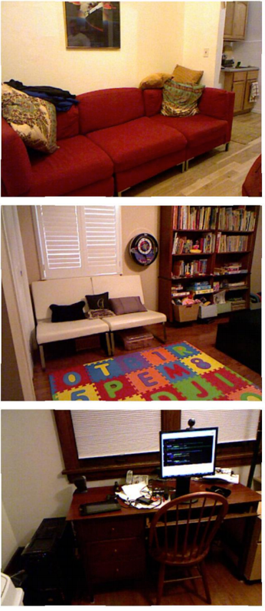
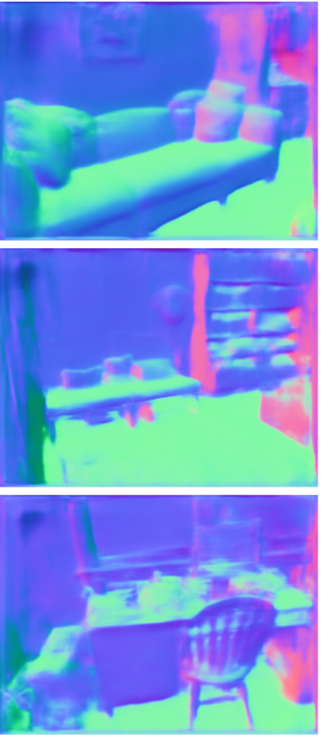
Estimating normals from a single image

Slide 38
2.5D vs 3D prediction
Predicting depth / surface normals for every pixel is not full reconstruction
  “2.5D reconstruction”
  Does not contain parts of the scene that are hidden from view
Can we do full 3D reconstruction?
Simpler situation: can we do full 3D reconstruction of isolated objects?

Slide 39
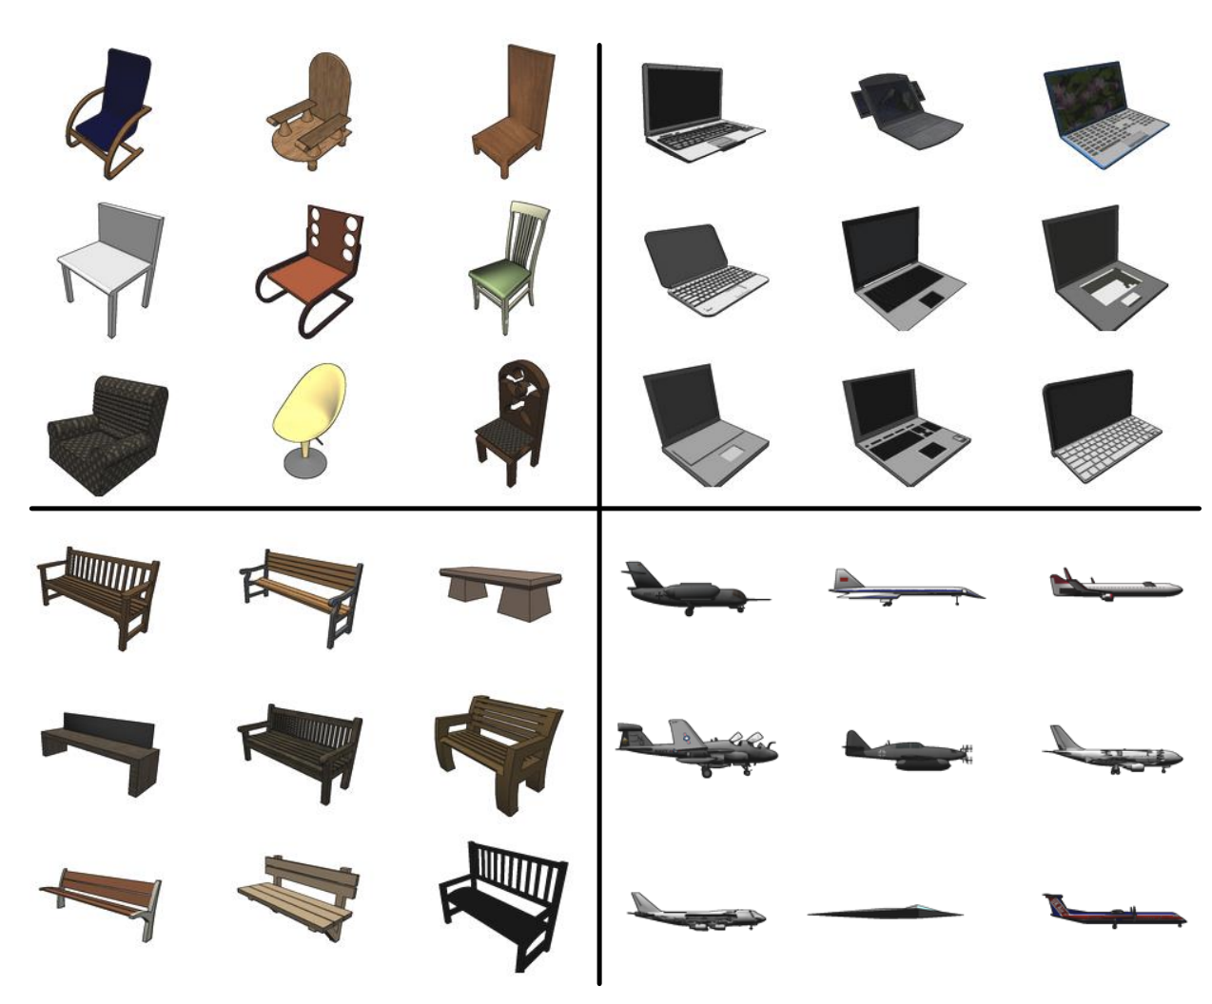
Shapenet

Slide 40
Reconstructing 3D shapes from images using machine learning
Input:
  Single image or multiple images of the same object
Output:
  3D shape
Representation?

Slide 41
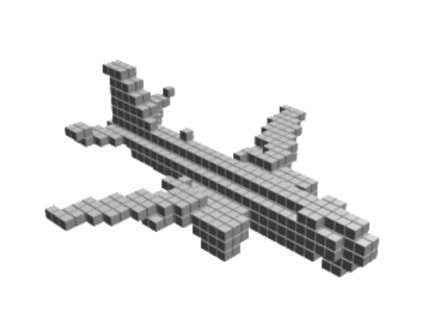
Representation of 3D shapes
Voxel grids
  Discretize volume into grid cells
  Identify cells that are occupied by object
Advantages:
  Easy representation for ML: analog of pixels
Disadvantages:
  Memory-inefficient
  Difficult to capture surface

Slide 42
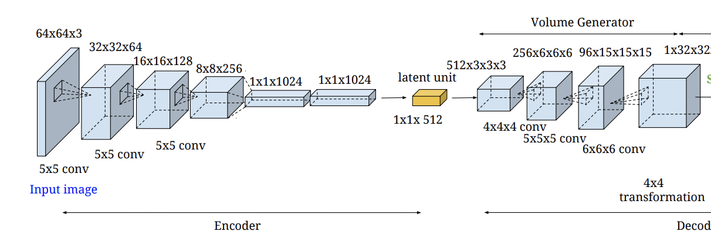
Architectures for generating voxel grids
Choy, Christopher B., et al. "3d-r2n2: A unified approach for single and multi-view 3d object reconstruction." European conference on computer vision. Springer, Cham, 2016.
Yan, Xinchen, et al. "Perspective transformer nets: Learning single-view 3d object reconstruction without 3d supervision." Advances in Neural Information Processing Systems. 2016.

Slide 43
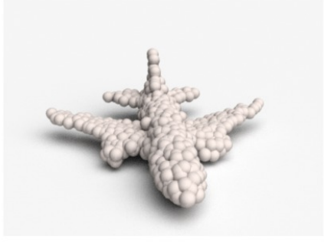
Representation of 3D shapes
Point clouds
Each point lies on surface
Advantages:
  Common representation produced by sensors (e.g. LiDAR)
  Sparse, so memory efficient
Disadvantages:
  Difficult output to predict: sets
  Difficult to extract surface

Slide 44


Architecture for generating point clouds
Not an established answer
One possibility: cloud of points = samples from an underlying distribution
Generative modeling
$$z∼ 𝒩(0, I)$$
$$\left(x_{i}, y_{i}, z_{i}\right)$$
Fan, Haoqiang, Hao Su, and Leonidas J. Guibas. "A point set generation network for 3d object reconstruction from a single image." Proceedings of the IEEE conference on computer vision and pattern recognition. 2017.

Slide 45
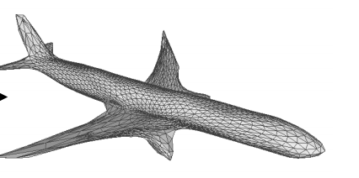
Representation of 3D shapes
Meshes
Advantages
  Common in graphics
  Surfaces are triangles in the mesh
  Sparse representation: memory efficient
  Can easily encode color, texture, surface normals
Disadvantages
  Extremely difficult to predict: graph

Slide 46
Architecture for producing meshes
Assume connectivity and faces are the same as that of a sphere
Move only vertices
Cannot change topology of objects
Wang, Nanyang, et al. "Pixel2mesh: Generating 3d mesh models from single rgb images." Proceedings of the European Conference on Computer Vision (ECCV). 2018.

Slide 47
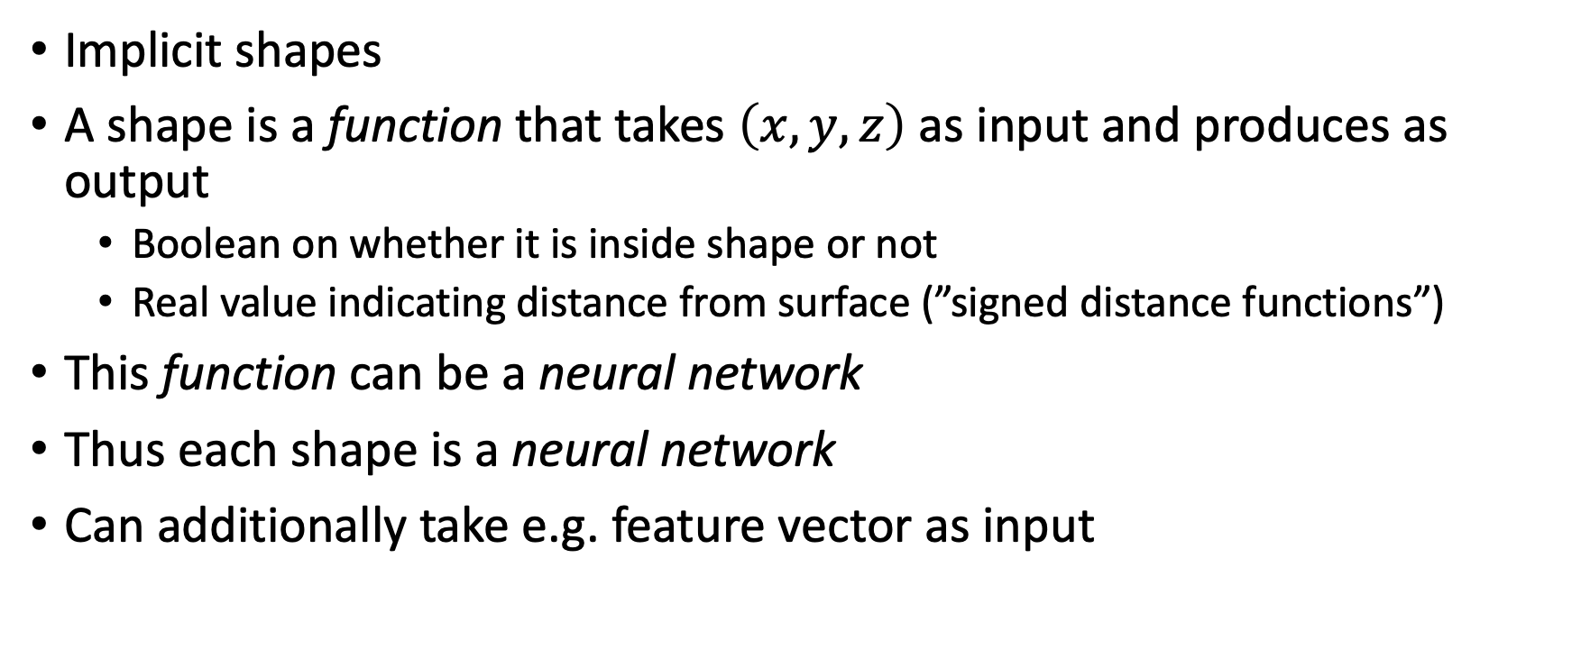
Representation of 3D shapes
Implicit shapes
A shape is a function that takes $\left(x,y,z\right)$ as input and produces as output
  Boolean on whether it is inside shape or not
  Real value indicating distance from surface (”signed distance functions”)
This function can be a neural network
Thus each shape is a neural network
Can additionally take e.g. feature vector as input
Park, Jeong Joon, et al. "Deepsdf: Learning continuous signed distance functions for shape representation." Proceedings of the IEEE Conference on Computer Vision and Pattern Recognition. 2019.
Mescheder, Lars, et al. "Occupancy networks: Learning 3d reconstruction in function space." Proceedings of the IEEE Conference on Computer Vision and Pattern Recognition. 2019.

Slide 48
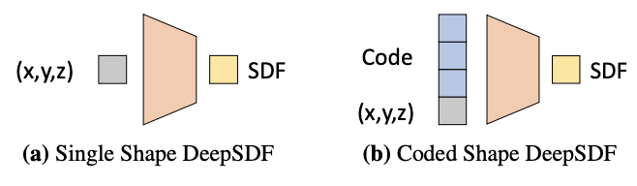
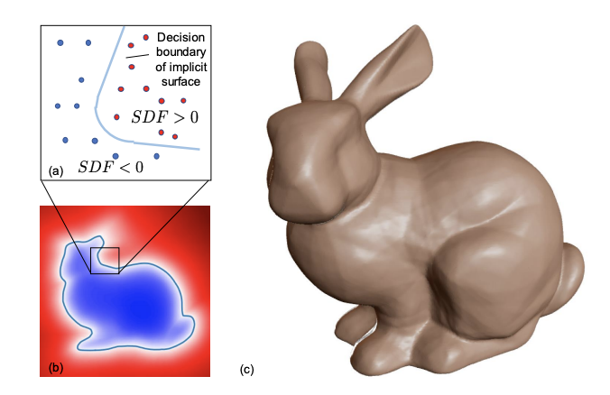
Implicit shapes
Park, Jeong Joon, et al. "Deepsdf: Learning continuous signed distance functions for shape representation." Proceedings of the IEEE Conference on Computer Vision and Pattern Recognition. 2019.
Mescheder, Lars, et al. "Occupancy networks: Learning 3d reconstruction in function space." Proceedings of the IEEE Conference on Computer Vision and Pattern Recognition. 2019.

Slide 49
Supervision?
Fully supervised [1]
Supervised with multiple views from known cameras [2]
  Predict shape from one image
  Project it to other views
  Ensure photometric consistency
Supervised with multiple views from unknown cameras [3]
  Also jointly learn to predict camera pose
Choy, Christopher B., et al. "3d-r2n2: A unified approach for single and multi-view 3d object reconstruction." European conference on computer vision. Springer, Cham, 2016.
Yan, Xinchen, et al. "Perspective transformer nets: Learning single-view 3d object reconstruction without 3d supervision." Advances in Neural Information Processing Systems. 2016.
Tulsiani, Shubham, et al. "Multi-view supervision for single-view reconstruction via differentiable ray consistency." Proceedings of the IEEE conference on computer vision and pattern recognition. 2017.

