Slide 1
Human pose estimation

Slide 2
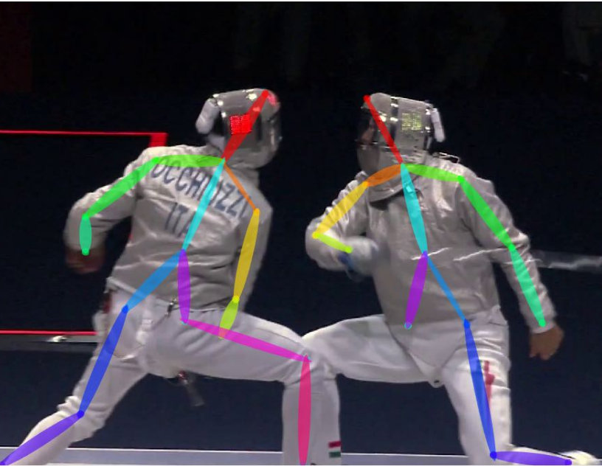
The task
Mark joint locations for person
Nose
Right/left shoulder
Right/left elbow
Right/left hip
…

Slide 3
Two versions of task
Assume people have been detected
Rough bounding box given
Key info available:
  scale
  only 1 location per joint
Pros: disentangles detection and pose estimation
Cons: unrealistic
Tabula rasa without detections
Challenge: no idea of scale or number
Possible opportunity: use keypoint estimates to improve detections
Pros: realistic
Cons: conflates detection and pose estimation

Slide 4
Pose estimation given detection

Slide 5
Evaluation metric - given detection
Evaluate every keypoint separately
For each person, check if keypoint is correct
Compure fraction of people for which keypoint is correct: PCK (Probability of Correct Keypoint)

Slide 6
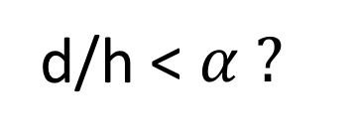
Evaluation metric - given detection
d
d/h < $α ?$
h

Slide 7
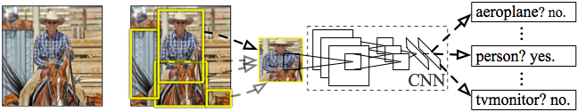
R-CNN: Regions with CNN features
Input
image
Extract region
proposals (~2k / image)
Compute CNN
features
Classify regions
(linear SVM)
Rich Feature Hierarchies for Accurate Object Detection and Semantic Segmentation
R. Girshick, J. Donahue, T. Darrell, J. Malik
IEEE Conference on Computer Vision and Pattern Recognition (CVPR), 2014
Slide credit : Ross Girshick
Notes:
Here’s a schematic of the system that we came up with.
Compared to previous state-of-the-art methods, R-CNN is relatively simple and does not rely on an ensemble of classifiers.
Let’s see how it works at test time.

Slide 8
Bounding-box regression
w
Δw × w + w
(x, y)
h
(Δx × w + x,
Δy × h + h)
Δh × h + h
original
predicted
Slide credit : Ross Girshick

Slide 9
Strategy 1: Regression
Regression targets relative to bounding box
Right elbow x: 0.45
Right elbow y: 0.12
Left elbow x: 0.98
…
DeepPose: Human Pose Estimation via Deep Neural Networks. Alexander Toshev and Christian Szegedy. In CVPR, 2014.

Slide 10
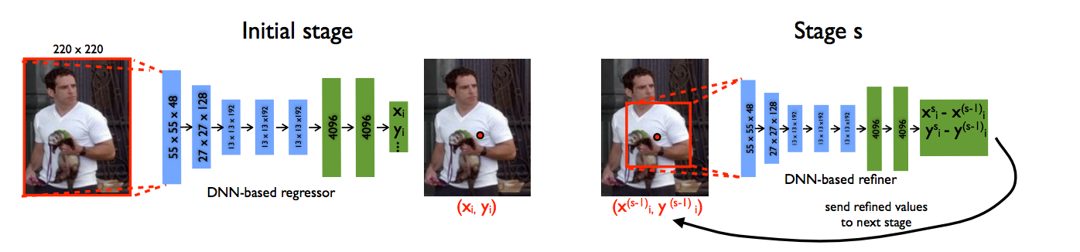
Strategy 1: Regression
Assumes global object features has enough information for accurate localization
  Localization info missing due to subsampling?
Solution: Refinement!
DeepPose: Human Pose Estimation via Deep Neural Networks. Alexander Toshev and Christian Szegedy. In CVPR, 2014.

Slide 11
Strategy 1: Regression
Minimizer of
Multimodal distributions?
p(x)
x

Slide 12
Strategy 2: Heatmaps

Slide 13
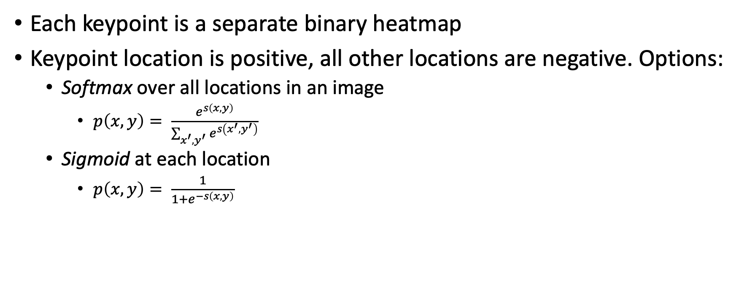
Strategy 2: Heatmaps - Training
Each keypoint is a separate binary heatmap
Keypoint location is positive, all other locations are negative. Options:
  Softmax over all locations in an image
    $p\left(x,y\right)= \frac{e^{s\left(x,y\right)}}{\sum_{x^{′},y^{′}}{e^{s\left(x^{′},y^{′}\right)}}}$
  Sigmoid at each location
    $p\left(x,y\right)= \frac{1}{1+e^{−s\left(x,y\right)}}$

Slide 14
Strategy 2: Heatmaps
Still have the resolution issue
Same solutions
  Dilation?
  Multiple layers?
  Multiple image scales?

Slide 15
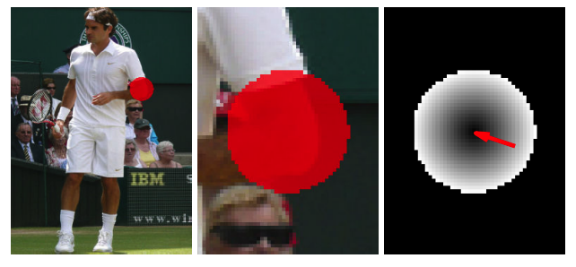

Heatmaps + Regression
Use heatmap to predict coarse location
Also predict at each coarse location an offset $(Δx, Δy)$.
Papandreou, George, et al. "Towards accurate multi-person pose estimation in the wild." CVPR. Vol. 3. No. 4. 2017.

Slide 16
Are all keypoints independent given the image?
Equally likely locations for
right wrist
Equally likely locations for
right elbow

Slide 17
Are all keypoints independent given the image?

Slide 18
Capturing keypoint dependence!
Structured prediction
l is a candidate location for each keypoint
Consistency between joints
Score from heatmap

Slide 19
Are all keypoints independent?
l is a candidate location for each keypoint
Consistency between joints
Score from heatmap

Slide 20

Joint prediction of keypoints
Conditional Random Field
But not just smoothness: $φ$ is unknown!
Needs to be learnt

Slide 21
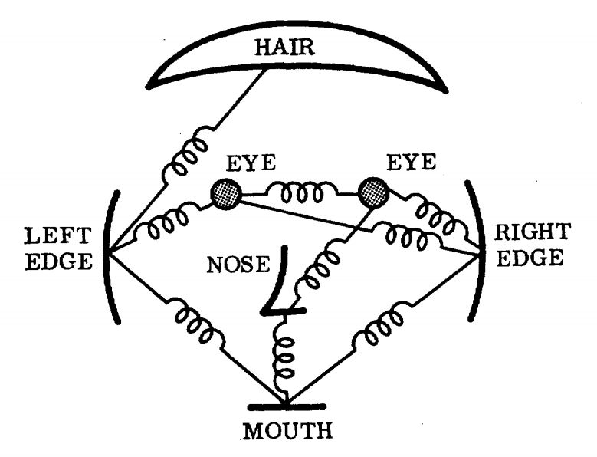
Pictorial structures

Slide 22
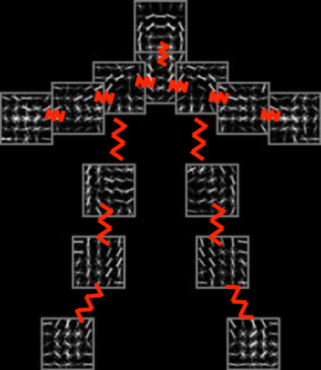
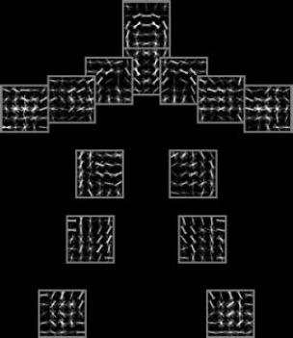
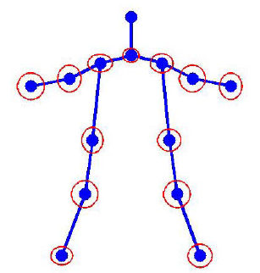




Flexible Mixture of Parts
$ψ(l_{i},l_{j})$: Spatial features between $l_{i}$ and $l_{j}$
$β_{ij}$: Pairwise springs between part $i$ and part $j$
Articulated Human Pose Estimation with Flexible Mixtures of Parts. Yi Yang and Deva Ramanan. TPAMI 2013.
Slide credit: Yang et al

Slide 23
Flexible Mixture of Parts
Learning?
Structured SVMs
  Very large output spaces
  A scoring function that scores input-output pairs
  Predicted output is arg max of scoring function
  Loss is margin rescaled loss
Support vector machine learning for interdependent and structured output spaces. Tsochantaridis I, Hofmann T, Joachims T, Altun Y. In ICML, 2004

Slide 24
Inference?

Slide 25
Iterative models
Inference in MRFs and CRFs usually iterative and approximate
  Except trees: FMP
Instead of learning scoring function, then approximately minimizing it
Learn iterative inference procedure?
  Similar to autocontext/inference machines

Slide 26
Autocontext and Inference Machines
Image
New
Pose estimate
Image
Pose
Current
Pose estimate

Slide 27
Autocontext and Inference Machines
Image
Image
Pose estimate(t)
Pose estimate(t+1)
Pose estimate(t+2)
Shared parameters: Inference Machines
Unshared parameters: Autocontext
Auto-context and Its Application to High-level Vision Tasks. Zhuowen Tu. In CVPR 2008.
Learning Message-Passing Inference Machines for Structured Prediction. Stephane Ross, Daniel Munoz, Martial Hebert, J. Andrew Bagnell. In CVPR 2011.

Slide 28
Iterative models
In each iteration, beliefs of one variable are updated using current beliefs of the others
Frame each iteration of inference as a differentiable function
Write inference as a convolutional network
Joint Training of a Convolutional Network and a Graphical Model for Human Pose Estimation. Jonathan Tompson, Arjun Jain, Yann LeCun, Christoph Bregler. In NIPS, 2014.

Slide 29
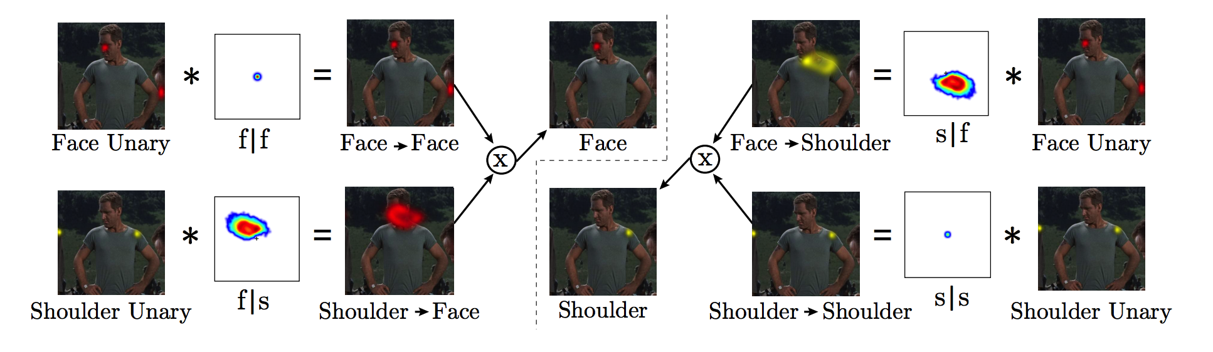
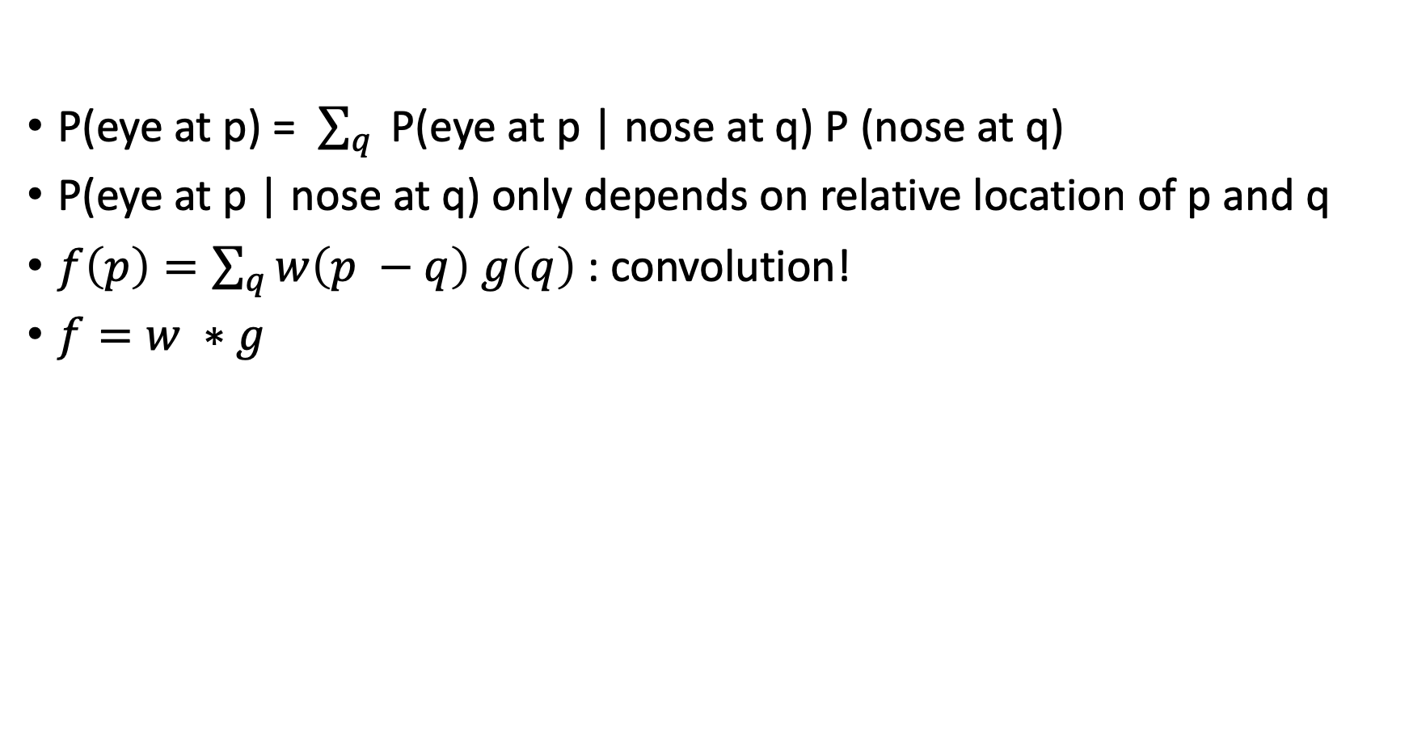
Iterative models
P(eye at p) = $\sum_{q}{ }$P(eye at p | nose at q) P (nose at q)
P(eye at p | nose at q) only depends on relative location of p and q
$f\left(p\right)=\sum_{q}{w\left(p −q\right) g\left(q\right)}$: convolution!
$f=w ∗g$

Slide 30
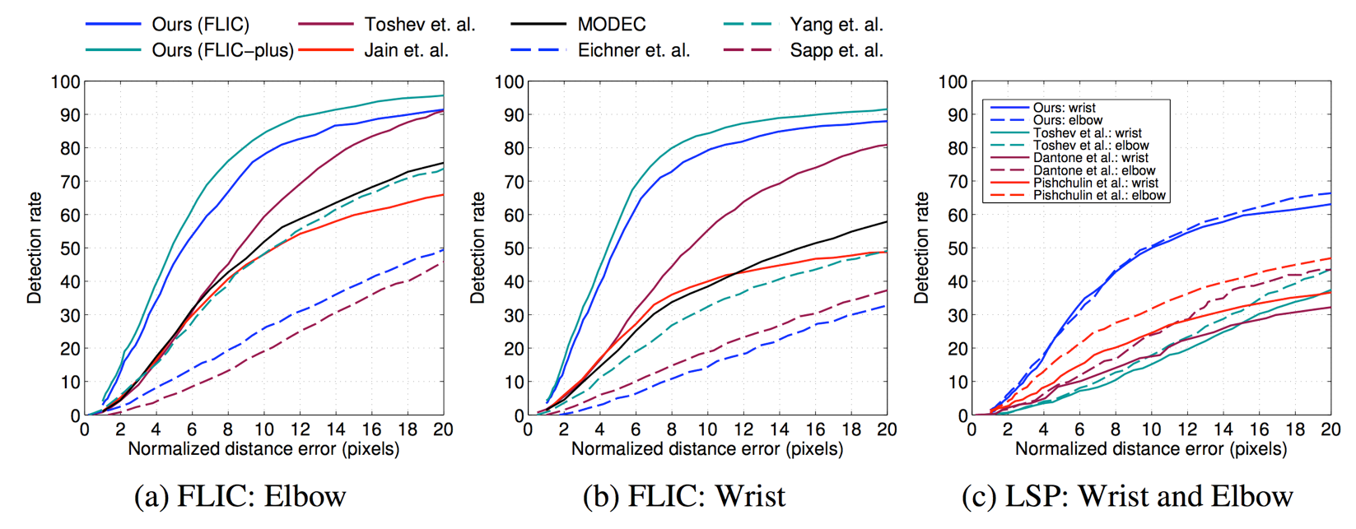
Iterative models
Mixture of parts
Regression
Joint Training of a Convolutional Network and a Graphical Model for Human Pose Estimation. Jonathan Tompson, Arjun Jain, Yann LeCun, Christoph Bregler. In NIPS, 2014.

Slide 31
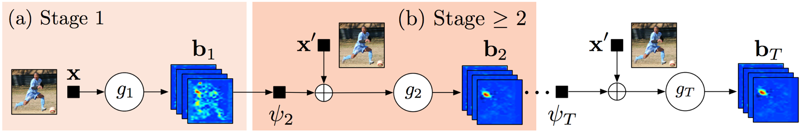
More iterative models
Why only one convolution?
Each iteration can involve multiple convolution/subsampling layers over beliefs from previous iteration
Convolutional Pose Machines. Shih-En Wei, Varun Ramakrishna, Takeo Kanade, Yaser Sheikh. In CVPR, 2016

Slide 32
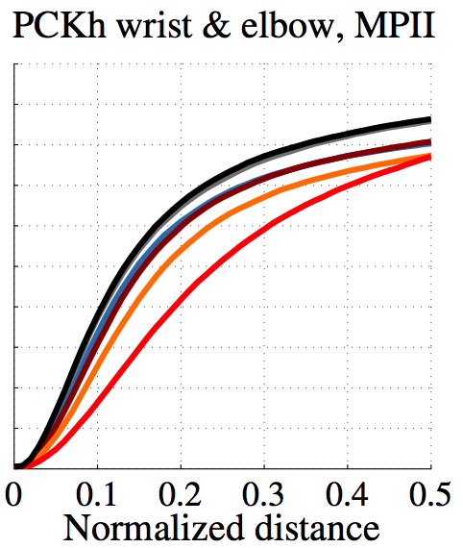

Slide 33
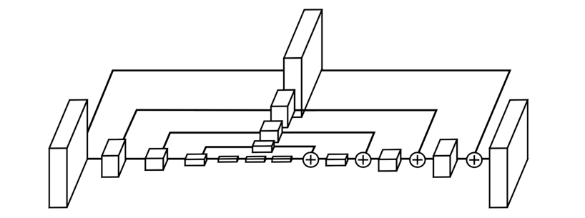
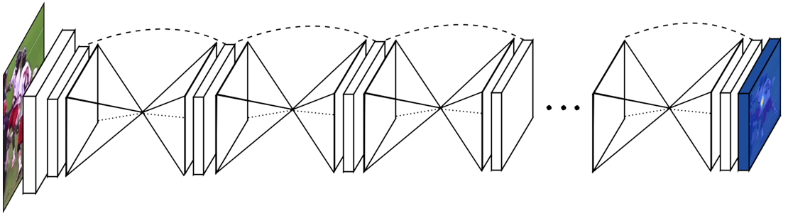
Stacked Hourglass Networks
Each refinement round has to
  Combine global information about pose
  Use global pose information to produce new precise pose estimate
Rounds need not share parameters
”Hourglass structure”
Stacked Hourglass Networks for Human Pose Estimation. Alejandro Newell, Kaiyu Yang, and Jia Deng. In ECCV, 2016.

Slide 34
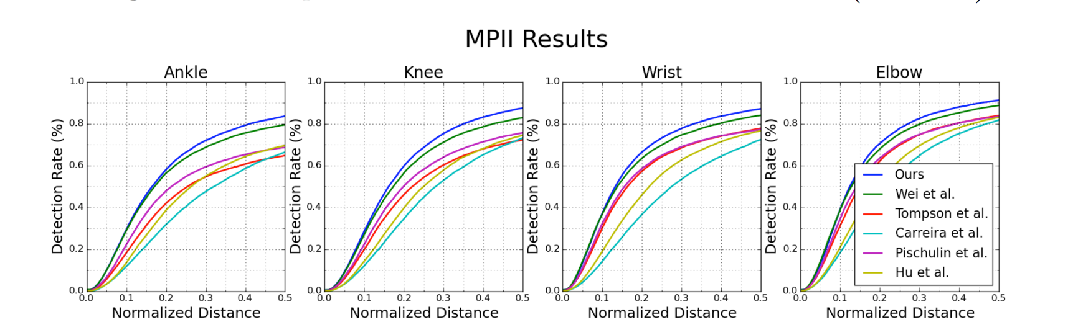
Stacked hourglass networks

Slide 35
Pose estimation without detection

Slide 36
Evaluation metric - tabula rasa
Algorithm detects keypoints + scores
Match keypoint to a ground truth keypoint if d/h is less than threshold
Compute precision-recall curve
Compute AP (called APK : AP Keypoint)

Slide 37
Two strategies
First detect, then estimate keypoints
  Can use any of previous techniques
  Similar to instance segmentation
  Easy to get object level information
  Hard to recover from bad detections
  e.g. Mask R-CNN
Detect keypoints, then group into people
  Need a way to group keypoints: hard problem, requires heuristics
  No simple way to have object level information

Slide 38
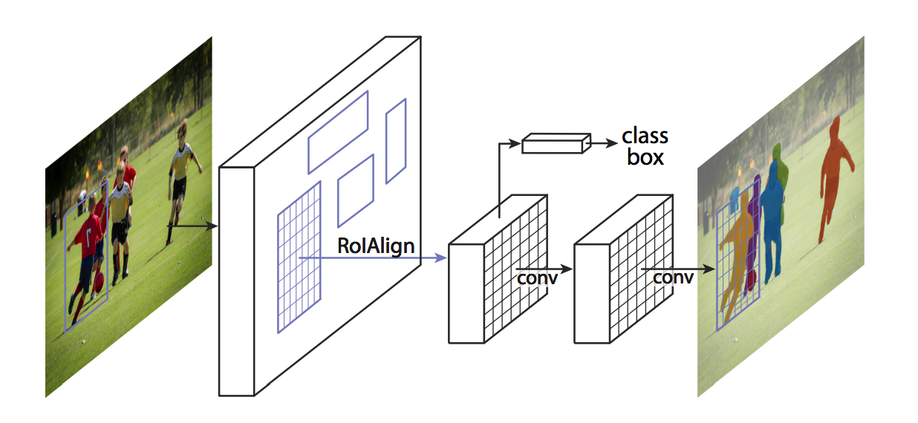
Top-down keypoint detection
He, Kaiming, et al. "Mask r-cnn." Computer Vision (ICCV), 2017 IEEE International Conference on. IEEE, 2017.

Slide 39
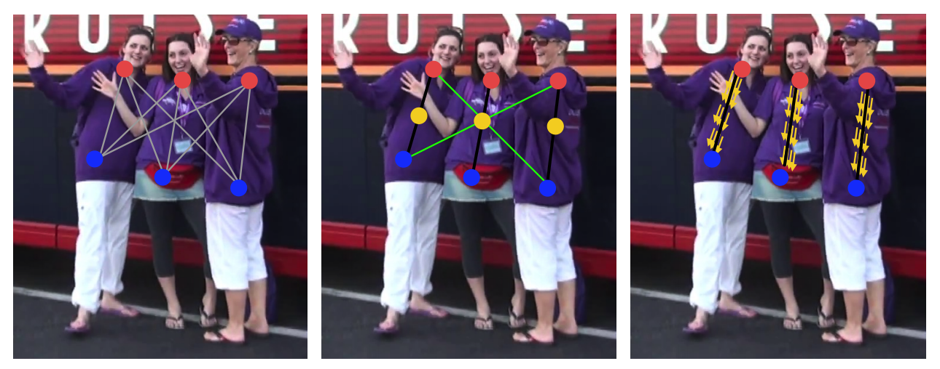
Bottom-up keypoint detection
Need to group keypoints. Can be really ambiguous
Idea: detect not just keypoints but also limbs + limb orientation
Realtime Multi-Person 2D Pose Estimation using Part Affinity Fields. Zhe Cao, Tomas Simon, Shih-En Wei, Yaser Sheikh. In CVPR, 2017.

Slide 40
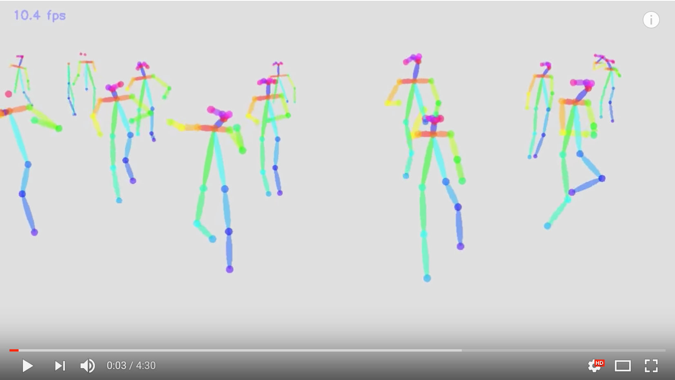
Realtime Multi-Person 2D Pose Estimation using Part Affinity Fields. Zhe Cao, Tomas Simon, Shih-En Wei, Yaser Sheikh. In CVPR, 2017.

Slide 41
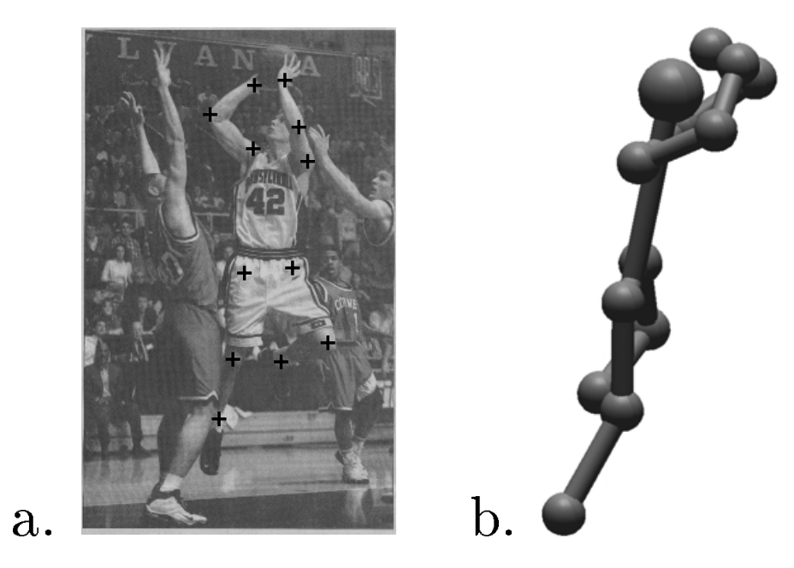
Pose estimation in 3D
Reconstruction of Articulated Objects from Point Correspondences in a Single Uncalibrated Image. C. J. Taylor. In CVPR, 2000

Slide 42
Pose estimation in 3D
Key idea: know relative lengths of each limb4
Assume scaled orthographic projection
  Valid when variation in depth much smaller than depth
constant
Reconstruction of Articulated Objects from Point Correspondences in a Single Uncalibrated Image. C. J. Taylor. In CVPR, 2000

Slide 43
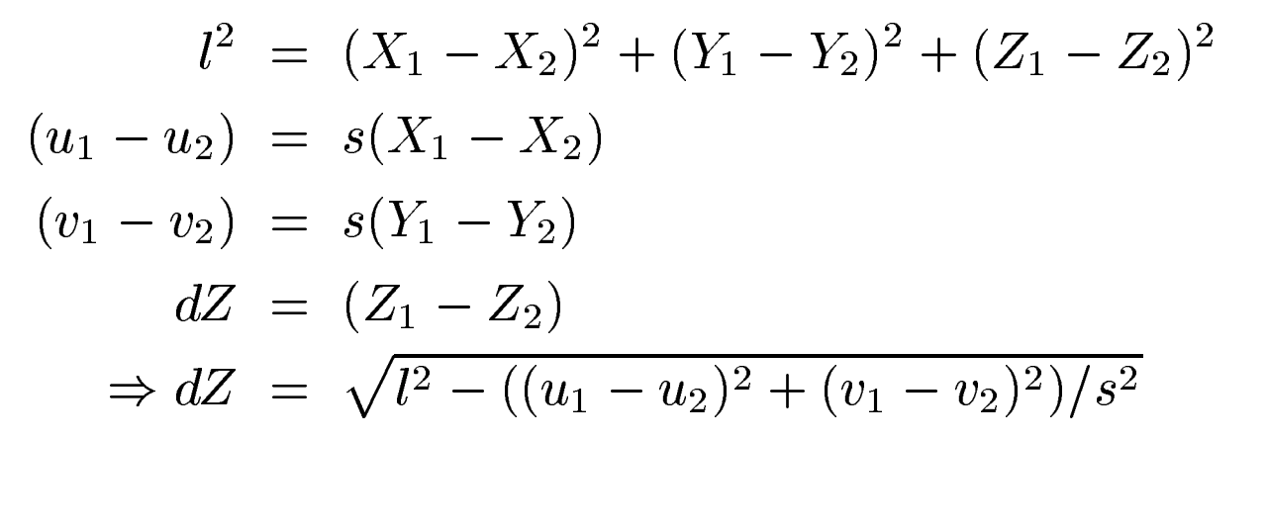
Pose estimation in 3D
Reconstruction of Articulated Objects from Point Correspondences in a Single Uncalibrated Image. C. J. Taylor. In CVPR, 2000

Slide 44
Pose estimation for rigid objects

Slide 45
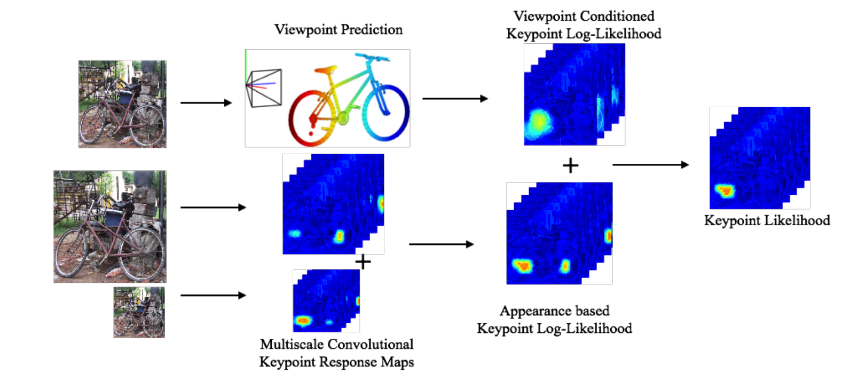
Pose estimation for rigid objects
Viewpoints and keypoints. S. Tulsiani and J. Malik. In CVPR, 2015

Slide 46
Pose estimation for rigid objects
Cyclo-rotation / roll
Azimuth / yaw
Elevation / pitch

Slide 47
Viewpoint-conditioned pose
Viewpoint prediction
Viewpoints and keypoints. S. Tulsiani and J. Malik. In CVPR, 2015

Slide 48
Viewpoint-conditioned pose
Viewpoint prediction
Viewpoints and keypoints. S. Tulsiani and J. Malik. In CVPR, 2015

Slide 49
Fitting viewpoint to keypoints
Idea: minimize reprojection error

Slide 50
Shape models
Problem: we need 3D location of each keypoint in canonical frame
  E.g., CAD model
If we have a set of CAD models, then we can try each one

Slide 51
Shape models

Slide 52
Shape models : shape basis
3p
c
3p
X
A
B
c
N
N

Slide 53
Shape models : shape basis

Slide 54
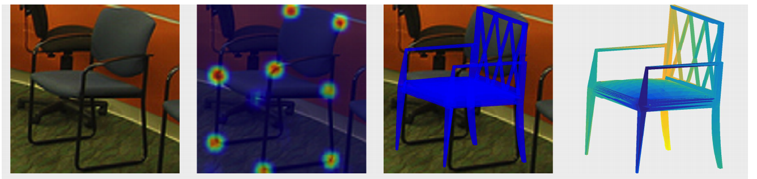
Fitting viewpoints to keypoints
6-DoF Object Pose from Semantic Keypoints. Georgios Pavlakos , Xiaowei Zhou , Aaron Chan , Konstantinos G. Derpanis , and Kostas Daniilidis. In ICRA, 2017.

