Slide 1
Object detection

Slide 2
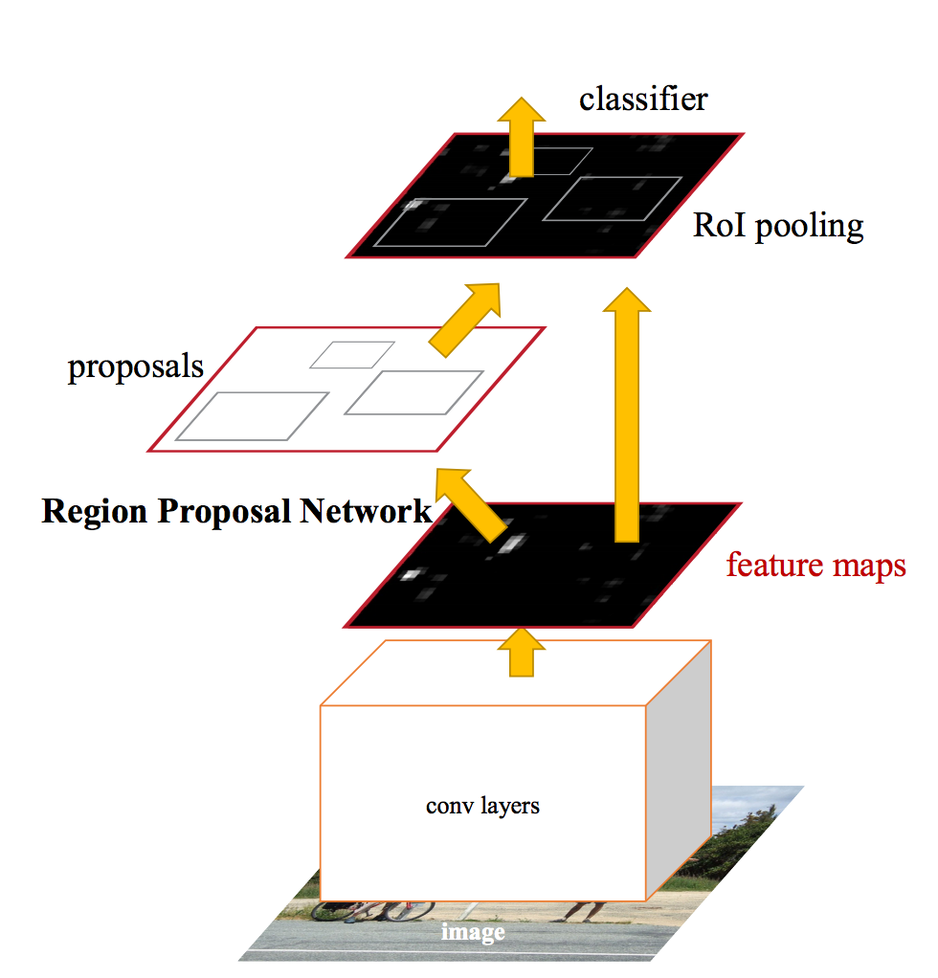
Faster R-CNN

Slide 3
Other details - Non-max suppression
0.9
0.8

Slide 4
Other details - Non-max suppression
Go down the list of detections starting from highest scoring
Eliminate any detection that overlaps highly with a higher scoring detection
Separate, heuristic step

Slide 5
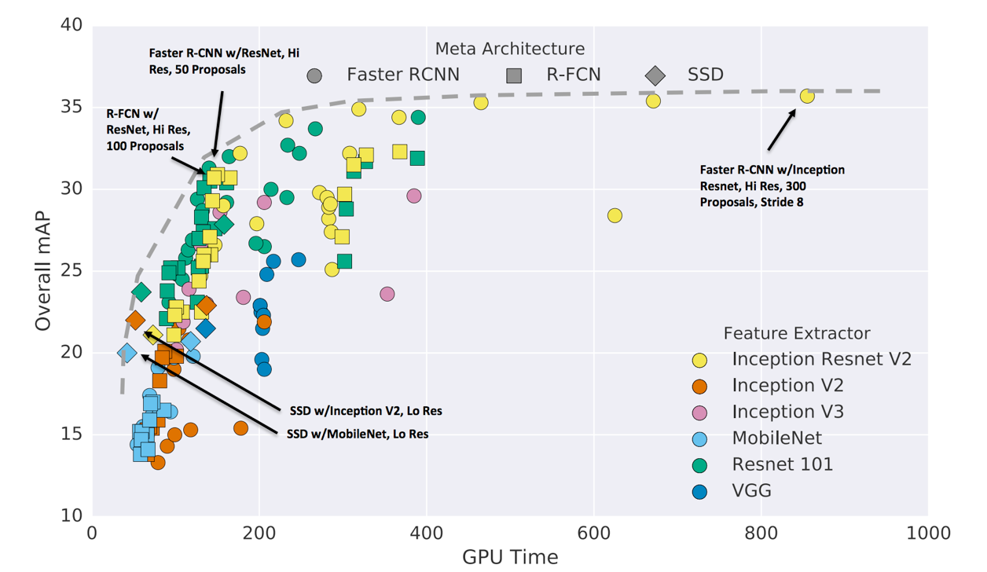
A comprehensive evaluation
Speed and accuracy trade-offs for modern convolutional object detectors
Alireza Fathi, Anoop Korattikara, Chen Sun, Ian Fischer, Jonathan Huang, Kevin Murphy, Menglong Zhu, Sergio Guadarrama, Vivek Rathod, Yang Song, Zbigniew Wojna
CVPR 2017

Slide 6
RoI pooling (Faster R-CNN) vs convolution (SSD)
Why does Faster R-CNN tend to be more accurate?
RoI pooling takes information from the precise box
Convolution takes information from just the kernel window

Slide 7
Other details - ROI Align
Snapping box to grid introduces quantization artifacts
Instead, use bilinear interpolation
Mask R-CNN. K. He, G. Gkioxari, P. Dollar, R. Girshick. In ICCV 2017.

Slide 8
Detecting small objects
Small objects get low resolution features

Slide 9
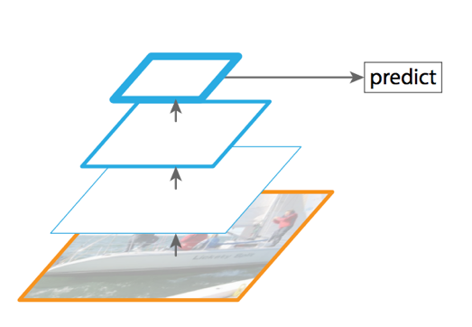
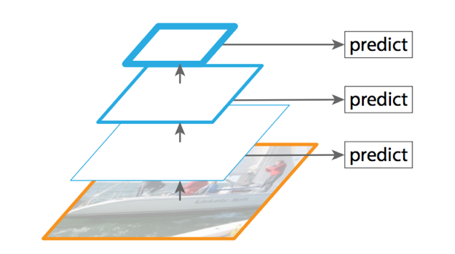
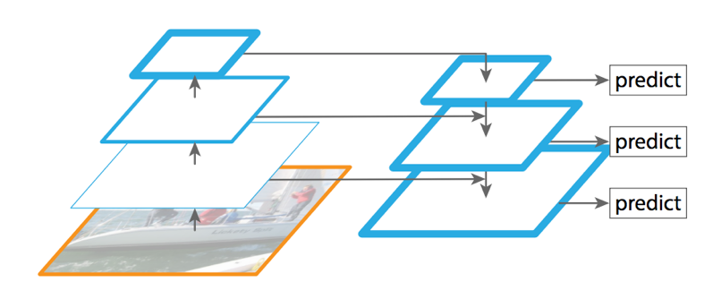
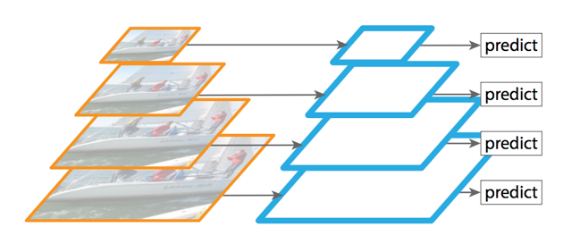
Feature pyramid networks
Standard detection
Detection using multiple layers
Detection on image pyramid
Detection using feature pyramid layers
Lin, Tsung-Yi, et al. "Feature Pyramid Networks for Object Detection." CVPR. Vol. 1. No. 2. 2017.

Slide 10
Feature pyramid networks
Lin, Tsung-Yi, et al. "Feature Pyramid Networks for Object Detection." CVPR. Vol. 1. No. 2. 2017.

Slide 11
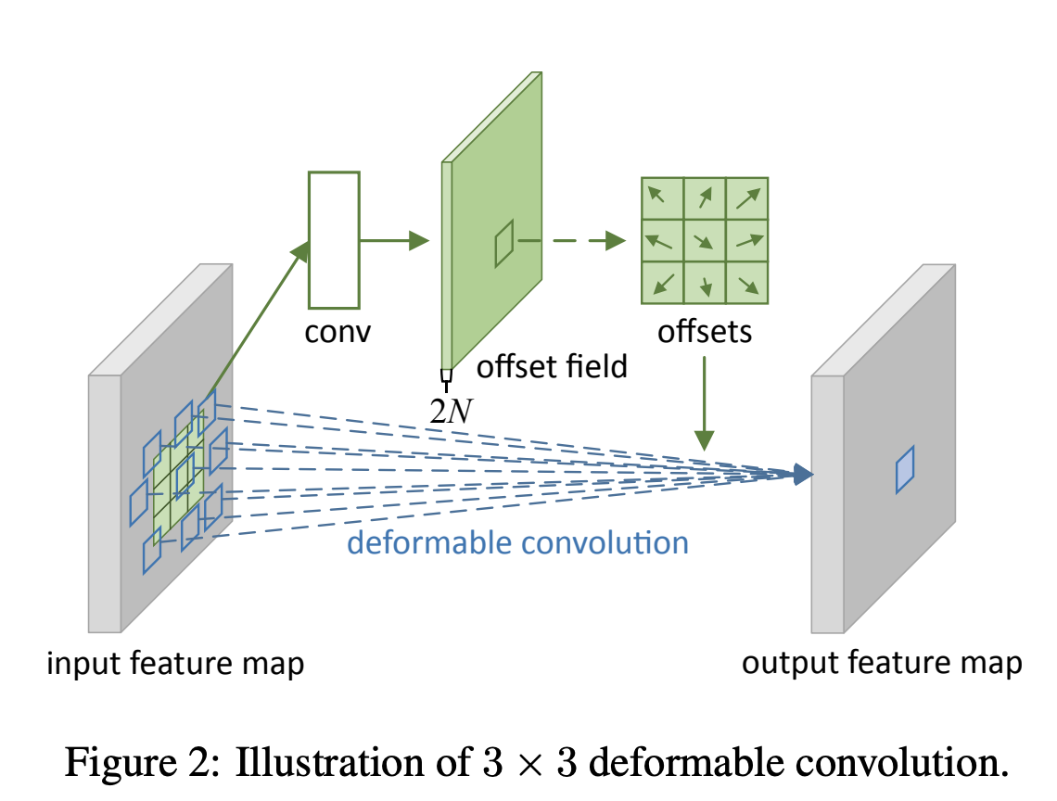
Deformable convolution
Convolution uses the same kernel size always
Want to capture more or less object region depending on scale
Or more generally properties of pixel
Idea: learn what pixels to combine using convolution

Slide 12
Instance segmentation

Slide 13
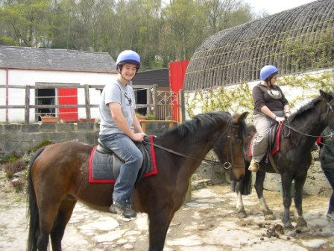
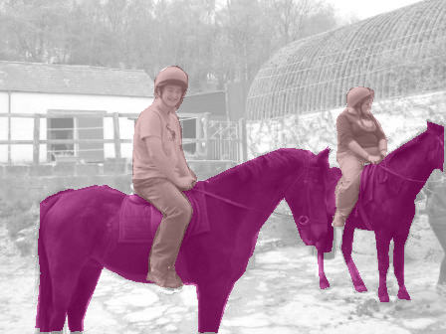
Till now
person 1
person 2
horse 1
horse, person
horse 2
Object Detection
horse
person
Image Classification
Semantic Segmentation
Notes:
Traditionally, “recognition” has been subdivided into a few different buckets. The first bucket is obviously image classification, where you want to assign labels to each image.
But we’ve also seen work on object detection. Given an image, an object detection system will detect each instance of a particular kind of object, and roughly localize it with a bounding box.
A bounding box is a very coarse output if you want to interact with a world. If you are trying to grasp an object you will need the precise boundaries of the object.
Alternatively a semantic segmentation system assigns category labels to pixels. This gives precise boundaries, but fails to resolve individual instances. This is again problematic because usually you want to interact with individual object instances, and a mass of “horseness” doesn’t help.

Slide 14
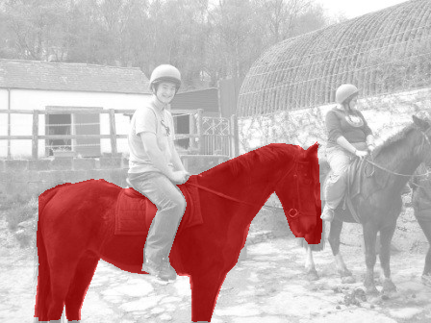
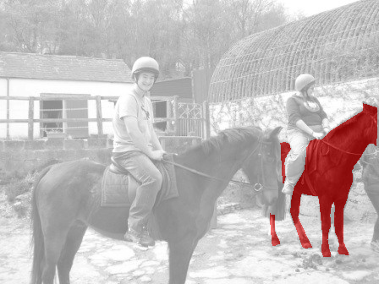
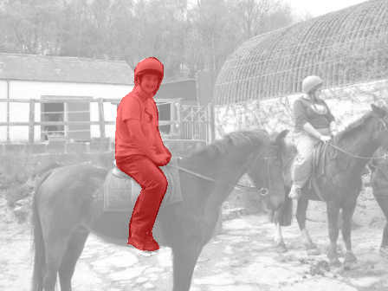
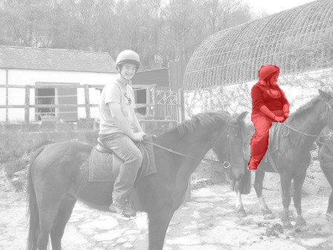
Fine-grained Localization
horse 1
horse 2
person 1
person 2
Instance Segmentation
Notes:
This motivation led us to propose the task of instance segmentation. An instance segmentation system detects every instance of a given object category and also segments them out. For instance, it will tell you that these are the boundaries of horse 1, these are the boundaries of horse 2, and so on.

Slide 15
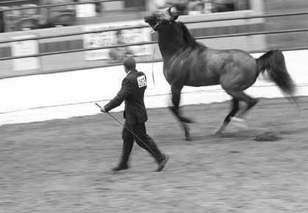
Evaluation Protocol
Sort predicted instances by confidence
Match prediction to closest annotation based on segment overlap
If segment overlap > threshold, correct
segment = overlap
U
Notes:
We will also assume that we have a held out test set annotated by humans with individual segmented instances and corresponding category labels. We will take each instance predicted by the model, and match it to the closest human annotation of that category based on the overlap of the two segments. The formula for this overlap is given here. If the overlap is greater than a threshold, we will consider the prediction a correct one, with the caveat that if a higher scoring prediction has already been matched to this annotation, we will consider the prediction a duplicate and thus incorrect.

Slide 16
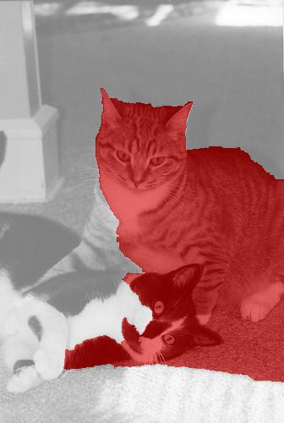
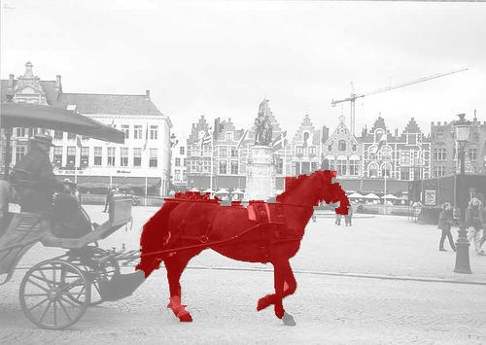
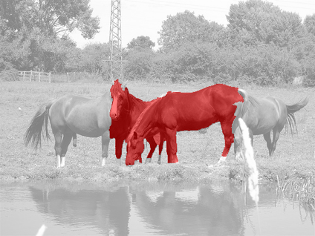
Evaluation Protocol
Labels = [ …. ]
Scores = [ 0.90 0.87 0.82 0.78 0.70 0.69 0.60 …. ]
Notes:
We therefore get a label for each prediction of the model.

Slide 17
Evaluation protocol
Average Precision (AP)

Slide 18
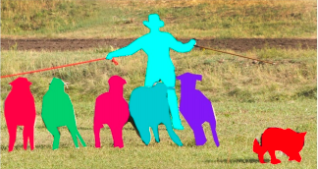
The COCO Challenge
mscoco.org
T. Y. Lin et al. Microsoft COCO: Common Objects in Context. In ECCV, 2014
Notes:
The task of instance segmentation gained a lot of traction in the community, and many people agreed that we need systems that can do this task. The COCO benchmark, which is not the definitive benchmark for all things object recognition, made this task front and center, and used our proposed evaluation protocol as part of their benchmark.
Instance segmentation is now an active area of research.

Slide 19
Two strategies
Segment then classify
Use bottom-up techniques to come up with segment proposals
Classify segment proposals with convnets
Segmentation is category agnostic
Modification: use convnets to produce segmentation proposals
Detect then segment
Use standard object detection to produce boxes
Segment boxes
Segmentation is category specific

Slide 20
Box proposals
Use segmentation to produce ~5K candidates
Selective Search for Object Recognition J. R. R. Uijlings, K. E. A. van de Sande, T. Gevers, A. W. M. Smeulders In International Journal of Computer Vision 2013.

Slide 21
Segment proposals
Multi-scale combinatorial grouping. Pablo Arbelaez, Jordi Pont-Tuset, Jonathan Barron, Ferran Marques, Jitendra Malik. In CVPR, 2014.

Slide 22
R-CNN for instance segmentation
Simultaneous Detection and Segmentation Bharath Hariharan , Pablo Arbelaez , Ross Girshick, Jitendra Malik. In ECCV 2014

Slide 23
Two strategies
Segment then classify
Use bottom-up techniques to come up with segment proposals
Classify segment proposals with convnets
Segmentation is category agnostic
Modification: use convnets to produce segmentation proposals
Detect then segment
Use standard object detection to produce boxes
Segment boxes
Segmentation is category specific

Slide 24
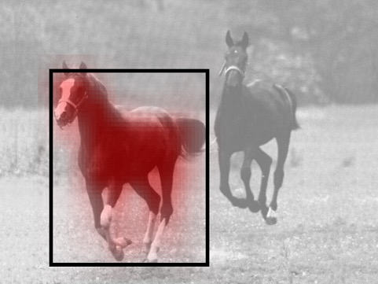
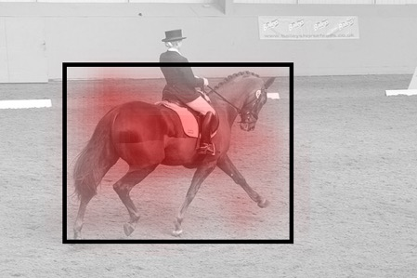
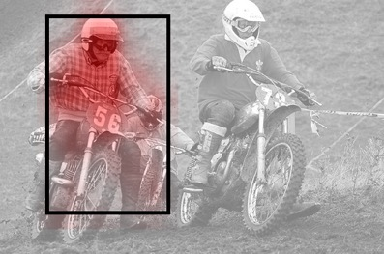
Detect then segment
How should we segment a detected object?
We have already computed features using ROI Pooling
Idea: use features to predict mask!
Can either use a simple linear layer
Or can use convolution
Issue: can be very coarse

Slide 25
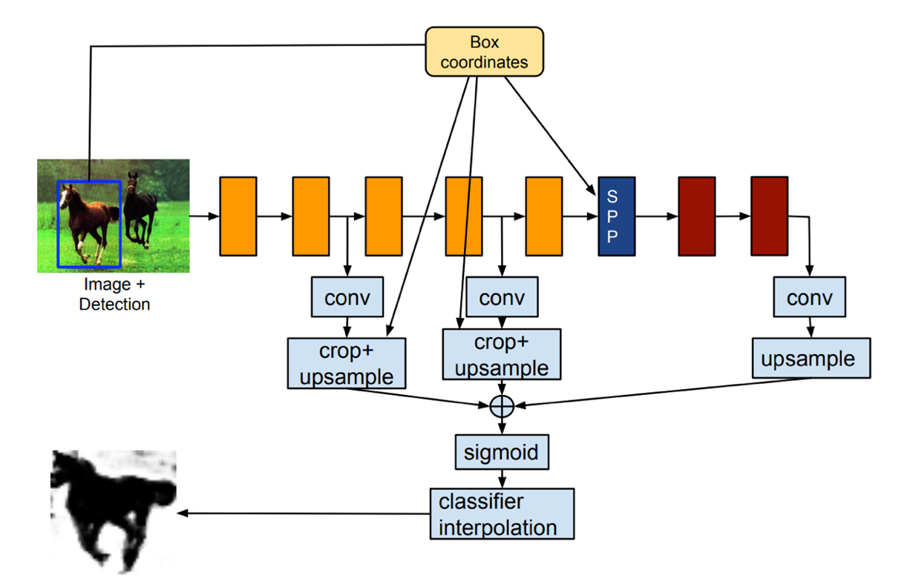
Skip connections with RoI pooling
Finer-grained segmentation: tap into earlier layers
RoI Pool
Hariharan, Bharath, et al. "Object instance segmentation and fine-grained localization using hypercolumns." IEEE Transactions on Pattern Analysis & Machine Intelligence 4 (2017): 627-639.

Slide 26
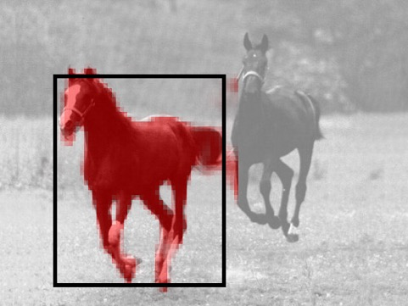
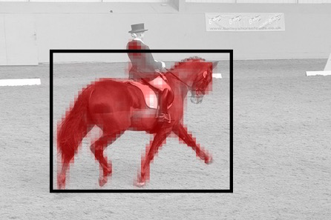
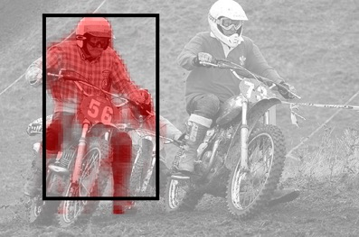
Skip connections for finer-grained details
Hypercolumns for Object Segmentation and Fine-grained Localization. Bharath Hariharan, Pablo Arbeláez, Ross Girshick, Jitendra Malik. CVPR, 2015

Slide 27
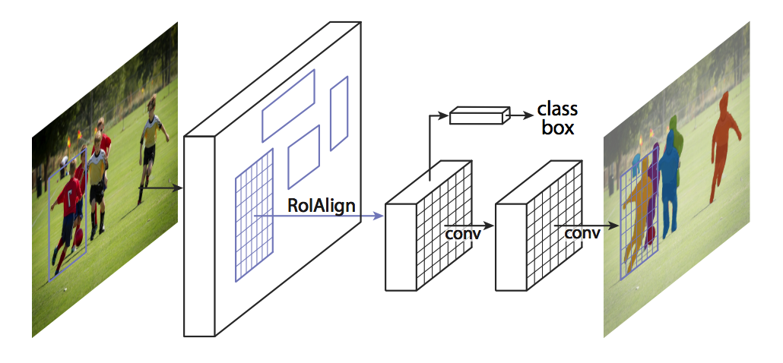
Mask R-CNN
With deeper networks and ROI Align, skip connections not needed (?)
He, Kaiming, et al. "Mask r-cnn." Computer Vision (ICCV), 2017 IEEE International Conference on. IEEE, 2017.

Slide 28
Final results - what works?
First detect, then segment
Big problem for instance segmentation is object detection
Mask R-CNN (Faster R-CNN + convolution on RoI Pooled feature to get masks) is good starting point

