Slide 1
Graphical models for refinement

Slide 2
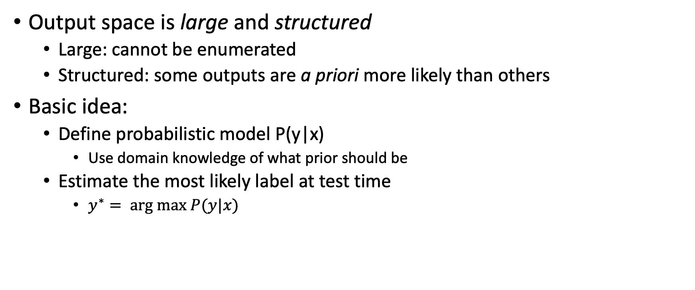
Last time: structured prediction
Output space is large and structured
  Large: cannot be enumerated
  Structured: some outputs are a priori more likely than others
Basic idea:
  Define probabilistic model P(y|x)
    Use domain knowledge of what prior should be
  Estimate the most likely label at test time
    $y^{∗}= arg max P(y|x)$

Slide 3
Defining probabilistic model for segmentation
Conditional Random Field

Slide 4
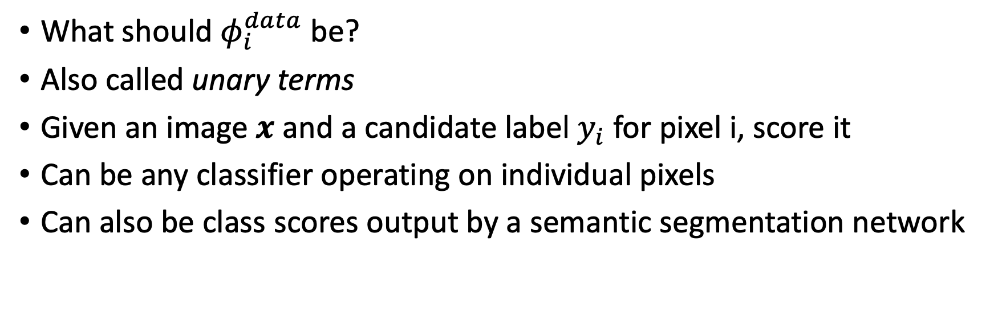
Example data terms
What should $φ_{i}^{data}$ be?
Also called unary terms
Given an image $x$ and a candidate label $y_{i}$ for pixel i, score it
Can be any classifier operating on individual pixels
Can also be class scores output by a semantic segmentation network

Slide 5
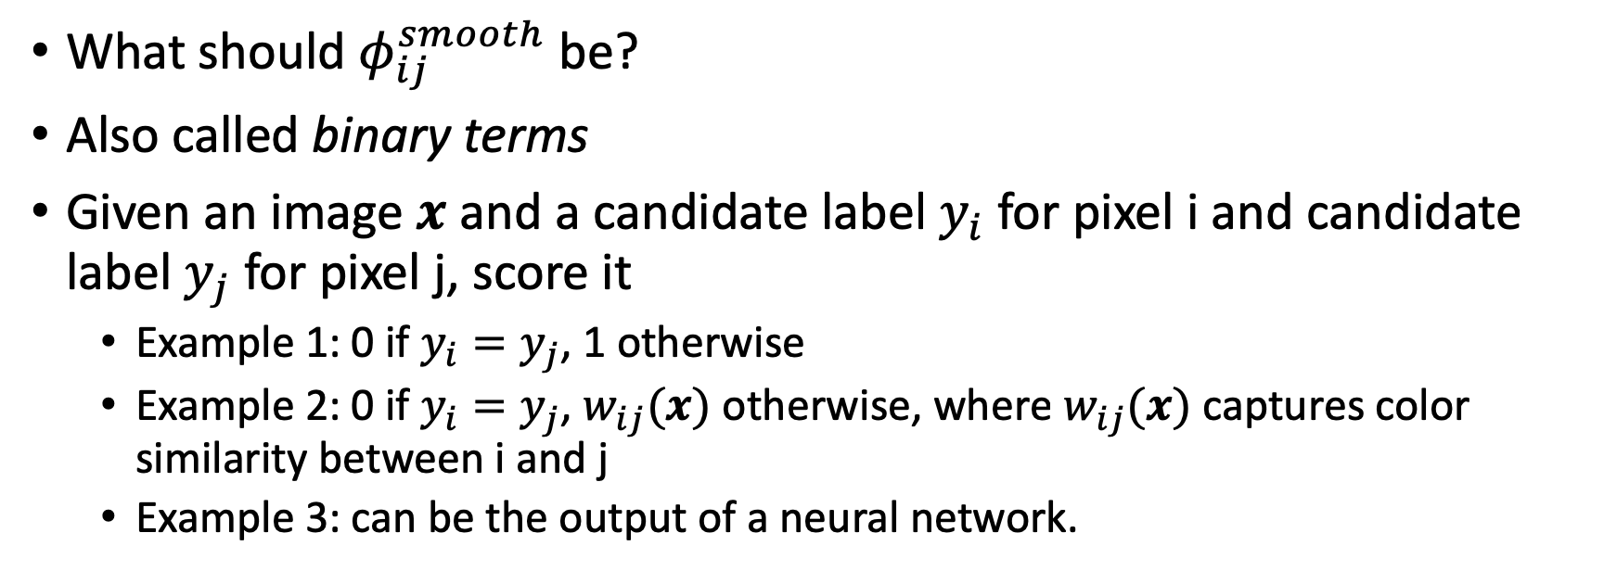
Example smoothness terms
What should $φ_{ij}^{smooth}$ be?
Also called binary terms
Given an image $x$ and a candidate label $y_{i}$ for pixel i and candidate label $y_{j}$ for pixel j, score it
  Example 1: 0 if $y_{i}=y_{j}$, 1 otherwise
  Example 2: 0 if $y_{i}=y_{j}$, $w_{ij}(x)$ otherwise, where $w_{ij}(x)$ captures color similarity between i and j
  Example 3: can be the output of a neural network.

Slide 6
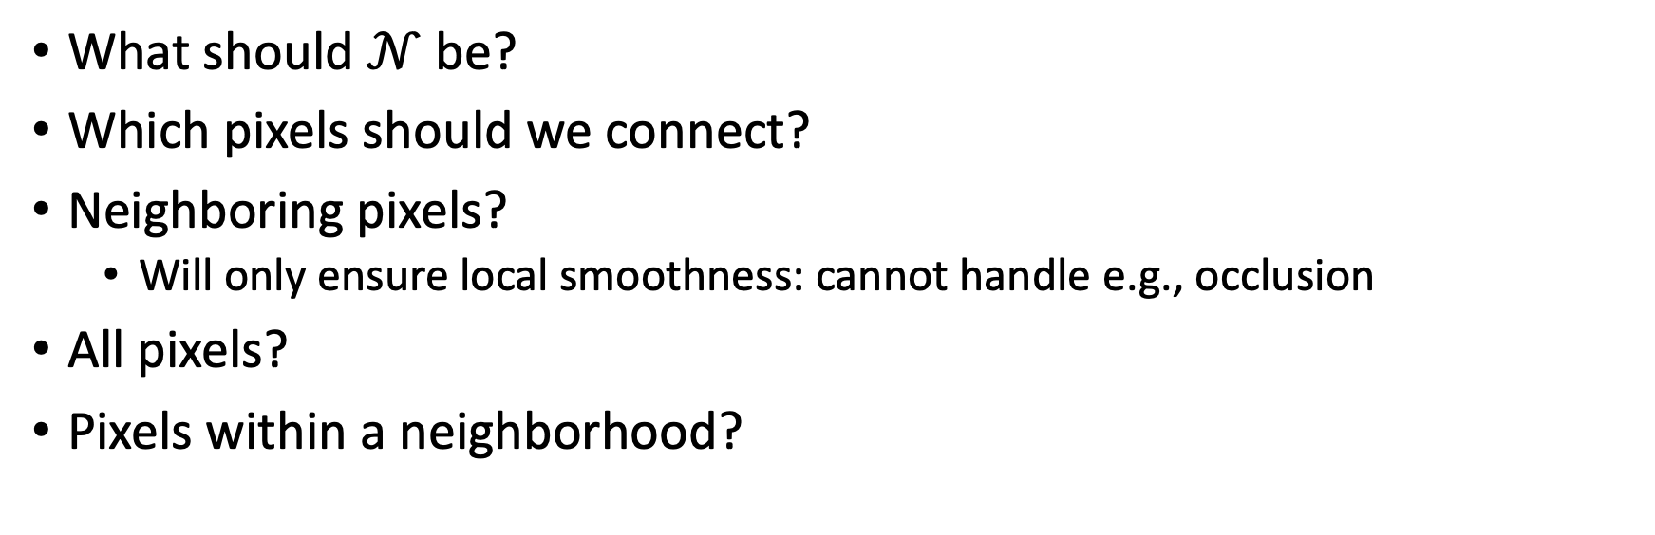
Example graph structure
What should $𝒩$ be?
Which pixels should we connect?
Neighboring pixels?
  Will only ensure local smoothness: cannot handle e.g., occlusion
All pixels?
Pixels within a neighborhood?

Slide 7
MAP estimation
When is this arg min solvable? When is it not?
If not solvable, can we make approximations?

Slide 8

When is MAP estimation tractable?
1
2
3
Consider a tree
MAP problem:
Let’s see how we might get the value of $y_{1}^{∗}$

Slide 9
When is MAP estimation tractable?
1
2
3
Consider a tree
Rearranging:

Slide 10
When is MAP estimation tractable?
1
2
3
Consider a tree
Push max in:
Get y₁* from here!

Slide 11
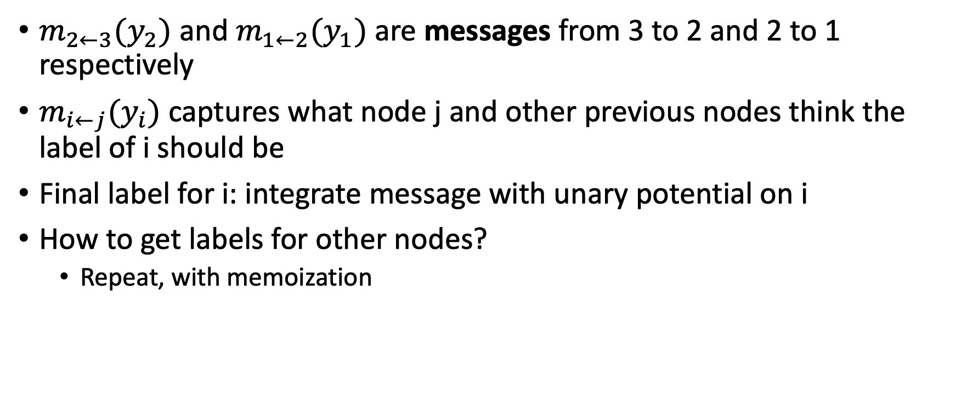
Message passing / Belief propagation
$m_{2←3}(y_{2})$ and $m_{1←2}(y_{1})$ are messages from 3 to 2 and 2 to 1 respectively
$m_{i←j}(y_{i})$ captures what node j and other previous nodes think the label of i should be
Final label for i: integrate message with unary potential on i
How to get labels for other nodes?
  Repeat, with memoization

Slide 12

Message passing/belief propagation
General algorithm: belief propagation
Each node starts with a belief $b_{i}(⋅)$ about what its label should be
Nodes send messages $m_{i←j}(⋅)$ to other nodes
Beliefs get updated based on messages

Slide 13
Messsage passing / belief propagation
Initialization
Repeat:

Slide 14
When is MAP estimation tractable?
When graph is a tree
  Designate one node as root
  Send messages from leaves inward
  Send messages from root outward
  Done!
When graph is not tree, belief propagation not guaranteed to converge and not guaranteed to be correct

Slide 15
Images
Usually grid structure: not tractable
Sometimes fully connected graphs
Smoothness potential depends on labels and color and position difference between pixels
Label compatibility
Pixel similarity

Slide 16
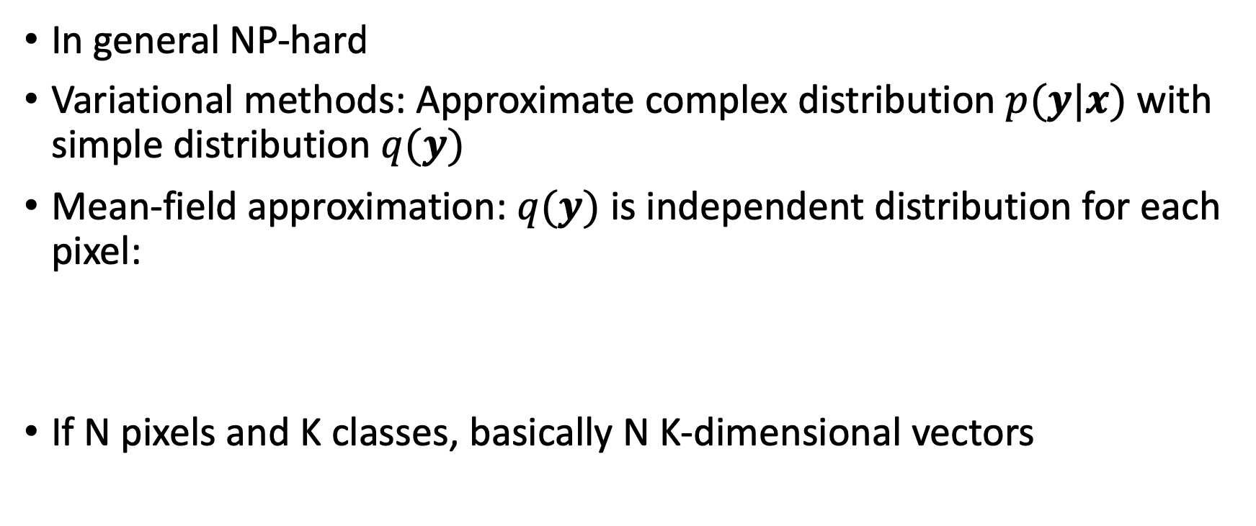
Inference in CRFs
In general NP-hard
Variational methods: Approximate complex distribution $p(y|x)$ with simple distribution $q(y)$
Mean-field approximation: $q(y)$ is independent distribution for each pixel:
If N pixels and K classes, basically N K-dimensional vectors

Slide 17
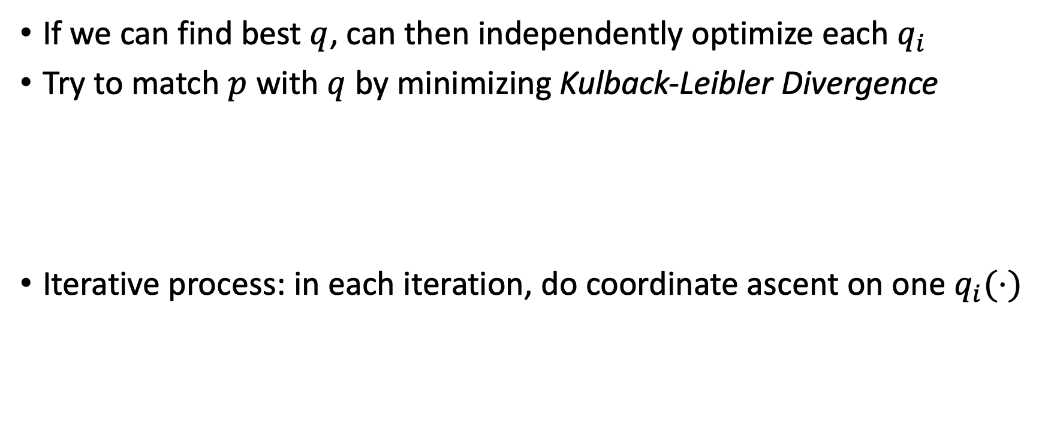
Mean field inference
If we can find best $q$, can then independently optimize each $q_{i}$
Try to match $p$ with $q$ by minimizing Kulback-Leibler Divergence
Iterative process: in each iteration, do coordinate ascent on one $q_{i}(⋅)$

Slide 18
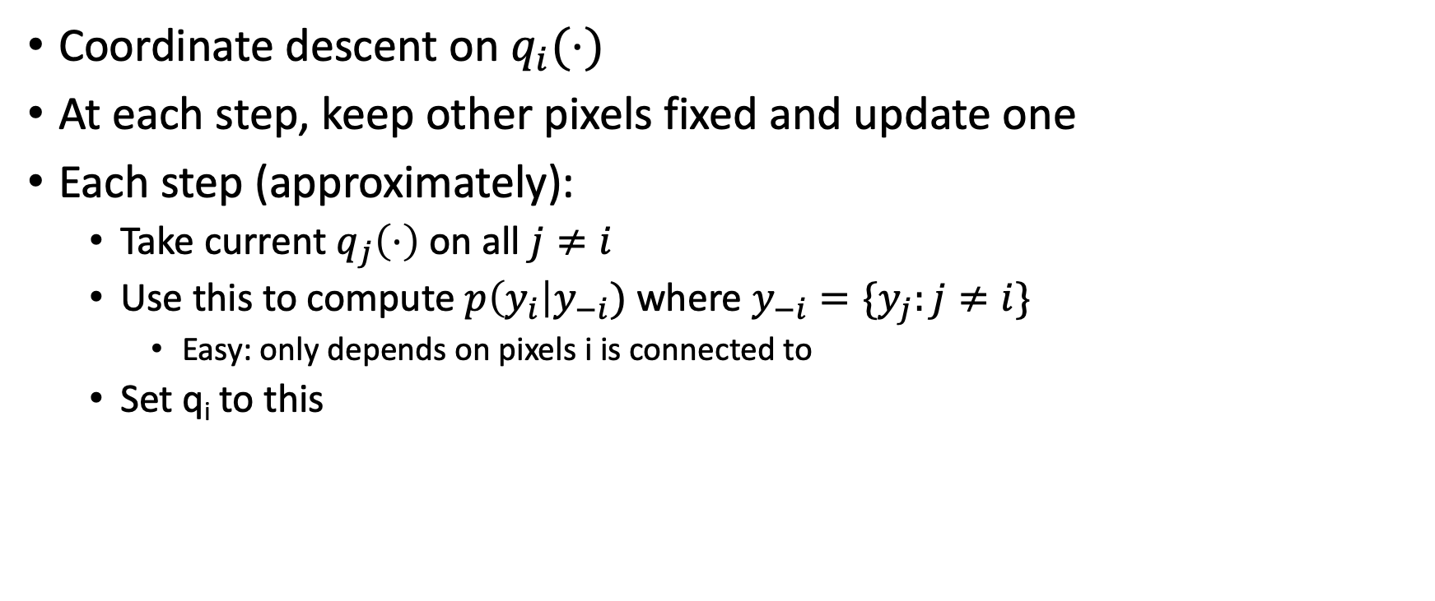
Mean field inference
Coordinate descent on $q_{i}(⋅)$
At each step, keep other pixels fixed and update one
Each step (approximately):
  Take current $q_{j}\left(⋅\right)$ on all $j≠i$
  Use this to compute $p\left(y_{i}\right|y_{−i})$ where $y_{−i}=\{y_{j}:j≠i\}$
    Easy: only depends on pixels i is connected to
  Set q_{i} to this

Slide 19
Fully Connected CRFs
Typically, only adjacent pixels connected
  Fewer connections => Easier to optimize
Dense connectivity: every pixel connected to everything else
Intractable to optimize except if pairwise potential takes specific form
Efficient Inference in Fully Connected CRFs with Gaussian Edge Potentials. Philipp Krahenbuhl, Vladlen Koltun. In NIPS, 2011.

Slide 20
Gaussian edge potentials
What should f be?
simple answer: color, position

Slide 21
Mean field inference for Dense-CRF
Unary
Label compatibility transform
Message passing

Slide 22
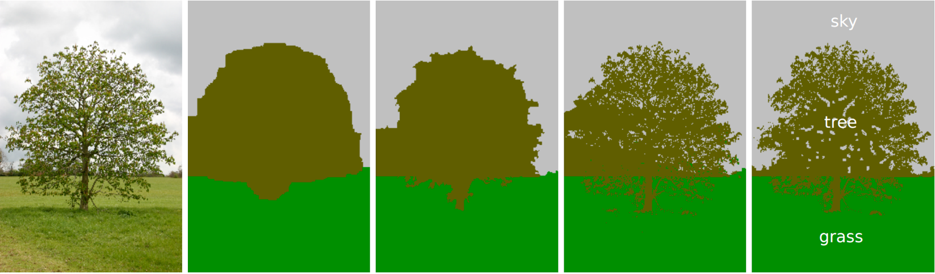
Fully Connected CRFs
Grid CRF
Fully connected CRF
Ground truth

Slide 23
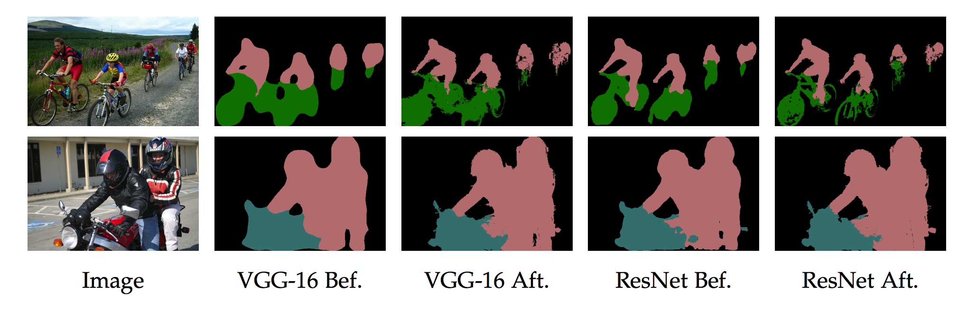
Fully connected CRFs
Semantic Image Segmentation with Deep Convolutional Nets and Fully Connected CRFs. Liang-Chieh Chen, George Papandreou, Iasonas Kokkinos, Kevin Murphy, Alan Yuille. In ICLR, 2015.

Slide 24
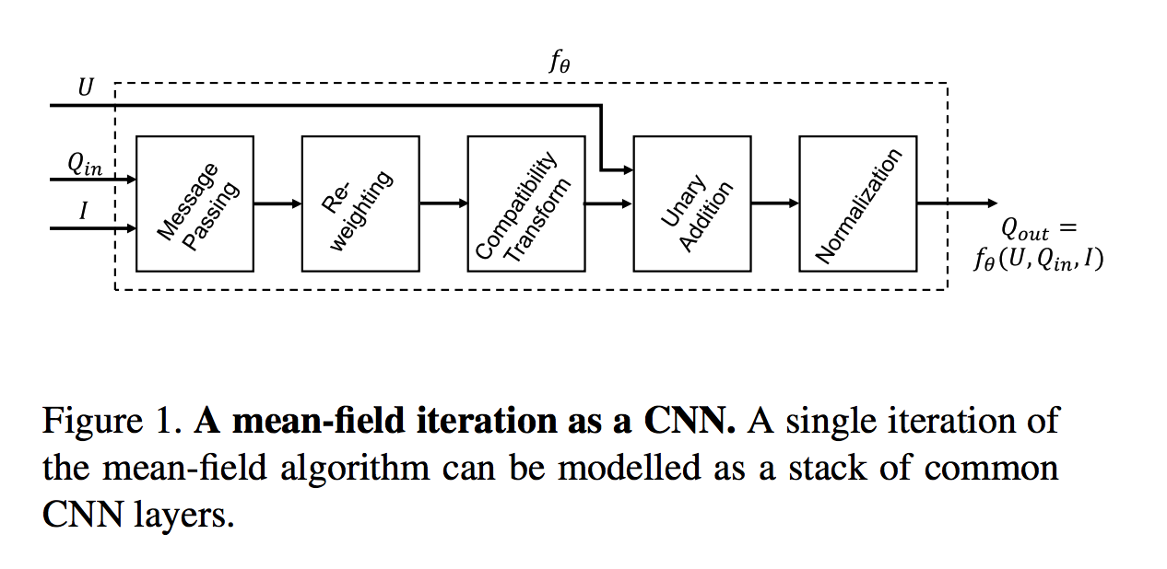
Mean field inference as a recurrent network
Zheng, Shuai, et al. "Conditional random fields as recurrent neural networks." Proceedings of the IEEE international conference on computer vision. 2015.

Slide 25
Inference as iterated refinement
Mean field inference and belief propagation are iterative processes
  In each iteration, update pixel beliefs based on current estimates of neighbors
In general approximate and may not converge
We created ideal probability distribution, then constructed approximate inference scheme
Can we directly design iterated inference scheme?

Slide 26
Autocontext-like techniques
Key idea: directly train iterative refinement scheme.
Initial prediction based just on unaries (for example)
i-th classifier takes as input image and output of (i-1)-th classifier and makes prediction
Allows each classifier to use full context from previous prediction

Slide 27
What if i-th classifier overfits?
Domain shift for the next classifier
Idea: train each classifier on a separate set of inputs
  Split dataset into 2 folds
  Train separate classifiers on each fold
  Use predictions on held-out set to train subsequent predictions

Slide 28
Shared vs separate classifiers
Using separate classifiers at each step adds parameters
Can we train a single refinement module?
Inference machines

Slide 29
Autocontext and Inference Machines
Image
Image
Estimate(t)
Estimate(t+1)
Estimate(t+2)
Shared parameters: Inference Machines
Unshared parameters: Autocontext
Auto-context and Its Application to High-level Vision Tasks. Zhuowen Tu. In CVPR 2008.
Learning Message-Passing Inference Machines for Structured Prediction. Stephane Ross, Daniel Munoz, Martial Hebert, J. Andrew Bagnell. In CVPR 2011.

