Slide 1
Optical flow

Slide 2
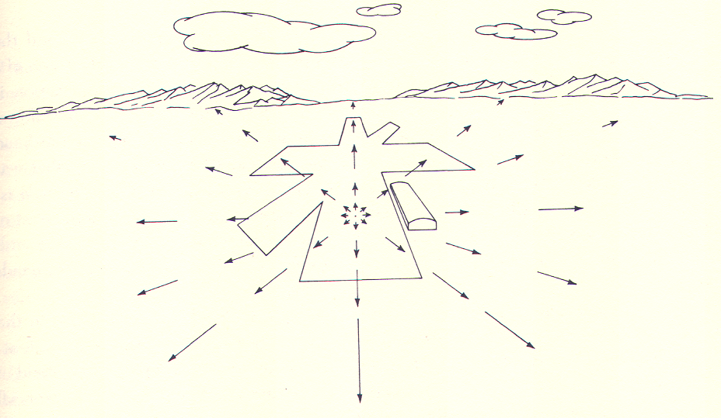
Focus of expansion
J. J. Gibson

Slide 3
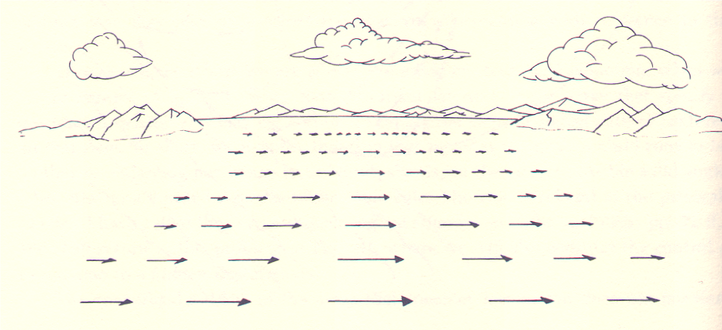

Slide 4
Optical flow due to camera motion
Consider camera translating and rotating

Slide 5
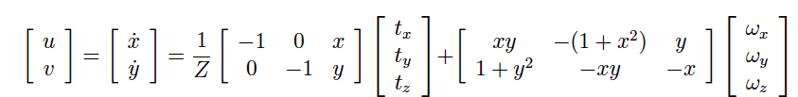
Optical flow due to camera motion

Slide 6
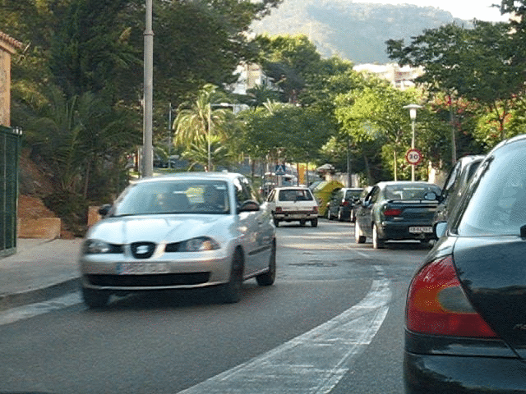
Optical flow for moving scenes

Slide 7
Optical flow for moving scenes

Slide 8
Optical flow for moving scenes
Optical flow helps grouping
Gestalt principle of common fate
  Things that move together belong together

Slide 9
Motion segmentation in humans
Elizabeth Spielke. Principles of Object Perception. In Cognitive Science, 1990.
Notes:
There is evidence from human psychology that this is a really important cue. For example, if you show really young infants this static display on the left, then they cannot distinguish between the two options on the right. In other words, they are unable to decide if the two halves of the rod form a single unified object, or whether they are indeed two rods.

Slide 10
Motion segmentation in humans
Elizabeth Spielke. Principles of Object Perception. In Cognitive Science, 1990.
Notes:
However, if you show infants this moving display

Slide 11
Motion segmentation in humans
Elizabeth Spielke. Principles of Object Perception. In Cognitive Science, 1990.
Notes:
Then they do perceive the rod as connected. This suggests that very young infants are unable to perceive any sort of depth ordering in the static image, but when objects move, they actually use the fact that things that move together form part of a single object.

Slide 12
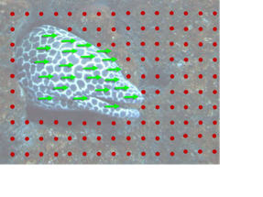
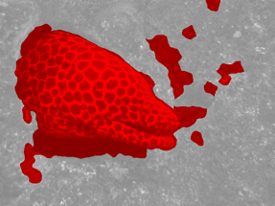
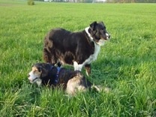
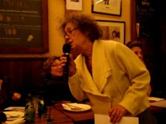
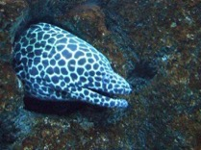
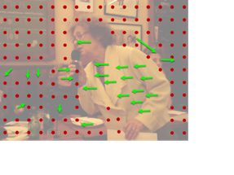
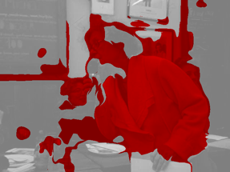
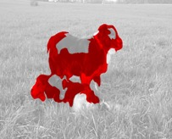
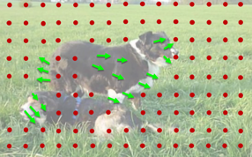
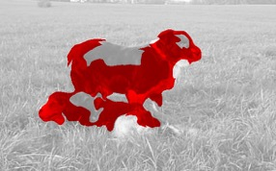


1. Collect videos
2. Segment using motion
3. Train ConvNet
Learning Features by Watching Objects Move. D. Pathak, R. Girshick, P. Dollar, T. Darrell, B. Hariharan. CVPR, 2017.
Notes:
This led to a fairly straightforward approach to learning representations in an unsupervised manner: we collected a large number of uncurated videos, we used motion grouping to segment out the foreground in each frame, and then we trained a ConvNet to predict this foreground segmentation

Slide 13
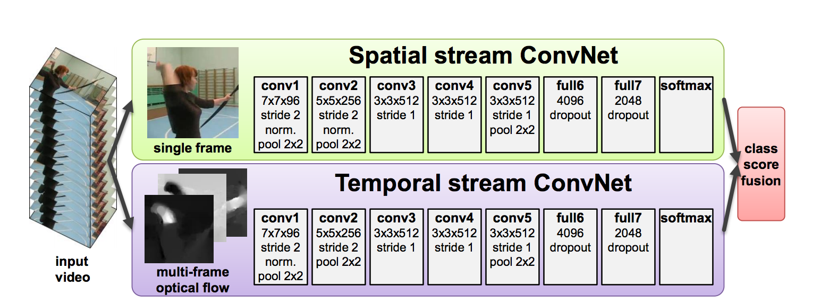
Optical flow for moving scenes
Motion is cue for recognition
  Gestures, actions, …
Two-Stream Convolutional Networks for Action Recognition in Videos. Simonyan and Zisserman. In NIPS 2014.

Slide 14
Optical flow for moving scenes
Motion is cue for recognition
  Gestures, actions, …
Model | Accuracy
Without optical flow | 73.0%
With optical flow | 88.0%
Two-Stream Convolutional Networks for Action Recognition in Videos. Simonyan and Zisserman. In NIPS 2014.

Slide 15
Estimating optical flow
Yet another correspondence problem!
But:
  Bad: scene can move
  Good: changes are usually very small (often sub-pixel)

Slide 16
Optical flow constraint equation
Image intensity continuous function of x, y, t
In time dt, pixel (x,y,t) moves to (x + u dt, y + v dt, t + dt)
Optical flow constraint equation: One equation, two variables

Slide 17
Lucas-Kanade
Assume all pixels in patch have the same flow
When will this produce a unique solution?

Slide 18
Aperture problem

Slide 19
Aperture problem

Slide 20
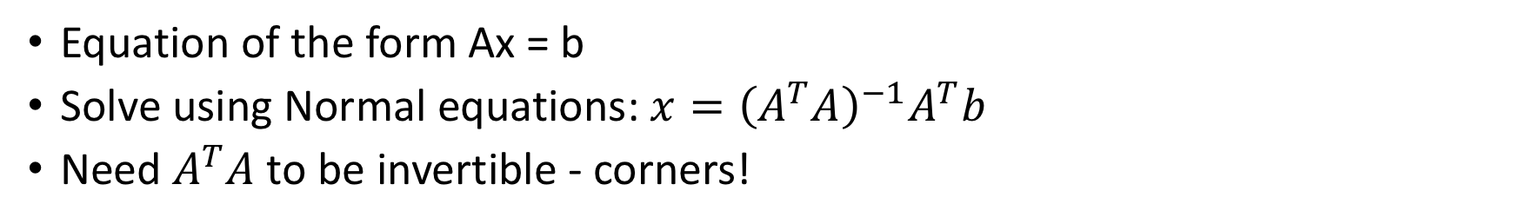
Lucas-Kanade
Equation of the form Ax = b
Solve using Normal equations: $x={\left(A^{T}A\right)}^{−1}A^{T}b$
Need $A^{T}A$ to be invertible - corners!

Slide 21
Lucas-Kanade
What if we consider the whole image as one patch?
  Constant optical flow for the entire image?
Better: what if we consider flow as a parametric function of pixel location?
  e.g. affine
  More generally:
    W is some 2D → 2D parametric warp function
    p is a parameter vector
  “Motion models”

Slide 22
Lucas-Kanade
T is the previous frame, also called template
I is the current frame
Goal is to find p
Baker, Simon, and Iain Matthews. "Lucas-kanade 20 years on: A unifying framework." International journal of computer vision 56.3 (2004): 221-255.

Slide 23
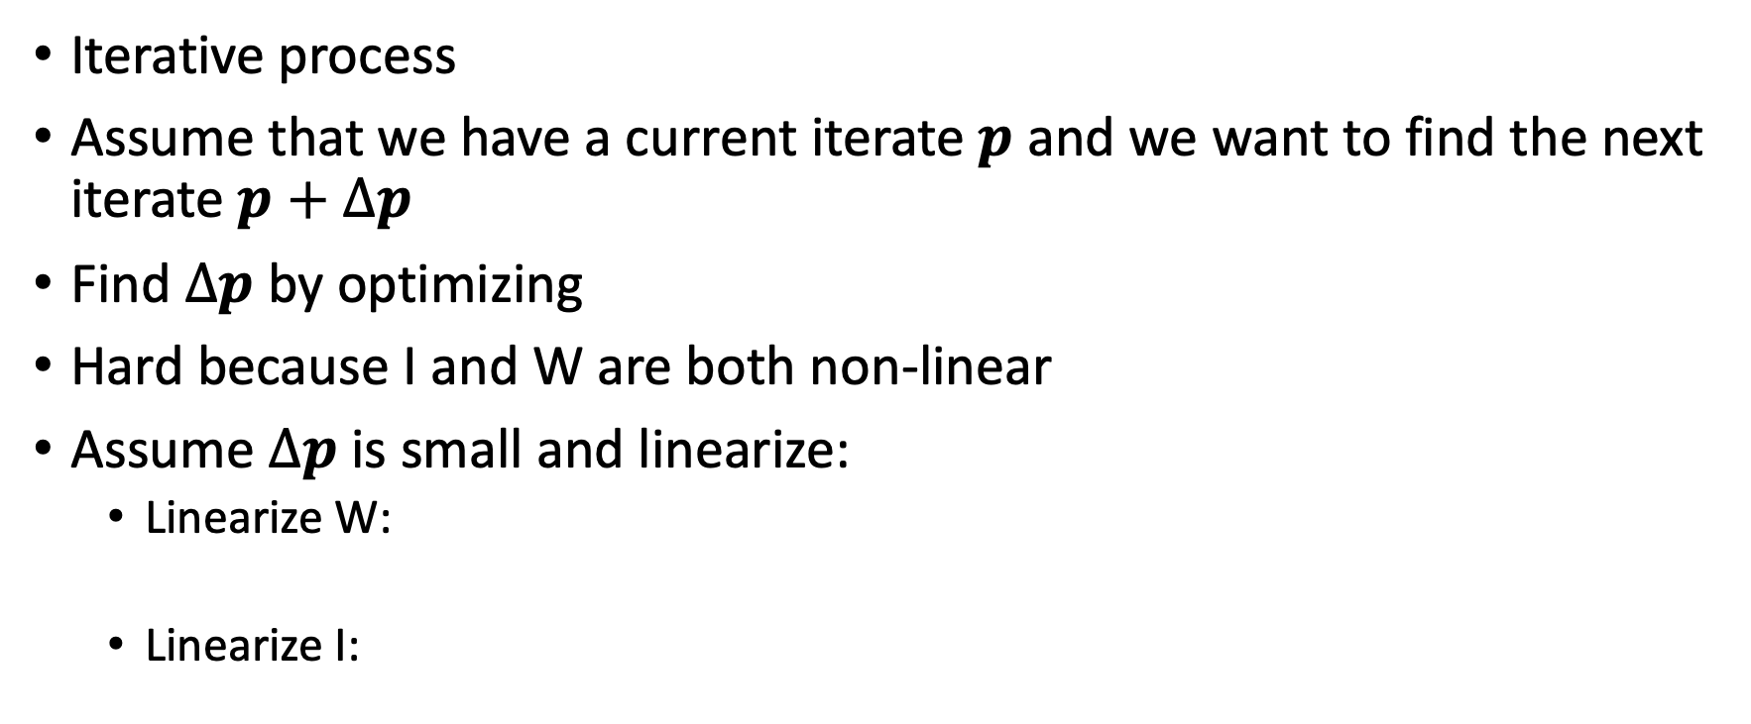
Lucas-Kanade
Iterative process
Assume that we have a current iterate $p$ and we want to find the next iterate $p+Δp$
Find $Δp$ by optimizing
Hard because I and W are both non-linear
Assume $Δp$ is small and linearize:
  Linearize W:
  Linearize I:
Baker, Simon, and Iain Matthews. "Lucas-kanade 20 years on: A unifying framework." International journal of computer vision 56.3 (2004): 221-255.

Slide 24
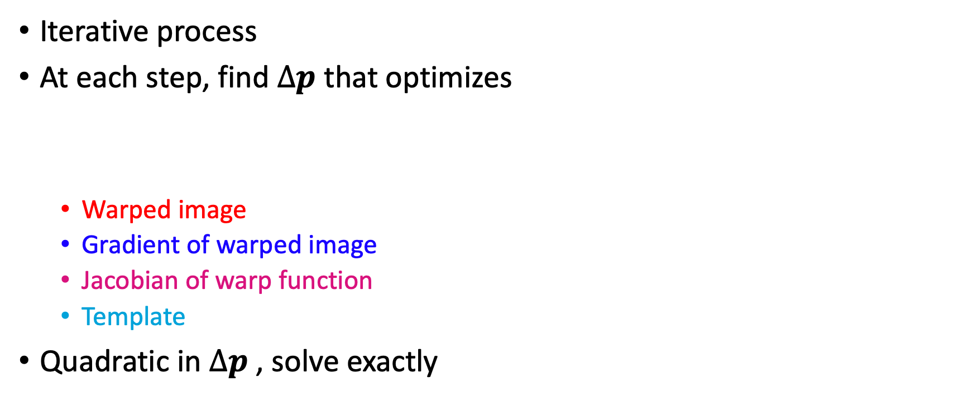
Lucas Kanade
Iterative process
At each step, find $Δp$ that optimizes
  Warped image
  Gradient of warped image
  Jacobian of warp function
  Template
Quadratic in $Δp$ , solve exactly

Slide 25
Lucas-Kanade
Solve by iterating on parameters
Equivalent to Newton iteration + linearization
Can we remove the parametric assumption?
Baker, Simon, and Iain Matthews. "Lucas-kanade 20 years on: A unifying framework." International journal of computer vision 56.3 (2004): 221-255.

Slide 26
Horn-Schunk
Data
Smoothness

Slide 27
Horn-Schunk
Data
Smoothness

Slide 28
Variational minimization
u and v are functions
Euler-lagrange equations
  Similar to “gradient=0”

Slide 29
Variational minimization

Slide 30
MPI-Sintel
Open-source animated movie “Sintel”
“Naturalistic” video
Ground truth optical flow
Large motions
Complex scenes
Butler, D. J. and Wulff, J. and Stanley, G. B. and Black, M. J. A naturalistic open source movie for optical flow evaluation. ECCV, 2012

Slide 31
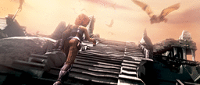
MPI-Sintel results

Slide 32
Optical flow with large displacements
Optical flow constraint equation assumes differential optical flow
“Large displacement”?
Key idea: reducing resolution reduces displacement
Reduce resolution, then upsample?
  will lose fine details
3
6
13
24
27

Slide 33
Optical flow with large displacements
Key idea 2: Use upsampled flow as initialization
Changes to initialization will be infinitesimal
compute flow
use as init
compute flow
…
Brox, Thomas, et al. "High accuracy optical flow estimation based on a theory for warping." Computer Vision-ECCV 2004 (2004)

Slide 34
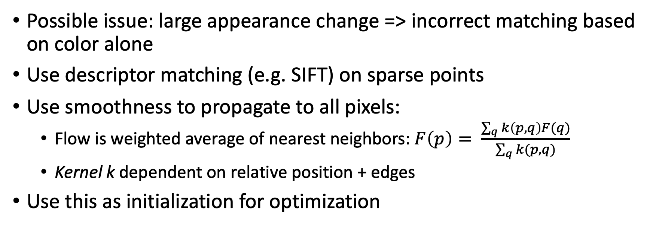
Optical flow for large displacements
Possible issue: large appearance change => incorrect matching based on color alone
Use descriptor matching (e.g. SIFT) on sparse points
Use smoothness to propagate to all pixels:
  Flow is weighted average of nearest neighbors: $F\left(p\right)= \frac{\sum_{q}{k\left(p,q\right)F(q)}}{\sum_{q}{k(p,q)}}$
  Kernel k dependent on relative position + edges
Use this as initialization for optimization
Brox, Thomas, Christoph Bregler, and Jitendra Malik. "Large displacement optical flow." CVPR, 2009.
Revaud, Jerome, et al. "Epicflow: Edge-preserving interpolation of correspondences for optical flow." CVPR. 2015.

Slide 35
LDOF and EpicFlow
Video
Basic Horn-Schunk (Error = 2.069)
LDOF (Brox et al, 2009) (Error = 1.606)
EpicFlow (Revaud et al, 2015) (Error = 1.295)

Slide 36
Coarse-to-fine processing
A specific instance of a general idea
  Also coarse-to-fine versions of Lucas-Kanade
Coarse scales:
  Global / large structures
  Long-range relationships
  But: imprecise localization
Fine scales:
  Precise localization
  But: aperture problem
Idea: start from coarse scales, add fine scale detail

Slide 37
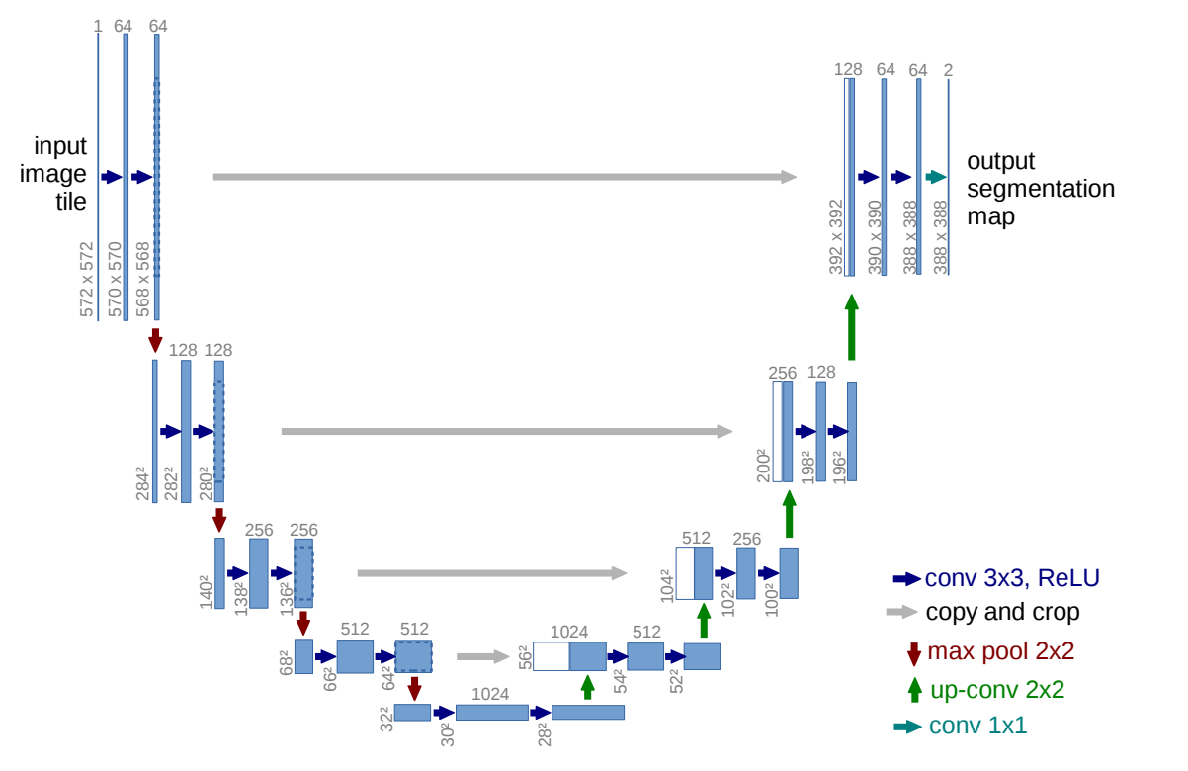
Coarse-to-fine processing
U-Net: Convolutional Networks for Biomedical Image Segmentation. Olaf Ronneberger, Philipp Fischer, and Thomas Brox. In MICCAI, 2015.

