Slide 1
Geometry of Image Formation

Slide 2
Today
Geometry of image formation: where a pixel projects in the world
Deriving perspective effects
Ways of using perspective effects in recognition

Slide 3
Camera obscura

Slide 4
The pinhole camera
Let’s get into the math

Slide 5
The pinhole camera

Slide 6
The pinhole camera

Slide 7
The pinhole camera
Y
P = (X,Y,Z)
p = (x,y)
Z
O
Z=-1
X

Slide 8
The pinhole camera
Y
P = (X,Y,Z)
p = (x,y)
Z
O
Z=-1
X

Slide 9

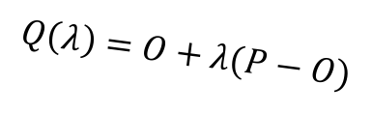
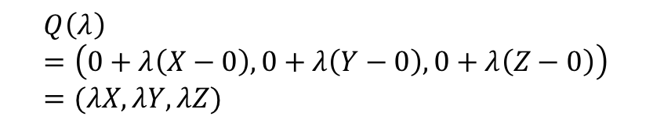

The pinhole camera
Y
P = (X,Y,Z)
$$Q\left(λ\right)=O+λ(P−O)$$
p = (x,y)
Z
O
$$λ=0⇒Q\left(λ\right)=O$$
$$λ=1⇒Q\left(λ\right)=P$$
Z=-1
X
$$Q\left(λ\right)=\left(0+λ\left(X−0\right), 0+λ\left(Y−0\right), 0+λ\left(Z−0\right)\right)=(λX, λY, λZ)$$

Slide 10
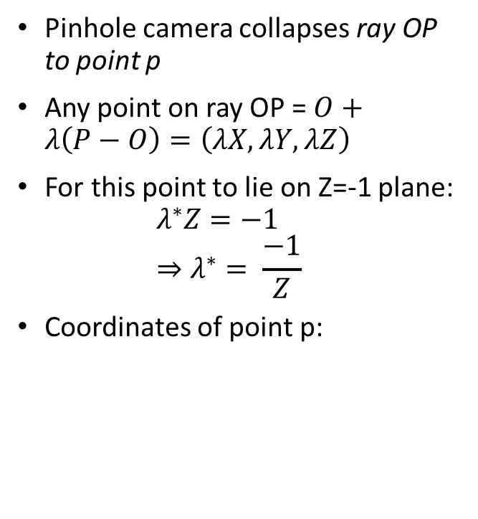
The pinhole camera
Pinhole camera collapses ray OP to point p
Any point on ray OP = $O+λ\left(P−O\right)=\left(λX, λY, λZ\right)$
For this point to lie on Z=-1 plane:
$λ^{∗}Z=−1$
$⇒λ^{∗}= \frac{−1}{Z}$
Coordinates of point p:
Y
p = (x,y)
P = (X,Y,Z)
Z
O
Z=-1
X

Slide 11
The projection equation
A point P = (X, Y, Z) in 3D projects to a point p = (x,y) in the image
But pinhole camera’s image is inverted, invert it back!

Slide 12
Another derivation
P = (X,Y,Z)
Y
1
O
Z
y
p = (x,y,z)

Slide 13
A virtual image plane
A pinhole camera produces an inverted image
Imagine a ”virtual image plane” in the front of the camera
P
P
Y
Y
y
1
Z
O
y
1
O
Z

Slide 14
The projection equation

Slide 15
Consequence 1: Farther away objects are smaller
(X, Y + h, Z)
(X, Y, Z)
Image of foot:
Image of head:

Slide 16
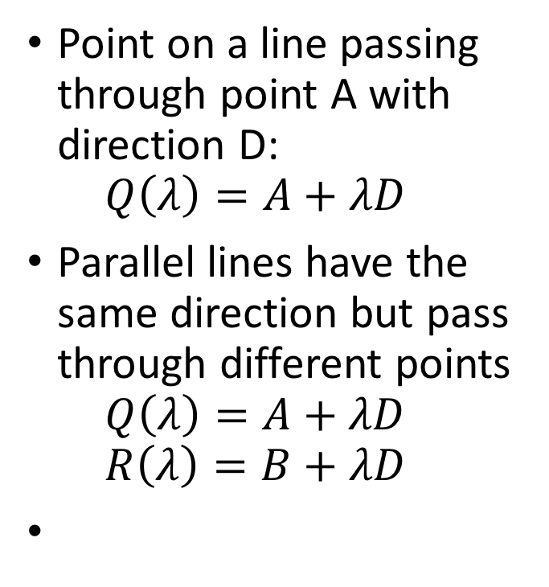
Consequence 2: Parallel lines converge at a point
Point on a line passing through point A with direction D:
$Q\left(λ\right)=A+λD$
Parallel lines have the same direction but pass through different points
$Q\left(λ\right)=A+λD$
$R\left(λ\right)=B+λD$

Slide 17
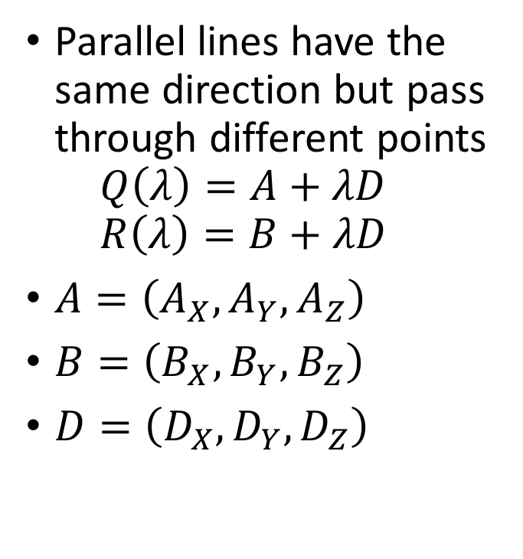
Consequence 2: Parallel lines converge at a point
Parallel lines have the same direction but pass through different points
$Q\left(λ\right)=A+λD$
$R\left(λ\right)=B+λD$
$A=\left(A_{X}, A_{Y}, A_{Z}\right)$
$B=\left(B_{X},B_{Y},B_{Z}\right)$
$D=\left(D_{X},D_{Y},D_{Z}\right)$

Slide 18
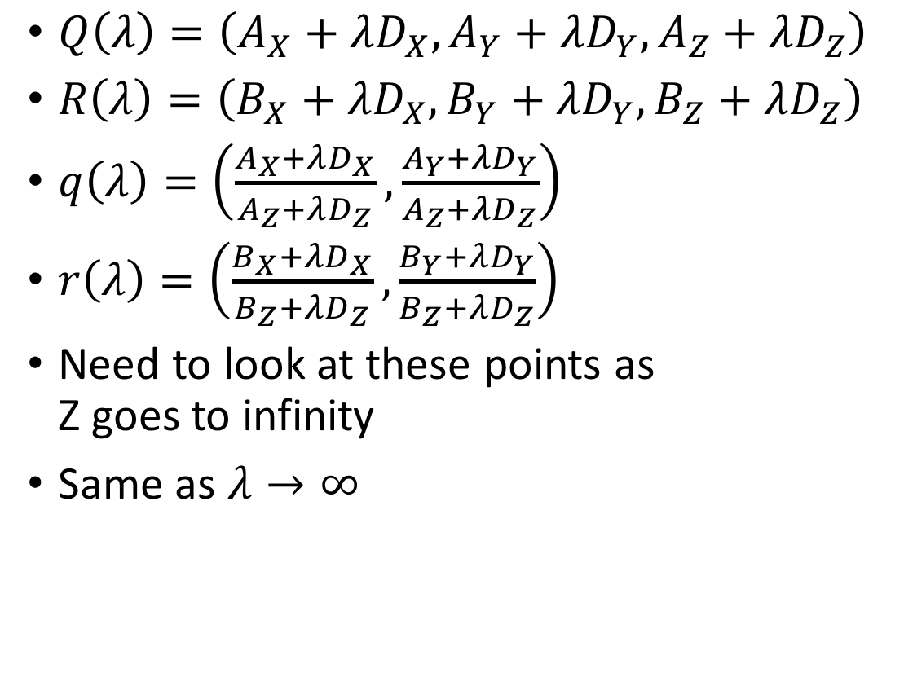
Consequence 2: Parallel lines converge at a point
$Q\left(λ\right)=\left(A_{X}+λD_{X}, A_{Y}+λD_{Y}, A_{Z}+λD_{Z}\right)$
$R\left(λ\right)=\left(B_{X}+λD_{X}, B_{Y}+λD_{Y}, B_{Z}+λD_{Z}\right)$
$q\left(λ\right)=\left(\frac{A_{X}+λD_{X}}{A_{Z}+λD_{Z}}, \frac{A_{Y}+λD_{Y}}{A_{Z}+λD_{Z}}\right)$
$r\left(λ\right)=\left(\frac{B_{X}+λD_{X}}{B_{Z}+λD_{Z}}, \frac{B_{Y}+λD_{Y}}{B_{Z}+λD_{Z}}\right)$
Need to look at these points as
Z goes to infinity
Same as $λ→∞$

Slide 19

Consequence 2: Parallel lines converge at a point
$q\left(λ\right)=\left(\frac{A_{X}+λD_{X}}{A_{Z}+λD_{Z}}, \frac{A_{Y}+λD_{Y}}{A_{Z}+λD_{Z}}\right)$
$r\left(λ\right)=\left(\frac{B_{X}+λD_{X}}{B_{Z}+λD_{Z}}, \frac{B_{Y}+λD_{Y}}{B_{Z}+λD_{Z}}\right)$

Slide 20
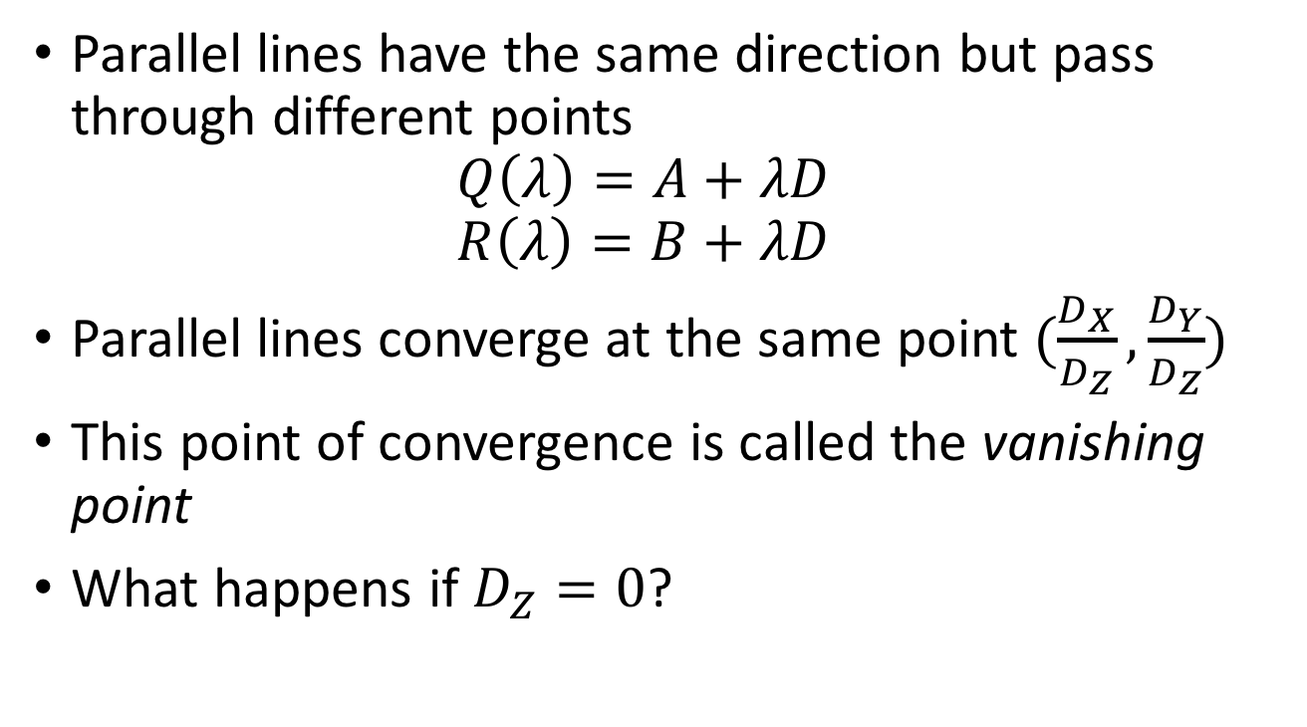
Consequence 2: Parallel lines converge at a point
Parallel lines have the same direction but pass through different points
$Q\left(λ\right)=A+λD$
$R\left(λ\right)=B+λD$
Parallel lines converge at the same point $(\frac{D_{X}}{D_{Z}},\frac{D_{Y}}{D_{Z}})$
This point of convergence is called the vanishing point
What happens if $D_{Z}=0$?

Slide 21
Consequence 2: Parallel lines converge at a point

Slide 22
What about planes?
Vanishing line of a plane
Take the limit as Z approaches infinity

Slide 23
What about planes?
Normal: (N_{X}, N_{Y}, N_{Z})
What do parallel planes look like?
Vanishing lines
Parallel planes converge!

Slide 24
Vanishing line
What happens if N_{X} = N_{Y} = 0?
Equation of the plane: Z = c
Vanishing line?

Slide 25
Accidental pinholes

Slide 26
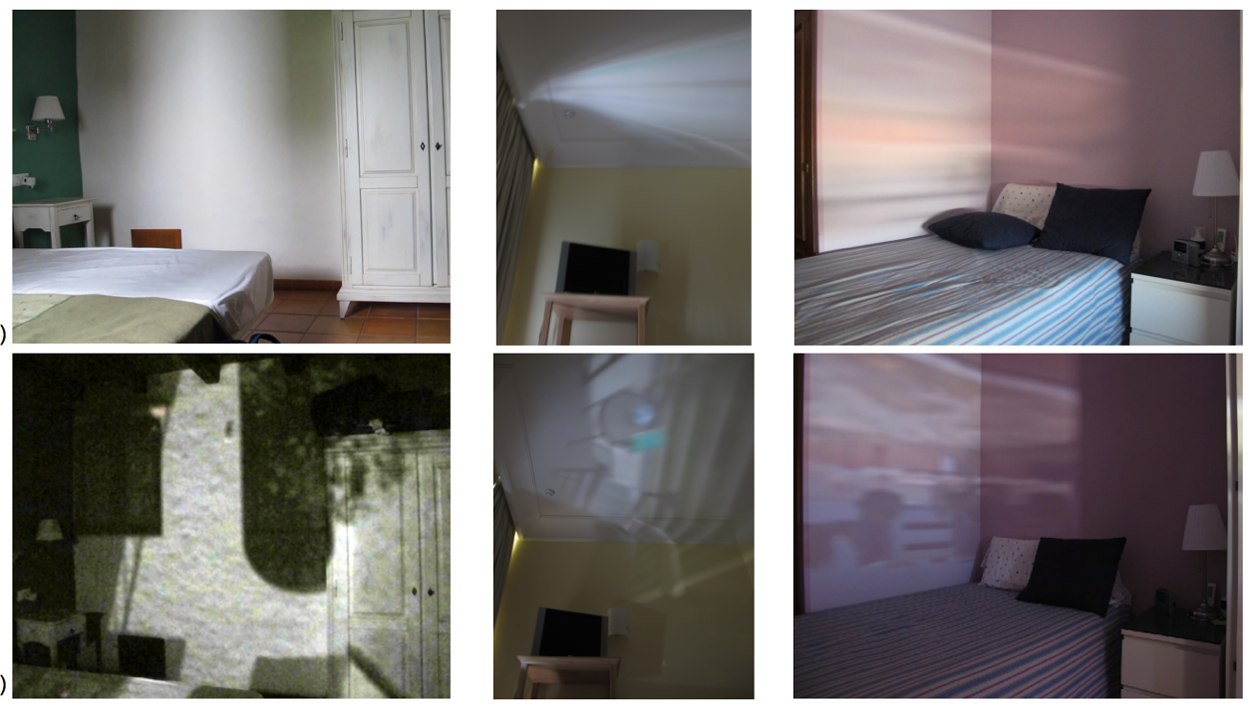
Accidental pinholes
Torralba, Antonio, and William T. Freeman. "Accidental pinhole and pinspeck cameras: Revealing the scene outside the picture." Computer Vision and Pattern Recognition (CVPR), 2012 IEEE Conference on. IEEE, 2012.

Slide 27
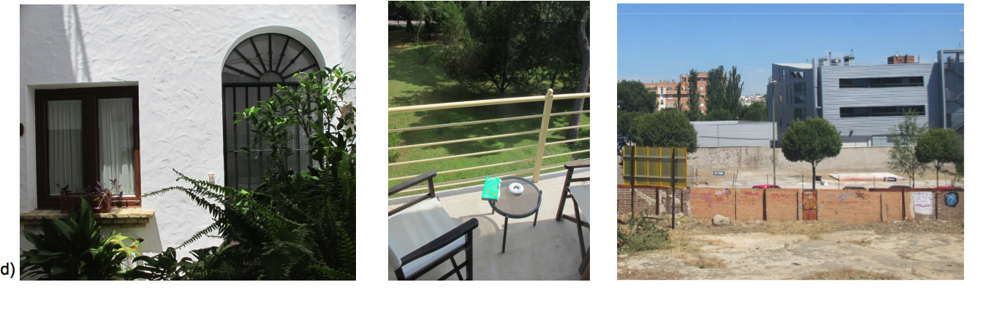
Accidental pinholes
Torralba, Antonio, and William T. Freeman. "Accidental pinhole and pinspeck cameras: Revealing the scene outside the picture." Computer Vision and Pattern Recognition (CVPR), 2012 IEEE Conference on. IEEE, 2012.

Slide 28
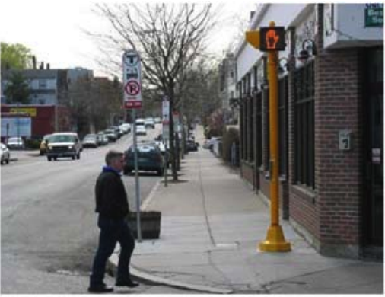
Geometry for recognition
Which of these is likely to be an adult human?

Slide 29

The math
What is the vanishing line of the ground plane?
$$Y=−c$$

Slide 30


The math
$$(X, H−c, Z)$$
$$(X, −c, Z)$$
$$Y=−c$$

Slide 31


The math
$$(x, y_{1})$$
$$(x, y_{2})$$

Slide 32

The math
$$y_{2}= \frac{−c}{Z}$$
$$⟹Z= \frac{−c}{y_{2}}$$
$$y_{1}= \frac{H−c}{Z}$$
$$⟹H=Z y_{1}+c$$
$$⟹H=\frac{c\left(y_{2}−y_{1}\right)}{y_{2}}= \frac{ch}{{|y}_{2}|}$$

Slide 33
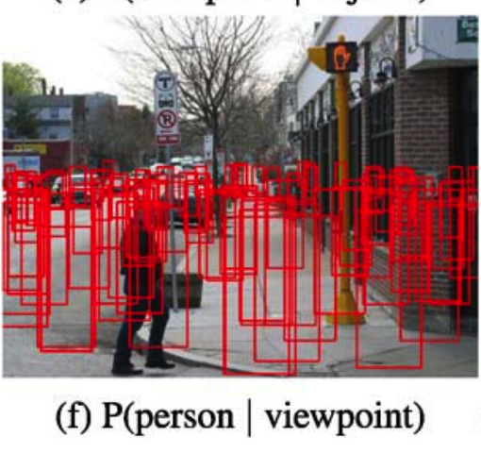
Geometry for recognition
Hoiem, Derek, Alexei A. Efros, and Martial Hebert. "Putting objects in perspective." International Journal of Computer Vision 80.1 (2008): 3-15.

Slide 34
Changing coordinate systems
Y
Y
P = (X,Y,Z)
Z
O
O’
X
X
Z

Slide 35
Changing coordinate systems
Y
Y
Z
O’
X
X
Z

Slide 36
Changing coordinate systems
Y
Y
Z
O’
X
Z
X

Slide 37
Changing coordinate systems
Y
Y
Z
O’
X
Z
X

Slide 38
Changing coordinate systems
Y
Y
Z
O’
X
Z
X

Slide 39
Changing coordinate systems
Y
Y
Z
O’
X
Z
X

Slide 40
Rotations and translations
How do you represent a rotation?
A point in 3D: (X,Y,Z)
Rotations can be represented as a matrix multiplication
What are the properties of rotation matrices?

Slide 41
Properties of rotation matrices
Rotation does not change the length of vectors

Slide 42
Properties of rotation matrices
Rotation
Reflection

Slide 43
Rotation matrices
Rotations in 3D have an axis and an angle
Axis: vector that does not change when rotated
Rotation matrix has eigenvector that has eigenvalue 1

Slide 44

Rotation matrices from axis and angle
Rotation matrix for rotation about axis $v$ and $θ$
First define the following matrix
Interesting fact: this matrix represents cross product

Slide 45

Rotation matrices from axis and angle
Rotation matrix for rotation about axis $v$ and $θ$
Rodrigues’ formula for rotation matrices

Slide 46
Translations
Can this be written as a matrix multiplication?

Slide 47
Putting everything together
Change coordinate system so that center of the coordinate system is at pinhole and Z axis is along viewing direction
Perspective projection

Slide 48
The projection equation
Is this equation linear?
Can this equation be represented by a matrix multiplication?

Slide 49
Is projection linear?

Slide 50
Can projection be represented as a matrix multiplication?
Matrix multiplication
Perspective projection

Slide 51

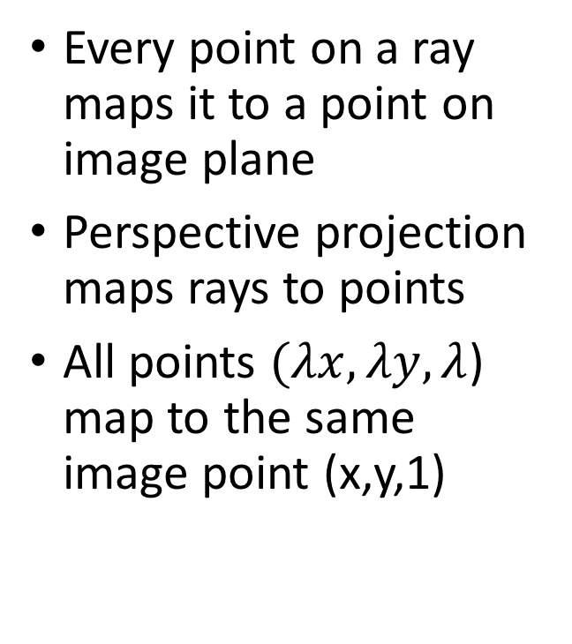
The space of rays
Every point on a ray maps it to a point on image plane
Perspective projection maps rays to points
All points $(λx, λy, λ$) map to the same image point (x,y,1)
($λx, λy, λ$)
(x,y,1)
O

Slide 52
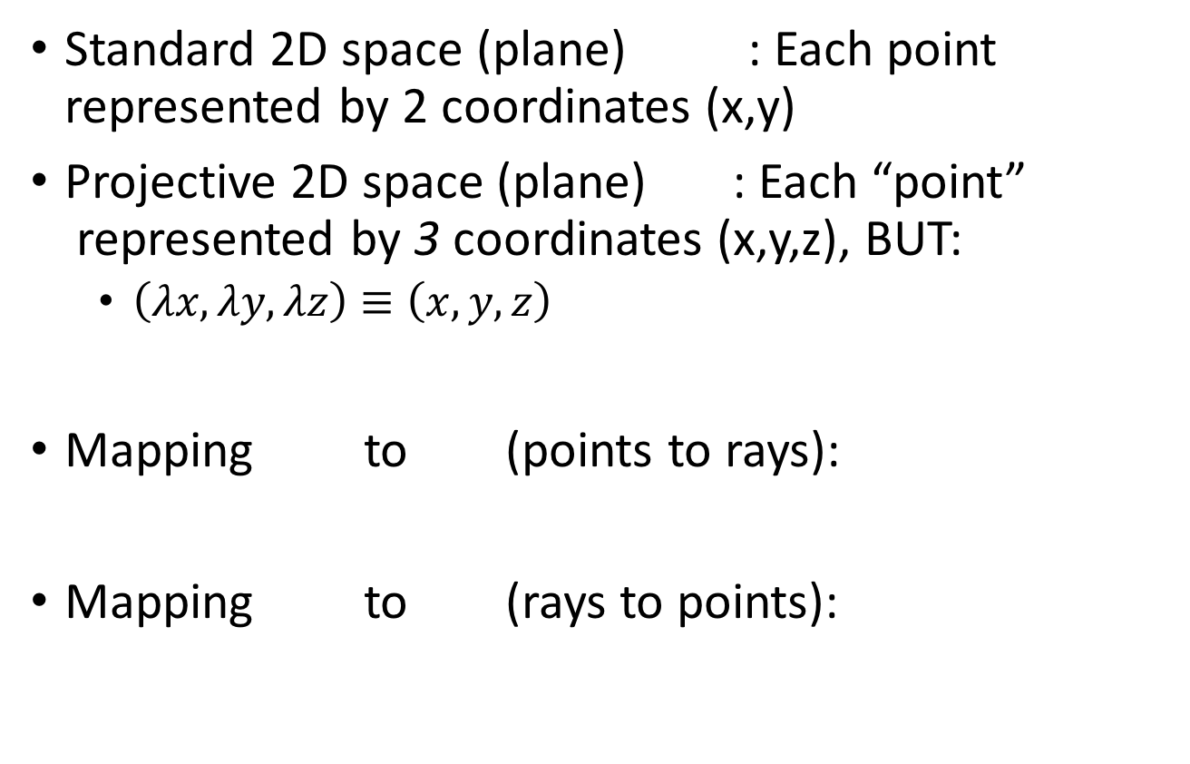
Projective space
Standard 2D space (plane) : Each point represented by 2 coordinates (x,y)
Projective 2D space (plane) : Each “point”
represented by 3 coordinates (x,y,z), BUT:
  $\left(λx, λy, λz\right)≡\left(x,y,z\right)$
Mapping to (points to rays):
Mapping to (rays to points):

Slide 53
Projective space and homogenous coordinates
Mapping to (points to rays):
Mapping to (rays to points):
A change of coordinates
Also called homogenous coordinates

Slide 54
Homogenous coordinates
In standard Euclidean coordinates
  2D points : (x,y)
  3D points : (x,y,z)
In homogenous coordinates
  2D points : (x,y,1)
  3D points : (x,y,z,1)

Slide 55
Why homogenous coordinates?
Homogenous coordinates of world point
Homogenous coordinates of image point

Slide 56
Why homogenous coordinates?
Perspective projection is matrix multiplication in homogenous coordinates!

Slide 57
Why homogenous coordinates?
Translation is matrix multiplication in homogenous coordinates!

Slide 58
Homogenous coordinates

Slide 59
Homogenous coordinates

Slide 60
Perspective projection in homogenous coordinates

Slide 61
More about matrix transformations
3 x 4 : Perspective projection
4 x 4 : Translation
4 x 4 : Affine transformation (linear transformation + translation)

Slide 62
More about matrix transformations
Euclidean

Slide 63
More about matrix transformations
Similarity transformation

Slide 64
More about matrix transformations
Anisotropic scaling and translation

Slide 65
More about matrix transformations
General affine transformation

Slide 66
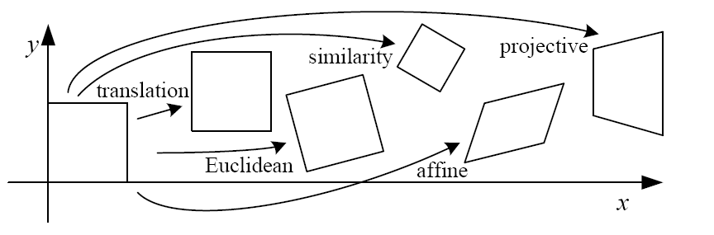
Matrix transformations in 2D

Slide 67
Perspective projection in homogenous coordinates

Slide 68
Matrix transformations in 2D
Translation
Scaling of Image x and y (conversion from “meters” to “pixels”)
Added skew if image x and y axes are not perpendicular

Slide 69
Final perspective projection
Camera extrinsics: where your camera is relative to the world. Changes if you move the camera
Camera intrinsics: how your camera handles pixel. Changes if you change your camera

Slide 70
Final perspective projection
Camera parameters

