Slide 1
Rethinking Operating System Designs for a Multicore World
Ken Birman
Based heavily on a slide set by Colin Ponce

Slide 2
The Rise of Multicore CPUs
Multicore computer: A computer with more than one CPU.
1960-1990: Multicore existed in mainframes and supercomputers.
1990's: Introduction of commodity multicore servers.
2000's: Multicores placed on personal computers.
Soon: Everywhere except embedded systems?
But switched on and off based on need: each active core burns power
Debated: Will they be specialized cores (like GPUs, NetFPGA) or general purpose cores? Or perhaps both?

Slide 3
Multicore is Inescapable!
Clearly, traditional speedup could not continue beyond 2005. or s0
But we do need speedup or technology progress comes to a halt…

Slide 4
The End of the General-Purpose Uniprocessor

Slide 5
Multicore Research Issues
The machines have become common, but in fact are mostly useful in one specific situation
Cloud computing virtualization benefits hugely from multicore
We end up with multiple VMs running side by side, maybe sharing read-only code pages (VM hardware ideally understands that these are “never dirty” and won’t suffer from false sharing). Each VM uses the same cores each time it becomes active (hence good affinity)
Offers a very good price/performance tradeoff to Google, Amazon
But general purpose exploitation of multicore has been hard
So the machine on your desk might have 12 cores, yet rarely uses 2…

Slide 6
Puzzle: Is Multicore Useful?
To host multiple VMs concurrently, for sure.
Any modern multitenant data center exploits this feature
VMs “share nothing”, hence ideal for use with multicore servers
But for general purpose programming, far less evident
We see this in mini-project 1: Leveraging multicore parallelism for speedup is very difficult. Slow-down is not uncommon!
Problem: any form of sharing seems to be an obstacle to speed
Even compilers have serious difficulty with modern hardware models.

Slide 7
Basic Concepts
Memory Sharing Styles:
Uniform Memory Access (UMA)
Non-Uniform Memory Access (NUMA)
No Remote Memory Memory Access (NORMA)
Cache Coherence
Many models: barrier, sequential, causal…
Inter-Process (and inter-core) Communication
Shared Memory: At granularity of “cache line”
Message Passing: Implemented by OS but shapes what the h/w sees

Slide 8
Writing Parallel Programs: Amdahl's Law
N: Number of processors
B: Unavoidably sequential portion
T(n): Runtime with N processors
Speedup:

Slide 9
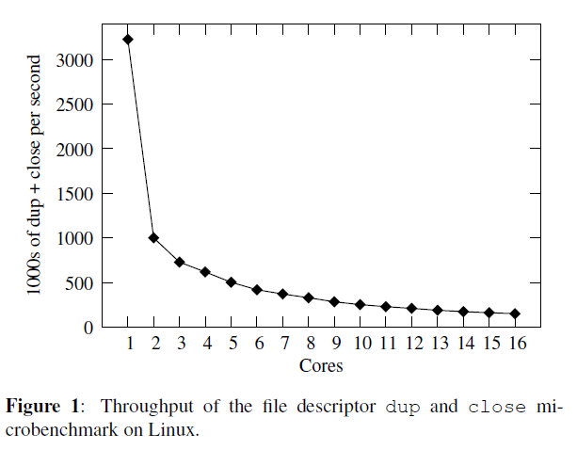
Exploiting Parallel Processors
Experiment by Boyd-Wickizer et. al. on machine with four quad-core AMD Operton chips running Linux 2.6.25.
n threads running on n cores:
Looks embarassingly parallel… so it should scale well, right?
i d = g e t t h r e a d i d ( ) ;
f = c r e a t e f i l e ( i d ) ;
wh i l e ( True ) {
f 2 = dup ( f ) ;
c l o s e ( f 2 ) ;
}
Boyd-Wickizer et. al., “Corey: An Operating System for Many Cores"

Slide 10
Linux is not good at Multicore!
Application developer could provide the OS with hints:
Parallelization opportunities
Which data to share
Which messages to pass
Where to place data in memory
Which cores should handle a given thread
Right now, this doesn’t happen, except for “pin thread to core”
Should hints be architecture specific? What about GPU?

Slide 11
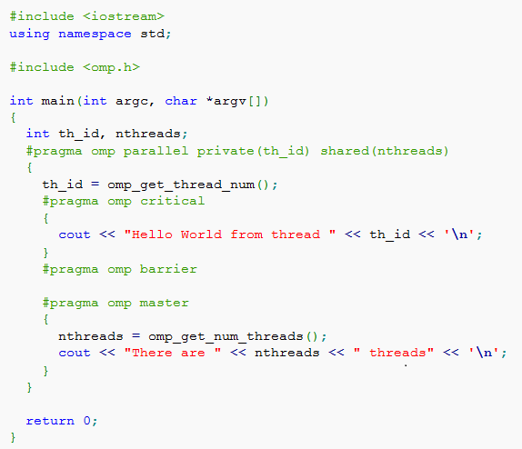
Hints in Action
Example: OpenMP (Open MultiProcessing)
Coded in C++ 11
But the pragmas tell the compiler about intent
Compiler can then optimize the code for parallelism / speed

Slide 12
Is it one machine? Or many?
Modern machines often have several identical cores
But even with identical cores it isn’t obvious how to think about these machines
Problem: Location of data very much shapes performance of computation on that data
Here is a simple one-chip AMD 4-core design…

Slide 13
Even with Identical Cores…
With multiple AMD chips in a multisocket CPU board, looks more and more like a distributed computer cluster!
This illustrates a 16-core system, but looks just like a quad-computer system with each chip being a 4-core AMD processor

Slide 14
AMD 64-core Chip
AMD keeps pushing it to larger and larger scale…
Like a cluster on a chip

Slide 15
AMD 256-Core Chip
Will it ever end?
Real puzzle: how to harness all the cores

Slide 16
Core diversity
More and more vendors are exploring specialized cores
GPU cores for high speed graphics
NetFPGA: devices that can process video streams or other streams of data on the network at optical line speeds
Computational geometry cores for manipulating complex objects
Scientific computing accelerators that offer special functions like DFFTs via hardware support: you load the data, the chip does the operation, and then the outcome is available on the other side
Some of these can support complex programs that run on the special processor, but use its own domain-specific programming style

Slide 17
Today’s Papers: Tornado
Context: Need to understand the state of play in late 1990’s:
Ten years prior, memory was fast relative to the CPU. During the 90's, CPU speeds improved over 5x as quickly as memory speeds.
Over the course of the 90's, communication became a bottleneck.
1990 was prior to the full multicore revolution. But even in 1990 these issues were exacerbated in multicore systems.
Tornado developers saw this as a primary issue
Tornado: Maximizing Locality and Concurrency in a Shared Memory Multiprocessor Operating System"
Ben Gamsa, Orran Krieger, Jonathan Appavoo, Michael Stumm OSDI 1999

Slide 18
Initial Observations
The hardware makes cross-core interactions transparent, but in fact the cost penalty is often high
Locking by threads is cheap if on same core, expensive cross-core
Memory sharing looks free, but in reality cache-line migration can be very costly (true sharing with writes is the big issue)
L2 cache will be cold if a thread is paused, then resumes on a different core than where it ran previously
So Tornado tries to minimize these costly overheads

Slide 19
Tornado
Develops data structures and algorithms to minimize contention and cross-core communication. Intended for use with multicore servers.
These optimizations are all achieved through replication and partitioning.
Clustered Objects
Protected Procedure Calls
New locking strategy

Slide 20
Tornado: Clustered Objects
OS treats memory in an object-oriented manner.
Clustered objects are a form of object virtualization: the illusion of a single object, but actually composed of individual components spread across the cores called representatives.
One option is to simply replicate an object so that each core has a local copy, but can also partition functionality across representatives.
Exactly how the representatives function is up to the developer.
Representative functionality can even be changed dynamically.

Slide 21
Tornado: Protected Procedure Calls
Primary use case: To support parallel client-server interactions.
Idea is similar to that of clustered objects. Calls pass from a client task to a server task without leaving that core.
Benefits from affinity: hardware resources accessed by the collection of threads can live local to the core
In effect, the OS is structured in a way that matches what the hardware is already good at doing.
By spreading server representatives over multiple cores, we get parallel speedup without cross-core contention delays

Slide 22
Tornado: Locking
Locks are kept internal to an object, limiting the scope of the lock to reduce cross-core contention.
Locks can be partitioned by representative, allowing for optimizations involving mixed coarse and fine-grained uses.
For intended use (Apache web server), very good match to need, although seems a bit peculiar and not very general…

Slide 23
… Ten Years Passed
Pollack’s Rule:
Thousand Core Chips: A Technology Perspective. Shekhar Borkar
Pollack's Rule: Performance increase is roughly proportional to the square root of the increase in circuit complexity. This contrasts with power consumption increase, which is roughly linearly proportional to the increase in complexity
Implication: Many small cores instead of a few large cores.

Slide 24
Barrelfish
A completely new OS, built from scratch that
Views multicore machines as networked, distributed systems.
No inter-core communication except through message-passing.
Core OS seeks to be as hardware-neutral as possible, with per-architecture adaptors treated much like device drivers.
Replicates entire application state across cores: everything is local.
In effect, Barrelfish choses not to use features of the chip that might be very slow.
The Multikernel: A new OS architecture for scalable multicore systems. Andrew Baumann, Paul Barham, Pierre-Evariste Dagand, Tim Harris, Rebecca Isaacs, Simon Peter, Timothy Roscoe, Adrian Schaupbach, Akhilesh Singhania. SOSP 2009

Slide 25
The Way Of BarrelFish
Presumes that in fact, cores will be increasingly diverse
A small data center on a chip, with specialized computers that play roles on behalf of general computers
And also assumes the goal is really research
Not clear that Barrelfish intends to be a real OS people will use
More of a prototype to explore architecture choices and impact
“How fast can we make a multicomputer run”?

Slide 26
The Way Of Barrelfish
… so, Barrelfish
Starts with a view much like that of a virtual computing system
Lots of completely distinct VMs. Obvious fit for multicore
But then offers a more integrated set of OS features
So we can actually treat the Barrelfish as a single machine
And these center on ultrafast communication across cores
Not shared memory, but messages passed over channels

Slide 27
Barrelfish Message Passing
This is the only way for separate cores to communicate.
Advantages:
Cache coherence protocols look like message passing anyways, just harder to reason about.
Eases asynchronous application development.
Enables rigorous, theoretical reasoning about communication through tools like π-calculus.

Slide 28
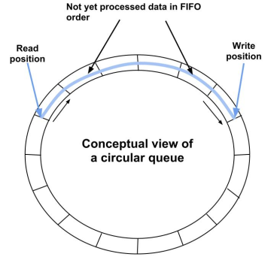
How it works
They design a highly asynchronous message-queue protocol
We’ll see it again in a few weeks when we discuss RDMA
The Barrelfish version is circular
Basically
Wait for a slot in the circular queue to some other processor
Drop your message into that slot, and done (no cross-core lock used)
Request/reply: You include a synchronization token, and reply will eventually turn up, and wake up your thread

Slide 29
The MultiKernel
Operating system state (and potentially application state) is automatically replicated across cores as necessary.
OS state, in reality, may be a bit different from core to core depending on needs, but that is behind the scenes.
Reduces load on system interconnect and contention for memory.
Allows us to specialize data structures on a core to its needs.
Makes the system robust to architecture changes, failures, etc.
Claim: Enables Barrelfish to leverage distributed systems research (like Isis2 ☺, although this has never been tried).

Slide 30
ATTEMPT TO BE Hardware Neutral
Separate the OS as much as possible from the hardware. Only two aspects of the OS deal with specific architectures:
Interface to hardware
Message transport mechanisms (needed for GPUs)
Advantages:
Facilitates adapting an OS to new hardware: “device driver”.
Allows easy and dynamic hardware- and situation-dependent message passing optimizations.
Limitation:
Treats specialized processors like general purpose ones…
Future world of NetFPGA devices “on the wire” would be problematic

Slide 31
Summary
Multicore computers are here!
They work really well in multitenant data centers (Amazon)
But less well for general purpose computing
Our standard style of coding may be the real culprit
Seems like pipelines of asynchronous tasks are a better fit to the properties of the hardware, but many existing OS features are completely agnostic and allow any desired style of coding, including styles that will be very inefficient

