Slide 1
What are the Right Roles for Formal Methods in High Assurance Cloud Computing?
Princeton Nov. 2012
Ken Birman, Cornell University

Slide 2

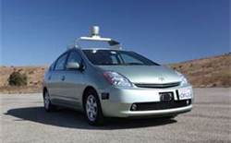

High Assurance in Cloud Settings
A wave of applications that need high assurance is fast approaching
  Control of the “smart” electric power grid
  mHealth applications
  Self-driving vehicles….
To run these in the cloud, we’ll need better tools
  Today’s cloud is inconsistent and insecure by design
  Issues arise at every layer (client… Internet… data center) but we’ll focus on the data center today

Slide 3
Isis² System
“join
myGroup”
update
update
state transfer
myGroup
Core functionality: groups of objects
  … fault-tolerance, speed (parallelism), coordination
  Intended for use in very large-scale settings
The local object instance functions as a gateway
  Read-only operations performed on local state
  Update operations update all the replicas

Slide 4
Isis² Functionality
We implement a wide range of basic functions
  Multicast (many “flavors”) to update replicated data
  Multicast “query” to initiate parallel operations and collect the results
  Lock-based synchronization
  Distributed hash tables
  Persistent storage…
Easily integrated with application-specific logic

Slide 5
Example: Cloud-Hosted Service
Standard Web-Services method invocation
A B C D
Some service
A distributed request that updates group “state”...
SafeSend
SafeSend
SafeSend
... and the response
SafeSend is a version of Paxos.

Slide 6
Isis² System
C# library (but callable from any .NET language) offering replication techniques for cloud computing developers
Based on a model that fuses virtual synchrony and state machine replication models
Research challenges center on creating protocols that function well despite cloud “events”
Elasticity (sudden scale changes)
Potentially heavily loads
High node failure rates
Concurrent (multithreaded) apps
Long scheduling delays, resource contention
Bursts of message loss
Need for very rapid response times
Community skeptical of “assurance properties”

Slide 7
Isis² makes developer’s life easier
Benefits of Using Formal model
Importance of Sound Engineering
Formal model permits us to achieve correctness
Think of Isis² as a collection of modules, each with rigorously stated properties
These help in debugging (model checking)
Isis² implementation needs to be fast, lean, easy to use, in many ways
Developer must see it as easier to use Isis² than to build from scratch
Need great performance under “cloudy conditions”

Slide 8
Isis² makes developer’s life easier
Group g = new Group(“myGroup”);
Dictionary<string,double> Values = new Dictionary<string,double>();
g.ViewHandlers += delegate(View v) {
  Console.Title = “myGroup members: “+v.members;
};
g.Handlers[UPDATE] += delegate(string s, double v) {
Values[s] = v;
};
g.Handlers[LOOKUP] += delegate(string s) {
g.Reply(Values[s]);
};
g.Join();
g.SafeSend(UPDATE, “Harry”, 20.75);
List<double> resultlist = new List<double>();
nr = g.Query(ALL, LOOKUP, “Harry”, EOL, resultlist);
First sets up group
Join makes this entity a member. State transfer isn’t shown
Then can multicast, query. Runtime callbacks to the “delegates” as events arrive
Easy to request security (g.SetSecure), persistence
“Consistency” model dictates the ordering aseen for event upcalls and the assumptions user can make

Slide 9
Isis² makes developer’s life easier
Group g = new Group(“myGroup”);
Dictionary<string,double> Values = new Dictionary<string,double>();
g.ViewHandlers += delegate(View v) {
  Console.Title = “myGroup members: “+v.members;
};
g.Handlers[UPDATE] += delegate(string s, double v) {
Values[s] = v;
};
g.Handlers[LOOKUP] += delegate(string s) {
g.Reply(Values[s]);
};
g.Join();
g.SafeSend(UPDATE, “Harry”, 20.75);
List<double> resultlist = new List<double>();
nr = g.Query(ALL, LOOKUP, “Harry”, EOL, resultlist);
First sets up group
Join makes this entity a member. State transfer isn’t shown
Then can multicast, query. Runtime callbacks to the “delegates” as events arrive
Easy to request security (g.SetSecure), persistence
“Consistency” model dictates the ordering seen for event upcalls and the assumptions user can make

Slide 10
Isis² makes developer’s life easier
Group g = new Group(“myGroup”);
Dictionary<string,double> Values = new Dictionary<string,double>();
g.ViewHandlers += delegate(View v) {
  Console.Title = “myGroup members: “+v.members;
};
g.Handlers[UPDATE] += delegate(string s, double v) {
Values[s] = v;
};
g.Handlers[LOOKUP] += delegate(string s) {
g.Reply(Values[s]);
};
g.Join();
g.SafeSend(UPDATE, “Harry”, 20.75);
List<double> resultlist = new List<double>();
nr = g.Query(ALL, LOOKUP, “Harry”, EOL, resultlist);
First sets up group
Join makes this entity a member. State transfer isn’t shown
Then can multicast, query. Runtime callbacks to the “delegates” as events arrive
Easy to request security (g.SetSecure), persistence
“Consistency” model dictates the ordering seen for event upcalls and the assumptions user can make

Slide 11
Isis² makes developer’s life easier
Group g = new Group(“myGroup”);
Dictionary<string,double> Values = new Dictionary<string,double>();
g.ViewHandlers += delegate(View v) {
  Console.Title = “myGroup members: “+v.members;
};
g.Handlers[UPDATE] += delegate(string s, double v) {
Values[s] = v;
};
g.Handlers[LOOKUP] += delegate(string s) {
g.Reply(Values[s]);
};
g.Join();
g.SafeSend(UPDATE, “Harry”, 20.75);
List<double> resultlist = new List<double>();
nr = g.Query(ALL, LOOKUP, “Harry”, EOL, resultlist);
First sets up group
Join makes this entity a member. State transfer isn’t shown
Then can multicast, query. Runtime callbacks to the “delegates” as events arrive
Easy to request security (g.SetSecure), persistence
“Consistency” model dictates the ordering seen for event upcalls and the assumptions user can make

Slide 12
Isis² makes developer’s life easier
Group g = new Group(“myGroup”);
Dictionary<string,double> Values = new Dictionary<string,double>();
g.ViewHandlers += delegate(View v) {
  Console.Title = “myGroup members: “+v.members;
};
g.Handlers[UPDATE] += delegate(string s, double v) {
Values[s] = v;
};
g.Handlers[LOOKUP] += delegate(string s) {
g.Reply(Values[s]);
};
g.Join();
g.SafeSend(UPDATE, “Harry”, 20.75);
List<double> resultlist = new List<double>();
nr = g.Query(ALL, LOOKUP, “Harry”, EOL, resultlist);
First sets up group
Join makes this entity a member. State transfer isn’t shown
Then can multicast, query. Runtime callbacks to the “delegates” as events arrive
Easy to request security (g.SetSecure), persistence
“Consistency” model dictates the ordering seen for event upcalls and the assumptions user can make

Slide 13
Isis² makes developer’s life easier
Group g = new Group(“myGroup”);
Dictionary<string,double> Values = new Dictionary<string,double>();
g.ViewHandlers += delegate(View v) {
  Console.Title = “myGroup members: “+v.members;
};
g.Handlers[UPDATE] += delegate(string s, double v) {
Values[s] = v;
};
g.Handlers[LOOKUP] += delegate(string s) {
g.Reply(Values[s]);
};
g.SetSecure(myKey);
g.Join();
g.SafeSend(UPDATE, “Harry”, 20.75);
List<double> resultlist = new List<double>();
nr = g.Query(ALL, LOOKUP, “Harry”, EOL, resultlist);
First sets up group
Join makes this entity a member. State transfer isn’t shown
Then can multicast, query. Runtime callbacks to the “delegates” as events arrive
Easy to request security, persistence, tunnelling on TCP...
“Consistency” model dictates the ordering seen for event upcalls and the assumptions user can make

Slide 14
Consistency model: Virtual synchrony meets Paxos (and they live happily ever after…)
Virtual synchrony is a “consistency” model:
  Membership epochs: begin when a new configuration is installed and reported by delivery of a new “view” and associated state
  Protocols run “during” a single epoch: rather than overcome failure, we reconfigure when a failure occurs
A=3
B=7
B = B-A
A=A+1
Non-replicated reference execution
Synchronous execution
Virtually synchronous execution

Slide 15
Why replicate?
High availability
Better capacity through load-balanced read-only requests, which can be handled by a single replica
Concurrent parallel computing on consistent data
Fault-tolerance through “warm standby”

Slide 16
Do users find formal model useful?
Developer keeps the model in mind, can easily visualize the possible executions that might arise
  Each replica sees the same events
  … in the same order
  … and even sees the same membership when an event occurs. Failures or joins are reported just like multicasts
All sorts of reasoning is dramatically simplified

Slide 17

... for example
To build a locking service, like Google Chubby
  Define an API (commands like “lock”, “unlock”, ....)
  Service state: table of active locks & holders, wait-list
  On lock request/release events, invoke SafeSend
  Make state persistent by enabling Isis² checkpointing
... and we’re done! Run your service on your cluster, or rent from EC2, and you’ve created myChubby

Slide 18
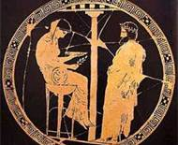
Expressing virtual synchrony model in constructive logic
Formalize notion of a reconfigurable state machine
  It runs in epochs: a period of fixed membership
  Simple protocols that don’t need to tolerate failures.
  If a failure occurs, or some other need arises, reconfigure by
    (1) stopping the current epoch,
    (2) forming a consensus on the new configuration, and
    (3) initializing new members as needed
The Isis² membership Oracle manages
its own state and tracks membership
for other groups

Slide 19
How is this formal model really used?
We used it in developing Isis² itself…
  One can use the model to reason about correctness
  It is also possible to discover bugs by running the system under stress while watching runs for violation of the model – a form of model checking.
  In fact we could go even further and generate the needed protocols from the model; more about this later

Slide 20



Roles for formal methods
Proving that SafeSend is a correct “virtually synchronous” implementation of Paxos?
  I worked with Robbert van Renesse and Dahlia Malkhi to optimize Paxos for the virtual synchrony model.
    Despite optimizations, protocol is still bisimulation equivalent
  Robbert later coded it in 60 lines of Erlang. His version can be proved correct using NuPRL
  Leslie Lamport was initially involved too. He
  suggested we call it “virtually synchronous Paxos”.
Virtually Synchronous Methodology for Dynamic Service Replication. Ken Birman, Dahlia Malkhi, Robbert van Renesse. MSR-2010-151. November 18, 2010. Appears as Appendix A in Guide to Reliable Distributed Systems. Building High-Assurance Applications and Cloud-Hosted Services. Birman, K.P. 2012, XXII, 730p. 138 illus.

Slide 21
How would we replicate mySQL?
We’ve said it simplifies reasoning… but does it?
A more elaborate use case:
  Take the replicated key/value code from 5 slides back (or the locking service: the code would look similar)
  Turn it into a “replicated MySQL database” using state machine replication (Lamport’s model)
State Machine Replication (SafeSend/Paxos)
Learner
MySQL replica
MySQL replica
MySQL replica

Slide 22
Start with our old code...
Group g = new Group(“myGroup”);
Dictionary<string,double> Values = new Dictionary<string,double>();
g.ViewHandlers += delegate(View v) {
  Console.Title = “myGroup members: “+v.members;
};
g.Handlers[UPDATE] += delegate(string s, double v) {
g.Values[s] = v;
};
g.Join();
g.SafeSend(UPDATE, “Harry”, 20.75);

Slide 23
How would we replicate mySQL?
We build the group as the system runs. Each participant just adds itself.
The leader monitors membership. This particular version doesn’t handle failures but the “full” version is easy.
We can trust the membership. Even failure notifications reflect a system-wide consensus.
Group g = new Group(“myGroup”);
g.ViewHandlers += delegate(View v) {
IMPORT “db-replica:”+v.GetMyRank();
};
g.Handlers[UPDATE] += delegate(string s, double v)
{
START TRANSACTION;
UPDATE salary = v WHERE SET name=s;
COMMIT;
};
...
g.SafeSend(UPDATE, “Harry”, “85,000”);
Modify the view handler to bind to the appropriate replicate (db-replica:0, ...)
Apply updates in the order received
Use the Isis² implementation of Paxos: SafeSend
SafeSend (Paxos) guarantees agreement on message set, the order in which to perform actions and durability: if any member learns an action, every member will learn it.
This code requires that mySQL is deterministic and that the serialization order won’t be changed by QUERY operations (read-only, but they might get locks).

Slide 24
But now we run into a “gotcha”
Using SafeSend to replicate a service
  SafeSend is provably correct... yet our solution is wrong!
    Our code lacked recovery logic needed because the application maintains state in an external database (file)
    After crash, must restart by checking each replica for updates that it lacks, and applying them, before going online.

Slide 25
Illustration of the problem
Apply action X
State Machine Replication (SafeSend/Paxos)
MySQL replica
MySQL replica
MySQL replica
MySQL replica
If one of the replicas is down, action X isn’t applied to that replica. Paxos behaved correctly yet our replicas are not currently in sync
On recovery, we’re supposed to repair the damaged copy, by comparing Paxos “state” with replica “state”

Slide 26

A puzzle
What did the formal properties of SafeSend/Paxos “tell us” about the obligations imposed on mySQL?
  Paxos is formalized today in an inward-looking manner.
  Connecting Paxos to an external service is just not addressed
Many researchers describe some service, than say “we use Paxos to replicate it”, citing a public Paxos library
  Isis²/SafeSend can be understood as one of these
  But one now starts to wonder: how many of those research systems are incorrect for the reasons just cited?

Slide 27
The issues...
With external services like mySQL, Paxos requires
  Determinism (not as trivial as you might think)
  A way to sense which requests have completed
  Logic to resync a recovering replica
    This is because the Paxos protocol state could be correct even if one of the mySQL replicas failed, then recovered by rolling back one of its operations, while other replicas didn’t roll back that update operation
Isis² includes a tool layered on SafeSend to address this... but doing so is surprisingly complicated

Slide 28

The fundamental issue...
How is state maintained?
  Basic Paxos: state is a replicated, durable, ordered list of updates, but individual replicas can have gaps.
  Virtually synchronous Paxos (SafeSend): Protocol is gap-free hence can replicate the “state” not the list of updates.
  Replicated dictionary: state was replicated in an in-memory data structure. Use checkpoint (or state transfer) at restart.
  Replicated MySQL: the state is in the MySQL replicas, and survives even if the associated machine fails, then restarts.
Our formalization of Paxos “ignores” the interaction of the Paxos protocol with the application using it

Slide 29
The fundamental issues...
How to formalize the notion of application state?
How to formalize the composition of a protocol such as SafeSend with an application such as replicated mySQL?
No obvious answer… just (unsatisfying) options
  A composition-based architecture: interface types (or perhaps phantom types) could signal user intentions. This is how our current tool works.
  An annotation scheme: in-line pragmas (executable “comments”) would tell us what the user is doing
  Some form of automated runtime code analysis

Slide 30
Is Isis² just “too general” to be useful?
Hypothesis: object-group replication via multicast with virtual synchrony is too flexible
  Claim: One size fits all would make developers happy
  Leslie Lamport once believed this.. but not anymore
Today there are a dozen Paxos varients!
  Each is specialized for a particular setting
  If a component has a performance or scale-critical role, optimizations can have huge importance

Slide 31
Performance demands flexibility!
A one-size fits-all version of SafeSend wouldn’t be popular with “real” cloud developers because it would lack necessary flexibility
  Speed and elasticity are paramount
  SafeSend is just too slow and too rigid: Basis of Brewer’s famous CAP conjecture (and theorem)
Let’s look at a use case in which being flexible is key to achieving performance and scalability

Slide 32
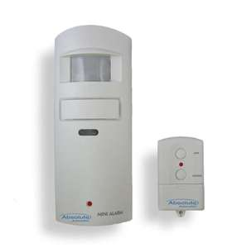

Building an online medical care system
Motion sensor, fall-detector
Healthcare provider monitors large numbers of remote patients
Medication station tracks, dispenses pills
Integrated glucose monitor and Insulin pump receives instructions wirelessly
Cloud Infrastructure
Monitoring subsystem
Home healthcare application

Slide 33
Two replication cases that arise
Replicating the database of patient records
  Goal: Availability despite crash failures, durability, consistency and security.
  Runs in an “inner” layer of the cloud
Replicating the state of the “monitoring” framework
  It monitors huge numbers of patients
  (cloud platform will monitor many, intervene rarely)
  Goal is high availability, high capacity for “work”
  Probably runs in the “outer tier” of the cloud
Patient Records DB
Patient Records DB
Patient Records DB

Slide 34
Which matters more: fast response, or durability of the data being updated?
Mrs. Marsh has been dizzy. Her stomach is upset and she hasn’t been eating well, yet her blood sugars are high.
Let’s stop the oral diabetes medication and increase her insulin, but we’ll need to monitor closely for a week
Cloud Infrastructure
Monitoring Layer
Patient Records DB

Slide 35
Pay for what you use!
Patient Records DB
Patient records database has stronger properties requirements but is under less load and needs a smaller degree of state replication
The monitoring infrastructure needs to scale to a much larger degree, but has weaker requirements (and because it lives in the soft-state first tier of the cloud, some kinds of goals would make no sense)
Similar pattern seen in the smart power grid, self-driving cars, many other high-assurance use cases

Slide 36
Real systems demand tradeoffs
The database with medical prescription records needs strong replication with consistency and durability
  The famous ACID properties. A good match for Paxos
But what about the monitoring infrastructure?
  A monitoring system is an online infrastructure
  In the soft state tier of the cloud, durability isn’t available
  Paxos works hard to achieve durability. If we use Paxos, we’ll pay for a property we can’t really use

Slide 37
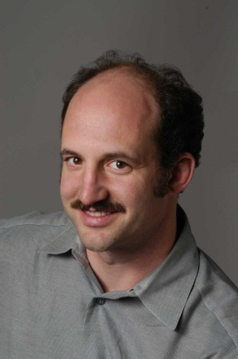
Why does this matter?
We’ll see that durability is expensive
  Basic Paxos always provides durability
  SafeSend is like Paxos and also has this guarantee
If we weaken durability we get better performance and scalability, but we no longer mimic Paxos
Generalization of Brewer’s CAP conjecture:
one-size-fits-all won’t work in the cloud.
You always confront tradeoffs.

Slide 38
Weakening properties in Isis²
SafeSend: Ordered+Durable
OrderedSend: Ordered but “optimistic” delivery
Send, CausalSend: FIFO or Causal order
RawSend: Unreliable, not virtually synchronous
Flush: Useful after an optimistic delivery
  Delays until any prior optimistic sends are finished.
  Like “fsync” for a asynchronously updated disk file.

Slide 39
Monitoring in a soft-state service with a primary owner issuing the updates
Update the monitoring and alarms criteria for Mrs. Marsh as follows…
g.Send is an optimistic, early-deliverying virtually synchronous multicast. Like the first phase of Paxos
Execution timeline for an individual first-tier replica
A B C D
Flush pauses until prior Sends have been acknowledged and become “stable”. Like the second phase of Paxos.
In our scenario, g.Send + g.Flush ≈ g.SafeSend
Soft-state first-tier service
Response delay seen by end-user would also include Internet latencies
Send
Send
Local response delay
Send
Confirmed
flush
In this situation we can replace SafeSend with Send+Flush.
But how do we prove that this is really correct?

Slide 40
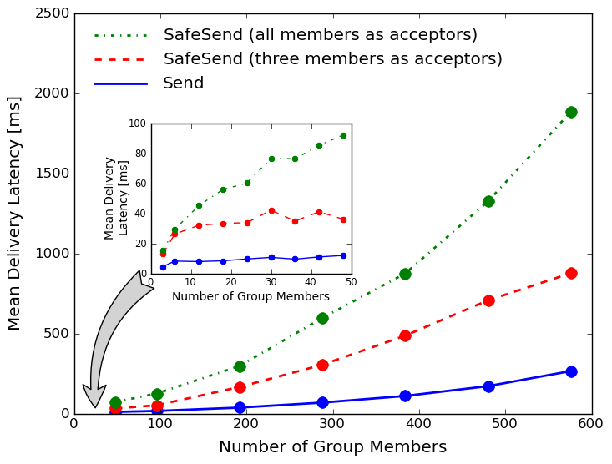
Isis²: Send v.s. SafeSend
Send scales best, but SafeSend with
modern disks (RAM-like performance) and small
numbers of acceptors isn’t terrible.

Slide 41
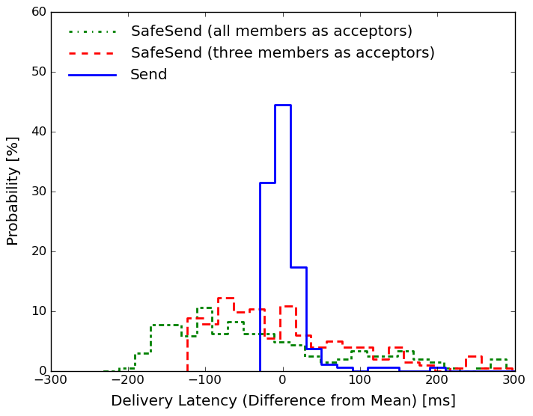
Jitter: how “steady” are latencies?
The “spread” of latencies is much
better (tighter) with Send: the 2-phase
SafeSend protocol is sensitive to
scheduling delays
Variance from mean, 32-member case

Slide 42
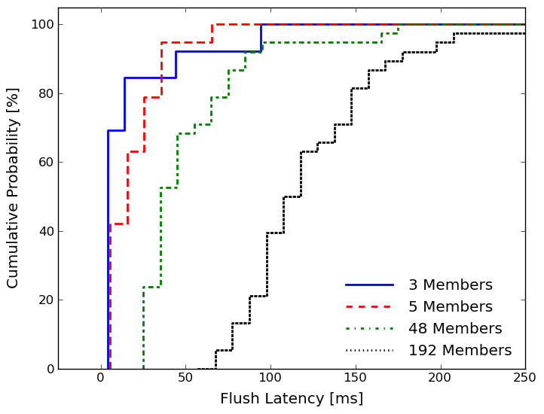
Flush delay as function of shard size
Flush is fairly fast if we only wait for
acks from 3-5 members, but is slow
if we wait for acks from all members.
After we saw this graph, we changed
Isis² to let users set the threshold.

Slide 43
What does the data tell us?
With g.Send+g.Flush we can have
  Strong consistency, fault-tolerance, rapid responses
  Similar guarantees to Paxos (but not identical)
  Scales remarkably well, with high speed
Had we insisted on Paxos
  It wasn’t as bad as one might have expected
  But no matter how we configure it, we don’t achieve adequate scalability, and latency is too variable
  CAP community would conclude: aim for BASE, not ACID

Slide 44

Are we done?
We’ve seen two issues so far
  Composition of our SafeSend protocol with application revealed limitations of “formal specifications”
  Need for speed and scalability forced us to make a
  non-trivial choice between SafeSend and Send+Flush
But are these the only such issues?

Slide 45


Modular designs pose many such questions
SafeSend and Send are two of the protocol components hosted over the sandbox. These share flow control, security, etc
Isis² user object
Isis² user object
Isis² user object
Other group
members
The SandBox is mostly composed of “convergent” protocols that use probabilistic methods
Send
CausalSend
OrderedSend
SafeSend
Query....
Membership Oracle
Isis² library
Flow Control
Group instances and multicast protocols
Group membership
Reliable Sending
Fragmentation
Group Security
Views
Oracle Membership
Large Group Layer
Dr. Multicast
Platform Security
TCP tunnels (overlay)
Sense Runtime Environment
Socket Mgt/Send/Rcv
Report suspected failures
Self-stabilizing
Bootstrap Protocol
Message Library
“Wrapped” locks
Bounded Buffers
We structured Isis² as a sandbox containing modular protocol objects
The sandbox provides system-wide properties; protocols “refine” them.

Slide 46
Drill down: Flow control
SafeSend (Paxos)
Flow Control
Consider SafeSend (Paxos) within Isis²
  Basic protocol looks very elegant
  Not so different from Robbert’s 60 lines of Erlang
But pragmatic details clutter this elegant solution
  E.g.: Need “permission to send” from flow-control module
  ... later tell flow-control that we’ve finished
Flow control is needed to prevent overload
  Illustrates a sense in which Paxos is “underspecified”

Slide 47
Pictoral representation
SafeSend (Paxos)
Flow Control
“Paxos” state depends on “flow control state”
Modules are concurrent. “State” spans whole group
SafeSend (Paxos)
Flow Control
SafeSend (Paxos)
Flow Control
SafeSend (Paxos)
Flow Control
SafeSend (Paxos)
Flow Control
SafeSend (Paxos)
Flow Control
Other nodes
This node

Slide 48
... flow control isn’t local
SafeSend (Paxos)
Flow Control
One often thinks of flow control as if the task is a local one: “don’t send if my backlog is large”
But actual requirement turns out to be distributed
  “Don’t send if the system as a whole is congested”
    Permission to initiate a SafeSend obtains a “token” representing a unit of backlog at this process
    Completed SafeSend must return the token
Flow Control is a non-trivial distributed protocol!
  Our version uses a gossip mechanism

Slide 49
Sandbox design principles
A “lesson learned” when building Isis²
  Many components use gossip-based algorithms
  These are robust, scalable, easy to reason about… but they are also sluggish
  In practice they ended up in the “sandbox”
The delicate, performance-critical protocols run on top of these more robust but slow components

Slide 50
… adding to our list!
Earlier, we observed that
  Today’s formal methods look inward, not outward. They overlook the need to relate the correctness of the component with the correctness of the use case
  They don’t offer adequate support for developers who must reason about (important) optimization decisions
… now we see that large-scale platforms confront us with a whole series of such issues

Slide 51

The challenge…
Which road leads forward?
  Extend our formal execution model to cover all elements of the desired solution: a “formal system”
  Develop new formal tools for dealing with complexities of systems built as communities of models
  Explore completely new kinds of formal models that might let us step entirely out of the box

Slide 52
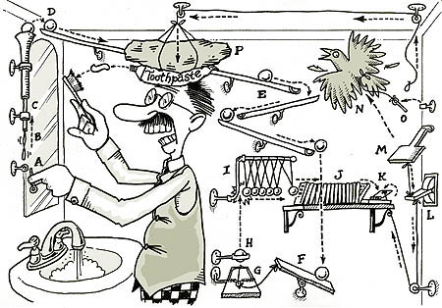
The challenge?
Which road leads forward?
  Extend our formal execution model to cover all elements of the desired solution: a “formal system”
  Develop new formal tools for dealing with complexities of systems built as communities of models
  Explore completely new kinds of formal models that might let us step entirely out of the box
Doubtful:
The resulting formal model would be unwieldy
Theorem proving obligations rise more than linearly in model size

Slide 53
The challenge?
Which road leads forward?
  Extend our formal execution model to cover all elements of the desired solution: a “formal system”
  Develop new formal tools for dealing with complexities of systems built as communities of models
  Explore completely new kinds of formal models that might let us step entirely out of the box
Our current focus:
Need to abstract behaviors of these complex “modules”
On the other hand, this is how one debugs platforms like Isis²

Slide 54
The challenge?
Which road leads forward?
  Extend our formal execution model to cover all elements of the desired solution: a “formal system”
  Develop new formal tools for dealing with complexities of systems built as communities of models
  Explore completely new kinds of formal models that might let us step entirely out of the box
Intriguing future topic:
All of this was predicated on a style of deterministic, agreement-based model
Could self-stabilizing protocols be composed in ways that permit us to tackle
equally complex applications but in an inherently simpler manner?

Slide 55

Summary?
We set out to bring formal assurance
guarantees to the cloud
  And succeeded: Isis² works (isis2.codeplex.com)!
  Industry is also reporting successes (e.g. Google spanner)
  But along the way, formal tools seem to break down!
Can the cloud “do” high assurance?
  At Cornell, we think the ultimate answer will be “yes”
  … but clearly much research is still needed

