Slide 1
Distributed Systems
Time Clocks and Ordering of events Distributed Snapshots – Determining Global States
Dinesh Bhat - Advanced Systems
(Some slides from 2009 class)
CS 6410 – Fall 2010

Slide 2
Time, Clocks, and the Ordering of Events in a distributed System
Leslie Lamport

Slide 3
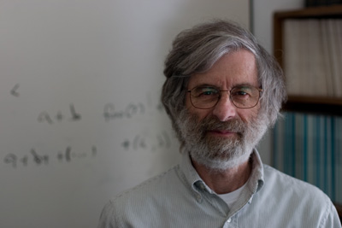
Author
Leslie Lamport
B.S., M.I.T., 1960. (Maths)
Ph D, Brandein University, 1972
ACM SIGOPS Hall of Fame Award (2007)
IEEE John von Neumann Medal (2008)
Microsoft Research ( from 2001-present )

Slide 4
Outline
Introduction
Partial Ordering of Events
Logical Clocks and Total ordering
Distributed algorithm: An Example
Strong Clock Condition using Physical Clocks
Discussion

Slide 5
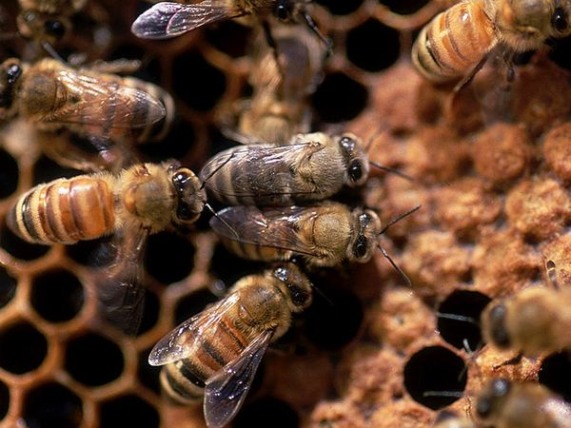
Introduction
Defn 1 : Collection of nodes connected via network representing a single coherent system
Defn 2 : Collection of processes within a computer
WHY DS ?
Resource sharing/
Load Balancing
Computation speedup
Reliability
SW/HW preference
Data access

Slide 6
Introduction
Design issues in building a DS:
Transparency – the distributed system should appear as a conventional, centralized system to the user.
Fault tolerance – the distributed system should continue to function in the face of failure.
Failure detection – in case of asynchronous DS, its hard to differentiate between message delay Vs lost message
Scalability – as demands increase, the system should easily accept the addition of new resources to accommodate the increased demand.

Slide 7
Introduction
Complexities in DS implementation :
Unpredictable order of events in a distributed system
Problem 1- Update A needs to occur before update B
No global clock shared by processes – if there was any, FCFS could have solved all issues of event ordering
Some ordering could be implicit
Events in a single process happen in order
Message between processes must be sent before they are received
WHAT IS THE SOLUTION ???

Slide 8
Space Time diagram of events
Process 1
a 1
a 2
a3
a4
Time
Process 2
b1
b 2
Process 3
c 1

Slide 9
Events
Send Event
Receive Event
Local event
Process
Process
Process

Slide 10
Partial Ordering of Events
Causal events satisfying relation → “Happens Before”
a) Two local events of a process : a → b
b) Two endpoints of a same message : a→b
c) Transitive : If a→b and b→c, then a→c
Concurrent events
a → b, a and b run independently

Slide 11
Space Time diagram of events
Process 1
a 1
a 2
a3
a4
a5
a6
Time
Process 2
b1
b 2
b 3
b 4
b 5
Process 3
c 1
c 2

Slide 12
Logical Clocks to implement Partial Ordering of events
Logical Clock = Way of assigning a number to an event
Following Clock condition should be satisfied for partial ordering :
If a → b, then C(a) < C(b)
“Converse is not true”

Slide 13
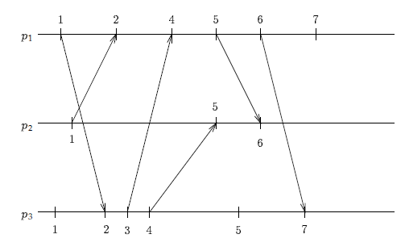
Logical Clocks to implement Partial Ordering of events

Slide 14
Logical Clocks(Contd..)
‘a’ and ‘b’ are local events, to hold C(a) < C(b),
Assign distinct numbers to every successive local events in incremental fashion
‘a’ and ‘b’ are send and receive events of message M, to hold C(a) < C(b),

Slide 15
Total ordering of events
Useful in implementing a distributed system
Logical clocks could be extended to obtain total ordering
If C(a) == C(b) && P(a) < P(b), then a => b
Example : mutual exclusion problem
Multiple processes contending for one resource

Slide 16
Total Ordering of Events : Example
Step 1: P_{i} Sends Request Resource
P_{i} sends Request T_{m}:P_{i} to P_{j}
P_{i} puts Request T_{m}:P_{i} on its request queue
T₀:P₁
T₁:P₁
P₁
P₂
P₃
Notes:
Step 1: Process Pi requests the resource.
Pi puts a request message (with the current timestamp and its ID) on its request queue.

Slide 17
Total Ordering of Events : Example
Step 1: P_{i} Sends Request Resource
P_{i} sends Request T_{m}:P_{i} to P_{j}
P_{i} puts Request T_{m}:P_{i} on its request queue
T₀:P₁
T₁:P₁
P₁
request
request
T₀:P₁
T₁:P₁
P₂
P₃
Time, Clocks, and the Ordering of Events in a Distributed System
Notes:
Step 1: Process Pi requests the resource.
Pi sends the request to every other process Pj.

Slide 18
Total Ordering of Events : Example
Step 2: P_{j} Adds Message
P_{j} puts Request T_{m}:P_{i} on its request queue
P_{j} sends Acknowledgement T_{m}:P_{j} to P_{i}
T₀:P₁
T₁:P₁
P₁
P₂
P₃
T₀:P₁
T₁:P₁
Time, Clocks, and the Ordering of Events in a Distributed System
Notes:
Step 2: Each process Pj sends acknowledgement to Pi.
Each Pj puts the request message on its request queue

Slide 19
Total Ordering of Events : Example
Step 2: P_{j} Adds Message
P_{j} puts Request T_{m}:P_{i} on its request queue
P_{j} sends Acknowledgement T_{m}:P_{j} to P_{i}
T₀:P₁
T₁:P₁
P₁
ack
ack
T₂:P₂
T₃:P₃
P₂
P₃
T₀:P₁
T₁:P₁
Time, Clocks, and the Ordering of Events in a Distributed System
Notes:
Step 2: Each process Pj sends acknowledgement to Pi.
Pj sends an acknowledgement message (with the current timestamp and its ID) to Pi

Slide 20
Total Ordering of Events : Example
Step 3: P_{i} Sends Release Resource
P_{i} removes Request T_{m}:P_{i} from request queue
P_{i} sends Release T_{m}:P_{i} to each P_{j}
P₁
P₂
P₃
T₀:P₁
T₁:P₁
Time, Clocks, and the Ordering of Events in a Distributed System
Notes:
Step 3: Release Resource
Pi removes any of its own request message from its request queue

Slide 21
Total Ordering of Events : Example
Step 3: P_{i} Sends Release Resource
P_{i} removes Request T_{m}:P_{i} from request queue
P_{i} sends Release T_{m}:P_{i} to each P_{j}
P₁
release
release
T₄:P₁
T₅:P₁
P₂
P₃
T₀:P₁
T₁:P₁
Time, Clocks, and the Ordering of Events in a Distributed System
Notes:
Step 3: Release Resource
Pi sends a release resource message to each Pj

Slide 22
Total Ordering of Events : Example
Step 4: P_{j} Removes Message
P_{j} receives Release T_{m}:P_{i} from P_{i}
P_{j} removes Request T_{m}:P_{i} from request queue
P₁
P₂
P₃
Time, Clocks, and the Ordering of Events in a Distributed System
Notes:
Step 4: Remove Message
Pj removes any request resource message from its request queue.

Slide 23
Anomalous behavior
T₃:P₃
T₁:P₂
P₁
T1:P₂
T3:P₃
P₂
P₃
T2:P₂
Solution 1 :
Attach a timestamp with T2:P2

Slide 24
Solution 2 : Physical Clocks
Board diagram

Slide 25
Discussion
Proof of concept
Defines event ordering in distributed systems
Building systems on top of Specifications, Set of assumptions ( No node failures, reliable channels )
Logical Clock counters – overflow issues ?
Set of assumptions were strong ?

Slide 26
Distributed Snapshots
K. Mani Chandy and Leslie Lamport

Slide 27
Authors
Leslie Lamport
K Mani Chandy
Simon Ramo Professor, CalTech
(since 1987)
Ph D, MIT, 1969
Honeywell, IBM, UT Austin
IEEE Koji Kobayashi Award (1987)
Event driven architecture( marketed by Avaya )

Slide 28
Outline
Motivation
Cuts and Consistent cuts
Distributed system model
Distributed Snapshots
Global State Detection Algorithm
Properties of recorded Global state
Stability Detection

Slide 29
Motivation and Goals
A process in a DS determines the global state of the system which is useful in detecting stability of the system
Challenges :
Communication delay
Relative speeds of computations differ
Stable properties examples:
- Computation is terminated
- kth computational phase is terminated
- System is deadlocked
State detection algorithm is similar to capturing panoramic view of migrating birds
Composite picture should be meaningful
Moving birds add complexity to the process

Slide 30
Distributed System Model
State of processes and Channels
States of processes and Channels are defined by events and messages respectively
Event e = <p, s, s’, M, c>
- process p
- s and s’ are states
- channel c and message M

Slide 31
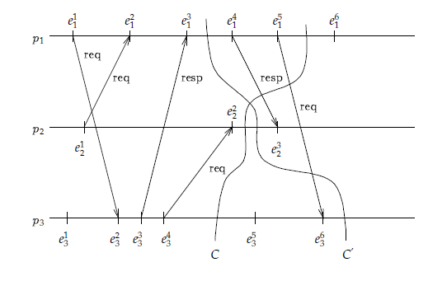
Cuts and Consistent Cuts

Slide 32
Consistent Global State
A cut C is consistent if for all events e and e’
Intuitively if an event is part of a cut then all events that happened before it must also be part of the cut
A consistent cut defines a consistent global state

Slide 33
Assumptions
Processes do not fail
Reliable communication channels
FIFO delivery between a pair of processes
Channels have infinite buffers

Slide 34
Distributed System Model
Single Token System – compute global states
In P
In c
P
Q
P
Q
P
Q
P
Q
In c’
In Q

Slide 35
Distributed System Model
Nondeterministic System
Global state: S3
Global state : S0
P
Q
P
Q
Event
P receives M’
Event
P sends M
P
Q
P
Q
Global state : S1
Event
Q sends M’
Global state : S2

Slide 36
Global State Detection Algorithm
Marker Snapshot Protocol
P records its state and pushes an empty marker M on all outgoing channels
Q, when receives a marker M along its incoming channel c,
If it was not in recording state,
Start recording Q’s state
Record c’s state as empty state
Pushes the Marker M onto all its outgoing channels
If it was already in recording state,
Stops recording on incoming channel c, and records the state of c as the sequence of messages received since Q started recording and before Marker M is received on this channel
When Q receives markers on all its incoming channels, stop recording the state of Q and its incoming channels and ‘call it a day’ for Q.

Slide 37
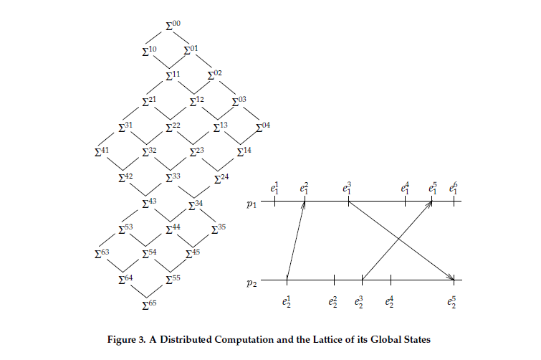
Properties of recorded global state

Slide 38
Stability Detection
Algorithm
Start: definite=false, y(S₀)=false
Repeat: record S*, definite=y(S*)
Implications of “definite”
definite == false: can not say YES/NO stability
definite == true: stable property at termination
Correctness
S₀ can lead to S*, S* can lead to S_{t}
for all j: y(S_{j}) = y(S_{j}+1)

Slide 39
Discussion
???

Slide 40
Other References
WikiPedia
http://www.cs.cornell.edu/courses/cs4410/2008fa/
Consistent Global States of Distributed Systems: Fundamental Concepts and Mechanisms

