Slide 1
VIRTUALIZATION
Xen and the Art of Virtualization
Are Virtual Machine Monitors Microkernels Done Right?
Presented by Brett Fernandes

Slide 2
Problems with Other Architectures
Microkernels
Poor Performance
overhead from IPC
Change the ABI
Must forfeit all available software for the system
Monolithic kernel in disguise?
Failure conditions of external pagers
Exokernels
No application multiplexing
No place for the untrustworthy!

Slide 3
Virtual Machines to the rescue?
Excellent Performance
Achieved through Paravirtualization
Retain the same ABIs
All required architectural features are virtualized
Internal Paging by each VM
Application multiplexing is everything
Each guest OS can multiplex applications securely
The untrustworthy are welcome
Strong resource isolation between VMs

Slide 4
VMs - The resurgence rather than the emergence
An old idea - IBM 370 in 1972.
A Virtual Machine Time-Sharing System (Meyer and Seawright) described the CP-67/CMS – the first virtual machine.
Newer ventures:
Vmware ESX Server (2001) - successor of Disco
The Denali project (2001) - coined the term paravirtualization
Sun’s VirtualBox (2008)
Microsoft released Hyper-V (2008)
Xen is the most widely used by far – available as open source but now owned by Citrix Inc.

Slide 5
Xen and the Art of Virtualization
Paul Barham
Microsoft Research, UK
Nemesis OS (QoS for I/O and virtual memory)
Rolf Neugebauer
Intel Research, Cambridge, UK
Boris Dragovic
XenoServer Team (Cambridge 2002), LinSec – Linux Security System
Keir Fraser, Steven Hand, Tim Harris, Alex Ho, Ian Pratt
Cambridge University, UK
Andrew Warfield
University of British Columbia

Slide 6
Introduction
Challenges to build virtual machines
Performance isolation
Scheduling priority
Memory demand
Network traffic
Disk accesses
Support for various OS platforms
Small performance overhead

Slide 7
Xen Principles
Unmodified Application Binaries
No change to applications required
Full multi-application OS support
Support for XenoLinux and ongoing work on Windows XP and BSD
Paravirtualization
High performance
Resource Isolation
Allows malicious users without harming other VMs
Partial view of physical resources provided

Slide 8
Xen: Approach and Overview
Multiplexes resources at the granularity of an entire OS
As opposed to process-level multiplexing
Price: higher overhead
Target: 100 virtual OSs per machine
Denali supported over a thousand

Slide 9
Xen: Approach and Overview
Conventional approach - Full virtualization
Virtual hardware is functionally identical to underlying machine
Virtualizing the entire instruction set
No view of physical resources
Problematic for certain privileged instructions
Failed silently rather than trapping
Shadow structures
Vmware traps every update page table event
No real time available
Hosted OS not modified

Slide 10
Xen: Approach and Overview
New approach - paravirtualization
Virtual hardware is similar, not identical to the underlying hardware
Partial view of the underlying hardware
No modification of applications
VMs handle paging
No shadow tables required
Real, virtual and clock time provided
Need modifications to the OS
porting to Xen for every version of every OS

Slide 11
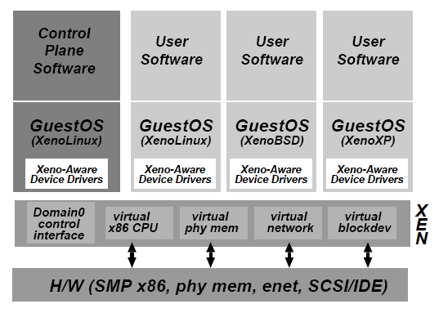
System Control Mechanism
Separation of policy and mechanism
Domain0 hosts the application-level management software
Creation and deletion
of virtual network
interfaces and block
devices

Slide 12
System Control Mechanism
Control Transfer: Hypercalls and Events
Hypercall: synchronous calls from a domain to Xen
Analogous to system calls
Events: asynchronous notifications from Xen to domains
Replace device interrupts

Slide 13
CPU Design
X86 supports 4 levels of privileges
0 for OS, and 3 for applications
Xen downgrades the privilege of OSes
System-call and page-fault handlers registered to Xen
“fast handlers” for most exceptions, Xen isn’t involved

Slide 14
CPU Implementation
Borrowed virtual time scheduling
Allows temporary violations of fair sharing to favor recently-woken domains
Goal: reduce wake-up latency

Slide 15
Time and Timers
Xen provides each guest OS with
Real time (since machine boot)
Virtual time (time spent for execution)
Wall-clock time
Each guest OS can program a pair of alarm timers
Real time
Virtual time

Slide 16
Memory Design
The conventional easier approach:
Software managed TLB
Associate address space IDs with TLB tags
Allow coexistence of OSes
Avoid TLB flushing across OS boundaries

Slide 17
Memory Design
X86 does not have software managed TLB
Xen exists at the top 64MB of every address space
Avoid TLB flushing when an guest OS enters/exits Xen
Each OS can only map to memory it owns
Writes are validated by Xen

Slide 18
Physical Memory Implementation
Reserved at domain creation times
Memory statically partitioned among domains
XenoLinux’s balloon driver
Does not guarantee contiguous allocation of memory

Slide 19
Virtual Address Translation
No shadow pages (VMWare)
Xen provides constrained but direct MMU updates
All guest OSes have read-only accesses to page tables
Updates are batched into a single hypercall

Slide 20
Device I/O Design
Xen exposes a set of simple device abstractions
Allows an efficient interface which provides protection and isolation
I/O data transfer between domains via Xen

Slide 21
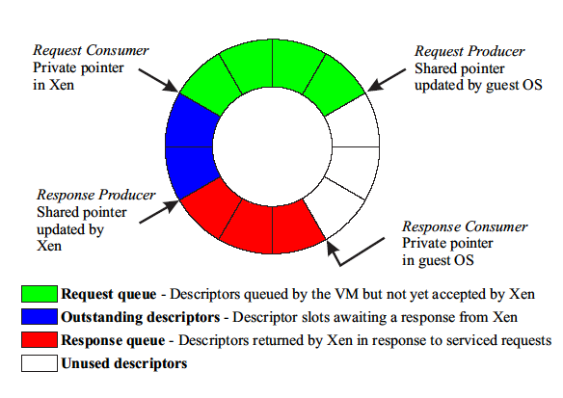
Data Transfer: I/O Rings
Zero-copy semantics

Slide 22
Disk Access Implementation
Only Domain0 has direct access to disks
Other domains need to use virtual block devices
Use the I/O ring
Reorder requests prior to enqueuing them on the ring
If permitted, Xen will also reorder requests to improve performance
Use DMA (zero copy)

Slide 23
Network
Virtual firewall-router attached to all domains
Round-robin packet scheduler
To send a packet, enqueue a buffer descriptor into the transmit ring
Use scatter-gather DMA (no packet copying)
A domain needs to exchange page frame to avoid copying
Page-aligned buffering

Slide 24
The Cost of Porting an OS to Xen
Architecture Independent (78 lines)
Virtual Block Device driver (1070 lines)
Virtual Network driver (484 lines)
Xen specific (1363 lines)
< 2% of code-base

Slide 25
Evaluation
Against other virtualization techniques
Vmware, User Mode Linux(UML)
Single Native OS vs Virtual Machine
Running multiple applications on a native OS vs a guest OS
Performance Isolation between Guest OSs
Overhead of running large number of OSs

Slide 26
Relative Performance
SPEC INT2000 score
CPU Intensive
Little I/O and OS interaction
SPEC WEB99
180Mb/s TCP traffic
Disk read-write on 2GB dataset

Slide 27
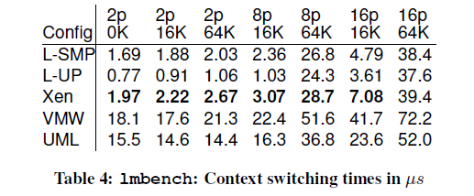
O.S Benchmarks
Context switching times – extra overhead due to hypercall required to change the page table base.

Slide 28
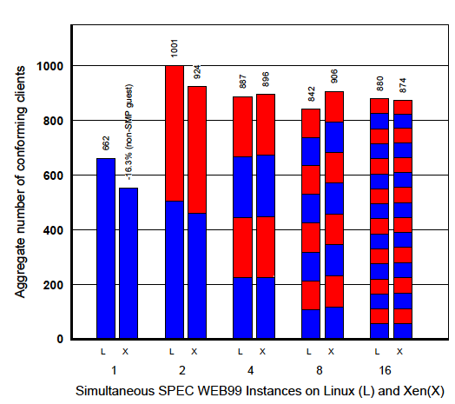
Concurrent Virtual Machines
Multiple Apache processes in Linux
vs.
One Apache process in each guest OS

Slide 29
Performance Isolation
4 Domains
2 running benchmarks
1 running dd
1 running a fork bomb in the background
2 antisocial domains contributed only 4% performance degradation

Slide 30
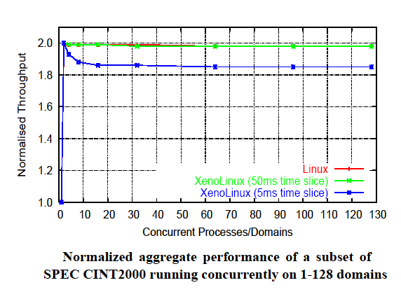
Scalability

Slide 31
Issues
Extra effort is required to port every version of every OS to Xen
Demonstrated by the ‘ongoing effort’ to port Windows XP and BSD
Running a full OS is more taxing in terms of resource consumption
The requirement of every privileged instruction being validated by Xen results in performance overhead
Difficult to implement on an architecture with only 2 privilege levels

Slide 32
Discussion/Takeaways
Main achievement – performance.
Completely outperformed Vmware in almost all benchmarks
Identified potential problems and took steps to minimize them
Eg Fast exception handler for system calls
OS level multiplexing
Solved the problem of performance isolation that plagued traditional OS techniques
Innovative approach to TLB
Allocation of top 64MB to Xen avoids TLB flushes

Slide 33
Are Virtual Machine Monitor Microkernels Done Right?
Steven Hand, Keir Fraser, Evangelos Kotsovinos
Cambridge University, UK
Andrew Warfield
University of British Columbia
Dan Magenheimer
HP labs, Fort Collins
Wrote the first PA-RISC simulator
Developed Vblades, the first Itanium VMM

Slide 34
Sparking the Debate
Mendel Rosenblum’s claim
VMMs are microkernels done right
Common system goals
Microkernels – Academia vs VMMs - Industry

Slide 35
Microkernels – Noble Idealism
Communication oriented
A smaller OS core is easier to maintain, validate and port
Architecturally better than monolithic kernels

Slide 36
VMMs – Rough Pragmatism
Strong resource isolation
Main concern is reducing overhead due to extra layer
Support execution of out-of-the-box applications
Where do Exokernels stand?

Slide 37
Architectural Lessons
Liability inversion
External pagers in microkernels vs Parallax using VMs for storage
IPC Performance
Minimum communication between VMs
Decoupling of control and data path operations
OS as a Component
Microkernels forfeit the software available
VMMs appeal to developers because of a familiar environment

Slide 38
Discussion
Very biased view of the debate
Possibly due to several of the authors working on Xen
Focused on microkernel flaws and how VMMs were the answer
(almost certainly) Knowingly chose to refer to certain aspects of VMMs ambiguously
Microkernels and VMMs appear to be more related rather than significantly different.

