Slide 1
Novel File Systems
Presented by Ki Suh Lee
(Based on slides from
Hakim Weatherspoon and
Mahadev Sataynarayanan)

Slide 2
M. Satyanarayanan
Systems faculty at Carnegie-Mellon University
A principal architect and implementor of the Andrew File System (AFS)
Inspired CODA and another 20 years of research

Slide 3
Coda
Coda is a distributed file system
Since 1987
The latest release is Coda 6.9.4 (Jan 09)
47 publications including 6 PhD Theses
Evolved with usage experience.

Slide 4
Motivation for Coda
Epilogue to the Andrew File System (AFS)
AFS was found to be vulnerable to server and network failures
Not that different from NFS
Limits scalability of AFS
Coda provides high data availability
Server replication (optimistic replication)
Disconnected operation

Slide 5
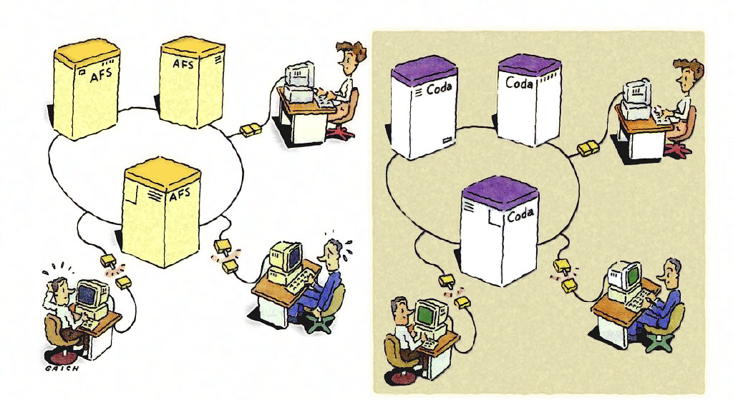
Coda Cartoon
http://www.cs.cmu.edu/~coda/images/nikkei-PAGE-213.JPG

Slide 6
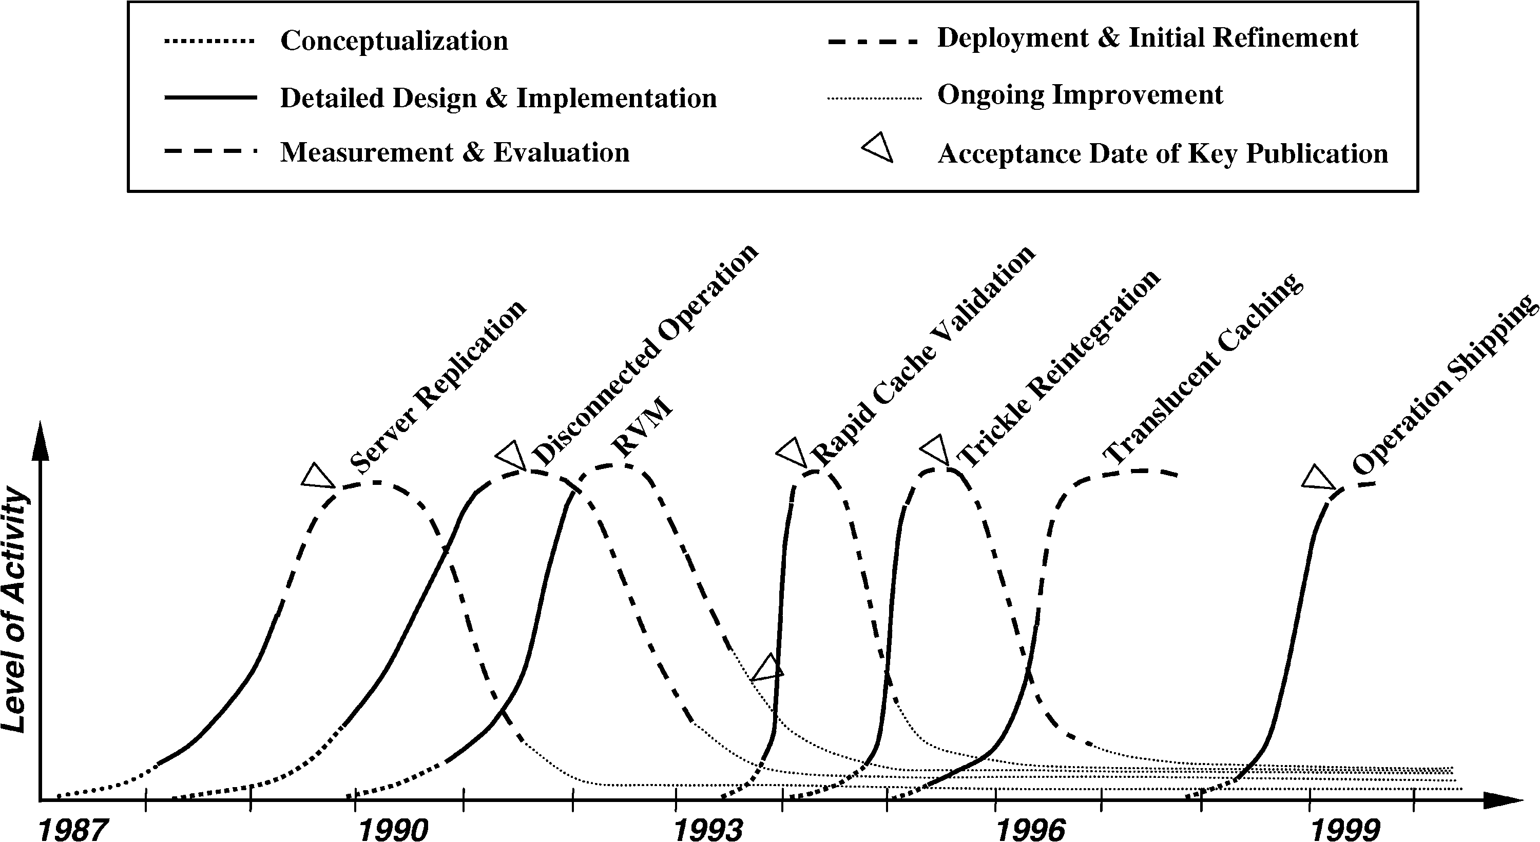
Timeline
Notes:
Lets talk about long tail

Slide 7
Lessons Learned
Optimistic Replication
Real systems need real users
Timing
Long software tail
Moore’s Law
Code reuse
System admins
Short projects never die

Slide 8
Outline
Intro to Coda
Server Replication
Recoverable Virtual Memory (RVM)
Disconnected Operation
Conflict Resolution

Slide 9
Server Replication: 1987-1991
Optimistic replication control protocols allow access in every disconnected mode
Tolerate temporary inconsistencies
Promise to detect them later
Provide much higher data availability
Optimistic replication control requires a reliable tool for detecting inconsistencies among replicas
Better than LOCUS tool

Slide 10
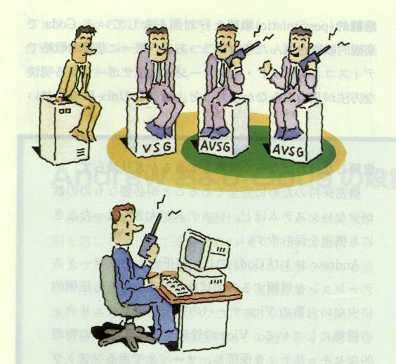
Replica Control
Volume
Volume storage group (VSG)
accessible volume storage group (AVSG)
Preferred server (PS)
Read-one-data, read-all-status, write-all
http://www.cs.cmu.edu/~coda/images/nikkei-PAGE-216.JPG

Slide 11
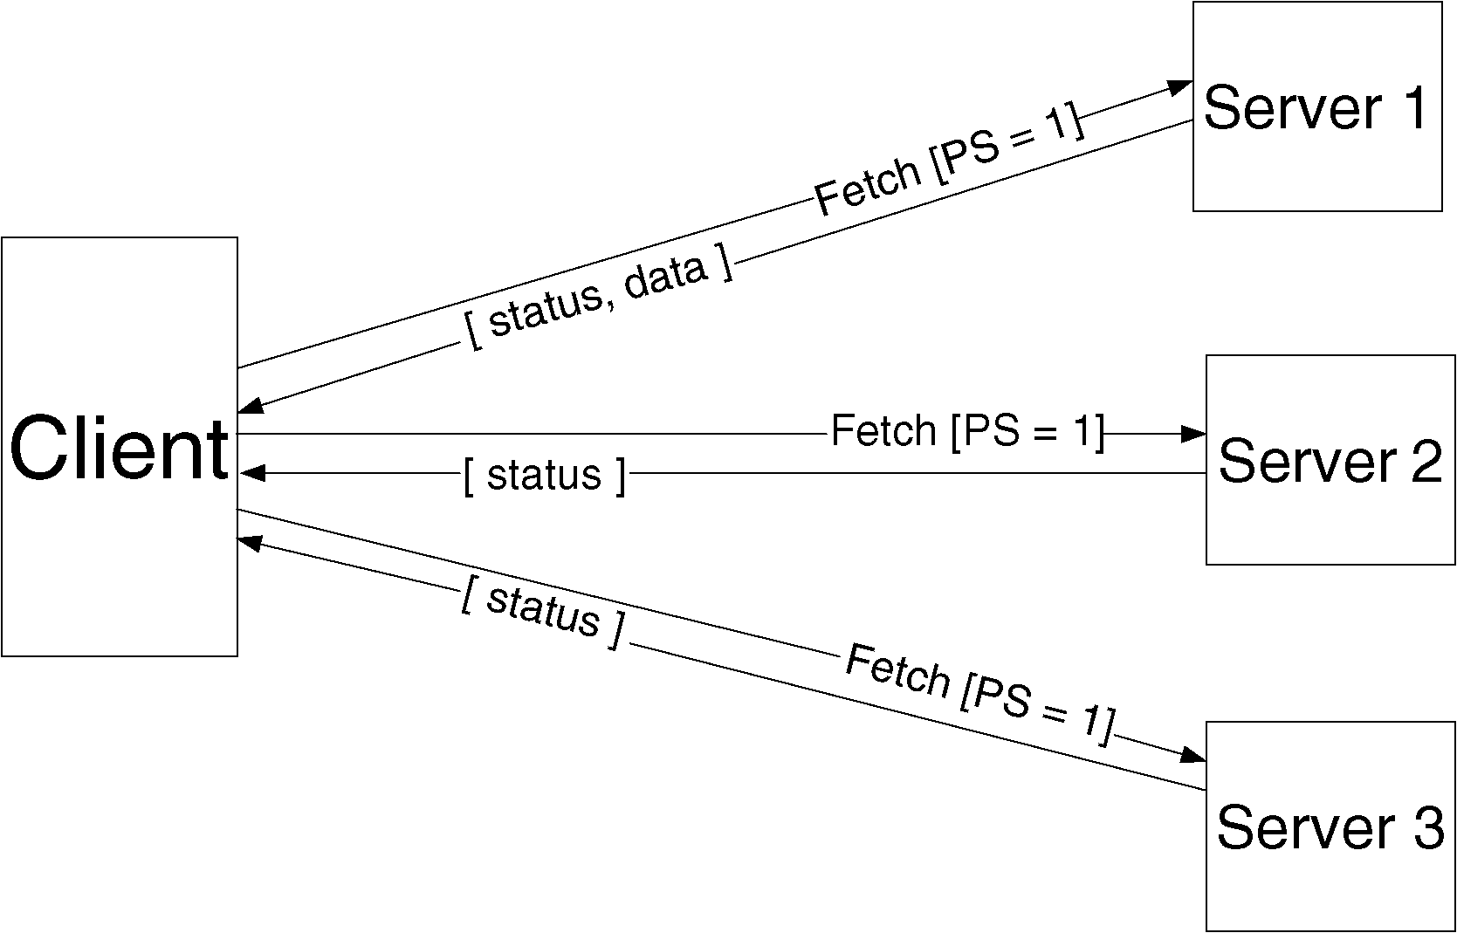
Read Protocol

Slide 12
Read Protocol
Client fetches data from PS
Also collects version information from AVSG
If a conflict is detected
Abort the read
Update stale replicas
Restart the fetch

Slide 13
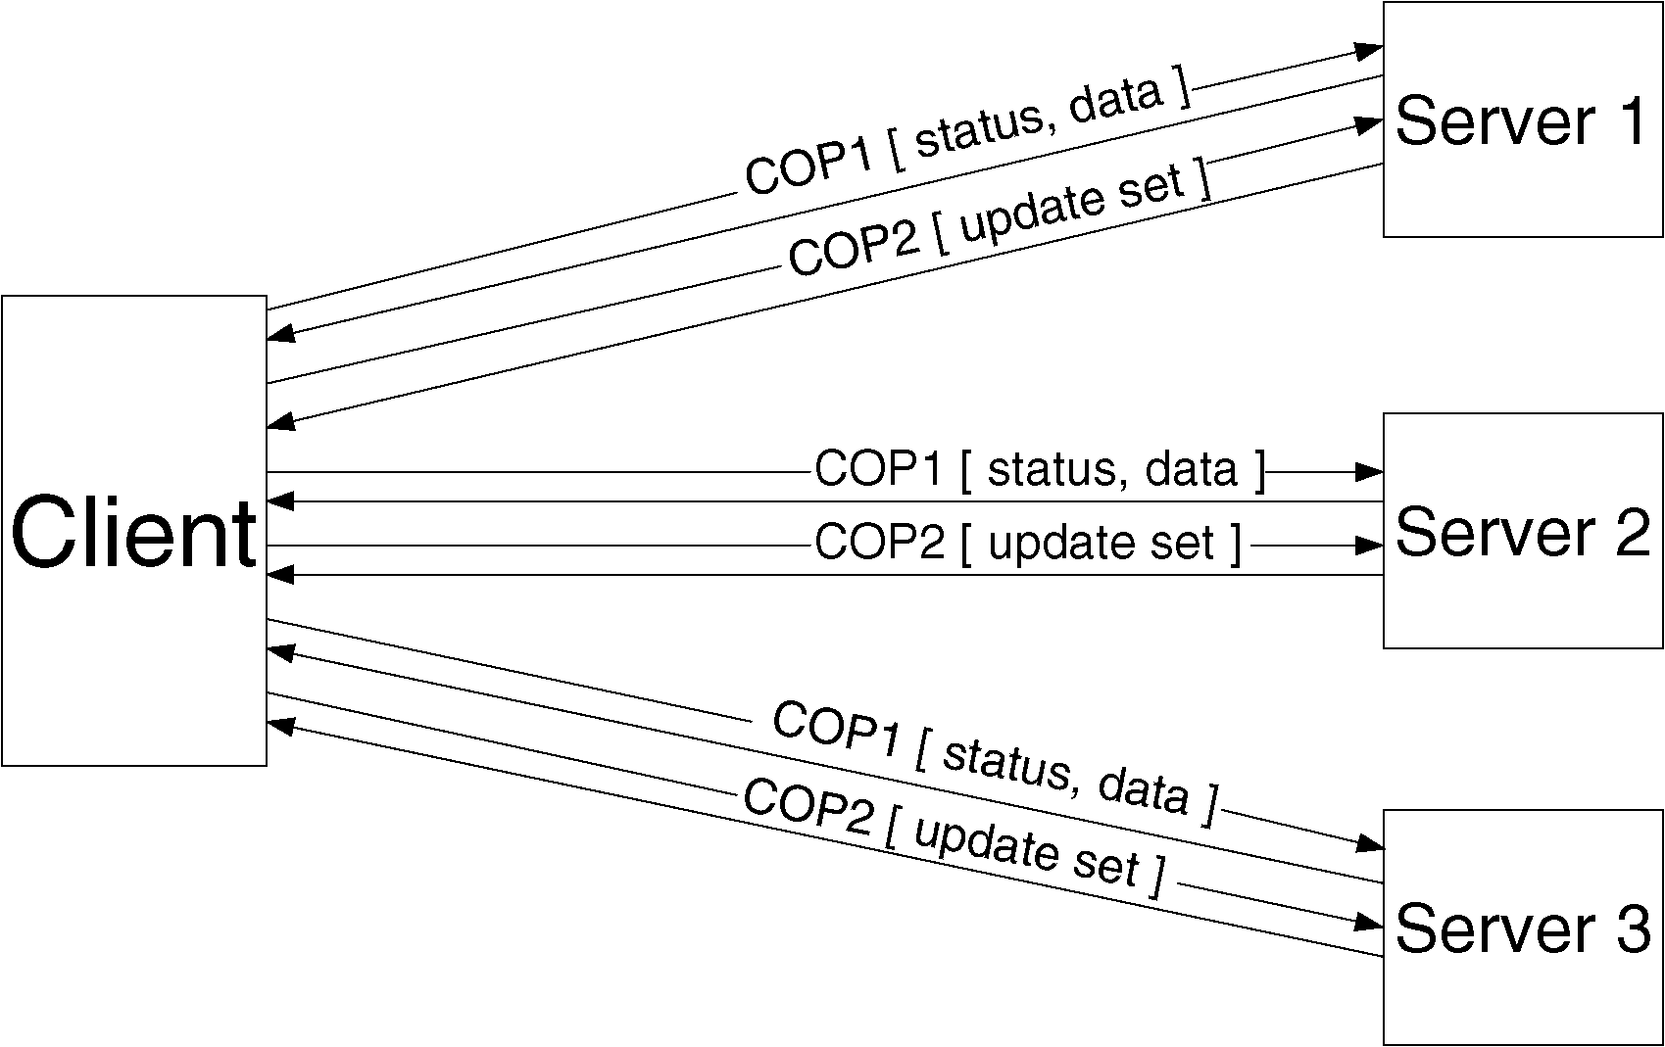
Update Protocol

Slide 14
Update Protocol
File modifications and directory updates are written to all members of AVSG
Two phases commit
In COP1, new status and data are sent
In COP2, update set is sent asynchronously
Non-blocking

Slide 15
Consistency Model
Accessible universe: set of replicas that the user can access
Accessible universe varies over time
One-copy serializability at open-close granularity in the accessible universe
Will read from the latest replica in accessible universe
Will update all replicas in accessible universe

Slide 16
Fault-tolerance
Correctness of update protocol requires atomicity and permanence of metadata updates
Recoverable virtual memory (RVM)
Implemented as a library

Slide 17
Lightweight Recoverable Virtual Memory
RVM updates persistent data structures in a fault-tolerant manner.
Allows independent control over the transactional properties.
Minimalism
Value Simplicity
portability
User-level library with minimal programming constraints.

Slide 18
Camelot
Used for two phase optimistic replication protocol by CODA
Poor scalability, programming constraints, and difficulty of maintenance
Considerable paging and context switching
Mach threads
Code size, tight dependence on Mach features
Coda only wanted recoverable virtual memory

Slide 19
Design Rationale
Keep it simple!
Factor out
Nesting
Distribution
Concurrency control
Resiliency
Instead, a layered approach
Less dependence on OS
Structured as a library

Slide 20
LRVM: Segments and Regions
Applications map regions of segments into their virtual memory.

Slide 21
Architecture
Newly mapped data represents the committed image of the region
No region of a segment can be mapped more then once by the same process
No overlap
Can be unmapped at any time, as long as no uncommitted transactions outstanding
simple APIs

Slide 22
LRVM: Crash Recovery
Recovery consists of reading the log from tail to head and then reconstructing the last committed changes.
Modifications are applied to the external data segment.
Log is emptied.

Slide 23
LRVM: Truncation
Reclaiming space in the log by applying changes to the external data segment.
Necessary because space is finite.

Slide 24
Evaluation
10K lines of C, compared to 60K lines in Camelot
Performance
Lack of RVM and VM integration
Scalability
Optimization
Overall, RVM is better then Camelot.

Slide 25
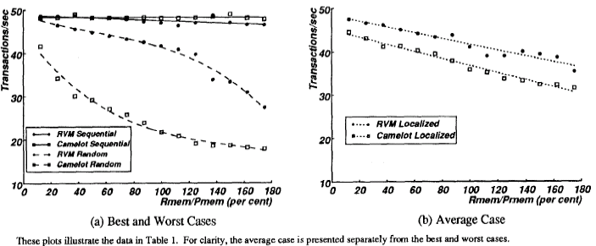
Transactional Throughput

Slide 26
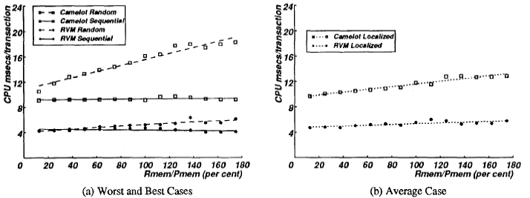
Scalability

Slide 27
Outline
Intro to Coda
Server Replication
Recoverable Virtual Memory (RVM)
Disconnected Operation
Conflict Resolution

Slide 28
Disconnected Operation: 1988-1993
Network isolation
Correlated server crashes
Overloaded or faulty routers
Caching
Optimistic replication
Improve availability

Slide 29
Disconnected Operation
Complimentary to server replication
Server replicas are first-class replicas
Cached replicas are secondary replicas

Slide 30
Implementation
Hoarding
disconnection
Logical reconnection
Emulating
Recovering
Physical reconnection

Slide 31
Hoarding
Implicit / Explicit sources of implementation
Hoard database (HDB)
Specifies files to be cached
Users update directly or via command scripts
Venus periodically reevaluates every ten minutes

Slide 32
Emulation / Reintegration
While disconnected, All changes are written to a log, Client modification log (CML)
After reconnection, perform reintegration for each volume independently.
Venus sends CML to all volumes
Each volume performs a log replay algorithm

Slide 33
Outline
Intro to Coda
Server Replication
Recoverable Virtual Memory (RVM)
Disconnected Operation
Conflict Resolution

Slide 34
Conflict Resolution
Syntactic approach to detect absence of conflicts.
Server replication
Version checks during the hoarding and reintegration
Semantic approach to resolve conflicts
Different control for directory and file resolution

Slide 35
Conflict Resolution: Objectives
No updates should ever be lost without explicit user approval
The common case of no conflict should be fast
Conflicts are ultimately an application-specific concept
The buck stops with the user

Slide 36
Directory Resolution
Automatic resolution by Coda
After disconnected operation
Apply the CML
During connected operation
Resolution log
Recovery protocol locks the replicas merges the logs and distributes the merged logs.

Slide 37
Application-Specific File resolution
Application-specific resolvers (ASRs) are executed entirely on clients.

Slide 38
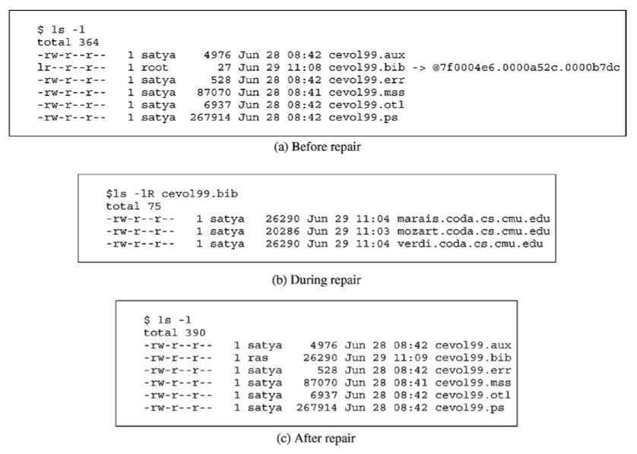
Conflict representation

Slide 39
Lessons Learned
Optimistic Replication
Real systems need real users
Timing
Long software tail
Moore’s Law
Code reuse
System admins
Short projects never die

Slide 40
Discussion

