Slide 1
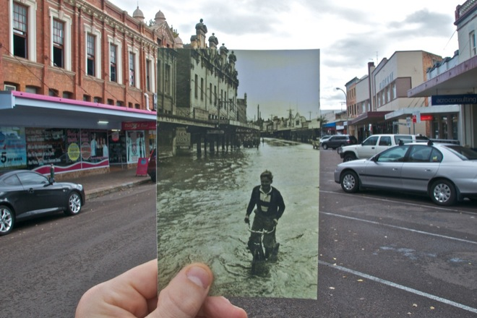
Image alignment
CS5760: Computer Vision
http://www.wired.com/gadgetlab/2010/07/camera-software-lets-you-see-into-the-past/

Slide 2
Reading
Szeliski: Chapter 6.1

Slide 3
Announcements
Project 2 out, due Monday, March 2, by 11:59pm on CMSX
  Report due Wednesday, March 4, by 11:59pm on CMSX
  Please form teams of 2, and create your team on CMSX
  Please declare your group on CMSX by this today
  After today, we will randomly assign ungrouped students to groups
  Feel free to use Piazza to form groups
Take home midterm
  To be released Wednesday, March 4
  Due Monday, March 9

Slide 4
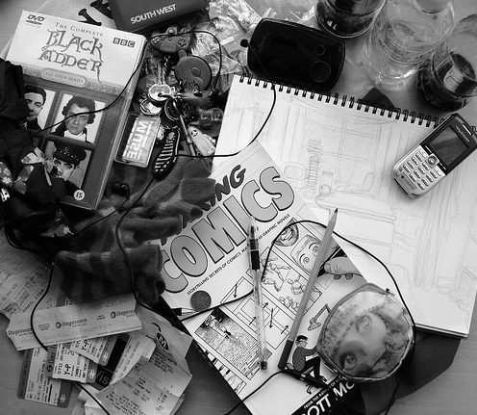
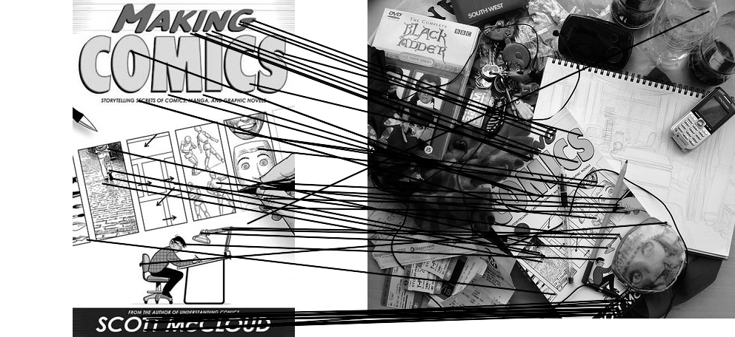
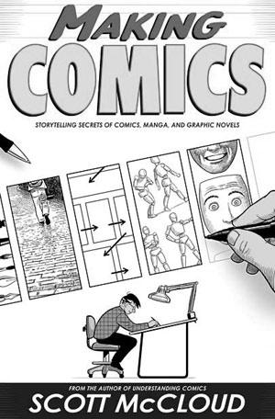
Computing transformations
Given a set of matches between images A and B
  How can we compute the transform T from A to B?
  Find transform T that best “agrees” with the matches

Slide 5
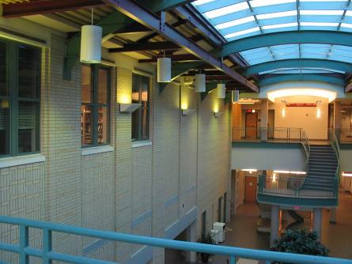
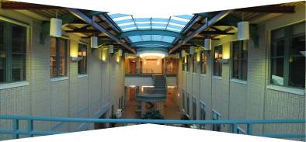
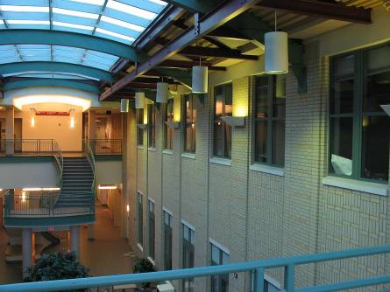
Computing transformations
?

Slide 6



Simple case: translations
How do we solve for
?

Slide 7









Simple case: translations
Displacement of match i =
Mean displacement =

Slide 8

Another view
System of linear equations
  What are the knowns? Unknowns?
  How many unknowns? How many equations (per match)?

Slide 9
Another view
Problem: more equations than unknowns
  “Overdetermined” system of equations
  We will find the least squares solution

Slide 10


Least squares formulation
For each point
we define the residuals as

Slide 11

Least squares formulation
Goal: minimize sum of squared residuals
“Least squares” solution
For translations, is equal to mean (average) displacement

Slide 12





Least squares formulation
Can also write as a matrix equation
2n x 2
2 x 1
2n x 1

Slide 13




Least squares
Find t that minimizes
To solve, form the normal equations

Slide 14
Questions?

Slide 15
Least squares: linear regression
(y_{i}, x_{i})
y = mx + b

Slide 16
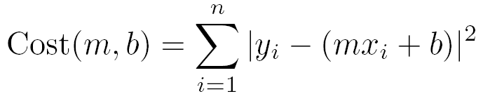
Linear regression
residual error

Slide 17
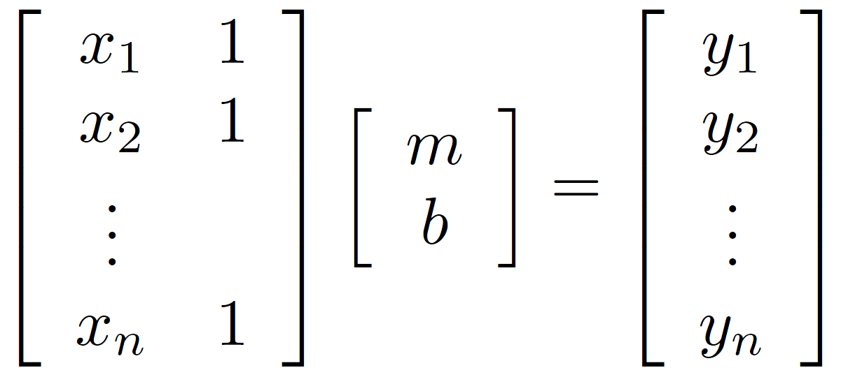
Linear regression

Slide 18

Affine transformations
How many unknowns?
How many equations per match?
How many matches do we need?

Slide 19



Affine transformations
Residuals:
Cost function:

Slide 20

Affine transformations
Matrix form
2n x 6
6 x 1
2n x 1

Slide 21


Homographies
p’
p
To unwarp (rectify) an image
  solve for homography H given p and p’
  solve equations of the form: wp’ = Hp
    linear in unknowns: w and coefficients of H
    H is defined up to an arbitrary scale factor
    how many points are necessary to solve for H?

Slide 22



Solving for homographies
Not linear!

Slide 23

Solving for homographies

Slide 24






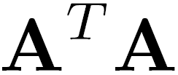
Solving for homographies
2n × 9
9
2n
Defines a least squares problem:
  Since is only defined up to scale, solve for unit vector
  Solution: = eigenvector of with smallest eigenvalue
  Works with 4 or more points

Slide 25





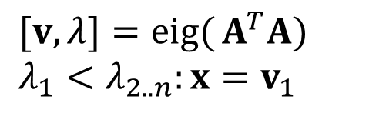
Recap: Two Common Optimization Problems
Problem statement
Solution
$$\operatorname{minimize}{ } {\left\|Ax−b\right\|}^{2}$$
$$x={\left(A^{T}A\right)}^{−1}A^{T}b$$
$$\text{(}\text{least} \text{squares} \text{solution} \text{to} Ax=b)$$
$$x=A\backslash b$$
(matlab)
Problem statement
Solution
$$\operatorname{minimize}{ } x^{T}A^{T}Ax s.t. x^{T}x=1$$
$$[v,λ]=\operatorname{eig}{(}A^{T}A) \\ λ_{1}<λ_{2..n}:x=v_{1}$$
($\text{non}\text{−}\text{trivial} \text{lsq} \text{solution} \text{to} Ax=0$)

Slide 26
Computing transformations

Slide 27
Questions?

Slide 28
Image Alignment Algorithm
Given images A and B
Compute image features for A and B
Match features between A and B
Compute homography between A and B using least squares on set of matches
What could go wrong?

Slide 29
Outliers
outliers
inliers

