Slide 1
Lecture 26: CNN Structure and Training
CS5670: Computer Vision
Noah Snavely
Image credit: Aphex34, [CC BY-SA 4.0 (http://creativecommons.org/licenses/by-sa/4.0)]
Slides from Andrej Karpathy and Fei-Fei Li
http://vision.stanford.edu/teaching/cs231n/

Slide 2
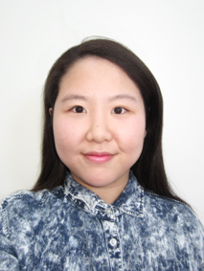
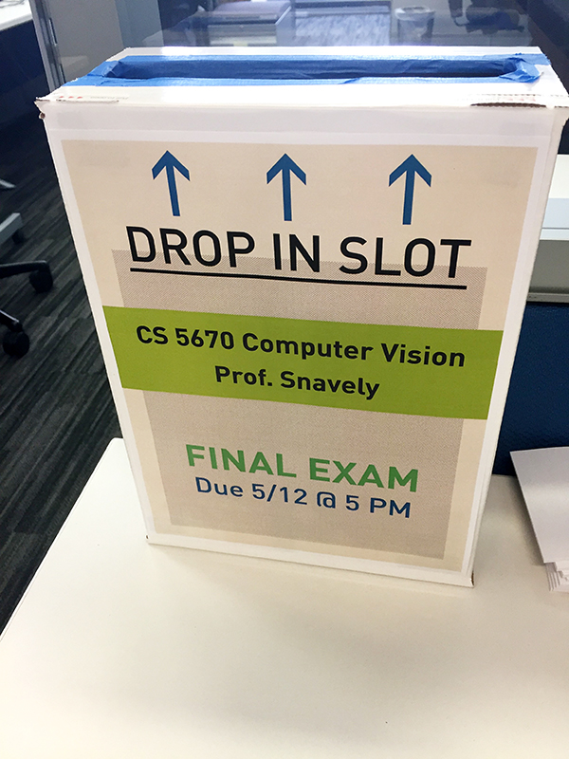
Announcements
Final project (P5), due Wednesday, 5/10, by 11:59pm
Final exam will be handed out at the end of class today, due Friday, 5/12, by 5pm to Christina Ko’s desk on 12th floor

Slide 3
Today
Finishing up backpropagation
ConvNet architectures
How to train ConvNets

Slide 4
(Recap) Backprop
From Geoff Hinton seminar at Stanford

Slide 5
(Recap) Backprop
Parameters:
All of the weights and biases in the network, stacked together
Gradient:
Intuition: “How fast would the error change if I change myself by a little bit”

Slide 7
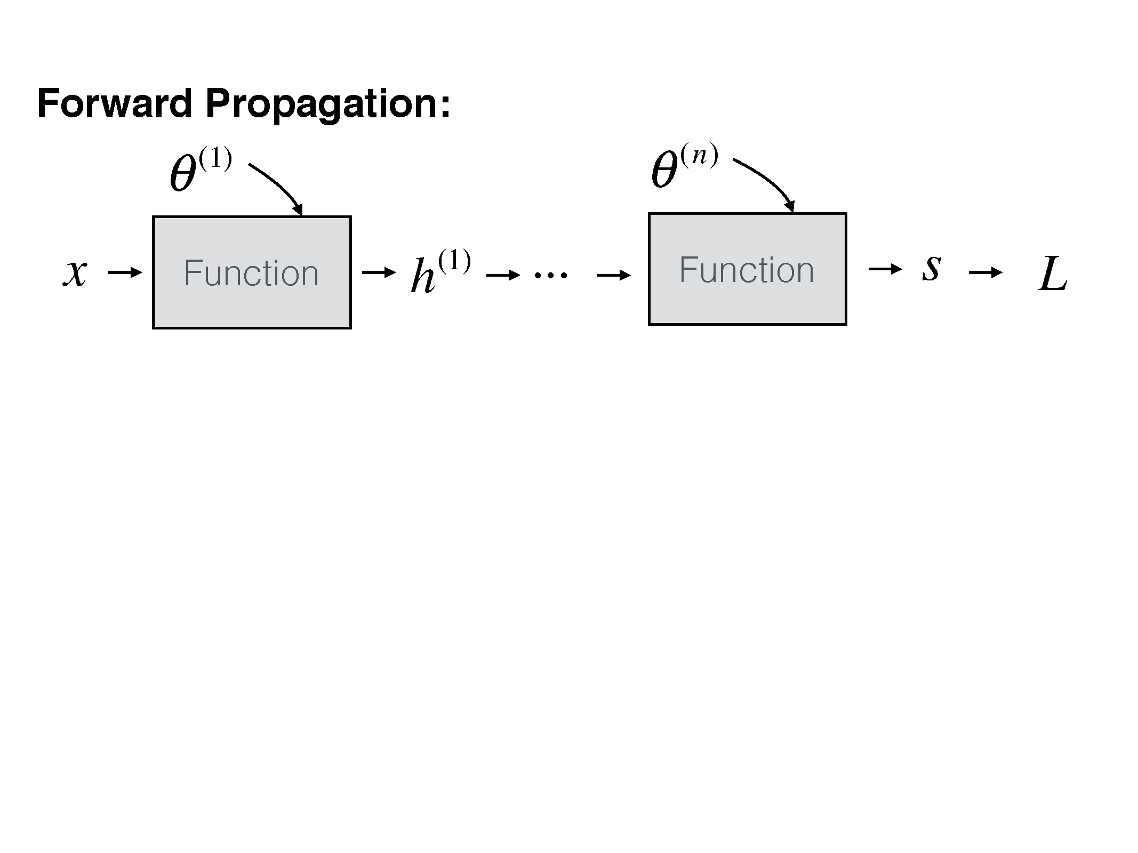

Slide 8
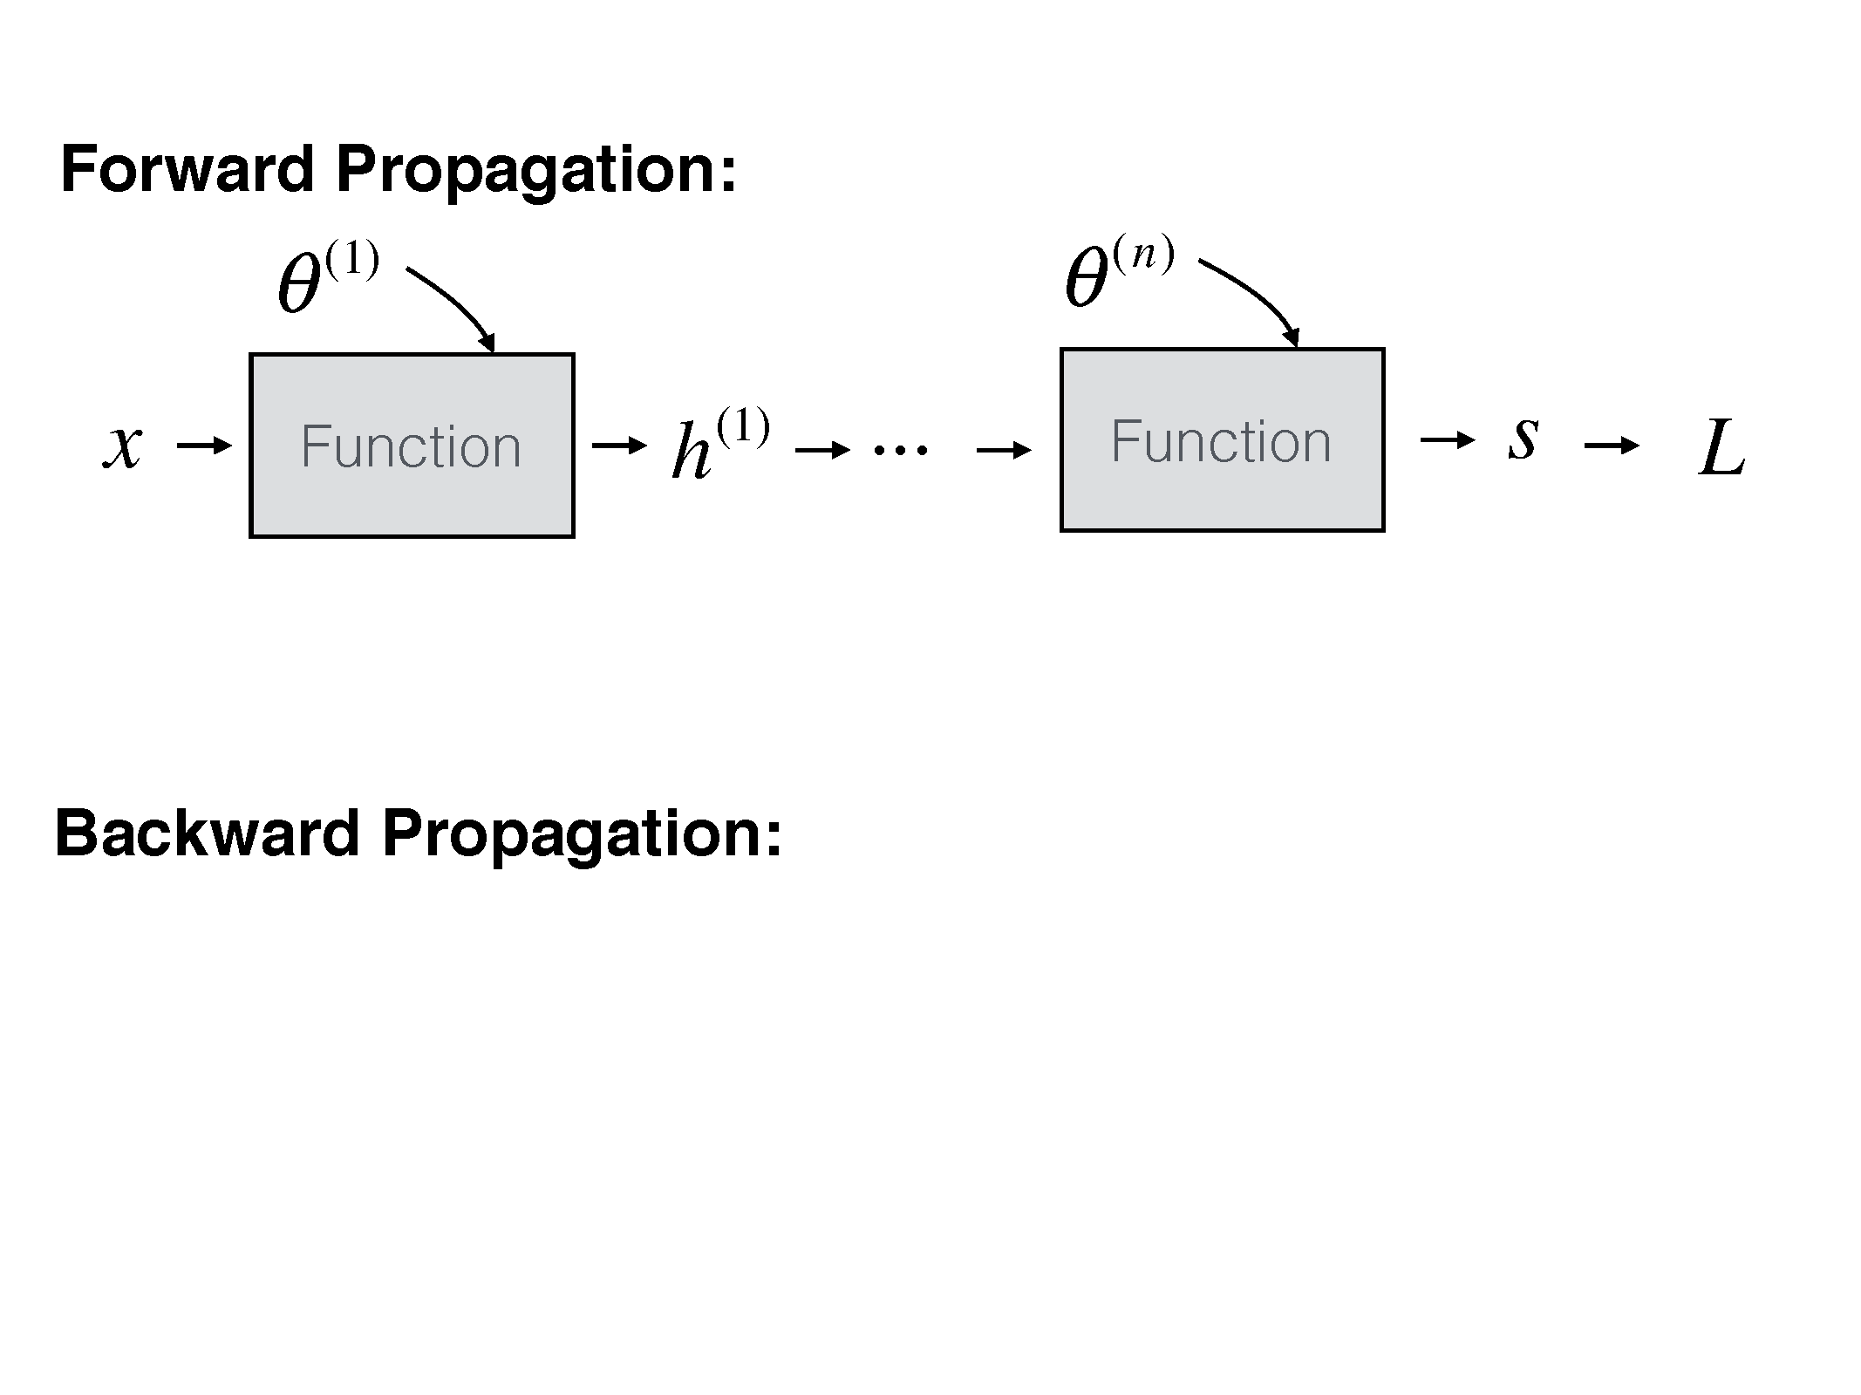

Slide 9
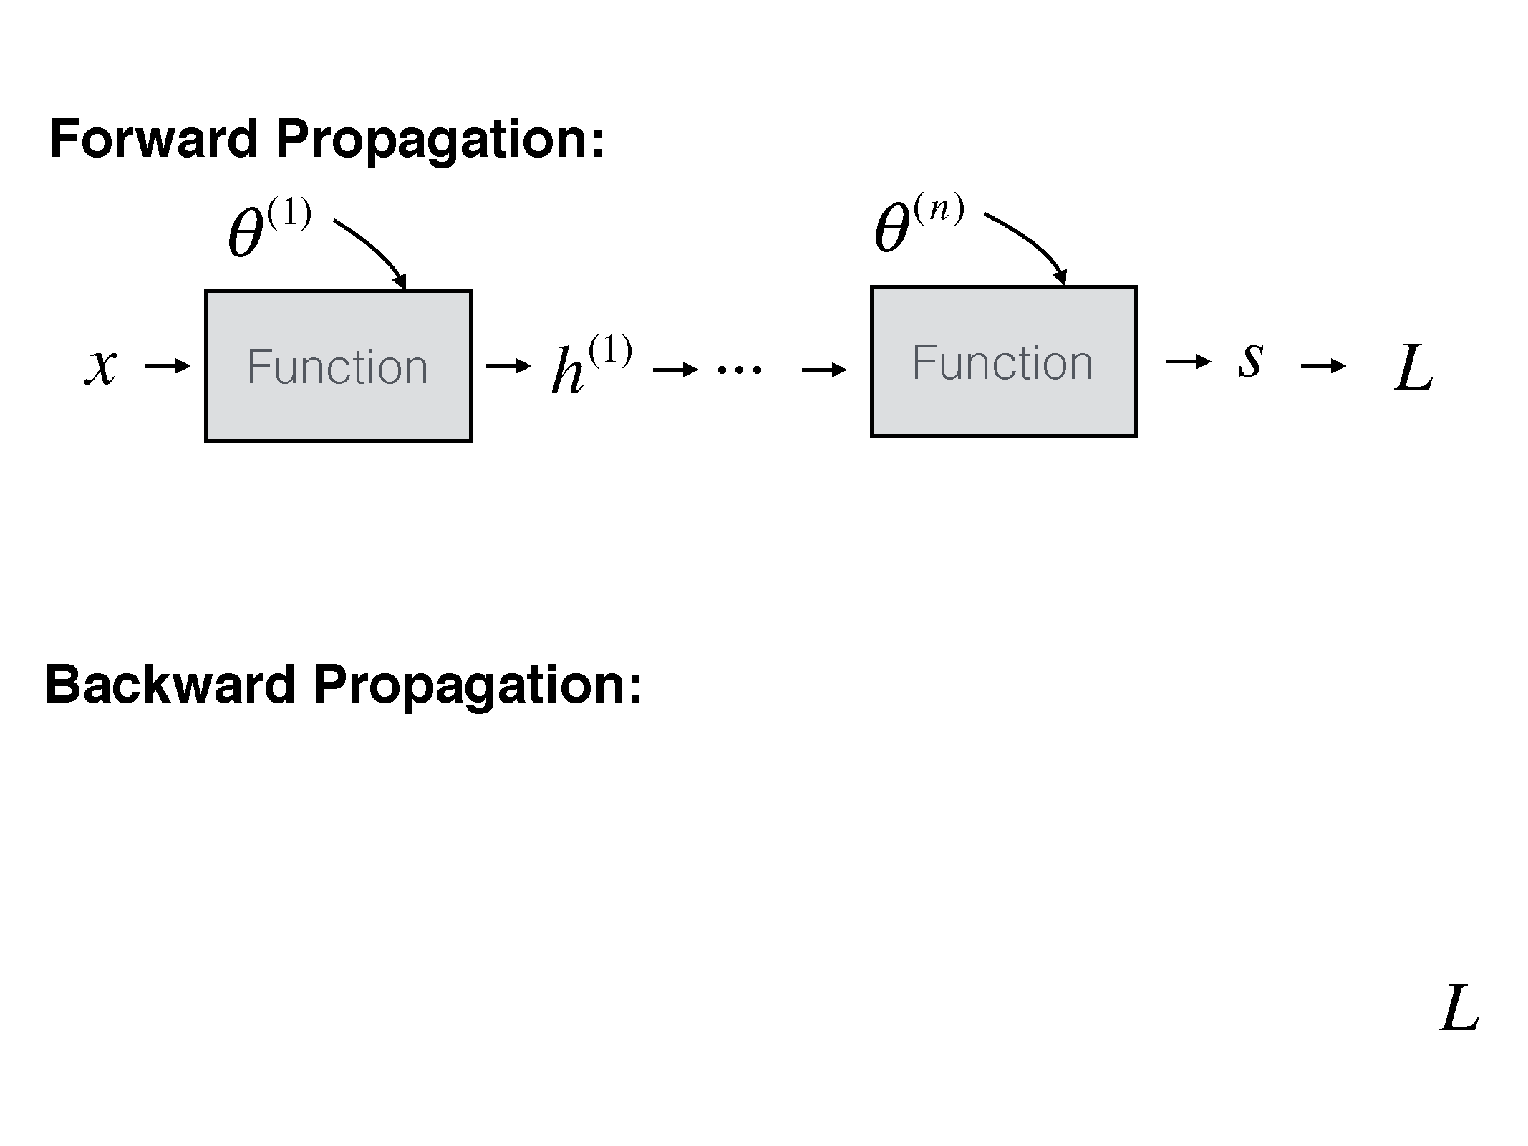

Slide 10
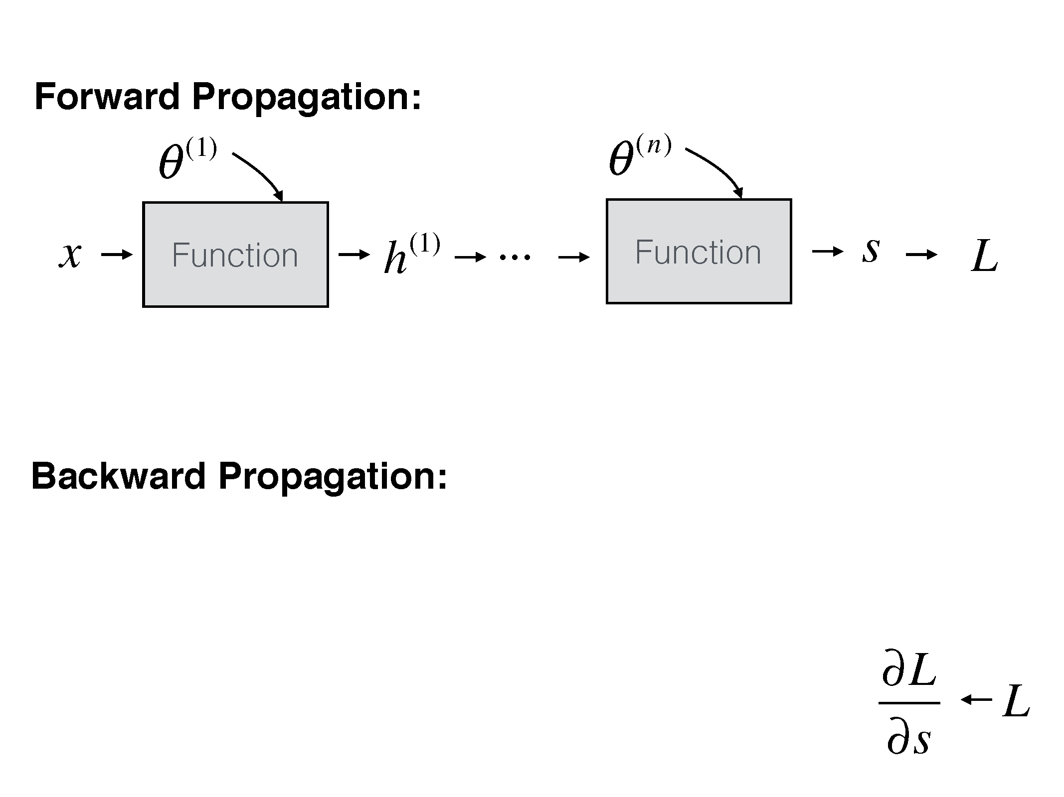

Slide 11
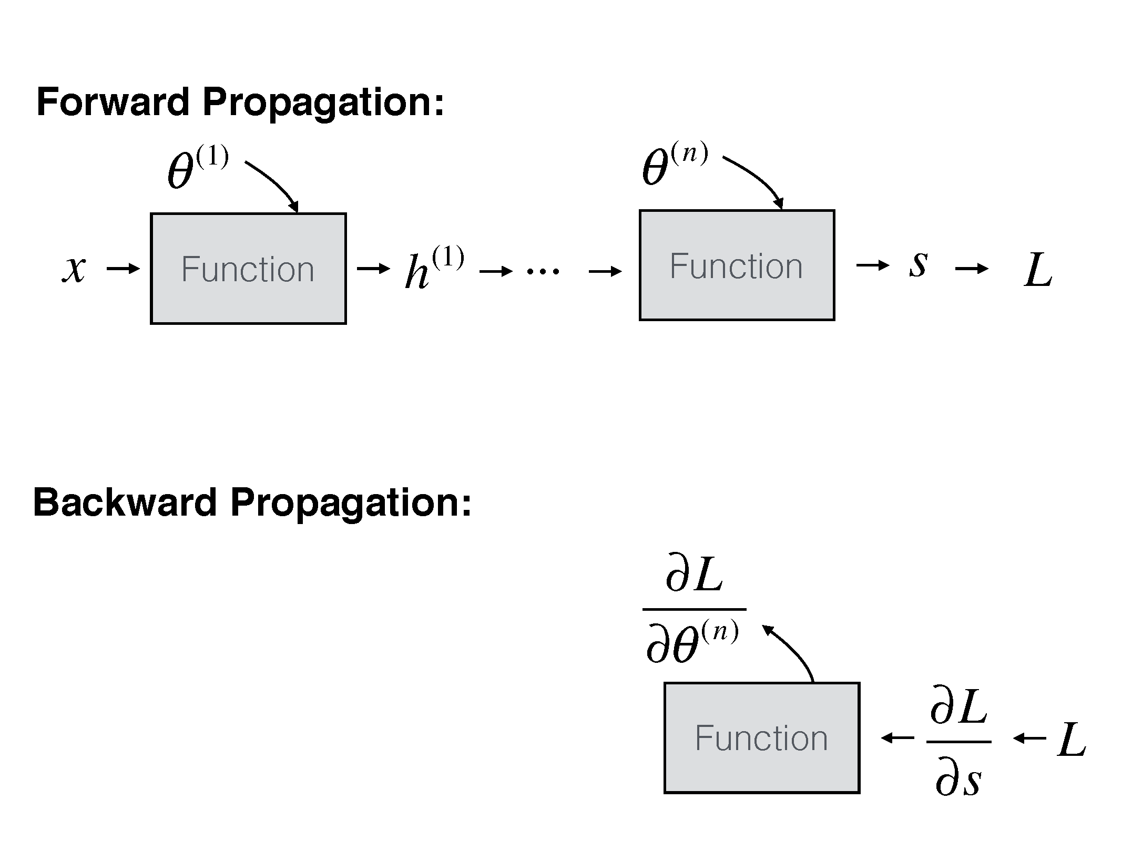

Slide 12
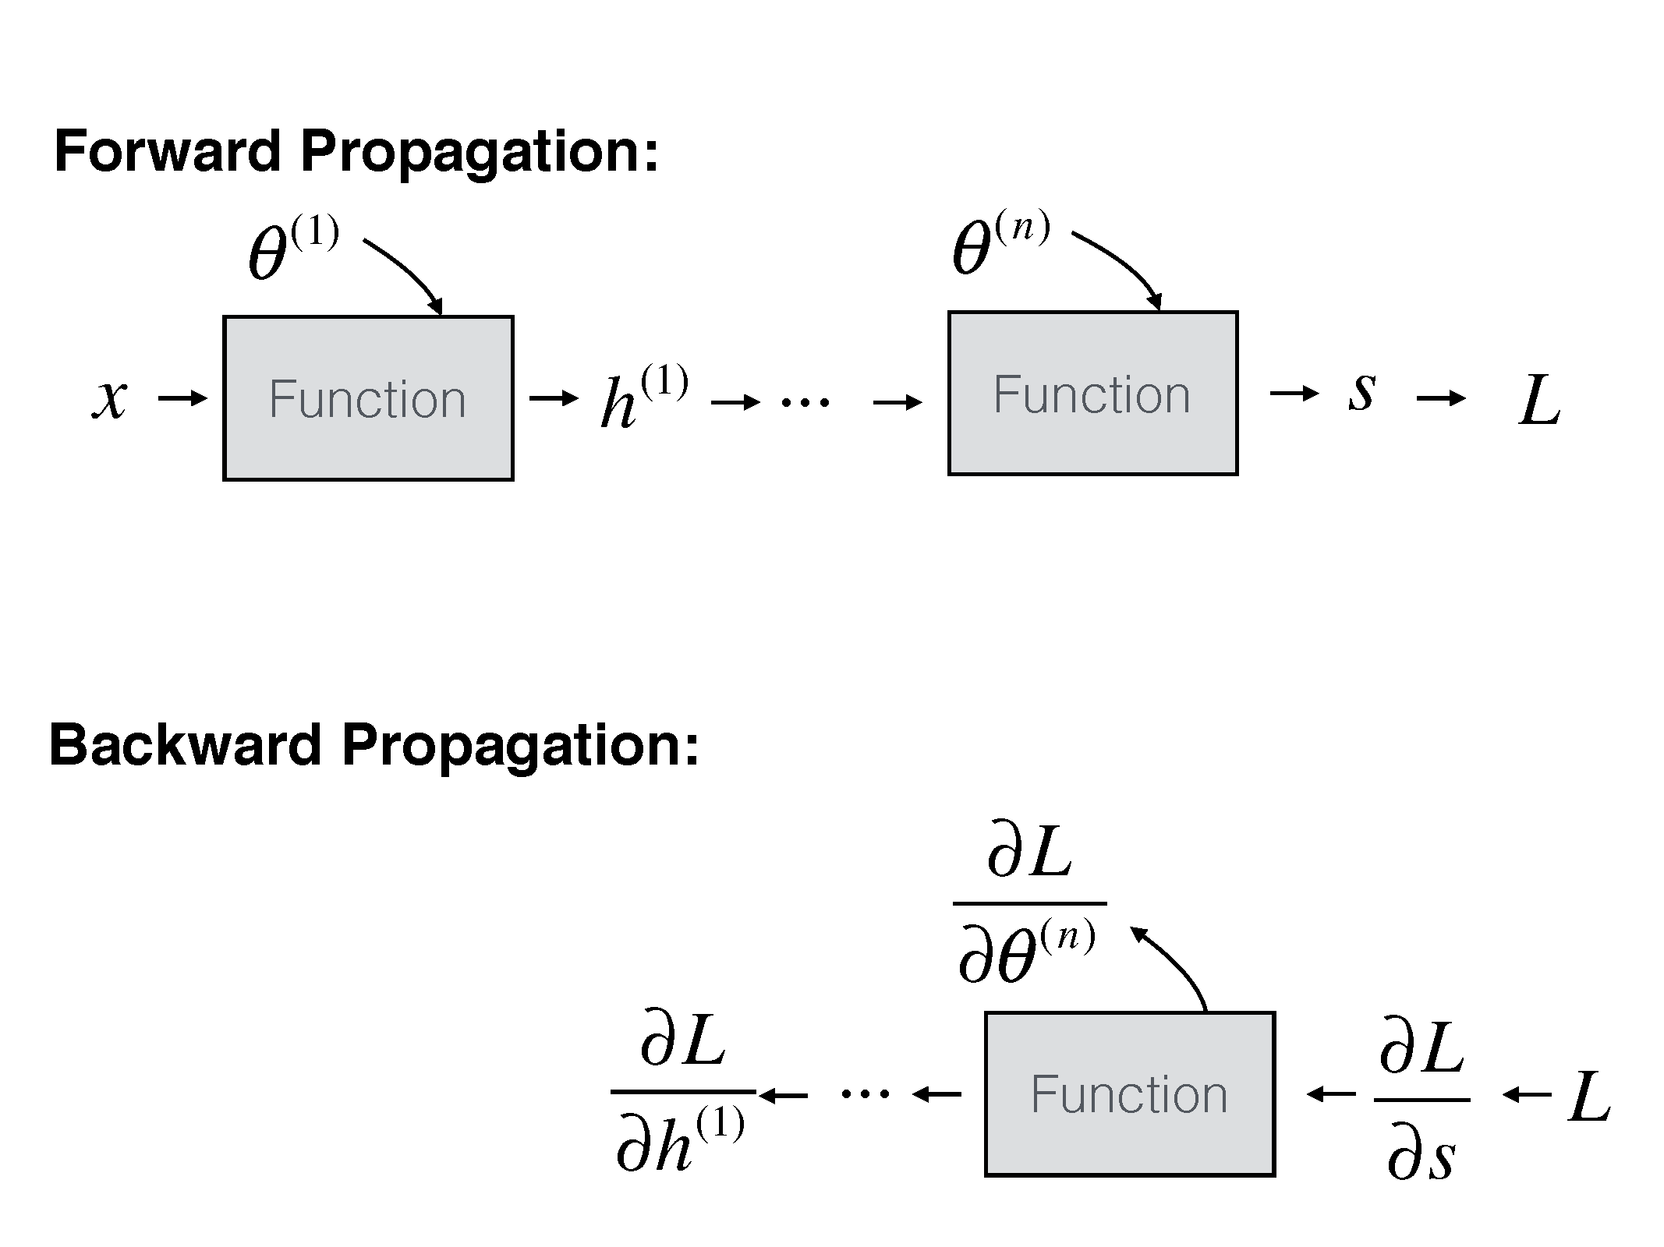

Slide 13
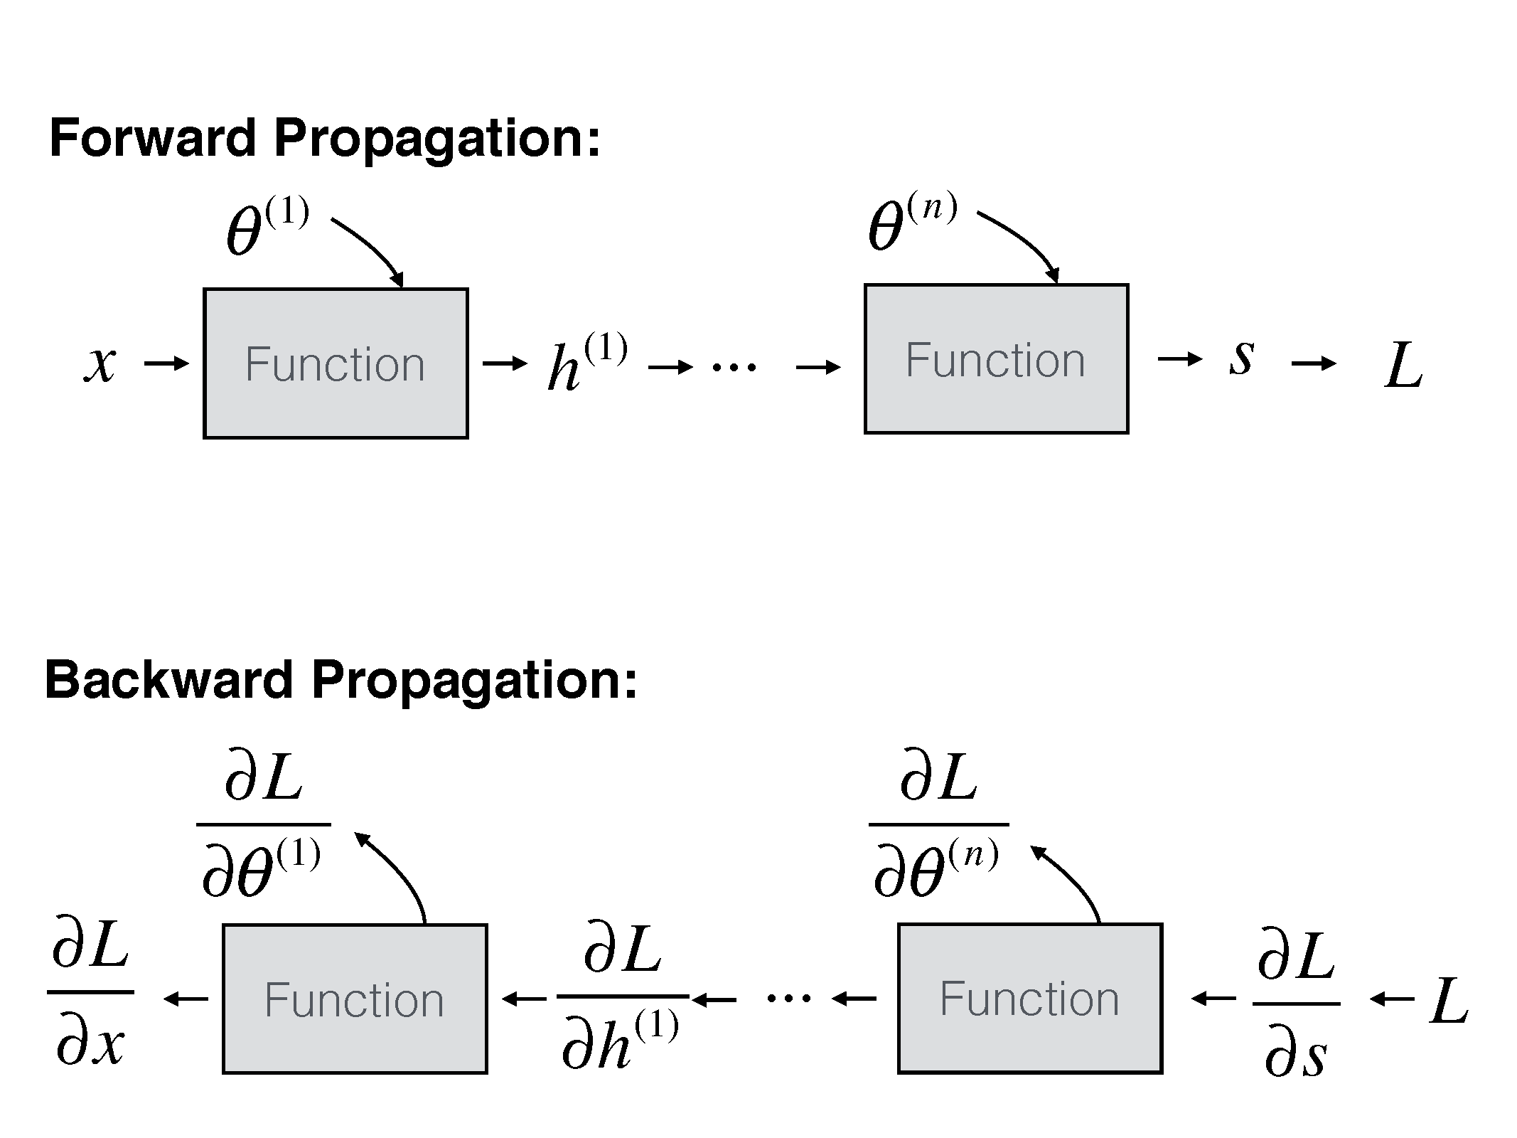

Slide 15
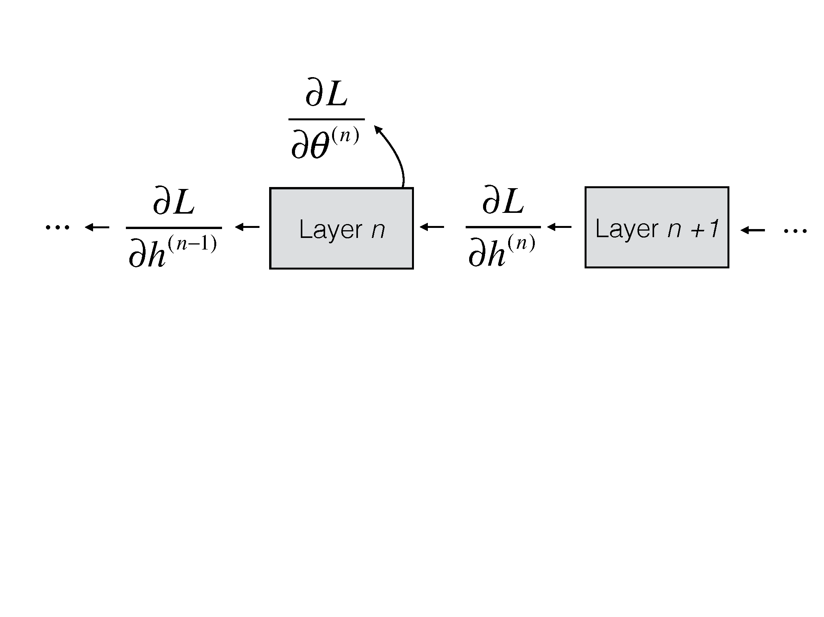

Slide 86
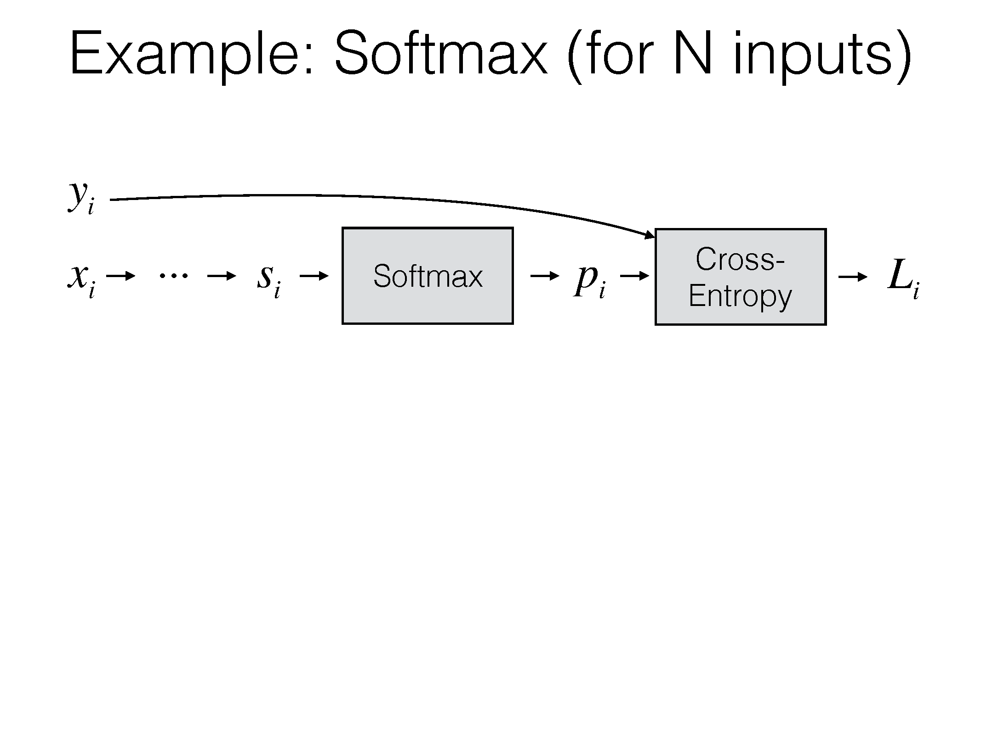

Slide 87
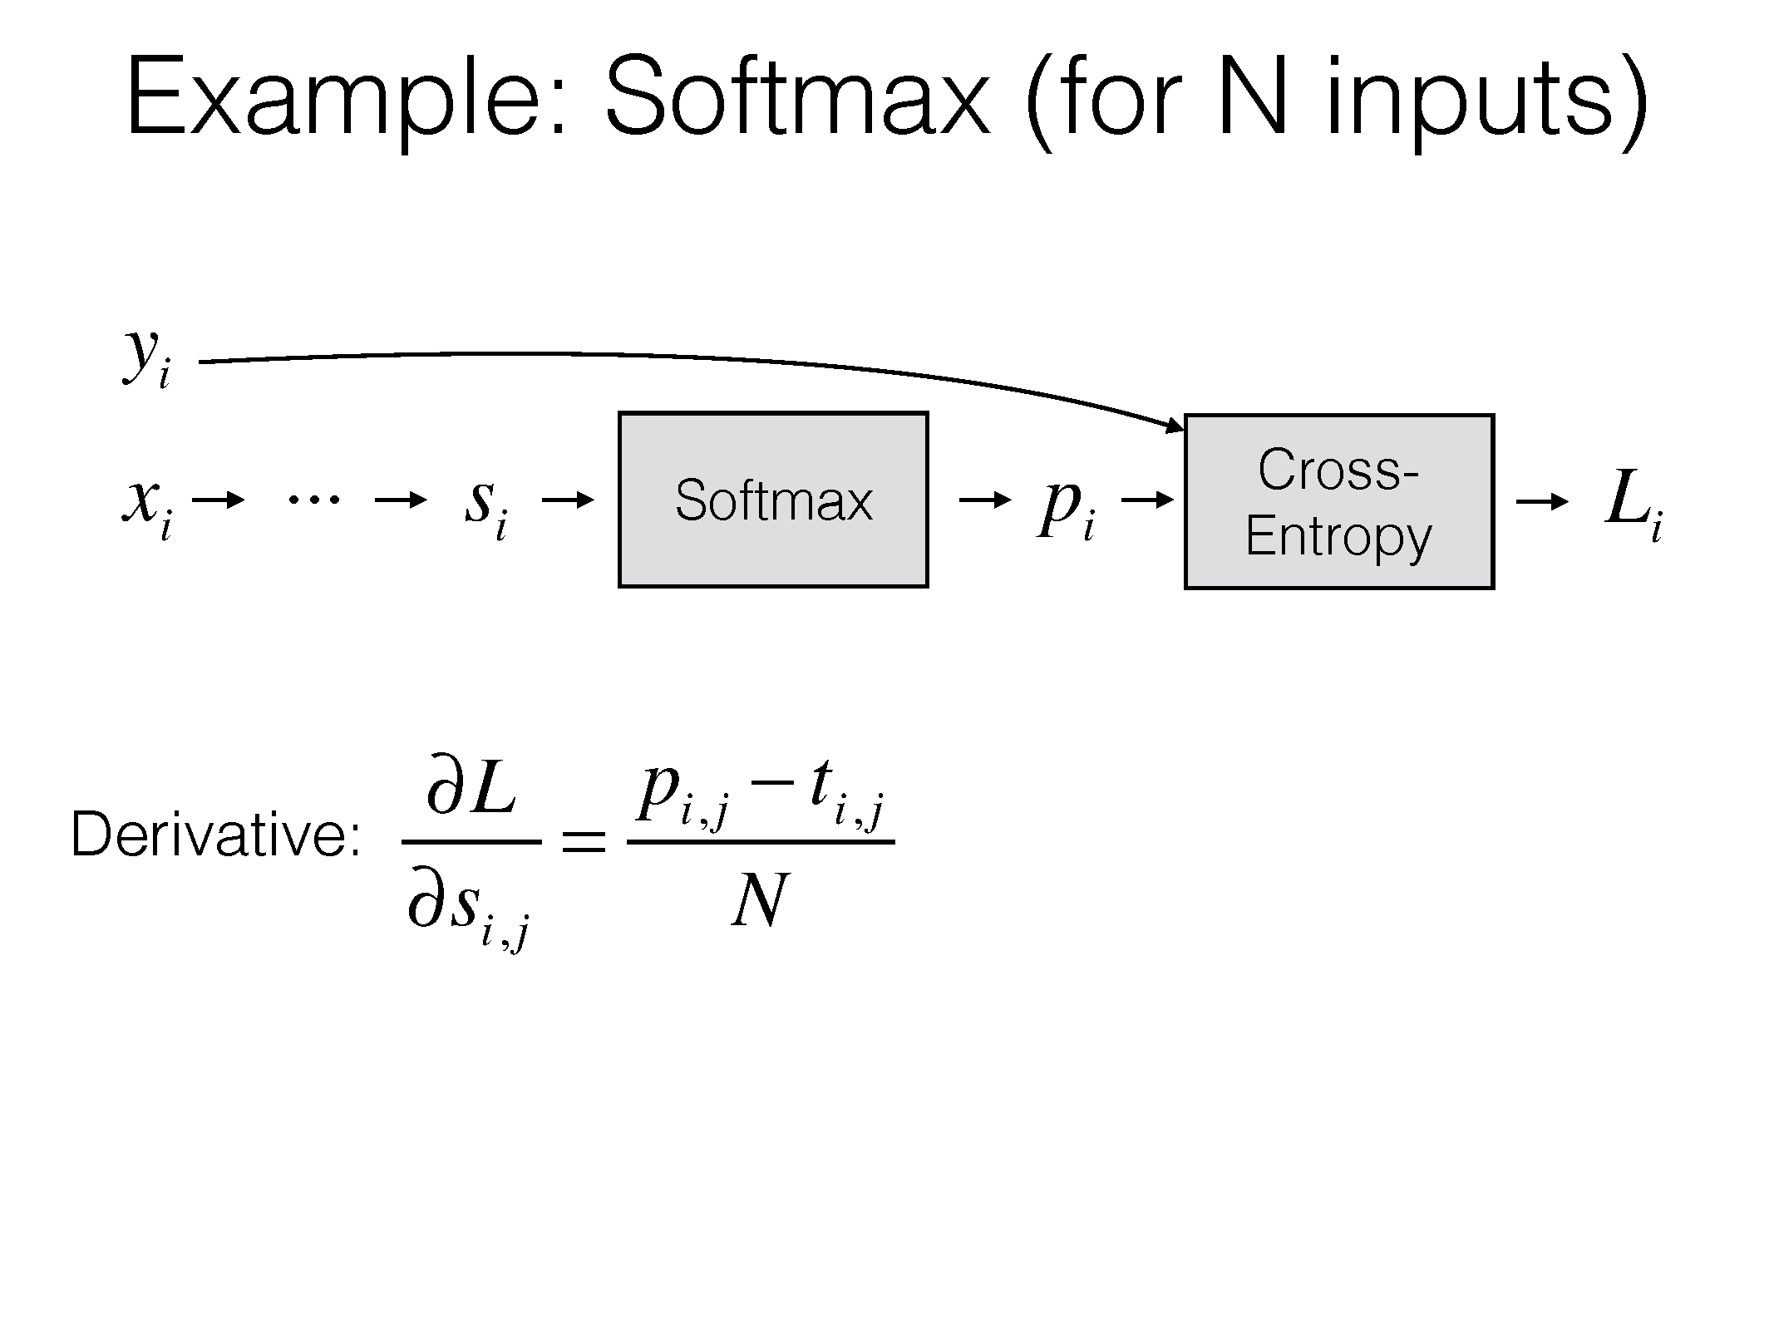

Slide 136
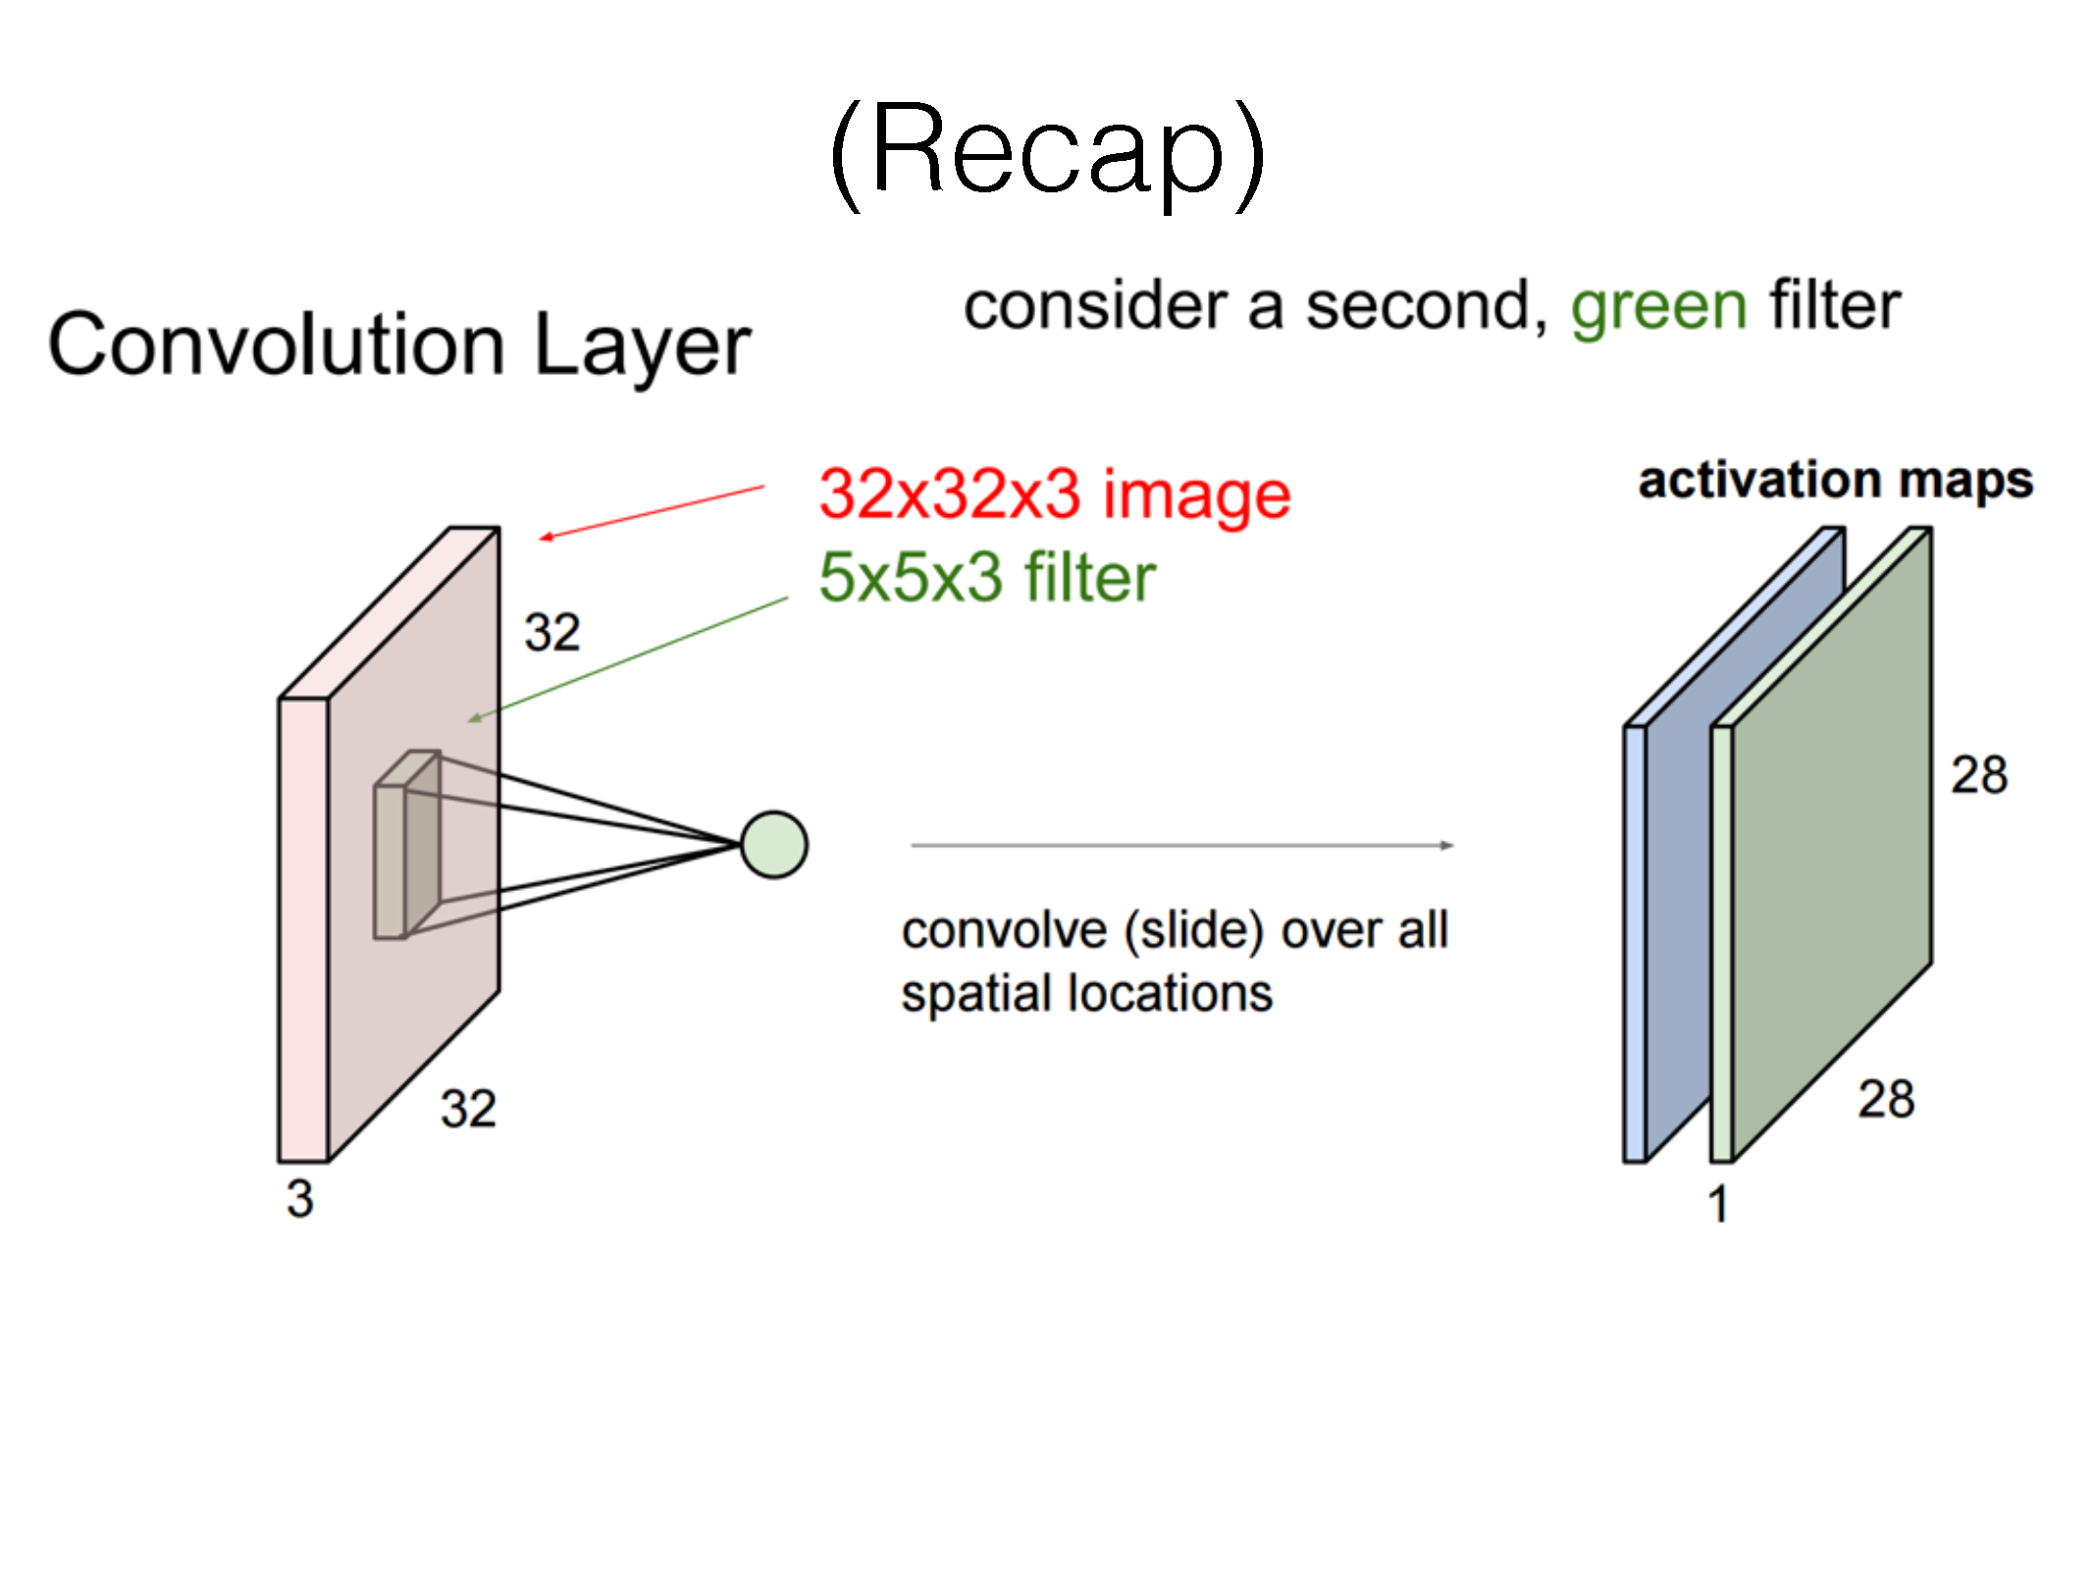

Slide 138
Demos
http://cs231n.stanford.edu/
http://cs.stanford.edu/people/karpathy/convnetjs/demo/mnist.html

Slide 211
Questions?

