Slide 1
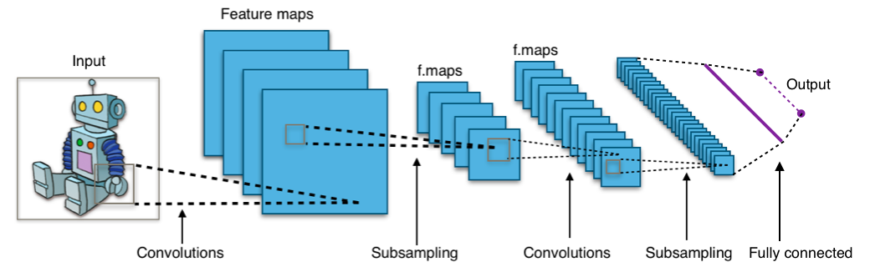
Lecture 25: Backprop and convnets
CS5670: Computer Vision
Noah Snavely
Image credit: Aphex34, [CC BY-SA 4.0 (http://creativecommons.org/licenses/by-sa/4.0)]
Slides from Andrej Karpathy and Fei-Fei Li
http://vision.stanford.edu/teaching/cs231n/

Slide 2
Review: Setup
_{θ} (2 )
_{θ} (1)
Function
_{h}(1)
Function
_{h}(2 )
s
x
y
L
- Goal: Find a value for parameters (θ ⁽¹,⁾ θ ⁽² ⁾, …), so that the loss (L) is small

Slide 3
Review: Setup
_{θ} (2 )
_{W} (1)_{, b}(1)
_{W} (1)_{x + b}(1)
_{h}(1)
Function
_{h}(2 )
x
s
y
L
Toy Example:

Slide 4
Review: Setup
_{θ} (2 )
_{W} (1)_{, b}(1)
_{W} (1)_{x + b}(1)
_{h}(1)
Function
_{h}(2 )
x
s
y
L
L
Toy Example:
Loss
_{W} (1)
12
A weight somewhere in the network

Slide 5
Review: Setup
_{θ} (2 )
_{W} (1)_{, b}(1)
_{W} (1)_{x + b}(1)
_{h}(1)
Function
_{h}(2 )
x
s
y
L
L
Toy Example:
Loss
_{W} (1)
12
A weight somewhere in the network

Slide 6
Review: Setup
_{θ} (2 )
_{W} (1)_{, b}(1)
_{W} (1)_{x + b}(1)
_{h}(1)
Function
_{h}(2 )
x
s
y
L
L
Toy Example:
Loss
_{W} (1)
12
A weight somewhere in the network

Slide 7
Review: Setup
_{θ} (2 )
_{W} (1)_{, b}(1)
_{W} (1)_{x + b}(1)
_{h}(1)
Function
_{h}(2 )
x
s
y
L
L
Toy Example:
Loss
_{W} (1)
12
A weight somewhere in the network

Slide 8
Review: Setup
_{θ} (2 )
_{W} (1)_{, b}(1)
_{W} (1)_{x + b}(1)
_{h}(1)
Function
_{h}(2 )
x
s
y
L
L
∂L
_{∂W} (1)
Toy Example:
12
Loss
1
_{W} (1)
12
A weight somewhere in the network

Slide 9
Review: Setup
_{θ} (2 )
_{W} (1)_{, b}(1)
_{W} (1)_{x + b}(1)
_{h}(1)
Function
_{h}(2 )
x
s
y
L
L
∂L
_{∂W} (1)
Toy Example:
(Gradient)
12
Loss
1
_{W} (1)
12
A weight somewhere in the network

Slide 10
Review: Setup
_{θ} (2 )
_{W} (1)_{, b}(1)
_{W} (1)_{x + b}(1)
_{h}(1)
Function
_{h}(2 )
x
s
y
L
L
∂L
_{∂W} (1)
Toy Example:
(Gradient)
12
Loss
Take a step
1
_{W} (1)
12
A weight somewhere in the network

Slide 11
Review: Setup
_{θ} (2 )
_{W} (1)_{, b}(1)
_{W} (1)_{x + b}(1)
_{h}(1)
Function
_{h}(2 )
x
s
y
L
L
∂L
_{∂W} (1)
Toy Example:
(Gradient)
12
Loss ₁
How do we get the gradient? Backpropagation
_{W} (1)
12
A weight somewhere in the network

Slide 12
Backprop
It’s just the chain rule

Slide 13
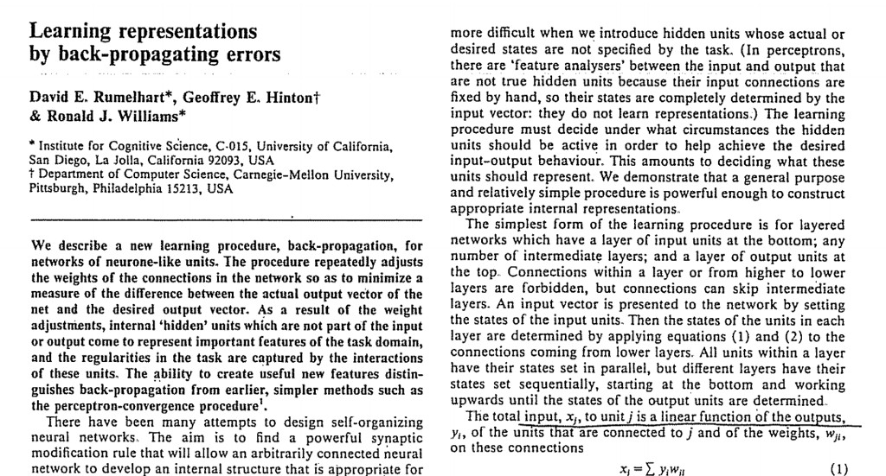
Backpropagation
[Rumelhart, Hinton, Williams. Nature 1986]

Slide 14
Chain rule recap
I hope everyone remembers the chain rule:
∂L ₌ ∂L ∂h
∂x ∂h ∂x

Slide 15
Chain rule recap
I hope everyone remembers the chain rule:
∂L ₌ ∂L ∂h
∂x ∂h ∂x
Forward propagation:
x
h
∂L
∂x
∂L
∂h
Backward propagation:

Slide 16
Chain rule recap
I hope everyone remembers the chain rule:
∂L ₌ ∂L ∂h
∂x ∂h ∂x
Forward propagation:
x
h
∂L
∂x
∂L
∂h
Backward propagation:
(extends easily to multi-dimensional x and y)

Slide 17
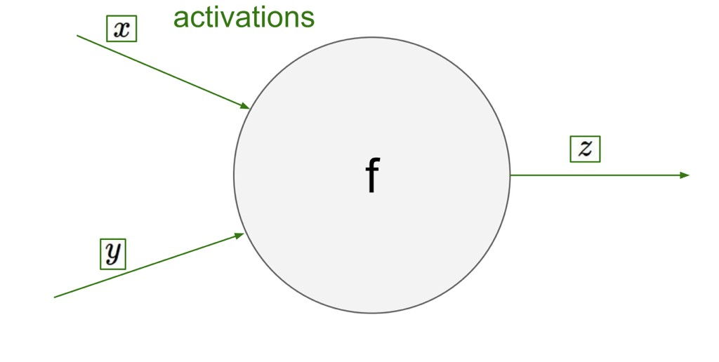
Slide from Karpathy 2016

Slide 18
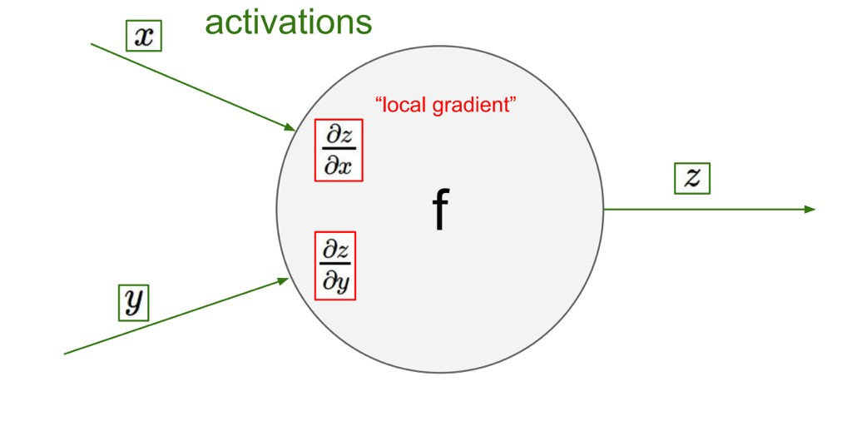
Slide from Karpathy 2016

Slide 19
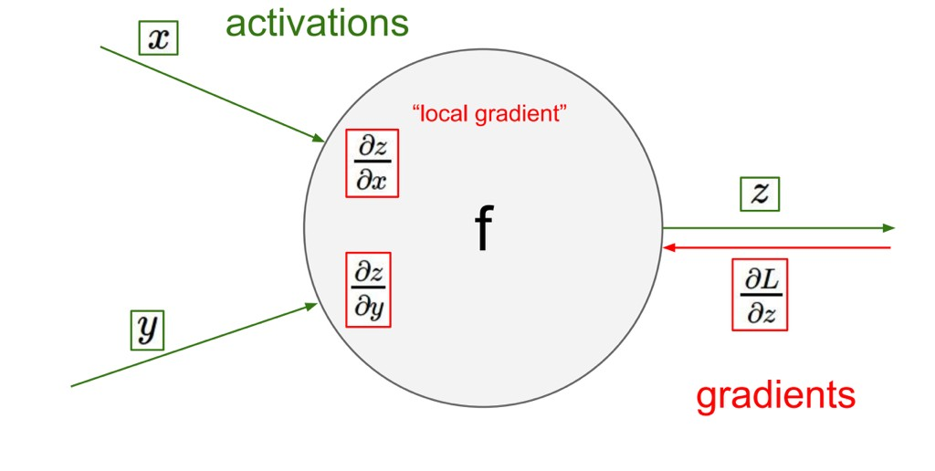
Slide from Karpathy 2016

Slide 20
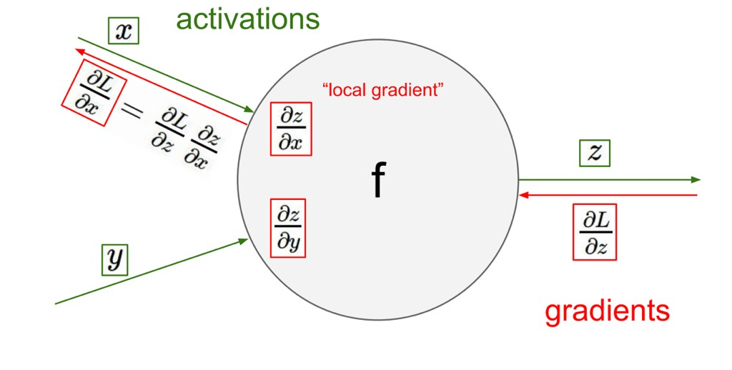
Slide from Karpathy 2016

Slide 21
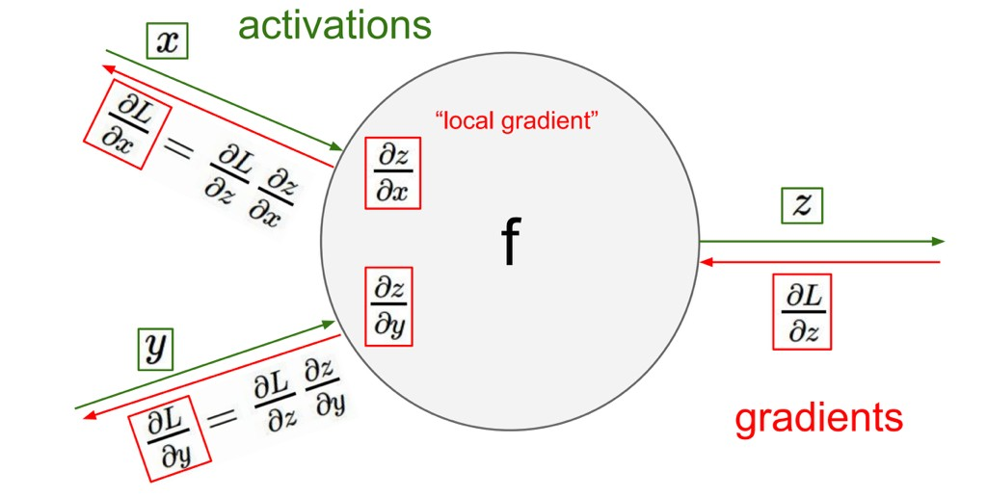
Slide from Karpathy 2016

Slide 22
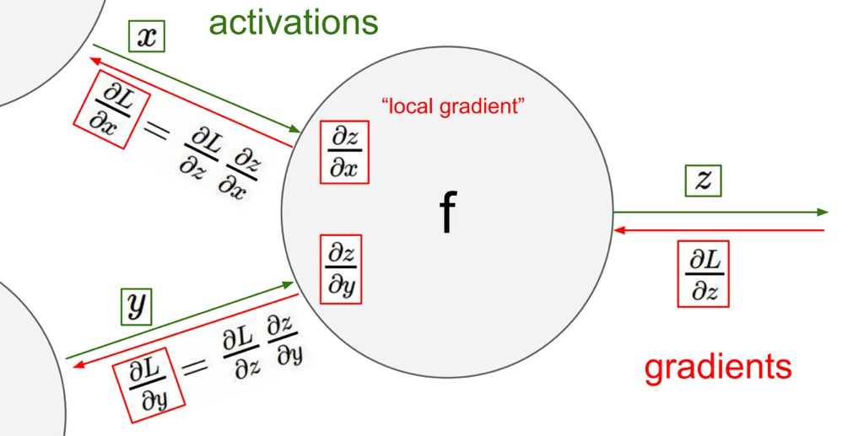
Slide from Karpathy 2016

Slide 23
Gradients add at branches
Activation

Slide 24
Gradients add at branches
Activation
Gradient

Slide 25
Gradients add at branches
Activation
Gradient
+

Slide 26
Gradients copy through sums
Activation
+

Slide 27
Gradients copy through sums
Activation
+
Gradient

Slide 28
Gradients copy through sums
Activation
+
Gradient

Slide 29
Gradients copy through sums
Activation
+
Gradient
The gradient flows through both branches at “full strength”

Slide 30
Symmetry between forward and backward
+
+
Forward: copy Backward: add
Forward: add Backward: copy

Slide 31
_{θ} (n )
Forward Propagation:
_{θ} (1)
Function
_{h}(1)
Function
s
x
L

Slide 32
_{θ} (n )
Forward Propagation:
_{θ} (1)
Function
_{h}(1)
Function
s
x
L
Backward Propagation:

Slide 33
_{θ} (n )
Forward Propagation:
_{θ} (1)
Function
_{h}(1)
Function
s
x
L
Backward Propagation:
L

Slide 34
_{θ} (n )
Forward Propagation:
_{θ} (1)
Function
_{h}(1)
Function
s
x
L
Backward Propagation:
∂L
∂s
L

Slide 35
_{θ} (n )
Forward Propagation:
_{θ} (1)
Function
_{h}(1)
Function
s
x
L
Backward Propagation:
∂L
_{∂θ} (n )
Function
∂L
∂s
L

Slide 36
_{θ} (n )
Forward Propagation:
_{θ} (1)
Function
_{h}(1)
Function
s
x
L
Backward Propagation:
∂L
_{∂θ} (n )
∂L
_{∂h}(1)
Function
∂L
∂s
L

Slide 37
_{θ} (n )
Forward Propagation:
_{θ} (1)
Function
_{h}(1)
Function
s
x
L
Backward Propagation:
∂L
_{∂θ} (1)
∂L
_{∂θ} (n )
∂L
∂x
∂L
_{∂h}(1)
∂L
∂s
Function
Function
L

Slide 38
What to do for each layer

Slide 39
_{∂θ} (n )
∂L
∂L
_{∂h}(n−1)
∂L
_{∂h}(n )
Layer n +1
Layer n

Slide 40
This is what we want for each layer
∂L
_{∂θ} (n )
∂L
_{∂h}(n−1)
∂L
_{∂h}(n )
Layer n +1
Layer n

Slide 41
This is what we want for each layer
∂L
_{∂θ} (n )
To compute it, we need to propagate this gradient
∂L
_{∂h}(n−1)
∂L
_{∂h}(n )
Layer n
Layer n +1

Slide 42
This is what we want for each layer
∂L
_{∂θ} (n )
To compute it, we need to propagate this gradient
∂L
_{∂h}(n−1)
∂L
_{∂h}(n )
Layer n
Layer n +1
For each layer:

Slide 43
This is what we want for each layer
∂L
_{∂θ} (n )
To compute it, we need to propagate this gradient
∂L
_{∂h}(n−1)
∂L
_{∂h}(n )
Layer n
Layer n +1
For each layer:
∂L ₌ ∂L ⋅ ∂h^{(n )}
_{∂θ} (n )
_{∂h}(n )
_{∂θ} (n )
What we want

Slide 44
This is what we want for each layer
∂L
_{∂θ} (n )
To compute it, we need to propagate this gradient
∂L
_{∂h}(n−1)
∂L
_{∂h}(n )
Layer n
Layer n +1
given to us
For each layer:
_{⋅ ∂h}(n )
∂L
_{∂θ} (n )
∂L
_{∂h}(n )
=
_{∂θ} (n )
What we want

Slide 45
This is what we want for each layer
∂L
_{∂θ} (n )
To compute it, we need to propagate this gradient
∂L
_{∂h}(n−1)
∂L
_{∂h}(n )
Layer n
Layer n +1
given to us
For each layer:
∂L
_{∂θ} (n )
∂L
_{∂h}(n )
_{∂h}(n )
_{∂θ} (n )
=
⋅
What we want
This is just the local gradient of layer n

Slide 46
This is what we want for each layer
∂L
_{∂θ} (n )
To compute it, we need to propagate this gradient
∂L
_{∂h}(n−1)
∂L
_{∂h}(n )
Layer n
Layer n +1
given to us
For each layer:
∂L
_{∂θ} (n )
∂L
_{∂h}(n )
_{∂h}(n )
_{∂θ} (n )
∂L ₌ ∂L ⋅ ∂h^{(n )}
=
⋅
_{∂h}(n−1) _{∂h}(n−1)
_{∂h}(n )
What we want
This is just the local gradient of layer n

Slide 47
This is what we want for each layer
∂L
_{∂θ} (n )
To compute it, we need to propagate this gradient
∂L
_{∂h}(n−1)
∂L
_{∂h}(n )
Layer n
Layer n +1
given to us
For each layer:
∂L
_{∂h}(n )
_{∂h}(n )
_{∂θ} (n )
∂L
_{∂h}(n )
_{⋅ ∂h}(n )
∂L
_{∂θ} (n )
∂L ₌
=
⋅
_{∂h}(n−1)
_{∂h}(n−1)
What we want
This is just the local gradient of layer n

Slide 48
This is what we want for each layer
∂L
_{∂θ} (n )
To compute it, we need to propagate this gradient
∂L
_{∂h}(n−1)
∂L
_{∂h}(n )
Layer n
Layer n +1
given to us
For each layer:
∂L
_{∂θ} (n )
∂L
_{∂h}(n )
_{∂h}(n )
_{∂θ} (n )
∂L ₌
∂L
_{∂h}(n )
_{∂h}(n )
_{∂h}(n−1)
=
⋅
⋅
_{∂h}(n−1)
What we want
This is just the local gradient of layer n

Slide 49
Summary
For each layer, we compute:
[Propagated gradient to the left] =
[Propagated gradient from right]⋅[Local gradient]

Slide 50
Summary
For each layer, we compute:
[Propagated gradient to the left] =
[Propagated gradient from right]⋅[Local gradient]
(Can compute immediately)

Slide 51
Summary
For each layer, we compute:
[Propagated gradient to the left] =
[Propagated gradient from right]⋅[Local gradient]
(Received during backprop)
(Can compute immediately)

Slide 52

30s cat picture break
http://stylonica.com/cat-pictures/

Slide 53
Backprop in N-dimensions
just add more subscripts and more summations

Slide 54
Backprop in N-dimensions
just add more subscripts and more summations
∂L ₌ ∂L ∂h
∂x ∂h ∂x
x, h scalars
(L is always scalar)

Slide 55
Backprop in N-dimensions
just add more subscripts and more summations
∂L ₌ ∂L ∂h
∂x ∂h ∂x
x, h scalars
(L is always scalar)
x, h 1D arrays (vectors)
∂L _{= ∑} ∂L ∂h_{i}
∂x_{j} ∂h_{i} ∂x_{j}
i

Slide 56
Backprop in N-dimensions
just add more subscripts and more summations
∂L ₌ ∂L ∂h
∂x ∂h ∂x
x, h scalars
(L is always scalar)
x, h 1D arrays (vectors)
x, h 2D arrays
∂L _{= ∑} ∂L ∂h_{i}
∂x_{j} ∂h_{i} ∂x_{j}
i
∂L _{= ∑∑} ∂L ∂h_{ij}
∂x_{ab} ∂h_{ij} ∂x_{ab}
i j

Slide 57
Backprop in N-dimensions
just add more subscripts and more summations
∂L ₌ ∂L ∂h
∂x ∂h ∂x
x, h scalars
(L is always scalar)
x, h 1D arrays (vectors)
x, h 2D arrays
x, h 3D arrays
∂L _{= ∑} ∂L ∂h_{i}
∂x_{j} ∂h_{i} ∂x_{j}
i
∂L _{= ∑∑} ∂L ∂h_{ij}
∂x_{ab} ∂h_{ij} ∂x_{ab}
i j
∂L _{= ∑∑∑} ∂L ∂h_{ijk}
^{∂x}abc ^{∂h}ijk ^{∂x}abc
i j k

Slide 58
Examples

Slide 59
Example: Mean Subtraction
(for a single input)

Slide 60
Example: Mean Subtraction
(for a single input)
•
Example layer: mean subtraction:

Slide 61
Example: Mean Subtraction
(for a single input)
•
Example layer: mean subtraction:
1
h_{i} = x_{i} −
∑
k
x
D
k

Slide 62
Example: Mean Subtraction
(for a single input)
•
Example layer: mean subtraction:
1
h_{i} = x_{i} −
∑
k
x
(here, “i” and “k” are channels)
D
k

Slide 63
Example: Mean Subtraction
(for a single input)
•
Example layer: mean subtraction:
1
h_{i} = x_{i} −
∑
x
(here, “i” and “k” are channels)
D
k
k
•
Always start with the chain rule (this one is for 1D):
∂L _{= ∑} ∂L ∂h_{i}
∂x_{j} ∂h_{i} ∂x_{j}
i

Slide 64
Example: Mean Subtraction
(for a single input)
•
Example layer: mean subtraction:
1
h_{i} = x_{i} −
∑
x
(here, “i” and “k” are channels)
D
k
k
•
Always start with the chain rule (this one is for 1D):
∂L _{= ∑} ∂L ∂h_{i}
∂x_{j} ∂h_{i} ∂x_{j}
i
•
Note: Be very careful with your subscripts! Introduce new variables and don’t re-use letters.

Slide 65
Example: Mean Subtraction
(for a single input)
^{∂L} _{= ∑} ^{∂L ∂h}i (backprop
∂x_{j i} ∂h_{i} ∂x_{j} aka chain rule)
₌ ∂L ⎛ _{δ −} 1 ⎞
∑ ⎜ ij ⎟
_{i} ∂h_{i} ⎝ D ⎠
₌ ∂L _{δ −} 1 ∂L
∑ ij ∑
_{i} ∂h_{i} D _{i} ∂h_{i}
₌ ∂L ₋ 1 ∑ ∂L
∂h_{j} D _{i} ∂h_{i}

Slide 66
Example: Mean Subtraction
(for a single input)
1
∑
k
•
Forward:
h_{i} = x_{i} −
x
D
k
^{∂L} _{= ∑} ^{∂L ∂h}i (backprop
∂x_{j i} ∂h_{i} ∂x_{j} aka chain rule)
₌ ∂L ⎛ _{δ −} 1 ⎞
∑ ⎜ ij ⎟
_{i} ∂h_{i} ⎝ D ⎠
₌ ∂L _{δ −} 1 ∂L
∑ ij ∑
_{i} ∂h_{i} D _{i} ∂h_{i}
₌ ∂L ₋ 1 ∑ ∂L
∂h_{j} D _{i} ∂h_{i}

Slide 67
Example: Mean Subtraction
(for a single input)
1
∑
•
Forward:
h_{i} = x_{i} −
x
D
k
k
•
Taking the derivative of the layer:
^{∂L} _{= ∑} ^{∂L ∂h}i (backprop
∂x_{j i} ∂h_{i} ∂x_{j} aka chain rule)
₌ ∂L ⎛ _{δ −} 1 ⎞
∑ ⎜ ij ⎟
_{i} ∂h_{i} ⎝ D ⎠
₌ ∂L _{δ −} 1 ∂L
∑ ij ∑
_{i} ∂h_{i} D _{i} ∂h_{i}
₌ ∂L ₋ 1 ∑ ∂L
∂h_{j} D _{i} ∂h_{i}

Slide 68
Example: Mean Subtraction
(for a single input)
1
∑
•
Forward:
h_{i} = x_{i} −
x
D
k
k
∂h_{i}
1
•
Taking the derivative of the layer: _{∂x} = δ_{ij} − _{D}
^{∂L} _{= ∑} ^{∂L ∂h}i (backprop
∂x_{j i} ∂h_{i} ∂x_{j} aka chain rule)
j
₌ ∂L ⎛ _{δ −} 1 ⎞
∑ ⎜ ij ⎟
_{i} ∂h_{i} ⎝ D ⎠
₌ ∂L _{δ −} 1 ∂L
∑ ij ∑
_{i} ∂h_{i} D _{i} ∂h_{i}
₌ ∂L ₋ 1 ∑ ∂L
∂h_{j} D _{i} ∂h_{i}

Slide 69
Example: Mean Subtraction
(for a single input)
1
∑
•
Forward:
h_{i} = x_{i} −
x
D
k
k
∂h_{i}
1
•
Taking the derivative of the layer: _{∂x} = δ_{ij} − _{D}
^{∂L} _{= ∑} ^{∂L ∂h}i (backprop
∂x_{j i} ∂h_{i} ∂x_{j} aka chain rule)
j
⎛
⎧
1 i = j ⎞
⎪
₌ ∂L ⎛ _{δ −} 1 ⎞
∑ ⎜ ij ⎟
_{i} ∂h_{i} ⎝ D ⎠
⎜
δ =
⎨
⎟
⎝
ij
⎪⎩ 0 else
⎠
₌ ∂L _{δ −} 1 ∂L
∑ ij ∑
_{i} ∂h_{i} D _{i} ∂h_{i}
₌ ∂L ₋ 1 ∑ ∂L
∂h_{j} D _{i} ∂h_{i}

Slide 70
Example: Mean Subtraction
(for a single input)
1
∑
•
Forward:
h_{i} = x_{i} −
x
D
k
k
∂h_{i}
1
•
Taking the derivative of the layer: _{∂x} = δ_{ij} − _{D}
∂L ∂L ∂h_{i}
∂x_{j} ∂h_{i} ∂x_{j}
j
= ∑
i
(backprop aka chain rule)
⎛
⎧
⎞
i = j
⎪⎩ 0 else
₌ ∂L ⎛ _{δ −} 1 ⎞
∑ ⎜ ij ⎟
_{i} ∂h_{i} ⎝ D ⎠
δ = ^{⎪ 1}
⎜
⎨
⎟
⎝
ij
⎠
₌ ∂L _{δ −} 1 ∂L
∑ ij ∑
_{i} ∂h_{i} D _{i} ∂h_{i}
₌ ∂L ₋ 1 ∑ ∂L
∂h_{j} D _{i} ∂h_{i}

Slide 71
Example: Mean Subtraction
(for a single input)
1
∑
•
Forward:
h_{i} = x_{i} −
x
D
k
k
∂h_{i}
1
•
Taking the derivative of the layer: _{∂x} = δ_{ij} − _{D}
∂L ∂L ∂h_{i}
∂x_{j} ∂h_{i} ∂x_{j}
j
= ∑
i
(backprop aka chain rule)
⎛
⎧
⎞
⎨ i = j
0 else
∂L ⎛ 1 ⎞
⎜
δ = ^{⎪ 1}
⎟
=
∑
i
δ −
ij
⎜
⎟
⎝ ⎪⎩
⎠
∂h
⎝
ij
D
⎠
i
₌ ∂L _{δ −} 1 ∂L
∑ ij ∑
_{i} ∂h_{i} D _{i} ∂h_{i}
₌ ∂L ₋ 1 ∑ ∂L
∂h_{j} D _{i} ∂h_{i}

Slide 72
Example: Mean Subtraction
(for a single input)
1
∑
•
Forward:
h_{i} = x_{i} −
x
D
k
k
∂h_{i}
1
•
Taking the derivative of the layer: _{∂x} = δ_{ij} − _{D}
∂L ∂L ∂h_{i}
∂x_{j} ∂h_{i} ∂x_{j}
j
= ∑
i
(backprop aka chain rule)
⎛
⎧
⎞
⎨ i = j
0 else
∂L ⎛ 1 ⎞
⎜
δ = ^{⎪ 1}
⎟
=
∑
i
δ −
ij
⎜
⎟
⎝ ⎪⎩
⎠
∂h
⎝
ij
D
⎠
i
∑
i
∂L 1 ∂L
=
δ −
∑
i
∂h
ij
D
∂h
i
i
₌ ∂L ₋ 1 ∑ ∂L
∂h_{j} D _{i} ∂h_{i}

Slide 73
Example: Mean Subtraction
(for a single input)
1
∑
•
Forward:
h_{i} = x_{i} −
x
D
k
k
∂h_{i}
1
•
Taking the derivative of the layer: _{∂x} = δ_{ij} − _{D}
∂L ∂L ∂h_{i}
∂x_{j} ∂h_{i} ∂x_{j}
j
= ∑
i
(backprop aka chain rule)
⎛
⎧
⎞
⎨ i = j
0 else
∂L ⎛ 1 ⎞
⎜
δ = ^{⎪ 1}
⎟
=
∑
i
δ −
ij
⎜
⎟
⎝ ⎪⎩
⎠
∂h
⎝
ij
D
⎠
i
∑
∂L 1 ∂L
=
δ −
∑
∂h
ij
D
∂h
i
i
i
i
₌ ∂L ₋ 1 ∑ ∂L
∂h_{j}
D
∂h_{i}
i

Slide 74
Example: Mean Subtraction
(for a single input)
1
∑
•
Forward:
h_{i} = x_{i} −
x
D
k
k
∂h_{i}
1
•
Taking the derivative of the layer: _{∂x} = δ_{ij} − _{D}
∂L ∂L ∂h_{i}
∂x_{j} ∂h_{i} ∂x_{j}
j
= ∑
i
(backprop aka chain rule)
⎛
⎧
⎞
⎨ i = j
0 else
∂L ⎛ 1 ⎞
⎜
δ = ^{⎪ 1}
⎟
=
∑
i
δ −
ij
⎜
⎟
⎝ ⎪⎩
⎠
∂h
⎝
ij
D
⎠
i
∑
∂L 1 ∂L
=
δ −
∑
∂h
ij
D
∂h
i
i
i
i
₌ ∂L ₋ 1 ∑ ∂L
Done!
∂h_{j}
D
∂h_{i}
i

Slide 75
Example: Mean Subtraction
(for a single input)
1
∑
h_{i} = x_{i} −
x
D
k
k
∂L ₌ ∂L ₋ 1 ∑ ∂L
∂x_{i} ∂h_{i} D ∂h_{k}
k

Slide 76
Example: Mean Subtraction
(for a single input)
1
∑
•
Forward:
h_{i} = x_{i} −
x
D
k
k
∂L ₌ ∂L ₋ 1 ∑ ∂L
•
Backward:
∂x_{i} ∂h_{i} D ∂h_{k}
k

Slide 77
Example: Mean Subtraction
(for a single input)
1
∑
•
Forward:
h_{i} = x_{i} −
x
D
k
k
∂L ₌ ∂L ₋ 1 ∑ ∂L
•
Backward:
∂x_{i} ∂h_{i} D ∂h_{k}
k
•
In this case, they’re identical operations!

Slide 78
Example: Mean Subtraction
(for a single input)
1
∑
•
Forward:
h_{i} = x_{i} −
x
D
k
k
∂L ₌ ∂L ₋ 1 ∑ ∂L
•
Backward:
∂x_{i} ∂h_{i} D ∂h_{k}
k
•
In this case, they’re identical operations!
•
Usually the forwards pass and backwards pass are similar but not the same.

Slide 79
Example: Mean Subtraction
(for a single input)
1
∑
•
Forward:
h_{i} = x_{i} −
x
D
k
k
∂L ₌ ∂L ₋ 1 ∑ ∂L
•
Backward:
∂x_{i} ∂h_{i} D ∂h_{k}
k
•
In this case, they’re identical operations!
•
Usually the forwards pass and backwards pass are similar but not the same.
•
Derive it by hand, and check it numerically

Slide 80
Example: Mean Subtraction
(for a single input)
1
∑
•
Forward:
h_{i} = x_{i} −
x
D
k
k
Let’s code this up in NumPy:

Slide 81

Example: Mean Subtraction
(for a single input)
1
∑
•
Forward:
h_{i} = x_{i} −
x
D
k
k
Let’s code this up in NumPy:

Slide 82
Example: Mean Subtraction
(for a single input)
1
∑
•
Forward:
h_{i} = x_{i} −
x
D
k
k
Let’s code this up in NumPy:
Dimension mismatch

Slide 83

Example: Mean Subtraction
(for a single input)
1
∑
•
Forward:
h_{i} = x_{i} −
x
D
k
k
Let’s code this up in NumPy:
Dimension mismatch
You need to broadcast properly:

Slide 84

Example: Mean Subtraction
(for a single input)
1
∑
•
Forward:
h_{i} = x_{i} −
x
D
k
k
Let’s code this up in NumPy:
Dimension mismatch
You need to broadcast properly:
This also works:

Slide 85
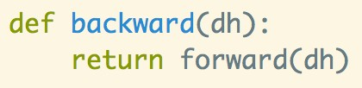
Example: Mean Subtraction
(for a single input)
The backward pass is easy:
(Remember they’re usually not the same)

Slide 86
Example: Euclidean Loss

Slide 87
Example: Euclidean Loss
•
Euclidean loss layer:

Slide 88
Example: Euclidean Loss
•
Euclidean loss layer:
z
y
Euclidean Loss
L

Slide 89
Example: Euclidean Loss
•
Euclidean loss layer:
z
y
1
2
Euclidean Loss
∑
j
₎2
L
L =
(z − y
i
i, j
i, j

Slide 90
Example: Euclidean Loss
•
Euclidean loss layer:
z
y
1
2
Euclidean Loss
∑
₎2
L
L =
(z − y
i
i, j
i, j
j
(“i” is the batch index, “j” is the channel)

Slide 91
Example: Euclidean Loss
•
Euclidean loss layer:
z
y
1
2
Euclidean Loss
∑
₎2
L
L =
(z − y
i
i, j
i, j
j
(“i” is the batch index, “j” is the channel)
•
The total loss is the average over N examples:

Slide 92
Example: Euclidean Loss
•
Euclidean loss layer:
z
y
1
2
Euclidean Loss
∑
₎2
L
L =
(z − y
i
i, j
i, j
j
(“i” is the batch index, “j” is the channel)
•
The total loss is the average over N examples:
1
L =
∑
i
L
N
i

Slide 93
Example: Euclidean Loss

Slide 94
Example: Euclidean Loss
•
Used for regression, e.g. predicting an adjustment to box coordinates when detecting objects:

Slide 95
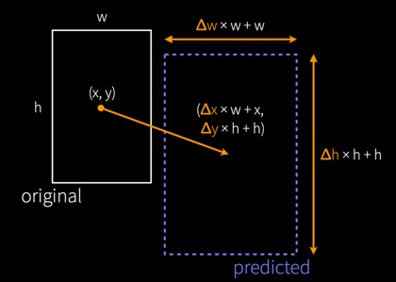
Example: Euclidean Loss
•
Used for regression, e.g. predicting an adjustment to box coordinates when detecting objects:
Bounding box regression from the R-CNN object detector [Girshick 2014]

Slide 96
Example: Euclidean Loss
•
Used for regression, e.g. predicting an adjustment to box coordinates when detecting objects:
Bounding box regression from the R-CNN object detector [Girshick 2014]
•
Note: Can be unstable and other losses often work better. Alternatives: L1 distance (instead of L2), discretizing into category bins and using softmax

Slide 97
Example: Euclidean Loss

Slide 98
Example: Euclidean Loss
1
L_{i} =
∑^{(z}i, j ^{− y}i, j ⁾
j
2
•
Forward:
2

Slide 99
Example: Euclidean Loss
1
L_{i} =
∑^{(z}i, j ^{− y}i, j ⁾
j
2
•
Forward:
2
•
Backward:

Slide 100
Example: Euclidean Loss
1
L_{i} =
∑^{(z}i, j ^{− y}i, j ⁾
j
2
•
Forward:
2
∂L_{i}
•
Backward:
^{= z}i, j ^{− y}i, j
∂z
i, j

Slide 101
Example: Euclidean Loss
1
L_{i} =
∑^{(z}i, j ^{− y}i, j ⁾
j
2
•
Forward:
2
∂L_{i}
•
Backward:
^{= z}i, j ^{− y}i, j
∂z
i, j
∂L_{i}
= y − z
∂y
i, j
i, j
i, j

Slide 102
Example: Euclidean Loss
1
L_{i} =
∑^{(z}i, j ^{− y}i, j ⁾
j
2
•
Forward:
2
∂L_{i}
•
Backward:
^{= z}i, j ^{− y}i, j
∂z
i, j
∂L_{i}
= y − z
∂y
i, j
i, j
i, j
•
Q: If you scale the loss by C, what happens to
gradient computed in the backwards pass?

Slide 103
Example: Euclidean Loss
1
L_{i} =
∑^{(z}i, j ^{− y}i, j ⁾
j
2
•
Forward:
2
∂L_{i}
•
Backward:
^{= z}i, j ^{− y}i, j
∂z
i, j
(note that this is with respect to Li, not L)
∂L
i
= y − z
∂y
i, j
i, j
i, j
•
Q: If you scale the loss by C, what happens to
gradient computed in the backwards pass?

Slide 104
Example: Euclidean Loss

Slide 105
Example: Euclidean Loss
•
Forward pass, for a batch of N inputs:

Slide 106
Example: Euclidean Loss
•
Forward pass, for a batch of N inputs:
L = ¹ ∑ L
1
2
₎2
L =
∑
j
(z − y
N
i
i
i, j
i, j
i

Slide 107
Example: Euclidean Loss
•
Forward pass, for a batch of N inputs:
L = ¹ ∑ L
1
2
₎2
L =
∑
j
(z − y
N
i
i
i, j
i, j
i
•
Backward pass:

Slide 108
Example: Euclidean Loss
•
Forward pass, for a batch of N inputs:
L = ¹ ∑ L
1
2
₎2
L =
∑
j
(z − y
N
i
i
i, j
i, j
i
•
Backward pass:
∂L ₌ ^{z}i, j ^{− y}i, j
∂L ₌ ^{y}i, j ^{− z}i, j
^{∂x}i, j
N
^{∂y}i, j
N

Slide 109
Example: Euclidean Loss
•
Forward pass, for a batch of N inputs:
L = ¹ ∑ L
1
2
₎2
L =
∑
j
(z − y
N
i
i
i, j
i, j
i
•
Backward pass:
∂L ₌ ^{z}i, j ^{− y}i, j
∂L ₌ ^{y}i, j ^{− z}i, j
^{∂x}i, j
N
^{∂y}i, j
N
(You should be able to derive this)

Slide 110
Example: Softmax (for N inputs)
Remember Softmax?
It’s a loss function for predicting categories?

Slide 111
Example: Softmax (for N inputs)
Remember Softmax?
It’s a loss function for predicting categories?
y_{i}
s
Softmax
p
Cross- Entropy
L
x
i
i
i
i

Slide 112
Example: Softmax (for N inputs)
Remember Softmax?
It’s a loss function for predicting categories?
(ground truth labels)
y_{i}
s
Softmax
p
Cross- Entropy
L
x
i
i
i
i
(input)
(scores)
(probabilities)
(loss)

Slide 113
Example: Softmax (for N inputs)
Remember Softmax?
It’s a loss function for predicting categories?
(ground truth labels)
(here, “i” are different examples)
y
i
s
Softmax
p
Cross- Entropy
L
x
i
i
i
i
(input)
(scores)
(probabilities)
(loss)

Slide 114
Example: Softmax (for N inputs)
Remember Softmax?
It’s a loss function for predicting categories?
(ground truth labels)
(here, “i” are different examples)
y
i
s
Softmax
p
Cross- Entropy
L
x
i
i
i
i
(input)
(scores)
_{e}^{s}i , j
(probabilities)
(loss)
^{p}i, j ⁼
∑ e
s
i ,k
k
(Softmax)

Slide 115
Example: Softmax (for N inputs)
Remember Softmax?
It’s a loss function for predicting categories?
(ground truth labels)
(here, “i” are different examples)
y
i
s
Softmax
p
Cross- Entropy
L
x
i
i
i
i
(input)
(scores)
_{e}^{s}i , j
(probabilities)
(loss)
^{p}i, j ⁼ ∑
L = − log p
e
^{s}i ,k
i
i,y_{i}
k
(Softmax)
(Cross-entropy)

Slide 116
Example: Softmax (for N inputs)
Remember Softmax?
It’s a loss function for predicting categories?
(ground truth labels)
(here, “i” are different examples)
y
i
s
Softmax
p
Cross- Entropy
L
x
i
i
i
i
(input)
(scores)
_{e}^{s}i , j
(probabilities)
(loss)
1
N
^{p}i, j ⁼
∑ e
L = − log p
L =
∑
L
s
i ,k
i
i,y_{i}
i
k
(Softmax)
i
(Cross-entropy)
(Avg. over examples)

Slide 117
Example: Softmax (for N inputs)
y_{i}
x
s
Softmax
p
Cross- Entropy
L
i
i
i
i

Slide 118
Example: Softmax (for N inputs)
y_{i}
x
s
Softmax
p
Cross- Entropy
L
i
i
i
i
∂L
∂s
^{p}i, j ^{− t}i, j
Derivative:
=
N
i, j

Slide 119
Example: Softmax (for N inputs)
y_{i}
x
s
Softmax
p
Cross- Entropy
L
i
i
i
i
∂L ₌ ^{p}i, j ^{− t}i, j
where t_{i} = [0 ... 1 ... 0]
Derivative:
^{∂s}i, j
N
(Entry y_{i}
set to 1)

Slide 120
Example: Softmax (for N inputs)
y_{i}
x
Softmax
p
Cross- Entropy
s_{i}
L
i
i
i
∂L
^{∂s}i, j
₌ ^{p}i, j ^{− t}i, j
where t_{i} = [0 ... 1 ... 0]
Derivative:
N
(Entry y_{i}
set to 1)

Slide 121
Example: Softmax (for N inputs)
y_{i}
x
Softmax
p
Cross- Entropy
s_{i}
L
i
i
i
∂L
^{∂s}i, j
₌ ^{p}i, j ^{− t}i, j
where t_{i} = [0 ... 1 ... 0]
Derivative:
N
(Entry y_{i}
set to 1)
(You will derive this in PA5)

Slide 122
Example: Softmax (for N inputs)
y_{i}
x
Softmax
p
Cross- Entropy
s_{i}
L
i
i
i
∂L
^{∂s}i, j
₌ ^{p}i, j ^{− t}i, j
where t_{i} = [0 ... 1 ... 0]
Derivative:
N
(Entry y_{i}
set to 1)
(You will derive this in PA5)
Now we can continue backpropagating to the layer before “f”

Slide 123
What about the weights?
To get the derivative of the weights, use the chain rule again!

Slide 124
What about the weights?
To get the derivative of the weights, use the chain rule again!
Example: 2D weights, 1D bias, 1D hidden activations:

Slide 125
What about the weights?
To get the derivative of the weights, use the chain rule again!
Example: 2D weights, 1D bias, 1D hidden activations:
W ,b
x
Layer
h
h = h(x;W )

Slide 126
What about the weights?
To get the derivative of the weights, use the chain rule again!
Example: 2D weights, 1D bias, 1D hidden activations:
W ,b
x
Layer
h
h = h(x;W )
∂L _{= ∑} ∂L ∂h_{k}
∂W_{ij} ∂h_{k} ∂W_{ij}
k

Slide 127
What about the weights?
To get the derivative of the weights, use the chain rule again!
Example: 2D weights, 1D bias, 1D hidden activations:
W ,b
x
Layer
h
h = h(x;W )
∂L _{= ∑} ∂L ∂h_{k}
∂L _{= ∑} ∂L ∂h_{k}
∂W_{ij} ∂h_{k} ∂W_{ij}
∂b_{i} ∂h_{k} ∂b_{i}
k
k

Slide 128
What about the weights?
To get the derivative of the weights, use the chain rule again!
Example: 2D weights, 1D bias, 1D hidden activations:
W ,b
x
Layer
h
h = h(x;W )
∂L _{= ∑} ∂L ∂h_{k}
∂L _{= ∑} ∂L ∂h_{k}
∂W_{ij} ∂h_{k} ∂W_{ij} ∂b_{i} ∂h_{k} ∂b_{i}
k k
(the number of subscripts and summations changes depending on your layer and parameter sizes)

Slide 129
ConvNets
They’re just neural networks with 3D activations and weight sharing

Slide 130
What shape should the activations have?
Layer
_{h}(1)
Layer
_{h}(2 )
f
x
- The input is an image, which is 3D (RGB channel, height, width)

Slide 131
What shape should the activations have?
Layer
_{h}(1)
Layer
_{h}(2 )
f
x
The input is an image, which is 3D (RGB channel, height, width)
We could flatten it to a 1D vector, but then we lose structure

Slide 132
What shape should the activations have?
Layer
_{h}(1)
Layer
_{h}(2 )
f
x
The input is an image, which is 3D (RGB channel, height, width)
We could flatten it to a 1D vector, but then we lose structure
What about keeping everything in 3D?

Slide 133
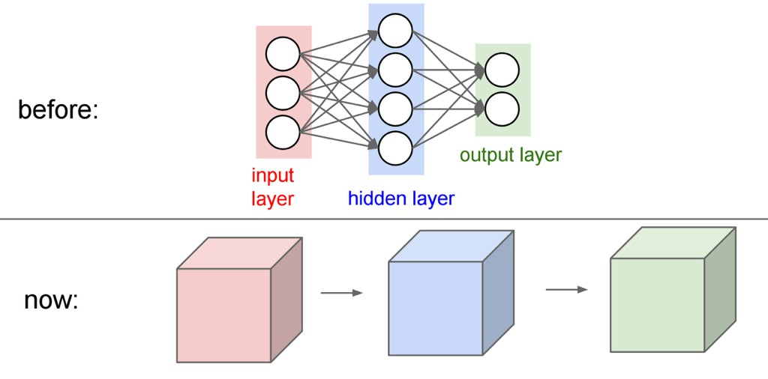
3D Activations
(1D vectors)
x ^{h}1 ^{h}2
(3D arrays)
Figure: Andrej Karpathy

Slide 134
3D Activations
(1D vectors)
x
h₁
h₂
(3D arrays)
Figure: Andrej Karpathy

Slide 135
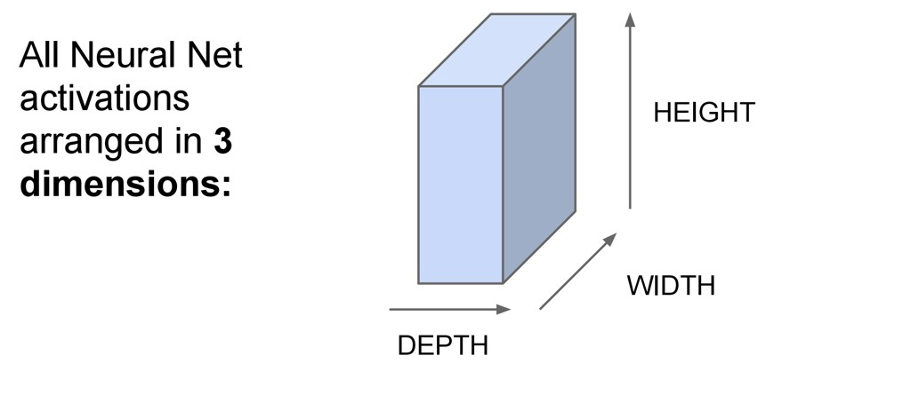
3D Activations
Figure: Andrej Karpathy

Slide 136
3D Activations
For example, a CIFAR-10 image is a 3x32x32 volume (3 depth — RGB channels, 32 height, 32 width)
Figure: Andrej Karpathy

Slide 137
3D Activations
1D Activations:
Figure: Andrej Karpathy

Slide 138
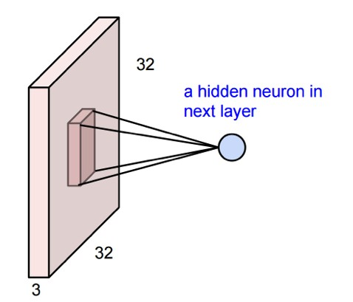
3D Activations
1D Activations:
3D Activations:
Figure: Andrej Karpathy

Slide 139
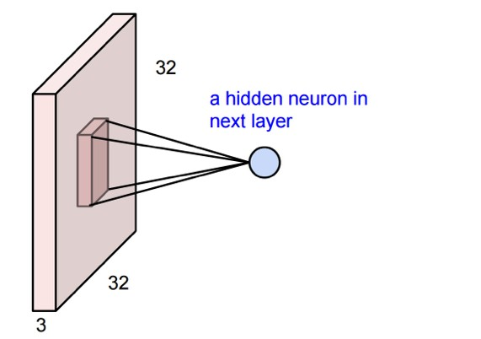
3D Activations
-
The input is 3x32x32
-
This neuron depends on a 3x5x5 chunk of the input
5
5
-
The neuron also has a 3x5x5 set of weights and a bias (scalar)
Figure: Andrej Karpathy

Slide 140
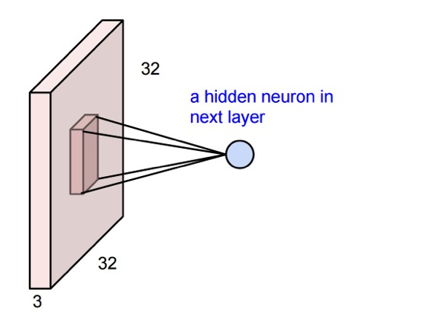
3D Activations
Example: consider the region of the input “ x^{r}”
With output neuron h^{r}
_{x}r
5
_{h}r
5
Figure: Andrej Karpathy

Slide 141
3D Activations
Example: consider the region of the input “ x^{r}”
With output neuron h^{r}
_{x}r
5
_{h}r
5
Then the output is:
h^{r} = ∑ x^{r} W + b
ijk
ijk ijk
Figure: Andrej Karpathy

Slide 142
3D Activations
Example: consider the region of the input “ x^{r}”
With output neuron h^{r}
_{x}r
5
_{h}r
5
Then the output is:
h^{r} = ∑ x^{r} W + b
ijk ijk
ijk
Sum over 3 axes
Figure: Andrej Karpathy

Slide 143
3D Activations
_{x}r
5
_{h}r
1
5
Figure: Andrej Karpathy

Slide 144

3D Activations
_{x}r
5
_{h}r r
1 ^{h} 2
5
Figure: Andrej Karpathy

Slide 145
3D Activations
With 2 output neurons
_{x}r
_{h}r
= ∑ x^{r} W + b
ijk
1
ijk 1ijk
1
5
_{h}r _{h}r
5
1
2
_{h}r
= ∑ x^{r} W + b
ijk
2
ijk 2ijk
2
Figure: Andrej Karpathy

Slide 146
3D Activations
With 2 output neurons
_{x}r
_{h}r
= ∑ x^{r} W + b
ijk
1
ijk 1ijk
1
5
_{h}r _{h}r
5
1
2
_{h}r
= ∑ x^{r} W + b
ijk
2
ijk 2ijk
2
Figure: Andrej Karpathy

Slide 147
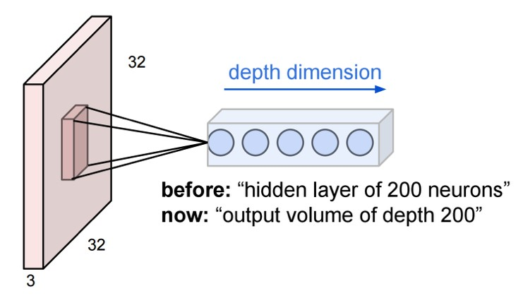
3D Activations
Figure: Andrej Karpathy

Slide 148
3D Activations
We can keep adding more outputs
These form a column in the output volume: [depth x 1 x 1]
Figure: Andrej Karpathy

Slide 149
3D Activations
We can keep adding more outputs
These form a column in the output volume: [depth x 1 x 1]
Each neuron has its own 3D filter and own (scalar) bias
Figure: Andrej Karpathy

Slide 150
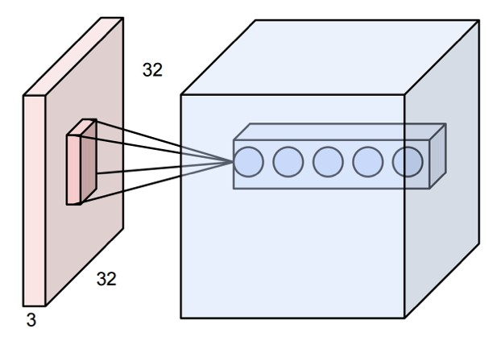
3D Activations
Now repeat this across the input
D sets of weights (also called filters)
Figure: Andrej Karpathy

Slide 151
3D Activations
Now repeat this across the input
Weight sharing:
Each filter shares the same weights (but each depth index has its own set of weights)
D sets of weights (also called filters)
Figure: Andrej Karpathy

Slide 152
3D Activations
D sets of weights (also called filters)
Figure: Andrej Karpathy

Slide 153
3D Activations
With weight sharing,
this is called
convolution
D sets of weights (also called filters)
Figure: Andrej Karpathy

Slide 154
3D Activations
With weight sharing,
this is called
convolution
Without weight sharing,
this is called a locally connected layer
D sets of weights (also called filters)
Figure: Andrej Karpathy

Slide 155
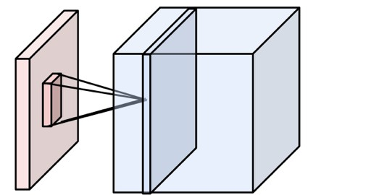
3D Activations
Output of one filter
One set of weights gives one slice in the output
To get a 3D output of depth D, use D different filters
In practice, ConvNets use many filters (~64 to 1024)
(input depth)
(output depth)

Slide 156
3D Activations
Output of one filter
One set of weights gives one slice in the output
To get a 3D output of depth D, use D different filters
In practice, ConvNets use many filters (~64 to 1024)
(input depth)
(output depth)
All together, the weights are 4 dimensional:
(output depth, input depth, kernel height, kernel width)

Slide 157
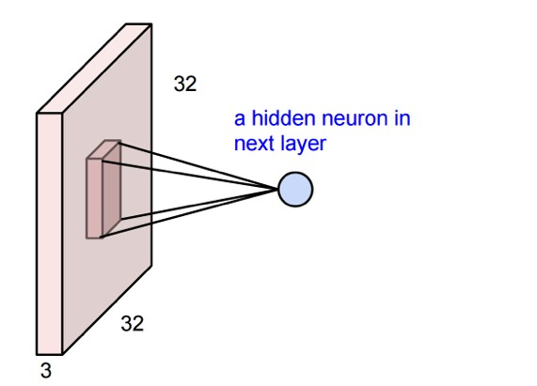
3D Activations
Let’s code this up in NumPy

Slide 158
3D Activations
Let’s code this up in NumPy
_{n}th
example

Slide 159
3D Activations
Let’s code this up in NumPy
first filter
_{n}th
example

Slide 160
3D Activations
Let’s code this up in NumPy
output position
first filter
_{n}th
example

Slide 161
3D Activations
Let’s code this up in NumPy
output position
first filter
_{n}th
example

Slide 162
3D Activations
_{x}r
Let’s code this up in NumPy
output position
first filter
_{n}th
example

Slide 163
3D Activations
_{x}r
Let’s code this up in NumPy
output position
first filter
_{n}th
example
_{n}th
example

Slide 164
3D Activations
_{x}r
Let’s code this up in NumPy
output position
first filter
all input channels
_{n}th
example
_{n}th
example

Slide 165
3D Activations
_{x}r
Let’s code this up in NumPy
output position
first filter
input region
all input channels
_{n}th
example
_{n}th
example

Slide 166
3D Activations
_{x}r
Let’s code this up in NumPy
output position
first filter
input region
all input channels
_{n}th
example
_{n}th
example

Slide 167
3D Activations
_{x}r
Let’s code this up in NumPy
output position
first filter
input region
all input channels
_{n}th
example
_{n}th
example
first filter

Slide 168
3D Activations
_{x}r
Let’s code this up in NumPy
output position
first filter
input region
all input channels
all channels
_{n}th
example
_{n}th
example
first filter

Slide 169
3D Activations
_{x}r
Let’s code this up in NumPy
output position
first filter
input region
all positions
all channels
all input channels
_{n}th
example
_{n}th
example
first filter

Slide 170
3D Activations
_{x}r
Let’s code this up in NumPy
bias
output position
first filter
input region
all positions
all channels
all input channels
_{n}th
example
_{n}th
example
first filter

Slide 171
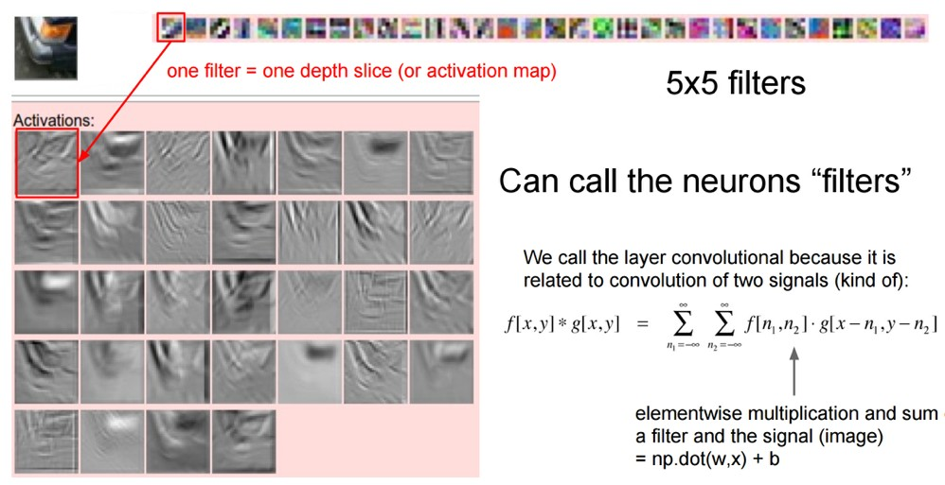
3D Activations
We can unravel the 3D cube and show each layer separately:
(Input)
(32 filters, each 3x5x5)
Figure: Andrej Karpathy

Slide 172
3D Activations
We can unravel the 3D cube and show each layer separately:
(Input)
(32 filters, each 3x5x5)
Figure: Andrej Karpathy

Slide 173

3D Activations
We can unravel the 3D cube and show each layer separately:
(Input)
(32 filters, each 3x5x5)
Figure: Andrej Karpathy

Slide 174
3D Activations
We can unravel the 3D cube and show each layer separately:
(Input)
(32 filters, each 3x5x5)
Figure: Andrej Karpathy

Slide 175
Questions?

