Slide 1
Lecture 23: Optimization and Neural Nets
CS5670: Computer Vision
Noah Snavely
Slides from Andrej Karpathy and Fei-Fei Li
http://vision.stanford.edu/teaching/cs231n/

Slide 2
Today
Optimization
Today and Thursday: Neural nets, CNNs
Mon: http://cs231n.github.io/classification/
Wed: http://cs231n.github.io/linear-classify/
Today:
http://cs231n.github.io/optimization-1/
http://cs231n.github.io/optimization-2/

Slide 3
Announcements
Final project (P5) released, due Tuesday, 5/9, by 11:59pm, to be done in groups of two
Final exam will be handed out in class Tuesday, due Friday, 5/12, by 5pm
Project 3 voting results

Slide 4
Third Place

Slide 5
Boting Li and Ran Godrich

Slide 6
Second Place

Slide 7
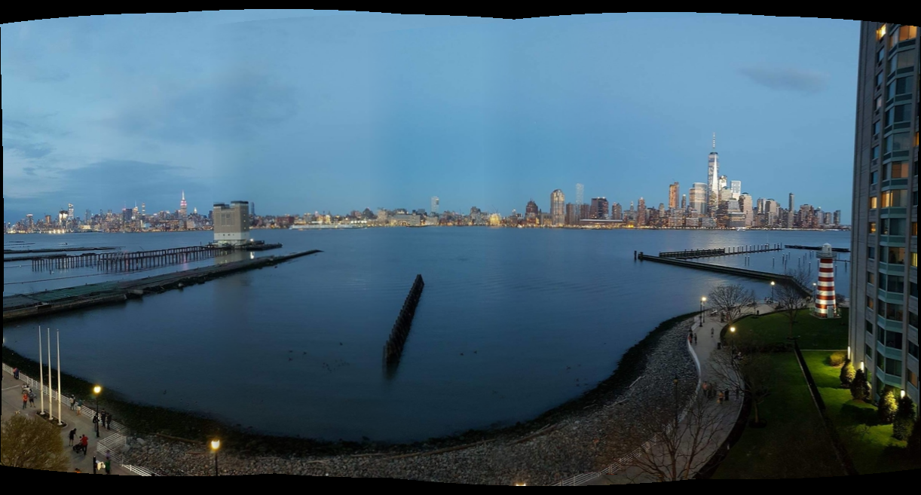
Arpit Sabherwal and Jaldeep Acharya

Slide 8
First Place

Slide 9
Hong Gan and Renkai Xiang

Slide 10
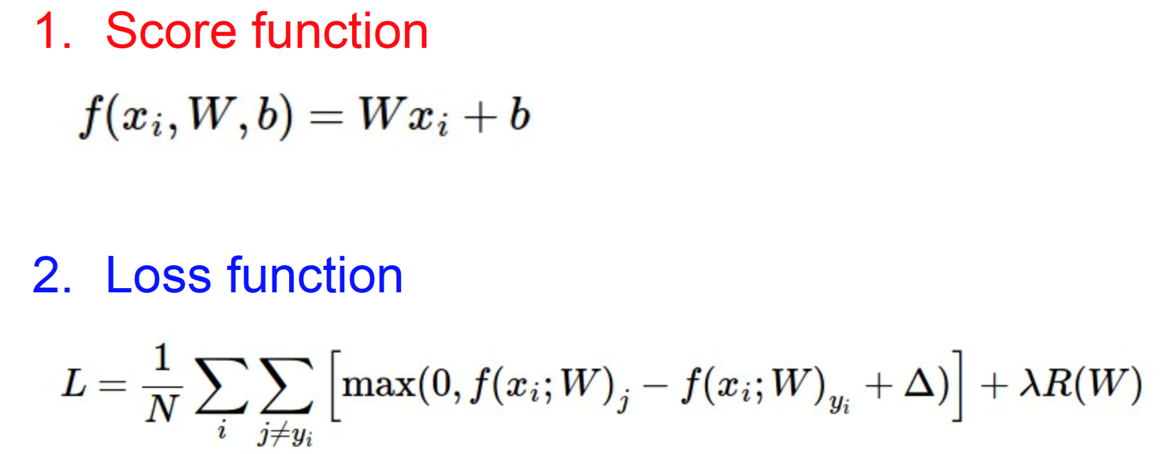
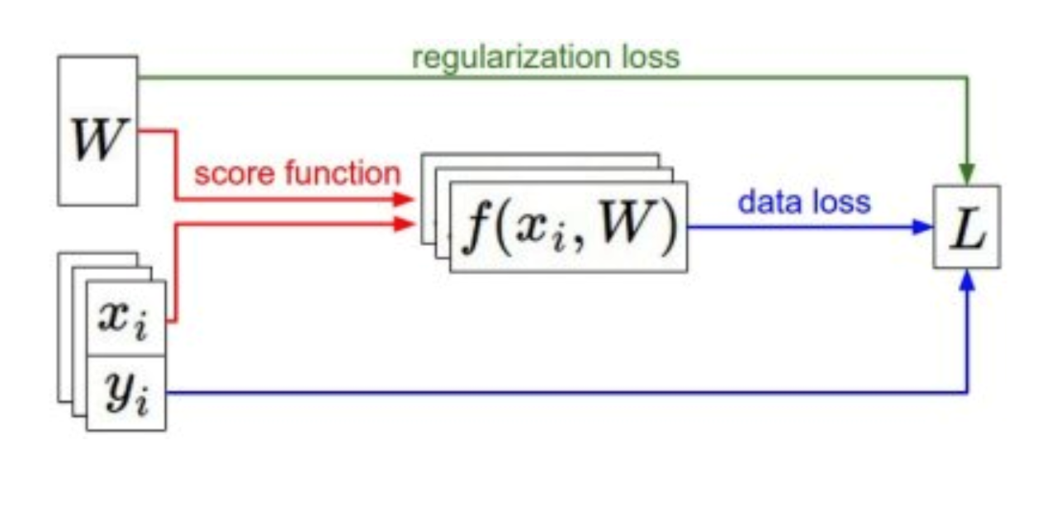
Summary

Slide 11
Other loss functions
Scores are not very intuitive
Softmax classifier
Score function is same
Intuitive output: normalized class probabilities
Extension of logistic regression to multiple classes
Notes:
SVM: output is score for each class. Not so easy to interpret
Softmax classifier output is probabilistic interpretation
The binary logistic model is used to predict a binary response based on one or more predictor variables (features).

Slide 12
Softmax classifier
Interpretation: squashes values into range 0 to 1
Notes:
The binary logistic model is used to predict a binary response based on one or more predictor variables (features).
Notation: f_j is the jth element of the vector of class scores f.

Slide 13
Cross-entropy loss

Slide 14
Aside: Loss function interpretation
Probability
Maximum Likelihood Estimation (MLE)
Regularization is Maximum a posteriori (MAP) estimation
Cross-entropy H
p is true distribution (1 for the correct class), q is estimated
Softmax classifier minimizes cross-entropy
Minimizes the KL divergence (Kullback-Leibler) between the distribution: distance between p and q

Slide 15
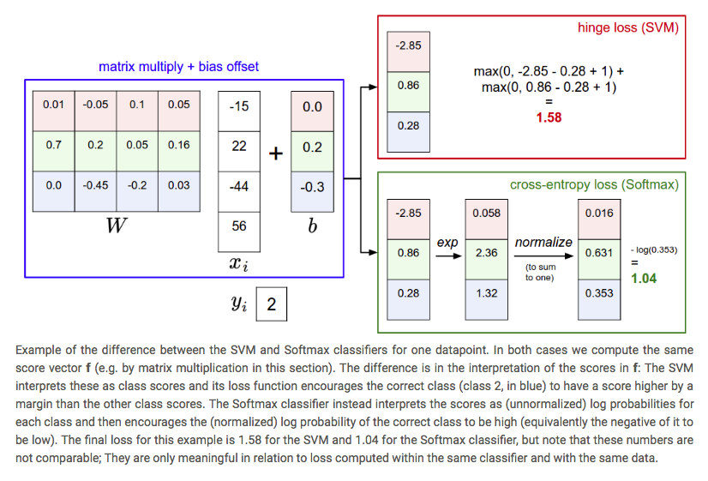
SVM vs. Softmax

Slide 16
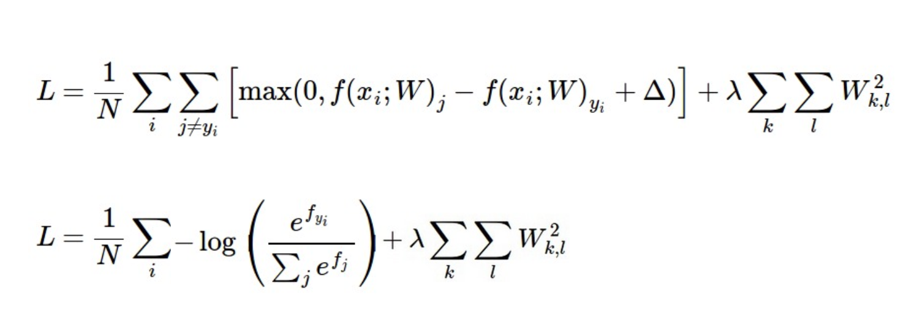
Summary
Have score function and loss function
Will generalize the score function
Find W and b to minimize loss
SVM vs. Softmax
Comparable in performance
SVM satisfies margins, softmax optimizes probabilities
Notes:
In other words, the Softmax classifier is never fully happy with the scores it produces: the correct class could always have a higher probability and the incorrect classes always a lower probability and the loss would always get better. However, the SVM is happy once the margins are satisfied and it does not micromanage the exact scores beyond this constraint. This can intuitively be thought of as a feature: For example, a car classifier which is likely spending most of its "effort" on the difficult problem of separating cars from trucks should not be influenced by the frog examples, which it already assigns very low scores to, and which likely cluster around a completely different side of the data cloud.

Slide 17
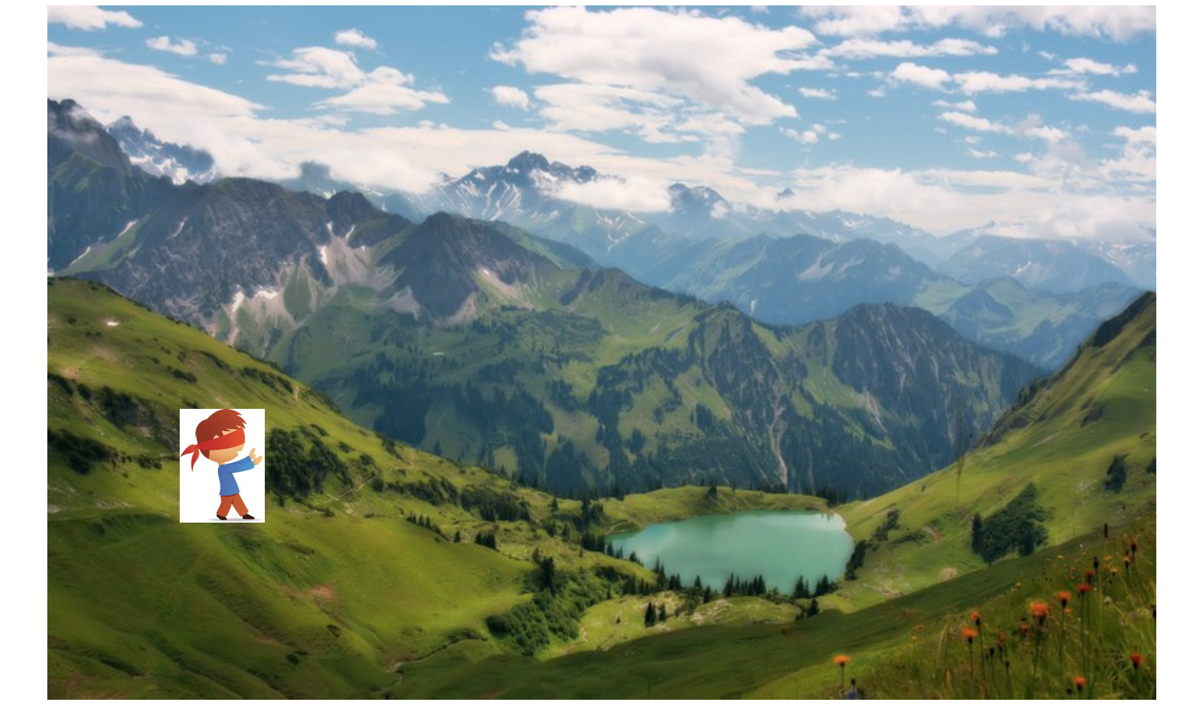
Gradient Descent

Slide 18
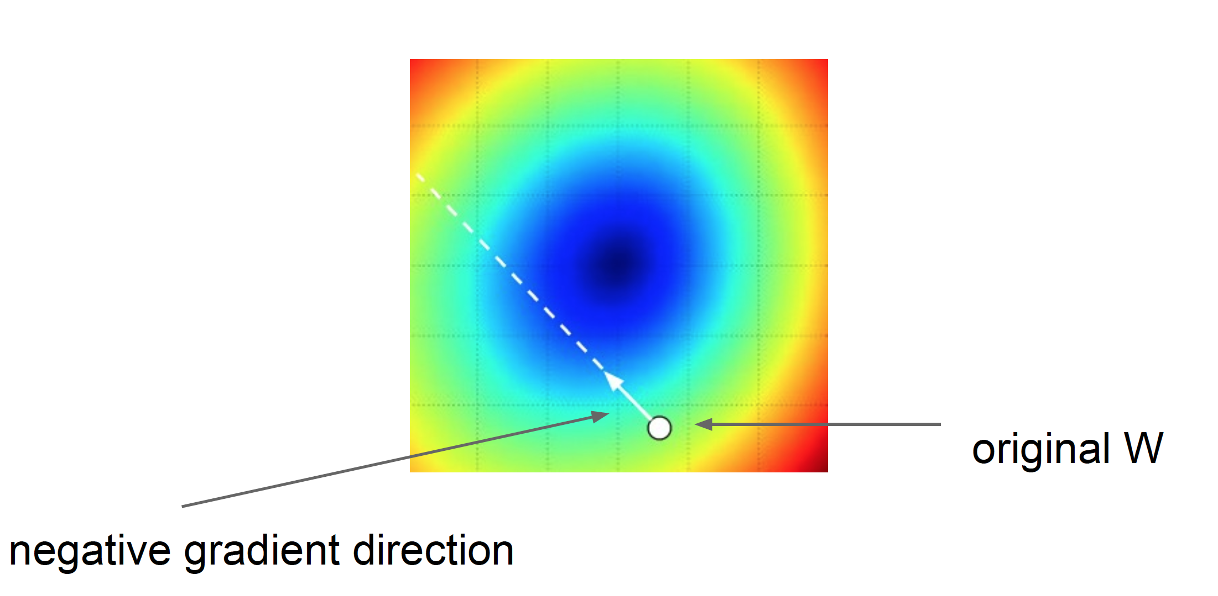
Step size: learning rate
Too big: will miss the minimum
Too small: slow convergence

Slide 19
Analytic Gradient
Full gradient is the sum of all L_{i}s over all training examples x_{i}
Notes:
Where is the indicator function that is one if the condition inside is true or zero otherwise. You simply count the number of classes that didn't meet the desired margin (and hence contributed to the loss function) and then the data vector scaled by this number is the gradient.

Slide 21
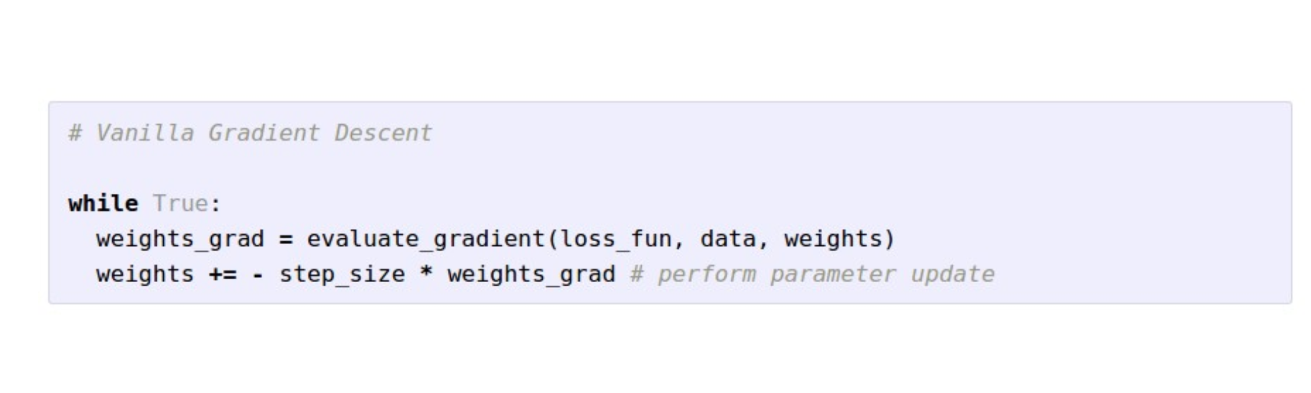
Gradient Descent

Slide 22
Mini-batch Gradient Descent

Slide 23
Stochastic Gradient Descent (SGD)

Slide 24
Summary

Slide 27
Notes:
Limited memory Broyden–Fletcher–Goldfarb–Shanno

Slide 28
Where are we?
Classifiers: SVM vs. Softmax
Gradient descent to optimize loss functions
Batch gradient descent, stochastic gradient descent
Momentum
Numerical gradients (slow, approximate), analytic gradients (fast, error-prone)

Slide 29
Derivatives
Given f(x), where x is vector of inputs
Compute gradient of f at x:

Slide 30
Examples
Notes:
What does the derivative say? A step in direction of gradient of size h

Slide 31
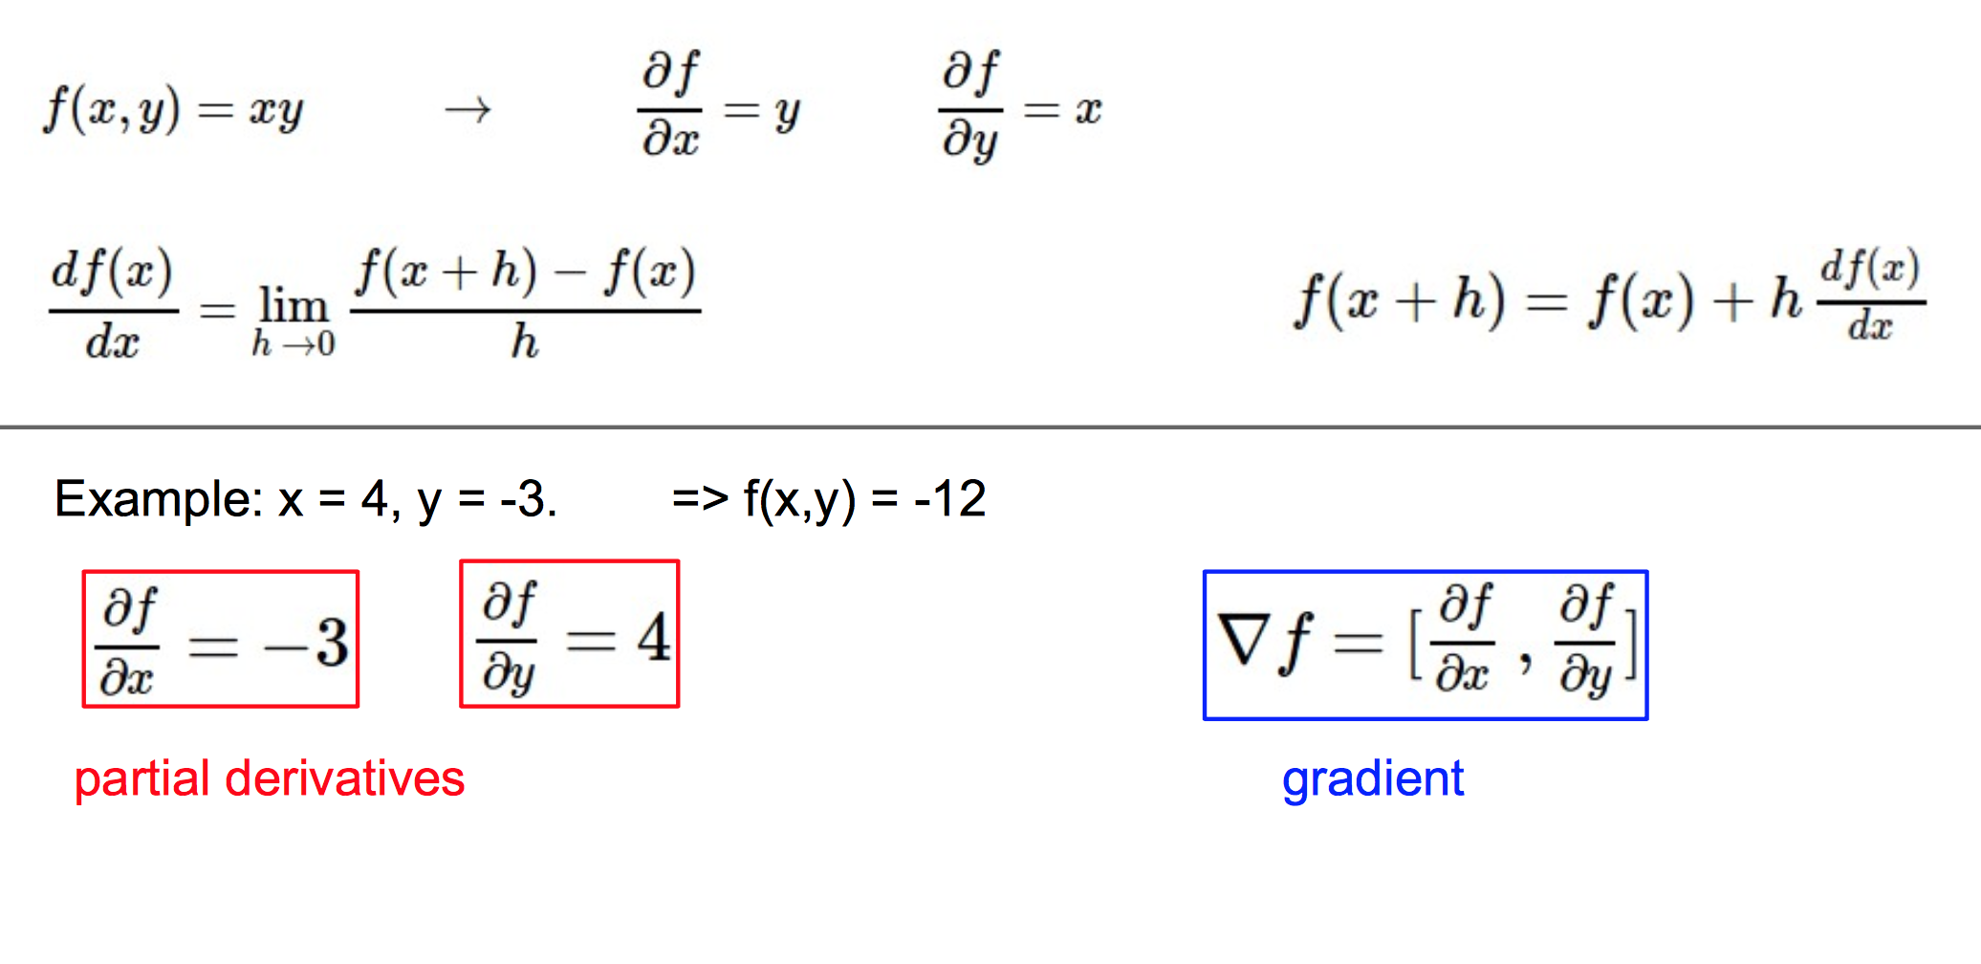
Notes:
Gradient is a vector of partial derivatives.

Slide 32
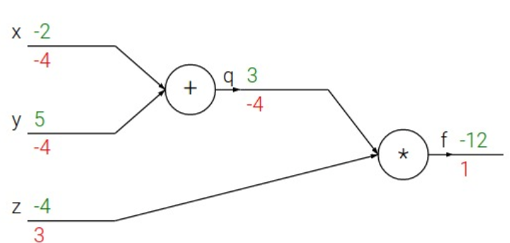

Slide 33
Backprop gradients
Can create complex stages, but easily compute gradient

Slide 34
Now onto Deep Learning
[Monroe 2014, xkcd]

Slide 35
Slide: Flickr

Slide 36
Slide: Flickr

Slide 37
Slide: Flickr

Slide 38
Slide: Flickr

Slide 39
In the next week, we’ll learn what this is, how to compute it, and how to learn it
Slide: Flickr

Slide 40
What is a Convolutional Neural Network (CNN)?
function
function
…
“horse”
P(class)
Key questions:
What kinds of of functions should we use?
How do we learn the parameters for those functions?

Slide 41
Example CNN
Softmax
Fully Connected
ReLU
ReLU
Conv
Conv
Pool
[Andrej Karpathy]

Slide 42
CNNs in 1989: “LeNet”
CNNs were not invented overnight
LeNet: a classifier for handwritten digits. [LeCun 1989]

Slide 43
CNNs in 2012: “SuperVision” (aka “AlexNet”)
“AlexNet” — Won the ILSVRC2012 Challenge
Major breakthrough: 15.3% Top-5 error on ILSVRC2012 (Next best: 25.7%)
[Krizhevsky, Sutskever, Hinton. NIPS 2012]

Slide 44
CNNs in 2014: “GoogLeNet”
“GoogLeNet” — Won the ILSVRC2014 Challenge
6.67% top-5 error rate! (1000 classes!)
[Szegedy et al, arXiv 2014]

Slide 45
CNNs in 2014: “VGGNet”
“VGGNet” — Second Place in the ILSVRC2014 Challenge
No fancy picture, sorry
7.3% top-5 error rate
(and 1st place in the detection challenge)
[Simonyan et al, arXiv 2014]

Slide 46
CNNs in 2015: “ResNet”
GoogLeNet, 22 layers
(ILSVRC 2014)
Note: Despite its massive depth, ResNet has a lower runtime complexity than VGG
https://youtu.be/1PGLj-uKT1w?t=4m40s
[Kaiming et al, “Deep Residual Learning for Image Recognition” 2015]

Slide 47
CNNs in 2015: “ResNet”
[Kaiming et al, “Deep Residual Learning for Image Recognition” 2015]

Slide 48
Aside: Before Deep Learning
SVM
Ans
Input Pixels
Extract Features
Concatenate into a vector x
Linear Classifier
Figure: Karpathy 2016

Slide 49
Why use features?
Why not pixels?
Q: What would be a
very hard set of classes for a linear classifier to distinguish?
(assuming x = pixels)
Slide from Karpathy 2016

Slide 50
The last layer of (most) CNNs are linear classifiers
This piece is just a linear classifier
Ans
(GoogLeNet)
Input Pixels
Perform everything with a big neural network, trained end-to-end
Key: perform enough processing so that by the time you get to the end of the network, the classes are linearly separable

Slide 51
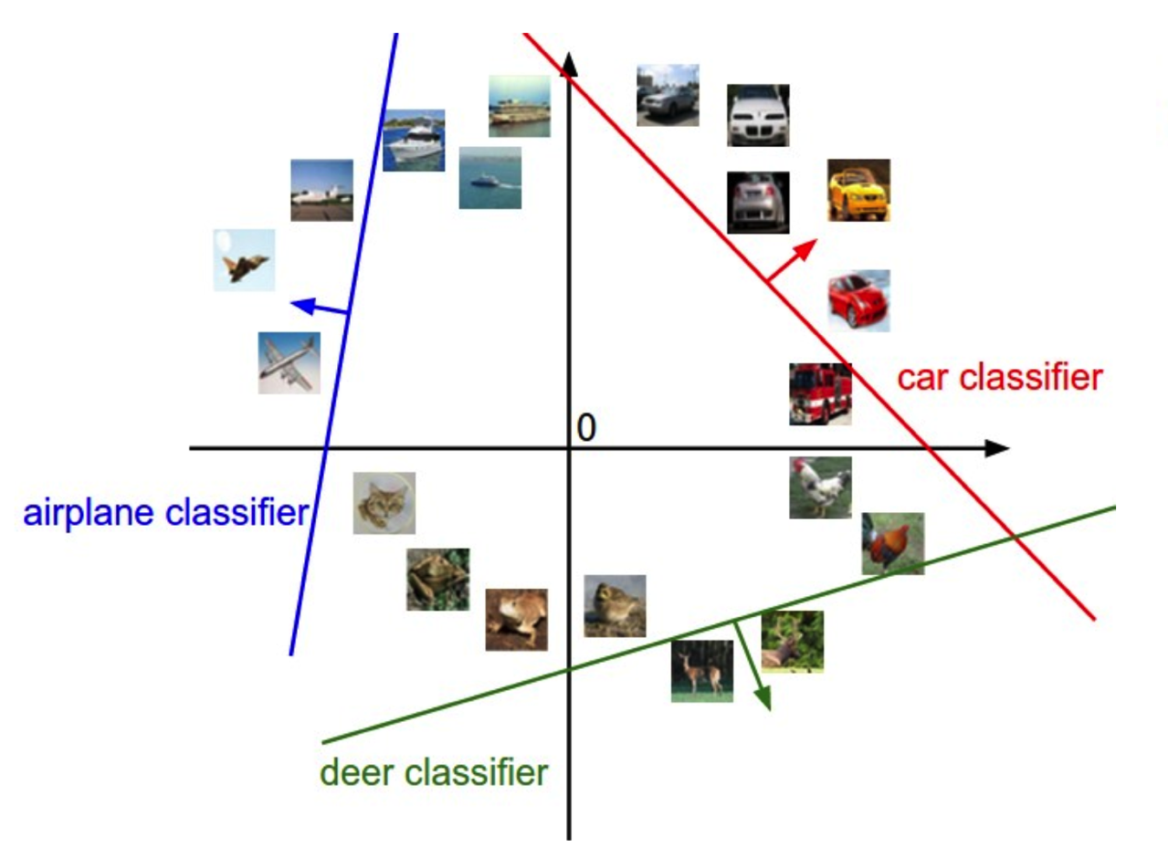
Linearly separable classes

Slide 52
Example: Visualizing AlexNet in 2D with t-SNE
Linear Classifier
(2D visualization using t-SNE)
[Donahue, “DeCAF: DeCAF: A Deep Convolutional …”, arXiv 2013]

Slide 53
Questions?

