Slide 1
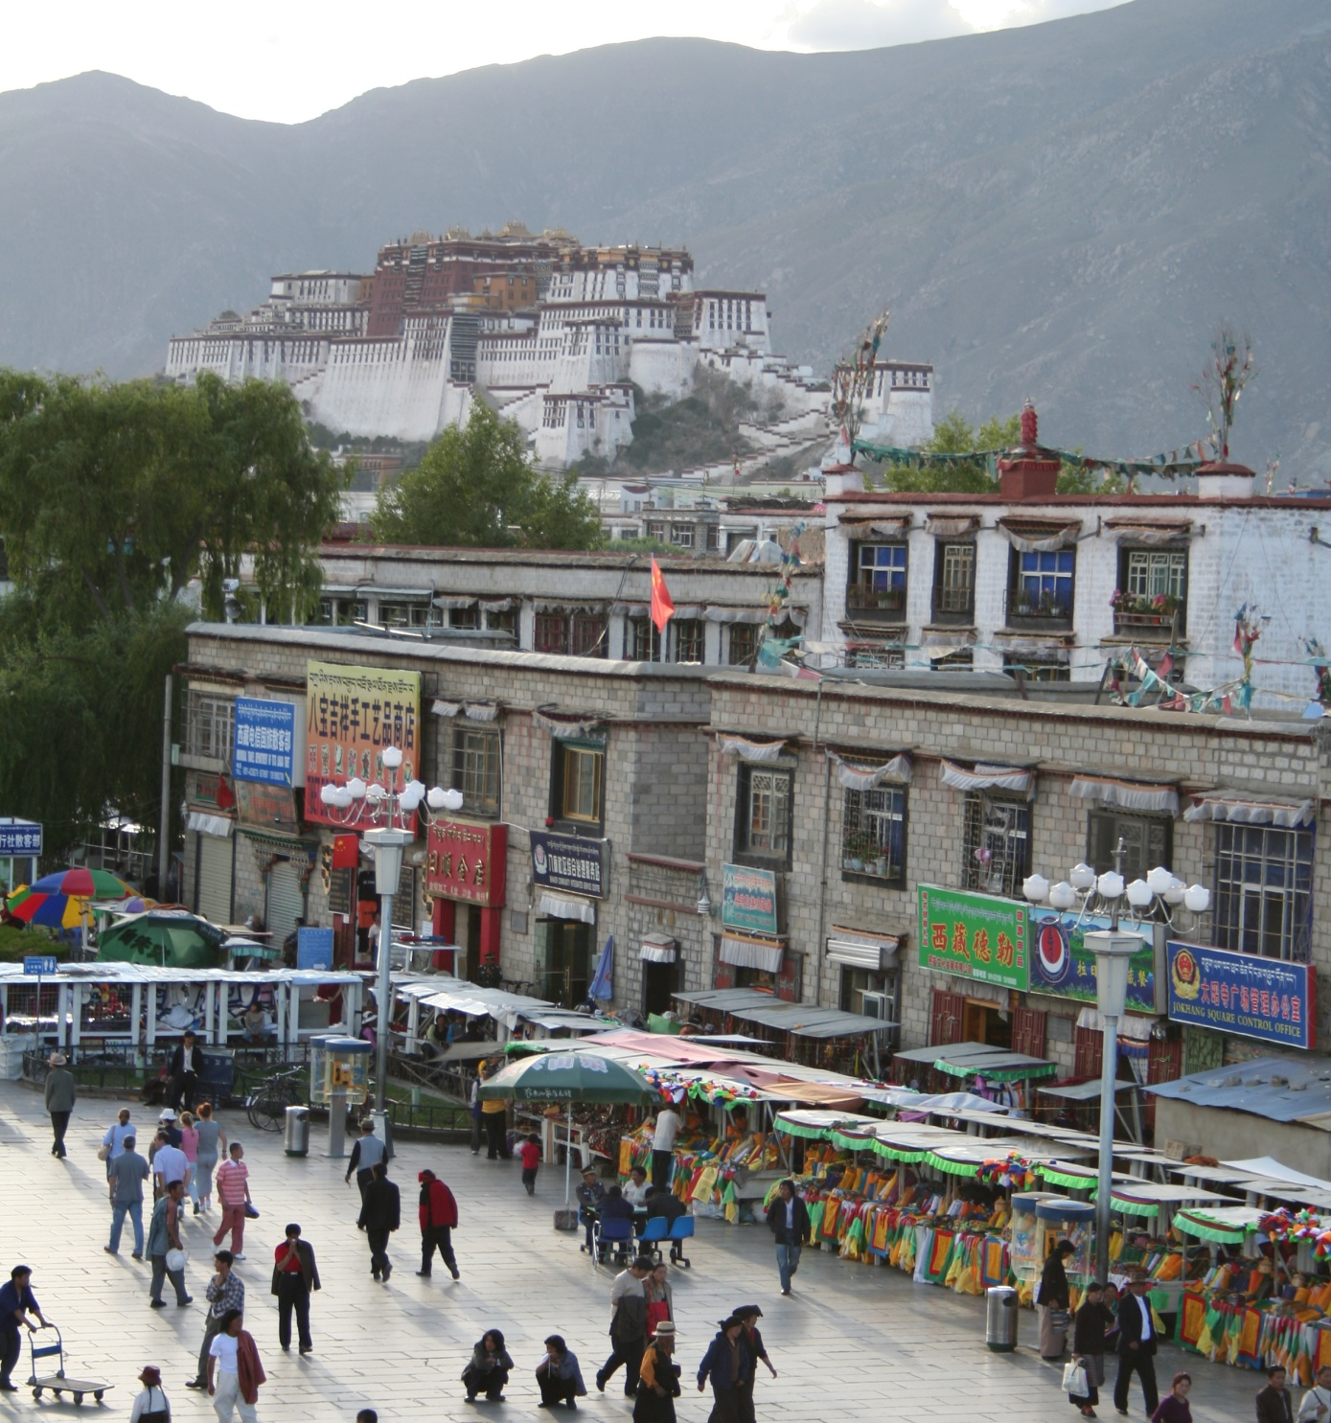
Introduction to Recognition, Part 2
CS5670: Intro to Computer Vision
Noah Snavely
mountain
tree
building
banner
street lamp
vendor
people

Slide 2
Announcements
Project 4 (Stereo)
  Due this Friday, April 28, by 11:59pm
  To be done in pairs
Voting on Project 3 artifacts
Quiz in class Thursday
Final will be take-home, details to be announced next time

Slide 3
History of ideas in recognition
1960s – early 1990s: the geometric era
1990s: appearance-based models
Mid-1990s: sliding window approaches
Late 1990s: local features
Early 2000s: parts-and-shape models

Slide 4
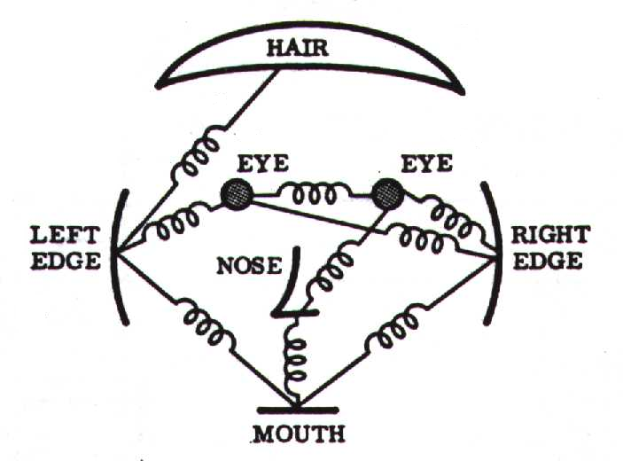
Parts-and-shape models
Model:
  Object as a set of parts
  Relative locations between parts
  Appearance of part
Figure from [Fischler & Elschlager 73]

Slide 5
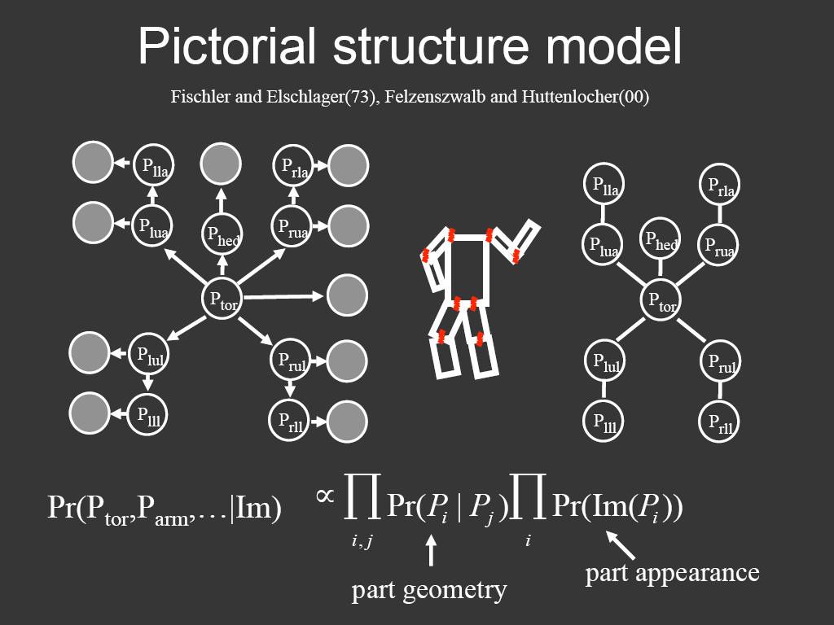
Representing people

Slide 6
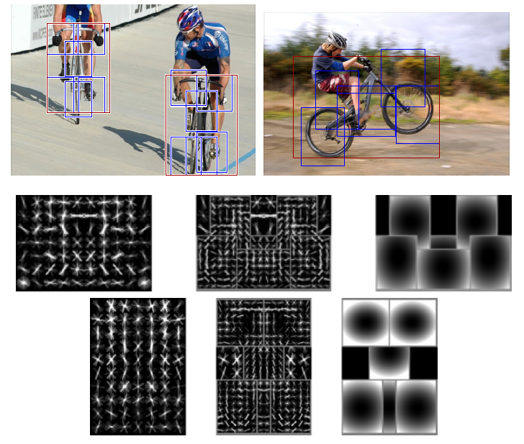
Discriminatively trained part-based models
P. Felzenszwalb, R. Girshick, D. McAllester, D. Ramanan, "Object Detection with Discriminatively Trained Part-Based Models," PAMI 2009

Slide 7
History of ideas in recognition
1960s – early 1990s: the geometric era
1990s: appearance-based models
Mid-1990s: sliding window approaches
Late 1990s: local features
Early 2000s: parts-and-shape models
Mid-2000s: bags of features
Svetlana Lazebnik

Slide 8
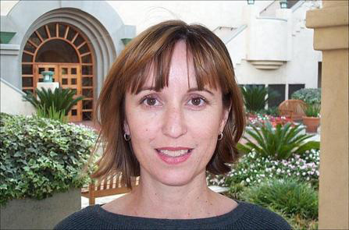

Bag-of-features models
Svetlana Lazebnik

Slide 9



Bag-of-features models
Bag of ‘words’
Object
Svetlana Lazebnik

Slide 10
History of ideas in recognition
1960s – early 1990s: the geometric era
1990s: appearance-based models
Mid-1990s: sliding window approaches
Late 1990s: local features
Early 2000s: parts-and-shape models
Mid-2000s: bags of features
Present trends: data-driven methods, deep learning
Svetlana Lazebnik

Slide 11
What Matters in Recognition?
Learning Techniques
  E.g. choice of classifier or inference method
Representation
  Low level: SIFT, HoG, GIST, edges
  Mid level: Bag of words, sliding window, deformable model
  High level: Contextual dependence
  Deep features
Data
  More is always better
  Annotation is the hard part

Slide 12
Types of Recognition
Instance recognition
  Recognizing a known object but in a new viewpoint, with clutter and occlusion
  Location/Landmark Recognition
    Recognize Paris, Rome, ... in photographs
    Ideas from information retrieval
Category recognition
  Harder problem, even for humans
  Bag of words, part-based, recognition and segmentation

Slide 13
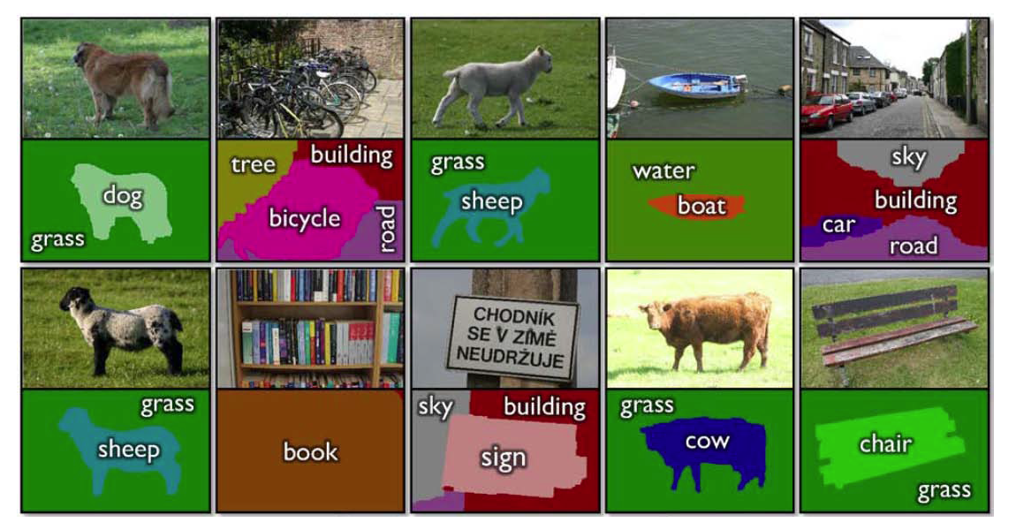
Simultaneous recognition and detection
Notes:
Label each pixel with its class (say dog, grass) and use CRF to do the segmentation.

Slide 14
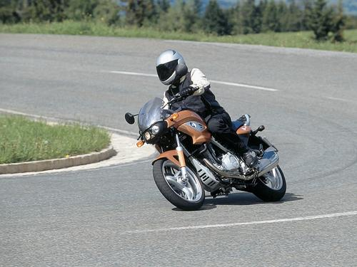

PASCAL VOC 2005-2012
20 object classes 22,591 images
Classification: person, motorcycle
Detection
Segmentation
Person
Motorcycle
Action: riding bicycle
Everingham, Van Gool, Williams, Winn and Zisserman.
The PASCAL Visual Object Classes (VOC) Challenge. IJCV 2010.

Slide 15

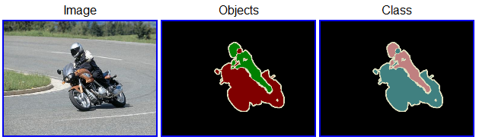
20 object categories (aeroplane to TV/monitor)
Three (+2) challenges:
  Classification challenge (is there an X in this image?)
  Detection challenge (draw a box around every X)
  Segmentation challenge (which class is each pixel?)
Notes:
+2 action classification and person layout.

Slide 16
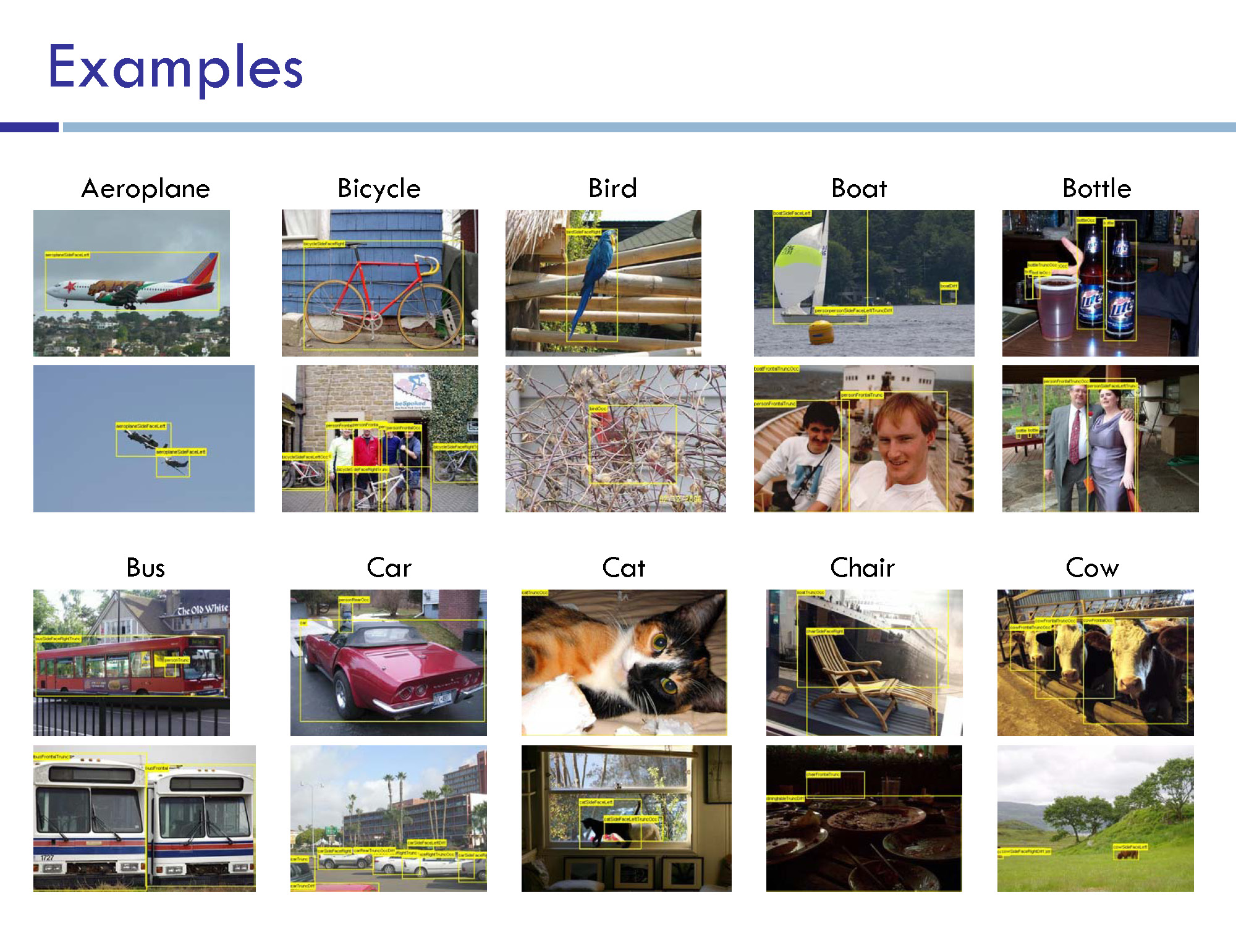
Notes:
Images downloaded from flickr. 500k images downloaded. Random subset selected for annotation.
Full annotation

Slide 17
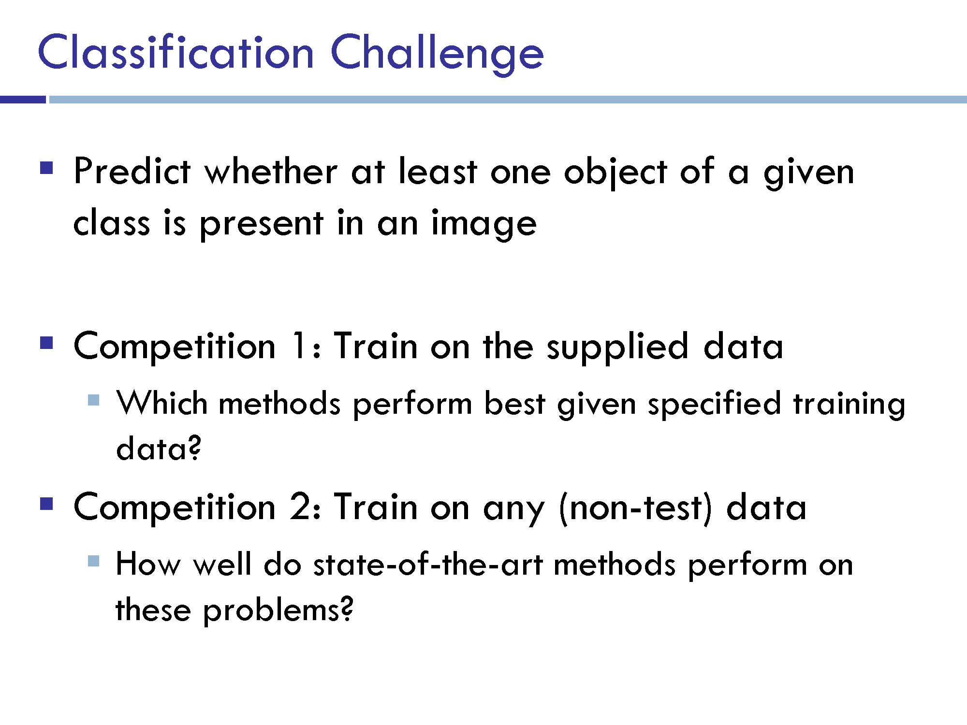
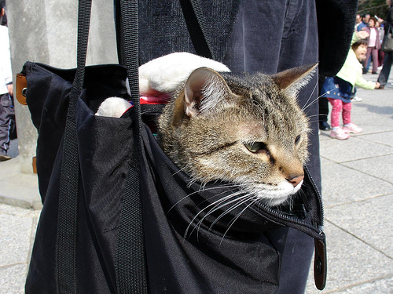
is
is there a cat?

Slide 18
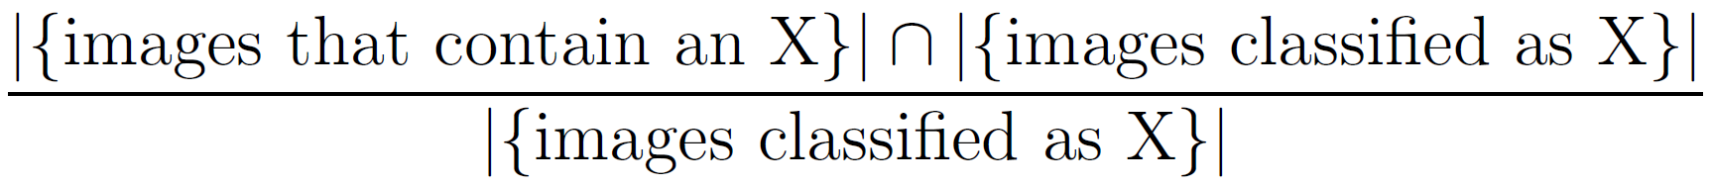
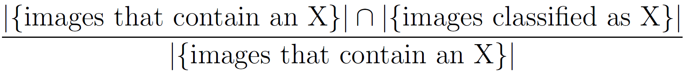
Precision / Recall for a Category X
Precision:
Recall:
In reality, methods give a continuous-valued score for each image / category ➔ PR curve
Notes:
Precision: Images Classified as X (denominator). BUT only some number of them actually have X. 90/100
Recall: Images that contain X (denominator). How many of them do you find?
Say 100 images have a bike.
If it returns 200 images then precision is 0.5, but all the 100 are included then recall is 1.
If it returns 50 images and they all have a bike, then precision is 1.0, but recall is 0.5
information retrieval scenario, the instances are documents and the task is to return a set of relevant documents given a search term; or equivalently, to assign each document to one of two categories, "relevant" and "not relevant". In this case, the "relevant" documents are simply those that belong to the "relevant" category. Recall is defined as the number of relevant documents retrieved by a search divided by the total number of existing relevant documents, while precision is defined as the number of relevant documents retrieved by a search divided by the total number of documents retrieved by that search.

Slide 19
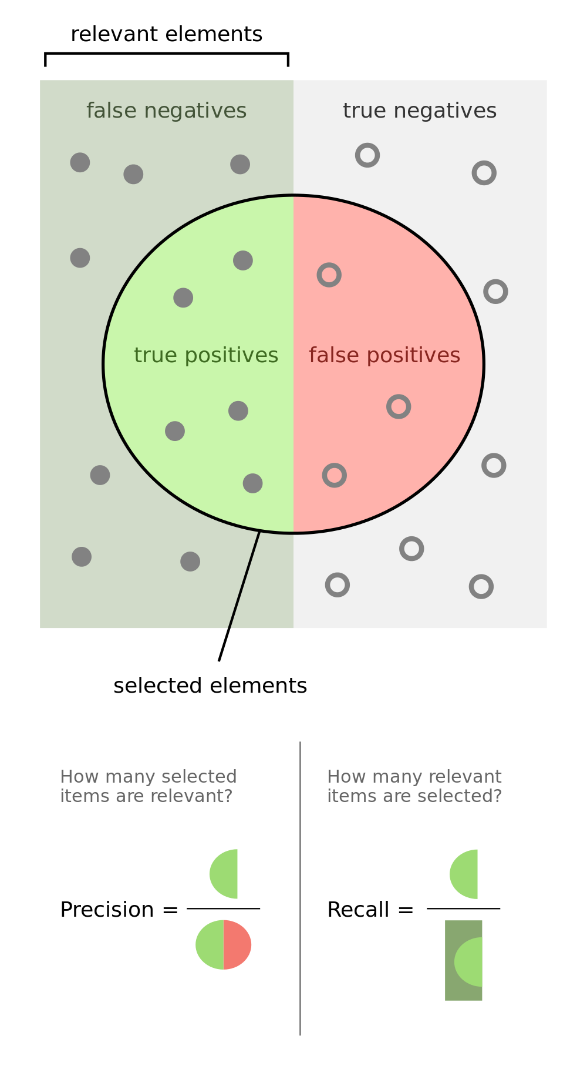
"Precisionrecall" by Walber - Own work. Licensed under CC BY-SA 4.0 via Wikimedia Commons - http://commons.wikimedia.org/wiki/File:Precisionrecall.svg#mediaviewer/File:Precisionrecall.svg

Slide 20
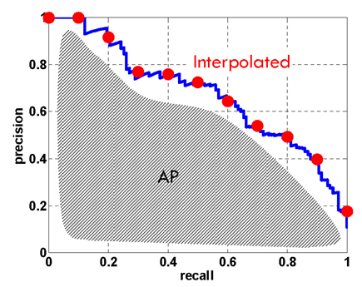
Precision / Recall Curve
Similar to the ROC curves you saw in Project 2

Slide 21
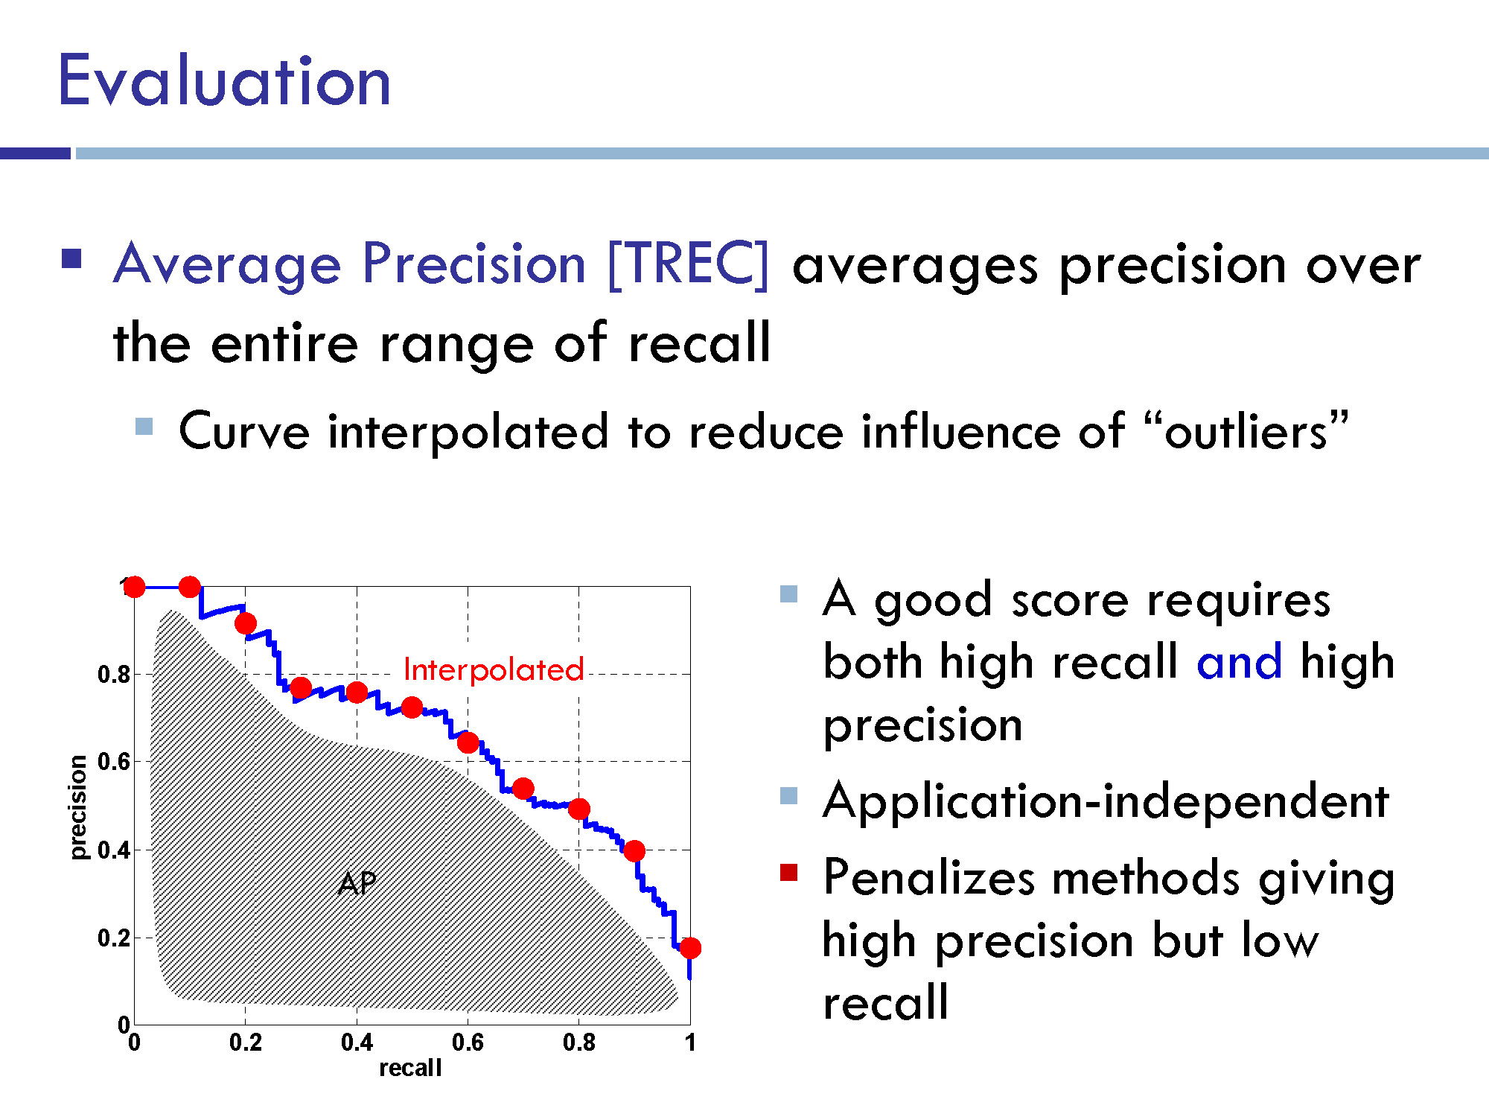

Slide 22
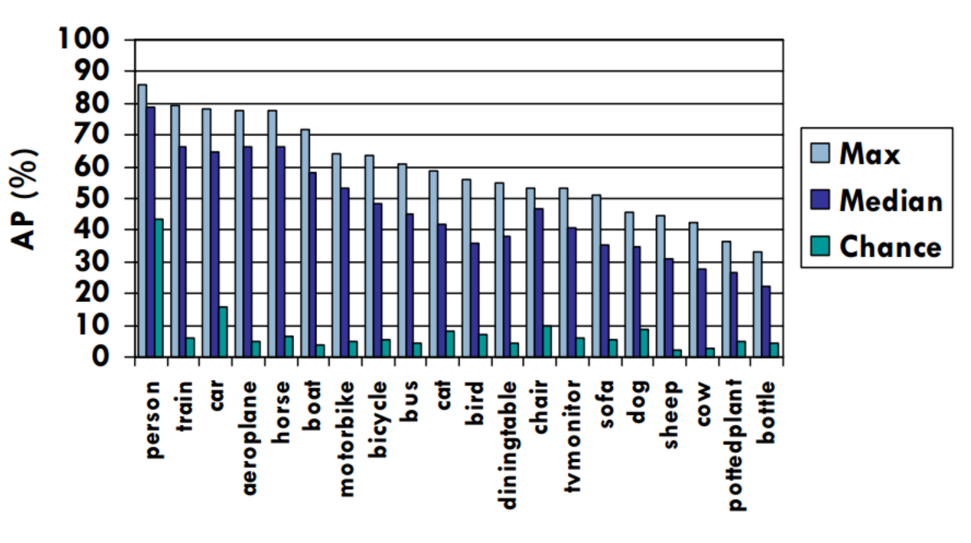
Pascal VOC 2007 Average Precision
Notes:
2007 was not the first year, but it’s the first year with 20 classes and the same evaluation metric (AP vs Area under ROC)

Slide 23
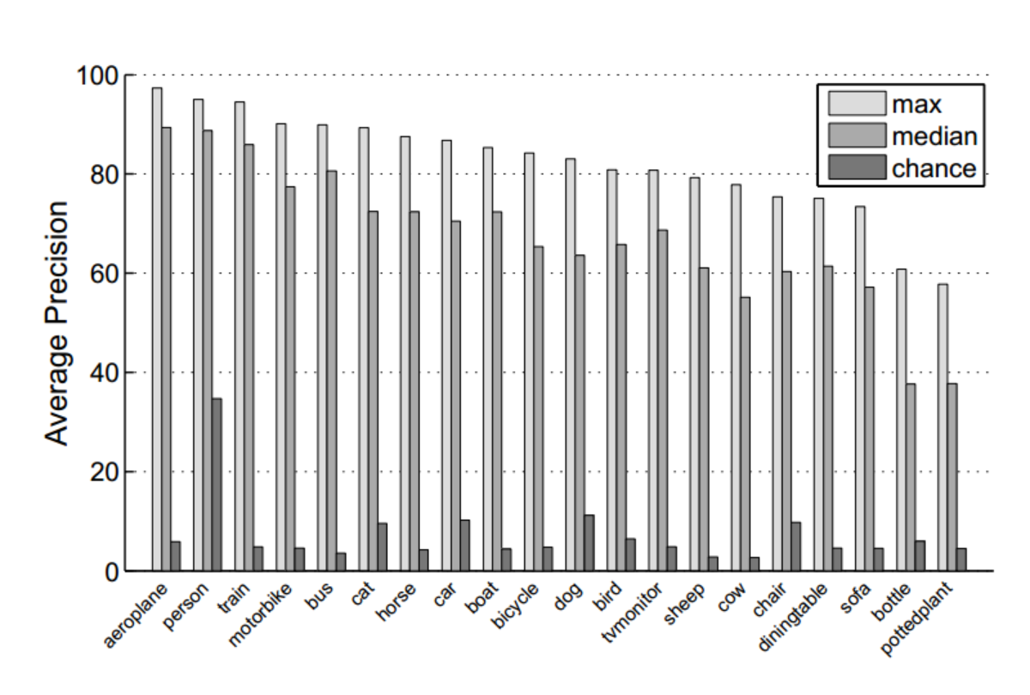
Pascal VOC 2012 Average Precision

Slide 24
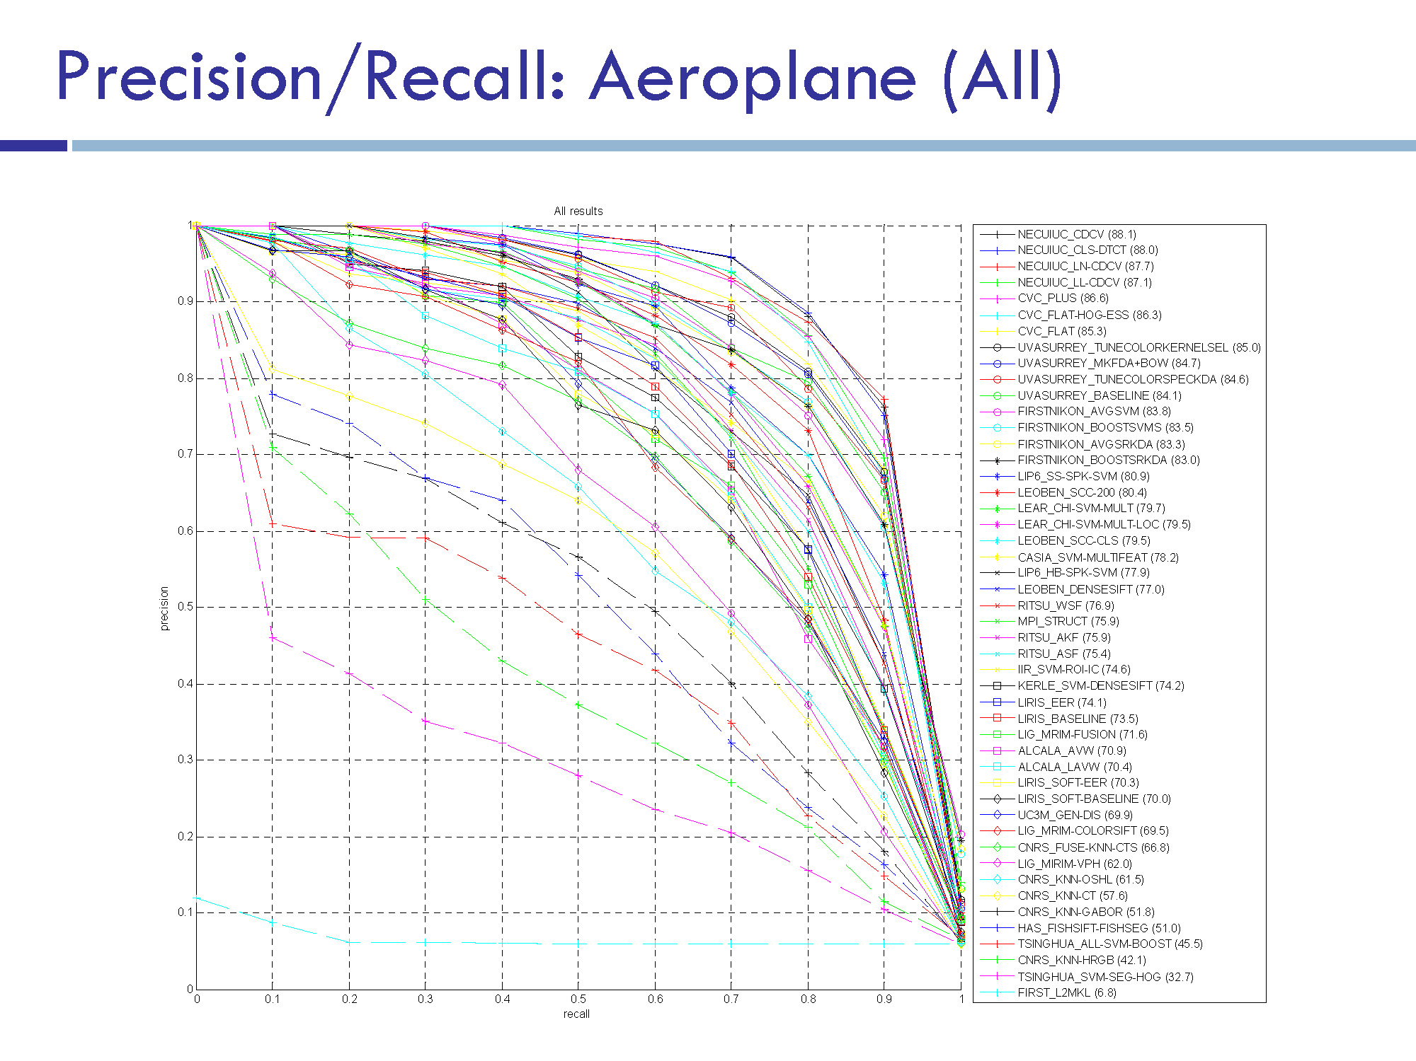

Slide 25
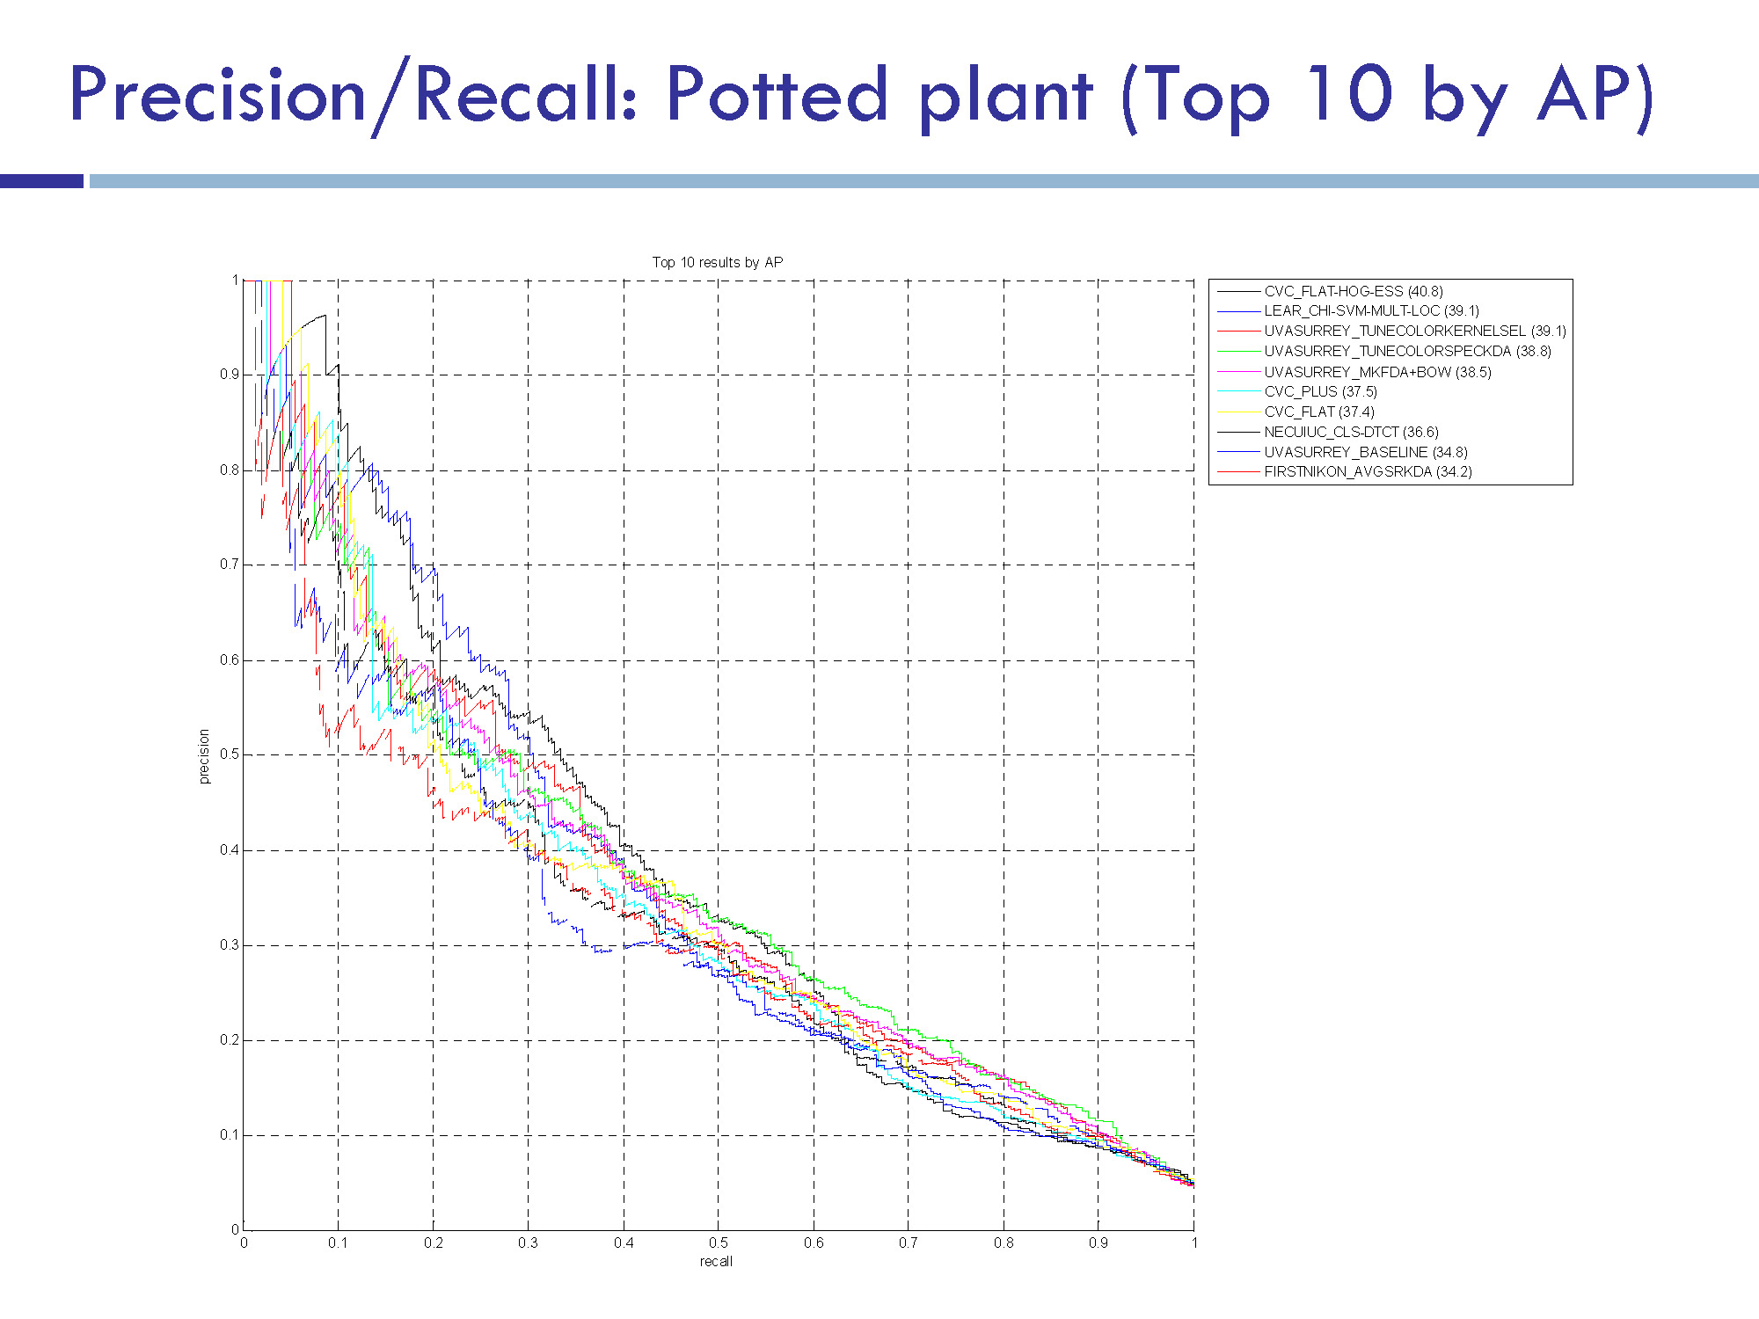

Slide 26
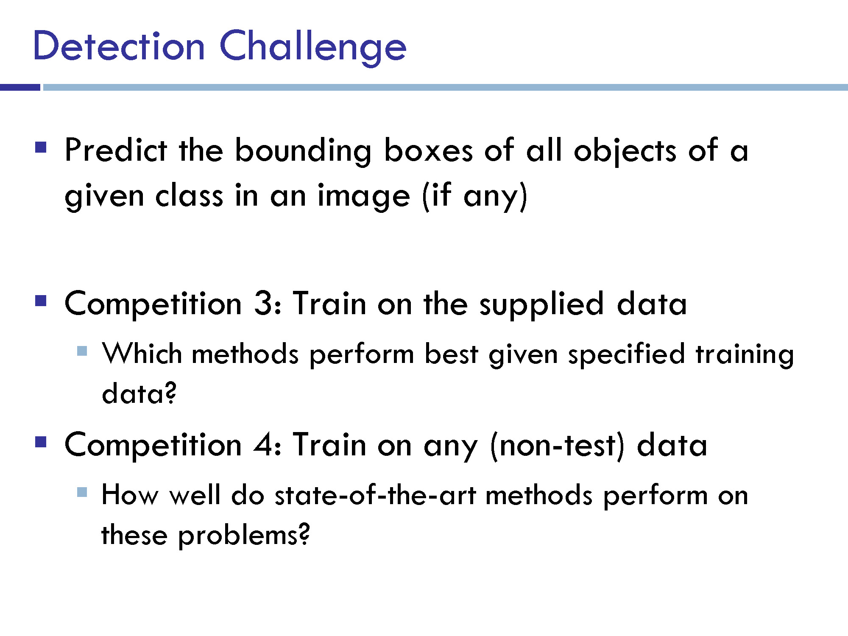
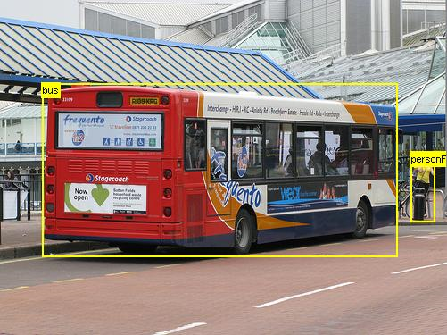

Slide 27
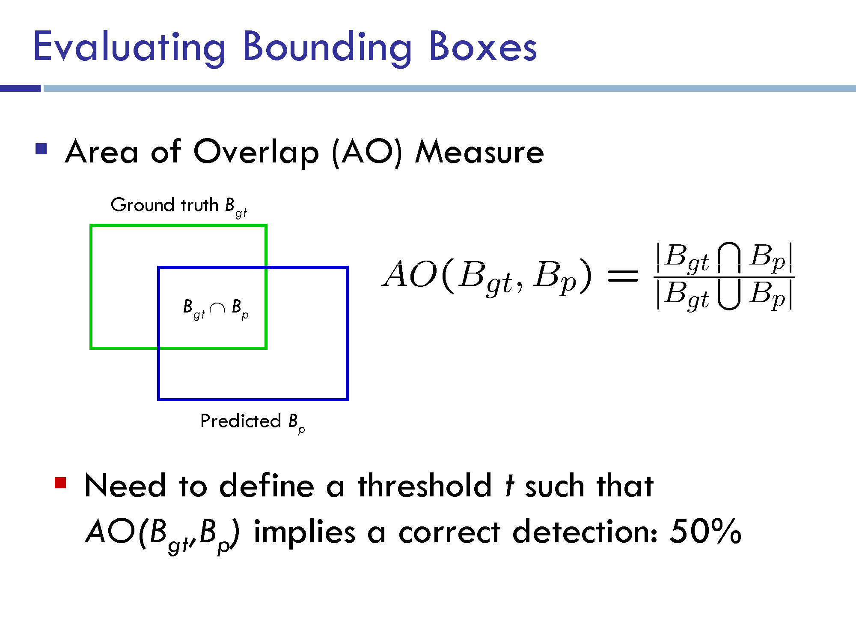

Slide 28
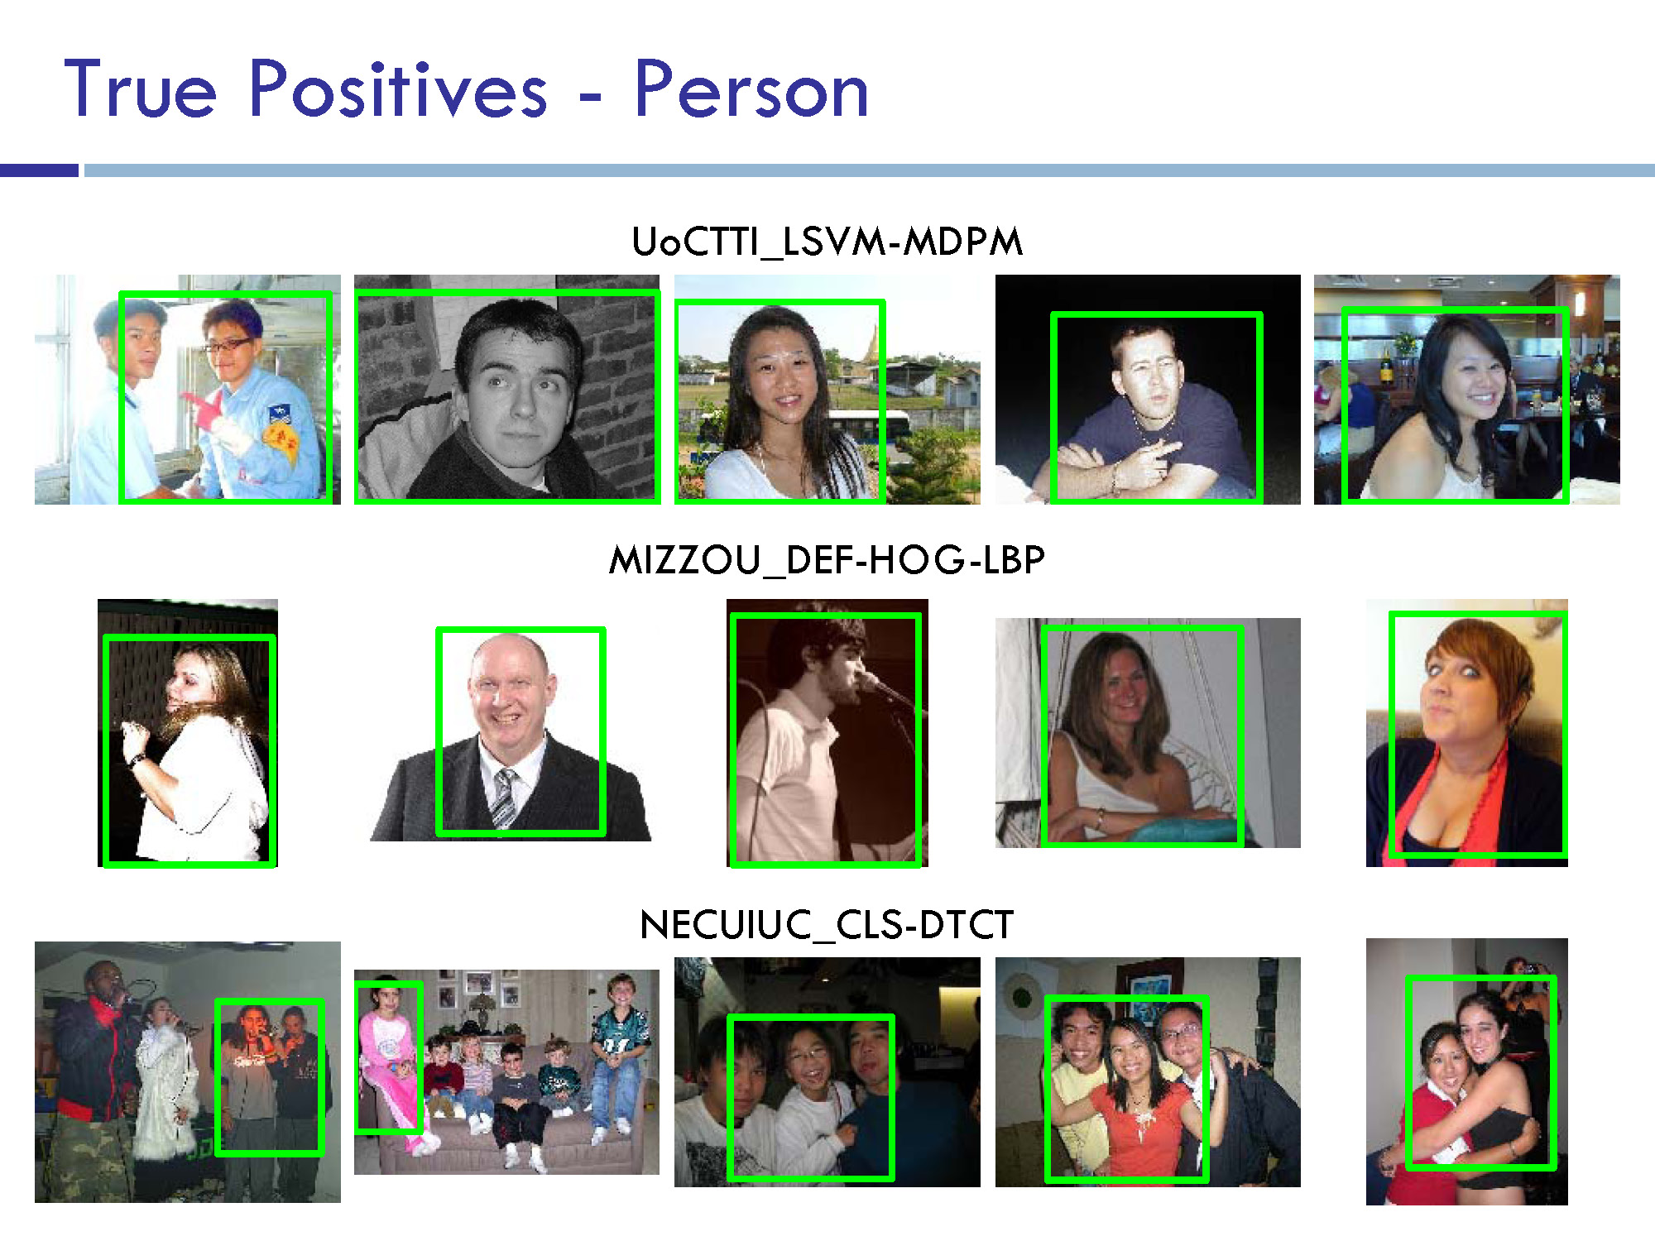

Slide 29
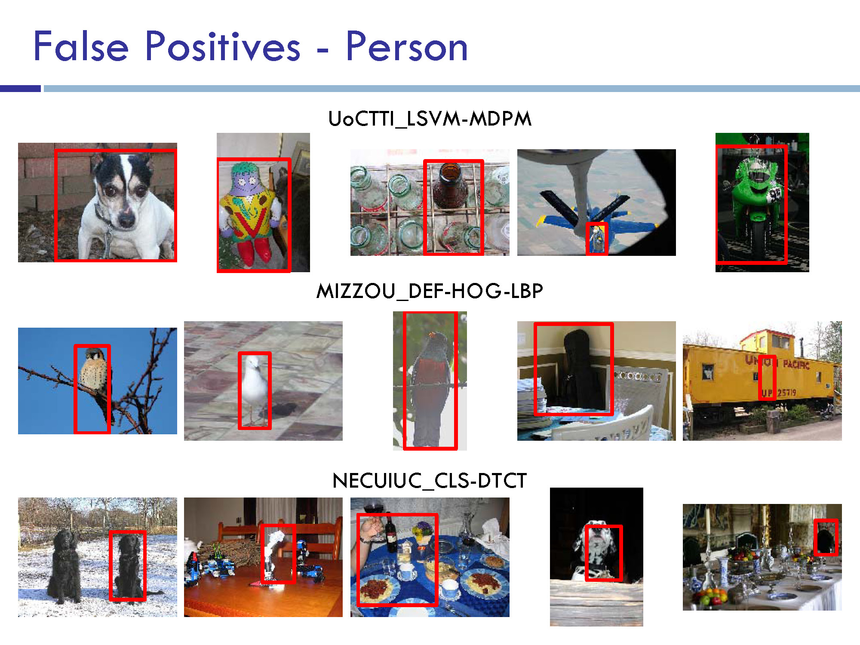

Slide 30
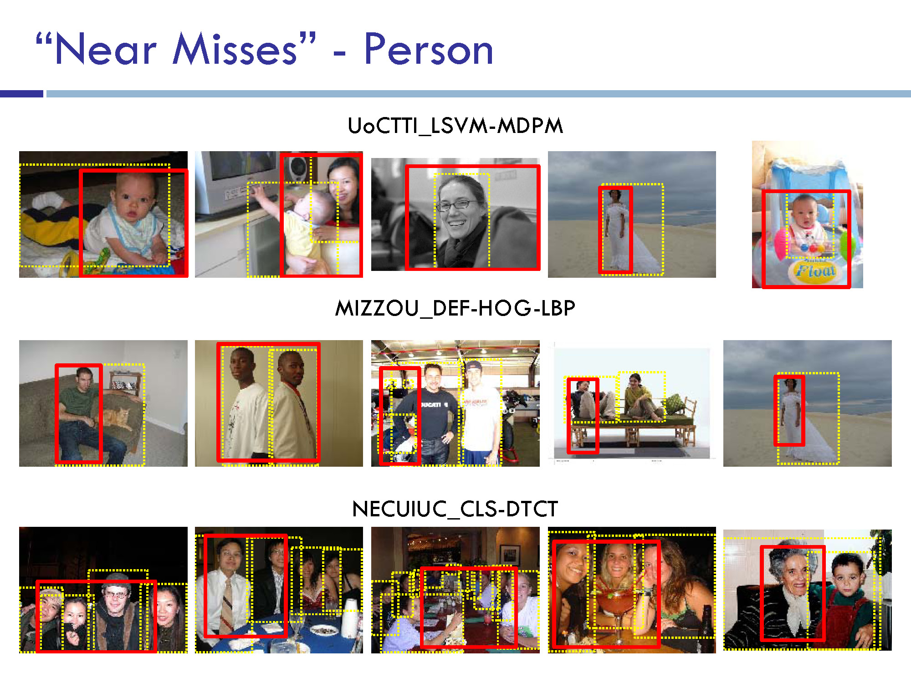

Slide 31
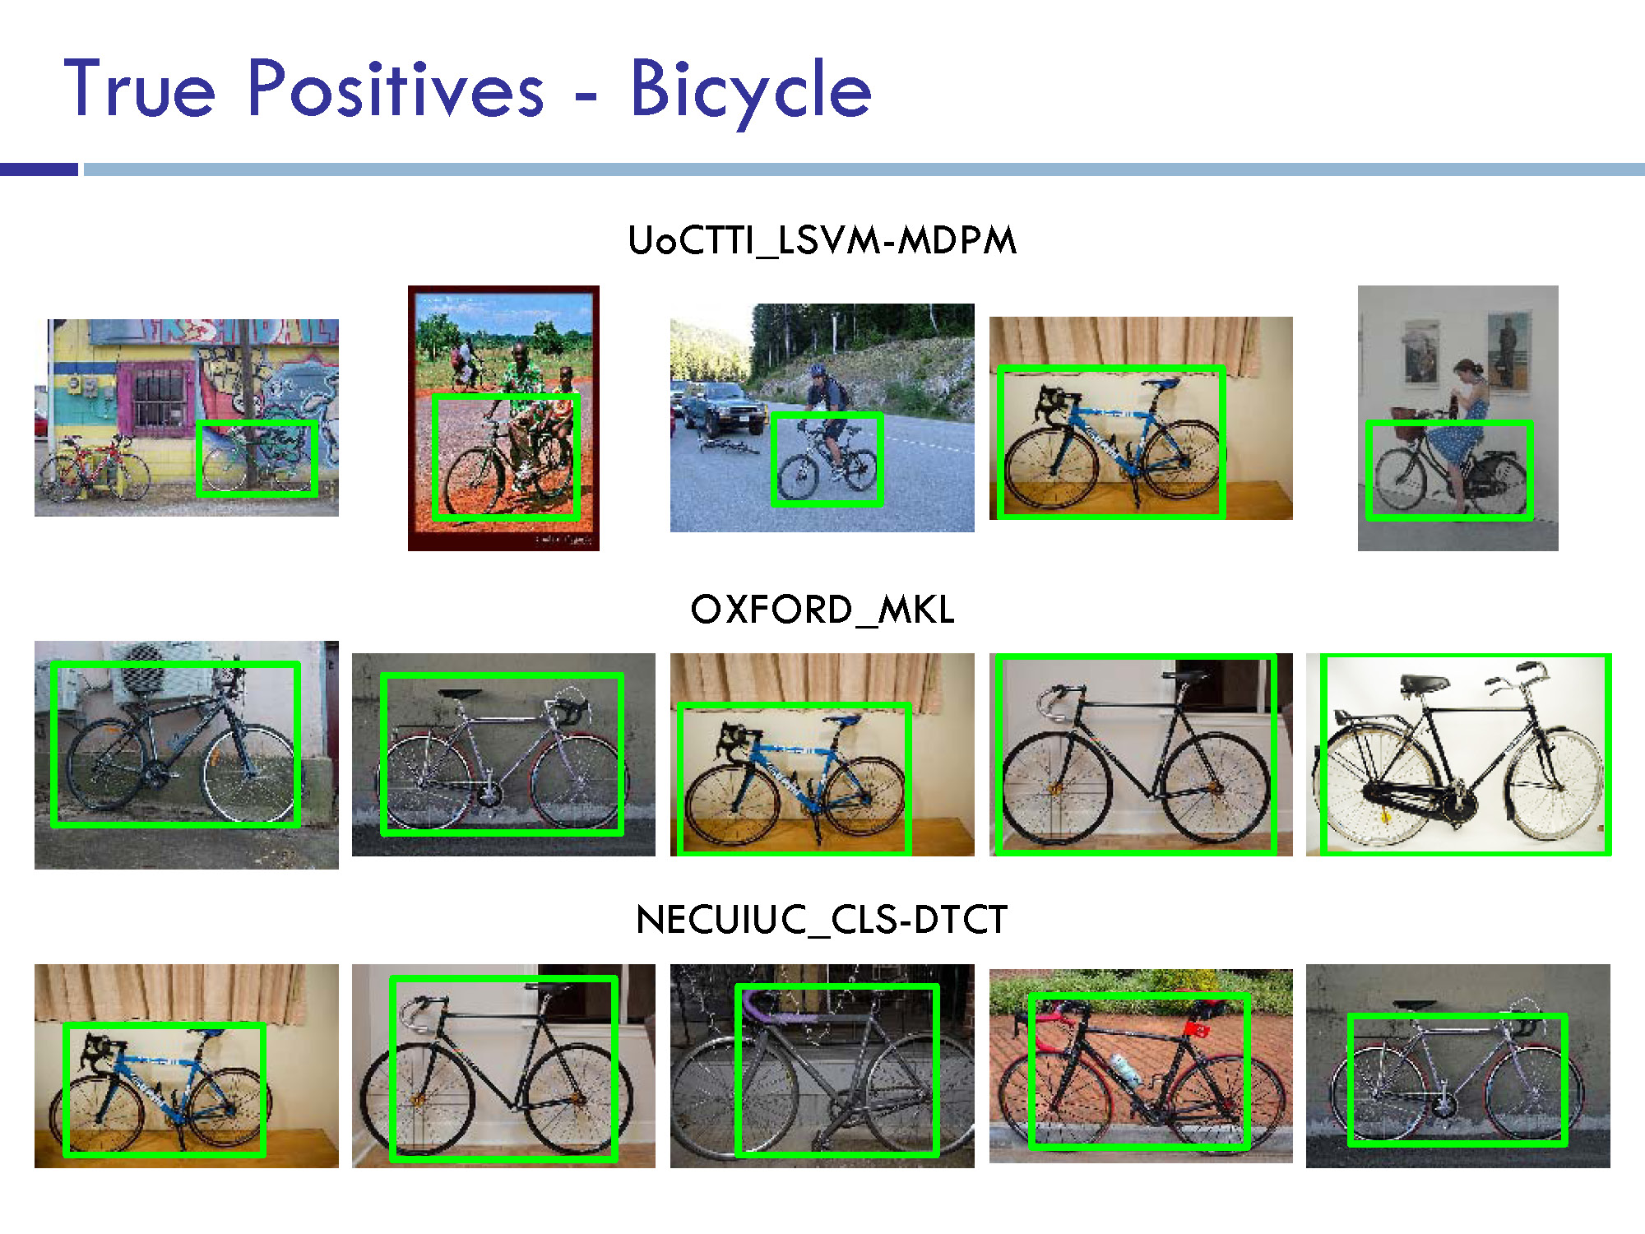

Slide 32
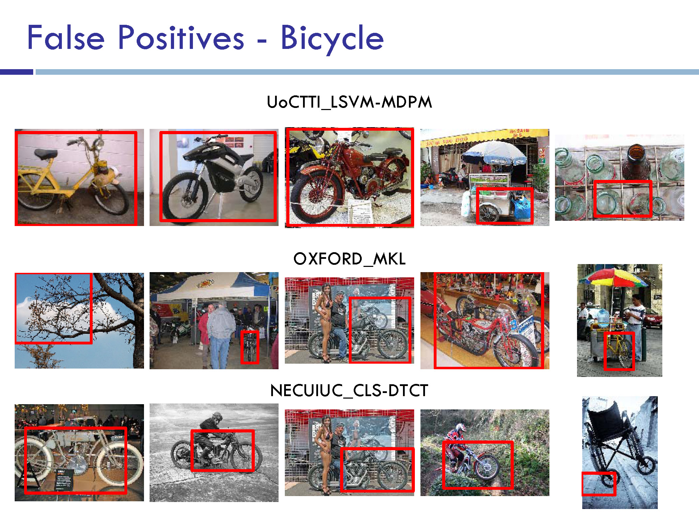

Slide 33
Where to from here?
Scene Understanding
  Big data – lots of images
  Crowd-sourcing – lots of people
  Deep Learning – lots of compute

Slide 34
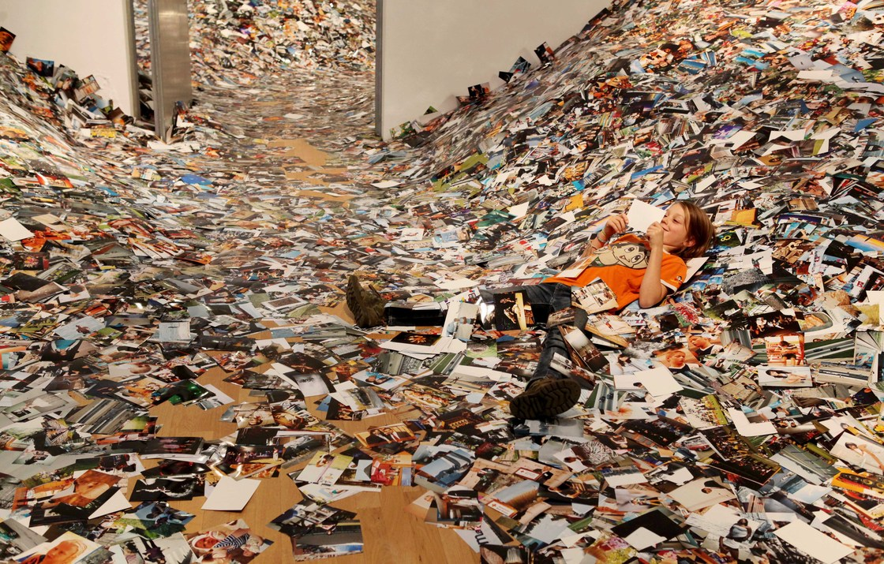
24 Hrs in Photos
http://www.kesselskramer.com/exhibitions/24-hrs-of-photos
installation by Erik Kessels

Slide 35
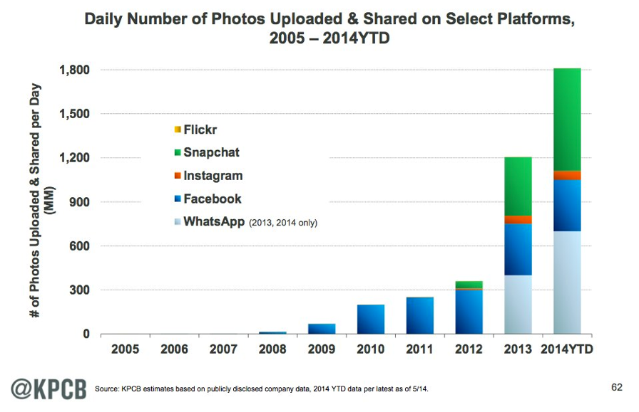

Slide 36


Slide 37
Data Sets
ImageNet
  Huge, Crowdsourced, Hierarchical, Iconic objects
PASCAL VOC
  Not Crowdsourced, bounding boxes, 20 categories
SUN Scene Database, Places
  Not Crowdsourced, 397 (or 720) scene categories
LabelMe (Overlaps with SUN)
  Sort of Crowdsourced, Segmentations, Open ended
SUN Attribute database (Overlaps with SUN)
  Crowdsourced, 102 attributes for every scene
OpenSurfaces
  Crowdsourced, materials
Microsoft COCO
  Crowdsourced, large-scale objects

Slide 38
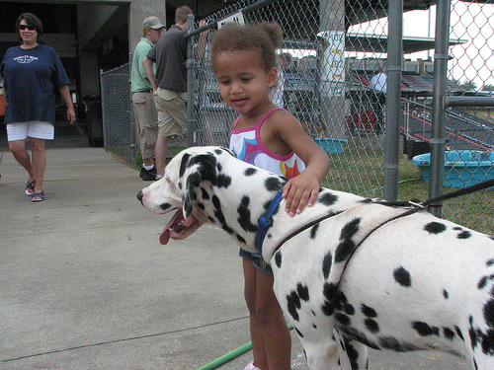
Large Scale Visual Recognition Challenge (ILSVRC) 2010-2012
20 object classes 22,591 images
1000 object classes 1,431,167 images
Dalmatian
http://image-net.org/challenges/LSVRC/{2010,2011,2012}

Slide 39
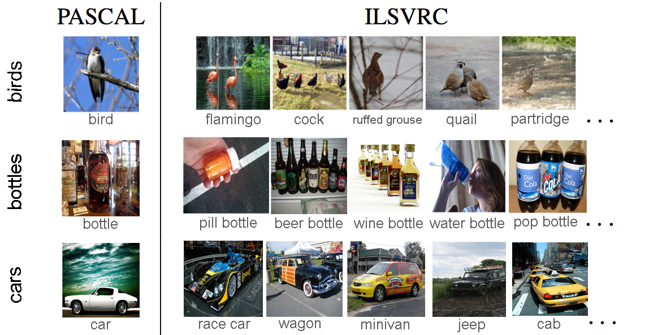
Variety of object classes in ILSVRC

Slide 40
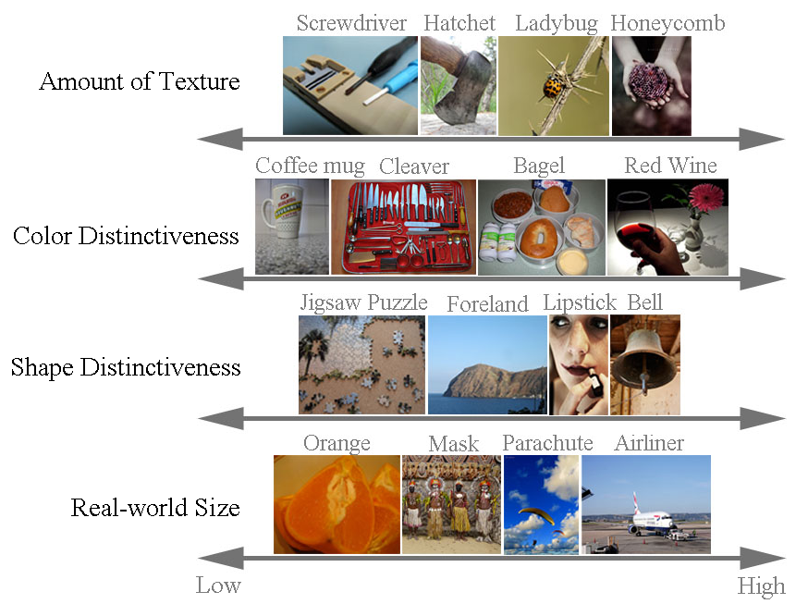
Variety of object classes in ILSVRC

Slide 41
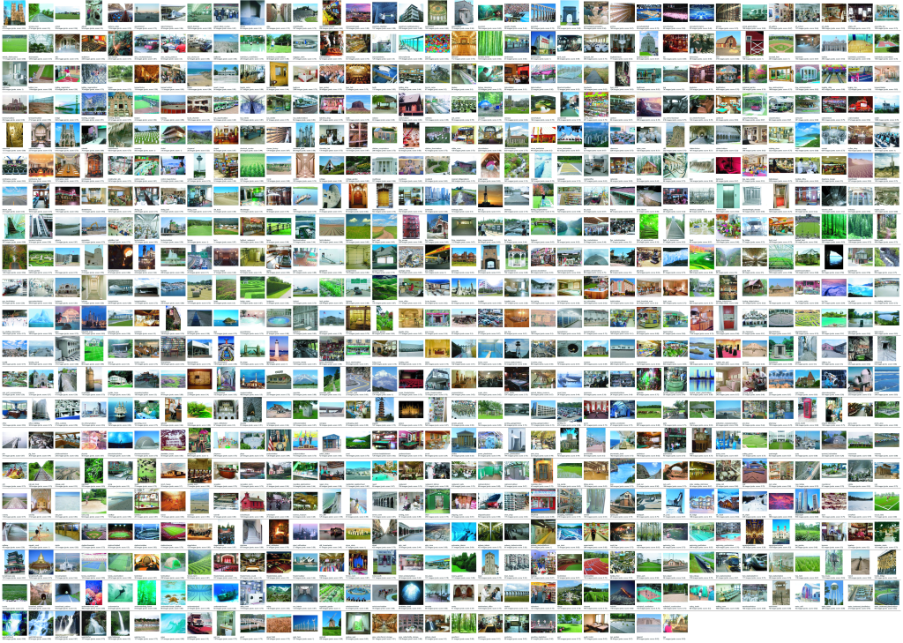
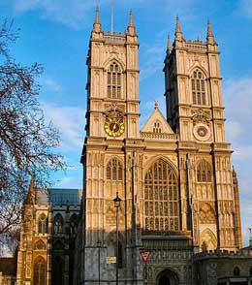
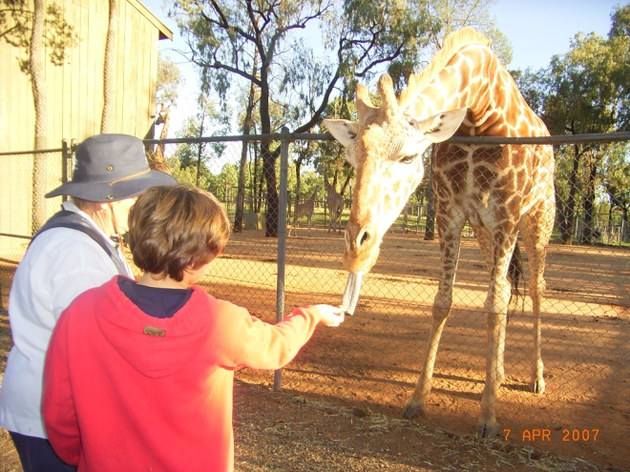
Notes:
899 categories from Abbey to Zoo
For each of those categories we perform keyword searches on the Internet to find candidate scenes, and manually filter each category according to strict guidelines (e.g. what distinguishes a pasture and a corral). We end up with 130, 519 images.
It turns out that, even with an Internet worth of imagery, some categories are sparsely sampled. For all the experiments in this talk, we used only the 397 well-sampled categories with at least 100 unique images.

Slide 42
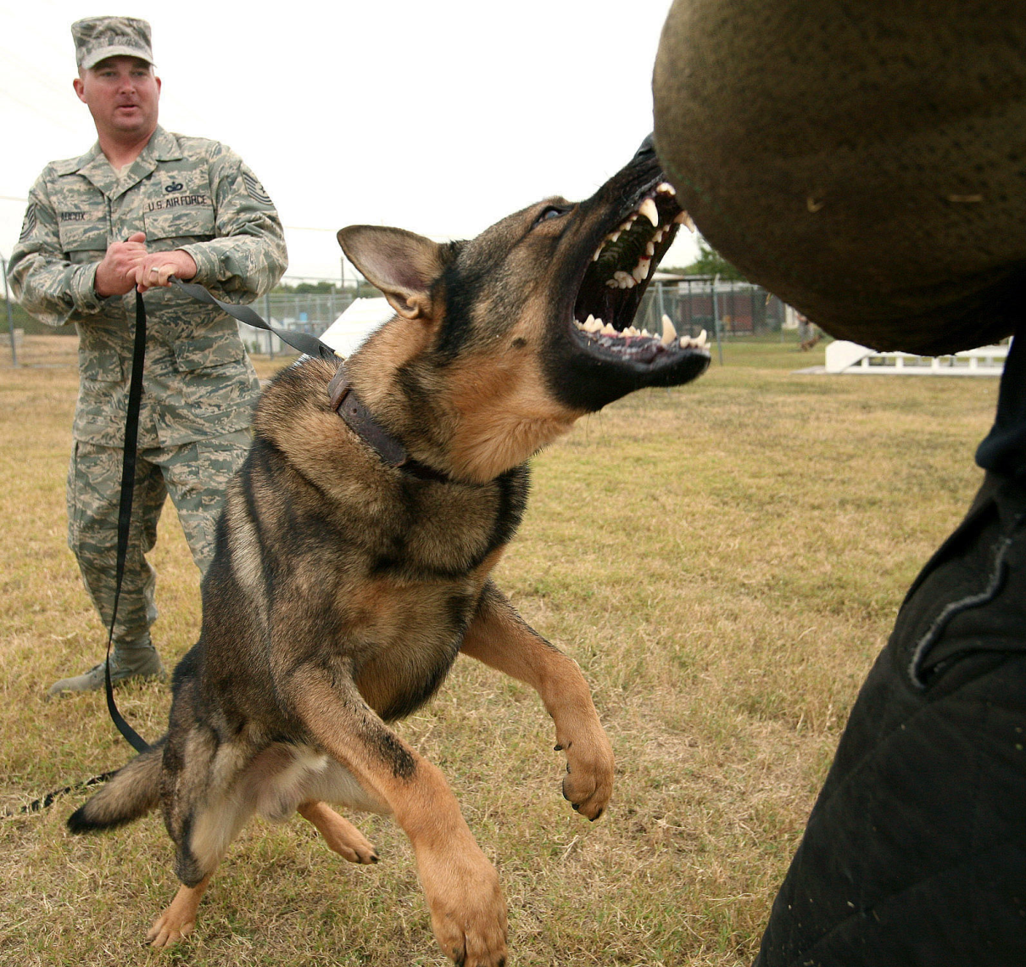
What are attributes?
What do we want to know about this object?
Object recognition expert:
“Dog”

Slide 43

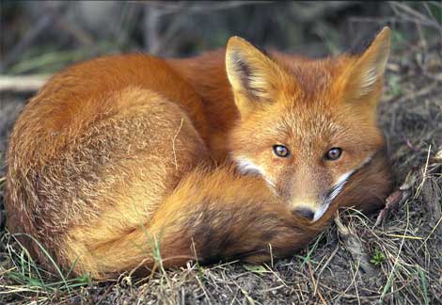

Next step: Infer object properties
Can I poke with it?
Can I put stuff in it?
Is it alive?
What shape is it?
Is it soft?
Does it have a tail?
Will it blend?

Slide 44
What are attributes?
What do we want to know about this object?
Object recognition expert:
“Dog”
Person in the Scene:
“Big pointy teeth”, “Can move fast”, “Looks angry”

Slide 45
Why infer properties
We want detailed information about objects
“Dog”
vs.
“Large, angry animal with pointy teeth”

Slide 46
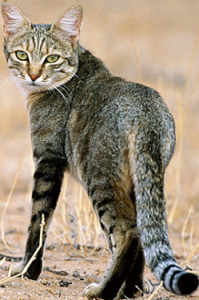
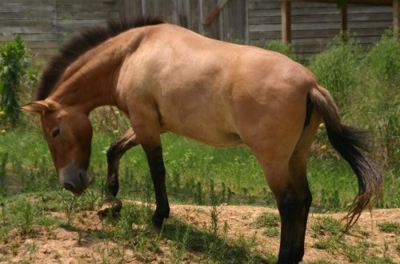
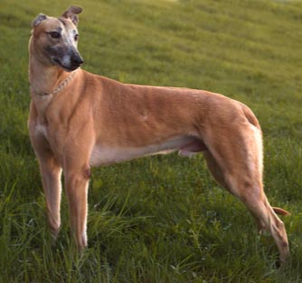
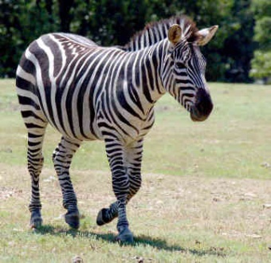
Why infer properties
2. We want to be able to infer something about unfamiliar objects
Familiar Objects
New Object

Slide 47
Why infer properties
2. We want to be able to infer something about unfamiliar objects
If we can infer properties…
Familiar Objects
New Object
Has Stripes
Has Ears
Has Eyes
….
Has Four Legs
Has Mane
Has Tail
Has Snout
….
Brown
Muscular
Has Snout
….
Has Stripes (like cat)
Has Mane and Tail (like horse)
Has Snout (like horse and dog)

Slide 48
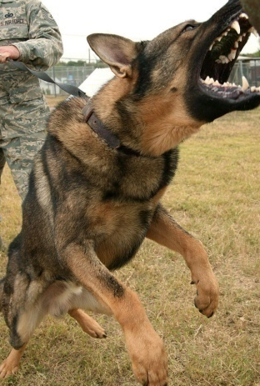


Why infer properties
3. We want to make comparisons between objects or categories
What is unusual about this dog?
What is the difference between horses and zebras?

Slide 49
Questions?

Slide 50
Where to from here?
Scene Understanding
  Big data – lots of images
  Crowd sourcing – lots of people
  Deep Learning – lots of compute

Slide 51


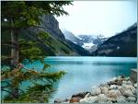

Image categorization
Training
Training Images
Training Labels
Image Features
Classifier Training
Trained Classifier

Slide 52
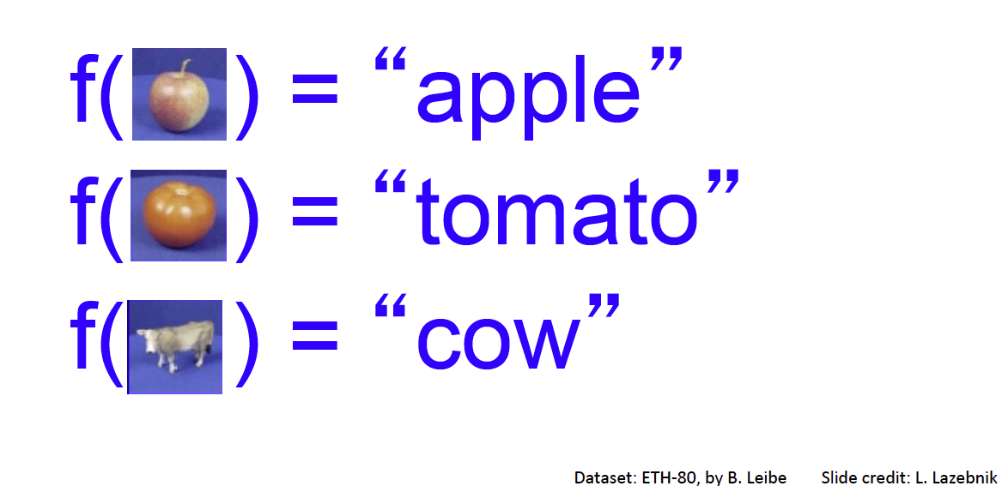
Categorization

Slide 53
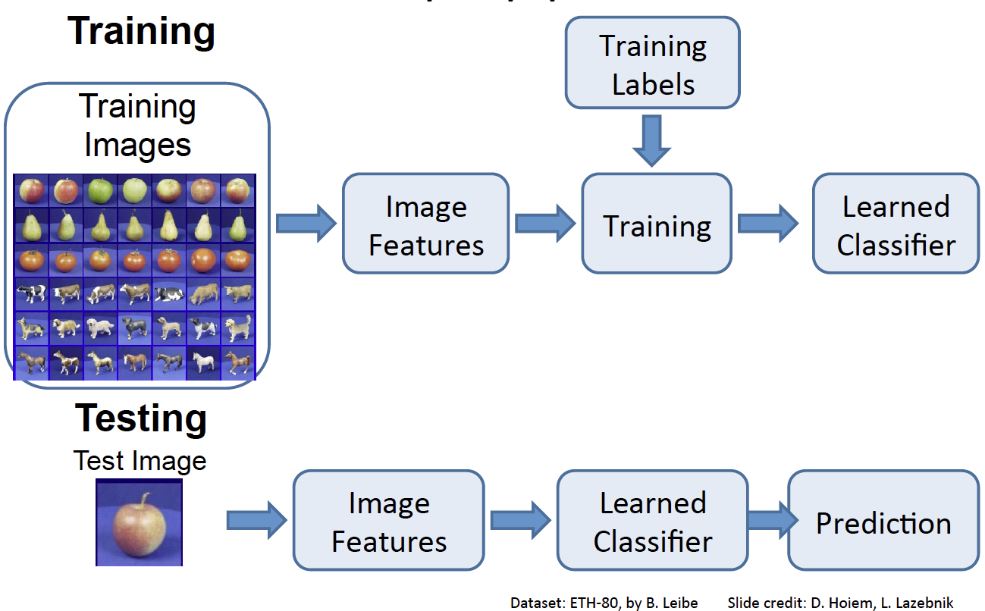

Slide 54
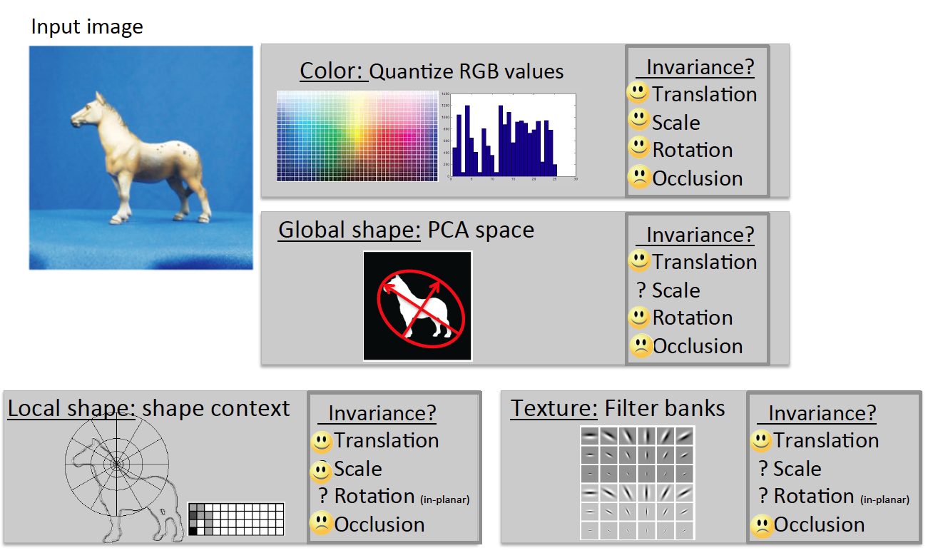

Slide 55
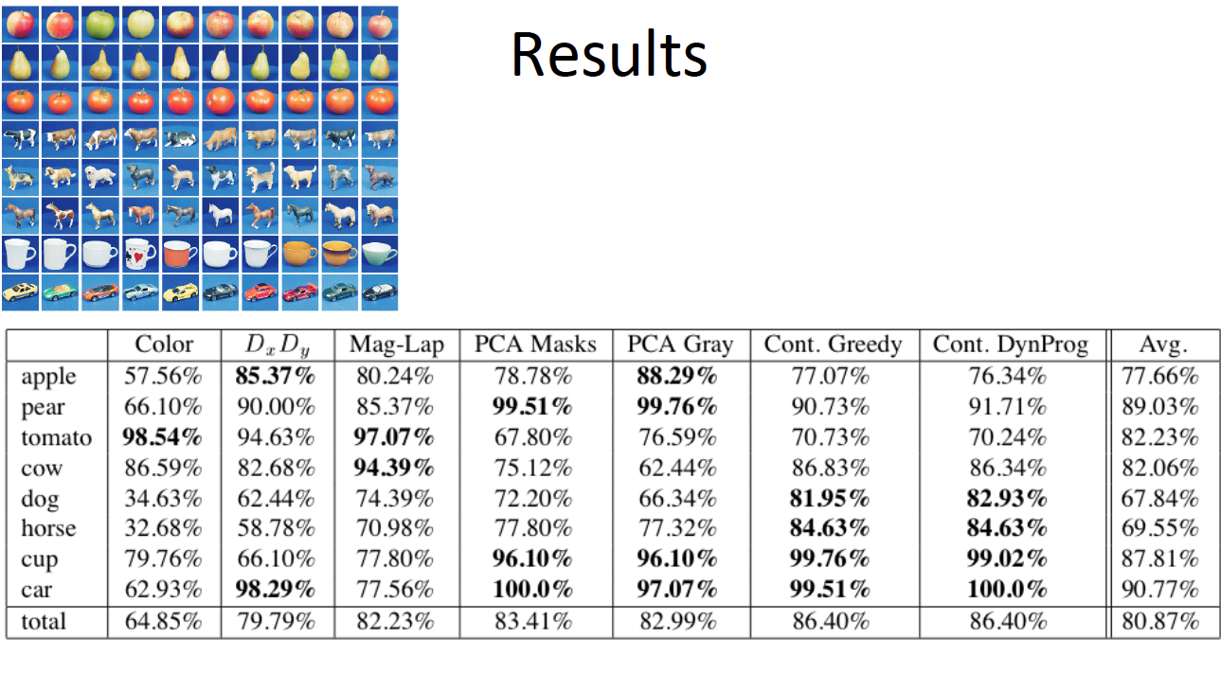

Slide 56

Image Categorization
Training
Training Images
Training Labels
Image Features
Classifier Training
Trained Classifier
Testing
Image Features
Trained Classifier
Prediction
Outdoor
Test Image

Slide 57

Crowdsourcing
Unlabeled Images
Show images,
Collect and filter labels
Training Labels
Training Images
Image Features
Classifier Training
Trained Classifier
Training

Slide 58
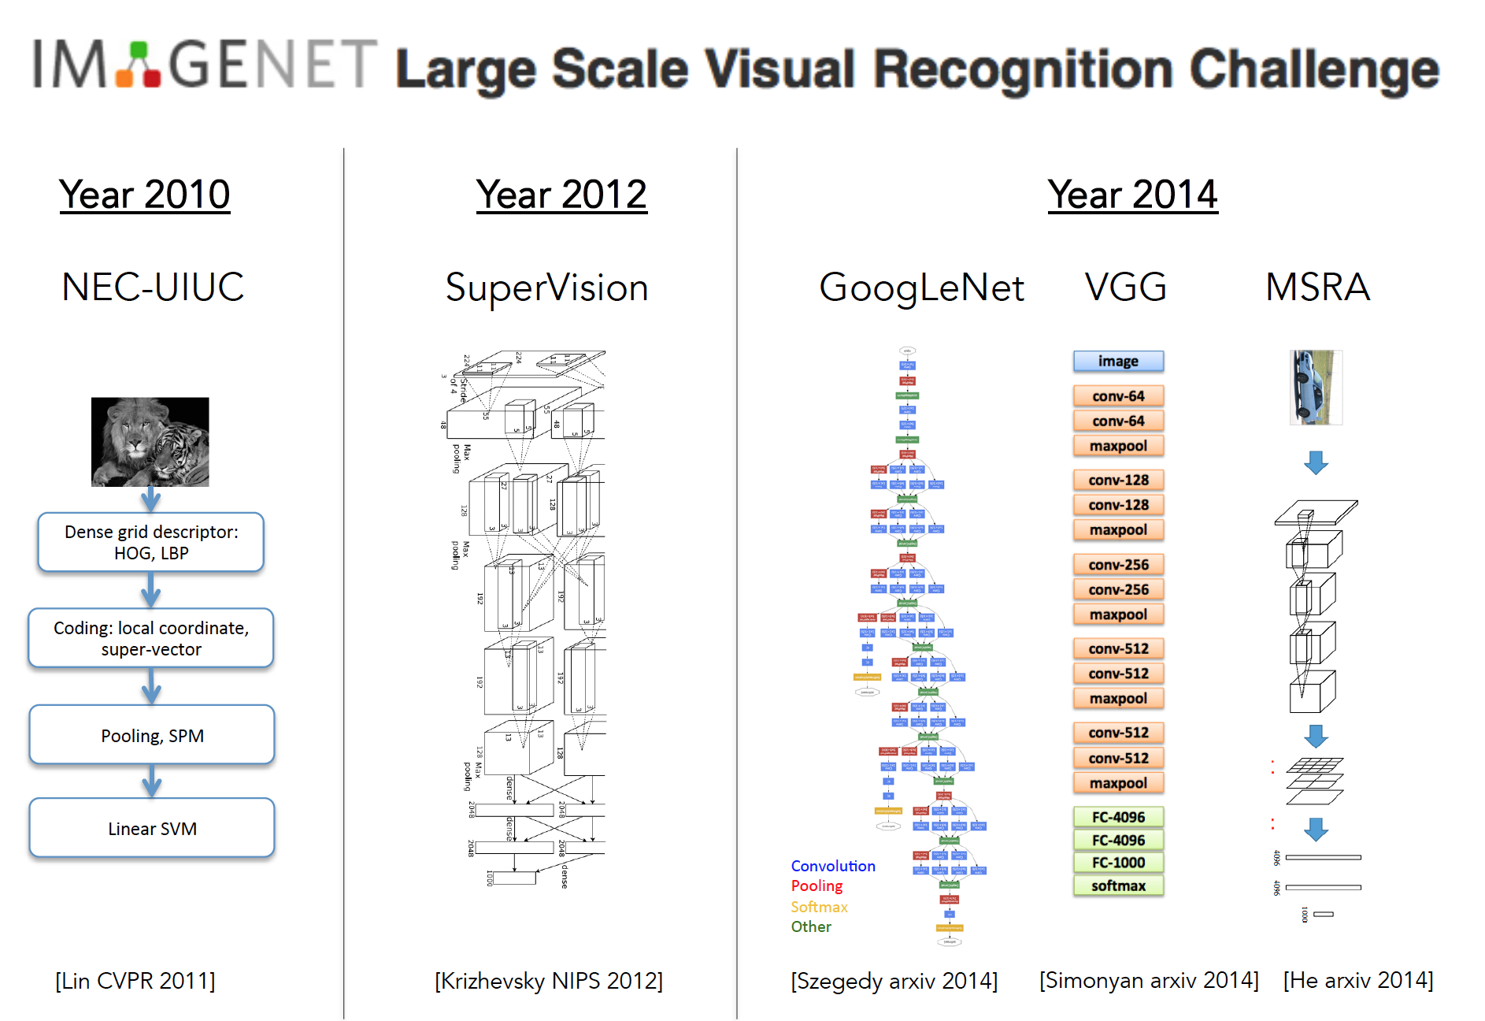

Slide 59
Deep Learning or CNNs
Since 2012, huge impact…, best results
Can soak up all the data for better prediction

