Slide 1
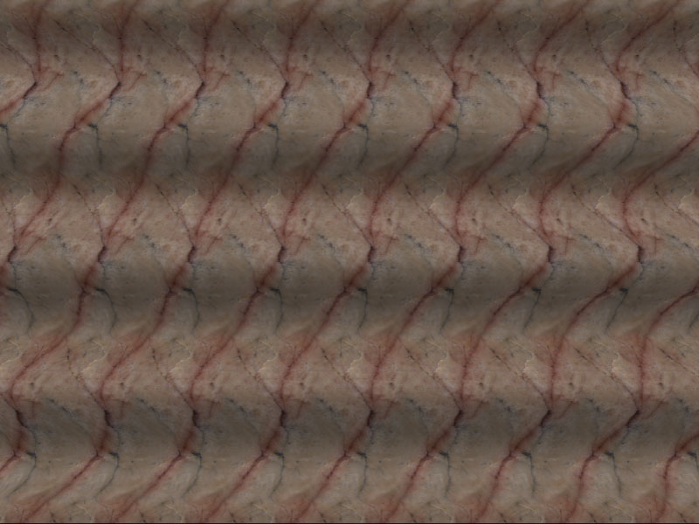
Stereo
CS5670: Computer Vision
Noah Snavely, Zhengqi Li
Single image stereogram, by Niklas Een

Slide 2
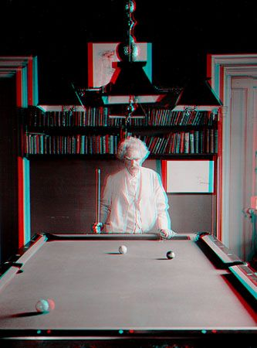
Mark Twain at Pool Table", no date, UCR Museum of Photography

Slide 3

Stereo
Given two images from different viewpoints
  How can we compute the depth of each point in the image?
  Based on how much each pixel moves between the two images
Notes:
Goal of Stereo is: Given two images from different viewpoints, how can we compute the depth for each pixel.

Slide 4
How do we get 3D from Stereo Images?
Perception of depth arises from “disparity” of a given 3D point in your right and left retinal images’
3D point
left image right image
disparity: the difference in image location of the same 3D
point when projected under perspective to two different cameras
d = xleft -xright

Slide 5
Recall :Perspective Projection
real image
This is the axis of the real image plane.
O is the center of projection.
point
E
O
camera lens
image of point B in front image
f
D
This is the axis of the front image plane, which we use.
z
x_{i}
x_{i} x f z
=
x
B
3D object point
(from similar triangles)
Z

Slide 6
Projection for Stereo Images
Simple Model: Optic axes of 2 cameras are parallel
image planes
z
camera L
f
Z
O
xl
baseline
camera R
b
f
xr
x-b
P=(x,z)
Y-axis is perpendicular to the page.
X
z f
x xl
z f
x-b z
xr f
y yl
y yr
=
=
=
=
(from similar triangles)

Slide 7
3D from Stereo Images: Triangulation
For stereo cameras with parallel optical axes, focal length f, baseline b, corresponding image points (xl,yl) and (xr,yr), the location of the 3D point can be derived from previous slide’s equations:
Depth z = f*b / (xl - xr) = f*b/d
This method of determining depth from disparity d is called triangulation.
x = xl*z/f or b + xr*z/f
y = yl*z/f or yr*z/f
Note that depth is inversely proportional to disparity

Slide 8
Depth z = f*b / (xl - xr) = f*b/d
x = xl*z/f or b + xr*z/f
y = yl*z/f or yr*z/f
Two main problems:
Need to know focal length f, baseline b
- use prior knowledge or camera calibration
(http://www.vision.caltech.edu/bouguetj/calib_doc)
Need to find corresponding point (xr,yr) for each (xl,yl) ⇒ Correspondence problem

Slide 9
Q: Given a point in the left image, do you need to search the entire right image for the corresponding point?

Slide 10
Epipolar Constraint for Correspondence
Epipolar plane = plane connecting C1, C2, and point P
P
y1
z1
z2
epipolar plane
y2
P1
x
P2
C1
b
C2
.
*Epipolar plane cuts through image planes forming an epipolar line in each plane
*Match for P1 (or P2) in the other image must lie on epipolar line

Slide 11
Epipolar Constraint for Correspondence
Match for P1 in the other image must lie on epipolar line So need search only along this line
P
P1
C1
b
C2
Epipolar line

Slide 12
What if the optical axes of the 2 cameras are not parallel to each other? Does Epipolar constraint still holds ?

Slide 13
Epipolar constraint still holds…
P
e1 and e2 are the epipolar lines for point P
y1
y2
P2
x2
P1
e2
e1
x1
C1
C2
But the epipolar lines may no longer be horizontal
Java demo: http://www.ai.sri.com/~luong/research/Meta3DViewer/EpipolarGeo.html

Slide 14
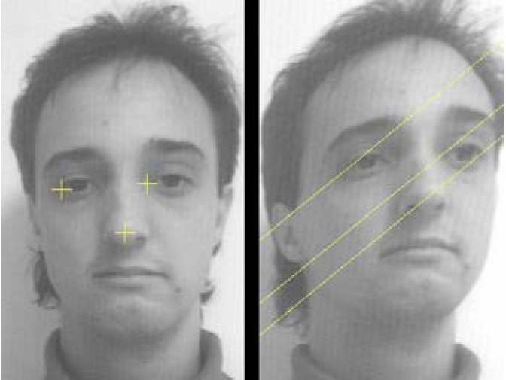
Example
Yellow epipolar lines for the three points shown on the left image
(from a slide by Pascal Fua)
Given a point P1 in left image on epipolar line e1, can find epipolar line e2 provided we know relative orientations of cameras ⇒ Requires camera calibration (see lecture 5)

Slide 15

Alternate approach: Stereo image rectification
Reproject image planes onto a common
plane parallel to the line between optical centers
Epipolar line is horizontal after this transformation
Two homographies (3x3 transforms), one for each input image reprojection, is computed. See:
C. Loop and Z. Zhang. Computing Rectifying Homographies for Stereo Vision. IEEE Conf. Computer Vision and Pattern Recognition, 1999.

Slide 16
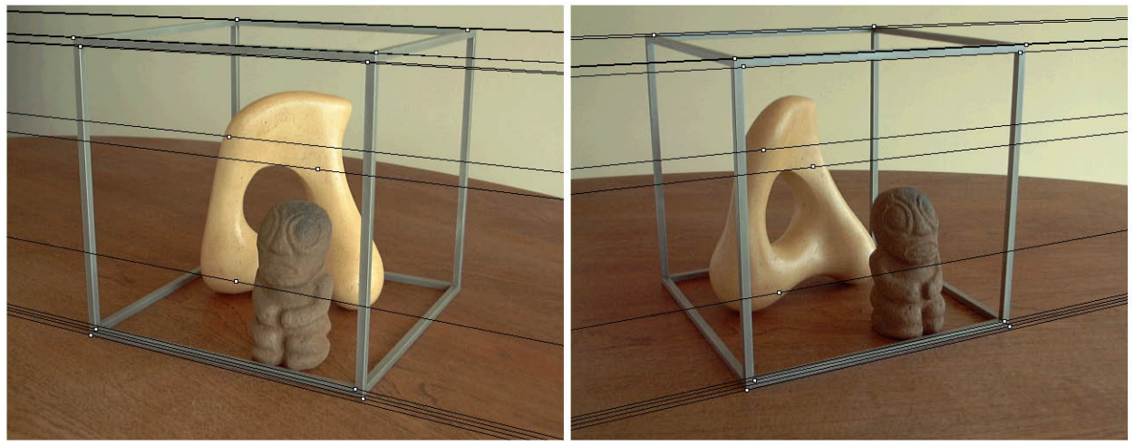
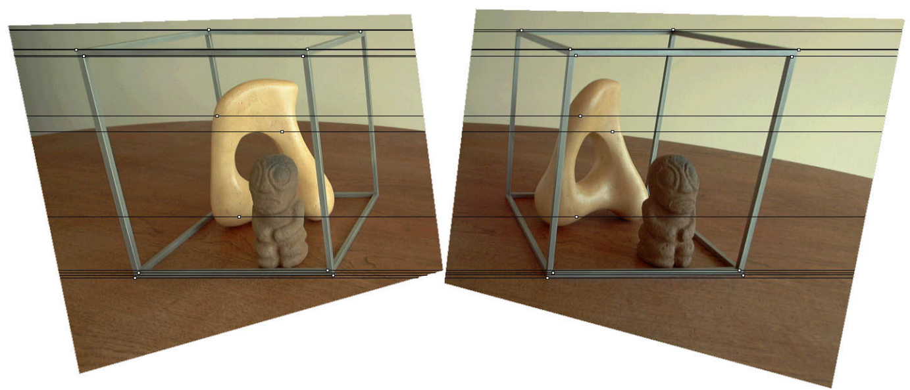
Original stereo pair
After rectification

Slide 17
Epipolar geometry
epipolar lines
(x₁, y₁)
(x₂, y₁)
Two images captured by a purely horizontal translating camera
(rectified stereo pair)
x₁ –x₂ = the disparity of pixel (x₁, y₁)

Slide 18
Stereo matching algorithms
Match Pixels in Conjugate Epipolar Lines
  Assume brightness constancy
  This is a tough problem
  Numerous approaches
    A good survey and evaluation: http://www.middlebury.edu/stereo/

Slide 19
Your basic stereo algorithm
For each epipolar line
For each pixel in the left image
    compare with every pixel on same epipolar line in right image
    pick pixel with minimum match cost
Improvement: match windows
Notes:
How do we define the match cost?

Slide 20
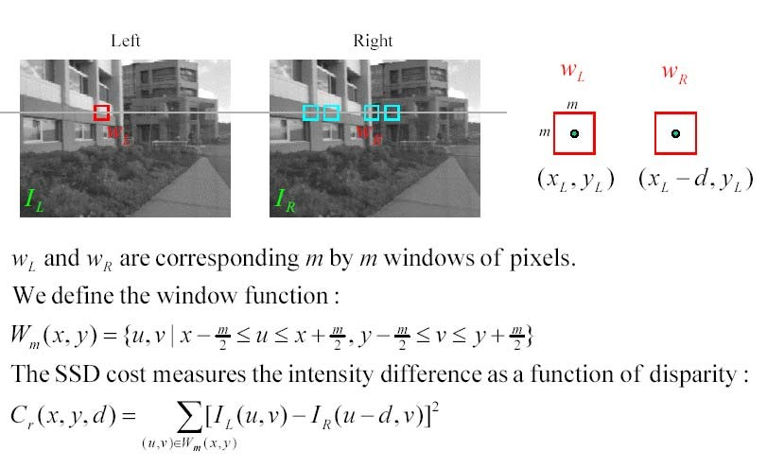
Matching using Sum of Squared Differences (SSD)

Slide 21
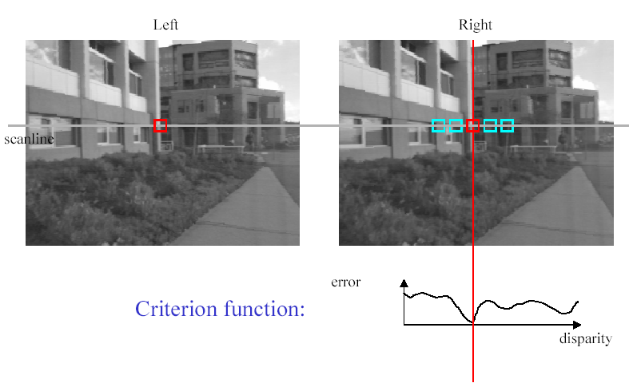
Stereo matching based on SSD
SSD
^{d}min d
Best matching disparity

Slide 22


Window size
W = 3
W = 21
Effect of window size
Better results with adaptive window
  T. Kanade and M. Okutomi, A Stereo Matching Algorithm with an Adaptive Window: Theory and Experiment,, Proc. International Conference on Robotics and Automation, 1991.
  D. Scharstein and R. Szeliski. Stereo matching with nonlinear diffusion. International Journal of Computer Vision, 28(2):155-174, July 1998
  Smaller window
  Larger window
Notes:
smaller window: more detail, more noise
bigger window: less noise, more detail

Slide 23
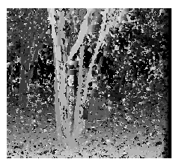
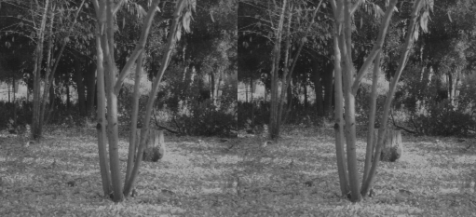
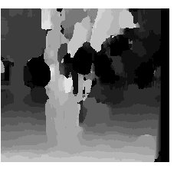
Problems with window size
Input stereo pair
W = 3
Effect of window size W
Smaller window
+ Good precision, more detail
– Sensitive to noise
Larger window
+ Robust to noise
– Reduced precision, less detail
W = 21

Slide 24


Stereo results
  Data from University of Tsukuba
  Similar results on other images without ground truth
Scene
Ground truth

Slide 25


Results with window search
Window-based matching
(best window size)
Ground truth

Slide 26

Better methods exist...
State of the Art method
  Boykov et al., Fast Approximate Energy Minimization via Graph Cuts,
  International Conference on Computer Vision, September 1999.
Ground truth
    For the latest and greatest: http://www.middlebury.edu/stereo/

Slide 27
Stereo as energy minimization
What defines a good stereo correspondence?
  Match quality
    Want each pixel to find a good match in the other image
  Smoothness
    If two pixels are adjacent, they should (usually) move about the same amount

Slide 28

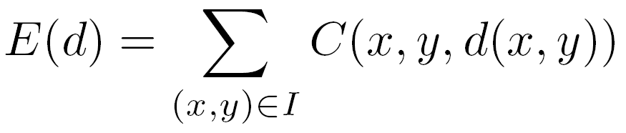

Stereo as energy minimization
Find disparity map d that minimizes an energy function
Simple pixel / window matching
=
SSD distance between windows I(x, y) and J(x + d(x,y), y)

Slide 29
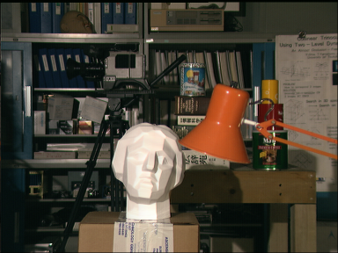
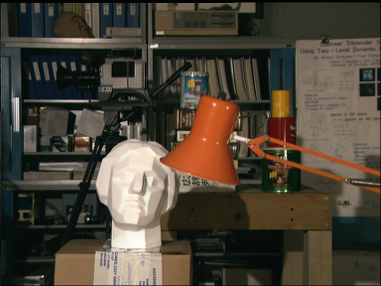
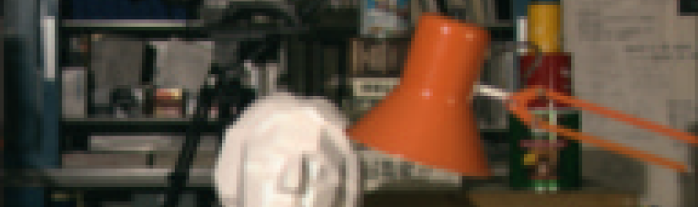
Stereo as energy minimization
I(x, y)
J(x, y)
y = 141
d
x
C(x, y, d); the disparity space image (DSI)

Slide 30
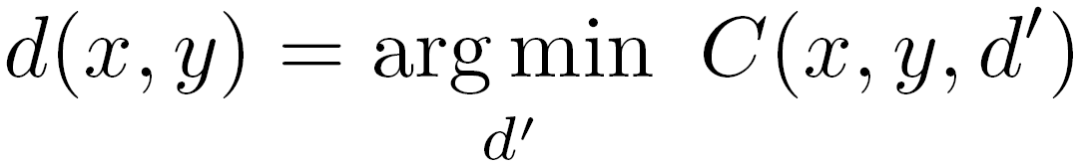
Stereo as energy minimization
y = 141
d
x
Simple pixel / window matching: choose the minimum of each column in the DSI independently:

Slide 31
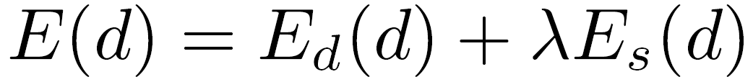
Stereo as energy minimization
Better objective function
{
{
match cost
smoothness cost
    Want each pixel to find a good match in the other image
    Adjacent pixels should (usually) move about the same amount

Slide 32
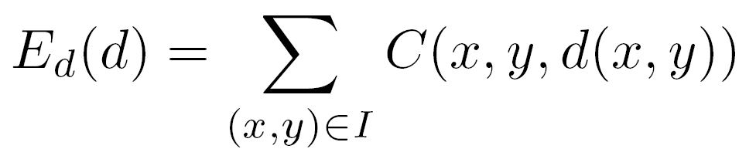
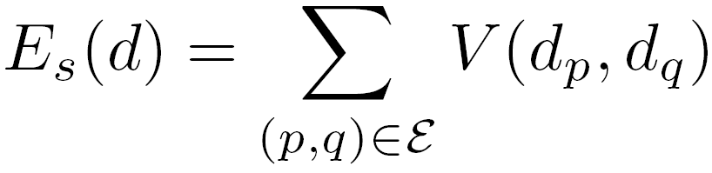

Stereo as energy minimization
match cost:
smoothness cost:
: set of neighboring pixels
4-connected neighborhood
8-connected neighborhood

Slide 33
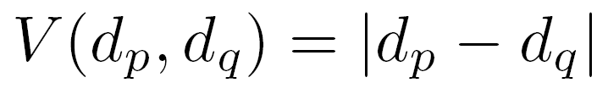
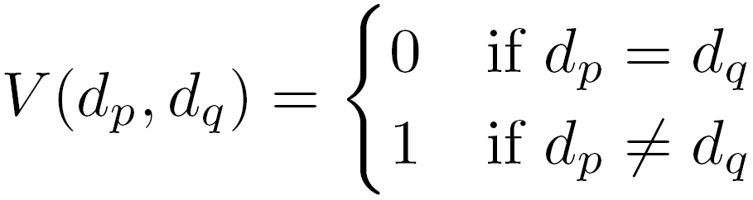
Smoothness cost
How do we choose V?
L₁ distance
“Potts model”

Slide 34

Dynamic programming
Can minimize this independently per scanline using dynamic programming (DP)
: minimum cost of solution such that d(x,y) = d

Slide 35
Dynamic programming
y = 141
d
x
Finds “smooth” path through DPI from left to right

Slide 36
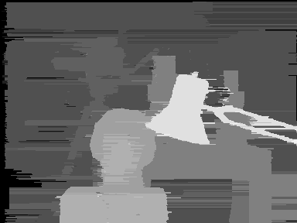
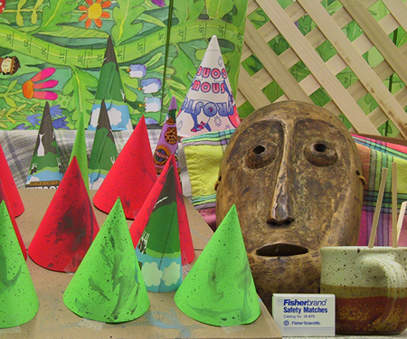
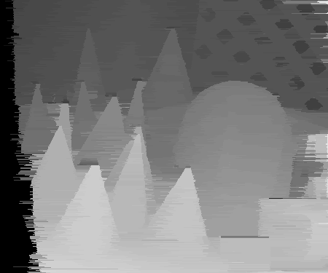
Dynamic Programming

Slide 37
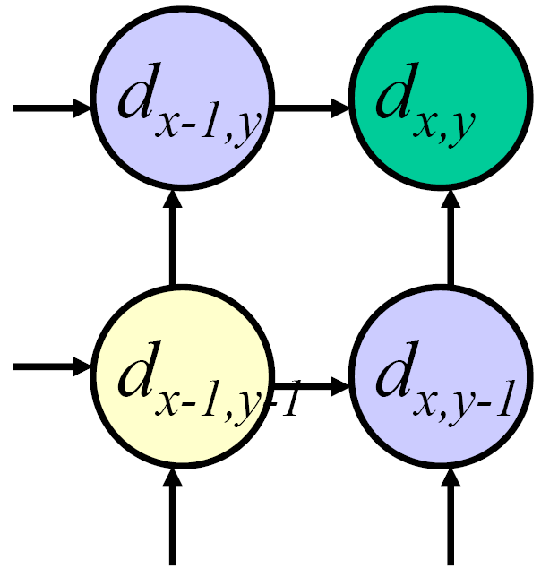
Dynamic programming
Can we apply this trick in 2D as well?
No: d_{x,y-1} and d_{x-1,y} may depend on different values of d_{x-1,y-1}
Slide credit: D. Huttenlocher

Slide 38
Stereo as a minimization problem
The 2D problem has many local minima
  Gradient descent doesn’t work well
And a large search space
  n x m image w/ k disparities has k^{nm} possible solutions
  Finding the global minimum is NP-hard in general
Good approximations exist… we’ll see this soon

Slide 39
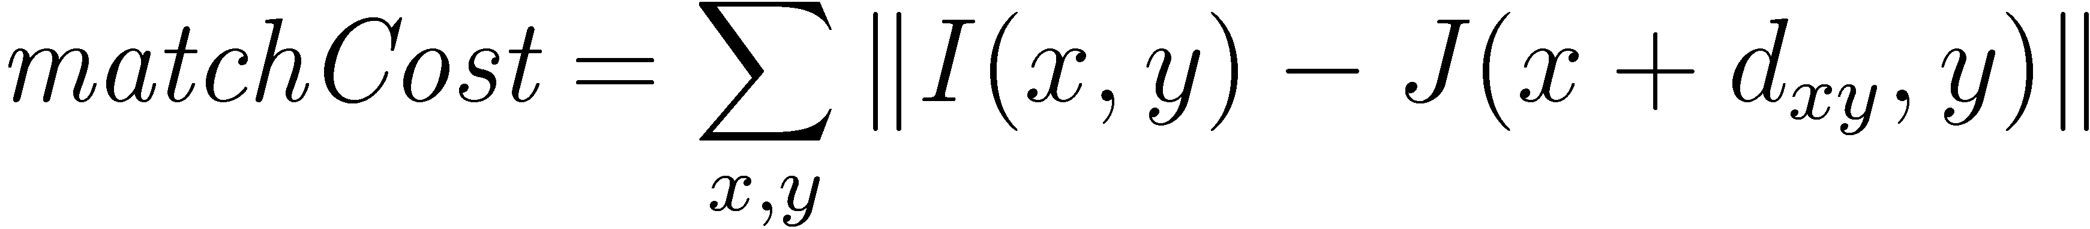
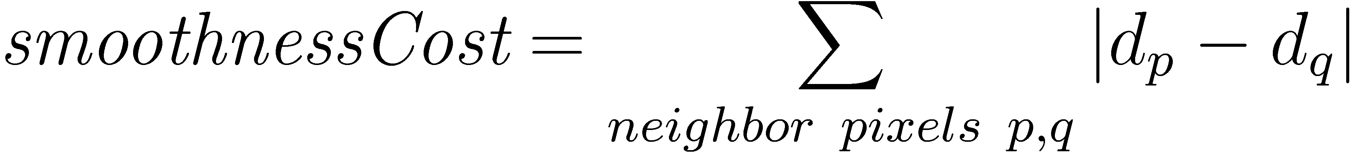
Stereo as energy minimization
Expressing this mathematically
  Match quality
    Want each pixel to find a good match in the other image
  Smoothness
    If two pixels are adjacent, they should (usually) move about the same amount
We want to minimize
  This is a special type of energy function known as an
  MRF (Markov Random Field)
    Effective and fast algorithms have been recently developed:
      Graph cuts, belief propagation….
      for more details (and code): http://vision.middlebury.edu/MRF/
      Great tutorials available online (including video of talks)

Slide 40
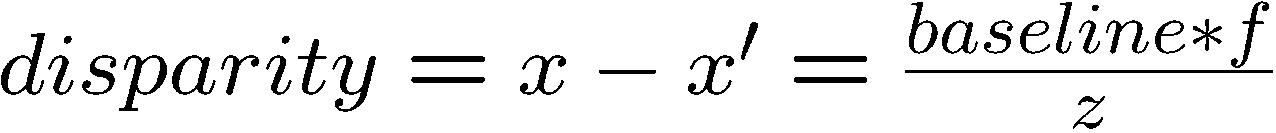
Depth from disparity
X
z
x
x’
f
f
C
baseline
C’

Slide 41
Questions?

Slide 42
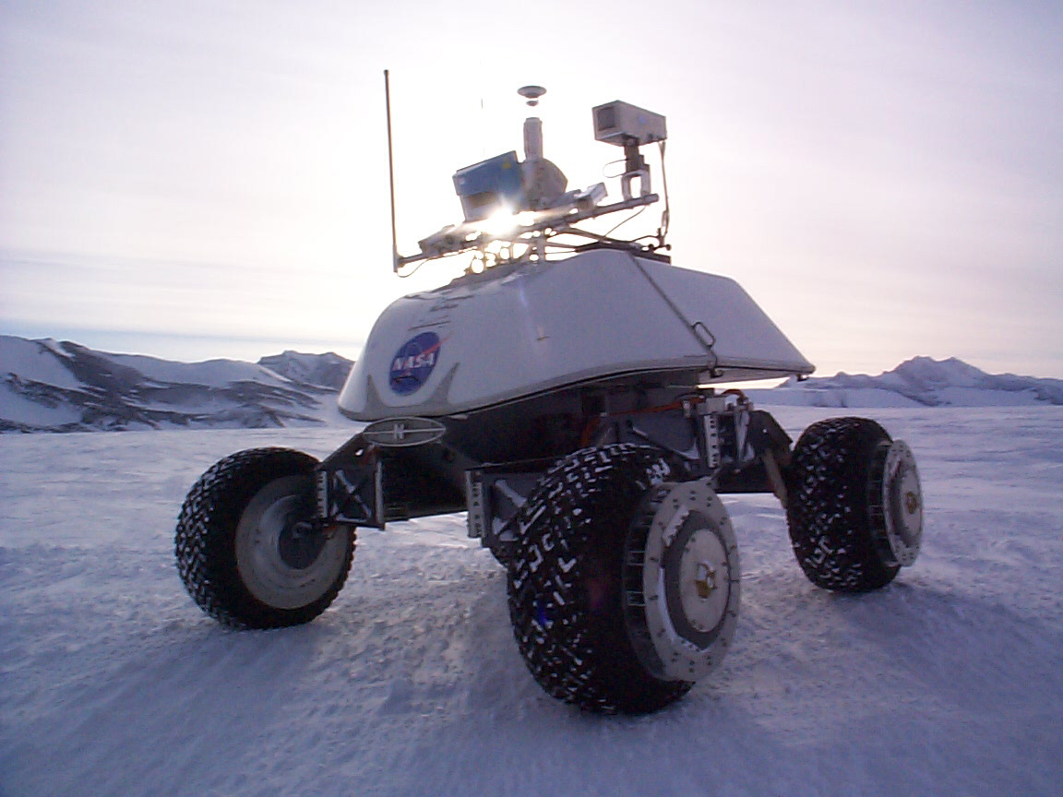
Real-time stereo
Nomad robot searches for meteorites in Antartica
  http://www.frc.ri.cmu.edu/projects/meteorobot/index.html
Used for robot navigation (and other tasks)
  Several software-based real-time stereo techniques have been developed (most based on simple discrete search)

Slide 43
Stereo reconstruction pipeline
Steps
  Calibrate cameras
  Rectify images
  Compute disparity
  Estimate depth
  Camera calibration errors
  Poor image resolution
  Occlusions
  Violations of brightness constancy (specular reflections)
  Large motions
  Low-contrast image regions
What will cause errors?

Slide 44
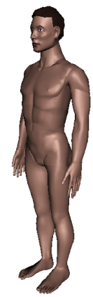
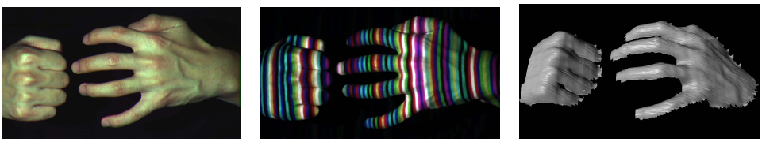
Active stereo with structured light
Li Zhang’s one-shot stereo
camera 1
camera 1
projector
projector
camera 2
Project “structured” light patterns onto the object
  simplifies the correspondence problem

Slide 45
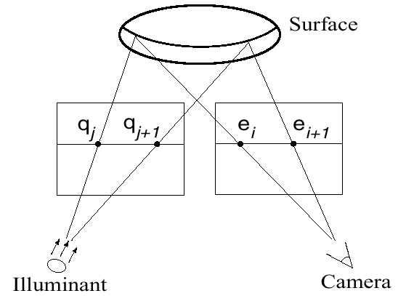
Active stereo with structured light

Slide 46

Laser scanning
Digital Michelangelo Project
http://graphics.stanford.edu/projects/mich/
Optical triangulation
  Project a single stripe of laser light
  Scan it across the surface of the object
  This is a very precise version of structured light scanning

Slide 47

Laser scanned models
  The Digital Michelangelo Project, Levoy et al.

Slide 48
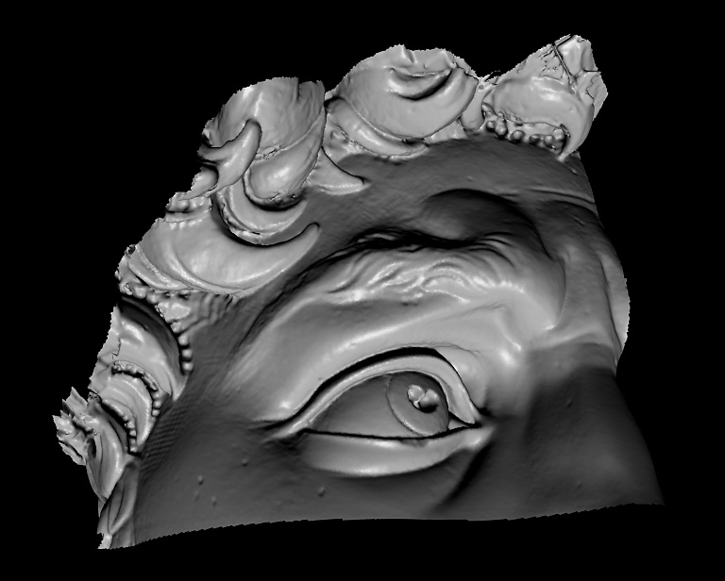
Laser scanned models
  The Digital Michelangelo Project, Levoy et al.

Slide 49
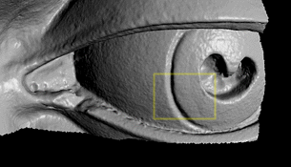
Laser scanned models
  The Digital Michelangelo Project, Levoy et al.

Slide 50
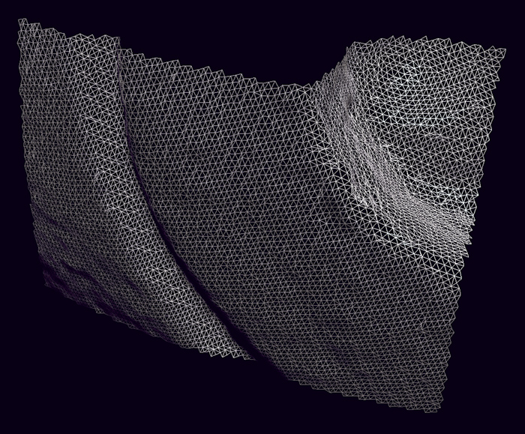
Laser scanned models
  The Digital Michelangelo Project, Levoy et al.

