Slide 1
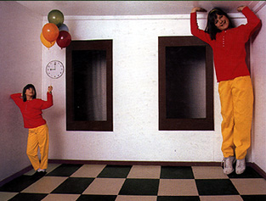
Single-View Modeling
CS5670: Computer Vision
Noah Snavely

Slide 2
Announcements
Midterm to be handed out at the end of class
  Due on Tuesday (March 21) by 1pm (beginning of class).
  No late exams accepted
Project 3 to be released after midterm (possibly next week)

Slide 3










Projection matrix recap
=
0
(in homogeneous image coordinates)

Slide 4
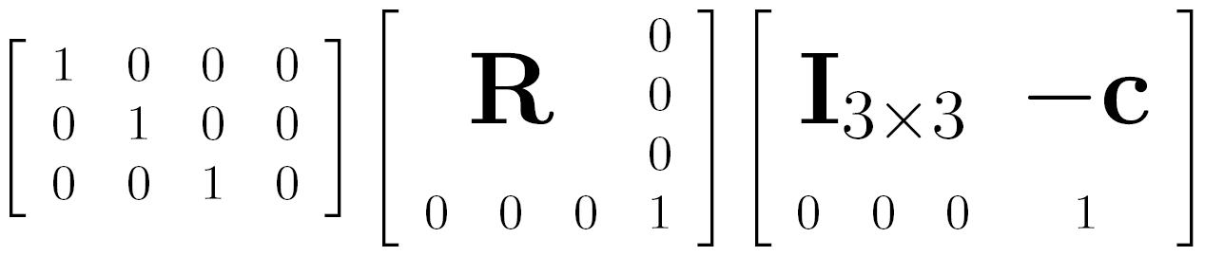


Projection matrix recap
intrinsics
projection
rotation
translation
This part converts 3D points in world coordinates to 3D rays in the camera’s coordinate system
The K matrix converts 3D rays in the camera’s coordinate system to 2D image points in image (pixel) coordinates

Slide 5
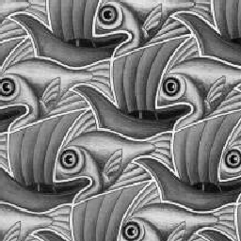
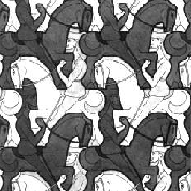
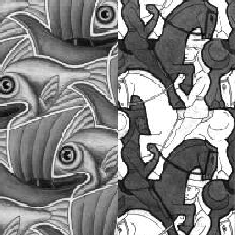
Image Blending

Slide 6

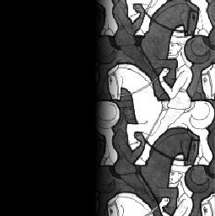

Feathering
+
1
1
0
0
=

Slide 7
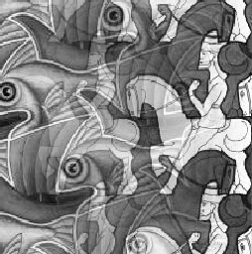
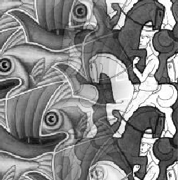
Effect of window size
1
left
1
right
0
0

Slide 8


Effect of window size
1
1
0
0

Slide 9

Good window size
1
0
“Optimal” window: smooth but not ghosted
  Doesn’t always work...

Slide 10
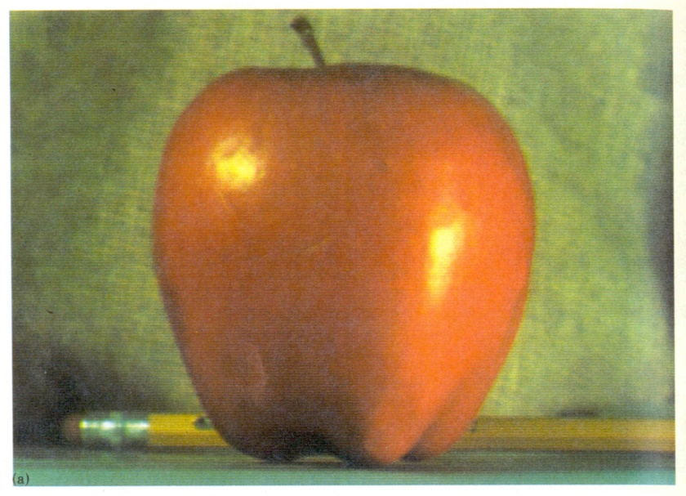
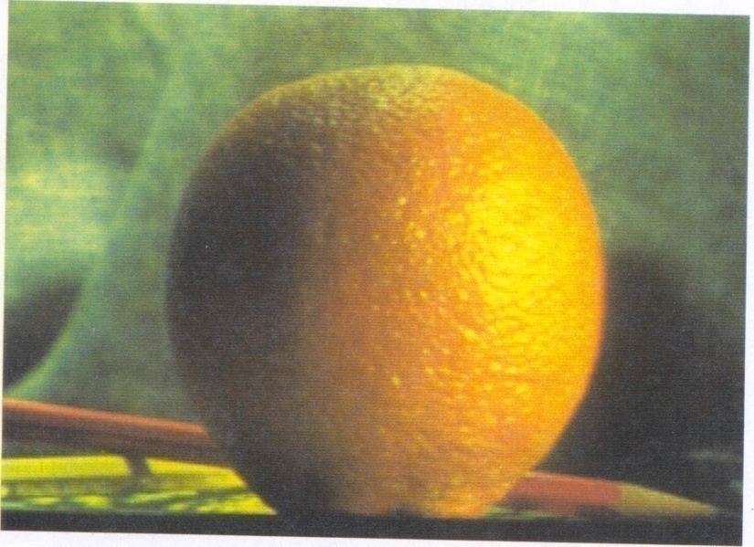
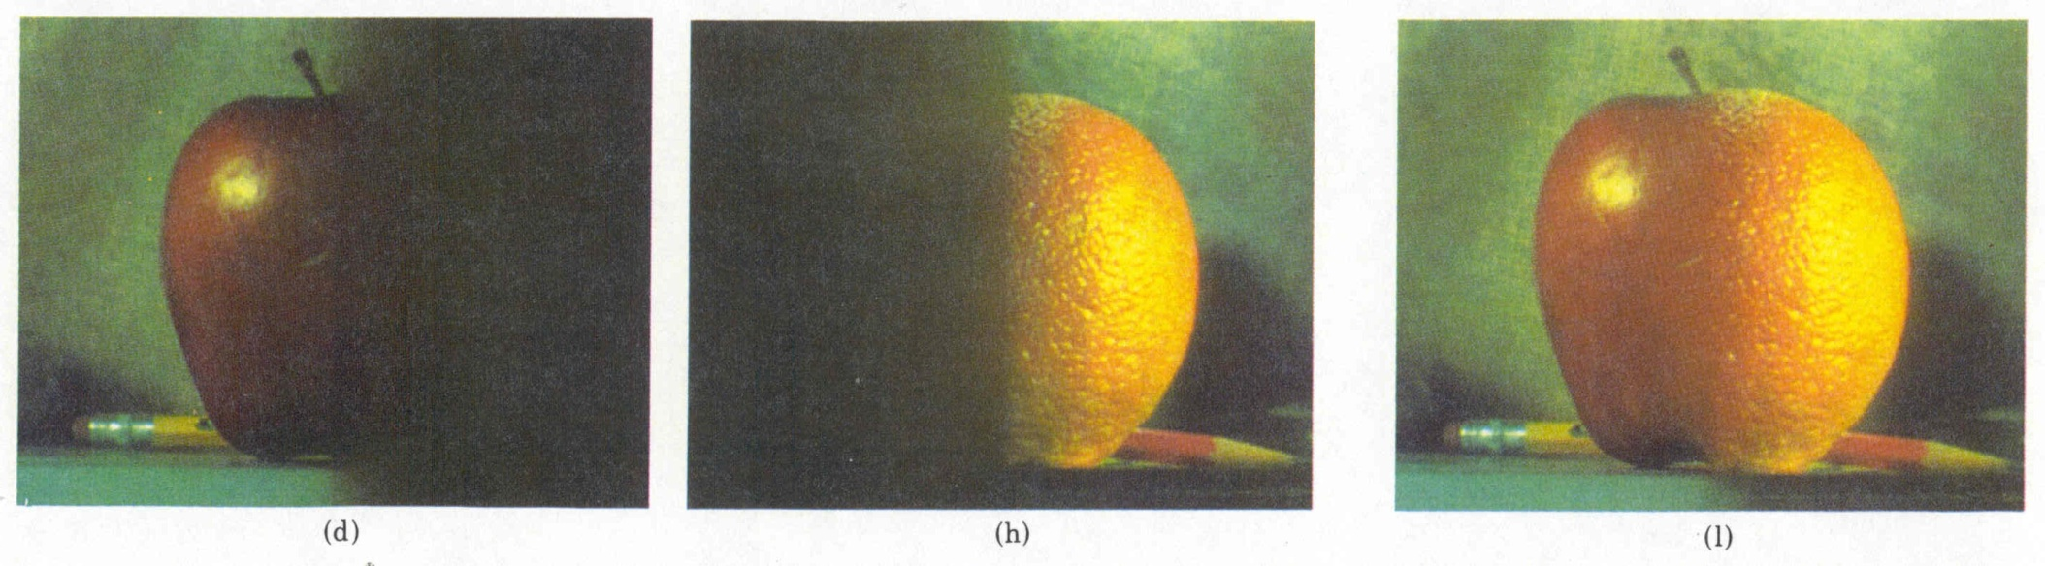
Pyramid blending
Create a Laplacian pyramid, blend each level
  Burt, P. J. and Adelson, E. H., A multiresolution spline with applications to image mosaics, ACM Transactions on Graphics, 42(4), October 1983, 217-236.

Slide 11










The Laplacian Pyramid
Gaussian Pyramid
Laplacian Pyramid
expand
-
=
expand
-
=
expand
-
=

Slide 12
Alpha Blending
I₃
p
I₁
Optional: see Blinn (CGA, 1994) for details:
http://ieeexplore.ieee.org/iel1/38/7531/00310740.pdf?isNumber=7531&prod=JNL&arnumber=310740&arSt=83&ared=87&arAuthor=Blinn%2C+J.F.
I₂
Encoding blend weights: I(x,y) = (αR, αG, αB, α)
color at p =
Implement this in two steps:
  1. accumulate: add up the (α premultiplied) RGBα values at each pixel
  2. normalize: divide each pixel’s accumulated RGB by its α value
    Q: what if α = 0?
Notes:
A: render as black

Slide 13
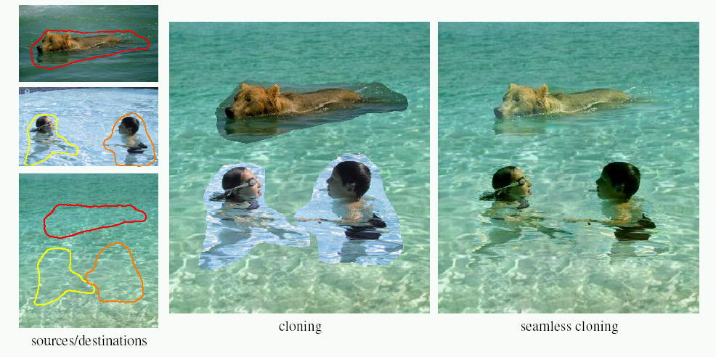
Poisson Image Editing
For more info: Perez et al, SIGGRAPH 2003
  http://research.microsoft.com/vision/cambridge/papers/perez_siggraph03.pdf

Slide 14
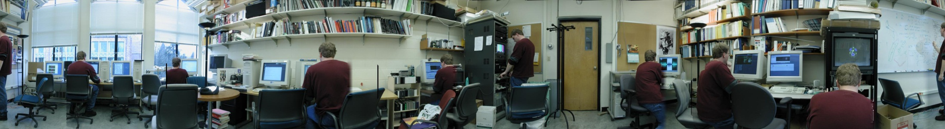
Some panorama examples
Before Siggraph Deadline: http://www.cs.washington.edu/education/courses/cse590ss/01wi/projects/project1/students/dougz/siggraph-hires.html

Slide 15
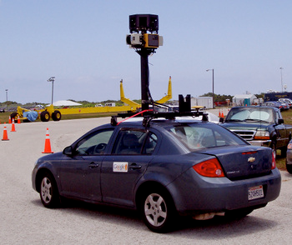
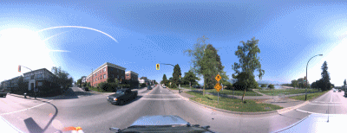
Some panorama examples
Every image on Google Streetview

Slide 16
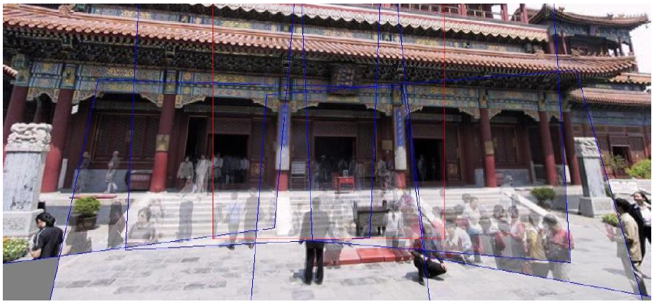
Magic: ghost removal
M. Uyttendaele, A. Eden, and R. Szeliski.
Eliminating ghosting and exposure artifacts in image mosaics.
In Proceedings of the Interational Conference on Computer Vision and Pattern Recognition,
volume 2, pages 509--516, Kauai, Hawaii, December 2001.

Slide 17
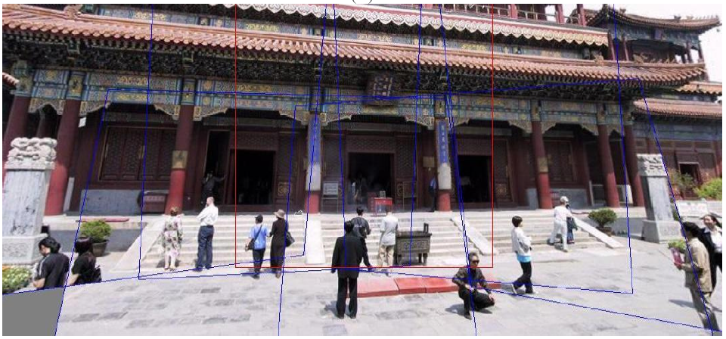
Magic: ghost removal
M. Uyttendaele, A. Eden, and R. Szeliski.
Eliminating ghosting and exposure artifacts in image mosaics.
In Proceedings of the Interational Conference on Computer Vision and Pattern Recognition,
volume 2, pages 509--516, Kauai, Hawaii, December 2001.
Notes:
How to handle motion?

Slide 18

Other types of mosaics
Can mosaic onto any surface if you know the geometry
  See NASA’s Visible Earth project for some stunning earth mosaics
    http://earthobservatory.nasa.gov/Newsroom/BlueMarble/
    Click for images…

Slide 19
http://earthobservatory.nasa.gov/NaturalHazards/view.php?id=87675&src=twitter-nh

Slide 20
Questions?

Slide 21
Projective geometry
Ames Room
Readings
  Mundy, J.L. and Zisserman, A., Geometric Invariance in Computer Vision, Appendix: Projective Geometry for Machine Vision, MIT Press, Cambridge, MA, 1992,
  (read 23.1 - 23.5, 23.10)
    available online: http://www.cs.cmu.edu/~ph/869/papers/zisser-mundy.pdf

Slide 22
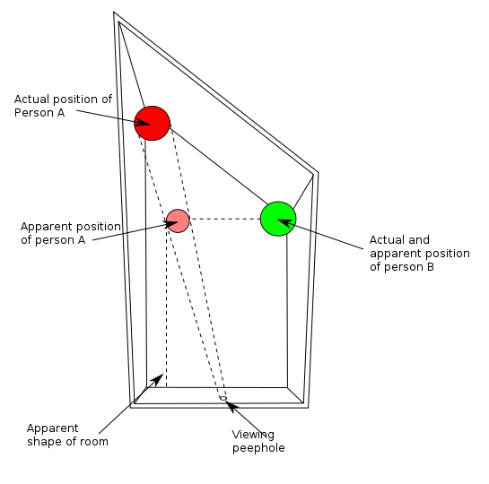
Ames Room

Slide 23
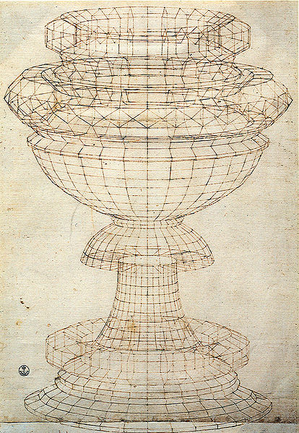
Projective geometry—what’s it good for?
Uses of projective geometry
  Drawing
  Measurements
  Mathematics for projection
  Undistorting images
  Camera pose estimation
  Object recognition
Paolo Uccello

Slide 24
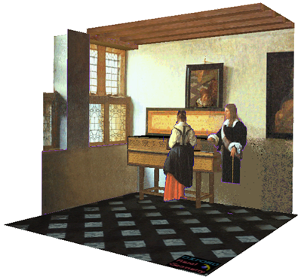
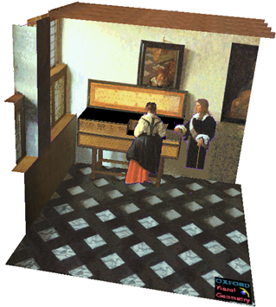

Applications of projective geometry
Vermeer’s Music Lesson
Reconstructions by Criminisi et al.

Slide 25

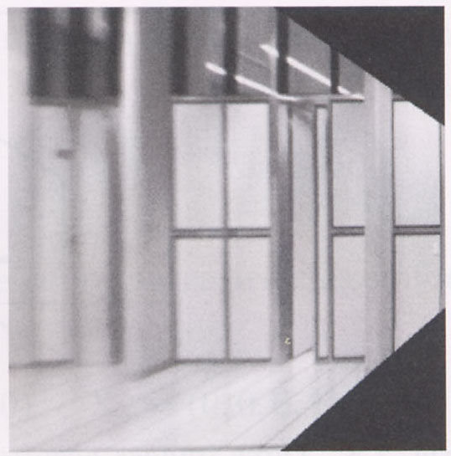

Measurements on planes
4
3
2
1
1
2
3
4
Approach: unwarp then measure
Notes:
homography!

Slide 26
Homogeneous coordinates and lines
(X,Y,W) same as (SX,SY,SW)
Line in projective plane
  ax + by + c = 0
  aX + bY + cW = 0
  u^{T}p = p^{T}u =0
    u = [a,b,c] ^{T} and p = [X,Y,W] ^{T}
    (x,y) Euclidean = (X/W,Y/W)
    W = 0? Ideal points, points at infinity (X,Y,0)

Slide 27
Point and line duality
  A line l is a homogeneous 3-vector
  It is ⊥ to every point (ray) p on the line: l.p=0
p₁
p₂
l₁
p
l
l₂
  What is the line l spanned by rays p₁ and p₂ ?
    l is ⊥ to p₁ and p₂ ⇒ l = p₁ × p₂
    l can be interpreted as a plane normal
  What is the intersection of two lines l₁ and l₂ ?
    p is ⊥ to l₁ and l₂ ⇒ p = l₁ × l₂
  Points and lines are dual in projective space

Slide 28
Ideal points and lines
(a,b,0)
-y
(sx,sy,0)
-y
-z
x
image plane
-z
image plane
x
Ideal point (“point at infinity”)
  p ≅ (x, y, 0) – parallel to image plane
  It has infinite image coordinates
Ideal line
  l ≅ (a, b, 0) – parallel to image plane
  Corresponds to a line in the image (finite coordinates)
    goes through image origin (principle point)

Slide 29
3D projective geometry
These concepts generalize naturally to 3D
  Homogeneous coordinates
    Projective 3D points have four coords: P = (X,Y,Z,W)
  Duality
    A plane N is also represented by a 4-vector
    Points and planes are dual in 3D: N P=0
    Three points define a plane, three planes define a point

Slide 30
3D to 2D: perspective projection
Projection:
Notes:
Preserved: lines, incidence
Not preserved: lengths, angles, parallelism

Slide 31
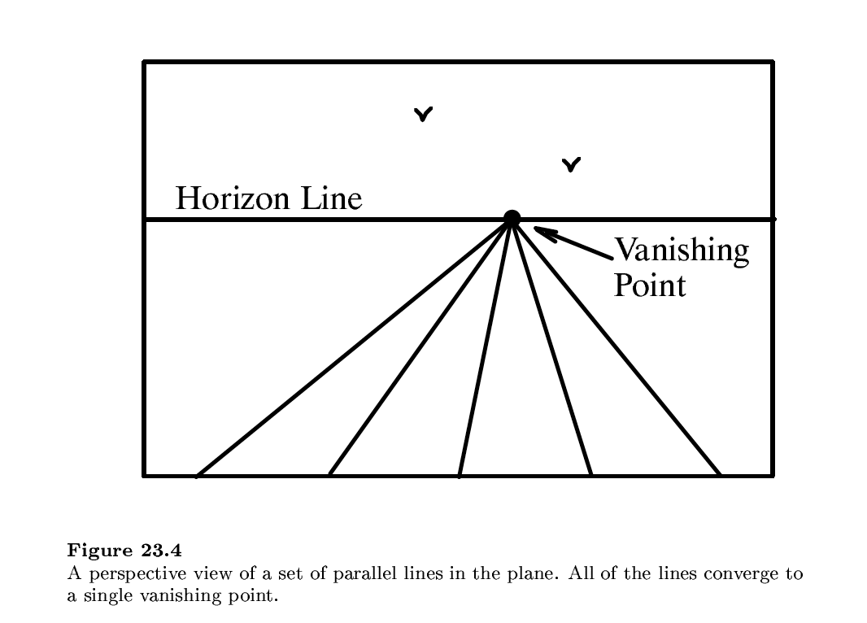

Slide 32
Vanishing points (1D)
image plane
vanishing point
camera
center
ground plane
Vanishing point
  projection of a point at infinity
  can often (but not always) project to a finite point in the image
camera
center
image plane

Slide 33
Vanishing points (2D)
image plane
vanishing point
camera
center
line on ground plane

Slide 34
Vanishing points
image plane
vanishing point V
camera
center
C
line on ground plane
line on ground plane
Properties
  Any two parallel lines (in 3D) have the same vanishing point v
  The ray from C through v is parallel to the lines
  An image may have more than one vanishing point
    in fact, every image point is a potential vanishing point
Notes:
How to determine which lines in the scene vanish at a given pixel?

Slide 35
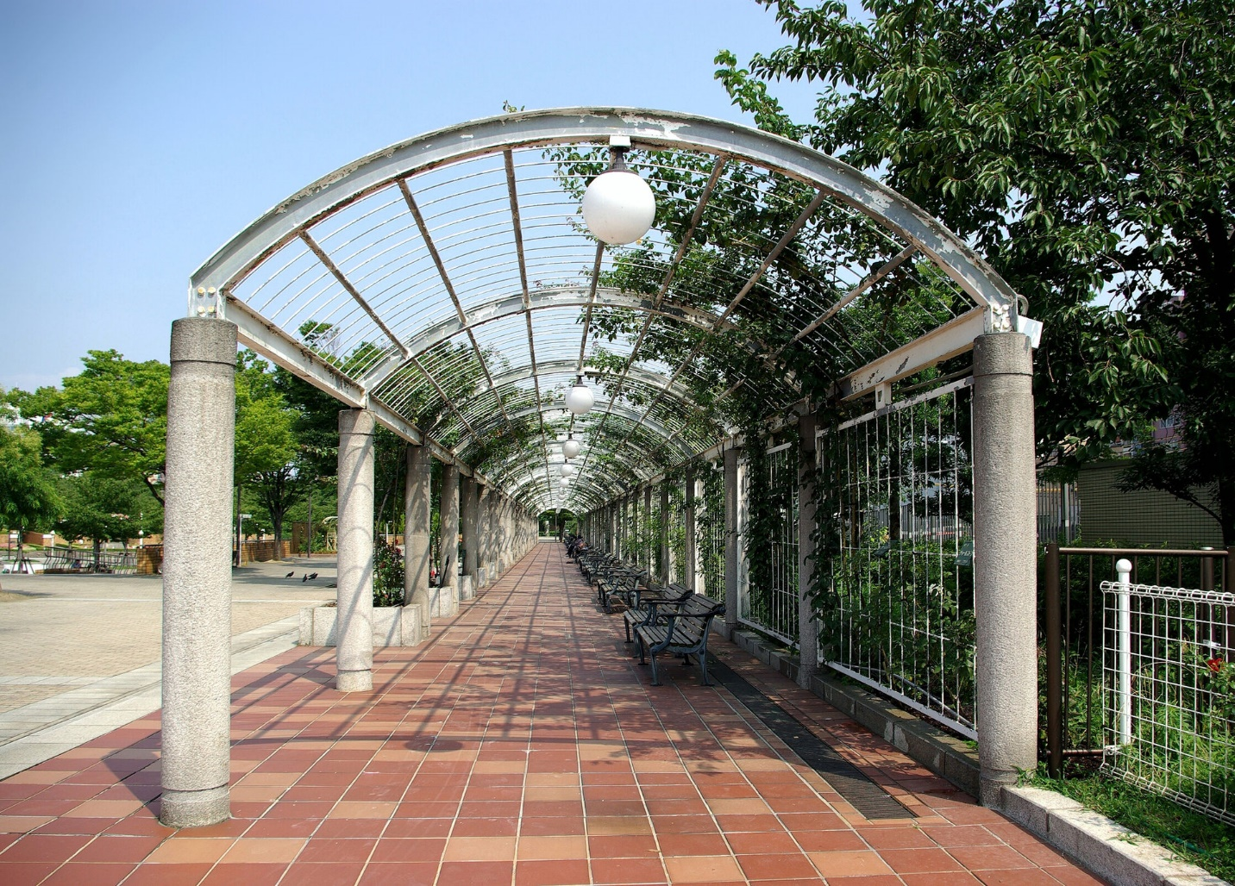
One-point perspective

Slide 36
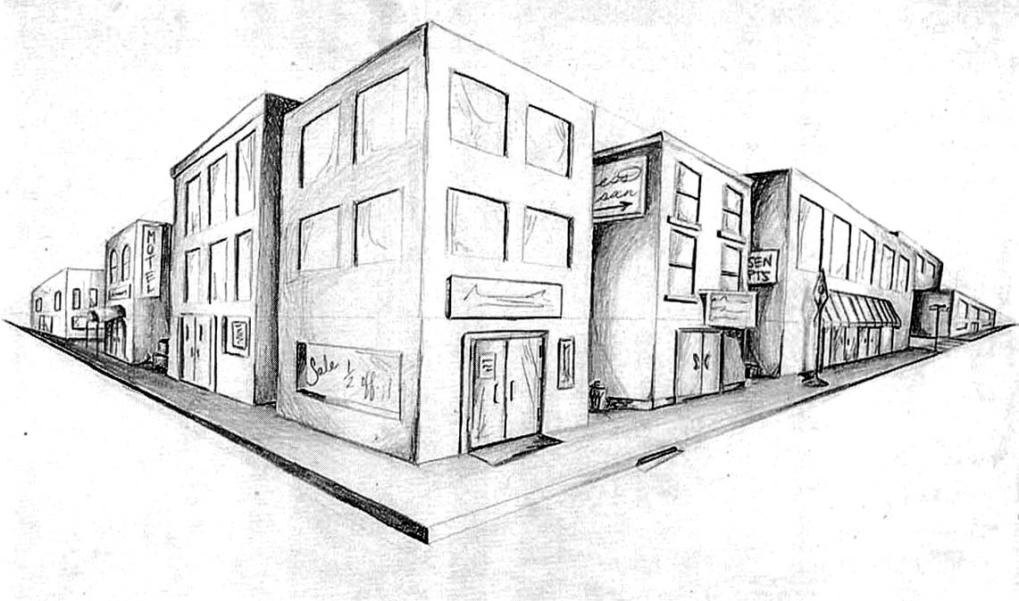
Two-point perspective
v_{y}
v_{x}

Slide 37
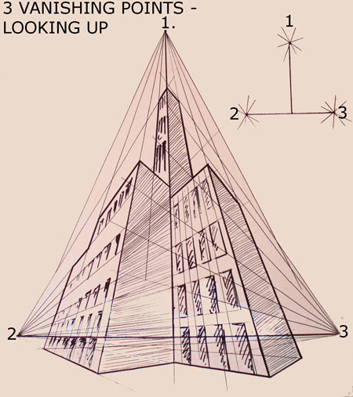
Three-point perspective

Slide 38
Questions?

Slide 39
Vanishing lines
v₁
v₂
Multiple Vanishing Points
  Any set of parallel lines on the plane define a vanishing point
  The union of all of these vanishing points is the horizon line
    also called vanishing line
  Note that different planes (can) define different vanishing lines

Slide 40
Vanishing lines
Multiple Vanishing Points
  Any set of parallel lines on the plane define a vanishing point
  The union of all of these vanishing points is the horizon line
    also called vanishing line
  Note that different planes (can) define different vanishing lines

Slide 41
Computing vanishing points
V
P₀
D

Slide 42
Computing vanishing points
V
P₀
D
Properties
  P∞ is a point at infinity, v is its projection
  Depends only on line direction
  Parallel lines P₀ + tD, P₁ + tD intersect at P∞

Slide 43
Computing vanishing lines
v₁
l
v₂
C
l
ground plane
Properties
  l is intersection of horizontal plane through C with image plane
  Compute l from two sets of parallel lines on ground plane
  All points at same height as C project to l
    points higher than C project above l
  Provides way of comparing height of objects in the scene

Slide 44

Notes:
Is this parachuter higher or lower than the person taking this picture?
Lower—he is below the horizon

Slide 45
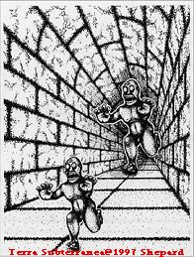
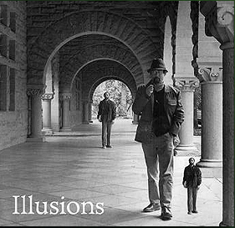
Fun with vanishing points

Slide 46
Perspective cues

Slide 47
Perspective cues

Slide 48
Perspective cues

Slide 49
Comparing heights
Vanishing
Point

