Slide 1
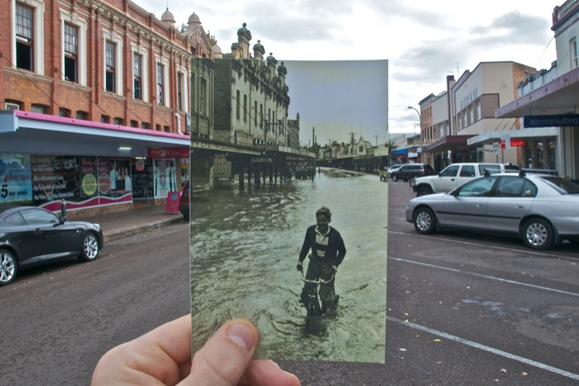
Lecture 8: Image alignment, Part 2
CS5760: Computer Vision
Noah Snavely
http://www.wired.com/gadgetlab/2010/07/camera-software-lets-you-see-into-the-past/

Slide 2
Reading
Szeliski: Chapter 6.1

Slide 3
Announcements
Project 2 is out
To be done in groups of 2
Due March 10
Project 1 artifact voting
Please submit your votes by Friday at 11:59pm

Slide 4
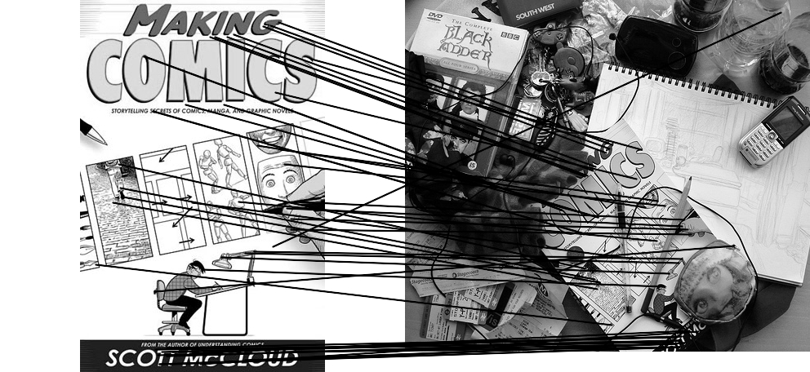
Computing transformations
Given a set of matches between images A and B
How can we compute the transform T from A to B?
Find transform T that best “agrees” with the matches

Slide 5
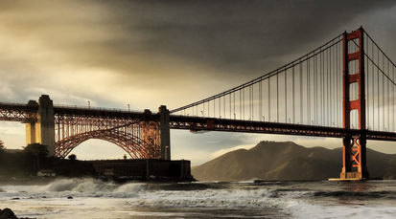
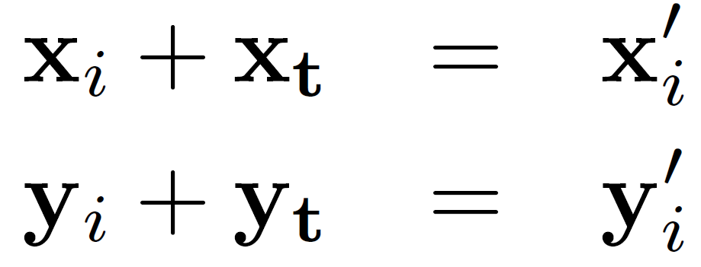
Translations
Solve using least squares

Slide 6
Affine transformations
How many unknowns?
How many equations per match?
How many matches do we need?

Slide 7
Affine transformations
Residuals:
Cost function:

Slide 8
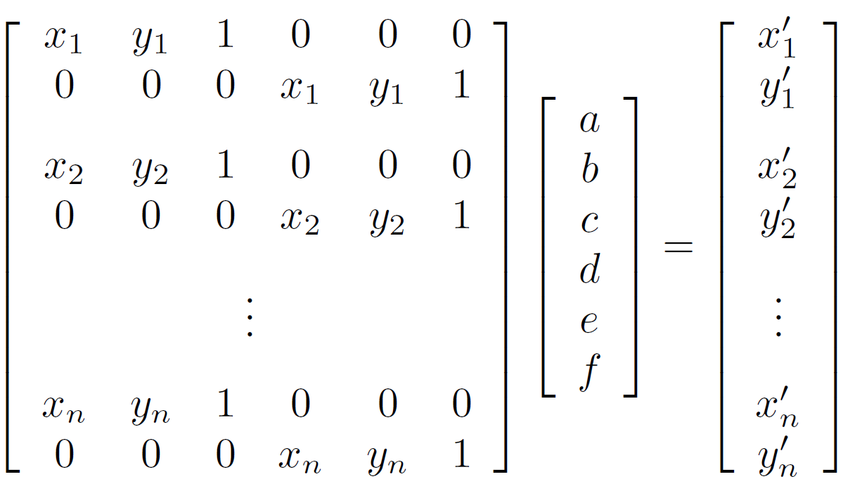
Affine transformations
Matrix form
2n x 6
6 x 1
2n x 1

Slide 9
Homographies
p’
p
To unwarp (rectify) an image
solve for homography H given p and p’
solve equations of the form: wp’ = Hp
linear in unknowns: w and coefficients of H
H is defined up to an arbitrary scale factor
how many points are necessary to solve for H?

Slide 10
Alternate formulation for homographies
where the length of the vector [h₀₀ h₀₁ … h₂₂] is 1

Slide 11
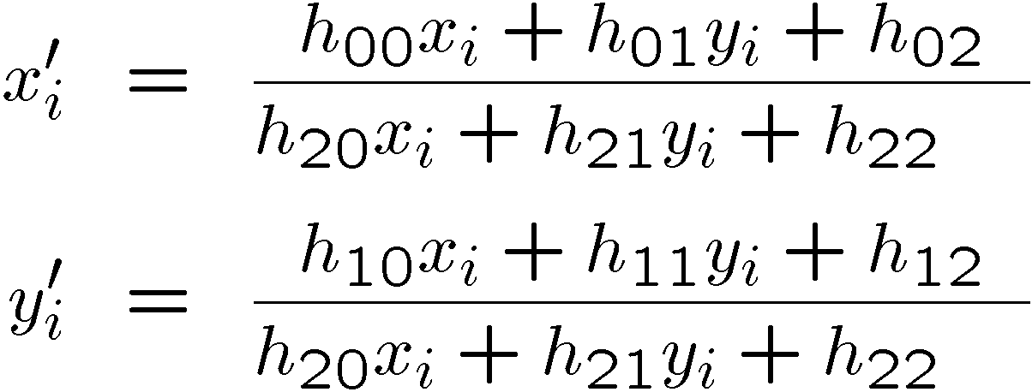
Solving for homographies
Not linear!

Slide 12
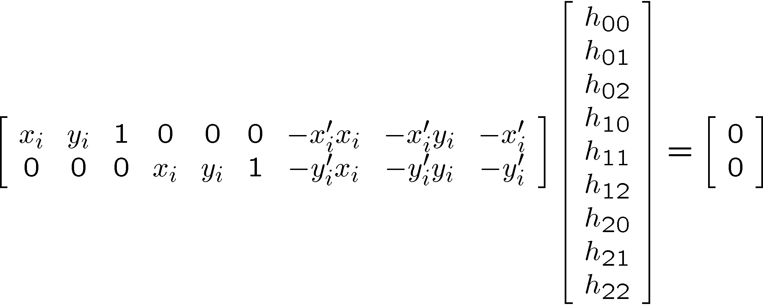
Solving for homographies

Slide 13
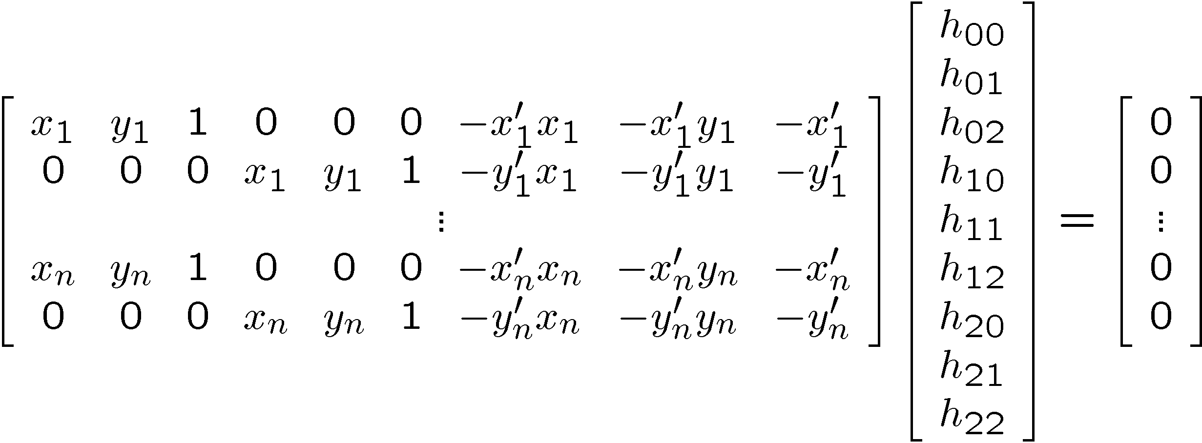
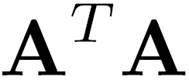
Solving for homographies
2n × 9
9
2n
Defines a least squares problem:
Since is only defined up to scale, solve for unit vector
Solution: = eigenvector of with smallest eigenvalue
Works with 4 or more points

Slide 14
Recap: Two Common Optimization Problems
Problem statement
Solution
(matlab)
Problem statement
Solution

Slide 15
Questions?

Slide 16
Image Alignment Algorithm
Given images A and B
Compute image features for A and B
Match features between A and B
Compute homography between A and B using least squares on set of matches
What could go wrong?

Slide 17
Outliers
outliers
inliers

Slide 18
Robustness
Let’s consider a simpler example… linear regression
How can we fix this?
Problem: Fit a line to these datapoints
Least squares fit

Slide 19
We need a better cost function…
Suggestions?

Slide 20
Idea
Given a hypothesized line
Count the number of points that “agree” with the line
“Agree” = within a small distance of the line
I.e., the inliers to that line
For all possible lines, select the one with the largest number of inliers

Slide 21
Counting inliers

Slide 22
Counting inliers
Inliers: 3

Slide 23
Counting inliers
Inliers: 20

Slide 24
How do we find the best line?
Unlike least-squares, no simple closed-form solution
Hypothesize-and-test
Try out many lines, keep the best one
Which lines?

Slide 25
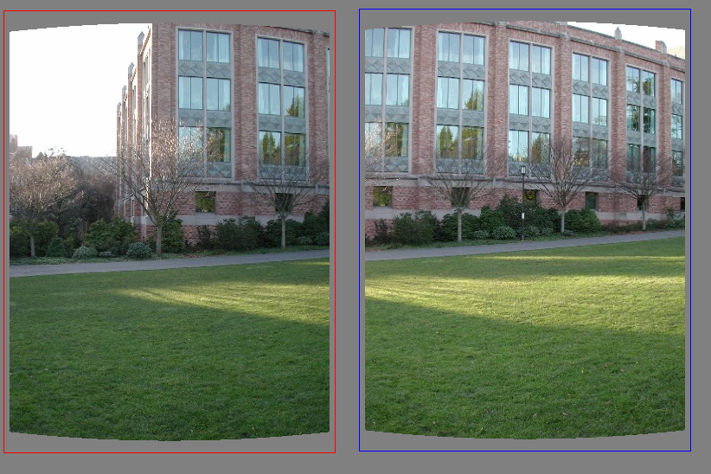
Translations

Slide 26
RAndom SAmple Consensus
Select one match at random, count inliers

Slide 27
RAndom SAmple Consensus
Select another match at random, count inliers

Slide 28
RAndom SAmple Consensus
Output the translation with the highest number of inliers

Slide 29
RANSAC
Idea:
All the inliers will agree with each other on the translation vector; the (hopefully small) number of outliers will (hopefully) disagree with each other
RANSAC only has guarantees if there are < 50% outliers
“All good matches are alike; every bad match is bad in its own way.”
– Tolstoy via Alyosha Efros

Slide 30
RANSAC
Inlier threshold related to the amount of noise we expect in inliers
Often model noise as Gaussian with some standard deviation (e.g., 3 pixels)
Number of rounds related to the percentage of outliers we expect, and the probability of success we’d like to guarantee
Suppose there are 20% outliers, and we want to find the correct answer with 99% probability
How many rounds do we need?

Slide 31
RANSAC
y translation
set threshold so that, e.g., 95% of the Gaussian
lies inside that radius
x translation

Slide 32
RANSAC
Back to linear regression
How do we generate a hypothesis?
y
x

Slide 33
RANSAC
Back to linear regression
How do we generate a hypothesis?
y
x

Slide 34
RANSAC
General version:
Randomly choose s samples
Typically s = minimum sample size that lets you fit a model
Fit a model (e.g., line) to those samples
Count the number of inliers that approximately fit the model
Repeat N times
Choose the model that has the largest set of inliers

Slide 35
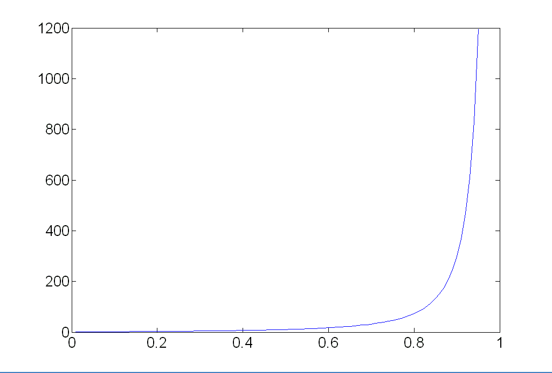
How many rounds?
If we have to choose s samples each time
with an outlier ratio e
and we want the right answer with probability p
 | proportion of outliers e
s | 5% | 10% | 20% | 25% | 30% | 40% | 50%
2 | 2 | 3 | 5 | 6 | 7 | 11 | 17
3 | 3 | 4 | 7 | 9 | 11 | 19 | 35
4 | 3 | 5 | 9 | 13 | 17 | 34 | 72
5 | 4 | 6 | 12 | 17 | 26 | 57 | 146
6 | 4 | 7 | 16 | 24 | 37 | 97 | 293
7 | 4 | 8 | 20 | 33 | 54 | 163 | 588
8 | 5 | 9 | 26 | 44 | 78 | 272 | 1177
p = 0.99
Source: M. Pollefeys

Slide 36
How big is s?
For alignment, depends on the motion model
Here, each sample is a correspondence (pair of matching points)

Slide 37
RANSAC pros and cons
Pros
Simple and general
Applicable to many different problems
Often works well in practice
Cons
Parameters to tune
Sometimes too many iterations are required
Can fail for extremely low inlier ratios
We can often do better than brute-force sampling

Slide 38
Final step: least squares fit
Find average translation vector over all inliers

Slide 39
RANSAC
An example of a “voting”-based fitting scheme
Each hypothesis gets voted on by each data point, best hypothesis wins
There are many other types of voting schemes
E.g., Hough transforms…

Slide 40
Panoramas
Now we know how to create panoramas!
Given two images:
Step 1: Detect features
Step 2: Match features
Step 3: Compute a homography using RANSAC
Step 4: Combine the images together (somehow)
What if we have more than two images?

Slide 41
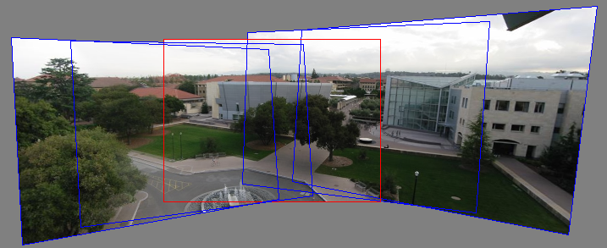
Can we use homographies to create a 360 panorama?
In order to figure this out, we need to learn what a camera is

Slide 42
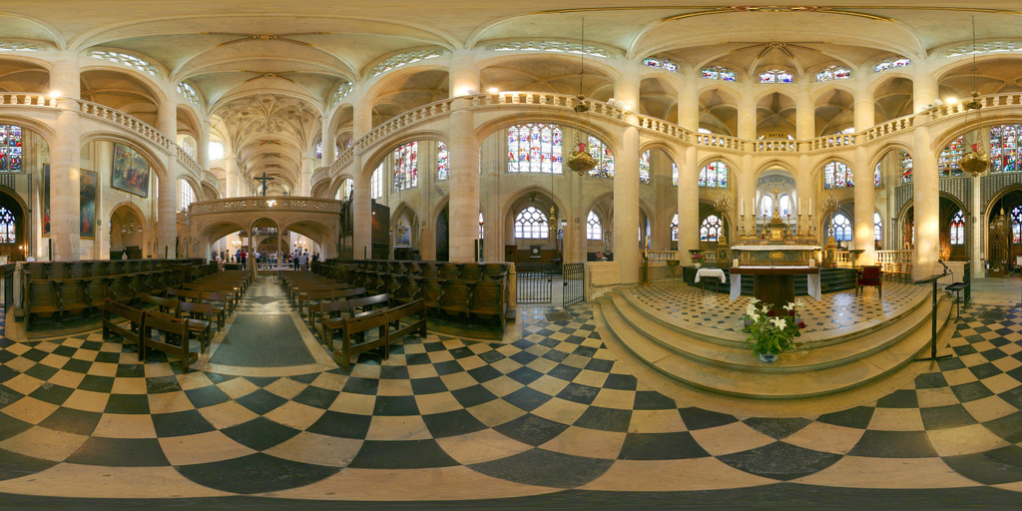
360 panorama

Slide 43
Questions?

Slide 44
Hough transform
ρ
θ

