Slide 1
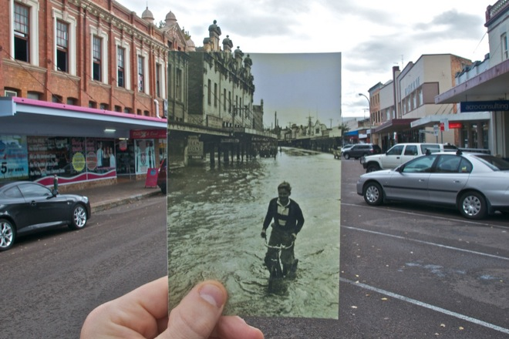
Lecture 7: Image alignment
CS5760: Computer Vision
Noah Snavely
http://www.wired.com/gadgetlab/2010/07/camera-software-lets-you-see-into-the-past/

Slide 2
Reading
Szeliski: Chapter 6.1

Slide 3
Announcements
Project 2 is out
  To be done in groups of 2
  Due March 10
Project 1 artifact voting
  Please submit your votes by Wednesday at 11:59pm

Slide 4
Project 2 Demo

Slide 5
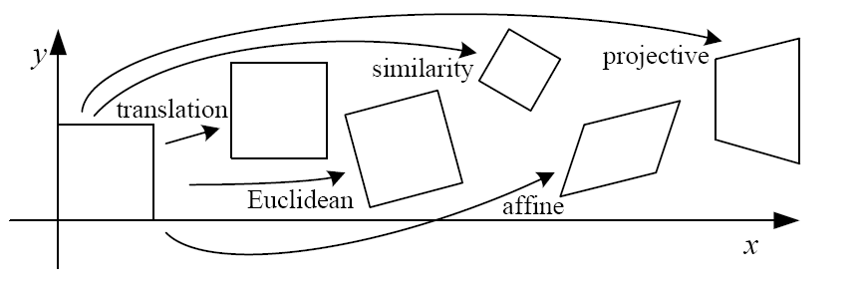
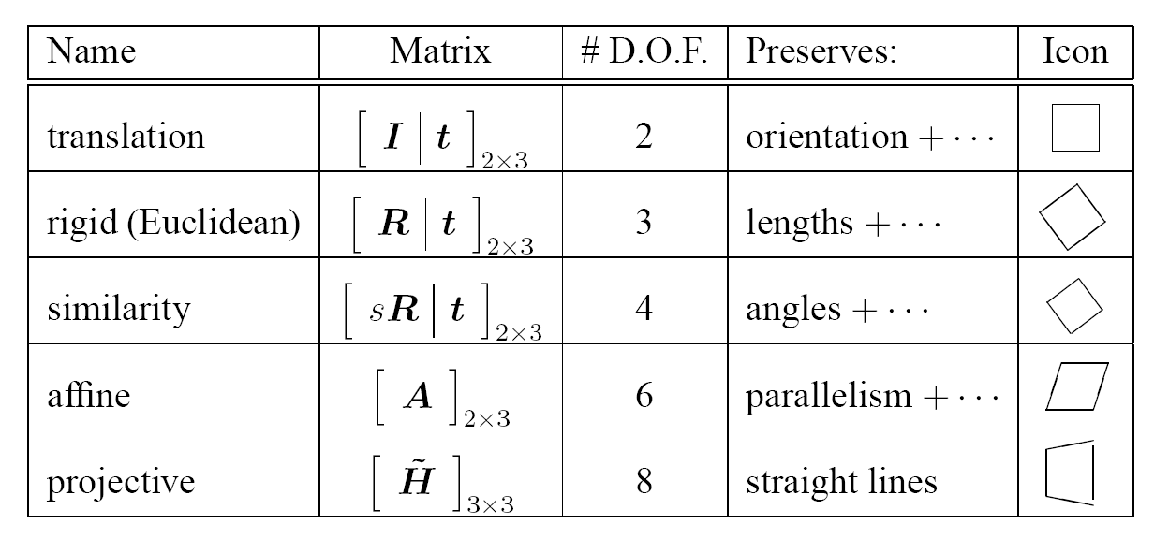
2D image transformations
These transformations are a nested set of groups
  Closed under composition and inverse is a member

Slide 6
All 2D Linear Transformations
Linear transformations are combinations of …
  Scale,
  Rotation,
  Shear, and
  Mirror
Properties of linear transformations:
  Origin maps to origin
  Lines map to lines
  Parallel lines remain parallel
  Ratios are preserved
  Closed under composition

Slide 7
Affine Transformations
Affine transformations are combinations of …
  Linear transformations, and
  Translations
Properties of affine transformations:
  Origin does not necessarily map to origin
  Lines map to lines
  Parallel lines remain parallel
  Ratios are preserved
  Closed under composition

Slide 8
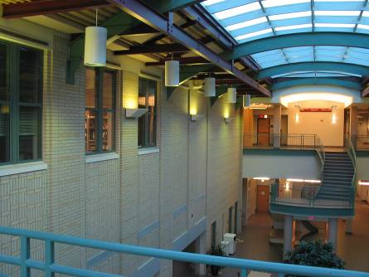
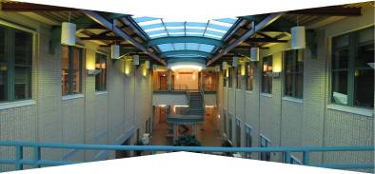
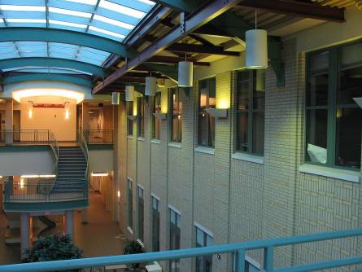
Homographies

Slide 9

Alternate formulation for homographies
where the length of the vector [h₀₀ h₀₁ … h₂₂] is 1

Slide 10


Image Warping
Given a coordinate xform (x’,y’) = T(x,y) and a source image f(x,y), how do we compute an xformed image g(x’,y’) = f(T(x,y))?
y
T(x,y)
y’
x
x’
f(x,y)
g(x’,y’)

Slide 11
Forward Warping
Send each pixel f(x) to its corresponding location (x’,y’) = T(x,y) in g(x’,y’)
What if pixel lands “between” two pixels?
y
T(x,y)
y’
x
x’
f(x,y)
g(x’,y’)

Slide 12
Forward Warping
Send each pixel f(x,y) to its corresponding location x’ = h(x,y) in g(x’,y’)
What if pixel lands “between” two pixels?
Answer: add “contribution” to several pixels, normalize later (splatting)
Can still result in holes
y
T(x,y)
y’
x
x’
f(x,y)
g(x’,y’)

Slide 13
Inverse Warping
Get each pixel g(x’,y’) from its corresponding location (x,y) = T⁻¹(x,y) in f(x,y)
Requires taking the inverse of the transform
What if pixel comes from “between” two pixels?
y
T⁻¹(x,y)
y’
x
x’
f(x,y)
g(x’,y’)

Slide 14
Inverse Warping
Get each pixel g(x’) from its corresponding location x’ = h(x) in f(x)
What if pixel comes from “between” two pixels?
Answer: resample color value from interpolated (prefiltered) source image
T⁻¹(x,y)
y
y’
x
x’
f(x,y)
g(x’,y’)

Slide 15

Interpolation
Possible interpolation filters:
  nearest neighbor
  bilinear
  bicubic (interpolating)
  sinc
Needed to prevent “jaggies”
and “texture crawl”
(with prefiltering)

Slide 16
Questions?

Slide 17

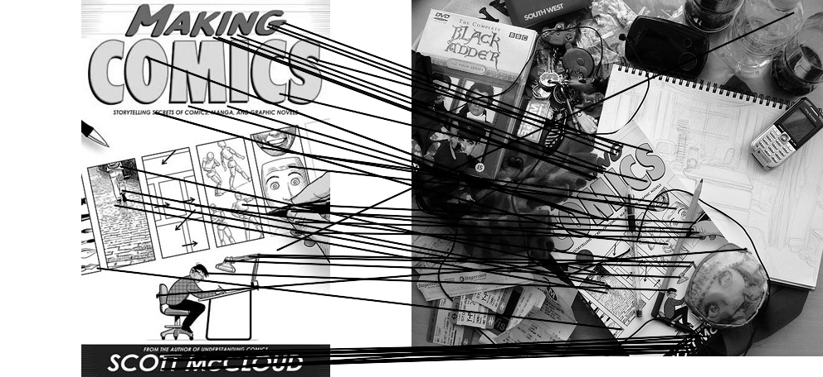
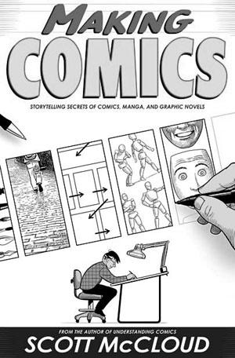
Computing transformations
Given a set of matches between images A and B
  How can we compute the transform T from A to B?
  Find transform T that best “agrees” with the matches

Slide 18
Computing transformations
?

Slide 19
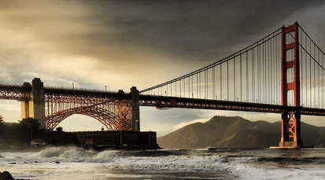
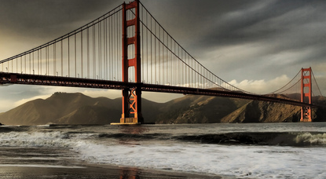

Simple case: translations
How do we solve for
?

Slide 20









Simple case: translations
Displacement of match i =
Mean displacement =

Slide 21

Another view
System of linear equations
  What are the knowns? Unknowns?
  How many unknowns? How many equations (per match)?

Slide 22
Another view
Problem: more equations than unknowns
  “Overdetermined” system of equations
  We will find the least squares solution

Slide 23


Least squares formulation
For each point
we define the residuals as

Slide 24

Least squares formulation
Goal: minimize sum of squared residuals
“Least squares” solution
For translations, is equal to mean (average) displacement

Slide 25





Least squares formulation
Can also write as a matrix equation
2n x 2
2 x 1
2n x 1

Slide 26




Least squares
Find t that minimizes
To solve, form the normal equations

Slide 27
Questions?

Slide 28
Least squares: linear regression
(y_{i}, x_{i})
y = mx + b

Slide 29
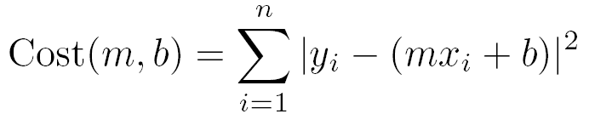
Linear regression
residual error

Slide 30
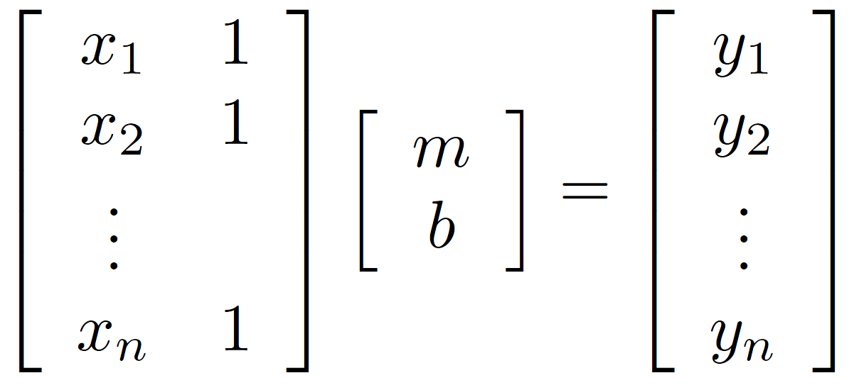
Linear regression

Slide 31

Affine transformations
How many unknowns?
How many equations per match?
How many matches do we need?

Slide 32



Affine transformations
Residuals:
Cost function:

Slide 33

Affine transformations
Matrix form
2n x 6
6 x 1
2n x 1

Slide 34


Homographies
p’
p
To unwarp (rectify) an image
  solve for homography H given p and p’
  solve equations of the form: wp’ = Hp
    linear in unknowns: w and coefficients of H
    H is defined up to an arbitrary scale factor
    how many points are necessary to solve for H?

Slide 35


Solving for homographies
Not linear!

Slide 36

Solving for homographies

Slide 37






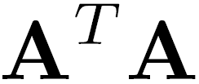
Solving for homographies
2n × 9
9
2n
Defines a least squares problem:
  Since is only defined up to scale, solve for unit vector
  Solution: = eigenvector of with smallest eigenvalue
  Works with 4 or more points

Slide 38
Recap: Two Common Optimization Problems
Problem statement
Solution
(matlab)
Problem statement
Solution

Slide 39
Questions?

Slide 40
Image Alignment Algorithm
Given images A and B
Compute image features for A and B
Match features between A and B
Compute homography between A and B using least squares on set of matches
What could go wrong?

Slide 41
Outliers
outliers
inliers

Slide 42
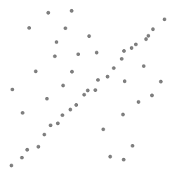
Robustness
Let’s consider a simpler example… linear regression
How can we fix this?
Problem: Fit a line to these datapoints
Least squares fit

Slide 43
We need a better cost function…
Suggestions?

Slide 44
Idea
Given a hypothesized line
Count the number of points that “agree” with the line
  “Agree” = within a small distance of the line
  I.e., the inliers to that line
For all possible lines, select the one with the largest number of inliers

Slide 45
Counting inliers

Slide 46
Counting inliers
Inliers: 3

Slide 47
Counting inliers
Inliers: 20

Slide 48
How do we find the best line?
Unlike least-squares, no simple closed-form solution
Hypothesize-and-test
  Try out many lines, keep the best one
  Which lines?

Slide 49

Translations

Slide 50
RAndom SAmple Consensus
Select one match at random, count inliers

Slide 51
RAndom SAmple Consensus
Select another match at random, count inliers

Slide 52
RAndom SAmple Consensus
Output the translation with the highest number of inliers

Slide 53
RANSAC
Idea:
  All the inliers will agree with each other on the translation vector; the (hopefully small) number of outliers will (hopefully) disagree with each other
    RANSAC only has guarantees if there are < 50% outliers
  “All good matches are alike; every bad match is bad in its own way.”
  – Tolstoy via Alyosha Efros

Slide 54
RANSAC
Inlier threshold related to the amount of noise we expect in inliers
  Often model noise as Gaussian with some standard deviation (e.g., 3 pixels)
Number of rounds related to the percentage of outliers we expect, and the probability of success we’d like to guarantee
  Suppose there are 20% outliers, and we want to find the correct answer with 99% probability
  How many rounds do we need?

Slide 55
RANSAC
y translation
set threshold so that, e.g., 95% of the Gaussian
lies inside that radius
x translation

Slide 56
RANSAC
Back to linear regression
How do we generate a hypothesis?
y
x

Slide 57
RANSAC
Back to linear regression
How do we generate a hypothesis?
y
x

Slide 58
RANSAC
General version:
  Randomly choose s samples
    Typically s = minimum sample size that lets you fit a model
  Fit a model (e.g., line) to those samples
  Count the number of inliers that approximately fit the model
  Repeat N times
  Choose the model that has the largest set of inliers

Slide 59
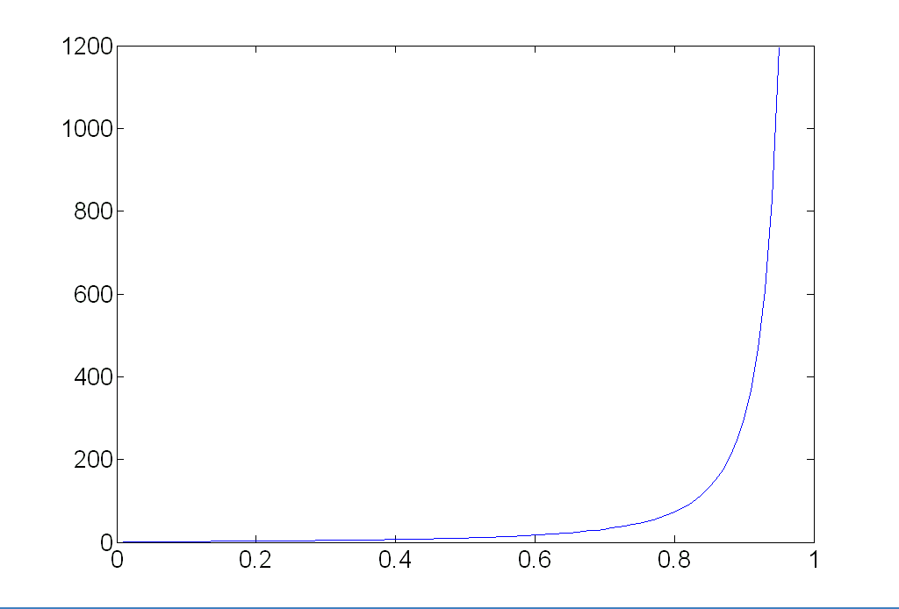
How many rounds?
If we have to choose s samples each time
  with an outlier ratio e
  and we want the right answer with probability p
 | proportion of outliers e
s | 5% | 10% | 20% | 25% | 30% | 40% | 50%
2 | 2 | 3 | 5 | 6 | 7 | 11 | 17
3 | 3 | 4 | 7 | 9 | 11 | 19 | 35
4 | 3 | 5 | 9 | 13 | 17 | 34 | 72
5 | 4 | 6 | 12 | 17 | 26 | 57 | 146
6 | 4 | 7 | 16 | 24 | 37 | 97 | 293
7 | 4 | 8 | 20 | 33 | 54 | 163 | 588
8 | 5 | 9 | 26 | 44 | 78 | 272 | 1177
p = 0.99
Source: M. Pollefeys

Slide 60
How big is s?
For alignment, depends on the motion model
  Here, each sample is a correspondence (pair of matching points)

Slide 61
RANSAC pros and cons
Pros
  Simple and general
  Applicable to many different problems
  Often works well in practice
Cons
  Parameters to tune
  Sometimes too many iterations are required
  Can fail for extremely low inlier ratios
  We can often do better than brute-force sampling

Slide 62
Final step: least squares fit
Find average translation vector over all inliers

Slide 63
RANSAC
An example of a “voting”-based fitting scheme
Each hypothesis gets voted on by each data point, best hypothesis wins
There are many other types of voting schemes
  E.g., Hough transforms…

Slide 64
Panoramas
Now we know how to create panoramas!
Given two images:
  Step 1: Detect features
  Step 2: Match features
  Step 3: Compute a homography using RANSAC
  Step 4: Combine the images together (somehow)
What if we have more than two images?

Slide 65

Can we use homographies to create a 360 panorama?
In order to figure this out, we need to learn what a camera is

Slide 66
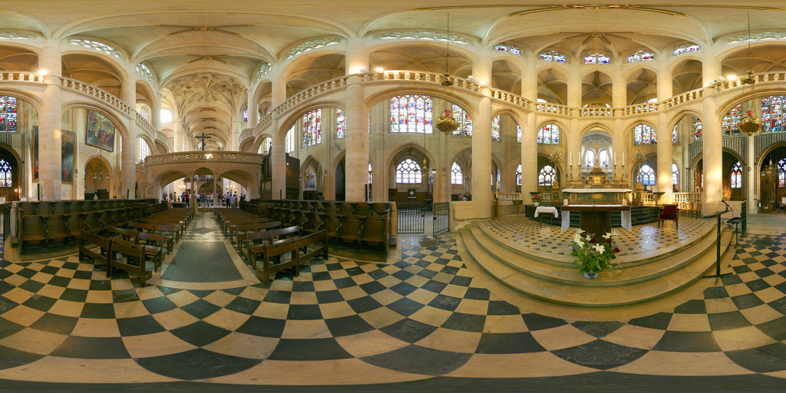
360 panorama

Slide 67
Questions?

Slide 68

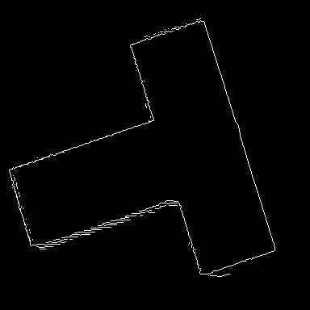
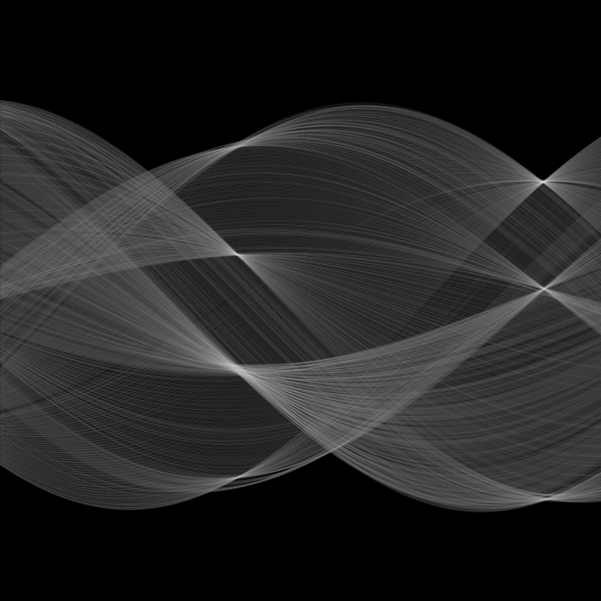
Hough transform
ρ
θ

