Slide 1

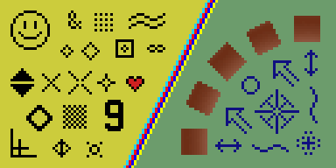
Image Resampling & Interpolation
CS5670: Computer Vision
Noah Snavely

Slide 2

Image Scaling
This image is too big to fit on the screen. How can we generate a half-sized version?
Source: S. Seitz

Slide 3



Image sub-sampling
1/8
1/4
Throw away every other row and column to create a 1/2 size image
  - called image sub-sampling
Source: S. Seitz

Slide 4
Image sub-sampling
1/2
1/4 (2x zoom)
1/8 (4x zoom)
Why does this look so crufty?
Source: S. Seitz

Slide 5
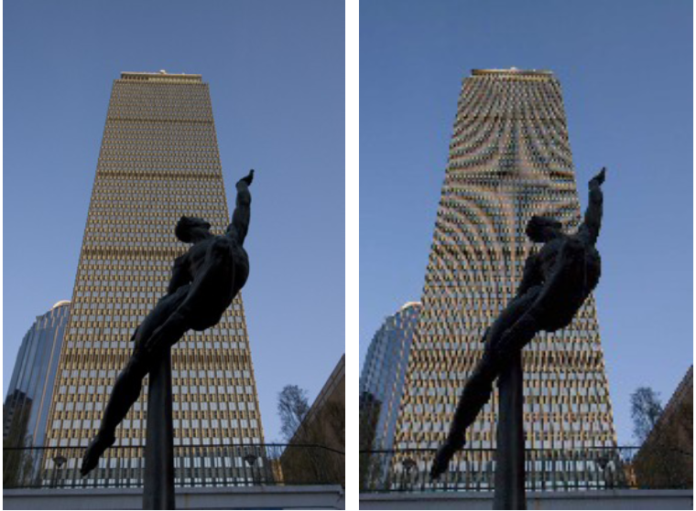
Image sub-sampling
Source: F. Durand

Slide 6
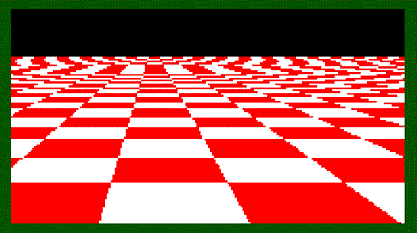
Even worse for synthetic images
Source: L. Zhang

Slide 7
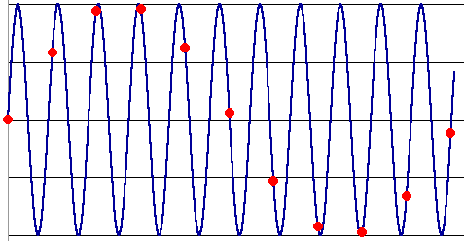
Aliasing
Occurs when your sampling rate is not high enough to capture the amount of detail in your image
Can give you the wrong signal/image—an alias
To do sampling right, need to understand the structure of your signal/image
Enter Monsieur Fourier…
To avoid aliasing:
  sampling rate ≥ 2 * max frequency in the image
    said another way: ≥ two samples per cycle
  This minimum sampling rate is called the Nyquist rate
Source: L. Zhang

Slide 8
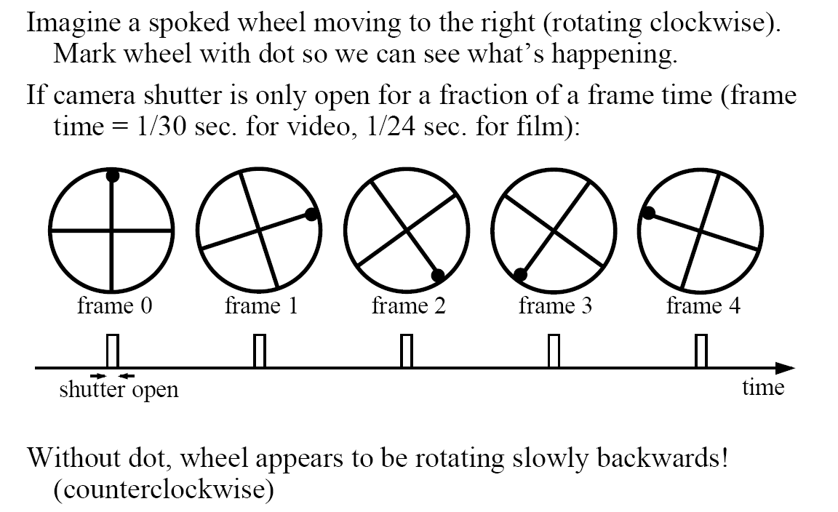
Wagon-wheel effect
(See http://www.michaelbach.de/ot/mot_wagonWheel/index.html)
Source: L. Zhang

Slide 9
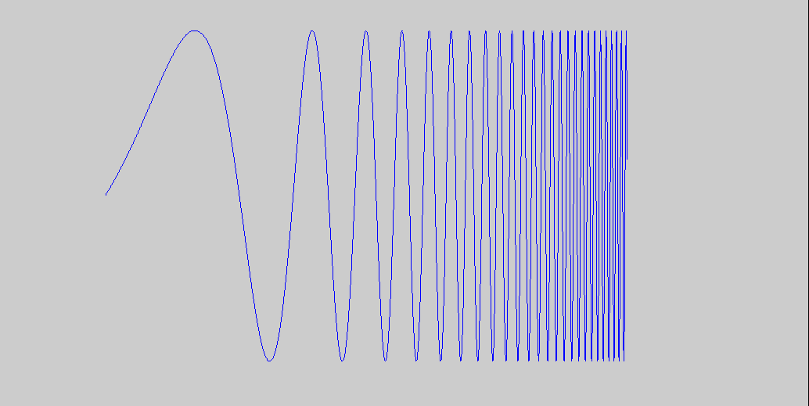
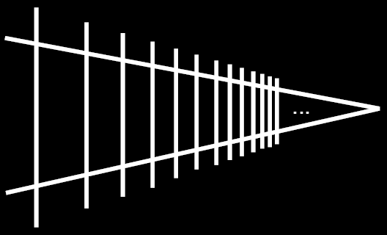
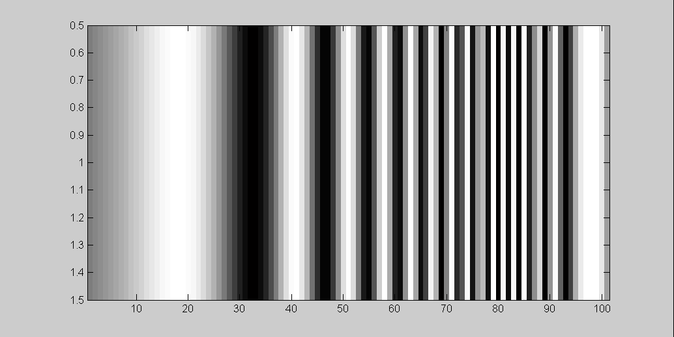
Alias: n., an assumed name
Input signal:
Matlab output:
Picket fence receding
Into the distance will
produce aliasing…
WHY?
x = 0:.05:5; imagesc(sin((2.^x).*x))
Aj-aj-aj:
Alias!
Not enough samples

Slide 10
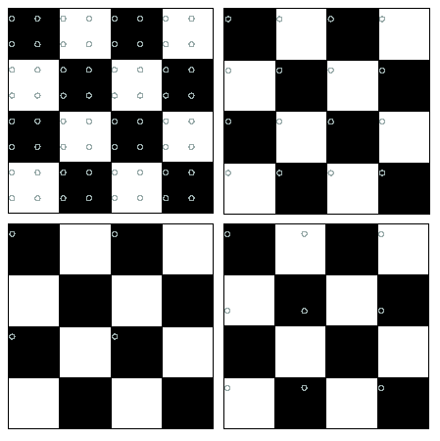
Nyquist limit – 2D example
Good sampling
Bad sampling

Slide 11
Aliasing
When downsampling by a factor of two
  Original image has frequencies that are too high
How can we fix this?

Slide 12



Gaussian pre-filtering
G 1/8
G 1/4
Gaussian 1/2
Solution: filter the image, then subsample
Source: S. Seitz

Slide 13
Subsampling with Gaussian pre-filtering
Gaussian 1/2
G 1/4
G 1/8
Solution: filter the image, then subsample
Source: S. Seitz

Slide 14
Compare with...
1/2
1/4 (2x zoom)
1/8 (4x zoom)
Source: S. Seitz

Slide 15
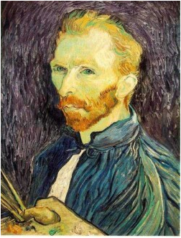







Gaussian pre-filtering
Solution: filter the image, then subsample
F₀
F₁
F₂
…
blur
subsample
blur
subsample
F₀ H
F₁ H
*
*

Slide 16
{
Gaussian pyramid
F₀
F₁
F₂
…
blur
subsample
blur
subsample
F₀ H
F₁ H
*
*

Slide 17
{
Gaussian pyramid
F₀
F₁
F₂
…
blur
subsample
blur
subsample
F₀ H
F₁ H
*
*

Slide 18
The Gaussian Pyramid
Low resolution
blur
sub-sample
blur
sub-sample
sub-sample
blur
sub-sample
blur
High resolution

Slide 19
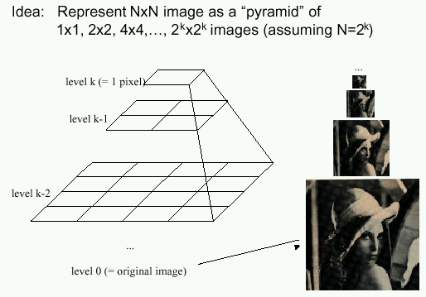
Gaussian pyramids
[Burt and Adelson, 1983]
In computer graphics, a mip map [Williams, 1983]
A precursor to wavelet transform
Gaussian Pyramids have all sorts of applications in computer vision
Source: S. Seitz

Slide 20
Gaussian pyramids
[Burt and Adelson, 1983]
How much space does a Gaussian pyramid take compared to the original image?
Source: S. Seitz

Slide 21
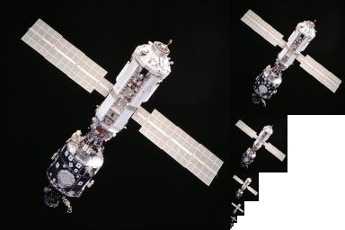
Gaussian Pyramid

Slide 22





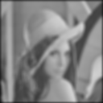
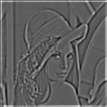


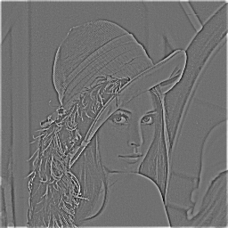
The Laplacian Pyramid
Gaussian Pyramid
Laplacian Pyramid
expand
-
=
expand
-
=
expand
-
=

Slide 23
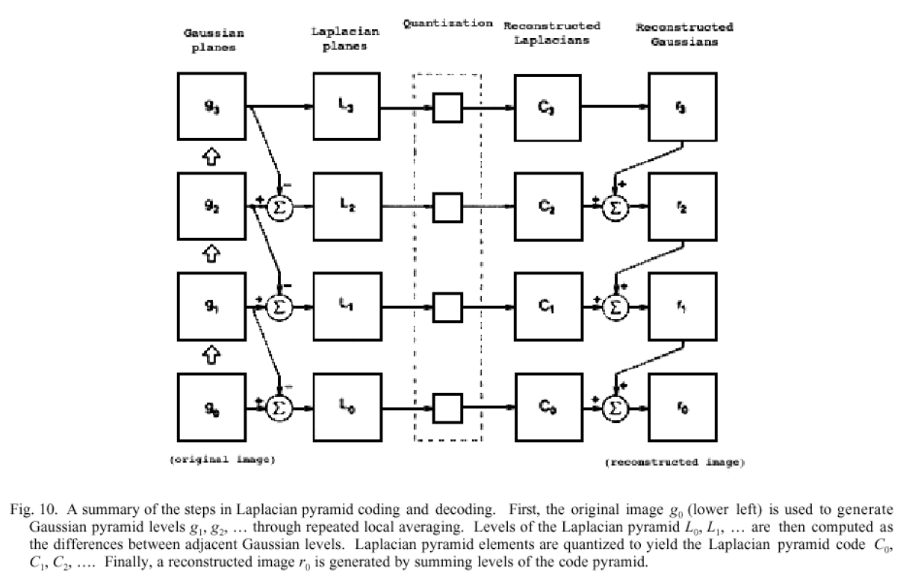

Slide 24
Questions?

Slide 25

Upsampling
This image is too small for this screen:
How can we make it 10 times as big?
Simplest approach:
repeat each row
and column 10 times
(“Nearest neighbor
interpolation”)

Slide 26


Image interpolation
d = 1 in this
example
1
2
3
4
5
Recall how a digital image is formed
  It is a discrete point-sampling of a continuous function
  If we could somehow reconstruct the original function, any new image could be generated, at any resolution and scale
Adapted from: S. Seitz

Slide 27
Image interpolation
d = 1 in this
example
1
2
3
4
5
Recall how a digital image is formed
  It is a discrete point-sampling of a continuous function
  If we could somehow reconstruct the original function, any new image could be generated, at any resolution and scale
Adapted from: S. Seitz

Slide 28




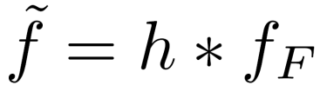
Image interpolation
1
d = 1 in this
example
1
2
2.5
3
4
5
What if we don’t know ?
  Guess an approximation:
  Can be done in a principled way: filtering
  Convert to a continuous function:
  Reconstruct by convolution with a reconstruction filter, h
Adapted from: S. Seitz

Slide 29
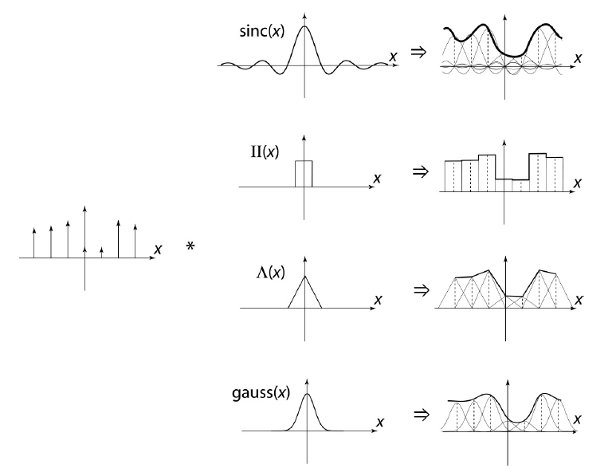
Image interpolation
“Ideal” reconstruction
Nearest-neighbor interpolation
Linear interpolation
Gaussian reconstruction
Source: B. Curless

Slide 30
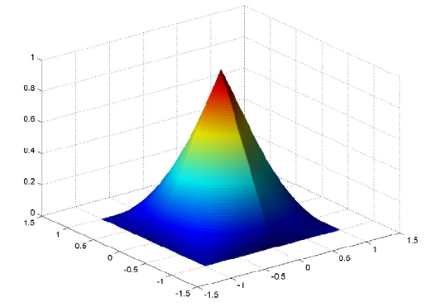



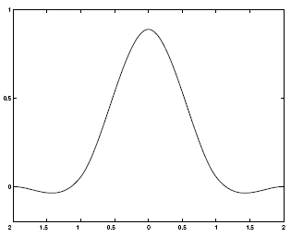
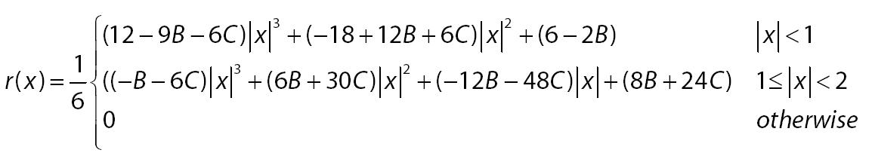
Reconstruction filters
What does the 2D version of this hat function look like?
performs
linear interpolation
(tent function) performs
bilinear interpolation
Often implemented without cross-correlation
  E.g., http://en.wikipedia.org/wiki/Bilinear_interpolation
Better filters give better resampled images
  Bicubic is common choice
Cubic reconstruction filter

Slide 31


Image interpolation
Original image: x 10
Nearest-neighbor interpolation
Bilinear interpolation
Bicubic interpolation

Slide 32
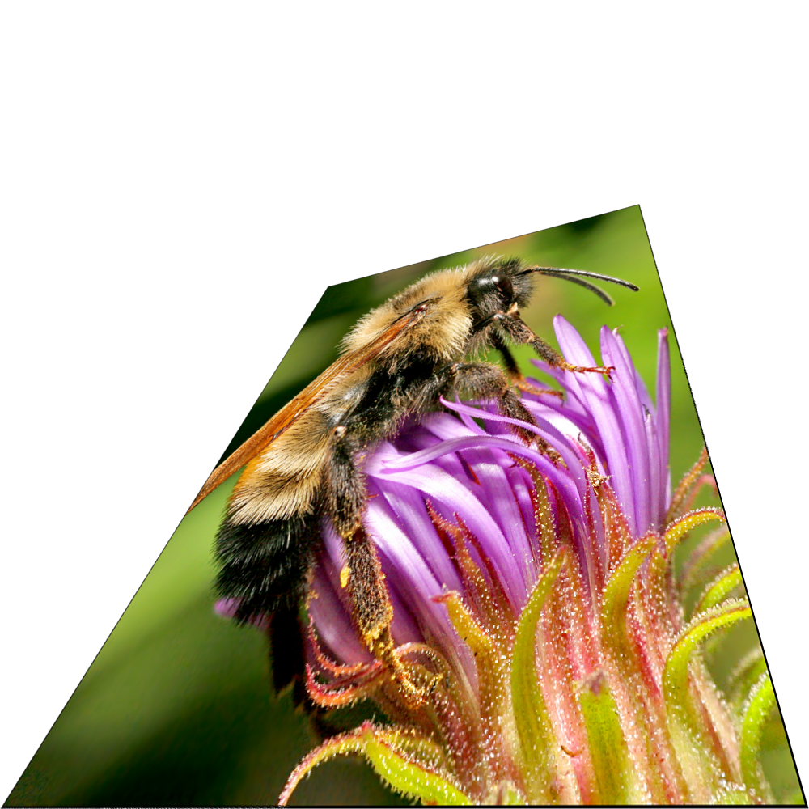
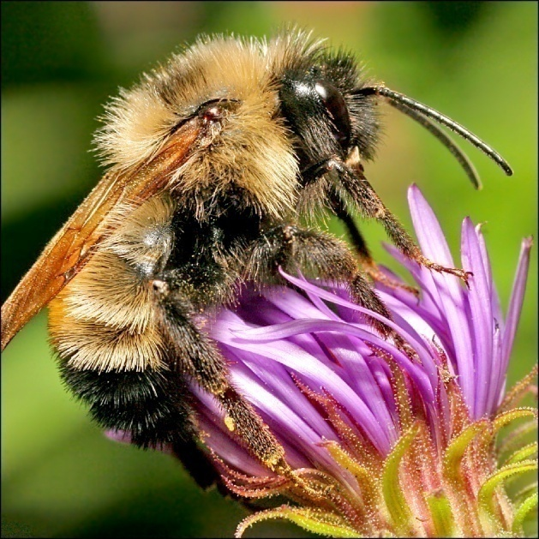
Image interpolation
Also used for resampling

Slide 33
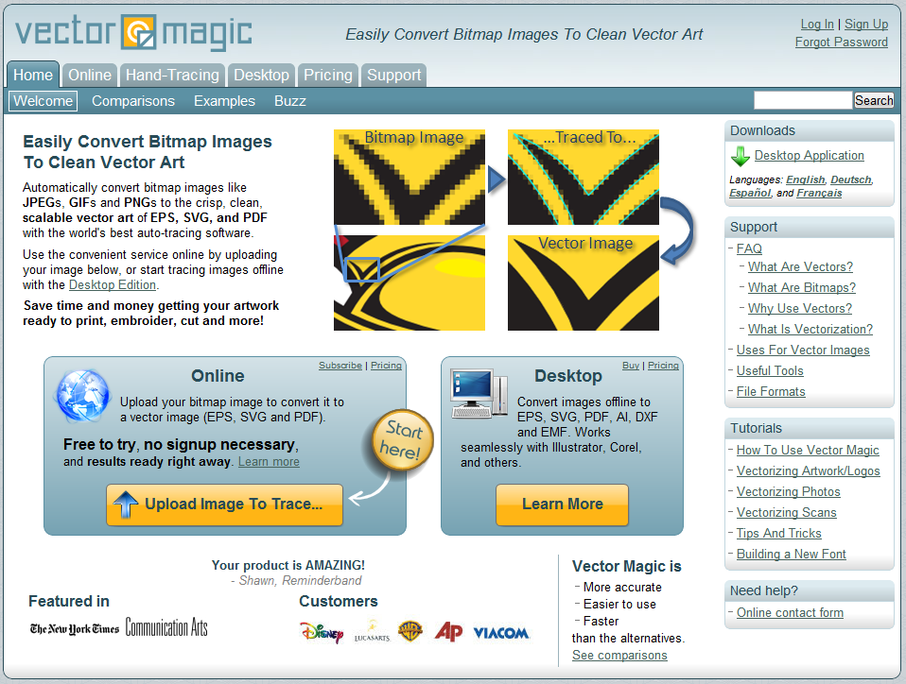
Raster to Vector Graphics

Slide 34
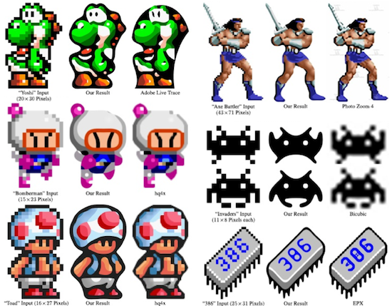
Depixelating Pixel Art

Slide 35
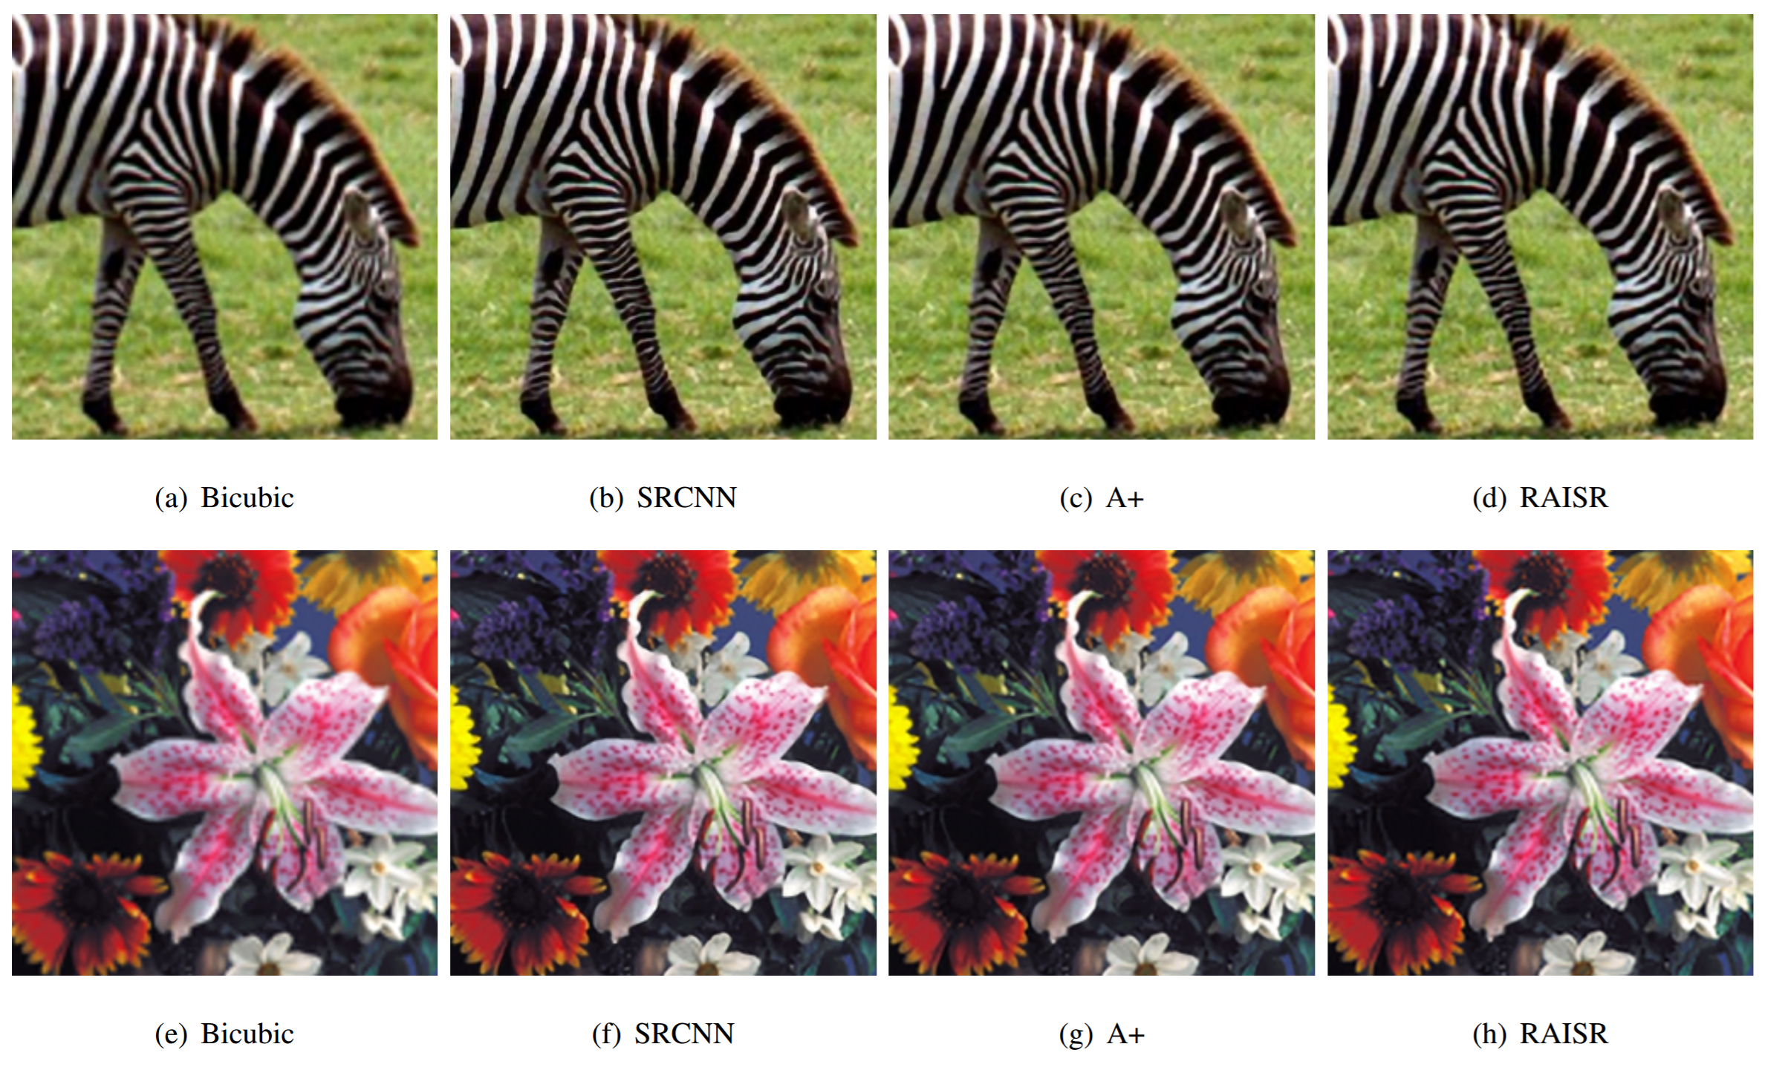
Modern methods
From Romano, et al: RAISR: Rapid and Accurate Image Super Resolution, https://arxiv.org/abs/1606.01299

Slide 36
Questions?

