Slide 1
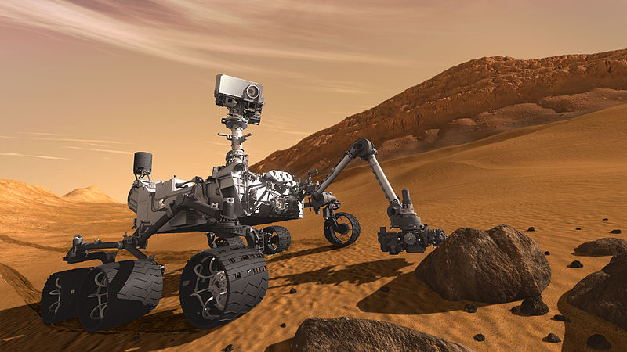
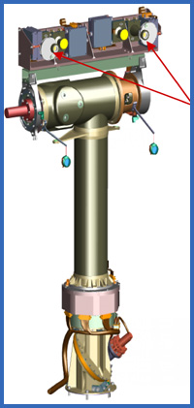
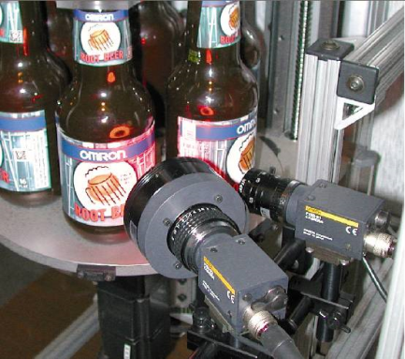
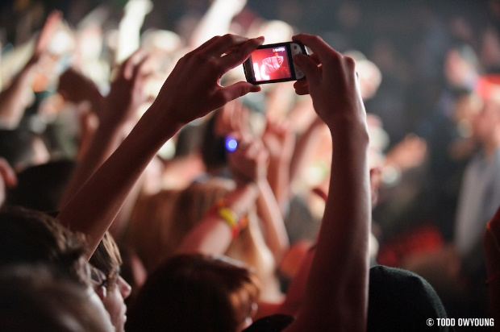
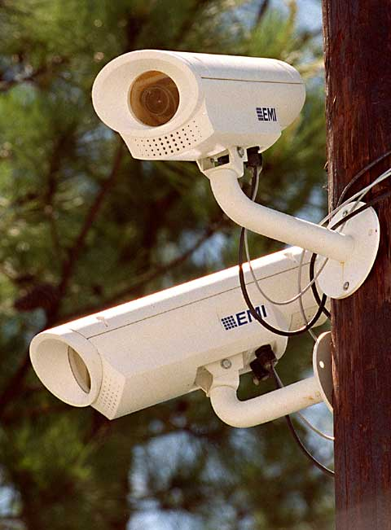
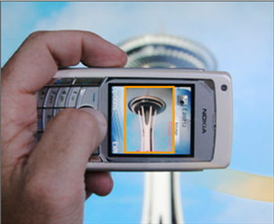
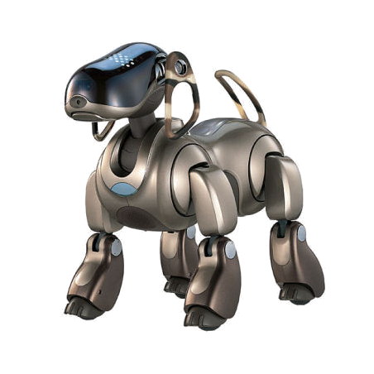
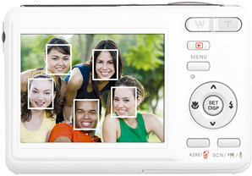
CS5670: Intro to Computer Vision
Instructor: Noah Snavely

Slide 2
Instructor
Noah Snavely (snavely@cs.cornell.edu)
Research interests:
  Computer vision and graphics
  3D reconstruction and visualization of Internet photo collections
  Deep learning for computer graphics
  Virtual reality video

Slide 3
Today
What is computer vision?
Course overview
Image filtering

Slide 4
Today
Readings
  Szeliski, Chapter 1 (Introduction)

Slide 5
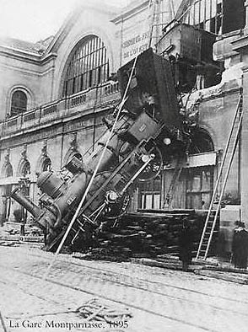
Every image tells a story
Goal of computer vision: perceive the “story” behind the picture
Compute properties of the world
  3D shape
  Names of people or objects
  What happened?

Slide 6

The goal of computer vision

Slide 7
Can the computer match human perception?
Yes and no (mainly no)
  computers can be better at “easy” things
  humans are much better at “hard” things
But huge progress has been made
  Accelerating in the last 4 years due to deep learning
  What is considered “hard” keeps changing

Slide 8
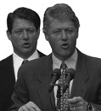
Human perception has its shortcomings
Sinha and Poggio, Nature, 1996

Slide 9

But humans can tell a lot about a scene from a little information…
Source: “80 million tiny images” by Torralba, et al.

Slide 10
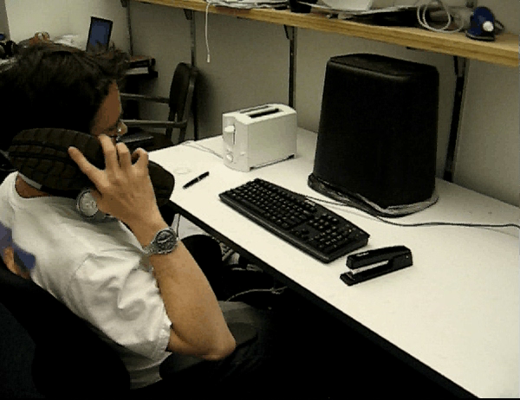


Slide 11
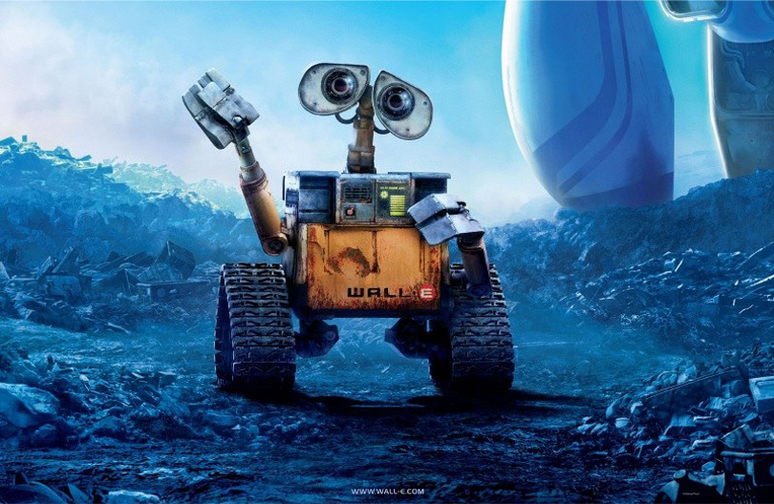
The goal of computer vision

Slide 12
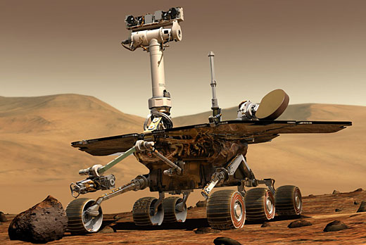
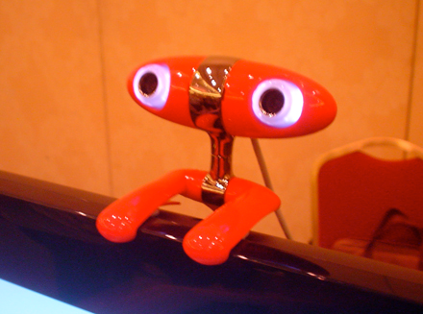
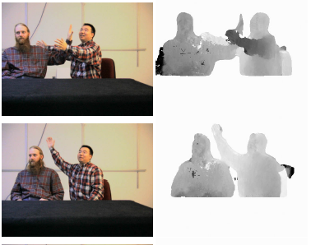
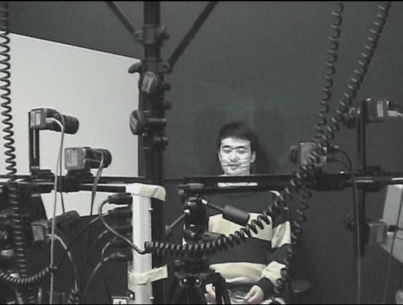
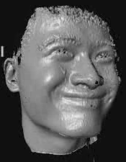
The goal of computer vision
Compute the 3D shape of the world

Slide 13
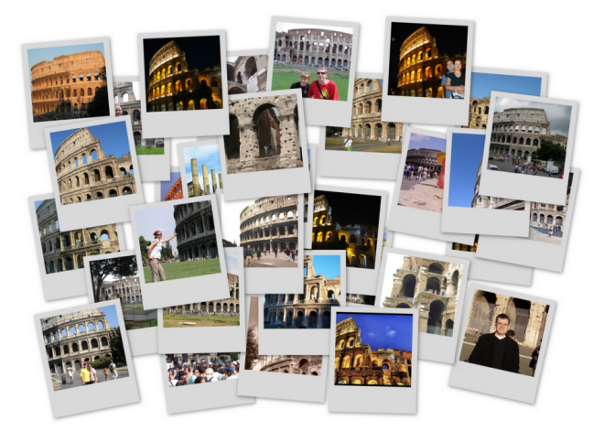
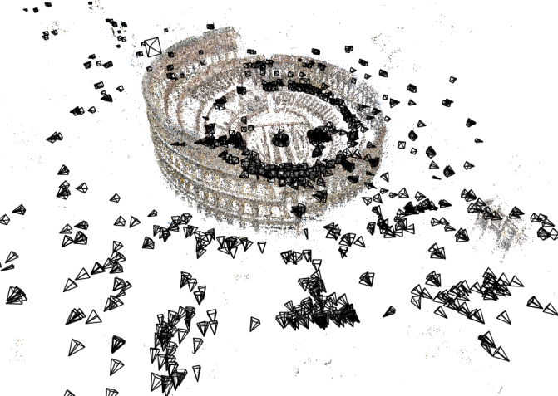
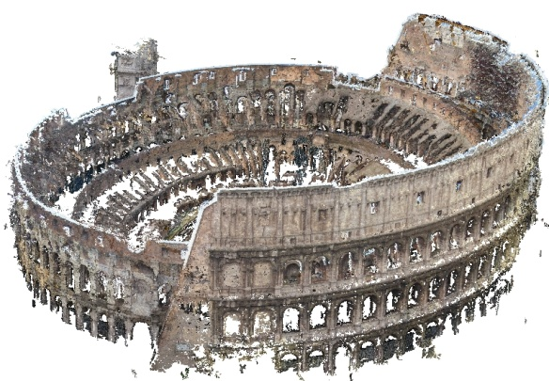
The goal of computer vision
Computing the 3D shape of the world
Internet Photos (“Colosseum”)
Reconstructed 3D cameras and points
Dense 3D model

Slide 14
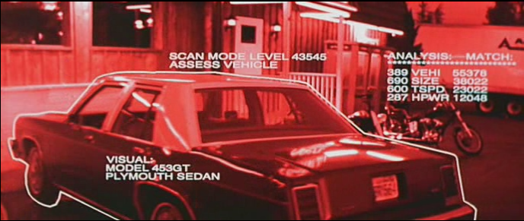
The goal of computer vision
Recognize objects and people
Terminator 2, 1991

Slide 15
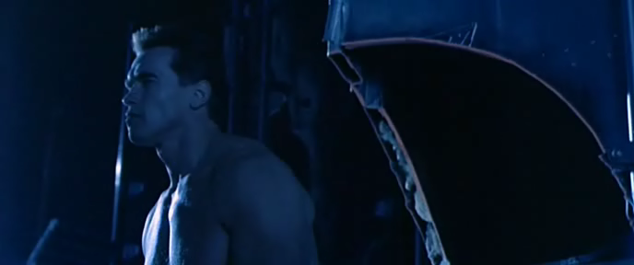


Slide 16
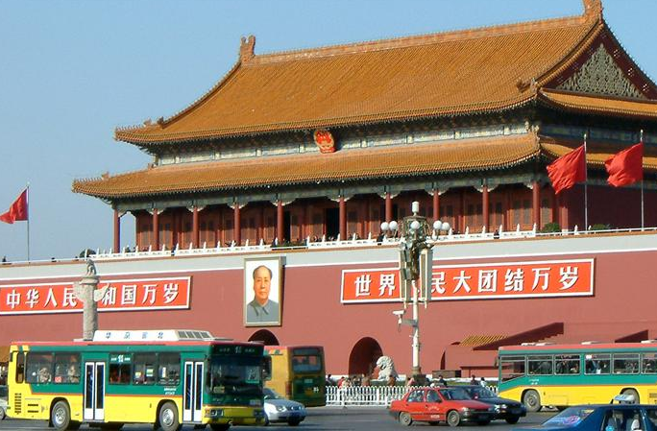
slide credit: Fei-Fei, Fergus & Torralba

Slide 17
sky
building
flag
face
banner
wall
street lamp
bus
bus
cars
slide credit: Fei-Fei, Fergus & Torralba

Slide 18
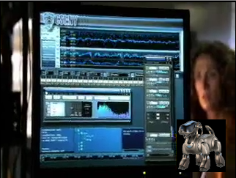
The goal of computer vision
“Enhance” images

Slide 19
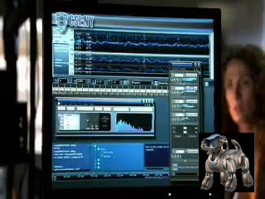

Slide 20
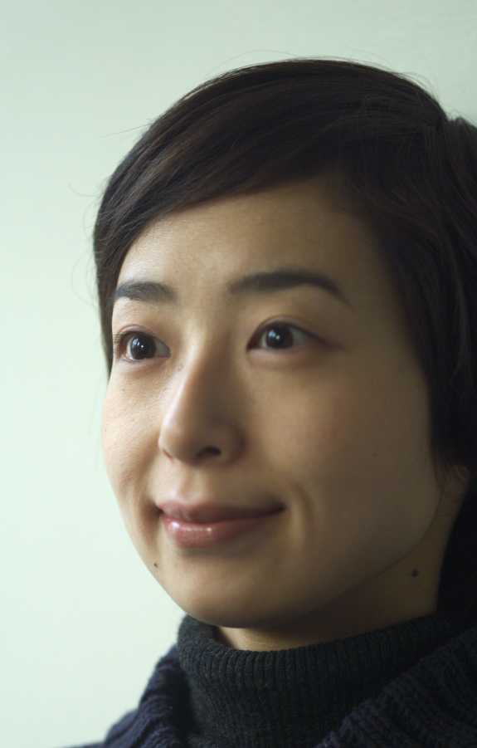
The goal of computer vision
Forensics
Source: Nayar and Nishino, “Eyes for Relighting”

Slide 21
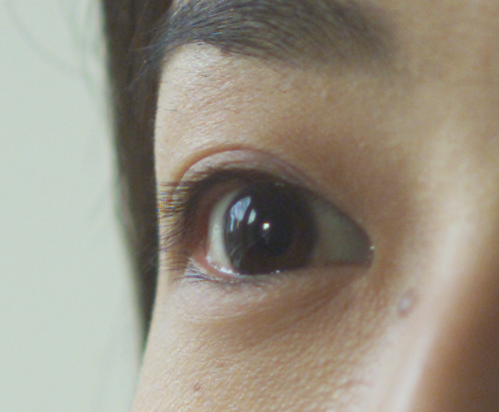

Source: Nayar and Nishino, “Eyes for Relighting”

Slide 22
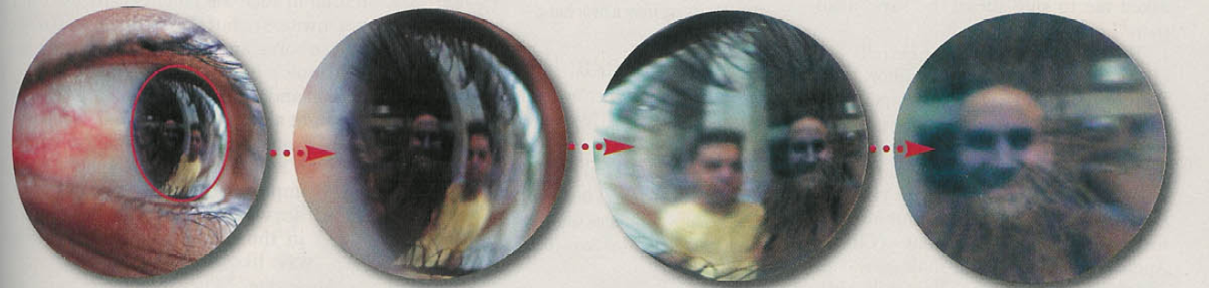
Source: Nayar and Nishino, “Eyes for Relighting”

Slide 23
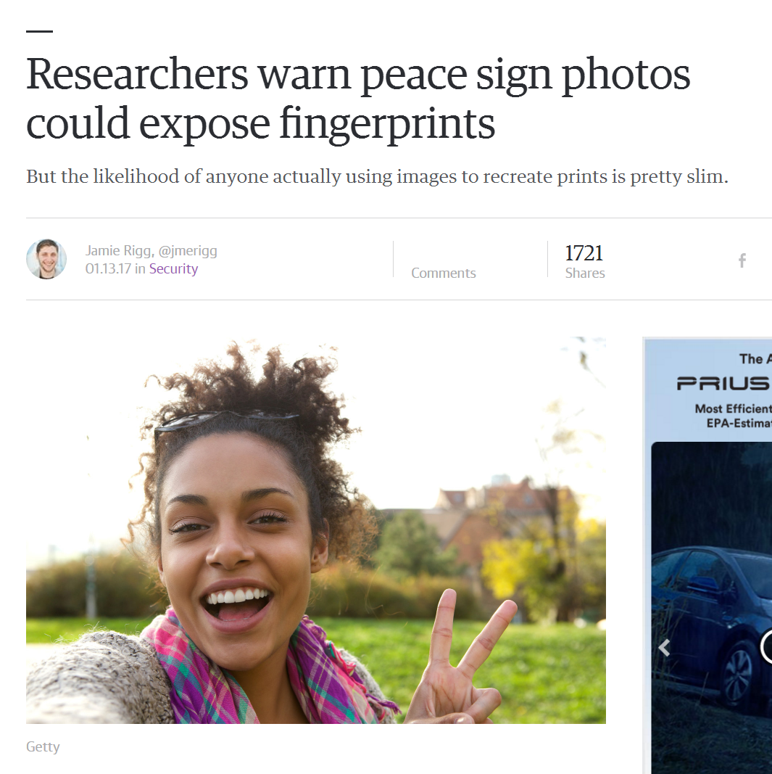

Slide 24
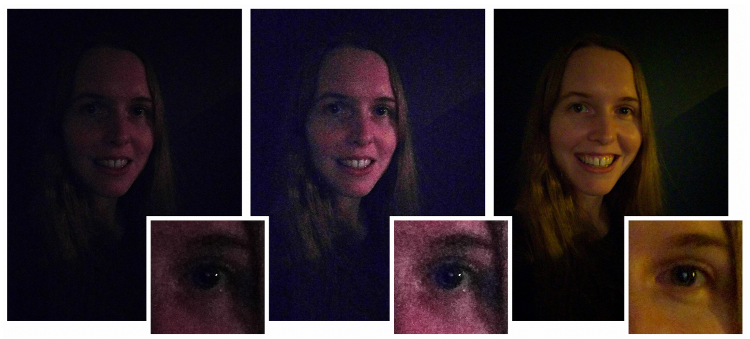
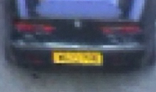
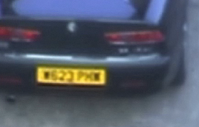
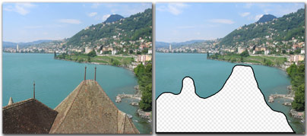
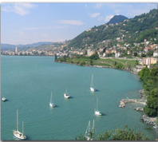
The goal of computer vision
Improve photos (“Computational Photography”)
Low-light photography (credit: Hasinoff et al., SIGGRAPH ASIA 2016)
Super-resolution (source: 2d3)
Inpainting / image completion (image credit: Hays and Efros)

Slide 25

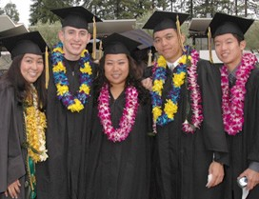
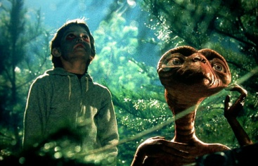

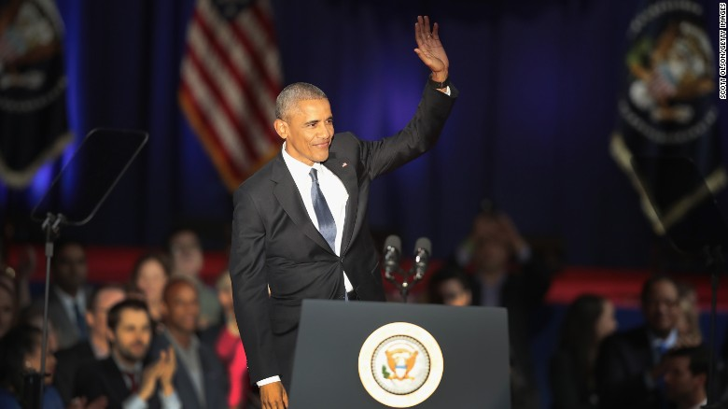
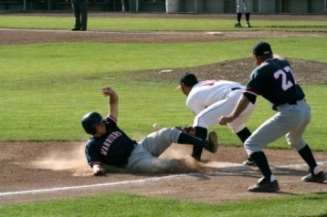
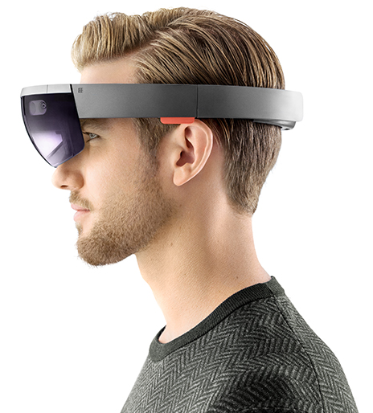





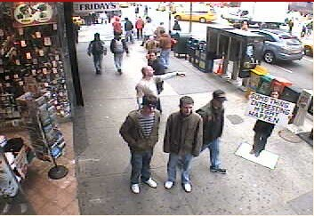
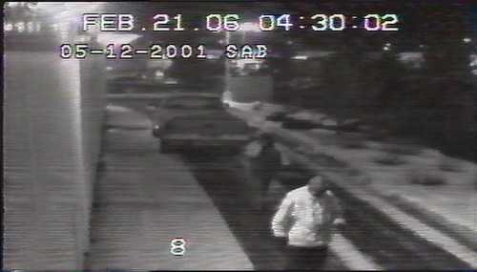
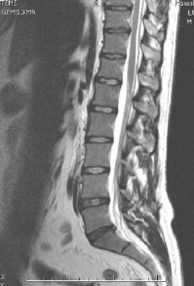
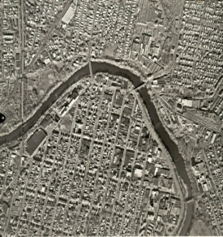
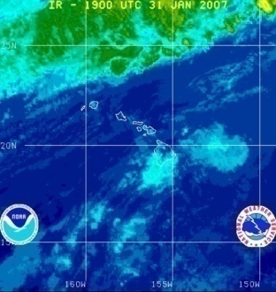
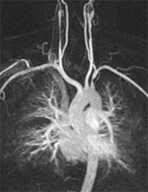
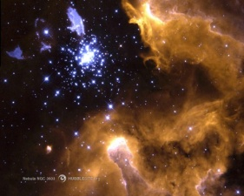
Why study computer vision?
Billions of images/videos captured per day
Huge number of useful applications
The next slides show the current state of the art

Slide 26
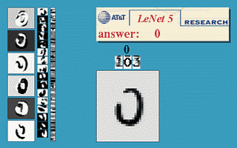
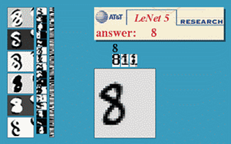
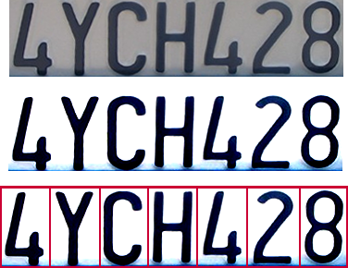
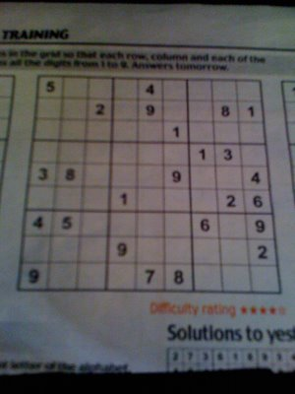

Optical character recognition (OCR)
  If you have a scanner, it probably came with OCR software
Digit recognition, AT&T labs
http://www.research.att.com/~yann/
License plate readers
http://en.wikipedia.org/wiki/Automatic_number_plate_recognition
Sudoku grabber
http://sudokugrab.blogspot.com/
Automatic check processing
Source: S. Seitz

Slide 27

Face detection
Nearly all cameras detect faces in real time
  (Why?)
Notes:
Why would this be useful? Main reason is focus. Also enables “smart” cropping.

Slide 28



Face Recognition

Slide 29

Face recognition
Who is she?
Source: S. Seitz

Slide 30



Vision-based biometrics
“How the Afghan Girl was Identified by Her Iris Patterns” Read the story
Source: S. Seitz

Slide 31




Login without a password…
Fingerprint scanners on many new laptops,
other devices
Face recognition systems now beginning to appear more widely
http://www.sensiblevision.com/
Source: S. Seitz

Slide 32

Object recognition (in supermarkets)
LaneHawk by EvolutionRobotics
“A smart camera is flush-mounted in the checkout lane, continuously watching for items. When an item is detected and recognized, the cashier verifies the quantity of items that were found under the basket, and continues to close the transaction. The item can remain under the basket, and with LaneHawk,you are assured to get paid for it… “
Source: S. Seitz

Slide 33

Object recognition (in mobile phones)
Source: S. Seitz

Slide 34


iPhone Apps: (www.kooaba.com)
Source: S. Lazebnik

Slide 35

Google Goggles

Slide 36
Google Search by Image

Slide 37

Leaf Recognition

Slide 38

Bird Identification
Merlin Bird ID (based on Cornell Tech technology!)

Slide 39

Special effects: camera tracking
Boujou, 2d3

Slide 40


Special effects: shape capture
The Matrix movies, ESC Entertainment, XYZRGB, NRC
Source: S. Seitz

Slide 41


Special effects: motion capture
Pirates of the Carribean, Industrial Light and Magic
Source: S. Seitz

Slide 42


3D face tracking w/ consumer cameras
Snapchat Lenses
Face2Face system (Thies et al.)

Slide 43


Sports
Sportvision first down line
Nice explanation on www.howstuffworks.com
Source: S. Seitz

Slide 44

Vision-based interaction (and games)
Assistive technologies
Nintendo Wii has camera-based IR
tracking built in. See Lee’s work at
CMU on clever tricks on using it to
create a multi-touch display!

Slide 45

Kinect

Slide 46

Smart cars
Mobileye
Tesla Autopilot
Safety features in many high-end cars

Slide 47

Self-driving cars
Google Waymo

Slide 48

Vision in space
The Heights of Mount Sharp
http://www.nasa.gov/mission_pages/msl/multimedia/pia16077.html
Panorama captured by Curiosity Rover, August 18, 2012 (Sol 12)
Vision systems (JPL) uses for several tasks
  Panorama stitching
  3D terrain modeling
  Obstacle detection, position tracking
  For more, read “Computer Vision on Mars” by Matthies et al.

Slide 49


Robotics
NASA’s Mars Curiosity Rover
https://en.wikipedia.org/wiki/Curiosity_(rover)
Amazon Picking Challenge
http://www.robocup2016.org/en/events/amazon-picking-challenge/
Amazon Prime Air

Slide 50


Medical imaging
3D imaging
MRI, CT
Image guided surgery
Grimson et al., MIT
Source: S. Seitz

Slide 51

Notes:
You may have read this headline last year and thought: 2 billion! That’s crazy? What is Virtual Reality? And why is it going to be so big?

Slide 52




Virtual & Augmented Reality
6DoF head tracking
Hand & body tracking
3D scene understanding
3D-360 video capture

Slide 53

My own work
Automatic 3D reconstruction from Internet photo collections
“Statue of Liberty”
“Half Dome, Yosemite”
“Colosseum, Rome”
Flickr photos
3D model

Slide 54

Photosynth

Slide 55

City-scale reconstruction
Reconstruction of Dubrovnik, Croatia, from ~40,000 images

Slide 56
Current state of the art
You just saw examples of current systems.
  Most of these are less than 5 years old
This is a very active research area, and rapidly changing
  Many new apps in the next 5 years
To learn more about vision applications and companies
  David Lowe maintains an excellent overview of vision companies
    http://www.cs.ubc.ca/spider/lowe/vision.html

Slide 57







Why is computer vision difficult?
Viewpoint variation
Scale
Illumination

Slide 58






Why is computer vision difficult?
Motion (Source: S. Lazebnik)
Intra-class variation
Background clutter
Occlusion

Slide 59


Challenges: local ambiguity
slide credit: Fei-Fei, Fergus & Torralba

Slide 60

But there are lots of cues we can exploit…
Source: S. Lazebnik

Slide 61

Bottom line
Perception is an inherently ambiguous problem
  Many different 3D scenes could have given rise to a particular 2D picture
  We often need to use prior knowledge about the structure of the world
Image source: F. Durand

Slide 62


Slide 65
CS5670: Introduction to Computer VIsion

Slide 66

Teaching Assistant
Zhengqi Li (zl548@cornell.edu)
Office hours:
  When: TuTh 3:30 – 5pm
  Where: Bear Hug
  (starting next week)

Slide 67

Important notes
Textbook:
  Rick Szeliski, Computer Vision: Algorithms and Applications
  online at: http://szeliski.org/Book/
Course webpage: http://www.cs.cornell.edu/courses/cs5670/2017sp/
Announcements/grades via Piazza/CMS
    https://piazza.com/class#fall2013/cs46705670
    https://cms.csuglab.cornell.edu/

Slide 68
Course requirements
Prerequisites—these are essential!
  Data structures
  A good working knowledge of Python programming
  Linear algebra
  Vector calculus
Course does not assume prior imaging experience
  computer vision, image processing, graphics, etc.

Slide 69




Course overview (tentative)
Low-level vision
  image processing, edge detection, feature detection, cameras, image formation
Geometry and algorithms
  projective geometry, stereo, structure from motion, Markov random fields
Recognition
  face detection / recognition, category recognition, segmentation
Light, color, and reflectance

Slide 70







1. Low-level vision
Basic image processing and image formation
*
=
Filtering, edge detection
Feature extraction
Image formation

Slide 71



Project: Hybrid images from image pyramids
G 1/8
G 1/4
Gaussian 1/2

Slide 72


Slide 73


Slide 74




Project: Feature detection and matching

Slide 75





2. Geometry
Projective geometry
Stereo
Multi-view stereo
Structure from motion

Slide 76



Project: Creating panoramas

Slide 77


Project: Single-View Modeling

Slide 78

Project: Photometric Stereo

Slide 79



3. Recognition
Face detection and recognition
Single instance recognition
Category recognition
Sources: D. Lowe, L. Fei-Fei

Slide 80

Project: Deep Learning for Recognition

Slide 81


4. Light, color, and reflectance
Light & Color
Reflectance

Slide 82





5. Advanced topics: Internet Vision
Turning the camera around
Human-aided computer vision
Internet datasets

Slide 83





5. Advanced topics
3D scanning
Motion and tracking
Monocular motion capture
Novel cameras and displays

Slide 84
Grading
Occasional quizzes (at the beginning of class)
One prelim, one final exam
  (considering final project instead of exam)
Rough grade breakdown:
  Quizzes + class evaluation: ~5%
  Midterm: 15-20%
  Programming projects: 40-50%
  Final exam: 15-20%

Slide 85
Late policy
Three free “slip days” will be available for the semester
Late projects will be penalized by 5% for first late day, and 10% for each day it is late after, and no extra credit will be awarded.

Slide 86
Academic Integrity
Assignments will be done solo or in pairs (we’ll let you know for each project)
Please do not leave any code public on GitHub (or the like) at the end of the semester!
Please see the Cornell Code of Academic Integrity (http://cuinfo.cornell.edu/aic.cfm)

Slide 87
Questions?

