Slide 1
Lecture 23: Reviewing Logs
CS 5430 4/23/2018

Slide 2
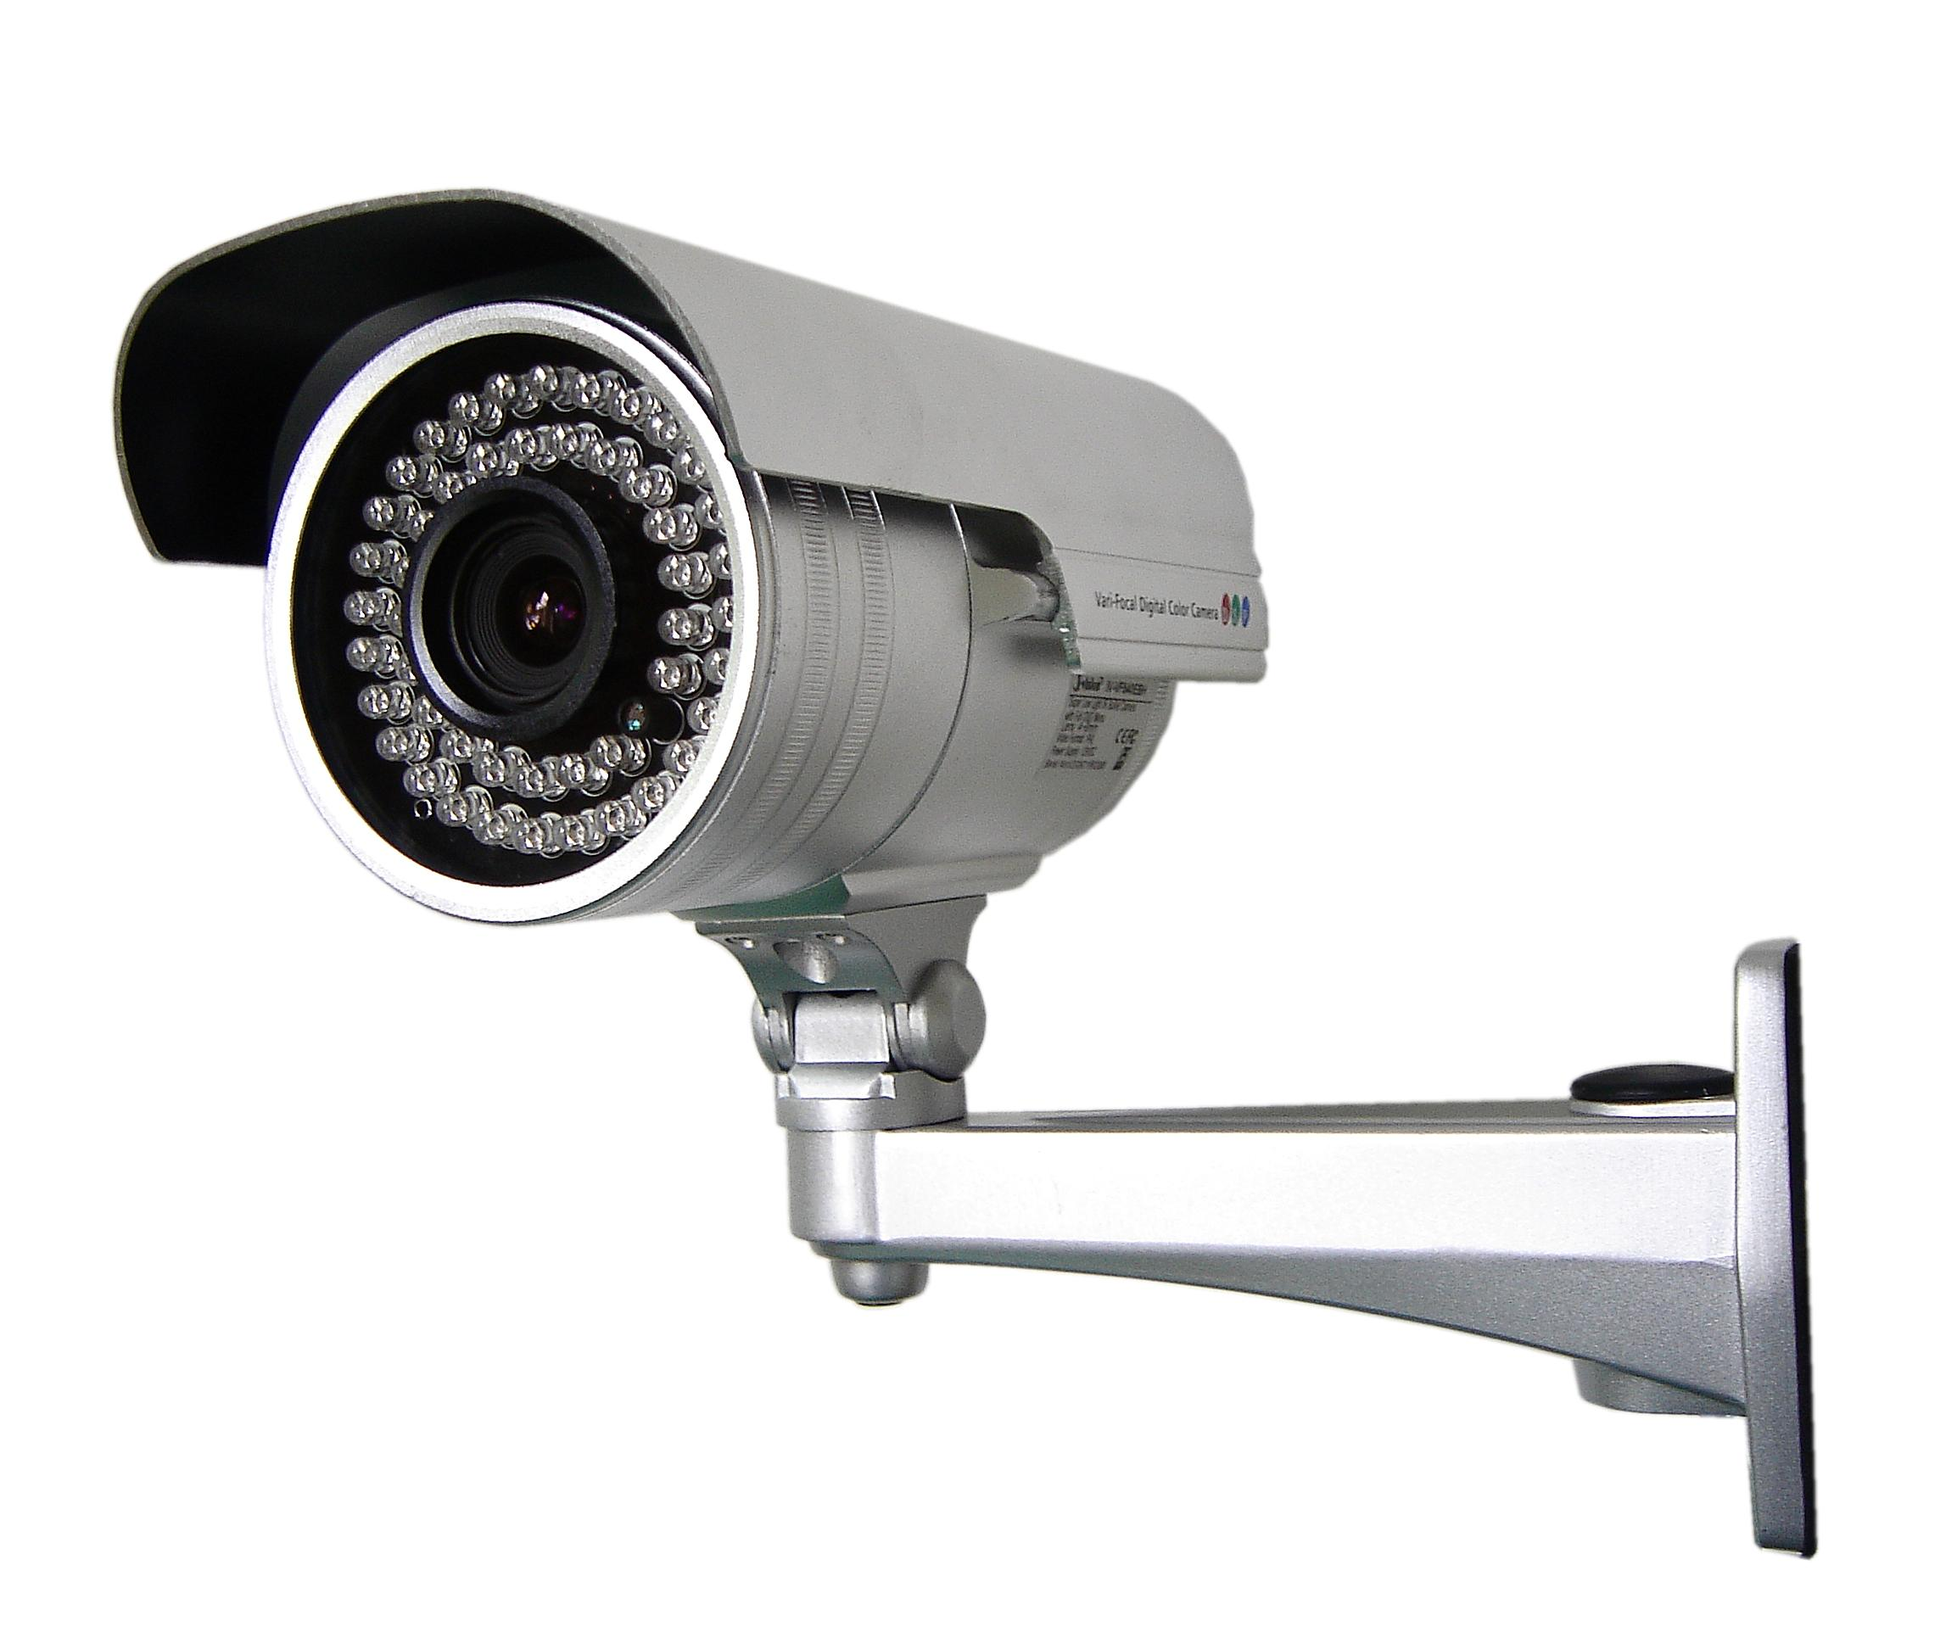
Classes of Countermeasures
Authentication: mechanisms that bind principals to actions
Authorization: mechanisms that govern whether actions are permitted
Audit: mechanisms that record and review actions

Slide 3
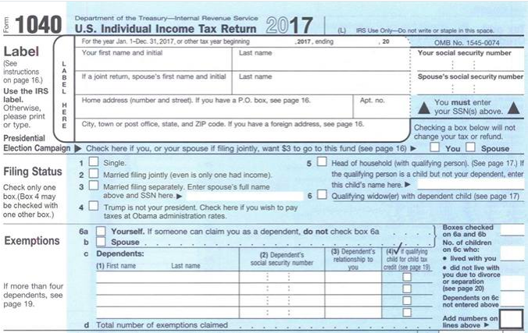
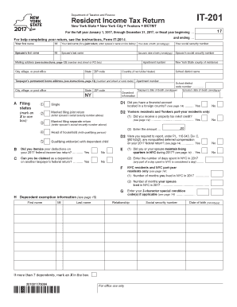
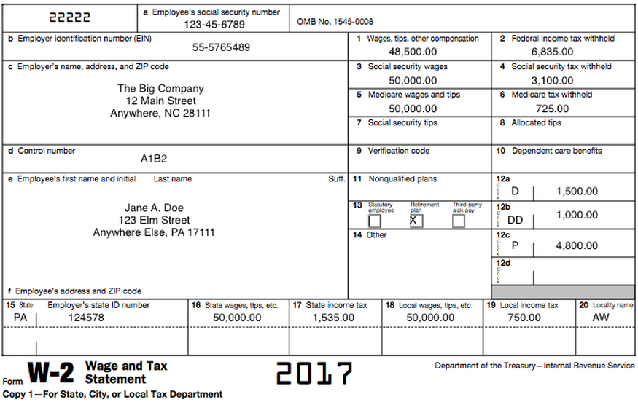
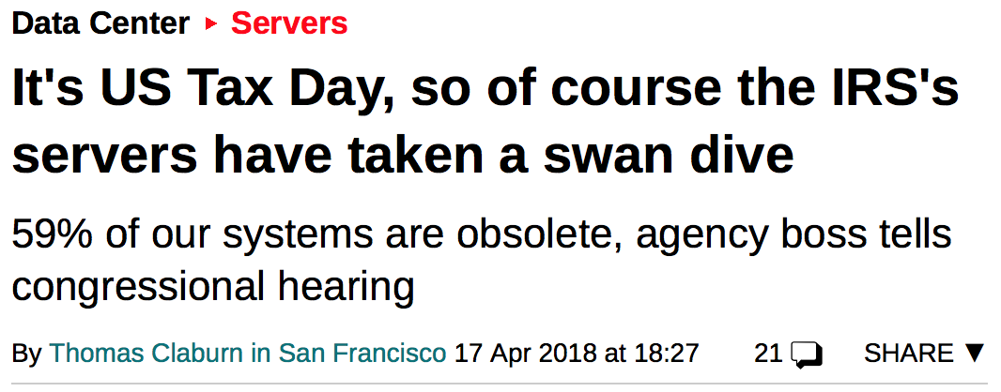
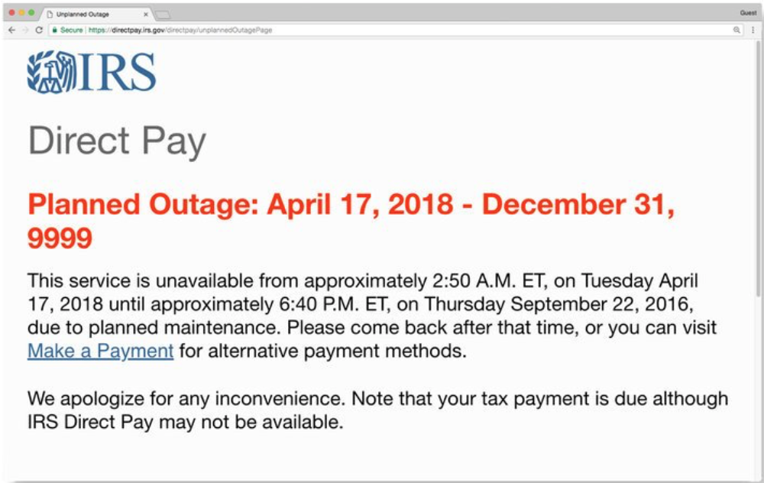
Uses of audit
Individual accountability: deter misbehavior
Event reconstruction: determine what happened and how to recover
Problem monitoring: real-time intelligence

Slide 4
Audit tasks
Recording:
what to log
what not to log
how to protect the log
Reviewing:
manual exploration
automated analysis

Slide 5
Manual

Slide 6
Manual review
Enable administrators to explore logs and look for {states, events}
Issues:
Designers might not have anticipated the right {states, events} to record
Visualization, query, expressivity (HCI/DB issues)
Correlation amongst multiple logs

Slide 7
Interfaces
Flat text [example: last time's syslog]
Hypertext [example]
DBMS [example: queries in CMS]
Graph (nodes might be entities like processes and files, edges might be associations like forking or times) [example]
Notes:
http://seclab.cs.ucdavis.edu/projects/awb/vabhg/demos/rdist/root.html
Discuss SUID attack example

Slide 8
Techniques
Temporal replay: animate what happened when [example]
Slice: display minimal set of log events that affect a given object
Notes:
Idea comes from program slicing: debugging technique that reveals program statements that led to current value of variable
Discuss example systems: splunk, logz.io, etc
https://www.keycdn.com/blog/log-analysis-tools/
https://youtu.be/OD1_I9IDvBs?t=213

Slide 9
Automatic

Slide 10
Automated review and response
Review: detect suspicious behavior that looks like an attack, or detect violations of explicit policy
Custom-built systems
Classic AI techniques like training neural nets, expert systems, etc.
Modern applications of machine learning
Response: report, take action

Slide 11
Intrusion detection

Slide 12
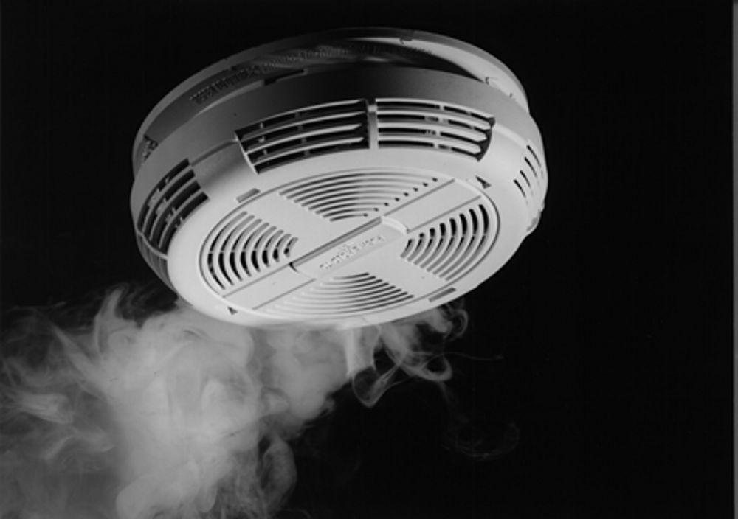
Intrusion detection
Intrusion detection system (IDS):
automated review and response
responds in (nearly) real time
components:
sensors
analysis engine
countermeasure deployment
audit log
Notes:
smoke alarm has all those components

Slide 13
Example: Network monitoring
Suspicious behavior: opening connections to many hosts
Automated response: router reconfigures to isolate suspicious host on its own subnet with access only to (e.g.) virus scanner download, notifies administrators
Issue: errors...

Slide 14
Errors
False positive: raise an alarm for a non-attack
makes administrators less confident in warnings
perhaps leading to actual attacks being dismissed
False negative: not raise an alarm for an attack
the attackers get in undetected!
Tradeoff between the two needs to be tunable; difficult to achieve the right classification statistics

Slide 15
Identification methodologies
[Denning 1987]
Signature based: recognize known attacks
Specification based: recognize bad behavior
Anomaly based: recognize abnormal behavior
Notes:
In practice, they are often combined

Slide 16
1. Signature-based detection
A.k.a. misuse detection and rule-based detection
Characterize known attacks with signatures
If behavior ever matches signature, declare an intrusion
Issues:
Works only for known attacks
Signature needs to be robust w.r.t. small changes in attack
Notes:
Examples:
e.g., 100 TCP SYN packets received on different ports of same host within 1 second (maybe a portscan)
e.g., creating a file while effective user is administrator but actual user is not, then transferring ownership of file to actual user (maybe indication that user managed to improperly escalate privileges)
e.g., an email with the subject "Free pictures!" and an attachment "freepics.exe" (maybe contains a virus)

Slide 17
Example: Tripwire
[open source tool and commercial product]
Policy: certain files shouldn't change
State snapshot: analyzes filesystem, stores database of file hashes
Automated response: runs (e.g. daily) and reports change of hash
Issues: where to store database, how to protect its integrity, how to protect tripwire itself?
Notes:
Policy: want to detect, e.g., rootkits that hide inside system executables
Issues: tripwire doesn’t make attacks impossible; just makes it a bit harder to be undetected

Slide 18
Example: Snort
# alert tcp $EXTERNAL_NET any -> $HOME_NET 53 ( msg:"OS-LINUX OS-LINUX x86 Linux overflow attempt ADMv2"; flow:to_server,established; content:"|89 F7 29 C7 89 F3 89 F9 89 F2 AC|<|FE|",fast_pattern,nocase; metadata:ruleset community; service:dns; classtype:attempted-admin; sid:265; rev:15; )

Slide 19
Network-based IDS
Typically a separate machine
Stealth mode:
one NIC faces the network being monitored, no packets ever sent out on it, no packets can be routed specifically to it
another NIC faces a separate network through which alarms are sent
Honeypot:
dedicated machines(s) or networks
purpose is to look attractive to attacker
but actually just a trap: monitored to detect and surveil attacker
Notes:
We’ve been thinking about this mostly as host-based so far, but can deploy on network as dedicated IDS device.

Slide 20
2. Specification-based detection
Characterize good behavior of program with a specification
If behavior ever departs from specification, declare an intrusion
Issues:
Effort to create specifications
Any program is a potential vulnerability if executed by a privileged user
Notes:
Examples:
e.g., the programs that may be loaded on a given host by a given user
e.g., the sequence of system calls that a given program is allowed to make

Slide 21
Example: Distributed Program Execution Monitor (DPEM)
[Ko et al. 1997]
Monitors Unix audit logs
Analyst writes grammar in DSL to describe good behavior
Parser checks conformance of logs with grammar
Distributed because it combines information from multiple hosts

Slide 22
3. Anomaly-based detection
Characterize normal behavior of system
If behavior ever departs far enough from normal, declare an intrusion
Issues:
Feature identification
Obtaining data on what is normal
Notes:
Examples:
e.g., maximum number of times user will mistype password is 3
e.g., number of processes a user launches during daytime and nighttime is between certain bounds that are dynamically adjusted based on past behavior

Slide 23
Example: Haystack
[Smaha 1988]
Monitors value of some statistic of interest over a sliding time window: a_{i}, a_{i+1}, ..., a_{j}
Determine lower and upper bounds t_{L} and t_{U} such that 90% of values lie between t_{L} and t_{U}
If next value is outside t_{L} and t_{U}, raise an alarm
Adaptive: as window moves, detector itself adjusts

Slide 24
Statistical models
Threshold models: min and max
Moment models: mean and standard deviation
Markov models: probability of next event based on current state
Seems like a job for machine learning…

Slide 25
Machine learning
Despite extensive academic research, “Machine learning [for IDS] is rarely employed in…real world settings” [Sommer & Paxson 2010]
ML is great for classification: finding similarities
ML is not as great at outlier detection: here, “normal vs. abnormal”
ML in adversarial setting not well understood
Notes:
This not to say that people aren’t trying or they aren’t to some extent succeeding. But it’s a harder problem than you might expect, given successes of ML.
ML is great for classification: finding similarities
E.g., recommending products or movies
E.g., determining which attack out of a set of training data a new trace most closely matches
ML is not as great at outlier detection: here, “normal vs. abnormal”
Especially given only examples of normality (closed-world assumption): Closed world assumption: giving only positive examples and assuming everything else is negative. Doesn’t work well in the real world because it’s rarely closed; positive examples are rarely sufficient.
Does work for spam detection, but…
Cost of false negatives there is low
Classification there is immediately actionable
ML in adversarial setting not as well understood
Techniques assume training and test data are from the same distribution
Adversary will exploit that assumption:
Poison training data
Evade classification
In IDS vs spam, classification not immediately actionable because security analyst now needs to divine what the attack is given the warning that [the trace] might be an attack.
https://www.utdallas.edu/~muratk/courses/dmsec_files/oakland10-ml.pdf

Slide 26
Identification methodologies
Signature based: recognize known attacks
Specification based: recognize bad behavior
Anomaly based: recognize abnormal behavior
Notes:
smoke alarm has all those components

Slide 27
Intrusion response

Slide 28
Intrusion handling
[Northcutt 1998]
Preparation
Identification
Containment
Eradication
Recovery
Follow up
Notes:
Preparation: establish procedures and mechanisms in advance
Identification: detect attack
Containment: limit ongoing damage
Eradication: stop attack and block similar attacks
Recovery: restore system to good state
Follow up: take action against attacker, identify problems, record lessons learned

Slide 29
Automated response
Monitor: collect (additional) data
Protect: reduce exposure of system
Alert: call a human
Notes:
Monitor: record additional traffic, system calls, etc.
Protect: shut off network connection, make file systems read only or take them offline, etc.
degrade response time, e.g. by making system calls take artificially, exponentially longer
jail attacker by redirecting to a confined area in which behavior can be controlled and manipulated

Slide 30
Counterattack
Legal: file criminal complaint
Technical: damage attacker to stop attack or prevent future attacks
Might harm an innocent party
Might expose you to legal liability
Notes:
Harming innocents:
what if your counterattack causes you to take out someone the attacker was just spoofing?
what if your counterattack degrades the network for everyone?

