Slide 1
Lecture 13: Tokens
CS 5430 3/16/2018

Slide 2
Review: Authentication of humans
Something you are
  fingerprint, retinal scan, hand silhouette, a pulse
Something you know
  password, passphrase, PIN, answers to security questions
Something you have
  physical key, ticket, {ATM, prox, credit} card, token

Slide 3
Humans vs. machines
At enrollment, human is issued a token
  Ranges from dumb (a physical key, a piece of paper) to a smart machine (a cryptographic processor)
  Token becomes attribute of human's identity
Authentication of human reduces to authentication of token

Slide 4

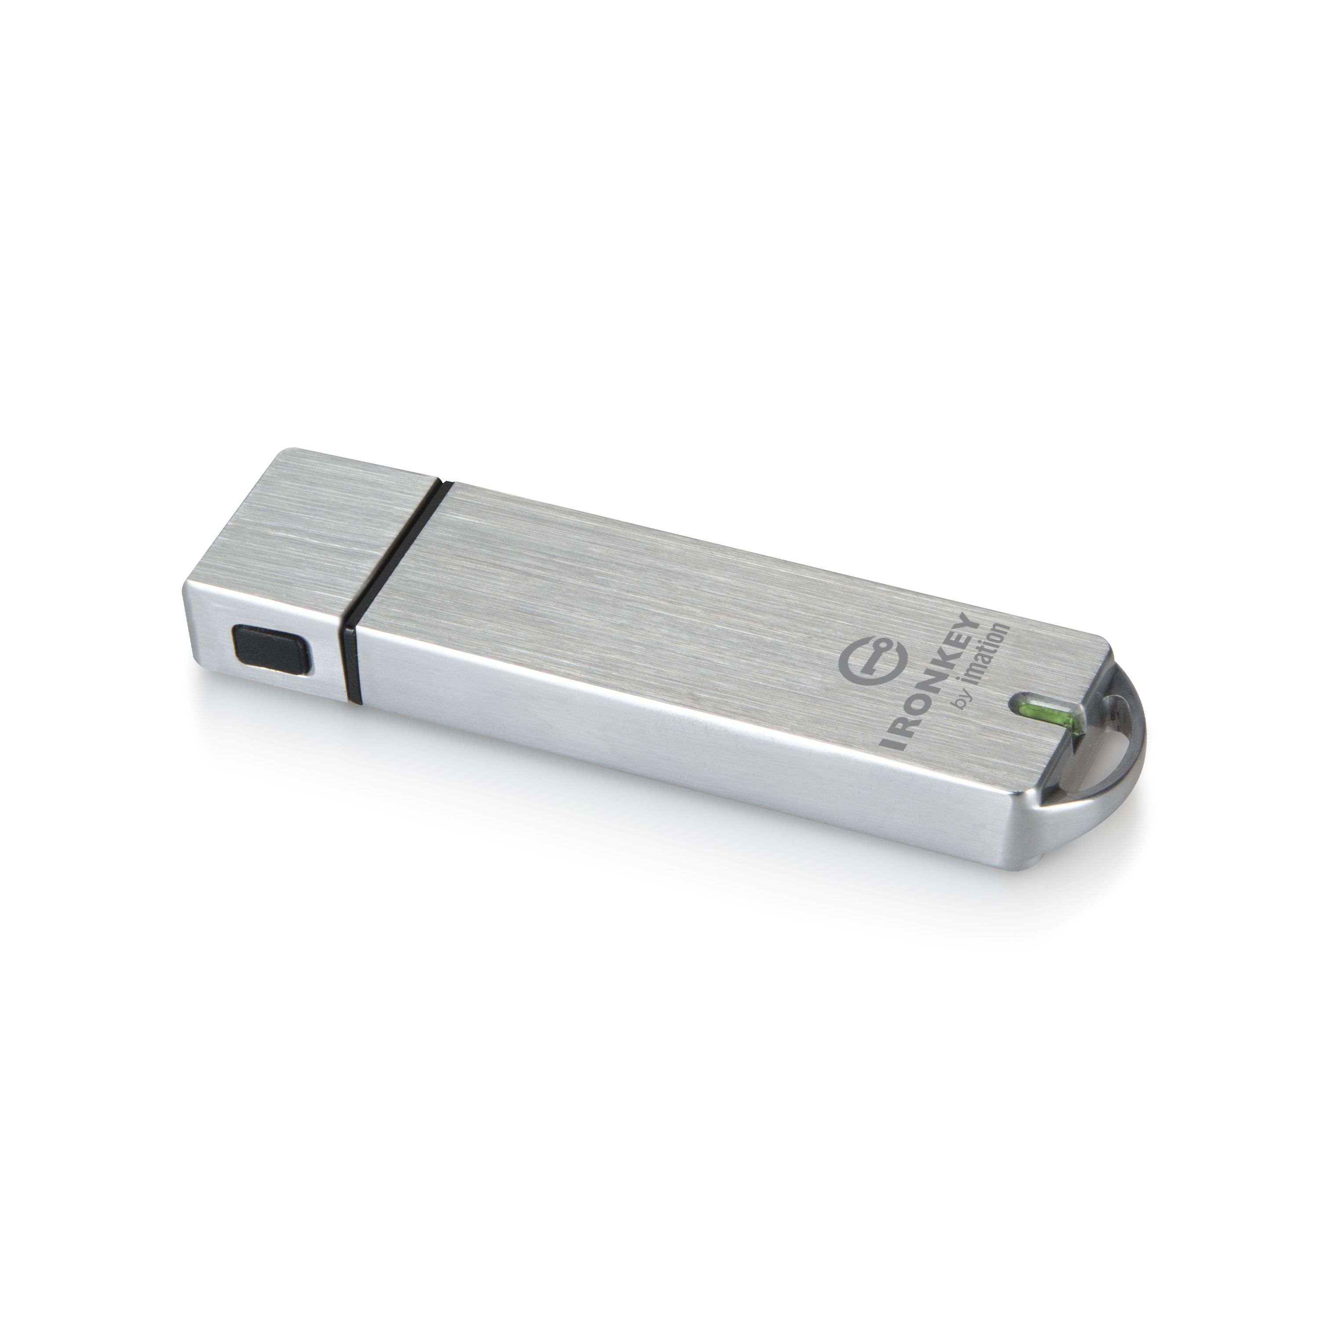
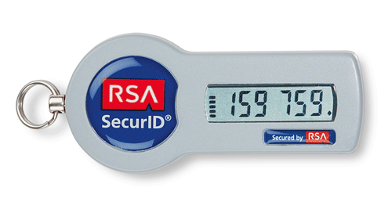

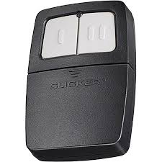
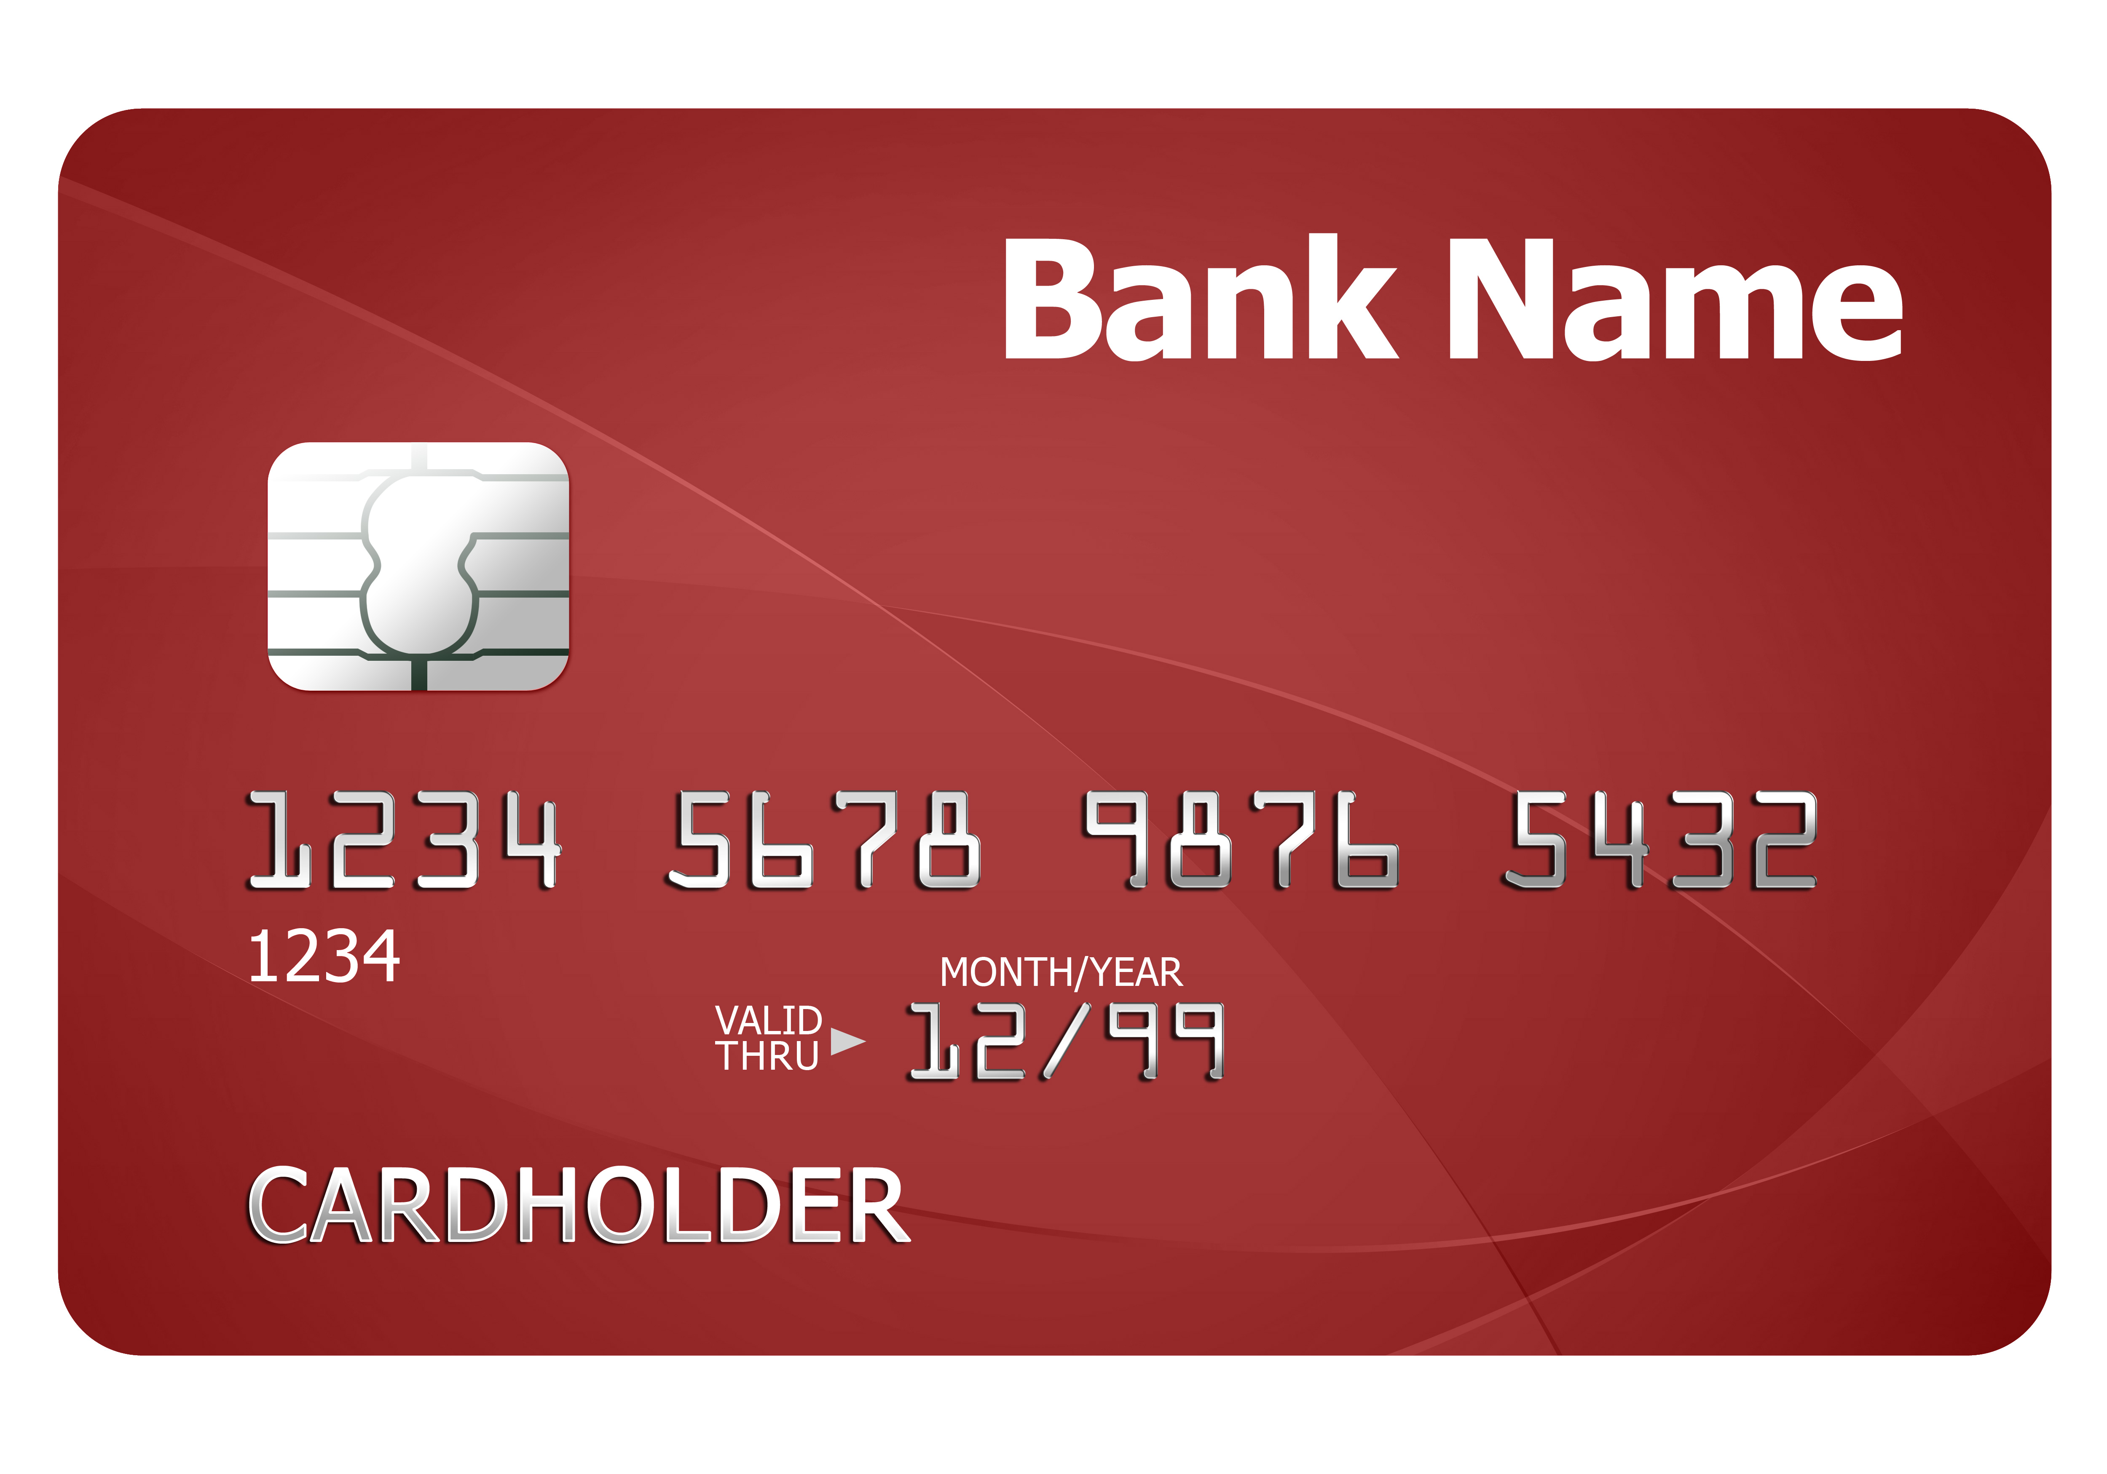
Authentication tokens
Notes:
Usability: users don't have to remember secrets, (often) easy to carry, efficient, infrequent errors
Deployability: (typically) low cost, but need to be physically distributed
Security: tokens store a value, this value can be longer/more random than value stored by human (ie, password),
some tokens can also do crypto -> typically more security

Slide 5
Threat Model: Eavesdropper
Adversary can read read and replay messages
Adversary cannot change messages during protocol execution (not full Dolev-Yao)

Slide 6
Fixed codes (Keyless Entry)
Token stores a secret value id_T (e.g., key, id, password)
Reader stores list of authorized ids
To enter: T->M: id_T
Attack: replay: thief sits in car nearby, records serial number, programs another token with same number, steals car
Attack: brute force: serial numbers were 16 bits, devices could search through that space in under an hour for a single car (and in a whole parking lot, could unlock some car in under a minute)
Attack: insider: serial numbers typically show up on many forms related to car, so mechanic, DMV, dealer's business office, etc. must be trusted
Notes:
relate to traditional rfid (note: rfid epc usually 96 or 128 bits, so eliminate 2/3 attacks)
replay concerns + privacy concerns

Slide 7
Fixed codes (RFIDs)
Token stores a secret value id_T (e.g., key, id, password)
Reader stores list of authorized ids
To enter: T->M: id_T
Attack: replay: thief sits nearby, records serial number, programs another token with same number, authenticates
Attack: privacy: adversary tracks token usage across system and learns user attributes and/or behaviors
Countermeasure: one-time passwords

Slide 8
“Rolling” codes
There is a master key, mk, for the barrier
Token stores:
  serial number T
  nonce N, which is a sequence counter
  shared key k, which is H(mk, T)
Barrier stores:
  all those values for all authorized tokens
  as well as master key mk
To enter: T->B: T, MAC(T, N; k)
  And T increments N
  So does B if MAC tag verifies
Problem: desynchronization of nonce
Partial solution: accept “rolling window” of nonces

Slide 9
Rolling window
Image source: Atmel
Notes:
Obviously an engineering tradeoff:
Bigger window => easier to automatically resynchronize, but easier to replay. So an example window size would be accepting 16 integers out of 2^16.
If preplay (e.g. valet captures token, records next nonce, robs you while you’re at restaurant) isn’t a concern, could maybe accept the next half of the space but reject the previous half (to defend against replay).
Still, this isn’t satisfying!

Slide 10
One-Time Passwords
OTP may be deemed valid only once (the first time)
Adversary cannot predict future OTPs, even with complete knowledge of what passwords have already been used
Notes:
rules out replay attacks, MITM attacks still possible

Slide 11
One-time passwords
A one-time password (OTP) is valid only once, the first time used
  Similar to changing your password with every use
  Rules out replays entirely
  But man-in-the-middle could still succeed
Use case: login at untrusted public machine where you fear keylogger
Use case: recovery
  "main password" is lost
  phone is lost during two-factor authentication (e.g., Google backup codes)
Older use case: send cleartext password over network

Slide 12
One-time passwords
Strawman implementation: Pre-registered OTPs
Solution: algorithmic generation of OTPs
  SecureID can be seen as an instantiation: each code is a OTP valid for only 60 sec.
  Iterated hashing is another possibility...
Notes:
Each user chooses many OTPs and stores them at server (in hashed salted form)At use, server checks whether provided password hashes to any of stored passwords, then deletes stored password if so to prevent re-use
Expensive! User has to pick and remember lots of strong passwordsServer has to store passwords and search for right password

Slide 13
Unique challenge: MACs
Assume: M stores a MAC key for each token,
i.e., a set of tuples (id_T, uid, k_T), and T stores k_T
1. U->M: I want to authenticate with T
2. M: invent unique nonce N
3. M->T: N
4. T: t=MAC(N; k_T)
5. T->M: id_T, t
6. M: lookup (uid, kT) for id_T;
U is authenticated as uid if t=MAC(N; k_T)
Non-problem: key distribution: already have to physically distribute tokens
Problem: key storage at L: what if key database is stolen?
Notes:
L needs to store many keys, can't hash and salt them because plaintext is needed; could use some kind of tamper-proof secure co-processor, or encrypt with key never stored on disk (if that’s possible)

Slide 14


EPC Gen2v2 RFID Cards
Notes:
EPC Gen2v2 is the most recent (2013) standard for UHF rfid implementations
introduced reader & tag authentication
Chips available on the market (e.g., ucode dna) but more expensive than standard tags

Slide 15
Unique challenge: Dig Sig
Assume: M stores a verification key for each token,
i.e., a set of tuples (id_T, uid, K_T), and T stores signing key k_T
1. U->M: I want to authenticate with T
2. M: invent unique nonce N
3. M->T: N
4. T: s=Sign(N; k_T)
5. T->M: id_T, s
6. M: lookup (uid, K_T) for id_T;
U is authenticated as uid if Ver(N; s; K_T)
Quasi-problems: cost? performance? power? patents?

Slide 16
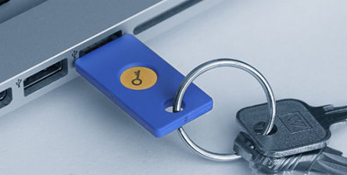
U2F
Notes:
created by Yubico and Google, open standard deployed in 2015
supported in Chrome, Firefox, Opera
derives app-specific ECC keypair using hardware secret, hashing
https://developers.yubico.com/U2F/Protocol_details/
also mobile app

Slide 17
Two-factor with PIN
Assume: M also stores a PIN for each token, i.e., a set of tuples (id_T, uid, k_T, pin), and T stores k_T
1. U->M: I want to authenticate with T
2. M: invent unique nonce N
3. M->T: N
4. T->U: Enter PIN on my keyboard
5. U->T: pin
6. T: compute t=MAC(N, pin; k_T)
7. T->M: id_T, t
8. M: lookup (uid, pin, k_T) for id_T;
U is authenticated as uid
if t=MAC(N, pin); k_T)

Slide 18
Remote Authentication
(Usually) No communication from server to token
Usability considerations render challenge-response impractical

Slide 19
Hypothetical protocol
Assume: S stores a set of tuples (id_T, uid, kT, pin), and T stores kT
1. U->L: I want to authenticate as uid to S
2. L and S: establish secure channel
3. L->U: Enter PIN and code on my keyboard
4. T->U: code = MAC(time@T, id_T; kT)
5. U->L: pin, code
6. L: compute h = H(pin, code)
7. L->S: uid, h
8. S: lookup (pin, id_T, kT) for uid;
id_Hu is authenticated
if h=H(pin, MAC(time@S, id_T; kT))
Engineering challenge: clock synchronization
Notes:
Pratical issues: clock drift, message delivery delay

Slide 20
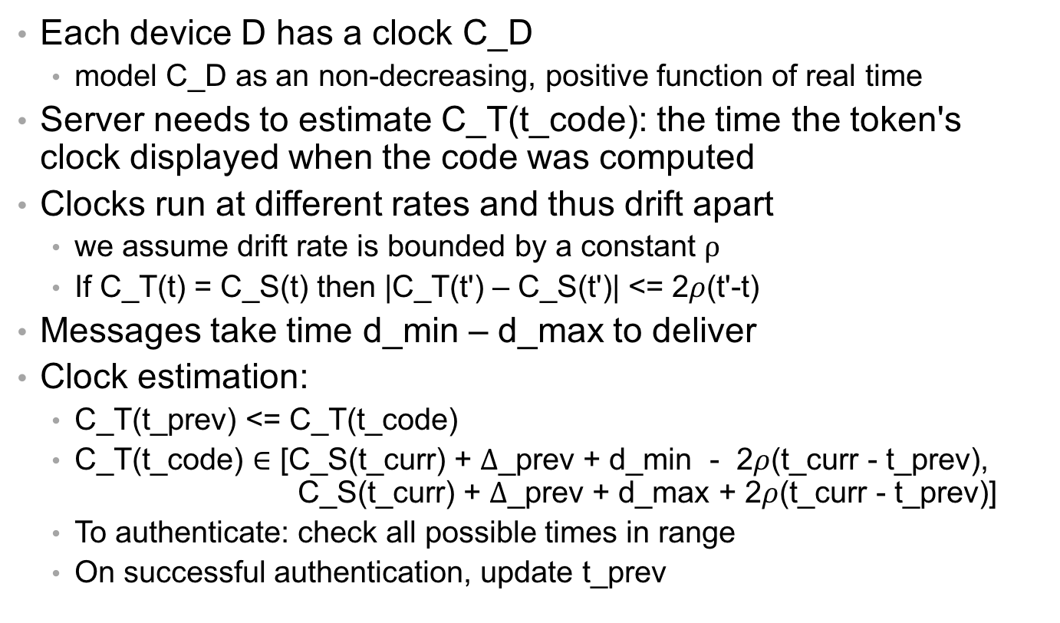
Estimating clock value
Each device D has a clock C_D
  model C_D as an non-decreasing, positive function of real time
Server needs to estimate C_T(t_code): the time the token's clock displayed when the code was computed
Clocks run at different rates and thus drift apart
  we assume drift rate is bounded by a constant $ρ$
  If C_T(t) = C_S(t) then |C_T(t') – C_S(t')| <= 2$ρ$(t'-t)
Messages take time d_min – d_max to deliver
Clock estimation:
  C_T(t_prev) <= C_T(t_code)
  C_T(t_code) $∈$ [C_S(t_curr) + $Δ$_prev + d_min - 2$ρ$(t_curr - t_prev), C_S(t_curr) + $Δ$_prev + d_max + 2$ρ$(t_curr - t_prev)]
  To authenticate: check all possible times in range
  On successful authentication, update t_prev
Notes:
clock granularity tradeoffs
For clocks found in digital electronics, drift rate \rhoe will be on the order of 10^−6 seconds per second.

Slide 21
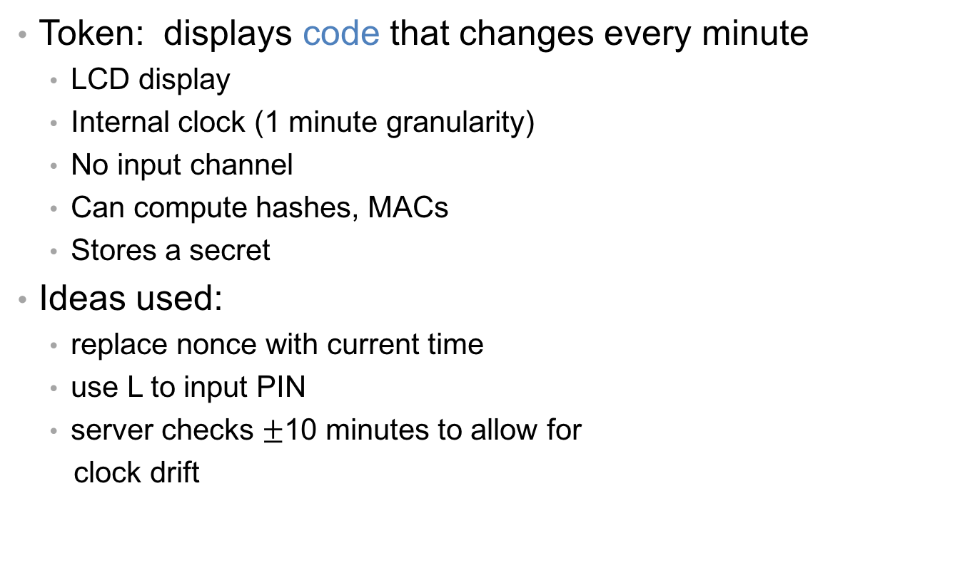
SecurID
Token: displays code that changes every minute
  LCD display
  Internal clock (1 minute granularity)
  No input channel
  Can compute hashes, MACs
  Stores a secret
Ideas used:
  replace nonce with current time
  use L to input PIN
  server checks $±$10 minutes to allow for
  clock drift
Notes:
built to be tamper-resistant, so an attacker who steals a SecurID token is unlikely to be able to physically open it and learn the secret it stores.
unique 128 bit secret installed at the factory
battery powered, with the expectation that the entire token will be replaced every 3 years.

Slide 22
Paper “token”
...
50: MEND VOTE MALE HIRE BEAU LAY
49: PUG LYRA CANT JUDY BOAR AVON
48: LOAM OILY FISH CHAD BRIG NOV
47: RUE CLOG LEAK FRAU CURD SAM
46: COY LUG DORA NECK OILY HEAL
45: SUN GENE LOU HARD ELY HOG
44: GET CANE SOY NOR MATE DUEL
43: LUST TOUT NOV HAN BACH FADE
42: HOLM GIN MOLL JAY EARN BUFF
41: KEEN ABUT GALA ASIA DAM SINK
...
Notes:
System prompts you for next number on list.
You type in passwords.
Then cross off that line and never reuse it.

Slide 23
Hash chains
Let H^{i}(x) be i iterations of H applied to x
  H⁰(x) = x
  H^{i+1}(x) = H(H^{i}(x))
Hash chain: H¹(x), H²(x), H³(x), ..., H^{n}(x)

Slide 24
OTPs from hash chains
Given a randomly chosen, large, secret seed s...
Bad idea: generate a sequence of OTPs as a hash chain: H¹(s), H²(s), ..., H^{n}(s)
  Suppose untrusted public machine learns H^{i}(s)
  From then on can compute next OTP H^{i+1}(s) by applying H, because hashes are easy to compute in forward direction
  But hashes are hard to invert...
Good idea [Lamport 1981]: generate a sequence of OTPs as a reverse hash chain: H^{n}(s), ..., H¹(s)
  Suppose untrusted public machine learns H^{i}(s)
  Next password is H^{i-1}(s)
  Computing that is hard!

Slide 25
Protocol (almost)
Assume: S stores a set of tuples (uid, n_u, s_u)
1. U->L->S: uid
2. S: lookup (n_u, s_u) for uid;
let n = n_u;
let otp = H^{n}(s_u);
decrement stored n_u
3. S->L->U: n
4. U: p = H^{n}(s_u)
5. U->L->S: p
6. S: uid is authenticated if p = otp
Problem: S has to compute a lot of hashes if authentication is frequent

Slide 26
Solution to S's hash burden
S stores last: last successful OTP for id_Hu, where last = H^{n+1}(s)
S receives next: next attempted OTP, where if all is well next = H^{n}(s)
S checks its correctness with a single hash:
  H(next) = H(H^{n}(s)) = H^{n+1}(s) = last
And if correct S updates last successful OTP: last := next
Next problem: what if Hu and S don't agree on what password should be used next? i.e., become desynchronized
network drops a message
attacker does some online guessing (impersonating Hu) or spoofing (impersonating S)

Slide 27
Solution to desynchronization
Hu and S independently store index of last used password from their own perspective, call them m_Hu and m_S
  Neither is willing to reuse old passwords (i.e., higher indexes)
  But both are willing to skip ahead to newer passwords (i.e., lower indexes)
To authenticate:
  S requests index m_S
  Hu computes min(m_S, m_Hu), sends that along with OTP for it
  S and Hu adjust their stored index
Next problem: running out of passwords: have to bother sysadmin to get new printed passwords periodically; might run out while traveling
Solution: replace system-chosen seed with user-chosen password plus salt

Slide 28
Salted passwords as seed
Compute OTP as H^{n}(pass,salt)
Whenever Hu wants to generate new set of OTPs:
  find a local machine Hu trusts (could be offline, phone, ...)
  request new salt from S
  enter pass
  generate as many new OTPs as Hu likes by running hash forward
  let S know how many were generated and what the last one was

Slide 29
Final protocol
Assume: S stores a set of tuples (uid, n_S, salt, last), Hu stores (pass, n_u)
1. U->L->S: uid
2. S: lookup n_S for uid
3. S->L->U: n_S
4. U: n = min(n_u, n_S) – 1;
if n<=0 then abort
else let p = H^{n}(pass, salt); // lookup on paper
n_u := n // cross off on paper
5. U->L->S: n, p
6. S: if n<n_S and H^{n_S-n}(p)=last
then n_S := n;
last := p;
uid is authenticated

Slide 30
S/KEY
[RFC 1760]:
Instantiation of that protocol for particular hash algorithms and sizes
But same idea works for newer hashes and larger sizes

Slide 31
Solution to human computation
Problem: humans aren't good at typing long bit strings
Solution: represent bit strings as short words
i.e., divide hash output into chunks, use each chunk as index into dictionary, where each word in dictionary is fairly short
...
50: MEND VOTE MALE HIRE BEAU LAY
49: PUG LYRA CANT JUDY BOAR AVON
48: LOAM OILY FISH CHAD BRIG NOV
47: RUE CLOG LEAK FRAU CURD SAM
46: COY LUG DORA NECK OILY HEAL
...

