Slide 1
Lecture 9: Public-Key Cryptography
CS 5430 3/05/2018

Slide 2
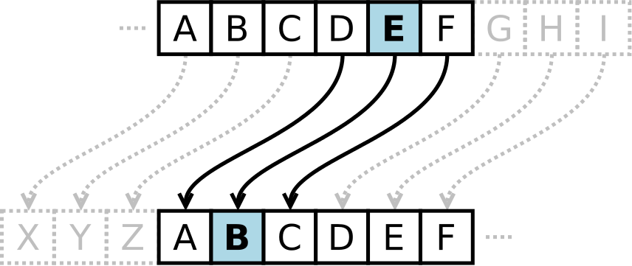
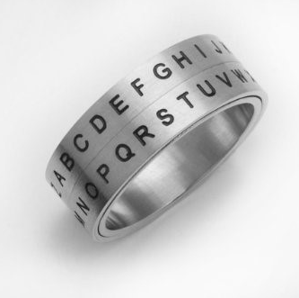
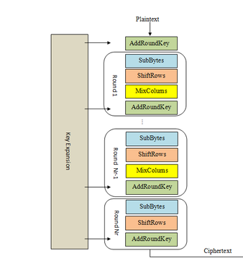
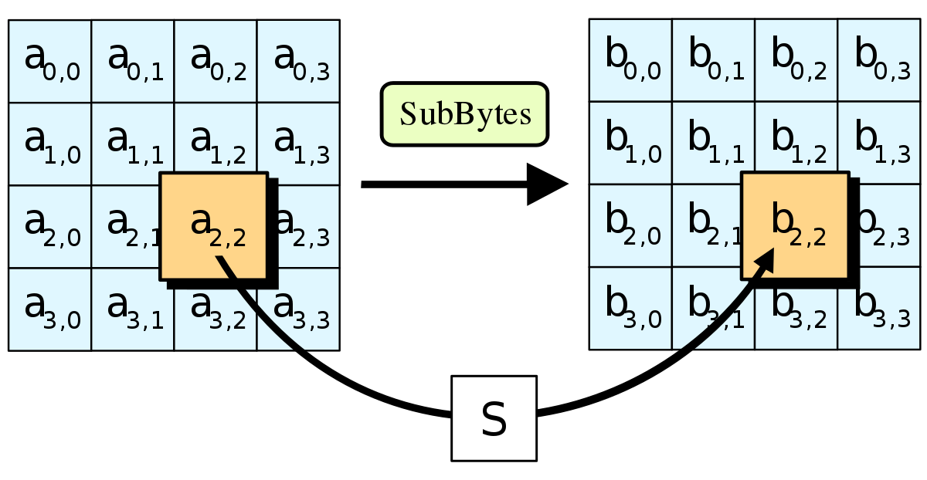
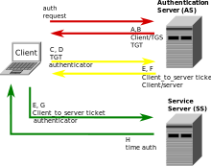
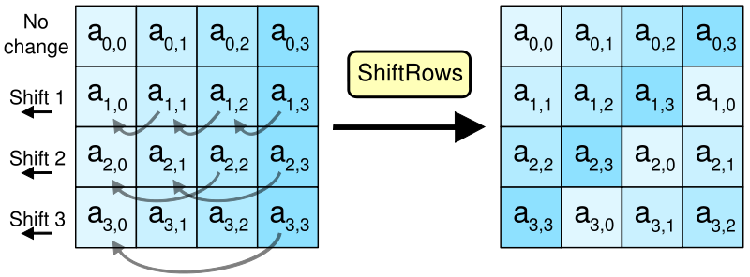
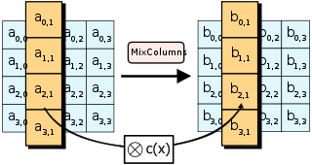
Crypto Thus Far…

Slide 3
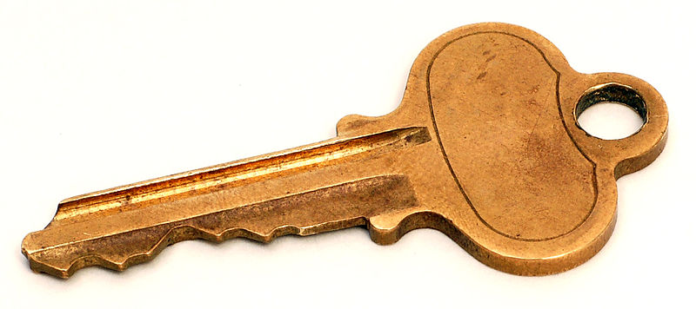
Key pairs
Instead of sharing a key between pairs of principals...
...every principal has a pair of keys
public key: published for the world to see
private key: kept secret and never shared
Notes:
Note that private keys are secret (but shared/symmetric keys are called "secret")

Slide 4
Protocol to exchange encrypted message
1. A: c = Enc(m; K_B)
2. A -> B: c
3. B: m = Dec(c; k_B)
key pair: (K_B, k_B)
public key written with uppercase letter
private key written with lowercase letter

Slide 5
Public keys
0. B: (K_B, k_B) = Gen(len)
...
All public keys published in "phonebook"
So A can lookup B's key to send message
Length of phonebook is O(n)
So quadratic problem reduced to linear!
Eliminates key distribution problem!

Slide 6
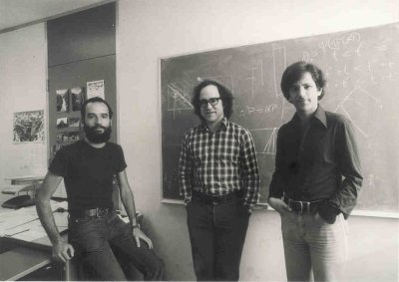
RSA
[Rivest, Shamir, Adleman 1977]
Shared Turing Award in 2002: ingenious
contribution to making public-key crypto
Pick primes $p,q$
Choose $e,d$ such that $ed=1 mod (p−1)(q−1)$
$PK=(n, e)$
$SK=(p,q, d)$
$$c=m^{e} mod n$$
$$m=c^{d} mod n$$
Notes:
size of modulus bounds size of keys and methods: usually 2048 bit (note: much bigger than AES keys!!!)
recommendations for strength summarized at https://www.keylength.com/en/
factoring n would break RSA (assumed to be hard) Largest challenge broken so far is 768-bit modulus [2010]
Shor's algorithm factors in polynomial time on a quantum computer: largest factorization so far is of the number 56153 (i.e., 16 bits); motivates work on post-quantum cryptography

Slide 7
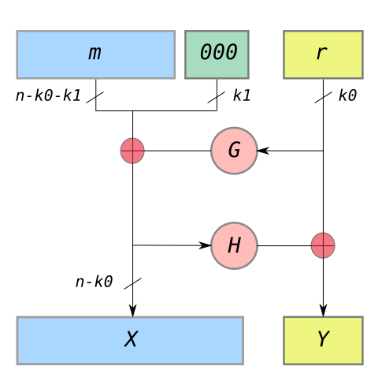
Textbook RSA is insecure
Deterministic: given same plaintext and key, always produces the same ciphertext
Several other attacks, too
Solution: incorporate a nonce in the message before encrypting
Called padding but encoding might be a better term
Don’t implement yourself; use OAEP implementation in your crypto library (Optimal Asymmetric Encryption Padding)

Slide 8
Problems of length
Asymmetric encryption uses big integers, not byte arrays
all messages must be encoded as integers
modulus dictates maximum integer that can be encrypted
big integer operations are slow
say, 1 to 3 orders of magnitude slower than block ciphers
So the problems we had before crop up again...
what if message length is too short?
actually that's okay: a small integer is still an integer
what if message length is too long?
in theory could use block modes like with symmetric encryption
in practice, that's too inefficient...
Notes:
Note other encryption schemes: el gamal, nonmalleable, homomorphic

Slide 9
Hybrid Encryption
Notes:
Liger cub: cross between lion and tiger

Slide 10
Hybrid encryption
Assume:
Symmetric encryption scheme (Gen_S, Enc_S, Dec_S)
Asymmetric encryption scheme (Gen_A, Enc_A, Dec_A)
Use asymmetric encryption to establish a shared session key
Avoids quadratic problem, assuming existence of phonebook
Session key will be short, so avoids inefficiency
Use symmetric encryption to exchange long plaintext encrypted under session key
Gain efficiency of block cipher and mode

Slide 11
Protocol to exchange encrypted message
0. B: (K_B, k_B) = Gen_A(len_A)
1. A: k_s = Gen_S(len_S)
c1 = Enc_A(k_s; K_B)
c2 = Enc_S(m; k_s) //mode
2. A -> B: c1, c2
3. B: k_s = Dec_A(c1; k_B)
m = Dec_S(c2; k_s)

Slide 12
Session keys
If key compromised, only those messages encrypted under it are disclosed
Used for a brief period then discarded
cryptoperiod: length of time for which key is valid
in this case, for a single (long) message
not intended for reuse in future messages
only intended for unidirectional usage:
A->B, not B->A
why? A chose the key, not B

Slide 13
Encryption
We can now protect confidentiality of messages against Dolev-Yao attacker
efficiently, thanks to hybrid of symmetric and asymmetric encryptionhonebook of public keys
But what about integrity...?

Slide 14
Digital Signatures

Slide 15
Recall: Key pairs
Instead of sharing a key between pairs of principals...
...every principal has a pair of keys
public key: published for the world to see
private key: kept secret and never shared

Slide 16
Key pair terminology
 | Encryption | Digital signatures
Public key | Encryption key | Verification key
Private key | Decryption key | Signing key

Slide 17
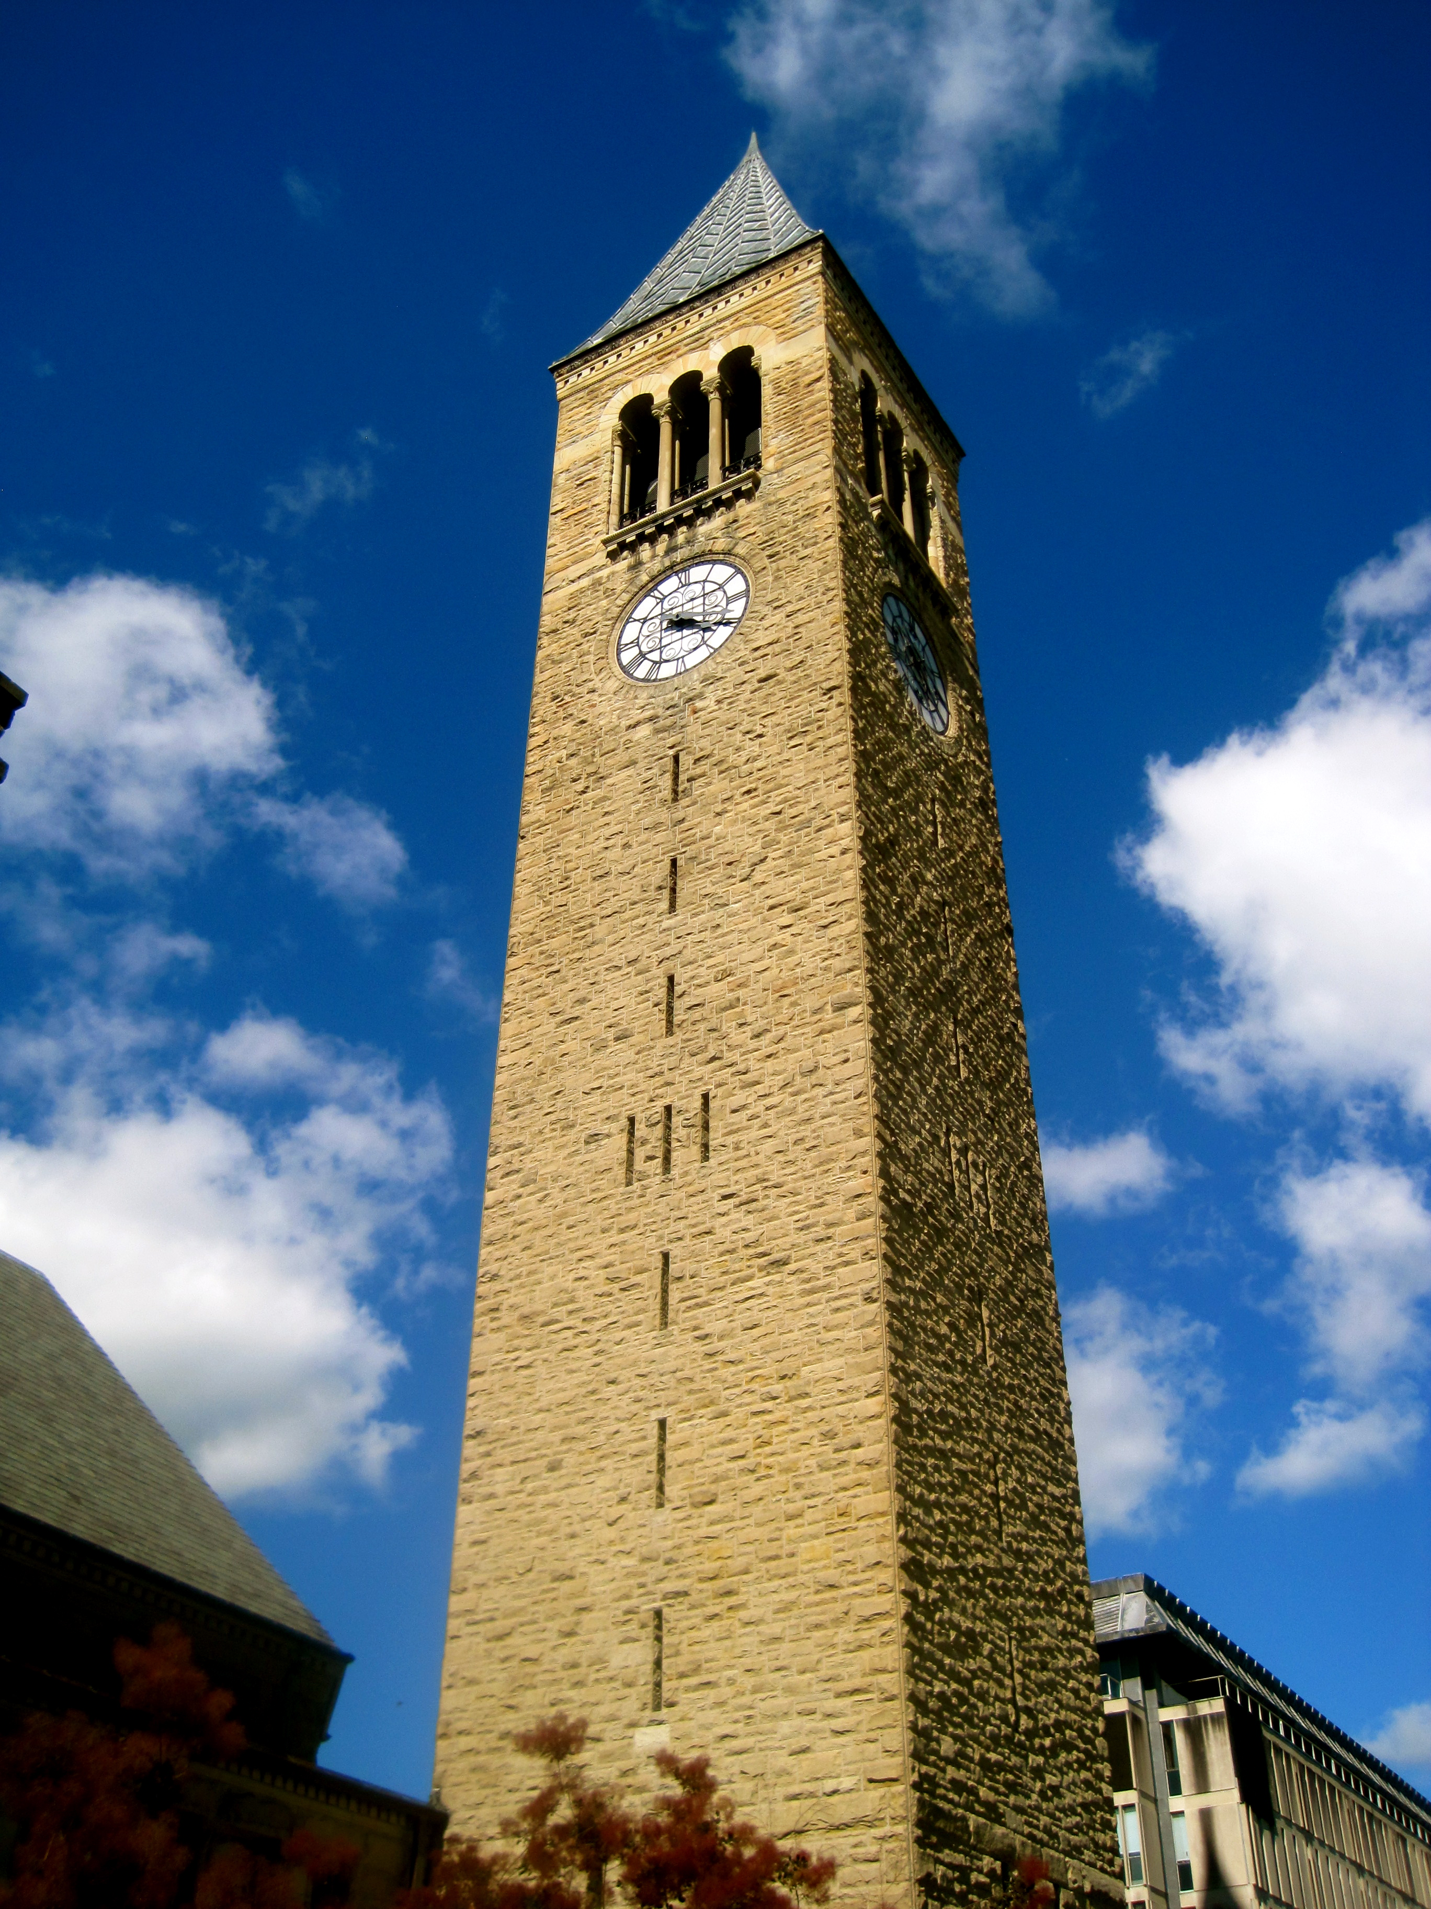
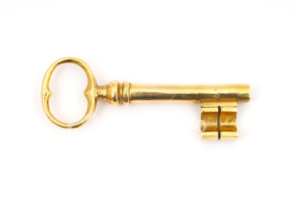
Digital signature scheme
Sign(m; k): sign message m with key k, producing signature s as output
Ver(m; s; K): verify signature s on message m with key K
Gen(len): generate a key pair (K,k) of length len
Sign

Slide 18
Protocol to exchange signed message
0. A: (K_A,k_A) = Gen(len)
1. A: s = Sign(m; k_A)
2. A -> B: m, s
3. B: accept if Ver(m; s; K_A)
Message is sent in plaintext: no protection of confidentiality
Goal is to detect modification not prevent
...what if message is too long for asymmetric algorithms?

Slide 19
Security of digital signatures
Must be hard to forge signature for a message without knowledge of key
...like handwritten signatures
Even if in possession of multiple (message, signature) pairs for that key
...unlike handwritten signatures

Slide 20
RSA
Core ideas are the same as RSA encryption
Common mistake: “RSA sign = encrypt with private key”
Truth (in real world, outside of textbooks):
there's a core RSA function R that works with either K or k
RSA encrypt = do some prep work on m then call R with K
RSA sign = do different prep work on m then call R with k
Prep work: recall “textbook RSA is insecure”
(For encryption: OAEP)
For signatures: PSS (probabilistic signature scheme)
Also need to handle long messages…
Notes:
The DSA patent credits Kravitz; NIST is who introduced it.

Slide 21
Signatures with hashing
1. A: s = Sign(H(m); k_A)
2. A -> B: m, s
3. B: accept if Ver(H(m); s; K_A)
So common a practice that I won't bother to write the hashing from now on

Slide 22
DSA
DSA: Digital Signature Algorithm [Kravitz 1991]
Standardized by NIST and made available royalty-free in 1991/1993
Used for decades without any serious attacks
Closely related to Elgamal encryption
Notes:
The DSA patent credits Kravitz; NIST is who introduced it.

Slide 23
Blind signatures
[Chaum 1983]
Purpose: signer doesn’t know what they are signing
Two additional algorithms: Blind and Unblind
Unblind(Sign(Blind(m); k)) = Sign(m; k)
Uses: e-cash, e-voting

Slide 24
Group signatures
[Chaum and van Heyst 1991]
Purpose: one member of group signs anonymously on behalf of group
Introduces a group manager who controls membership
Two new protocols: Join and Revoke, to manage membership
One new algorithm: Open, which manager can run to reveal who signed a message

