Slide 1
Lecture 6: Symmetric Cryptography
CS 5430 February 21, 2018

Slide 2
The Big Picture Thus Far…
Attacks are perpetrated by threats that inflict harm by exploiting vulnerabilities which are controlled by countermeasures.

Slide 3
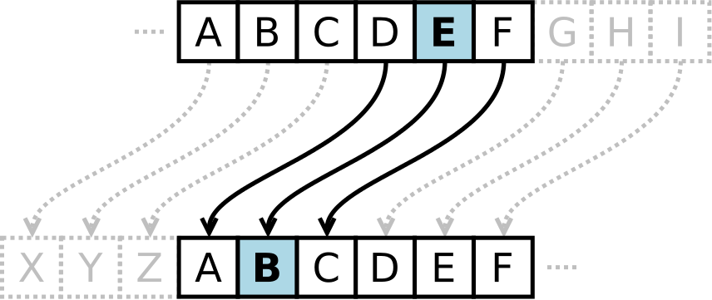
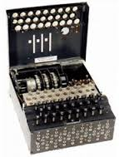
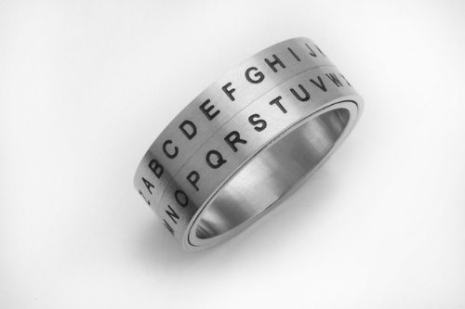
Classical Cryptography
Notes:
Caesar Cipher:
simple substitution cipher
first recorded use: caesar used shift of 3 to record military secrets
no real security now
Classical vs modern:
Enigma machine from WW2
RSA algorithm for encryption
Latex source:
\begin{tabular}{c}
$P$ and $Q$ prime \\
$N = PQ$ \\
$ED \equiv 1 \mod (P-1)(Q-1)$ \\
$C = M^E \mod N$ \\
$M = C^D \mod N$
\end{tabular}

Slide 4
Kerckhoffs' Principle
Secrecy should depend upon the key remaining secret
Secrecy should not depend upon the algorithm remaining secret
Instance of Open Design
Proprietary encryption schemes are to be avoided
Just google "proprietary encryption broken"

Slide 5
Tenants of modern cryptography
When inventing a cryptographic algorithm/protocol:
Formulate a precise definition of security
Provide a rigorous mathematical proof that the cryptographic algorithm/protocol satisfies the definition of security
State any required assumptions in the proof, keeping them as minimal as possible

Slide 6
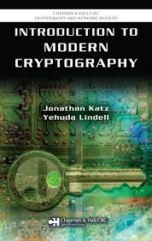
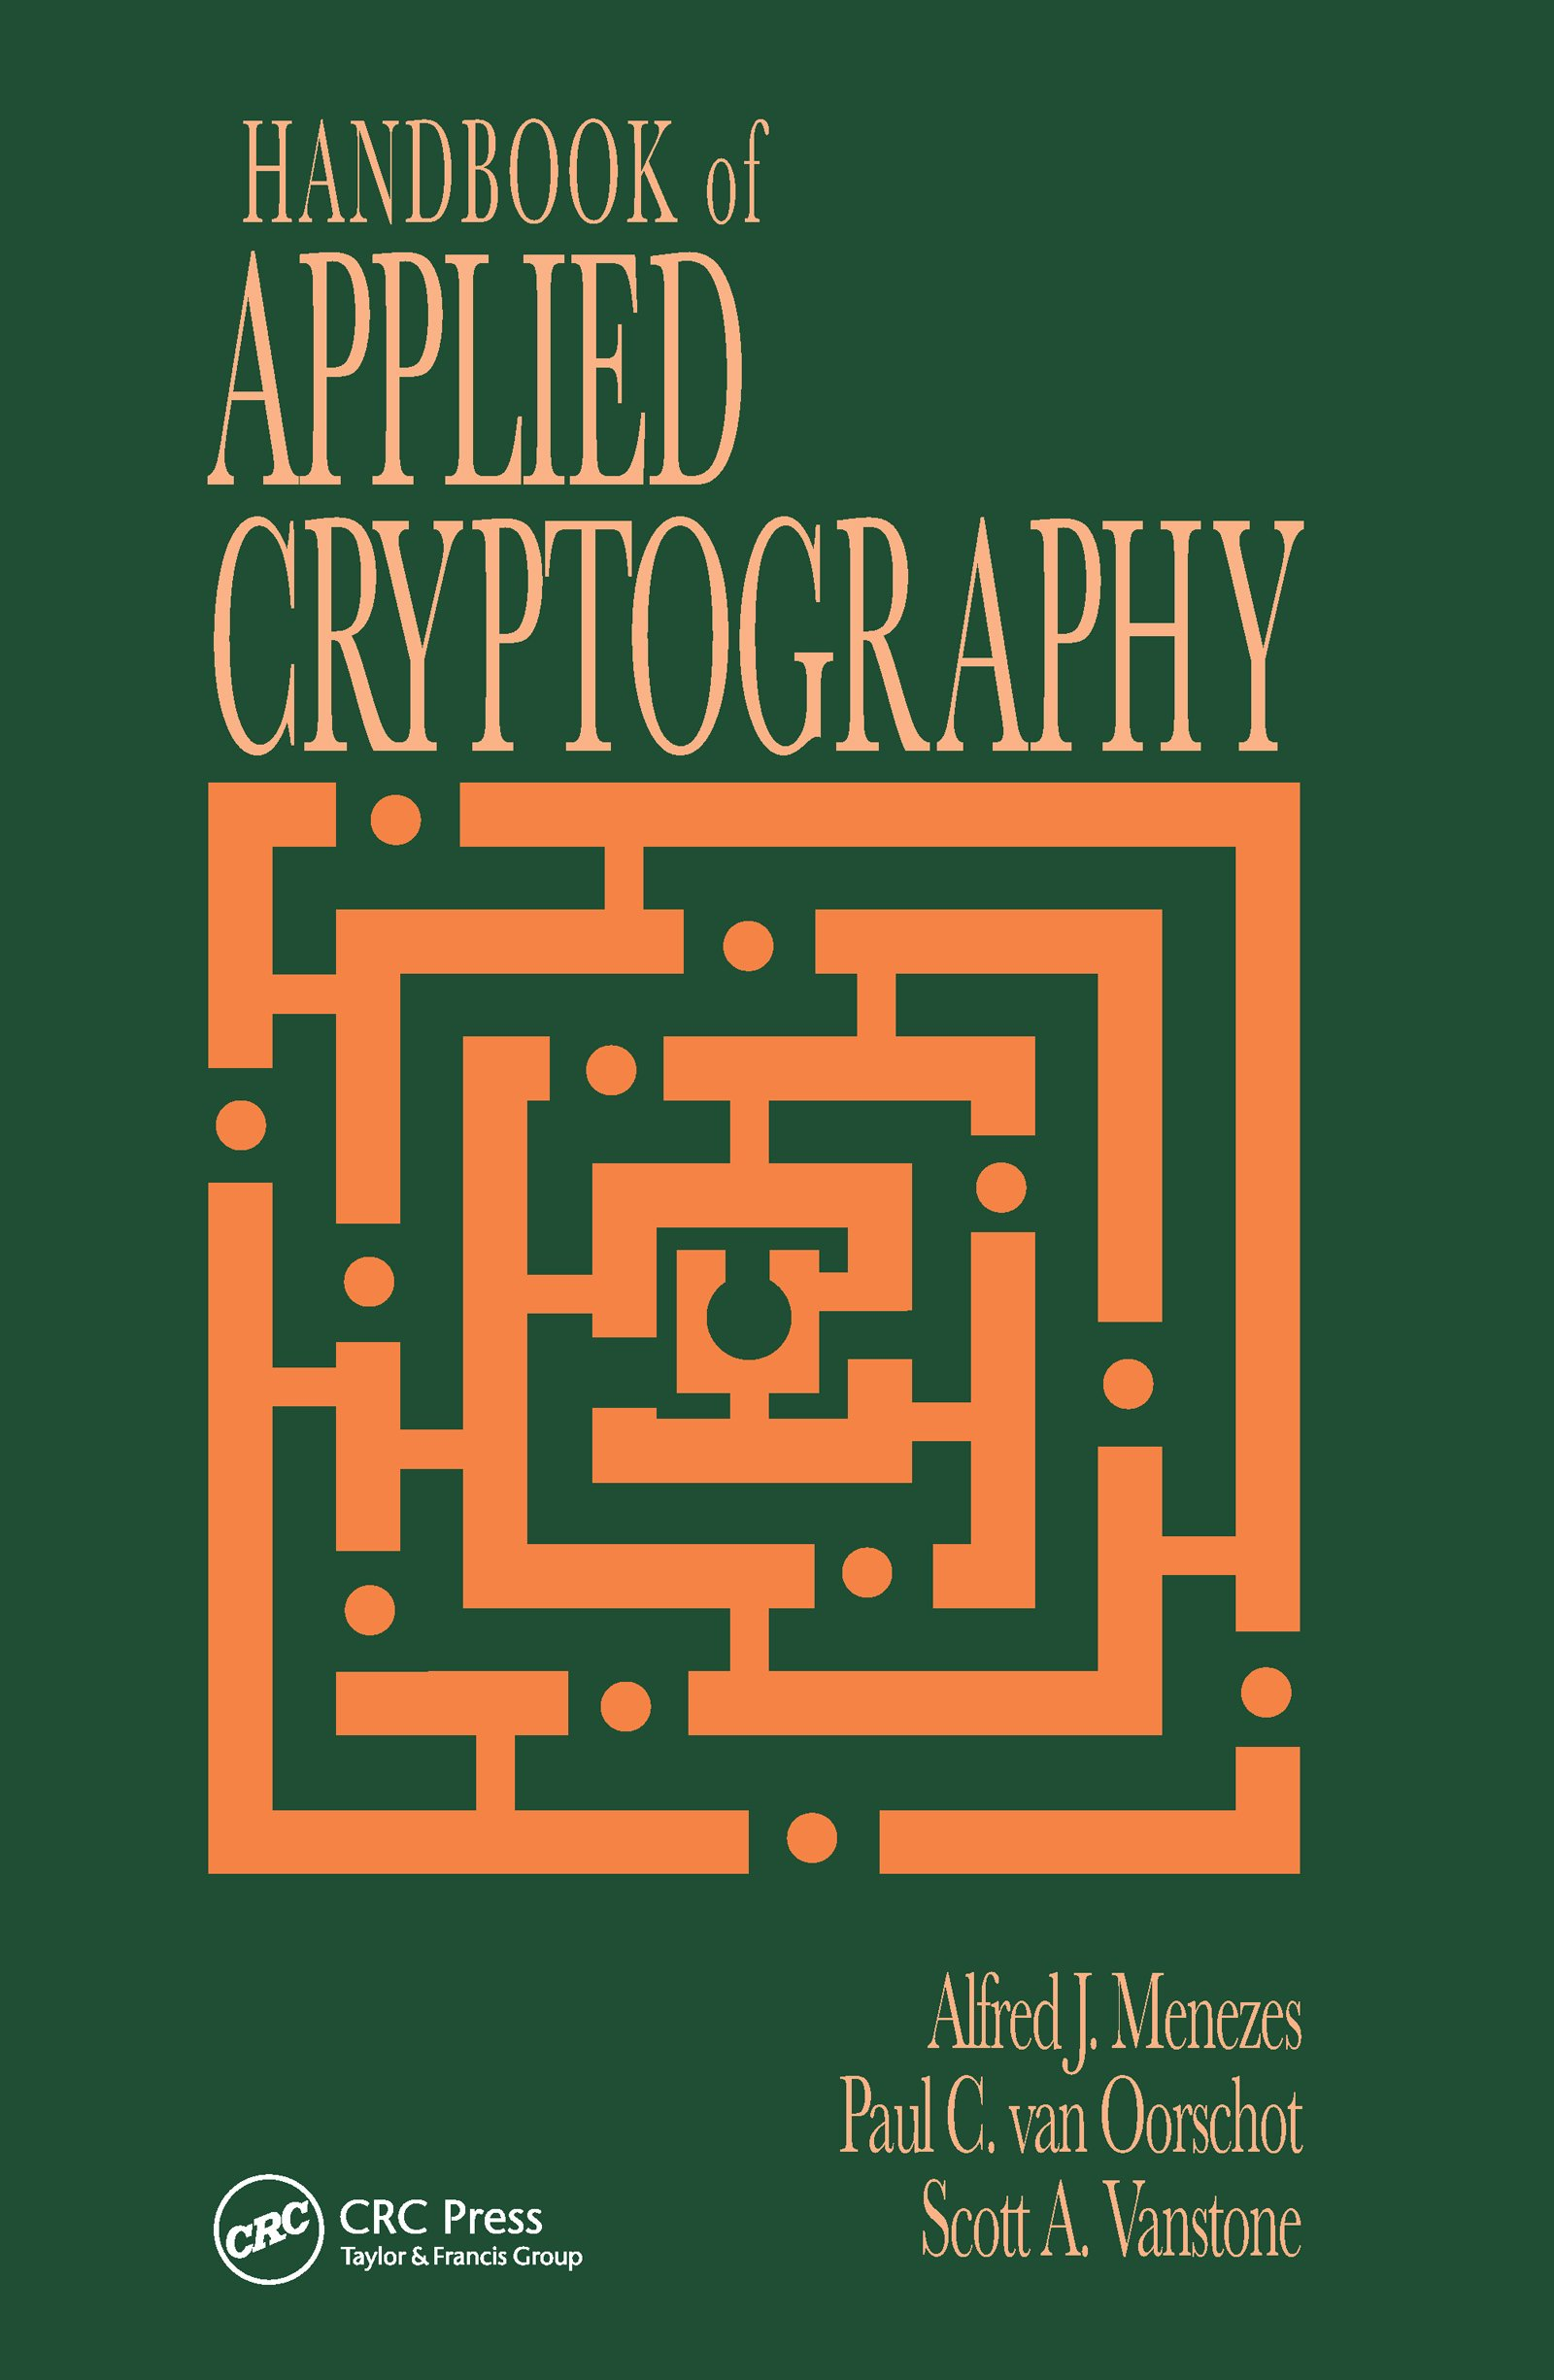
Cryptography
cf. CS 4830/6830
cf. CS 6832
Notes:
Modern vs. applied
Our concern is how to use cryptography

Slide 7
Purpose of Encryption
Threat: attacker who controls the network
can read, modify, delete messages
in essence, the attacker is the network
Dolev-Yao model [1983]
Notes:
Yao was the 2000 Turing Award winner: "…Since its introduction, [the] “Dolev-Yao model” has been the starting point for most work done on symbolic security…"

Slide 8
Purpose of encryption
Threat: attacker who controls the network
can read, modify, delete messages
in essence, the attacker is the network
Dolev-Yao model [1983]
Harm: messages containing secret information disclosed to attacker (violating confidentiality)
Vulnerability: communication channel between sender and receiver can be read by other principals
Countermeasure: encryption

Slide 9
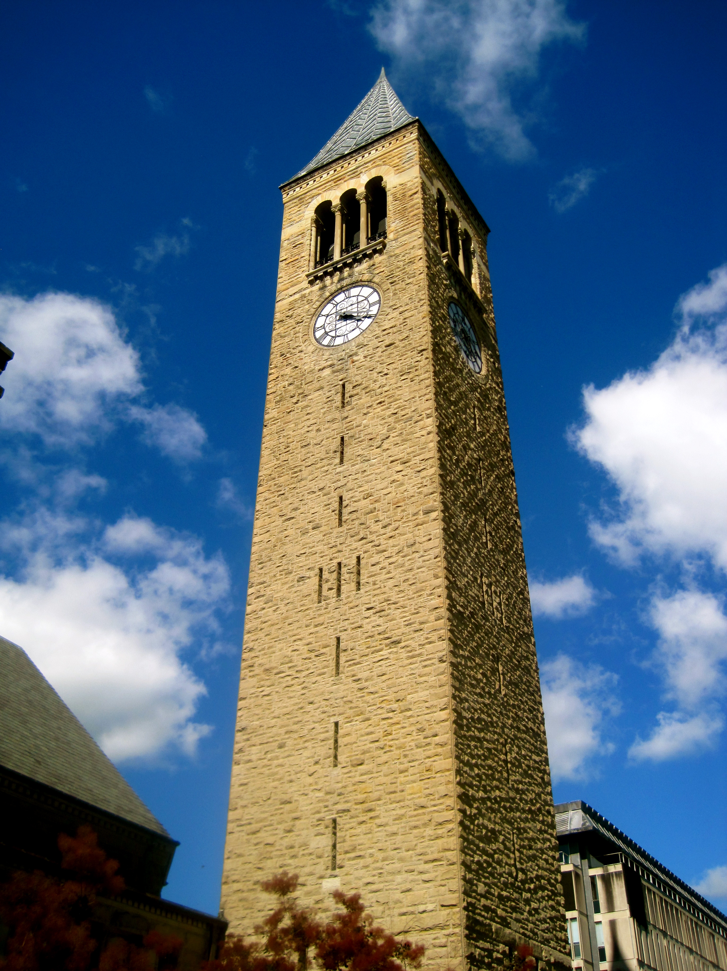
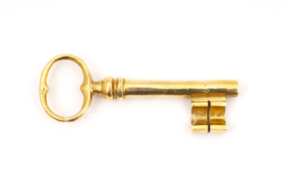
(Symmetric) Encryption algorithms
Gen(len): generate a key of length len
Enc(m; k): encrypt message (aka plaintext or cleartext) m under key k
Dec(c; k): decrypt ciphertext c with key k
note the semicolon
Enc
Dec
(Gen, Enc, Dec) is a symmetric-key encryption scheme aka cryptosystem

Slide 10
Shared key
How did Alice and Bob come to share key k?
maybe they met way in advance
maybe a trusted third party distributed the same key to both of them
better answers to come...
But at some point, it was generated and shared
Generation: k = Gen(len)
len is the length of the key

Slide 11
"Secure" encryption scheme?
Given ciphertext, cannot...
Determine key?
Misses the point: we want to protect message secrecy
Determine plaintext?
What if you could get 90% of plaintext?
Determine any character of plaintext?
What if you could determine it's greater than 1000?
Determine any function of the plaintext!
"Right" definition, but must be formulated carefully, and is stronger than some (many) real-world practical encryption schemes
Notes:
key -> "bits of security"

Slide 12
Breaking encryption schemes
Assume that attack of concern is determining the key, given many ciphertext/plaintext pairs
Brute-force attack: recover key by trying every possible key
e.g., AES-128, try all 2^128 keys
Break is an attack that recovers key in less work than brute-force
Suppose best-known attack requires 2^X operations....then X is the strength aka security level of the encryption scheme
Best case is that strength = key length
As attacks are discovered, strength degrades
e.g., 3DES-168 has known attack that requires 2^112 operations, reducing strength from 168 to 112
Notes:
Other attack models are possible; these ideas generalize

Slide 13
Perfect encryption
One-time pad:
Gen(len) = uniformly random sequence of bits of length len
Enc(m; k) = Dec(m; k) = m XOR k
length(m) = length(k)
Security:
Does reveal length of plaintext
But nothing else!
Practicality:
Keys must be long (as long as messages)
Keys can never be reused, would reveal relationships
e.g., (m1 XOR k) XOR (m2 XOR k) = m1 XOR m2
Distributing one-time use long keys is hard
Notes:
Doesn't reveal anything else because, given a ciphertext, every plaintext is equally likely (because every key is equally likely)

Slide 14
Stream Ciphers

Slide 15
Block Ciphers
Encryption schemes that operate on fixed-size messages
The fixed-size is a block
Well-known examples:
DES
3DES
AES

Slide 16
DES
DES (Data Encryption Standard)
Block size: 64 bits
Key size: 56 bits
Designed by IBM in 1973-4, tweaked by the NSA, then became the US standard for encryption. International adoption followed.
3DES (Triple DES)
Block size: 64 bits
Key size: 112 or 168 bits
Introduced in 1998, because 56 bit keys had become feasible to brute force.
3DES is simply three DES encryptions with two different keys, for an effective 112 bit key; or with three different keys, for an effective 168 bit key.
Notes:
NSA actually *strengthed* against differential cryptanalysis, even though everyone originally thought they might be weakening it

Slide 17
AES
AES (Advanced Encryption Standard)
Block size: 128 bits
Key size: 128, 192, or 256 bits
Public competition held by NIST, ending in 2001
Now the US standard, approved by the NSA for Top Secret information
Currently no practical attacks known

Slide 18
Key lengths
Various recommendations for strength summarized at https://www.keylength.com/en/
Based on:
known attacks
hardware capabilities
predicted advances
Why not use highest strength possible? Performance.

Slide 19
Key lengths

Slide 20
The obvious idea...
Divide long message into short chunks, each the size of a block
Encrypt each block with the block cipher
m

Slide 21
The obvious idea...
Divide long message into short chunks, each the size of a block
Encrypt each block with the block cipher
m1
m2
m3
m4
m5
Enc( . ; k)
c1
c2
c3
c4
c5

Slide 22
...is a bad idea
Enc-ECB(Tux; k)
Called electronic code book (ECB) mode

Slide 23
Good modes
Cipher Block Chaining (CBC) mode
idea: XOR previous ciphertext block into current plaintext block
Counter (CTR) mode
idea: derive one-time pad from increasing counter
(and others)
With both:
every ciphertext block depends in some way upon previous plaintext or ciphertext blocks
so even if plaintext blocks repeat, ciphertext blocks don't
so intra-message repetition doesn't disclose information

Slide 24
Good modes
Enc(Tux; k)
but what if you encrypt Tux twice under the same key?

Slide 25
Good modes
Problem: block ciphers are deterministic: inter-message repetition is visible to attacker
Both CBC and CTR modes require an additional parameter: a nonce
Enc(m; nonce; k)
Dec(c; nonce; k)
CBC calls the nonce an initialization vector (IV)
Different nonces make each encryption different than others
Hence inter-message repetition doesn't disclose information

Slide 26
Nonces
A nonce is a number used once
Must be
unique: never used before in lifetime of system
and/or (depending on intended usage)
unpredictable: attacker can't guess next nonce given all previous nonces in lifetime of system

Slide 27
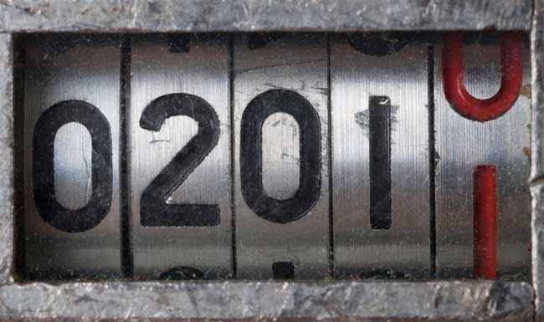
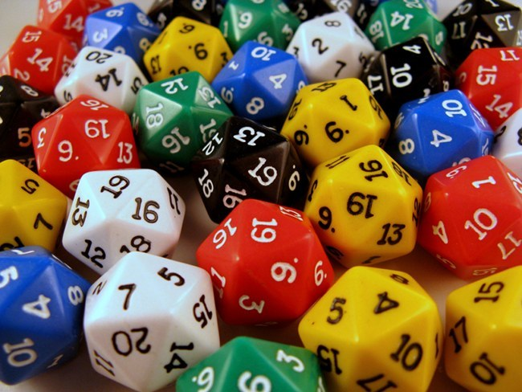
Nonce sources
counter
requires state
easy to implement
can overflow
highly predictable
clock: just a counter
random number generator
might not be unique, unless drawn from large space
might or might not be unpredictable
generating randomness:
standard library generators often are not cryptographically strong, i.e., unpredictable by attackers
cryptographically strong randomness is a black art

Slide 28
Padding
What if the message length isn't exactly a multiple of block length? End up with final block that isn't full:
Non-solution: pad out final block with 0's (not reversible)
Solution: Let B be the number of bytes that need to be added to final plaintext block to reach block length. Pad with B copies of the byte representing B. Called PKCS #5 or #7 padding.
m
Notes:
Don’t spend too much time on PKCS#5!

Slide 29
Protection of integrity
Threat: attacker who controls the network
Dolev-Yao model: attacker can read, modify, delete messages
Harm: information contained in messages can be changed by attacker (violating integrity)
Vulnerability: communication channel between sender and receiver can be controlled by other principals
Countermeasure: message authentication codes (MACs)
beware: not the same "MAC" as mandatory access control

Slide 30
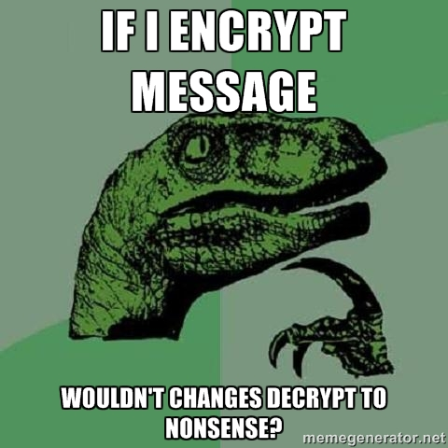
Encryption and integrity

Slide 31
Encryption and integrity
NO!
Plaintext block might be random number, and recipient has no way to detect change in random number
Attacker might substitute ciphertext from another execution of same protocol
In some block modes (e.g., CTR), it's easy to flip individual bits
change "admin=0" to "admin=1"
In some block modes (e.g., CBC), it's easy to truncate blocks from beginning of message
...
So you can't get integrity solely from encryption

Slide 32
MAC algorithms
Gen(len): generate a key of length len
MAC(m; k): produce a tag for message m with key k
message may be arbitrary size
tag is typically fixed length
“Secure MAC”? Must be hard to forge tag for a message without knowledge of key
MAC

Slide 33
Real-world MACs
CBC-MAC
Parameterized on a block cipher
Core idea: encrypt message with block cipher in CBC mode, use very last ciphertext block as the tag
HMAC
Parameterized on a hash function
Core idea: hash message together with key
Your everyday hash function isn't good enough...

Slide 34
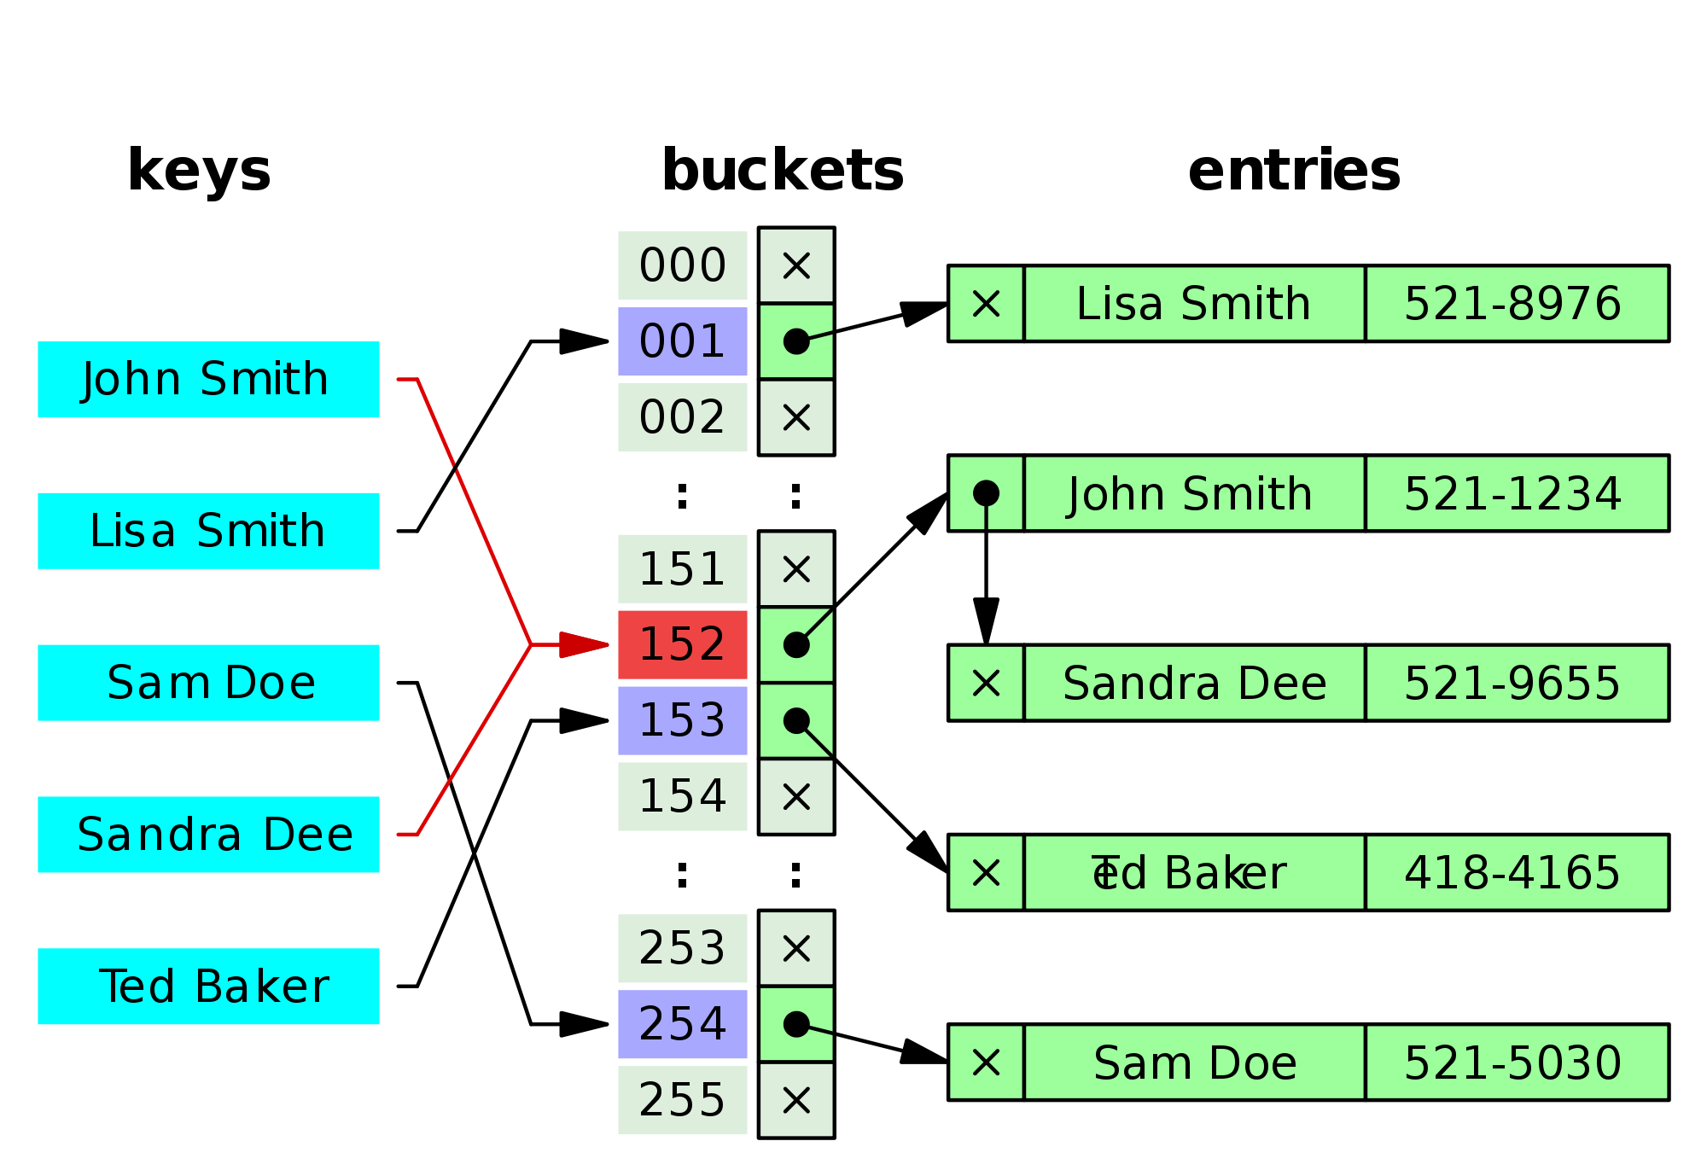
Hash functions
Input: arbitrary size bit string
Output: fixed size bit string
compression: many inputs map to same output, hence creating collision
for use with hash tables, diffusion: minimize collisions (and clustering)

Slide 35
Cryptographic hash functions
Aka message digest
Stronger requirements than (plain old) hash functions
Goal: hash is compact representation of original like a fingerprint
Hard to find 2 people with same fingerprint
Whether you get to pick pairs of people, or whether you start with one person and find another
...collision-resistant
Given person easy to get fingerprint
Given fingerprint hard to find person
...one-way

Slide 36
Real-world hash functions
MD5: Ron Rivest (1991)
128 bit output
Collision resistance broken 2004-8
Can now find collisions in seconds
Don't use it
SHA-1: NSA (1995)
160 bit output
Theoretical attacks that reduce strength to less than 80 bits
As of 2017, “practical attack” on PDFs: https://shattered.io/
Industry has been deprecating SHA-1 over the couple years

Slide 37
Real world hash functions
SHA-2: NSA (2001)
Family of algorithms with output sizes {224, 256, 385, 512}
In principle, could one day be vulnerable to similar attacks as SHA-1
SHA-3: public competition (won in 2012, standardized by NIST in 2015)
Same output sizes as SHA-2
Plus a variable-length output called SHAKE

Slide 38
Encrypt and MAC
m
0. k_E = Gen_E(len)
k_M = Gen_M(len)
1. A: c = Enc(m; k_E)
t = MAC(m; k_M)
2. A -> B: c, t
3. B: m' = Dec(c; k_E)
t' = MAC(m'; k_M)
if t = t'
then output m'
else abort
c
t

Slide 39
Encrypt and MAC
Pro: can compute Enc and MAC in parallel
Con: MAC must protect confidentiality
Example: ssh (Secure Shell) protocol
recommends AES-128-CBC for encryption
recommends HMAC with SHA-2 for MAC

Slide 40
Aside: Key reuse
Never use same key for both encryption and MAC schemes
Principle: every key in system should have unique purpose

Slide 41
Encrypt then MAC
m
1. A: c = Enc(m; k_E)
t = MAC(c; k_M)
2. A -> B: c, t
3. B: t' = MAC(c; k_M)
if t = t'
then output Dec(c; k_E)
else abort
c
t

Slide 42
Encrypt then MAC
Pro: provably most secure of three options [Bellare & Namprepre 2001]
Pro: don't have to decrypt if MAC fails
resist DoS
Example: IPsec (Internet Protocol Security)
recommends AES-CBC for encryption and HMAC-SHA1 for MAC, among others
or AES-GCM

Slide 43
MAC then encrypt
m
1. A: t = MAC(m; k_M)
c = Enc(m,t; k_E)
2. A -> B: c
3. B: m',t' = Dec(c; k_E)
if t' = MAC(m'; k_M)
then output m'
else abort
c

Slide 44
MAC then encrypt
Pro: provably next most secure
and just as secure as Encrypt-then-MAC for strong enough MAC schemes
HMAC and CBC-MAC are strong enough
Example: SSL (Secure Sockets Layer)
Many options for encryption, e.g. AES-128-CBC
For MAC, standard is HMAC with many options for hash, e.g. SHA-256

Slide 45
Authenticated encryption
Three combinations:
Enc and MAC
Enc then MAC
MAC then Enc
Let's unify all with a pair of algorithms:
AuthEnc(m; ke; km): produce an authenticated ciphertext x of message m under encryption key ke and MAC key km
AuthDec(x; ke; km): recover the plaintext message m from authenticated ciphertext x, and verify that the MAC is valid, using ke and km
Abort if MAC is invalid

Slide 46
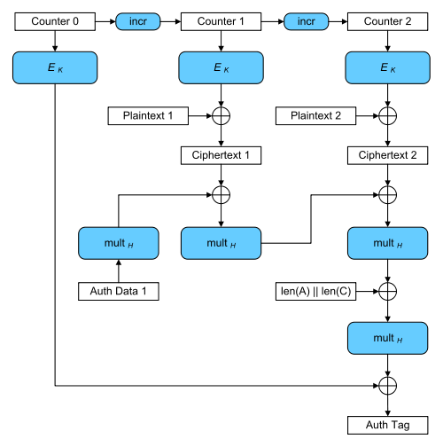
Authenticated encryption
Newer block cipher modes designed to provide confidentiality and integrity
OCB: Offset Codebook Mode
CCM: Counter with CBC-MAC Mode
GCM: Galois Counter Mode

