Slide 1
Software Routers: NetMap
Hakim Weatherspoon
Assistant Professor, Dept of Computer Science
CS 5413: High Performance Systems and Networking
October 8, 2014
Slides from the “NetMap: A Novel Framework for Fast Packet I/O” at the USENIX
Annual Technical Conference (ATC), June 2012.

Slide 2
Where are we in the semester?
Overview and Basics
Data Center Networks
  Basic switching technologies
  Data Center Network Topologies (today and Monday)
  Software Routers (eg. Click, Routebricks, NetMap, Netslice)
  Alternative Switching Technologies
  Data Center Transport
Data Center Software Networking
  Software Defined networking (overview, control plane, data plane, NetFGPA)
  Data Center Traffic and Measurements
  Virtualizing Networks
  Middleboxes
Advanced Topics

Slide 3
Goals for Today
Gates Data Center and Fractus tour
NetMap: A Novel Framework for Fast Packet I/O
  L. Rizzo. USENIX Annual Technical Conference (ATC), June 2012, pages 101-112.

Slide 4
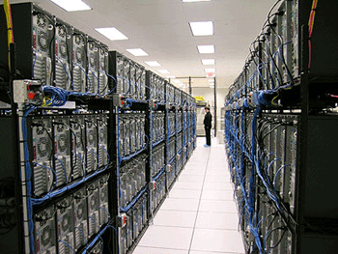
Fractus Cloud
Production-side and Experimental side
1 rack of 19 machines each
Network
  1x HP 10/100 Mb management switch
  1x Top-of-Rack switch: Dell Force10 10 Gb Ethernet data switch
    Contains a bonded pair of 40 Gb links to the research rack (80 Gb total)
Servers
  2x 8-core Intel Xeon E5-2690 2.9 GHz CPUs (16 cores/32 threads total)
  96 GB RAM
  A bonded pair of 10 Gb Ethernet links (20 Gb total)
  4x 900 GB 10k RPM SAS drives in RAID 0

Slide 5
Fractus Cloud
Internet
Border router
Access router
Tier-1 switches
Tier-2 switches
TOR switches
Server racks

Slide 6
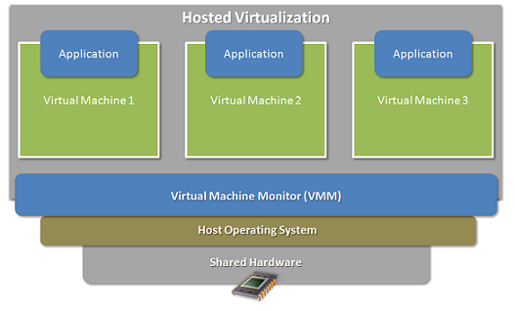
Fractus Cloud – Production-side
Multiple virtual machines on one physical machine
Applications run unmodified as on real machine
VM can migrate from one computer to another

Slide 7
Goals for Today
Gates Data Center and Fractus tour
NetMap: A Novel Framework for Fast Packet I/O
  L. Rizzo. USENIX Annual Technical Conference (ATC), June 2012, pages 101-112.

Slide 8
Direct Packet I/O Options
Good old sockets (BPF, raw sockets)
  Flexible, portable, but slow

Slide 9
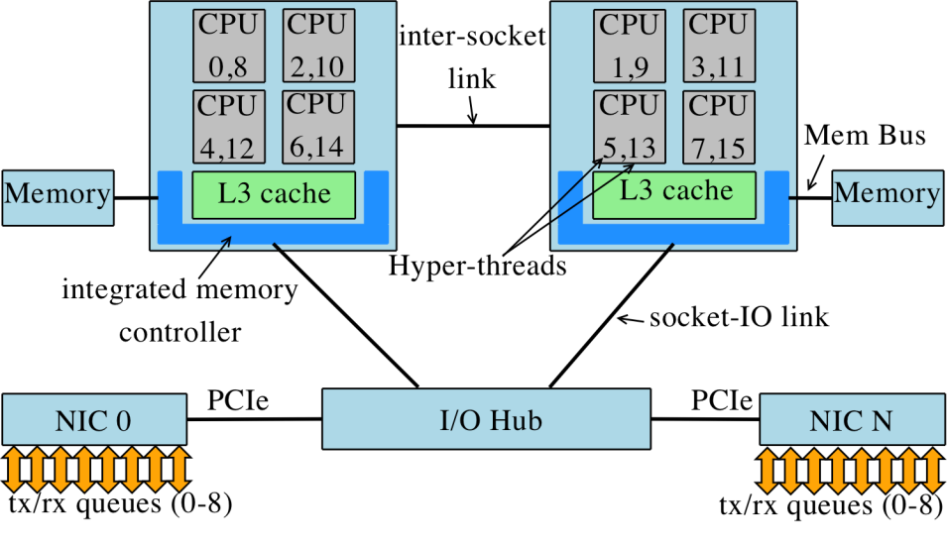
Direct Packet I/O options
Good old sockets (BPF, raw sockets)
  Flexible, portable, but slow
  Raw socket: all traffic from all NICs to user-space
  Too general, hence complex network stack
  Hardware and software are loosely coupled
  Applications have no control over resources
Application
Application
Network
Stack
Network
Stack
Network
Stack
Application
Network
Stack
Application
Network
Stack
Application
Network
Stack
Network
Stack
Application
Network
Stack
Network
Stack
Application
Application
Application
Raw socket
Network
Stack

Slide 10
Direct Packet I/O Options
Good old sockets (BPF, raw sockets)
  Flexible, portable, but slow
Memory mapped buffers (PF_PACKET, PF_RING)
  Efficient, if mbufs/skbufs do not get in the way

Slide 11
Direct Packet I/O Options
Good old sockets (BPF, raw sockets)
  Flexible, portable, but slow
Memory mapped buffers (PF_PACKET, PF_RING)
  Efficient, if mbufs/skbufs do not get in the way

Slide 12
Direct Packet I/O Options
Good old sockets (BPF, raw sockets)
  Flexible, portable, but slow
Memory mapped buffers (PF_PACKET, PF_RING)
  Efficient, if mbufs/skbufs do not get in the way
Run in the kernel (NETFILTER, PFIL, Netgraph, NDIS, Click)
  Can be fast, especially if bypassing mbufs
Custom Libraries (OpenOnLoad, Intel DPDK)
  Vendor specific: Normally tied to vendor hardware
Can we find a better (fast, safe, HW-independent) solution?

Slide 13
Traditional Network Stack
How slow is the
traditional raw socket
and host network stack?

Slide 14
Traditional Network Stack
Significant amount of time spent at all levels of the stack
The system call cannot be avoided (or can it?)
Device programming is extremely expensive
Complex mbufs are a bad idea
Data copies and mbufs can be saved in some cases
Headers should be cached and reused if possible

Slide 15
Motivation for a new design
Start from the easy problem: raw packet I/O
Simpler to address (some layers are not involved)
Useful to determine the maximum achievable performance
Poorly supported by current APIs, so the task has a high return (both for me and the users)

Slide 16
Motivation for a new design
Design Guidelines
No requirement/reliance on special hardware features
Amortize costs over large batches (syscalls)
Remove unnecessary work (copies, mbufs, alloc/free)
Reduce runtime decisions (a single frame format)
Modifying device drivers is permitted, as long as the code can be maintained

Slide 17
NetMap summary
Framework for raw packet I/O from userspace
65 cycles/packet between the wire in userspace
  14Mpps on one 900 MHz core
Device and OS independent
Good scalability with number of CPU frequency and number of cores
libpcap emulation library for easy porting of applications

Slide 18
Netmap data structure and API
packet buffers
  Numbered and
  fixed size
netmap rings
  Device independent
  copy of NIC ring
  cur: current tx/rx position
  avail: available slots
  Ptrs stored as offsets or indexes (so not dependent of virtual mem)
netmap_if
  Contains references to all rings attached to an interface

Slide 19
Protection
Rely on standard OS mechanism
The NIC is not exposed to the userspace
Kernel validates the netmap ring before using its contents
Cannot crash the kernel or trash other processes memory

Slide 20
Data Ownership
No races between kernel and user
Global fields, and [ cur…cur+avail-1 ]:
  Owned by the application, updated during system calls
other slots/buffers
  Owned by the kernel
Interrupt handler never touches shared memory regions

Slide 21
NetMap API
Access
  open: returns a file descriptor (fd)
  ioctl: puts an interface into netmap mode
  mmap: maps buffers and rings into user address space
Transmit (TX)
  Fill up to avail bufs, starting at slot cur
  ioctl(fd, NIOCTXSYNC) queues the packets
Receive (RX)
  ioctl(fd, NIOCTXSYNC) reports newly received packets
  Process up to avail bufs, starting at cur
poll()/select()

Slide 22
NetMap API
Access
  open: returns a file descriptor (fd)
  ioctl: puts an interface into netmap mode
  mmap: maps buffers and rings into user address space
Transmit (TX)
  Fill up to avail bufs, starting at slot cur
  ioctl(fd, NIOCTXSYNC) queues the packets
Receive (RX)
  ioctl(fd, NIOCTXSYNC) reports newly received packets
  Process up to avail bufs, starting at cur
poll()/select()

Slide 23
Multiqueue/multicore support
One netmap ring per physical NIC ring
By default, the fd is bound to all NIC rings, but
  ioctl can restrict the binding to a single NIC ring pair
  multiple fd’s can be bound to different rings on the same card
  The fd’s can be managed by different threads
  Threads mapped to cores with pthread_setaffinity()

Slide 24
NetMap and Host Stack
Netmap Mode
Data path
  Normal path between NIC and
  host stack is removed
Control path
  OS believes NIC is still there
  Ifconfig, ioctl, etc still work

Slide 25
NetMap and Host Stack
Netmap Mode
Data path
  Packets from NIC end up in
  netmap ring
  Packets from TX netmap ring
  are sent to the NIC
Control path
  OS believes NIC is still there
  Ifconfig, ioctl, etc still work

Slide 26
Zero copy
Zero-copy forwarding by swapping buffer indexes
Zero-copy also works with rings from/to host stack
  Firewalls, NAT boxes, IDS mechanisms

Slide 27
Performance Results

Slide 28
Performance Results
TX tput vs clock speed and number of cores

Slide 29
Performance Results
TX tput vs burst size

Slide 30
Performance Results
RX tput vs packet size

Slide 31
R Performance Results
Forwarding performance

Slide 32
NetMap summary
Framework for raw packet I/O from userspace
65 cycles/packet between the wire in userspace
  14Mpps on one 900 MHz core
Device and OS independent
Good scalability with number of CPU frequency and number of cores
libpcap emulation library for easy porting of applications

Slide 33
Before Next time
Project Progress
  Need to setup environment as soon as possible
  And meet with groups, TA, and professor
Lab3 – Packet filter/sniffer
  Due Thursday, October 16
  Use Fractus instead of Red Cloud
Required review and reading for Friday, October 15
  “NetSlices: Scalable Multi-Core Packet Processing in User-Space”, T. Marian, K. S. Lee, and H. Weatherspoon. ACM/IEEE Symposium on Architectures for Networking and Communications Systems (ANCS), October 2012, pages 27-38.
  http://dl.acm.org/citation.cfm?id=2396563
  http://fireless.cs.cornell.edu/publications/netslice.pdf
Check piazza: http://piazza.com/cornell/fall2014/cs5413
Check website for updated schedule

