Slide 1
Transport Layer and Data Center TCP
Hakim Weatherspoon
Assistant Professor, Dept of Computer Science
CS 5413: High Performance Systems and Networking
September 5, 2014
Slides used and adapted judiciously from Computer Networking, A Top-Down Approach

Slide 2
Goals for Today
Transport Layer
Abstraction / services
Multiplexing/Demultiplexing
UDP: Connectionless Transport
TCP: Reliable Transport
Abstraction, Connection Management, Reliable Transport, Flow Control, timeouts
Congestion control
Data Center TCP
Incast Problem

Slide 3
Transport Layer: Services/Protocols
application
transport
network
data link
physical
provide logical communication between app processes running on different hosts
transport protocols run in end systems
send side: breaks app messages into segments, passes to network layer
rcv side: reassembles segments into messages, passes to app layer
more than one transport protocol available to apps
Internet: TCP and UDP
logical end-end transport
application
transport
network
data link
physical

Slide 4
Transport Layer: Services/Protocols
Transport vs Network Layer
network layer: logical communication between hosts
transport layer: logical communication between processes
relies on, enhances, network layer services
household analogy:
12 kids in Ann’s house sending letters to 12 kids in Bill’s house:
hosts = houses
processes = kids
app messages = letters in envelopes
transport protocol = Ann and Bill who demux to in-house siblings
network-layer protocol = postal service

Slide 5
Transport Layer: Services/Protocols
reliable, in-order delivery (TCP)
congestion control
flow control
connection setup
unreliable, unordered delivery: UDP
no-frills extension of “best-effort” IP
services not available:
delay guarantees
bandwidth guarantees
application
transport
network
data link
physical
network
data link
physical
network
data link
physical
network
data link
physical
logical end-end transport
network
data link
physical
network
data link
physical
network
data link
physical
network
data link
physical
application
transport
network
data link
physical

Slide 6
Transport Layer: Services/Protocols
TCP service:
reliable transport between sending and receiving process
flow control: sender won’t overwhelm receiver
congestion control: throttle sender when network overloaded
does not provide: timing, minimum throughput guarantee, security
connection-oriented: setup required between client and server processes
UDP service:
unreliable data transfer between sending and receiving process
does not provide: reliability, flow control, congestion control, timing, throughput guarantee, security, or connection setup,
Q: why bother? Why is there a UDP?

Slide 7
Goals for Today
Transport Layer
Abstraction / services
Multiplexing/Demultiplexing
UDP: Connectionless Transport
TCP: Reliable Transport
Abstraction, Connection Management, Reliable Transport, Flow Control, timeouts
Congestion control
Data Center TCP
Incast Problem

Slide 8
Transport Layer
Sockets: Multiplexing/Demultiplexing
multiplexing at sender:
handle data from multiple
sockets, add transport header (later used for demultiplexing)
demultiplexing at receiver:
use header info to deliver
received segments to correct
socket
application
application
P1
P2
application
socket
P3
transport
P4
process
transport
network
transport
network
link
network
link
physical
link
physical
physical

Slide 9
Goals for Today
Transport Layer
Abstraction / services
Multiplexing/Demultiplexing
UDP: Connectionless Transport
TCP: Reliable Transport
Abstraction, Connection Management, Reliable Transport, Flow Control, timeouts
Congestion control
Data Center TCP
Incast Problem

Slide 10
UDP: Connectionless Transport
UDP: Segment Header
length, in bytes of UDP segment, including header
32 bits
source port #
dest port #
length
checksum
why is there a UDP?
no connection establishment (which can add delay)
simple: no connection state at sender, receiver
small header size
no congestion control: UDP can blast away as fast as desired
application
data
(payload)
UDP segment format

Slide 11
UDP: Connectionless Transport
UDP: Checksum
Goal: detect “errors” (e.g., flipped bits) in transmitted segment
sender:
treat segment contents, including header fields, as sequence of 16-bit integers
checksum: addition (one’s complement sum) of segment contents
sender puts checksum value into UDP checksum field
receiver:
compute checksum of received segment
check if computed checksum equals checksum field value:
NO - error detected
YES - no error detected. But maybe errors nonetheless? More later ….

Slide 12
Internet checksum: example
example: add two 16-bit integers
1 1 1 1 0 0 1 1 0 0 1 1 0 0 1 1 0
1 1 1 0 1 0 1 0 1 0 1 0 1 0 1 0 1
1 1 0 1 1 1 0 1 1 1 0 1 1 1 0 1 1
1 1 0 1 1 1 0 1 1 1 0 1 1 1 1 0 0
1 0 1 0 0 0 1 0 0 0 1 0 0 0 0 1 1
wraparound
sum
checksum
Note: when adding numbers, a carryout from the most significant bit needs to be added to the result
Notes:
Kurose and Ross forgot to say anything about wrapping the carry and adding it to low order bit

Slide 13
Goals for Today
Transport Layer
Abstraction / services
Multiplexing/Demultiplexing
UDP: Connectionless Transport
TCP: Reliable Transport
Abstraction, Connection Management, Reliable Transport, Flow Control, timeouts
Congestion control
Data Center TCP
Incast Problem

Slide 14
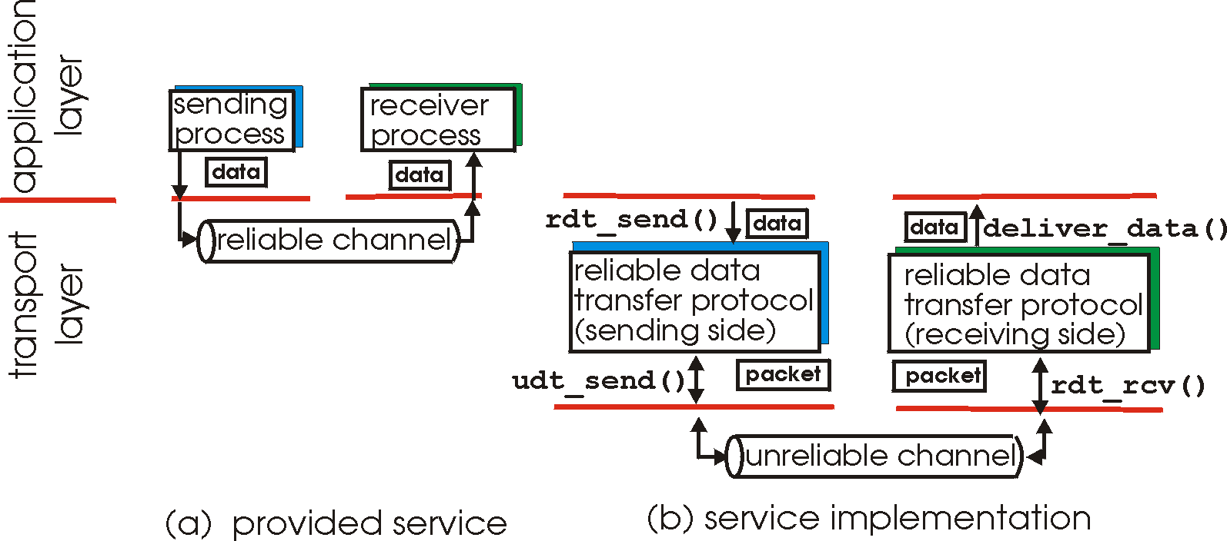
Principles of Reliable Transport
important in application, transport, link layers
top-10 list of important networking topics!
characteristics of unreliable channel will determine complexity of reliable data transfer protocol (rdt)

Slide 15
Principles of Reliable Transport
important in application, transport, link layers
top-10 list of important networking topics!
characteristics of unreliable channel will determine complexity of reliable data transfer protocol (rdt)

Slide 16
Principles of Reliable Transport
important in application, transport, link layers
top-10 list of important networking topics!
characteristics of unreliable channel will determine complexity of reliable data transfer protocol (rdt)

Slide 17
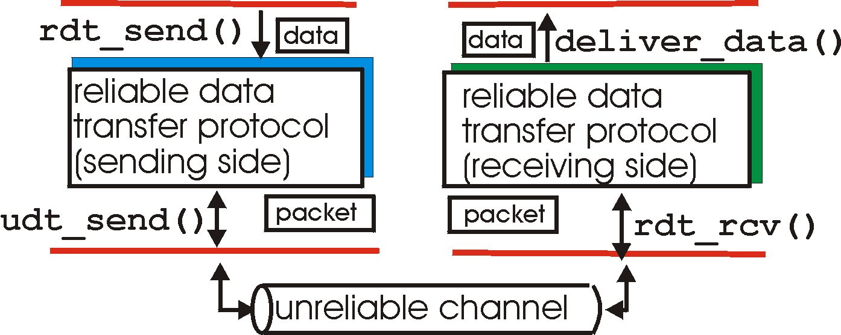
Principles of Reliable Transport
rdt_send(): called from above, (e.g., by app.). Passed data to
deliver to receiver upper layer
deliver_data(): called by rdt to deliver data to upper
send
side
receive
side
udt_send(): called by rdt,
to transfer packet over
unreliable channel to receiver
rdt_rcv(): called when packet arrives on rcv-side of channel

Slide 18
TCP: Reliable Transport
TCP: Transmission Control Protocol
RFCs: 793,1122,1323, 2018, 2581
point-to-point:
one sender, one receiver
reliable, in-order byte steam:
no “message boundaries”
pipelined:
TCP congestion and flow control set window size
full duplex data:
bi-directional data flow in same connection
MSS: maximum segment size
connection-oriented:
handshaking (exchange of control msgs) inits sender, receiver state before data exchange
flow controlled:
sender will not overwhelm receiver

Slide 19
TCP: Reliable Transport
TCP: Segment Structure
32 bits
URG: urgent data
(generally not used)
counting
by bytes
of data
(not segments!)
source port #
dest port #
sequence number
ACK: ACK #
valid
acknowledgement number
head
len
not
used
U
receive window
A
PSH: push data now
(generally not used)
P
R
S
F
# bytes
rcvr willing
to accept
checksum
Urg data pointer
RST, SYN, FIN:
connection estab
(setup, teardown
commands)
options (variable length)
application
data
(variable length)
Internet
checksum
(as in UDP)

Slide 20
TCP: Reliable Transport
TCP: Sequence numbers and Acks
outgoing segment from sender
sequence numbers:
byte stream “number” of first byte in segment’s data
acknowledgements:
seq # of next byte expected from other side
cumulative ACK
Q: how receiver handles out-of-order segments
A: TCP spec doesn’t say, - up to implementor
source port #
dest port #
sequence number
acknowledgement number
rwnd
checksum
urg pointer
window size
N
sender sequence number space
sent
ACKed
sent, not-yet ACKed
(“in-flight”)
usable
but not
yet sent
not
usable
incoming segment to sender
source port #
dest port #
sequence number
acknowledgement number
A
rwnd
checksum
urg pointer

Slide 21
TCP: Reliable Transport
TCP: Sequence numbers and Acks
Host A
Host B
User
types
‘C’
Seq=42, ACK=79, data = ‘C’
host ACKs
receipt of
‘C’, echoes
back ‘C’
Seq=79, ACK=43, data = ‘C’
host ACKs
receipt
of echoed
‘C’
Seq=43, ACK=80
simple telnet scenario

Slide 22
TCP: Reliable Transport
TCP: Transmission Control Protocol
RFCs: 793,1122,1323, 2018, 2581
point-to-point:
one sender, one receiver
reliable, in-order byte steam:
no “message boundaries”
pipelined:
TCP congestion and flow control set window size
full duplex data:
bi-directional data flow in same connection
MSS: maximum segment size
connection-oriented:
handshaking (exchange of control msgs) inits sender, receiver state before data exchange
flow controlled:
sender will not overwhelm receiver

Slide 23
TCP: Reliable Transport
Connection Management: TCP 3-way handshake
before exchanging data, sender/receiver “handshake”:
agree to establish connection (each knowing the other willing to establish connection)
agree on connection parameters
application
application
connection state: ESTAB
connection variables:
seq # client-to-server
server-to-client
rcvBuffer size
at server,client
connection state: ESTAB
connection Variables:
seq # client-to-server
server-to-client
rcvBuffer size
at server,client
network
network
Socket clientSocket =
newSocket("hostname","port number");
Socket connectionSocket = welcomeSocket.accept();

Slide 24
TCP: Reliable Transport
Connection Management: TCP 3-way handshake
client state
server state
LISTEN
LISTEN
choose init seq num, x
send TCP SYN msg
SYNSENT
SYNbit=1, Seq=x
choose init seq num, y
send TCP SYNACK
msg, acking SYN
SYN RCVD
SYNbit=1, Seq=y
ACKbit=1; ACKnum=x+1
received SYNACK(x)
indicates server is live;
send ACK for SYNACK;
this segment may contain
client-to-server data
ESTAB
ACKbit=1, ACKnum=y+1
received ACK(y)
indicates client is live
ESTAB

Slide 25
TCP: Reliable Transport
Connection Management: TCP 3-way handshake
closed
Socket connectionSocket = welcomeSocket.accept();
Λ
Socket clientSocket =
newSocket("hostname","port number");
SYN(x)
SYNACK(seq=y,ACKnum=x+1)
create new socket for
communication back to client
listen
SYN(seq=x)
SYN
rcvd
SYN
sent
SYNACK(seq=y,ACKnum=x+1)
ACK(ACKnum=y+1)
ESTAB
ACK(ACKnum=y+1)
Λ

Slide 26
TCP: Reliable Transport
Connection Management: Closing connection
client, server each close their side of connection
send TCP segment with FIN bit = 1
respond to received FIN with ACK
on receiving FIN, ACK can be combined with own FIN
simultaneous FIN exchanges can be handled

Slide 27
TCP: Reliable Transport
Connection Management: Closing connection
client state
server state
ESTAB
ESTAB
clientSocket.close()
FIN_WAIT_1
can no longer
send but can
receive data
FINbit=1, seq=x
CLOSE_WAIT
ACKbit=1; ACKnum=x+1
can still
send data
FIN_WAIT_2
wait for server
close
LAST_ACK
FINbit=1, seq=y
TIMED_WAIT
can no longer
send data
ACKbit=1; ACKnum=y+1
timed wait
for 2*max
segment lifetime
CLOSED
CLOSED

Slide 28
TCP: Reliable Transport
TCP: Transmission Control Protocol
RFCs: 793,1122,1323, 2018, 2581
point-to-point:
one sender, one receiver
reliable, in-order byte steam:
no “message boundaries”
pipelined:
TCP congestion and flow control set window size
full duplex data:
bi-directional data flow in same connection
MSS: maximum segment size
connection-oriented:
handshaking (exchange of control msgs) inits sender, receiver state before data exchange
flow controlled:
sender will not overwhelm receiver

Slide 29
TCP: Reliable Transport
data rcvd from app:
create segment with seq #
seq # is byte-stream number of first data byte in segment
start timer if not already running
think of timer as for oldest unacked segment
expiration interval: TimeOutInterval
timeout:
retransmit segment that caused timeout
restart timer
ack rcvd:
if ack acknowledges previously unacked segments
update what is known to be ACKed
start timer if there are still unacked segments

Slide 30
TCP: Reliable Transport
TCP: Retransmission Scenerios
Host A
Host B
Host A
Host B
SendBase=92
Seq=92, 8 bytes of data
Seq=92, 8 bytes of data
timeout
timeout
Seq=100, 20 bytes of data
ACK=100
X
ACK=100
ACK=120
Seq=92, 8 bytes of data
Seq=92, 8
bytes of data
SendBase=100
SendBase=120
ACK=100
ACK=120
SendBase=120
lost ACK scenario
premature timeout

Slide 31
TCP: Reliable Transport
TCP: Retransmission Scenerios
Host A
Host B
Seq=92, 8 bytes of data
Seq=100, 20 bytes of data
timeout
ACK=100
X
ACK=120
Seq=120, 15 bytes of data
cumulative ACK

Slide 32
Reliable Transport
TCP ACK generation [RFC 1122, 2581]
event at receiver
arrival of in-order segment with
expected seq #. All data up to
expected seq # already ACKed
arrival of in-order segment with
expected seq #. One other
segment has ACK pending
arrival of out-of-order segment
higher-than-expect seq. # .
Gap detected
arrival of segment that
partially or completely fills gap
TCP receiver action
delayed ACK. Wait up to 500ms
for next segment. If no next segment,
send ACK
immediately send single cumulative
ACK, ACKing both in-order segments
immediately send duplicate ACK,
indicating seq. # of next expected byte
immediate send ACK, provided that
segment starts at lower end of gap

Slide 33
TCP: Reliable Transport
TCP Fast Retransmit
time-out period often relatively long:
long delay before resending lost packet
detect lost segments via duplicate ACKs.
sender often sends many segments back-to-back
if segment is lost, there will likely be many duplicate ACKs.
TCP fast retransmit
if sender receives 3 ACKs for same data
(“triple duplicate ACKs”), resend unacked segment with smallest seq #
likely that unacked segment lost, so don’t wait for timeout
(“triple duplicate ACKs”),

Slide 34
TCP: Reliable Transport
TCP Fast Retransmit
Host A
Host B
Seq=92, 8 bytes of data
Seq=100, 20 bytes of data
X
ACK=100
timeout
ACK=100
ACK=100
ACK=100
Seq=100, 20 bytes of data
fast retransmit after sender
receipt of triple duplicate ACK

Slide 35
TCP: Reliable Transport
TCP: Roundtrip time and timeouts
Q: how to set TCP timeout value?
longer than RTT
but RTT varies
too short: premature timeout, unnecessary retransmissions
too long: slow reaction to segment loss
Q: how to estimate RTT?
SampleRTT: measured time from segment transmission until ACK receipt
ignore retransmissions
SampleRTT will vary, want estimated RTT “smoother”
average several recent measurements, not just current SampleRTT

Slide 36
TCP: Reliable Transport
TCP: Roundtrip time and timeouts
EstimatedRTT = (1- α)*EstimatedRTT + α*SampleRTT
exponential weighted moving average
influence of past sample decreases exponentially fast
typical value: α = 0.125
RTT: gaia.cs.umass.edu to fantasia.eurecom.fr
RTT (milliseconds)
sampleRTT
time (seconds)

Slide 37
TCP: Reliable Transport
TCP: Roundtrip time and timeouts
timeout interval: EstimatedRTT plus “safety margin”
large variation in EstimatedRTT -> larger safety margin
estimate SampleRTT deviation from EstimatedRTT:
DevRTT = (1-β)*DevRTT +
β*|SampleRTT-EstimatedRTT|
(typically, β = 0.25)
TimeoutInterval = EstimatedRTT + 4*DevRTT
estimated RTT
“safety margin”

Slide 38
TCP: Reliable Transport
TCP: Transmission Control Protocol
RFCs: 793,1122,1323, 2018, 2581
point-to-point:
one sender, one receiver
reliable, in-order byte steam:
no “message boundaries”
pipelined:
TCP congestion and flow control set window size
full duplex data:
bi-directional data flow in same connection
MSS: maximum segment size
connection-oriented:
handshaking (exchange of control msgs) inits sender, receiver state before data exchange
flow controlled:
sender will not overwhelm receiver

Slide 39
TCP: Reliable Transport
Flow Control
application
process
application may
remove data from
TCP socket buffers ….
application
TCP socket
receiver buffers
OS
… slower than TCP
receiver is delivering
(sender is sending)
TCP
code
flow control
IP
code
receiver controls sender, so sender won’t overflow receiver’s buffer by transmitting too much, too fast
from sender
receiver protocol stack

Slide 40
TCP: Reliable Transport
Flow Control
receiver “advertises” free buffer space by including rwnd value in TCP header of receiver-to-sender segments
RcvBuffer size set via socket options (typical default is 4096 bytes)
many operating systems autoadjust RcvBuffer
sender limits amount of unacked (“in-flight”) data to receiver’s rwnd value
guarantees receive buffer will not overflow
to application process
RcvBuffer
buffered data
rwnd
free buffer space
TCP segment payloads
receiver-side buffering

Slide 41
Goals for Today
Transport Layer
Abstraction / services
Multiplexing/Demultiplexing
UDP: Connectionless Transport
TCP: Reliable Transport
Abstraction, Connection Management, Reliable Transport, Flow Control, timeouts
Congestion control
Data Center TCP
Incast Problem

Slide 42
Principles of Congestion Control
congestion:
informally: “too many sources sending too much data too fast for network to handle”
different from flow control!
manifestations:
lost packets (buffer overflow at routers)
long delays (queueing in router buffers)

Slide 43
Principles of Congestion Control
two broad approaches towards congestion control:
end-end congestion control:
no explicit feedback from network
congestion inferred from end-system observed loss, delay
approach taken by TCP
network-assisted congestion control:
routers provide feedback to end systems
single bit indicating congestion (SNA, DECbit, TCP/IP ECN, ATM)
explicit rate for sender to send at

Slide 44
TCP Congestion Control
TCP Fairness
fairness goal: if K TCP sessions share same bottleneck link of bandwidth R, each should have average rate of R/K
TCP connection 1
bottleneck
router
capacity R
TCP connection 2

Slide 45
TCP Congestion Control
TCP Fairness: Why is TCP Fair?
AIMD: additive increase multiplicative decrease
approach: sender increases transmission rate (window size), probing for usable bandwidth, until loss occurs
additive increase: increase cwnd by 1 MSS every RTT until loss detected
multiplicative decrease: cut cwnd in half after loss
additively increase window size …
…. until loss occurs (then cut window in half)
AIMD saw tooth
behavior: probing
for bandwidth
cwnd: TCP sender
congestion window size
time

Slide 46
TCP Congestion Control
sender sequence number space
TCP sending rate:
roughly: send cwnd bytes, wait RTT for ACKS, then send more bytes
cwnd
last byte
ACKed
last byte sent
sent, not-yet ACKed
(“in-flight”)
sender limits transmission:
cwnd is dynamic, function of perceived network congestion
rate
cwnd
~
bytes/sec
~
RTT
LastByteSent-
LastByteAcked
cwnd
<

Slide 47
TCP Congestion Control
TCP Fairness: Why is TCP Fair?
two competing sessions:
additive increase gives slope of 1, as throughout increases
multiplicative decrease decreases throughput proportionally
R
equal bandwidth share
loss: decrease window by factor of 2
congestion avoidance: additive increase
Connection 2 throughput
loss: decrease window by factor of 2
congestion avoidance: additive increase
Connection 1 throughput
R

Slide 48
TCP Congestion Control
TCP Fairness
Fairness and UDP
multimedia apps often do not use TCP
do not want rate throttled by congestion control
instead use UDP:
send audio/video at constant rate, tolerate packet loss
Fairness, parallel TCP connections
application can open multiple parallel connections between two hosts
web browsers do this
e.g., link of rate R with 9 existing connections:
new app asks for 1 TCP, gets rate R/10
new app asks for 11 TCPs, gets R/2

Slide 49
TCP Congestion Control
Slow Start
Host A
Host B
when connection begins, increase rate exponentially until first loss event:
initially cwnd = 1 MSS
double cwnd every RTT
done by incrementing cwnd for every ACK received
summary: initial rate is slow but ramps up exponentially fast
one segment
RTT
two segments
four segments
time

Slide 50
TCP Congestion Control
Detecting and Reacting to Loss
loss indicated by timeout:
cwnd set to 1 MSS;
window then grows exponentially (as in slow start) to threshold, then grows linearly
loss indicated by 3 duplicate ACKs: TCP RENO
dup ACKs indicate network capable of delivering some segments
cwnd is cut in half window then grows linearly
TCP Tahoe always sets cwnd to 1 (timeout or 3 duplicate acks)

Slide 51
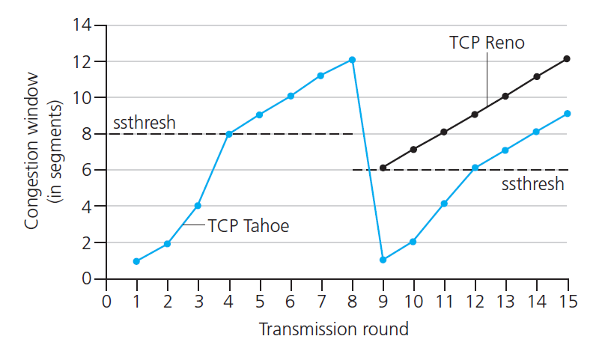
TCP Congestion Control
Switching from Slow Start to
Congestion Avoidance (CA)
Q: when should the exponential increase switch to linear?
A: when cwnd gets to 1/2 of its value before timeout.
Implementation:
variable ssthresh
on loss event, ssthresh is set to 1/2 of cwnd just before loss event

Slide 52
TCP Congestion Control
New
ACK!
New
ACK!
.
duplicate ACK
new ACK
dupACKcount++
new ACK
cwnd = cwnd + MSS (MSS/cwnd)
dupACKcount = 0
transmit new segment(s), as allowed
cwnd = cwnd+MSS
dupACKcount = 0
transmit new segment(s), as allowed
Λ
cwnd = 1 MSS
ssthresh = 64 KB
dupACKcount = 0
cwnd > ssthresh
slow
start
Λ
congestion
avoidance
timeout
ssthresh = cwnd/2
cwnd = 1 MSS
dupACKcount = 0
retransmit missing segment
duplicate ACK
timeout
dupACKcount++
ssthresh = cwnd/2
cwnd = 1 MSS
dupACKcount = 0
retransmit missing segment
timeout
New
ACK!
ssthresh = cwnd/2
cwnd = 1
dupACKcount = 0
retransmit missing segment
New ACK
dupACKcount == 3
cwnd = ssthresh
dupACKcount = 0
dupACKcount == 3
ssthresh= cwnd/2
cwnd = ssthresh + 3
retransmit missing segment
ssthresh= cwnd/2
cwnd = ssthresh + 3
retransmit missing segment
fast
recovery
duplicate ACK
cwnd = cwnd + MSS
transmit new segment(s), as allowed

Slide 53
TCP Throughput
avg. TCP thruput as function of window size, RTT?
ignore slow start, assume always data to send
W: window size (measured in bytes) where loss occurs
avg. window size (# in-flight bytes) is ¾ W
avg. thruput is 3/4W per RTT
avg TCP thruput =
3
W
4
RTT
bytes/sec
W
W/2

Slide 54
TCP over “long, fat pipes”
example: 1500 byte segments, 100ms RTT, want 10 Gbps throughput
requires W = 83,333 in-flight segments
throughput in terms of segment loss probability, L [Mathis 1997]:
➜ to achieve 10 Gbps throughput, need a loss rate of L = 2·10⁻¹⁰ – a very small loss rate!
new versions of TCP for high-speed
1.22
.
MSS
TCP throughput =
RTT
L

Slide 55
Goals for Today
Transport Layer
Abstraction / services
Multiplexing/Demultiplexing
UDP: Connectionless Transport
TCP: Reliable Transport
Abstraction, Connection Management, Reliable Transport, Flow Control, timeouts
Congestion control
Data Center TCP
Incast Problem
Slides used judiciously from “Measurement and Analysis of TCP Throughput Collapse in Cluster-
based Storage Systems”, A. Phanishayee, E. Krevat, V. Vasudevan, D. G. Andersen, G. R. Ganger,
G. A. Gibson, and S. Seshan. Proc. of USENIX File and Storage Technologies (FAST), February 2008.

Slide 56
TCP Throughput Collapse
What happens when TCP is “too friendly”?
E.g.
Test on an Ethernet-based storage cluster
Client performs synchronized reads
Increase # of servers involved in transfer
SRU size is fixed
TCP used as the data transfer protocol
Slides used judiciously from “Measurement and Analysis of TCP Throughput Collapse in Cluster-
based Storage Systems”, A. Phanishayee, E. Krevat, V. Vasudevan, D. G. Andersen, G. R. Ganger,
G. A. Gibson, and S. Seshan. Proc. of USENIX File and Storage Technologies (FAST), February 2008.

Slide 57
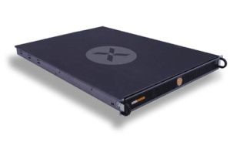
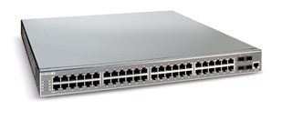
Cluster-based Storage Systems
Data Block
Synchronized Read
1
R
R
R
R
2
Client
Switch
3
1
2
3
4
Server
Request Unit
(SRU)
Client now sends
next batch of requests
4
Storage Servers
Notes:
Cluster-based storage systems are becoming increasingly popular. (both in research and in the industry)
Data is striped across multiple servers for reliability (coding/replication) and performance. Also aids in incremental scalability.
Client separated from servers by a hierarchy of switches – one here for simplicity
- high b/w, low latency network
- high b/w (1 Gbps), low latency (10s to 100 micro seconds)
Synchronized reads !
- describe block, SRU
- mention that this setting is simplistic
- could have multiple clients, multiple outstanding blocks,

Slide 58
Link idle time due to timeouts
Synchronized Read
1
R
R
R
R
2
4
Client
Switch
3
1
2
3
4
Server
Request Unit
(SRU)
4
Link is idle until server experiences a timeout
Notes:
Given this background of TCP timeouts, let us revisit the synchronized reads scenario to understand why timeouts cause link idle time (and hence throughput collapse).
Setting: SRU contains only one packet worth of information.
If 4 is dropped, when server 4 is timing out, the link is idle – no one is utilizing the available bandwidth.

Slide 59
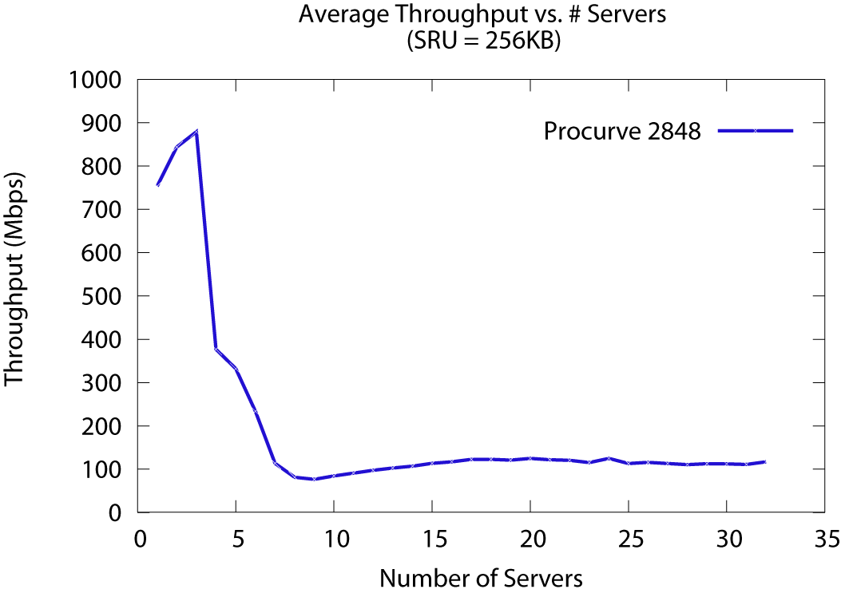
TCP Throughput Collapse: Incast
Collapse!
[Nagle04] called this Incast
Cause of throughput collapse: TCP timeouts
Notes:
Setup:
client---HP---server
SRU size = 256K
increase number of servers
X axis - # servers
Y axis – Goodput (throughput as seen by the application)
Order of magnitude drop for as low as 7 servers
Initially reported in a paper by Nagle et al. (Panasas) – called this Incast
Also observed before in research systems (NASD)
Cause – TCP timeouts (due to limited buffer space) + synchronized reads
With the popularity of iSCSI devices and companies selling cluster based storage file-systems, this throughput collapse is not a good thing.
If we want to play the blame game: if you wear the systems had you can easily say “Hey, this is the networks fault – networking guys fix it!”. If you wear the networking hat you would say “Well, TCP has been tried and tested over time in the wide area, and was designed to perform well and saturate the available bandwidth in settings like this one – so you must not be doing the right thing, like you might want to fine tune your TCP stack for performance”
Infact, Problem shows up only in synchronized read settings
- Nagle et al. ran netperf and showed that the problem did not show-up
In this paper, we perform an in-depth analysis of the effectiveness of possible “network-level” solutions.

Slide 60
TCP: data-driven loss recovery
Seq #
1
2
Ack 1
3
4
Ack 1
5
Ack 1
Ack 1
3 duplicate ACKs for 1
(packet 2 is probably lost)
Retransmit packet 2
immediately
In SANs
recovery in usecs
after loss.
2
Ack 5
Sender
Receiver
Notes:
The sender waits for 3 duplicate ACKs because
- it thinks that packets might have been reordered in the network and that the receiver might have received pkt 2 after 3 and 4
- but it can’t wait forever (hence a limit – 3 duplicate ACKs)

Slide 61
TCP: timeout-driven loss recovery
Seq #
1
Timeouts are
expensive
(msecs to recover
after loss)
2
3
4
5
Retransmission
Timeout
(RTO)
1
Ack 1
Sender
Receiver
Notes:
Timeouts are expensive because
- you have to wait for 1 RTO before realizing that a retransmission is required
- RTO is estimated based on the round trip time
- estimating RTO – tricky (timely response vs premature timeouts)
- minRTO value in ms (orders of magnitude greater than the )

Slide 62
TCP: Loss recovery comparison
Timeout driven recovery is
slow (ms)
Data-driven recovery is
super fast (us) in SANs
Seq #
Seq #
1
1
Ack 1
2
2
3
Ack 1
4
3
5
Ack 1
Ack 1
4
5
Retransmit
2
Ack 5
Retransmission
Timeout
(RTO)
Sender
Receiver
Ack 1
1
Sender
Receiver
Notes:
The sender waits for 3 duplicate ACKs because
- it thinks that packets might have been reordered in the network and that the receiver might have received pkt 2 after 3 and 4
- but it can’t wait forever (hence a limit – 3 duplicate ACKs)

Slide 63
TCP Throughput Collapse Summary
Synchronized Reads and TCP timeouts cause TCP Throughput Collapse
Previously tried options
Increase buffer size (costly)
Reduce RTOmin (unsafe)
Use Ethernet Flow Control (limited applicability)
DCTCP (Data Center TCP)
Limited in-network buffer (queue length) via both in-network signaling and end-to-end, TCP, modifications
Notes:
In conclusion …
Most solutions we have considered have drawbacks
Reducing the RTO_min value and EFC for single switches seem to be the most effective solutions.
Datacenter Ethernet (enhanced EFC)
Ongoing work: Application level solutions
Limit number of servers or throttle transfers
Globally schedule data transfers

Slide 64
Perspective
principles behind transport layer services:
multiplexing, demultiplexing
reliable data transfer
flow control
congestion control
instantiation, implementation in the Internet
UDP
TCP
Next time:
Network Layer
leaving the network “edge” (application, transport layers)
into the network “core”

Slide 65
Before Next time
Project Proposal
due in one week
Meet with groups, TA, and professor
Lab1
Single threaded TCP proxy
Due in one week, next Friday
No required reading and review due
But, review chapter 4 from the book, Network Layer
We will also briefly discuss data center topologies
Check website for updated schedule

